Slide 1
ATOPIC DERMATITIS AND ECZEMATOUS DISORDERS
Dr. Hend Alotaibi
Assistant professor & Consultant
College of Medicine, King Saud University
Dermatology Department /KKUH
Email: halotaibi1@ksu.edu.sa

Slide 2
Objectives
To know the definition & classification of Dermatitis/Eczema
To recognize the primary presentation of different types of eczema
To understand the possible pathogenesis of each type of eczema
To know the scheme of managements lines

Slide 3
Eczema - dermatitis
Definition: inflammation of the skin
What are the eczema phases?
Acute eczema: erosion, oozing and vesicles
Subacute eczema: Redness+ swelling, crust-+ scale +infection
Chronic eczema: lichenification, dark pigmentation and thick papules and plaques

Slide 4
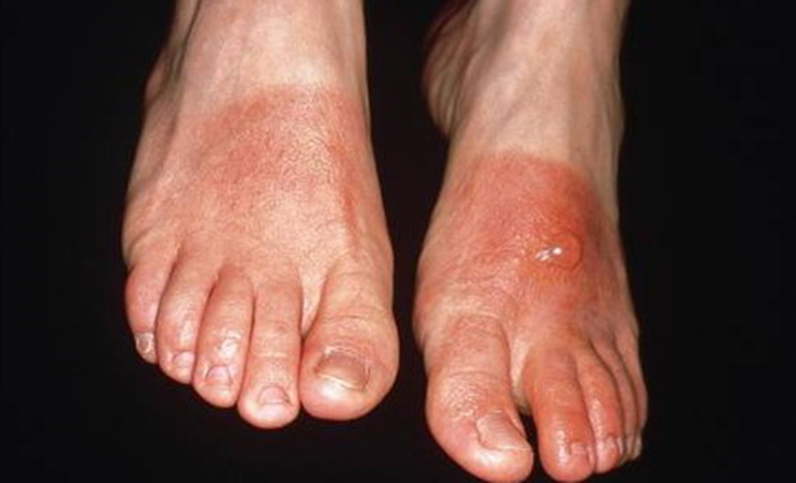
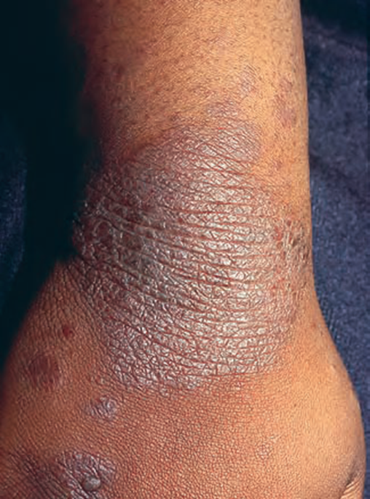
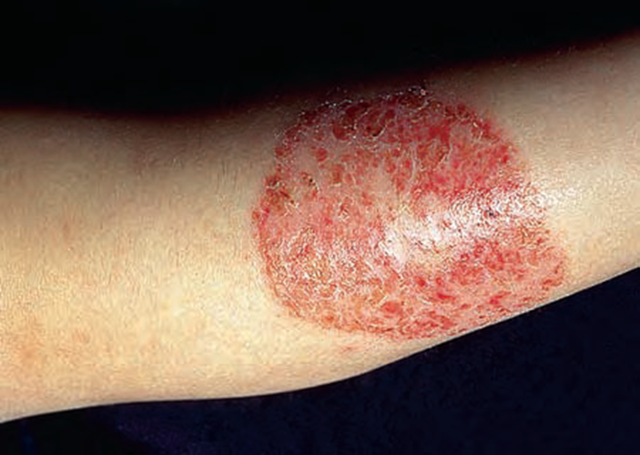

Slide 5
Atopic Dermatitis
Definition: chronic relapsing itchy skin disease in genetically predisposed patients.
Associated diseases: bronchial asthma, allergic rhinitis, allergic conjunctivitis( personal or family Hx)
Incidence: up to 15-20 % in early childhood
More in male
Age of onset:
60% ------ first 2 months of life
30 %------- by age of 5
10%-------- between age 6- 20 years
Improves in summer and flare in winter

Slide 6
Pathogenesis:
Cause :
Atopy”: genetic predisposition
skin barrier defect: Dry skin (decrease production of moisturizing lipids; sebum)
Immune dysregulation:
T cell activation
Ig E ? (Epiphenomenon)
Triggers:
Allergy, increased tendency to certain allergens (Autoallergen)
Infection : skin of pts with AD is colonized by S aureus. infection with S aureus often causes a flare of AD
AD and Food! minor role

Slide 7
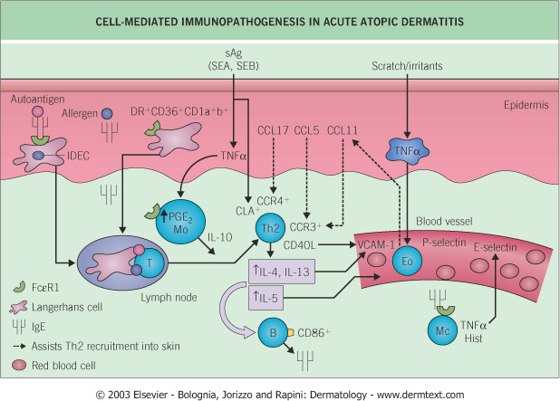

Slide 8
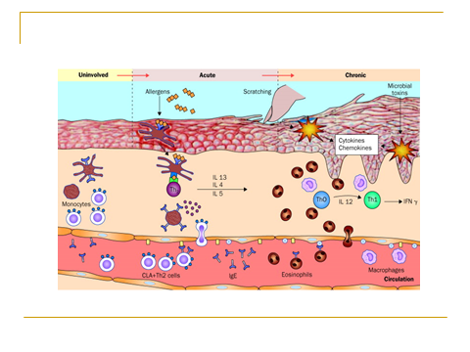

Slide 9
Clinical Variants:
Infantile AD
Childhood AD
Adult AD

Slide 10
Infantile AD
Distribution
Presentation
Red skin, tiny vesicles on
“puffy “ surface. Scaling, exudate
With wet crust and fissures.
Diaper area is usually spared

Slide 11
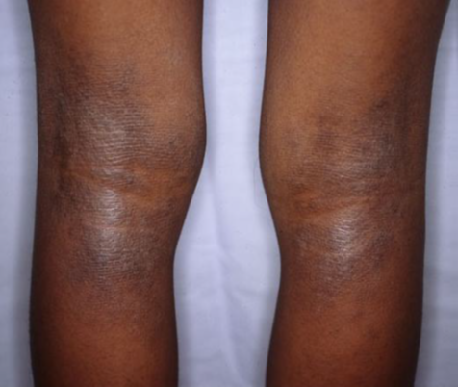
Childhood AD:
Distribution
Presentation
Antecubital, popliteal fossae, neck and face.
May be generalized
Papular, lichenified plaques, erosions, crusts.

Slide 12
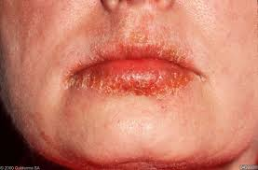
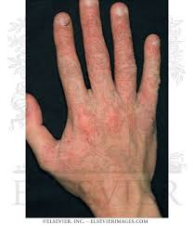
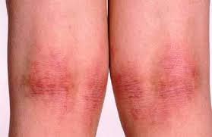
Adult AD:
Distribution
Presentation
Mostly flexural, face and neck.
May be generalized
Lichenification and excoriations

Slide 13
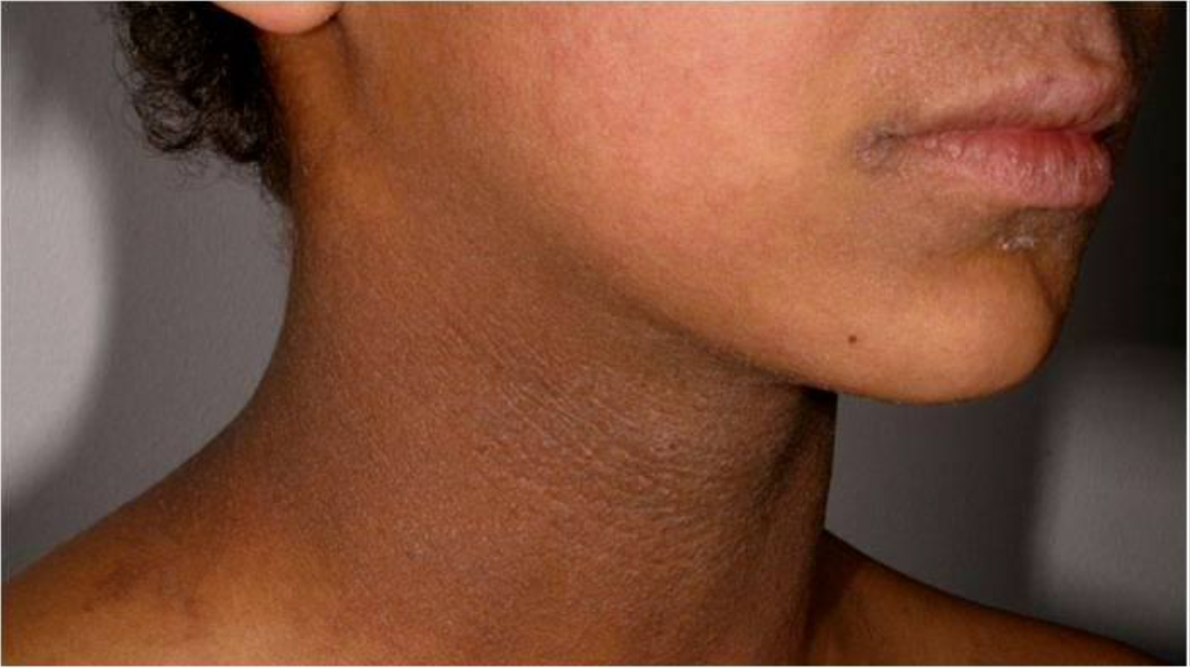

Slide 14
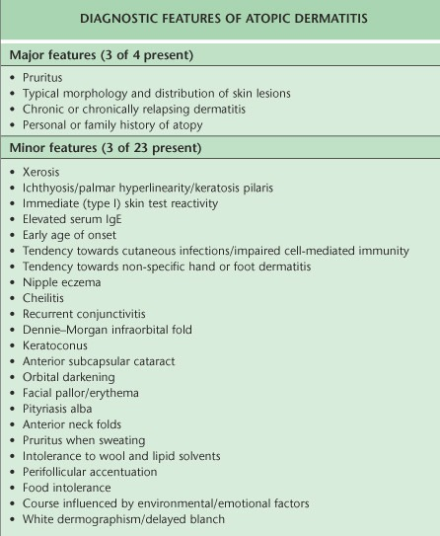

Slide 15
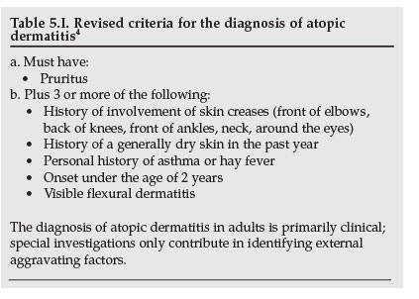

Slide 16
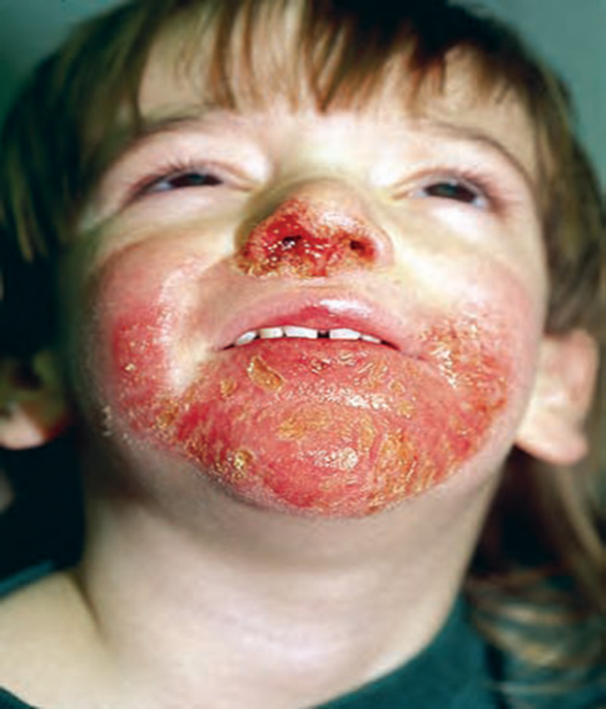
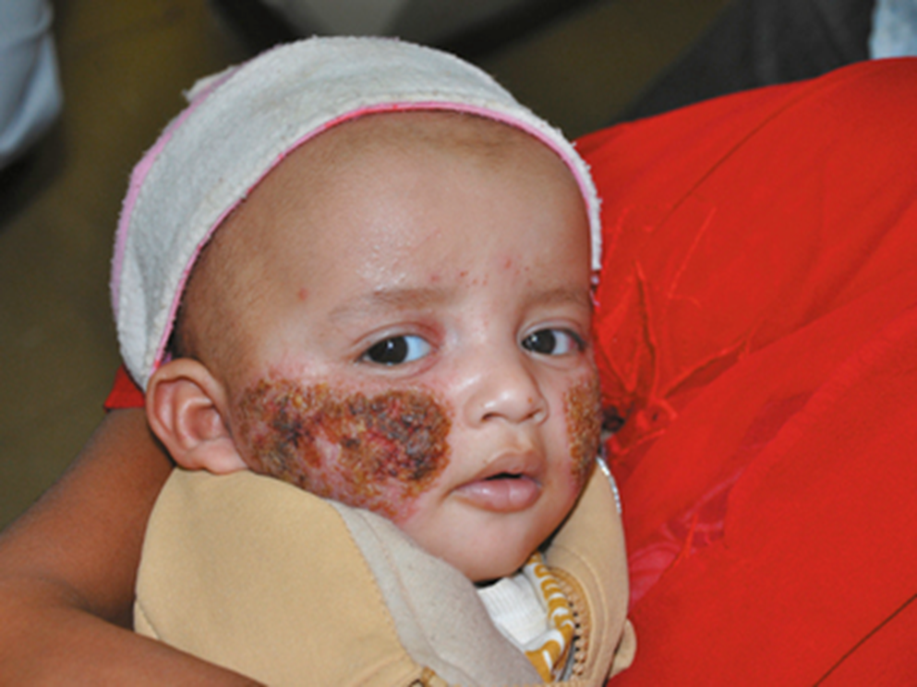
Complications:
Secondary infections

Slide 17
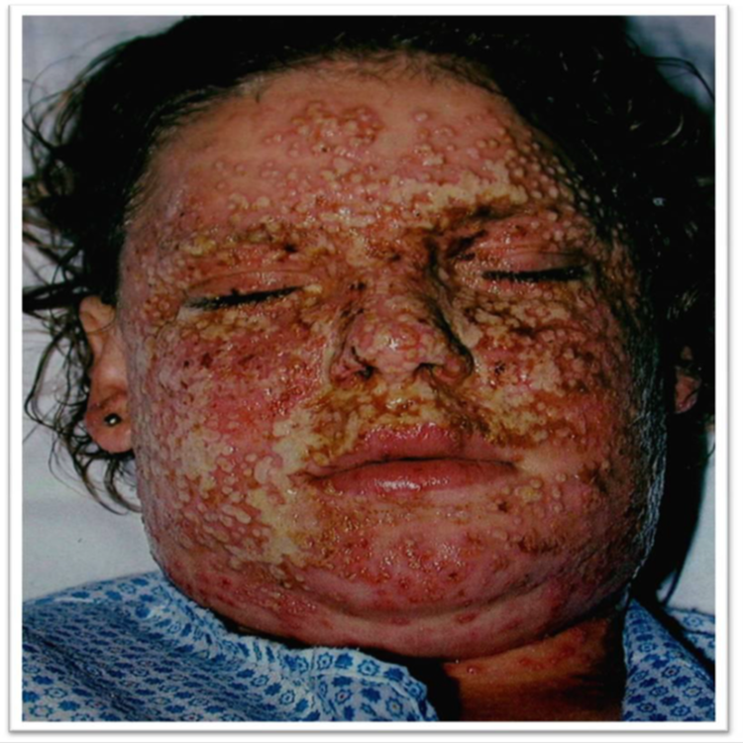
Complications:
Eczema herpeticum

Slide 18
Complications:
Growth retardation
psychological

Slide 19
Prognosis
Half of the cases improve by 2 years of age
Most improve by teenage years
<10% of patients have lifelong problems
30-50% will develop BA or hay fever

Slide 20
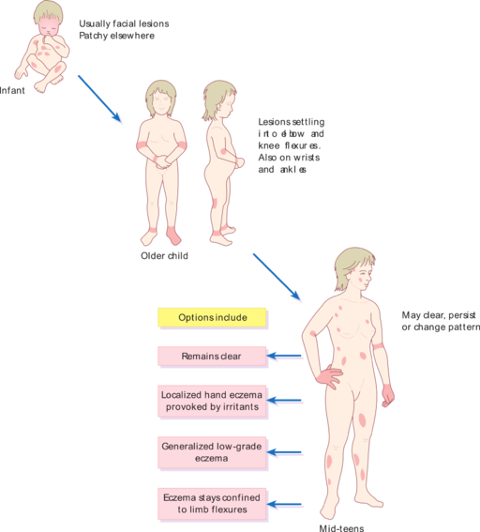

Slide 21
Management:
Education! Education! Education!
Psychological support!
Skin care: moisturizing the skin
Avoid irritant like soaps
Topical therapy: (topical steroids, Tacrolimus, Pimecrolimus)
Antibiotics--- Antistaphylococcal drugs
Sedative antihistamine ( Oral H1 antihistamine) to control itching and help sleep
Phototherapy
Systemic therapy: steroids, Cyclosporin, Methotrexate, Azathioprine

Slide 22
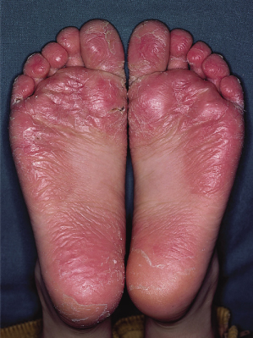
Juvenile planter dermatosis

Slide 23
Seborrhoeic Dermatits
Definition: redness and scaling in regions where the sebaceous glands are most active as the face, scalp, presternal area and body folds.
Very common chronic dermatosis.
Age: infancy, puberty , old age
More in male
Pathogenesis:
Increased Sebum!( seborrheic state)
Tendency
Pityrosporum ovale ( Maalassezia furfur )over growth
More in Parkinson, HIV/AIDS patients.

Slide 24
Clinical features
Presentation
Pruritus is variable
Gradual onset, worse in winter dry environment.
Orange- red greasy scaling macules, papules of varying size
Trunk: nummular, annular
Scalp: marked scaling, diffuse involvement

Slide 25
Distribution:
Hairy are of head, cradle cap
Face: forehead, nasolabial folds , glabella and eyebrows.
Trunk: DDx: PR vs pityriasis versicolor
Body folds: axillae, groins, anogenital area, submammary areas, umbilicus and diaper area (infants)--- sharply marginated erythematous eruption, erosions and fissures
Genitalia: with yellow crust and psoriasiform lesions.

Slide 26
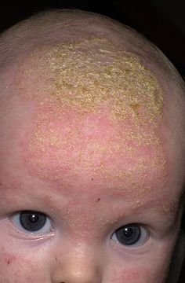

Slide 27
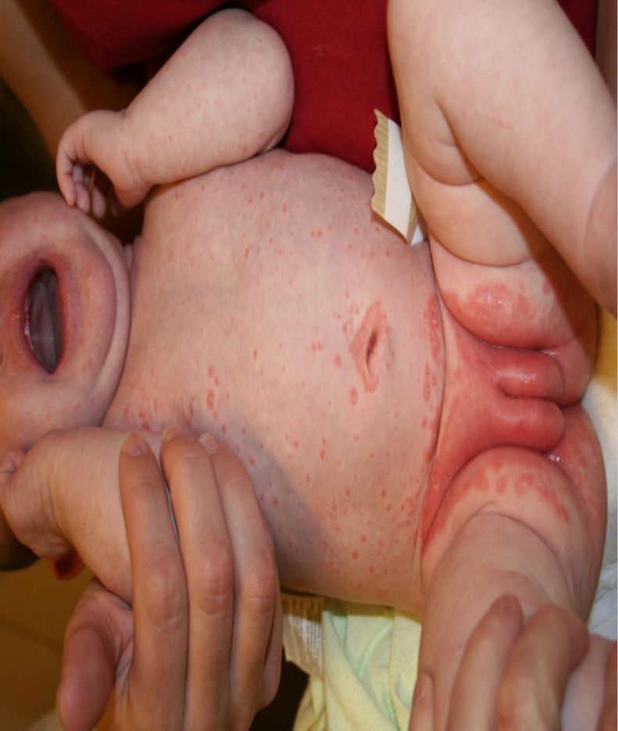

Slide 28
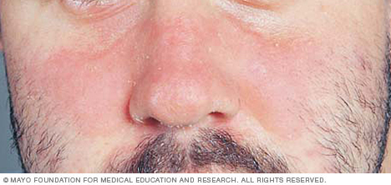

Slide 29
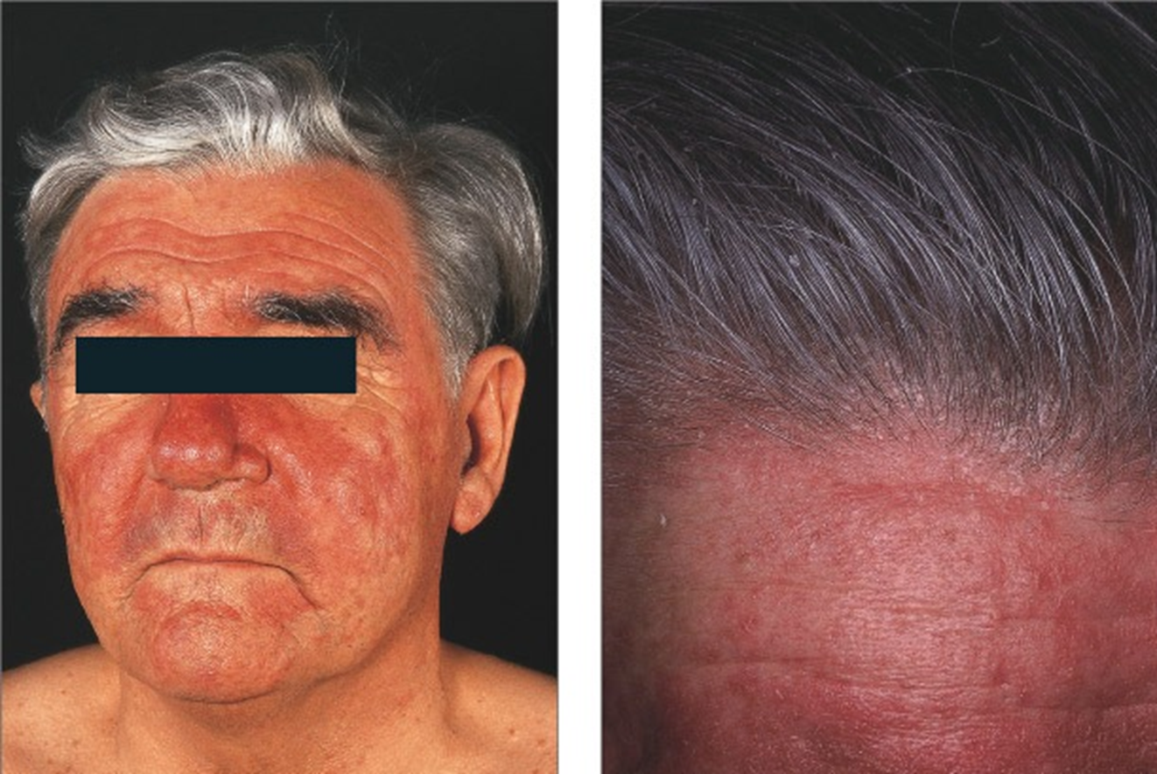

Slide 30
Management:
Scalp :
Zinc pyrithione Shampoo
Selenium sulfide 2.5% shampoo
2% ketoconazole shampoo
Low – potency glucocorticoid solution, lotion or gels.
Skin:
Topical: antifungals, glucocorticoid, pimecrolimus
Combined therapy
Maintenance & recurrence

Slide 31
Contact Dermatitis
Definition: dermatitis results from contact with external materials.
Pathogenesis:
Irritant vs. allergic : (cytotoxic vs type IV)
Common irritants: detergent, acids, dust, burning chemicals, etc
Common allergens: perfumes, hair dyes, nickels, leathers, metals, rubbers, latex, cosmetics, etc

Slide 32
IRRITANT CONTACT DERMATITIS
All people will react to an irritant if applied in a high enough concentration
At 1st exposure
Common causes:
Hands repeatedly exposed to water, cleansers
Lip-licking habit – wetting and drying caused by saliva
Napkin dermatitis

Slide 33
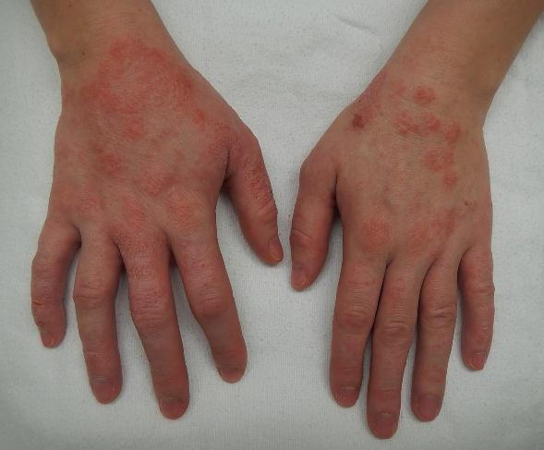

Slide 34
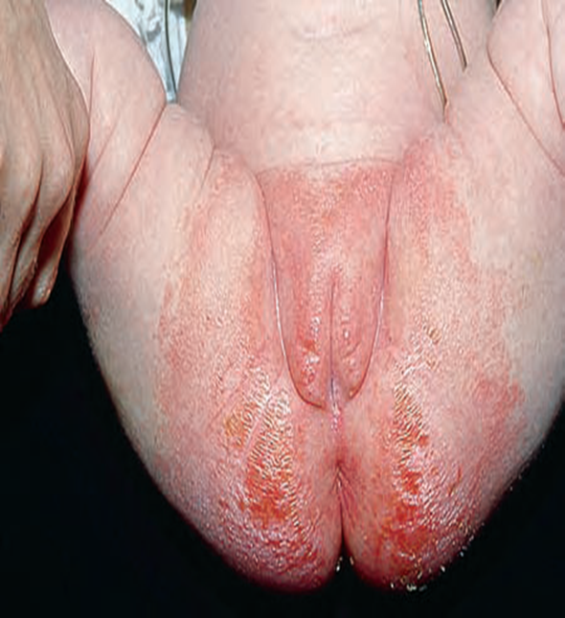

Slide 35
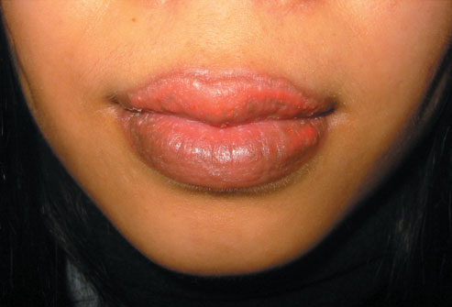

Slide 36
ALLERGIC CONTACT DERMATITIS
It is caused by allergen that trigger type IV hypersensitivity reaction in a sensitized person.
Characteristics
First exposure does not cause a reaction
Begins 24 h after subsequent exposure if already allergic
Commonest: Nickel, chromates, rubber, preservatives, topical Abx, topical cs
Diagnosis: Skin patch tests( read at 48, 96 h)

Slide 37

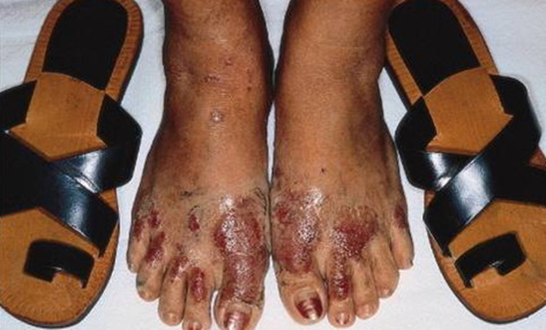
Shoe dermatitis
Causes:
a. Rubber (most common)
b. Chromates (in leather)
c. Glutaraldehyde (in leather)
d. Adhesives
e. Dyes

Slide 38
Clinical features
Predilection sites: site of contact
Distribution & configuration

Slide 41
Management:
Identification removal of causes.
Patch testing:
for allergic contact dermatitis not for irritant
Avoidance allergens
Topical corticosteroids

Slide 42
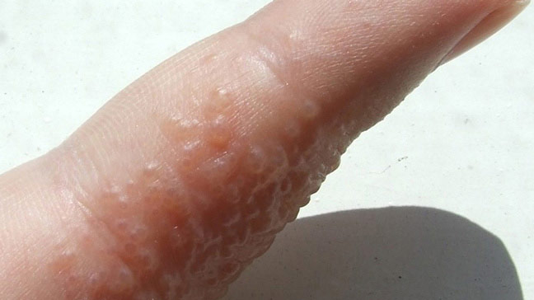
Dyshidrotic eczema

Slide 44
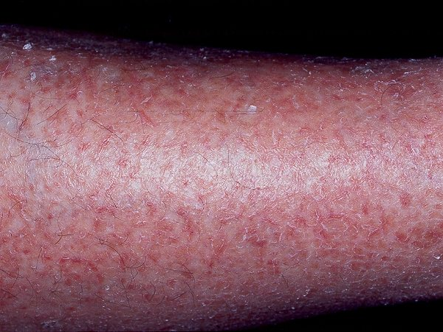
Asteatotic eczema

Slide 45
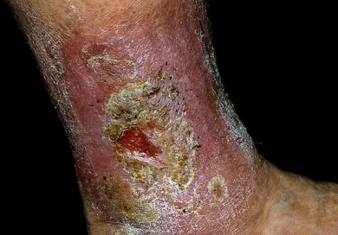
Stasis eczema

Slide 46
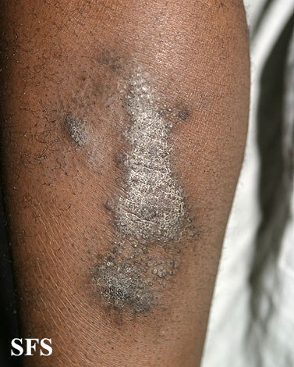
Lichen simplex Chronicus

Slide 47

THANK YOU

