Slide 1
Dermatological Emergencies
Dr. Hend Alotaibi
Assistant professor & Consultant
College of Medicine, King Saud University
Dermatology Department /KKUH
Email: halotaibi1@ksu.edu.sa

Slide 2
Clinical Real ER case

Slide 3
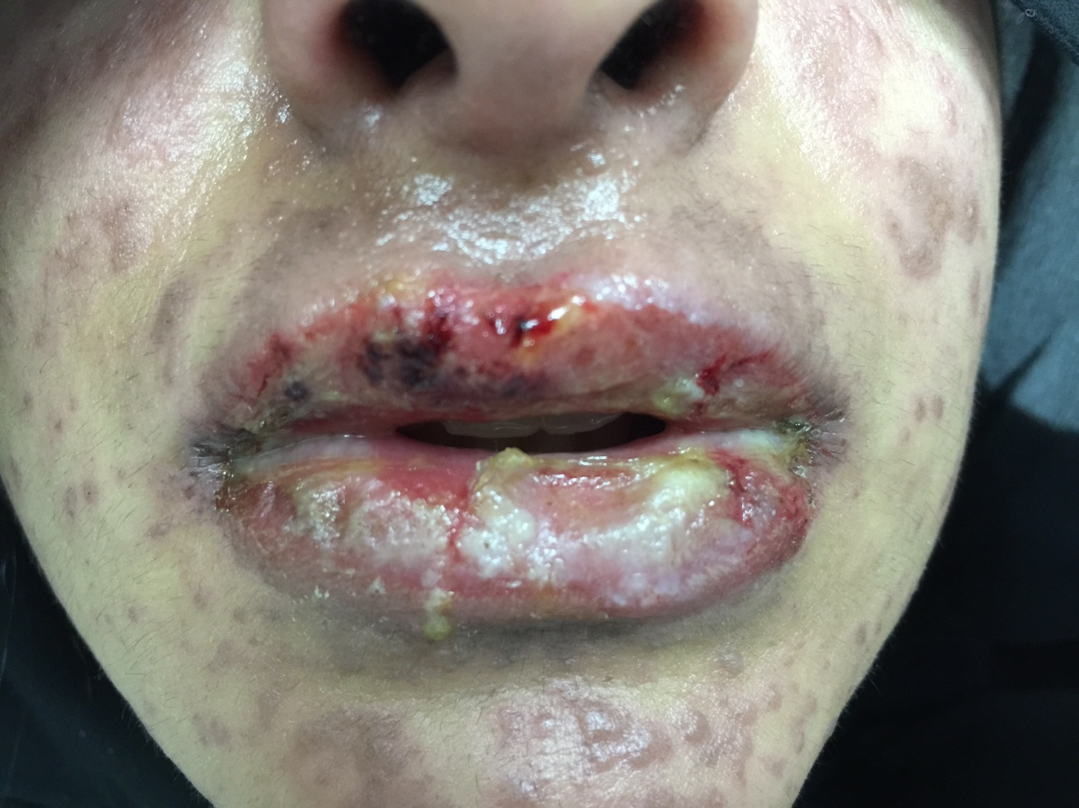

Slide 4
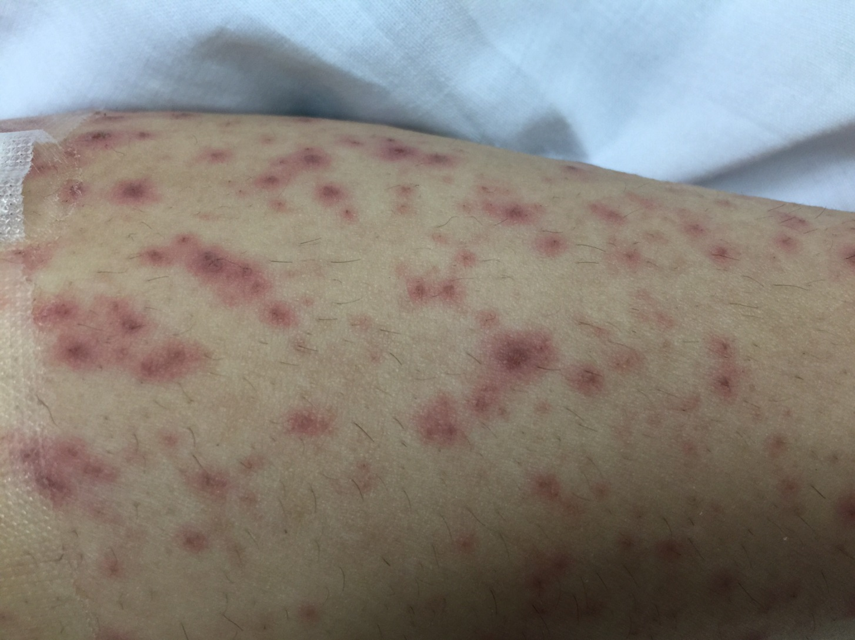

Slide 5
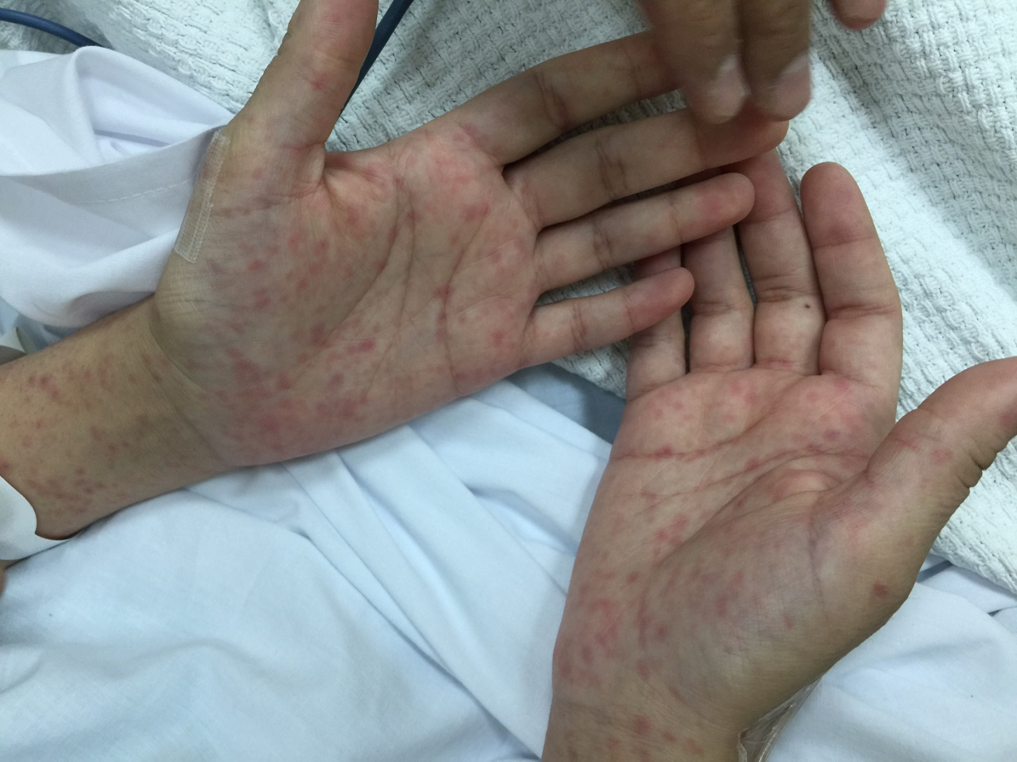

Slide 6
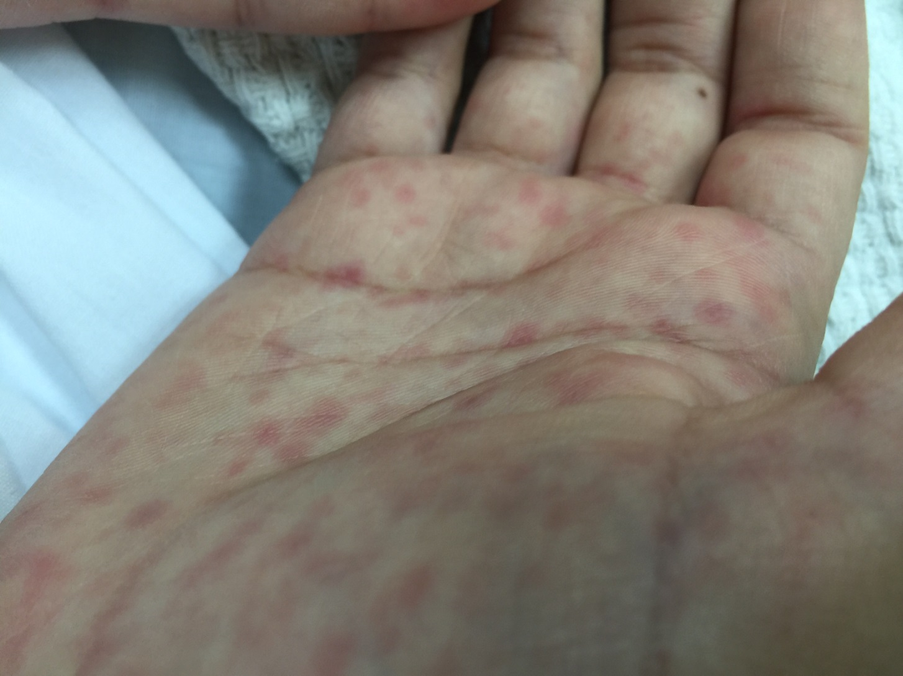

Slide 7




Slide 8

Approach

Slide 9
Hx

Slide 10
O/E

Slide 11
LAB

Slide 12
DDx

Slide 13
Mx

Slide 14
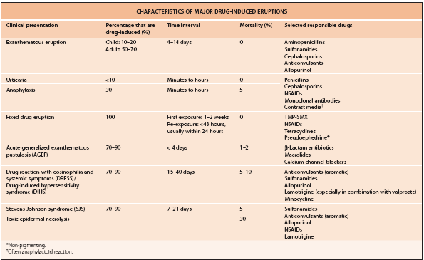

Slide 15
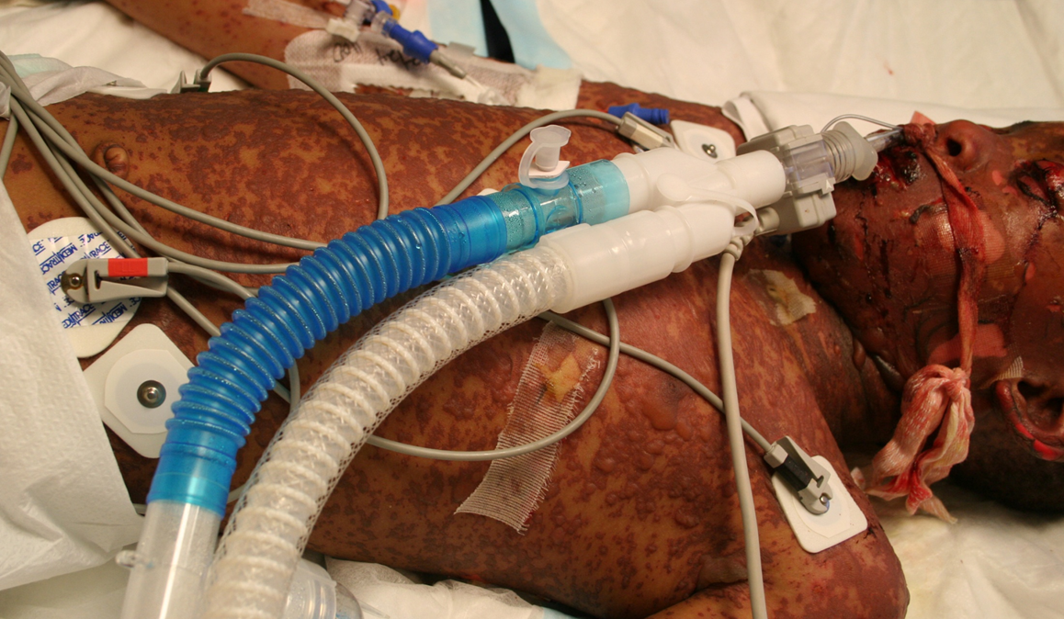
Dermatologic Emergencies

Slide 16
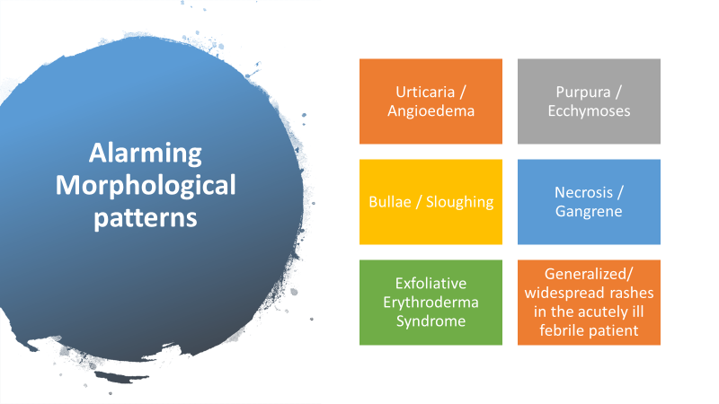

Slide 17
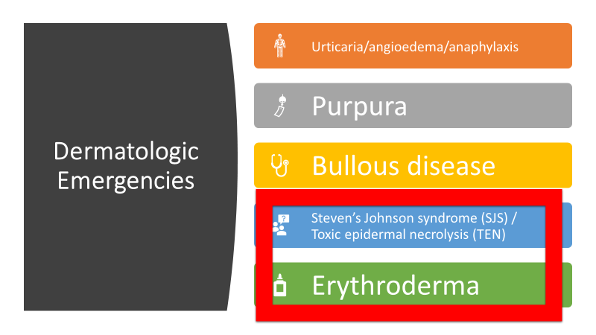

Slide 18
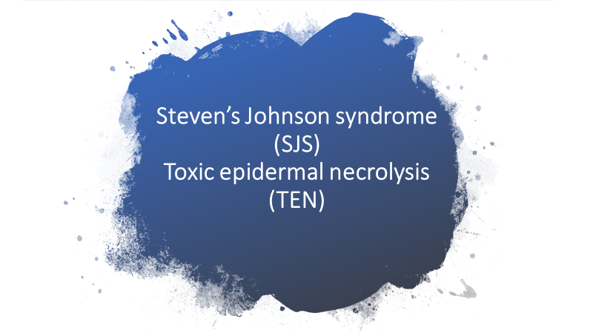

Slide 19

Steven’s Johnson syndrome (SJS)
Toxic epidermal necrolysis (TEN)
Rare, acute, life-threatening mucocutaneous disease.
Nearly always drug-related.
Keratinocyte death → separation of skin at the dermal-epidermal junction.
Characteristic symptoms: High fever, skin pain, anxiety and asthenia.
It is crucial to diagnose it early so the causal drug can be discontinued.
Notes:
Asthenia: abnormal physical weakness or lack of energy

Slide 20
Review
It has now become clear that Stevens-Johnson syndrome (SJS) and toxic epidermal necrolysis (TEN) are variants within a continuous spectrum of adverse drug reactions.

Slide 21
History
EM was first described by the Austrian dermatologist Ferdinand von Hebra in 1860.
In 1922, two US physicians, Stevens and Johnson, described an acute mucocutaneous syndrome in two young boys.
Characterized by severe purulent conjunctivitis, severe stomatitis with extensive mucosal necrosis, and “EM-like” cutaneous lesions. It became known as Stevens–Johnson syndrome (SJS) and was recognized as a severe mucocutaneous disease with a prolonged course and occasional fatalities.
SJS was later designated as EM major by Bernard Thomas in 1950. However, recent clinical investigations have made it clear that the term “EM major” should not be used to describe SJS as they are distinct disorders.

Slide 22
In 1956, Alan Lyell described four pts with an eruption 'resembling scalding of the skin objectively and subjectively', which he called toxic epidermal necrolysis or TEN. 'Toxic' referred to toxemia – circulation of a toxin – which was though to be responsible for the constitutional symptoms and epidermal necrosis.
Lyell coined the term 'necrolysis' by combining the key CF 'epidermolysis' with the characteristic histopathological feature 'necrosis'.
He also described an attack on the mucous membranes as part of the syndrome, with very little inflammation in the dermis, a feature that was later referred to as 'dermal silence.

Slide 23
Erythema multiform, SJS, and TEN were, at the time, considered to be part of a continuous spectrum of cutaneous reactions.
It was clear, that HSV was the major cause of EM, and that this virus was not related to TEN.
Recently, Assier et al. clarified this issue by providing clinical evidence that EM and SJS are clinically distinct disorders with different causes and prognosis.
Increasingly, SJS, and TEN are considered to be two ends of a spectrum of severe epidermolytic adverse cutaneous drug reactions, differing only by the extent of skin detachment.

Slide 24
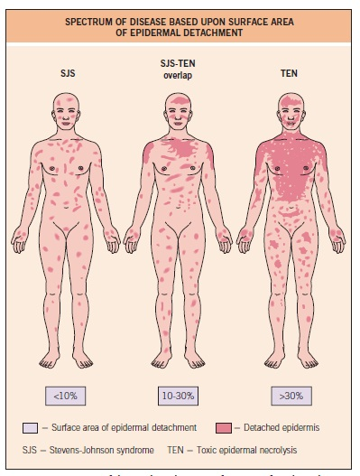

Slide 25
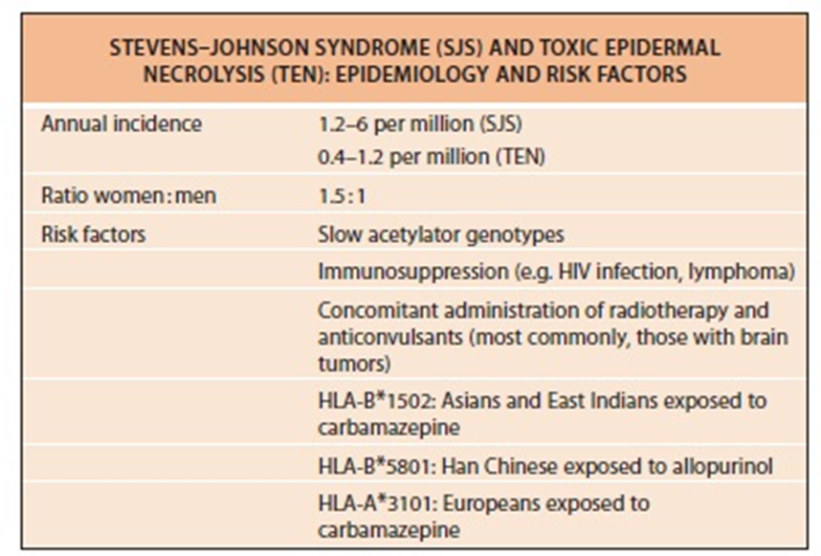
Epidemiology:

Slide 26
Mortality rates range from 25 to 50% (average: 30-35%) for patients with TEN . 5% for patients with SJS.
On average, death occurs in every third patient with TEN, and it is mainly due to infections (S. aureus and Pseudomonas aeruginosa)
Drug use is reported in over 95% of patients with TEN.
Other rare causes include infections and immunization.
More than 100 drugs have been identified to date as being associated with SJS/TEN.
Most common:
Allopurinol
Antibiotics (Sulfonamides)
NSAIDs
Anti-convulsants.

Slide 27
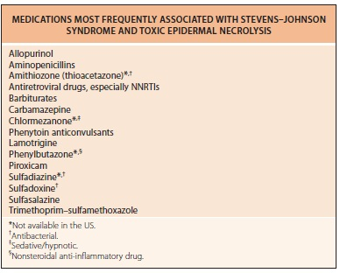

Slide 28
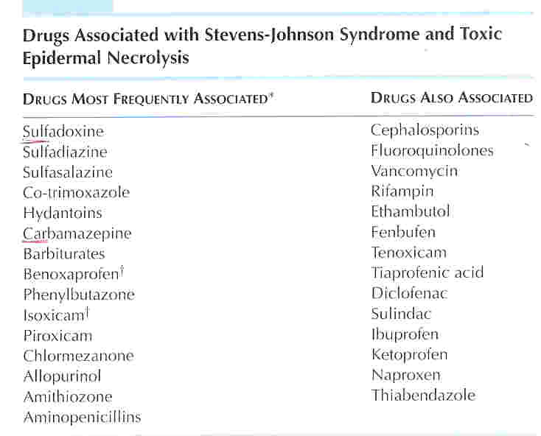

Slide 29
Pathogenesis of SJS/TEN :
An idiosyncratic, delayed hypersensitivity reaction.
TEN is associated with an impaired capacity to detoxify reactive intermediate drug metabolites.
Slow acetylators.
Immunocompromised pts.
HIV,With AIDS, the risk of developing TEN is 1000-fold higher than in the general population45
It is thought to be initiated by an immune response to an antigenic complex formed by the reaction of such metabolites with certain host tissues.
There is evidence that systemic lupus is a risk factor
Genetic susceptibility (increased incidence of HLA-B12 in affected individuals)

Slide 30
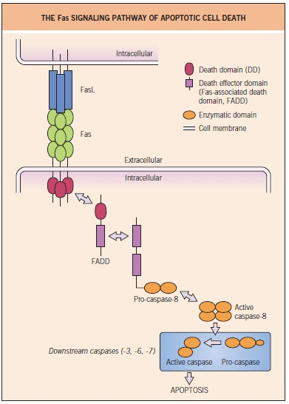

Slide 31
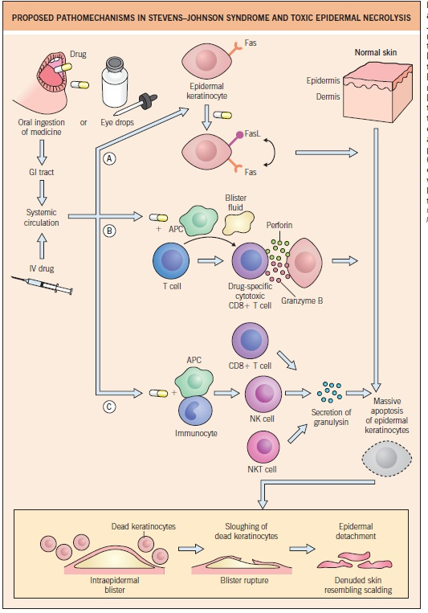

Slide 32
Clinical Features of SJS
Fever, stinging eyes.
Cough productive of thick, purulent sputum.
Headache. Malaise , Arthralgia.
Burning rash begins symmetrically on the face & upper part of the trunk.
Erythema and erosions of the buccal, ocular and genital mucosae are present in more than 90% of patients.
The epithelium of the respiratory tract is involved in 25% of patients with TEN, and gastrointestinal lesions (e.g. esophagitis, diarrhea) can also occur.

Slide 33
The cutaneous lesions are characterized as follows:
The rash can begin as macules that develop into papules, vesicles, bullae, urticarial plaques, or confluent erythema
The typical lesion has the appearance of a target – like ; this is considered pathognomonic
In contrast to the typical lesions of erythema multiforme, these lesions have only 2 zones of color
The lesions have a tendency to coalesce.
•

Slide 34
Lesions may become bullous and later rupture, leaving denuded skin; the skin becomes susceptible to secondary infection
Urticarial lesions typically are not pruritic
Infection may be responsible for the scarring associated with morbidity.
Although lesions may occur anywhere, the palms, soles, dorsum of the hands, and extensor surfaces are most commonly affected.
Nikolsky sign ( positive in some area )

Slide 35
Signs of mucosal involvement can include the following:
• Erythema
• Edema
• Sloughing
• Blistering
• Ulceration
• Necrosis

Slide 36
SJS

Slide 37
Clinical Features of TEN
Fever, stinging eyes, and pain upon swallowing, any of which can precede cutaneous manifestations by 1 to 3 days.
Skin lesions tend to appear first on the trunk, spreading to the neck, face, and proximal upper extremities.
The scalp , distal portions of the arms as well the legs are relatively spared, but the palms and soles can be an early site of involvement.

Slide 38
First, erythematous, dusky-red, or purpuric macules of irregular size and shape, and have a tendency to coalesce.
At this stage, and in the presence of mucosal involvement and tenderness, the risk of rapid progression to SJS or TEN should be strongly suspected.
In the absence of spontaneous epidermal detachment, a Nikolsky sign should be sought by exerting tangential mechanical pressure with a finger on several erythematous zones. This sign is considered positive if dermo-epidermal cleavage is induced.

Slide 40
A target-like appearance.
This process can be very rapid (hours), or several days.
The necrotic epidermis then detaches from the underlying dermis, and fluid fills the space between the dermis and the epidermis, giving rise to blisters
The blisters break easily (flaccid) and can be extended sideways by slight pressure of the thumb as more necrotic epidermis is displaced laterally (Asboe-Hansen sign).
Tense blisters are usually seen only on the palmar & plantar surfaces when the epidermis is thicker more resistant to mild trauma.

Slide 42
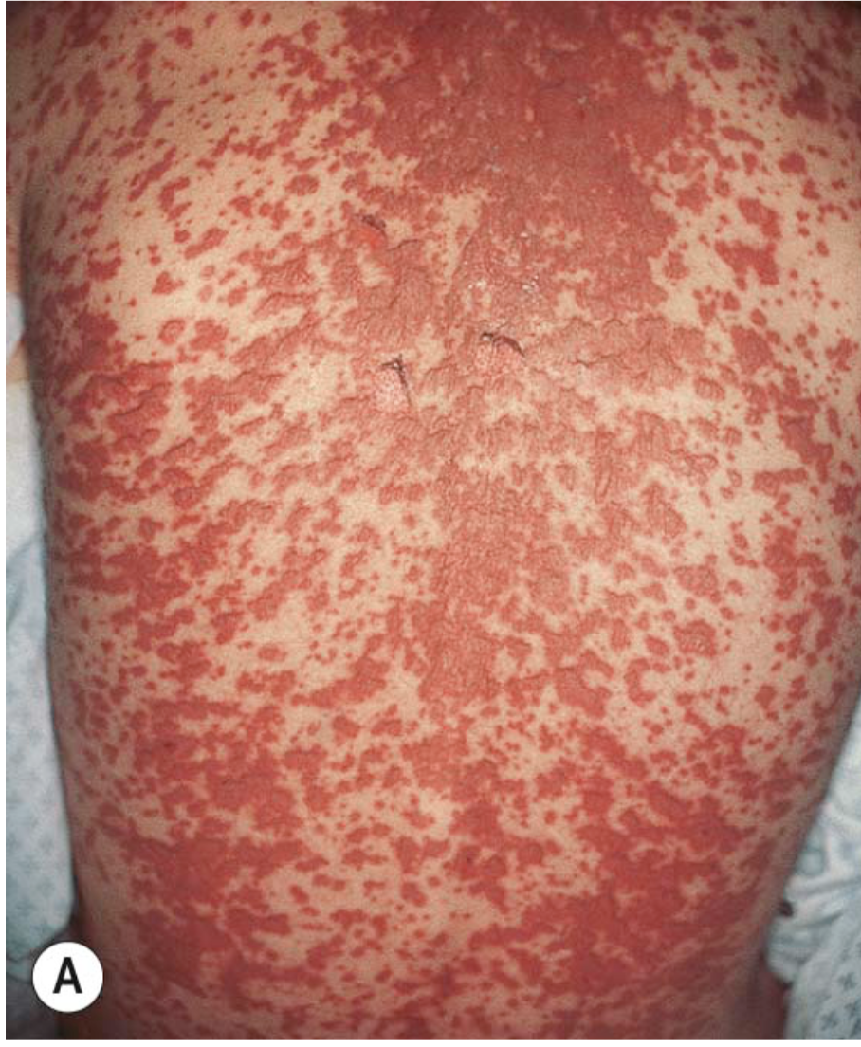
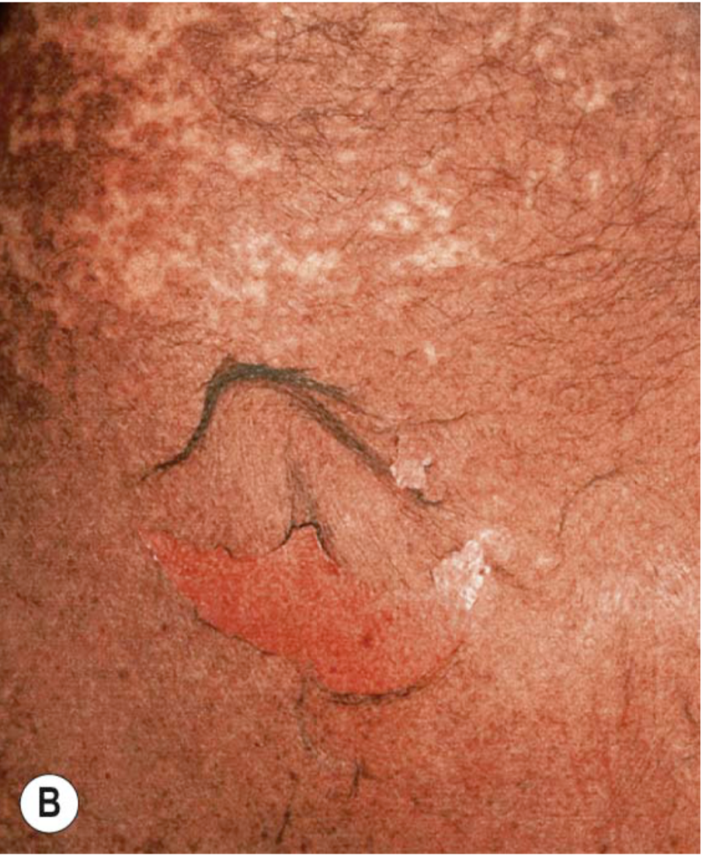
Notes:
Stevens–Johnson syndrome (SJS) versus SJS–TEN overlap.
A In addition to mucosal involvement and numerous dusky lesions with flaccid bullae, there are areas of coalescence and multiple sites of epidermal detachment. Because the latter involved >10% body surface area, the patient was classified as having SJS–TEN overlap. B Close-up of epidermal detachment, whose appearance has been likened to wet cigarette paper.

Slide 43
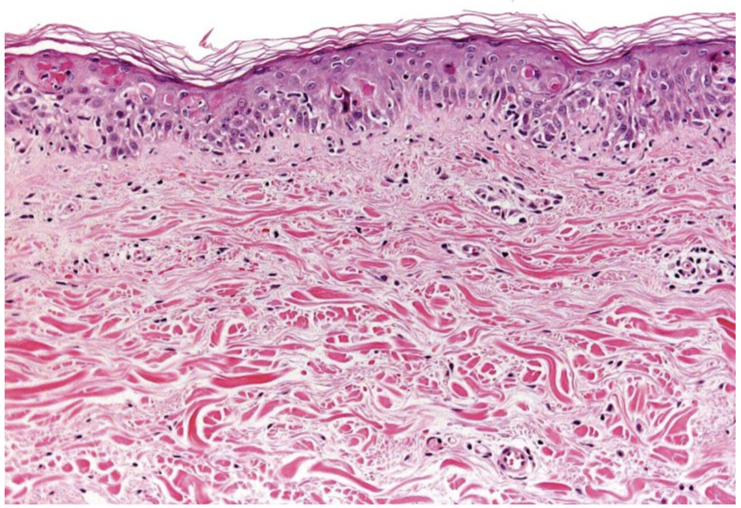
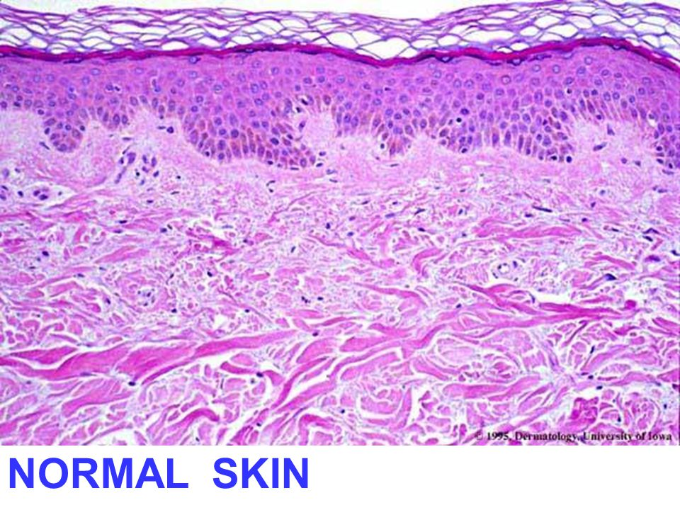
Histology
Notes:
Toxic epidermal necrolysis – histopathologic features.
Apoptotic keratinocytes are present individually and in clusters within the epidermis. Subtle vacuolar changes along the basal layer are accompanied by minimal inflammation, with scattered lymphocytes within the epidermis.

Slide 44
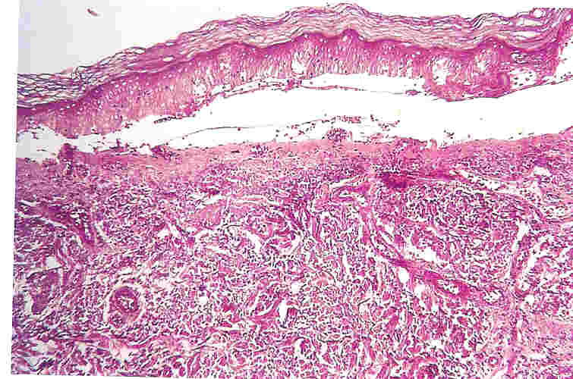
Pathology of TEN
A subepidermal blister with overlying confluent necrosis of the entire epidermis ad a sparse perivascular infiltrate composed primarily of lymphocytes.

Slide 45
DDx of TEN
Stevens-Johnson Syndrome
Staphylococcal Scalded Skin Syndrome
Toxic Shock Syndrome

Slide 46
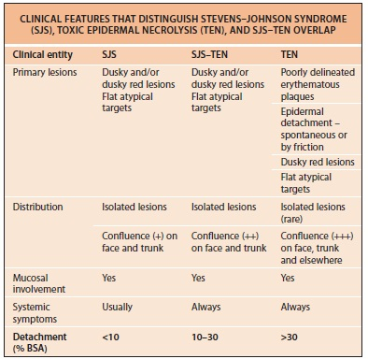

Slide 47
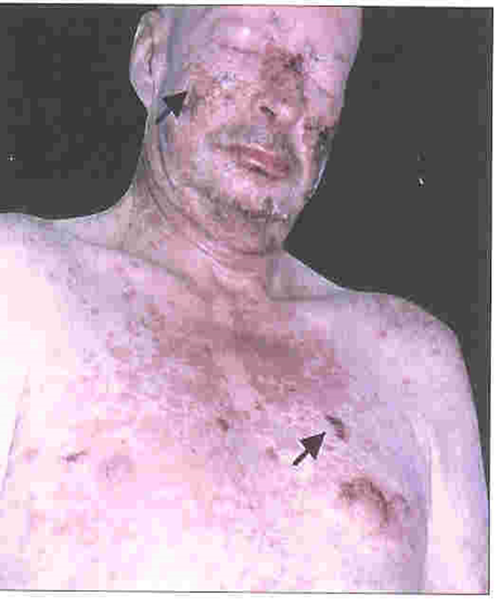
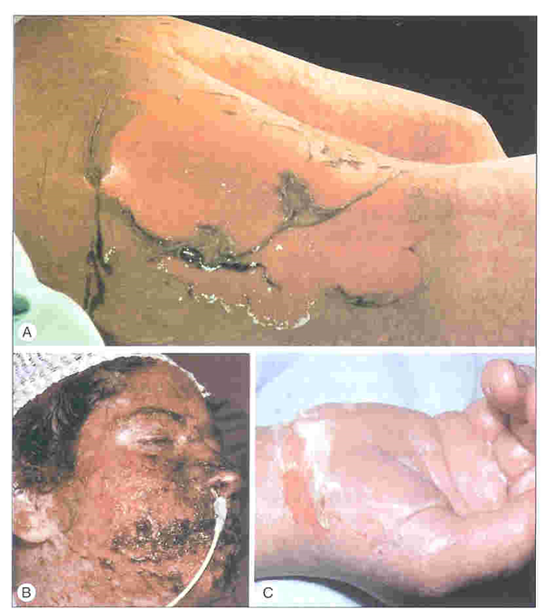
SJS
TEN

Slide 48
Staphylococcal scalded skin syndrome
usually occur in newborns and young children.
it is induced by a staphylococcal exotoxin (epidermolysin) that targets desmoglein 1.
The areas of erythema are tender and widespread, but spare the mucous membranes, palms, and soles.
The Nikolsky sign may be positive as in TEN, but it results in a superficial subcorneal cleavage, not a dermo-epidermal separation. Fragile bullous lesions then develop, and they are rapidly followed by exfoliation of sheets of epidermis.
Histologicallly shows a subcorneal split with normal underlying epidermis.

Slide 49
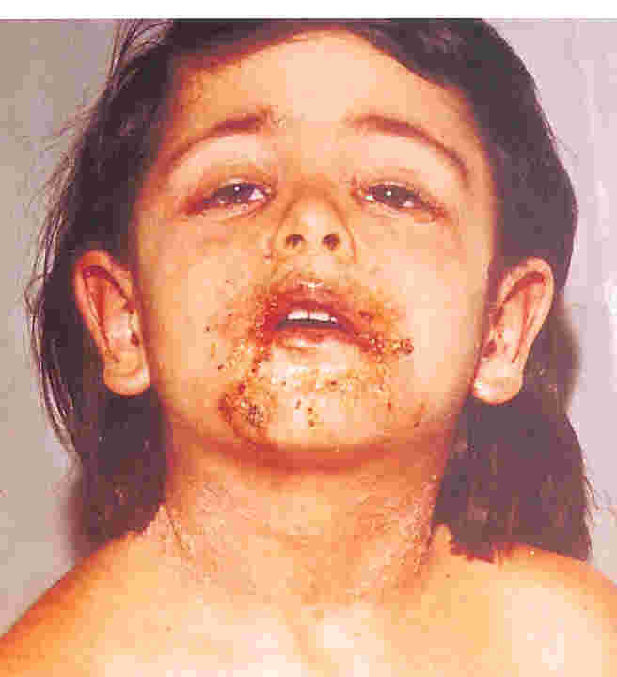
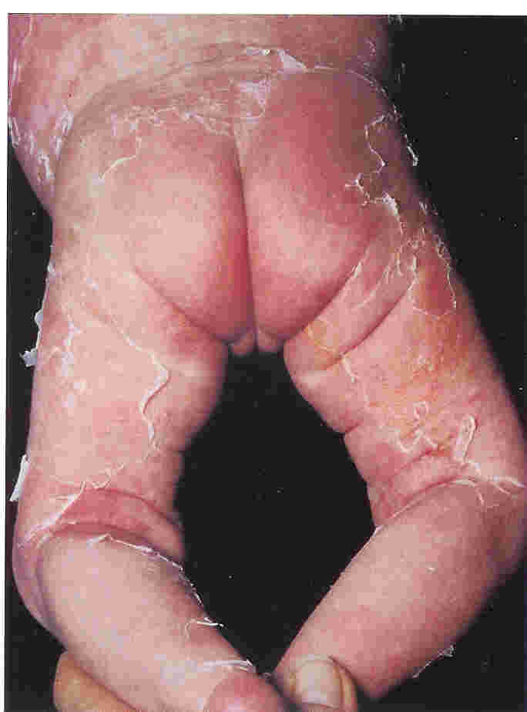
SSSS

Slide 50
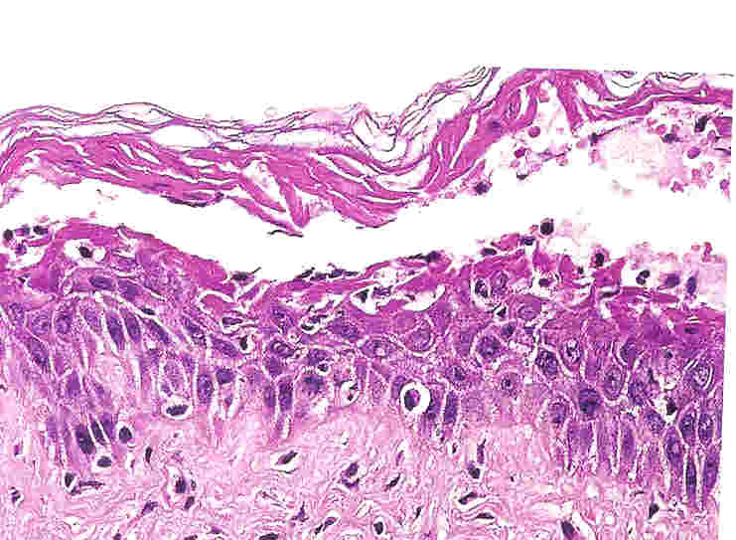
TEN
SSSS

Slide 51
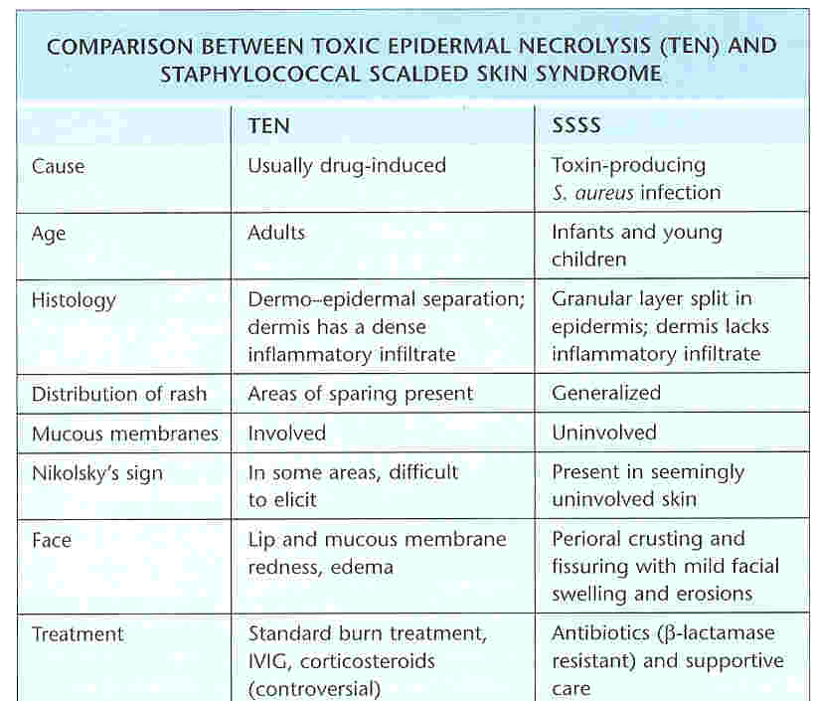

Slide 52
Toxic shock syndrome (TSS):
Is an inflammatory response syndrome characterized by fever, rash, hypotension and multiorgan involvement.
TSS has been typically associated with tampon use in healthy menstruating women.
The disease is now known to also exist in men, neonates, and nonmenstruating women.
It has been linked to many bacterial infections, including pneumonia, osteomyelitis, sinusitis, and skin and gynecologic infections.

Slide 53
Staphylococcal TSS- (15-35 years).
Streptococcal TSS— ( 20-50 years).
Staphylococcal TSS- higher in women .
Streptococcal TSS, both sex
Staph TSS, mortality rate is less than 3%.
Strept TSS, mortality rate is 30-70%.

Slide 54
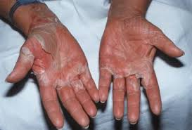
Prodromal period of 2-3 days:
Fever ,nausea and/or vomiting
Profuse watery diarrhea with abdominal pain.
Pharyngitis and/or headache, confusion.
Hypotension
Skin findings:
Diffuse rash, occasionally patchy and erythematous, with desquamation occurring approximately 1-2 weeks later
Rash initially appearing on trunk, spreading to arms and legs, and involving palms and soles
Signs of multiorgan involvement

Slide 55
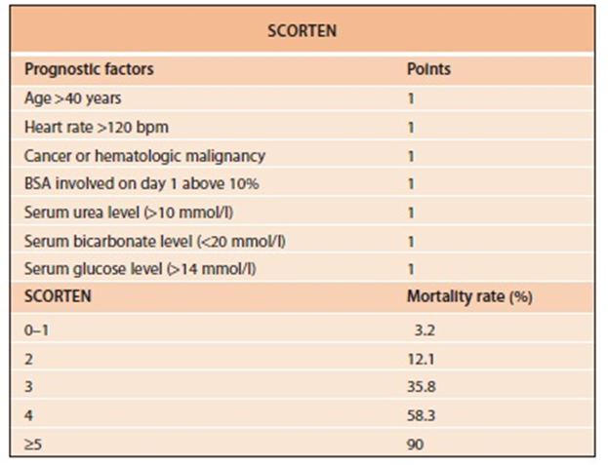
Prognosis of TEN

Slide 56
Management
Death occurs in 1/3 of pts with TEN (mainly due to infections).
General measures:-
Early diagnosis.
Immediate discontinuation of the causative drug(s)
Management on a specialist ICU or burn unit.
Multidisciplinary teamwork.
supportive care.
specific therapy.

Slide 57
Supportive care.
Pt should be manipulated as little as possible as every movement is a potential cause of epidermal detachment
all patient manipulations should be performed sterilely.
venous catheters should be placed, if possible, in a region of non-involved skin
Non-detached areas are kept dry and not manipulated.
Detached areas, should be covered with Vaseline® gauze until re-epithlialization has occurred.

Slide 58
Careful monitoring of fluid & electrolyte status with therapy for any imbalance.
Nutritional support.
Warming of environment to reduce the increase in metabolic rate.
Appropriate analgesia.
Prevention, early detection & treatment of infection.
There is NO evidence that prophylactic antibiotic provide benefit & most authors reserve antibiotics therapy for treatment of proven infection ( care must be taken in screening for sepsis & surveillance of lines/catheters to allow prompt intervention).

Slide 59
For the eyes regular examination by an ophthalmologist is recommended.
Eyelids should gently cleansed daily with isotonic sterile sodium chloride solution, and an ophthalmic antibiotic ointment applied to the eyelids.

Slide 60
Specific therapy
To date, no specific therapy has shown efficacy in prospective, controlled clinical trials.
Cyclosporine
Cyclophosphamide
Systemic steroids (their use has been much debated & remains controversial)
Intravenous Immunoglobulins (IVIG) :
Contain antibodies against Fas that are able to block the binding of FasL to Fas.
Used in high doses (0.75 g/ kg/day for 4 consecutive days) to treat patients with TEN.

Slide 61
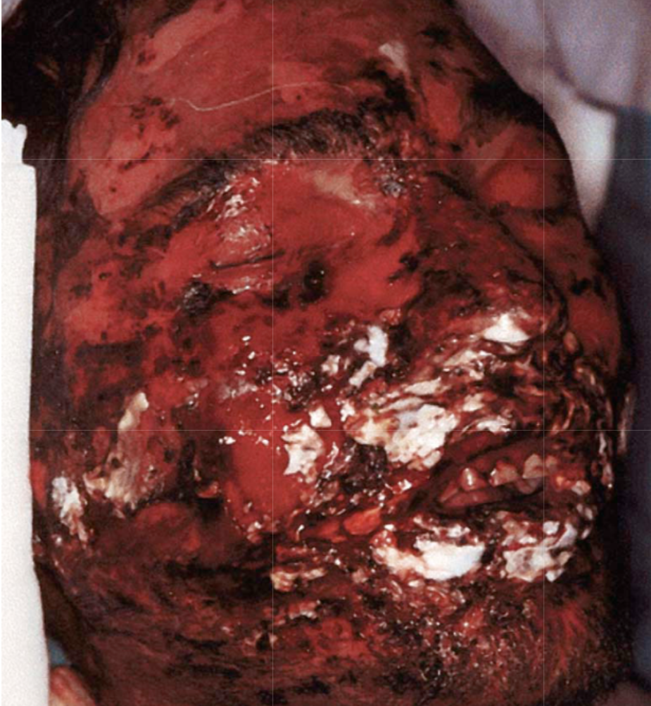
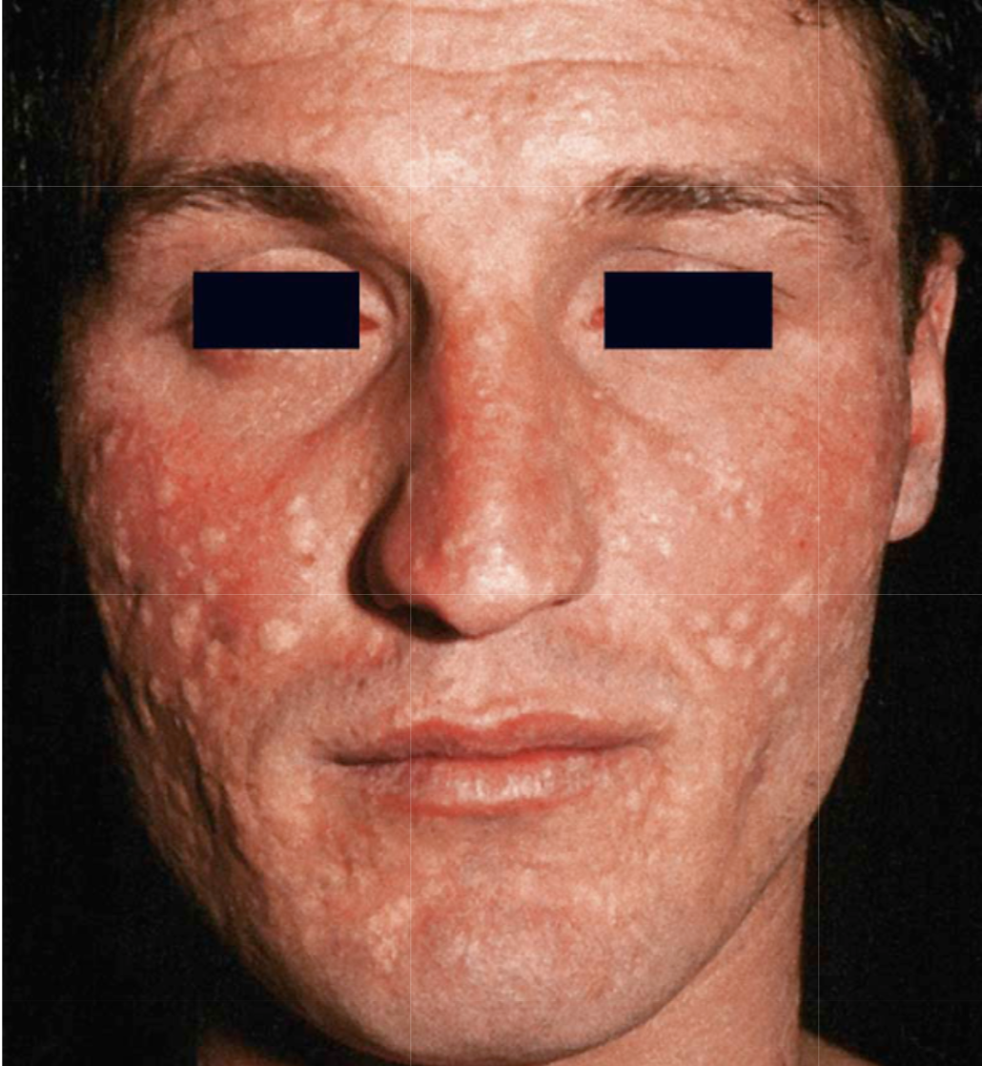
After IVIG
Before IVIG
Notes:
Treatment of toxic epidermal necrolysis (TEN).
Facial involvement of a patient with TEN (50% body surface area involvement) before (A) and 3 weeks after (B) treatment with IVIg (0.75 g/kg/day for 4 days).

Slide 62
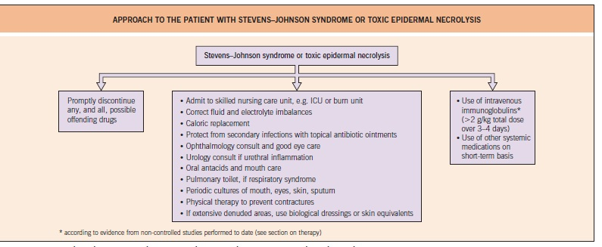

Slide 63
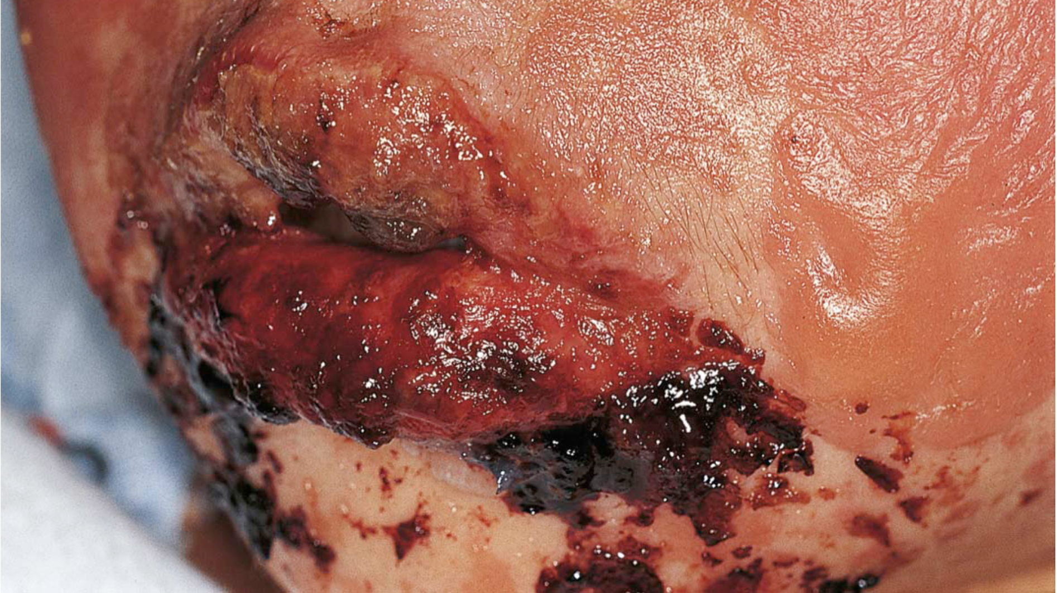
Notes:
Childhood Stevens–Johnson syndrome secondary to trimethoprim–sulfamethoxazole therapy.
Note the hemorrhagic crusts and denudation of the lips as well as bullous cutaneous lesions.

Slide 64
EM

Slide 65
Erythema multiforme (EM)
An acute, self-limited, and sometimes recurring skin condition that is considered to be a type IV hypersensitivity reaction associated with certain infections, medications, and other various triggers.
A mild, nonspecific URTI .
Abrupt onset of a skin rash usually occurs within 3 days, starting on the extremities symmetrically, with centripetal spreading.

Slide 66
Skin examination
The initial lesion is a dull-red, purpuric macule or urticarial plaque that expands slightly to a maximum of 2 cm over 24-48 H
In the center, a small papule, vesicle, or bulla develops, flattens, and then may clear.
An intermediate ring develops and becomes raised, pale, and edematous. The periphery gradually changes to become cyanotic or violaceous and forms typical concentric, “target” lesion.

Slide 67
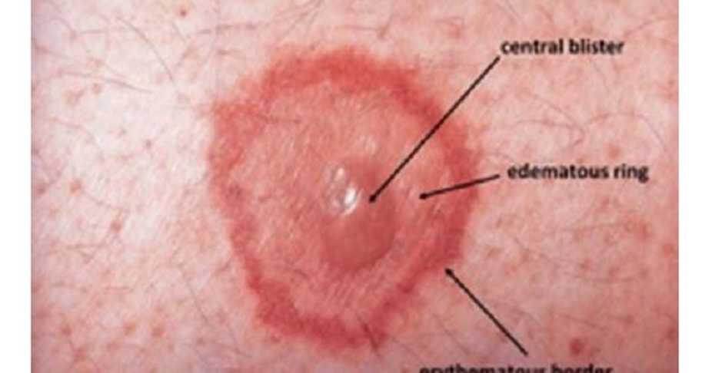

Slide 68
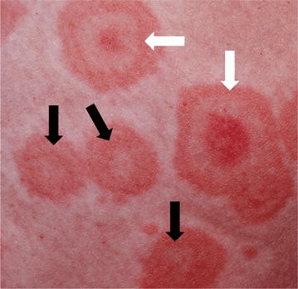
Some lesions consist of only 2 concentric rings
Some lesions appear at areas of previous trauma (Koebner phenomenon).
Postinflammatory hyperpigmentation or hypopigmentation.
Nikolsky sign is negative

Slide 69
The lesions are symmetrical, predominantly on the acral extensor surfaces of the extremities, and they spread centripetally to involve the abdomen and back.
Lesions may also coalesce and become generalized.
The palms, neck, and face are frequently involved.
Mucosal lesions usually heal without sequelae.
The mucosal involvement SJS is more severe and more extensive than that of EM.

Slide 70
EM

Slide 71
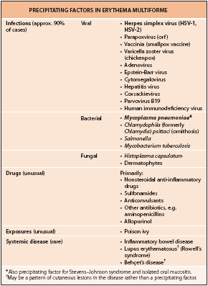

Slide 72
Investigations
No specific laboratory tests are indicated to make the diagnosis of EM, which should be clinically.
Specific HSV antigens have been detected within keratinocytes by IF study.
The HSV DNA has been identified primarily within the keratinocytes by PCR amplification.
Direct IF staining and examination may also identify an alternative diagnosis (eg, pemphigoid, immunoglobulin A [IgA] linear dermatosis.
Histopathologic examination of Skin biopsy may be used to confirm the Dx of EM and to rule out the DDxA ( e.g. blistering disorders)

Slide 73
Treatment
The cause of EM should be identified.
If a drug is suspected, it must be withdrawn as soon as possible.
Infections should be appropriately treated.
Local supportive care for eye involvement is important
Symptomatic Rx, including oral antihistamines, analgesics, local skin care, and soothing mouthwashes (e.g., oral rinsing with warm saline or a solution of diphenhydramine, xylocaine).
Topical steroids.
Suppression of HSV can prevent HSV-associated EM, but antiviral Rx started after the eruption EM has no effect on the course of the erythema multiforme

Slide 74
Course & complications
Most patients with (EM) have an uncomplicated course, healing of the mucosal areas is usually complete.
Scars and strictures of the esophageal, urethral, vaginal, and anal mucosa rarely occur.
Severe eye complications (20%), such as purulent conjunctivitis, anterior uveitis, scarring of the conjunctivae, symblepharon, may result in permanent blindness.

Slide 75
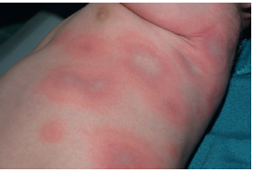
Dx ?

Slide 76
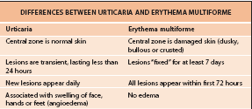

Slide 77
Erythroderma

Slide 78
Erythroderma
Generalized redness and scaling of >90% of the skin surface.
Considered a serious, at times life-threatening condition.
It does not represent a disease but rather a clinical presentation of a variety of diseases.
M > F (avg age is ~50 yrs)

Slide 79
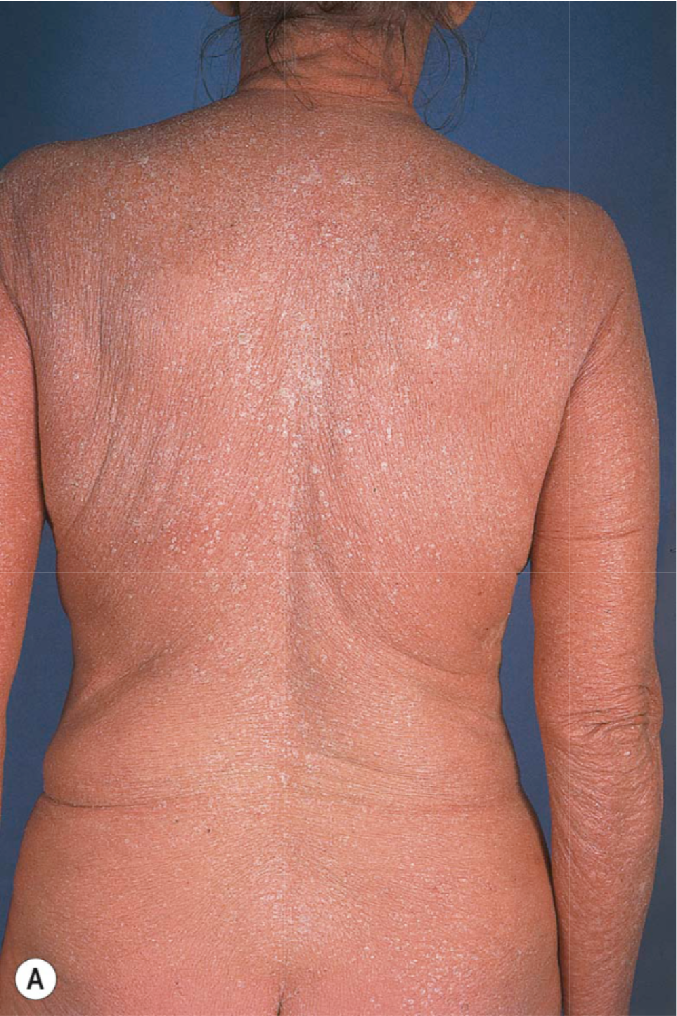
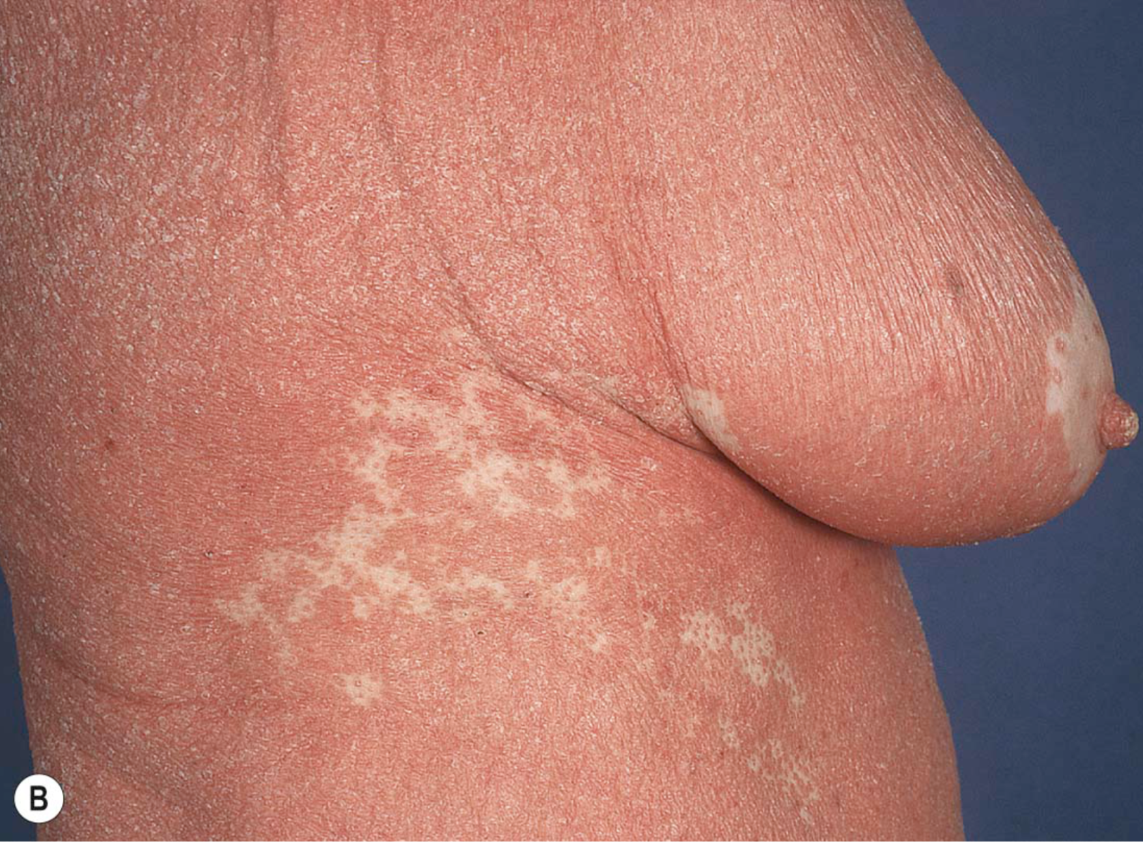
Notes:
Erythroderma secondary to pityriasis rubra pilaris.
A few islands of sparing are noted on the upper back (A), but are more noticeable on the flank and breast (B). Note the salmon color.

Slide 80
Causes of Erythroderma
Pre-existing dermatosis (psoriasis, eczema)
50%
Drugs
15%
Lymphoma, leukemia
10%
Undetermined
25%

Slide 81
Clinical features of erythroderma
Erythema precedes exfoliation by 2-6 days.
Pruritis in 90% of patients.
Palmoplantar keratoderma.
Nail changes in 40%.
Diffuse non-scarring alopecia.

Slide 82
Systemic manifestations
Generalized peripheral lymphadenopathy (50%)
Pedal or pretibial edema in ~50% of patients
Tachycardia, risk of high output cardiac failure (esp. in the elderly)
Thermoregulatory disturbances (hyper-hypo thermia)

Slide 83
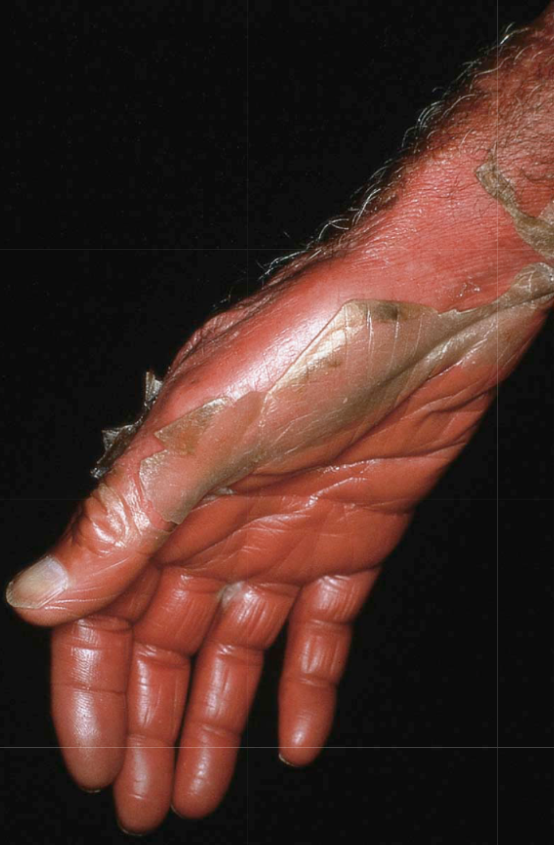
Notes:
Erythroderma with desquamation.
Obvious exfoliation of scale with underlying erythema.

Slide 84
Manifestations based on causative disease
1) Psoriasis:
Nail changes (Oil-drop, onycholysis, nail pits)
2) Atopic dermatitis:
- Pruritis is intense
- Lichenification
3) Drug reactions:
Morbiliform or scarlatiniform exanthem
4) Idiopathic erythroderma:
Elderly men
Lymphadenopathy and extensive palmoplantar keratoderma.
Peripheral edema
Notes:
Lichenification is a skin condition that occurs in response to excessive itching or rubbing of the skin and results in thick, leathery patches of skin.
The term morbilliform refers to a rash that looks like measles. The rash consists of macular lesions that are red and usually 2–10 mm in diameter but may be confluent in places.

Slide 85
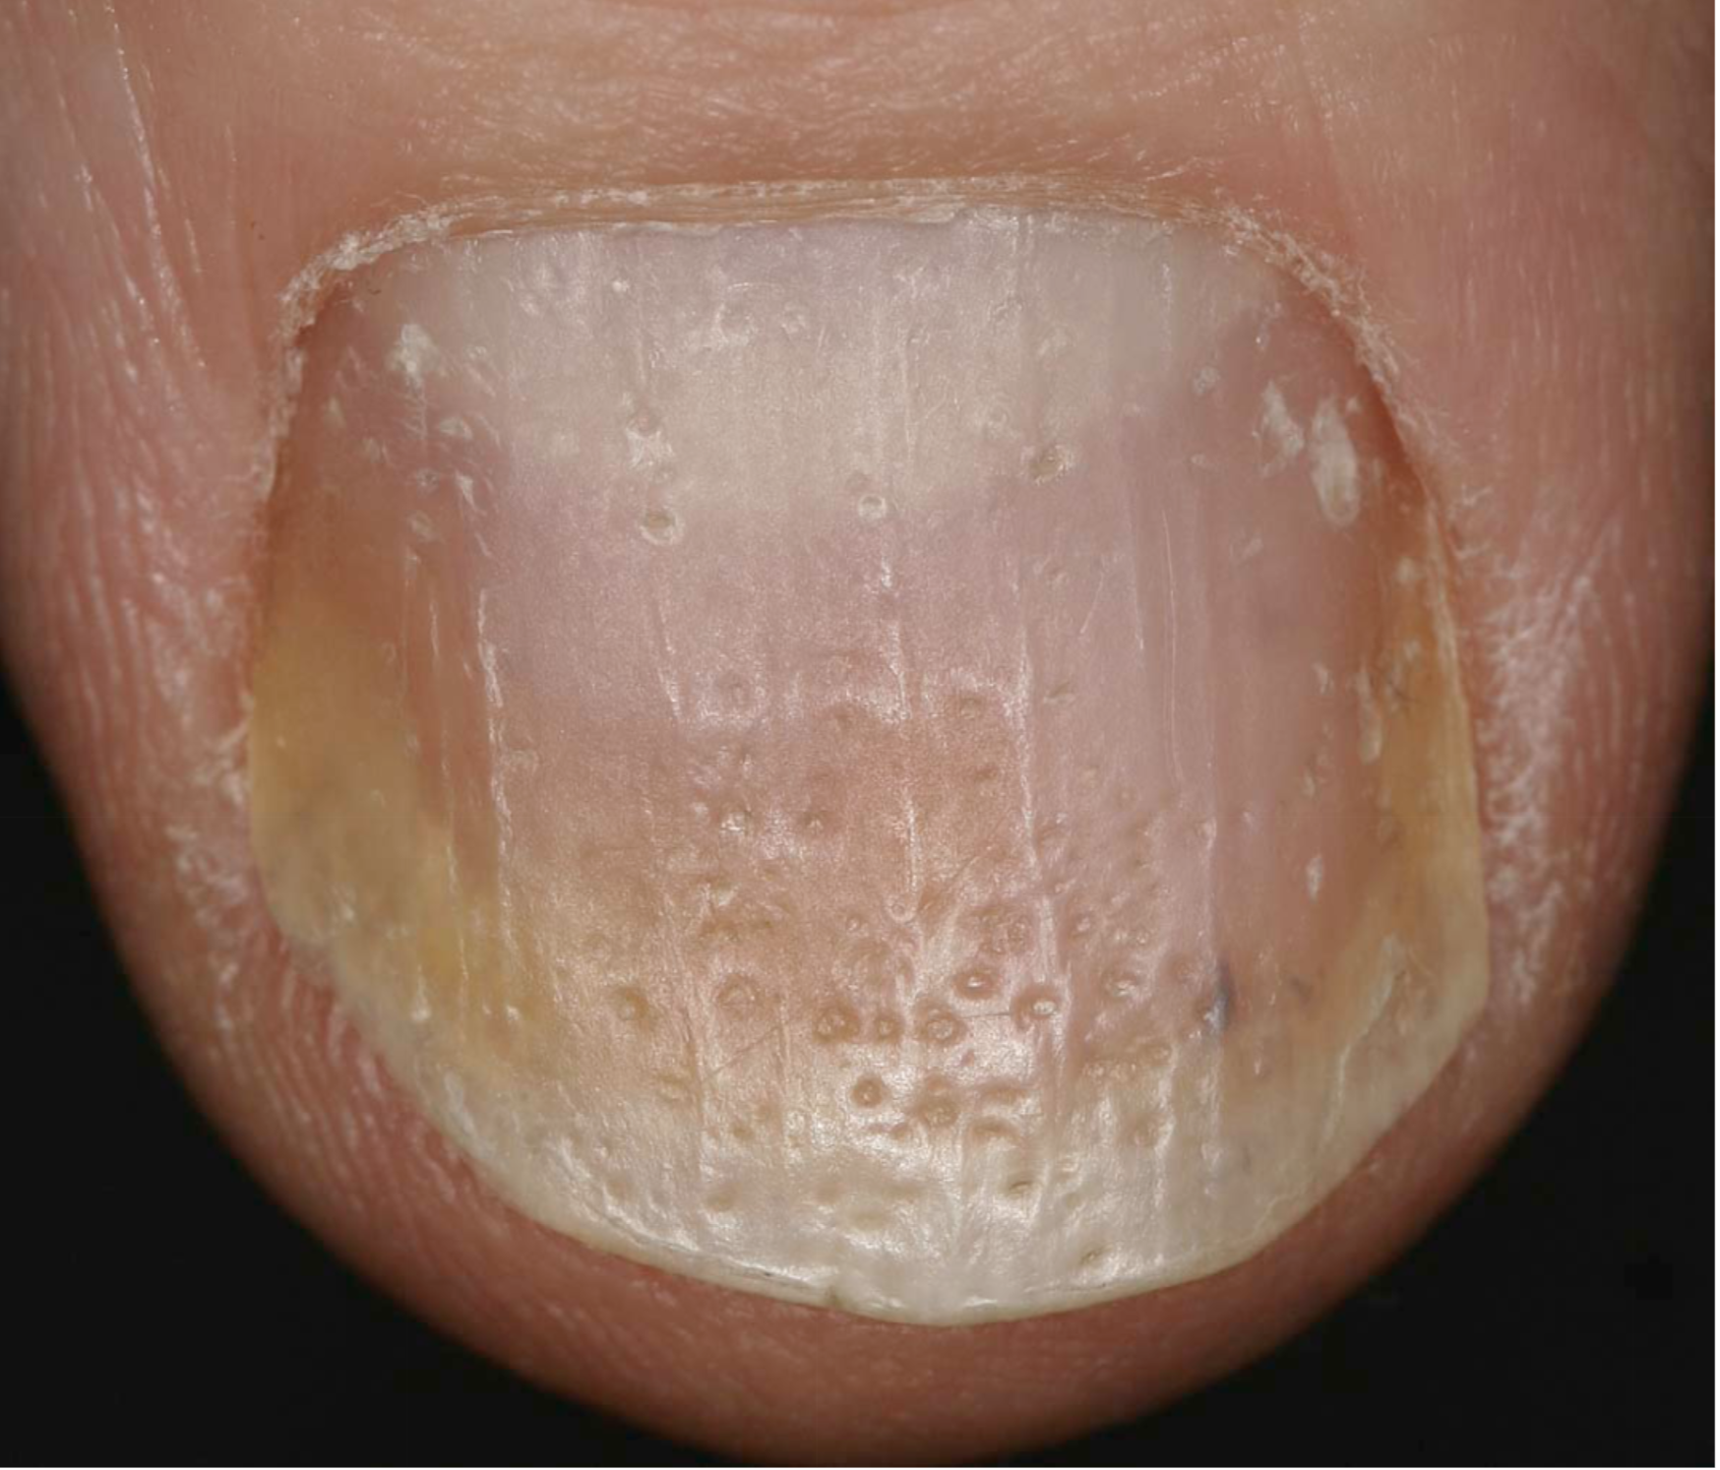
Notes:
Psoriatic erythroderma.
Nail findings (pitting and onycholysis with a proximal rim of inflammation) point to the diagnosis of psoriasis.

Slide 86
Manifestations based on causative disease
5) CTCL:
Sezary syndrome: Erythroderma, Malignant T lymphocytes and generalized lymphadenopathy.
Painful fissured keratoderma, diffuse alopecia, leonine facies.
6) PRP:
Salmon to orange color.
Follicular keratotic papules on the knees, elbows and dorsal fingers.
Islands of sparing.

Slide 87
Treatment
Hospitalization may be required.
Regardless of cause: Nutritional assessment, correction of fluid and electrolyte imbalance, prevention of hypothermia and tx of secondary infections.
Idiopathic: Topical and systemic corticosteroids. Anti-histamines.
Treat the cause of erythroderma.

Slide 88

Thank you

