Slide 1
King Saud University College of Medicine Kingdom of Saudi Arabia
Introduction to 394 Derma Course
(Female - Group F-2)
by: Dr. Hadeel Mitwalli
Assistant professor / Consultant Dermatologist
Dermatology Department
King Khalid University Hospital
13th February 2020

Slide 2
A Course Identification & General Information
1. Course title and code: 394 SKD
2. Credit hours : 2 hours
3. Course organizers: Dr. Hadeel Mitwalli
(Female students)

Slide 3
Objectives of the course:

Slide 4
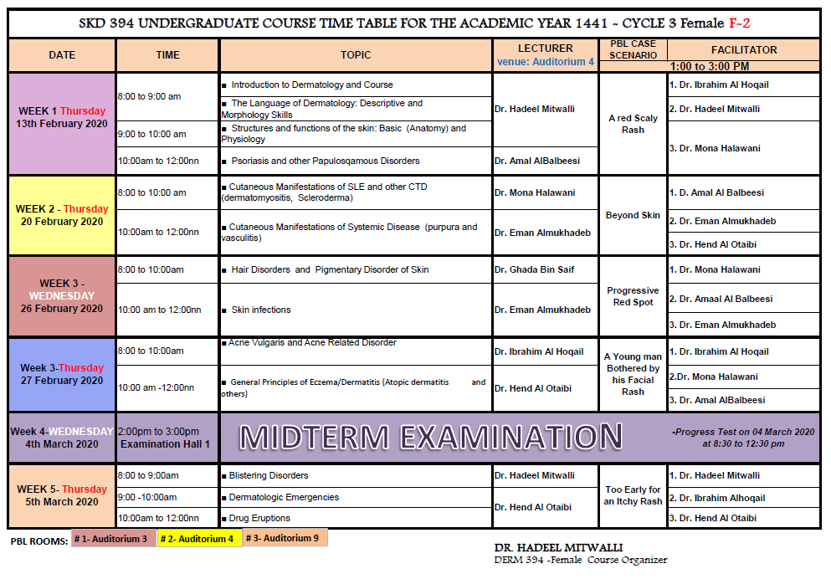
Course Description: (A) topics to be covered

Slide 5
Course Description: (B) Course components
Lectures: 20 / 20 hours | Tutorial: SGT/PBL 5 Sessions – 15 hours for each student | Practical/Clinical: Clinics: 4 for each student Inpatient rounds Surgery/ laser Procedure / biopsy Morphology | Other: SDL

Slide 6
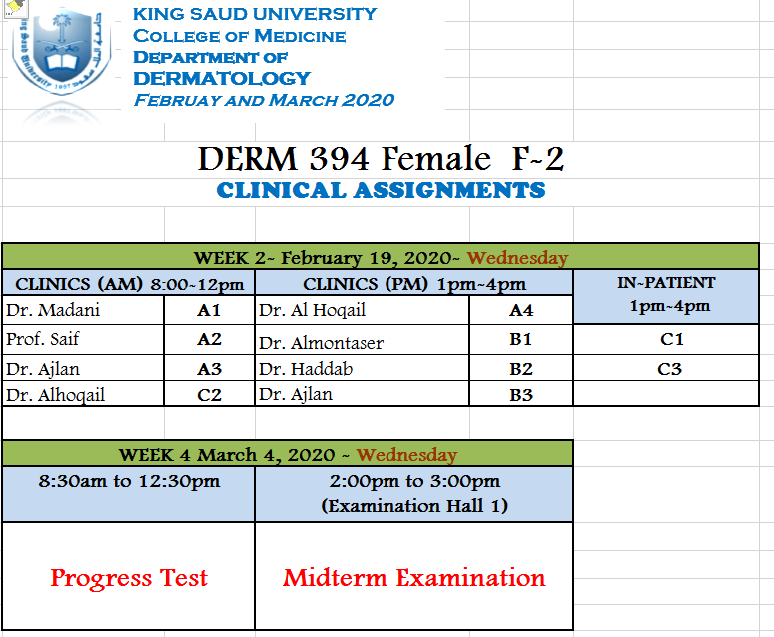

Slide 7
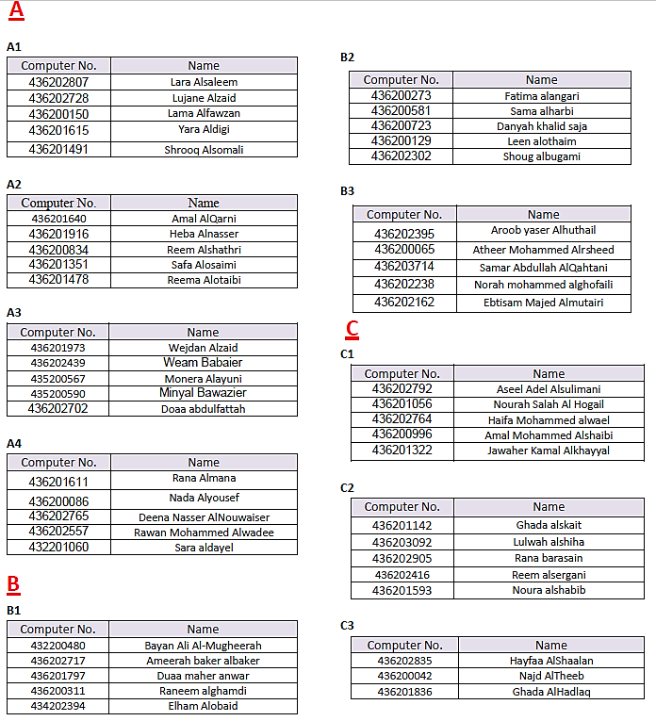
Clinical Attachment Groups Distribution

Slide 8
Lectures

Slide 9
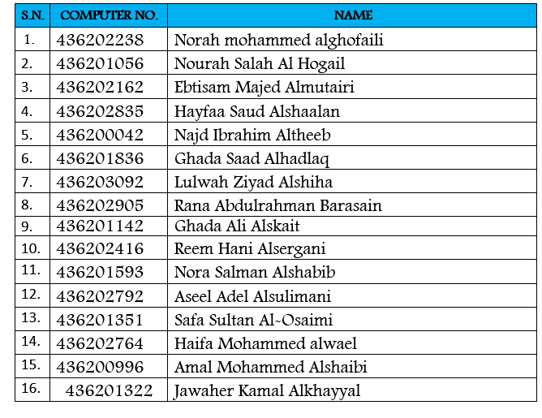
PBL (Problem Based Learning/Small Group Teaching) GROUPS
GROUP 1

Slide 10
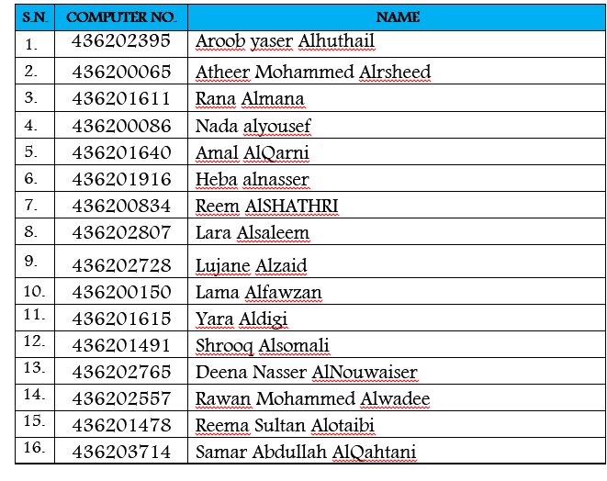
PBL (Problem Based Learning/Small Group Teaching) GROUPS
GROUP 2

Slide 11
PBL (Problem Based Learning/Small Group Teaching) GROUPS
GROUP 3

Slide 12
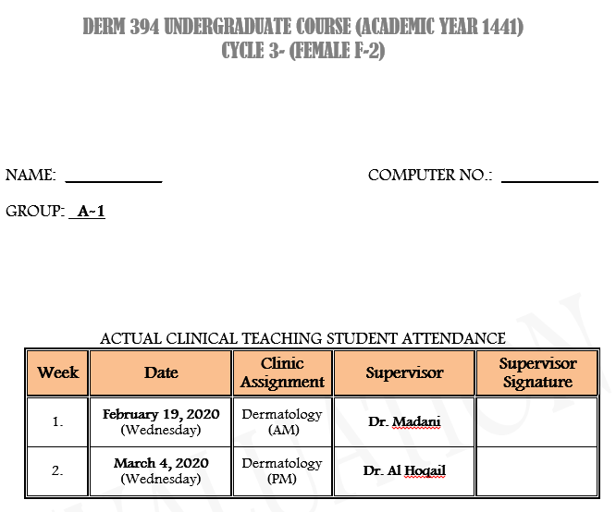
Sample of Individual Attendance

Slide 13
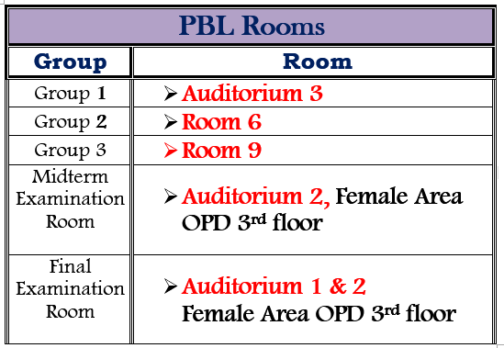
ROOM SCHEDULE
Lecture Rooms
Psychiatric Hall, Ground floor Old building

Slide 14
Assessment
5. Frame of Assessment for Students
 | Assessment type | Week due | Marks
1 | Clinical attachment | At the end of the clinic of the last 2 weeks for each group | 5%
2 | Discussion PBL | At the end of PBL session of the last 2 weeks for each group | 5%
3 | MCQs mid-term exam | At the 4th week of the course | 30%
4 | Short answer written final exam MCQs final-term exam ( N.B :explanation of assessment methods will be given later ) | At the end of the cycle ( after 2 groups rotation ) | 30% 30%

Slide 15
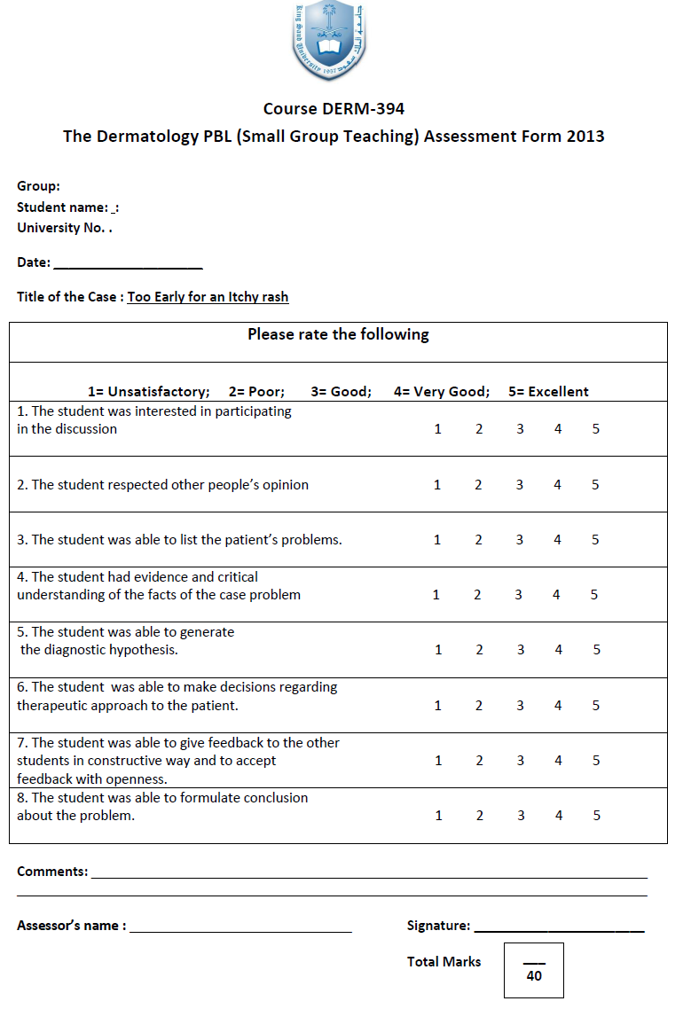
The Assessment forms

Slide 16
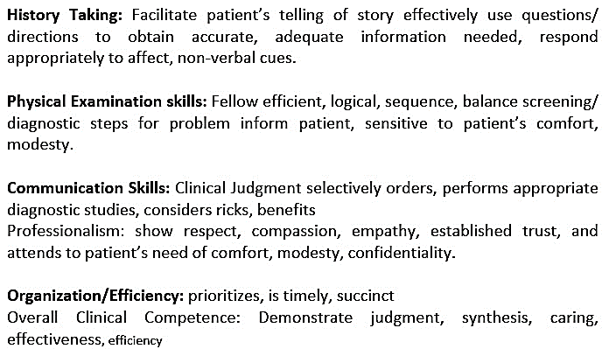

Slide 17
Ground Rules
Attendance on time is very important to lectures, clinical attachments and PBL sessions.
Keep the mobile silent during the academic activity.
If the students want to record the lecture, he should ask the permission from the attending lecturer first.
Distributions of the students into the clinical, small groups discussion and exams is based on the serial number list given by the college administration.

Slide 18
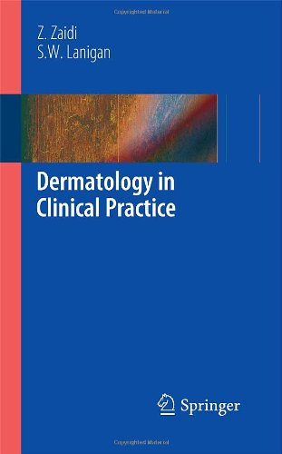
Learning Resources:
Essential References
Textbook and lectures.
Recommended Books and Reference Material
1. Fitzpatrick Color Atlas and Synopsis of Clinical
Dermatology (Vienna) By Klauss Wolff and
Richard Allen Johnson. (6th Edition)
ISBN: 9780071599757/ 007159974, Feb. 2009
2. Dermatology in Clinical Practice by Zohra Zaidi
and Sean W. Lanigan. Published by Springer
London Ltd(2010)
ISBN: 978-1-84882-861-2

Slide 19
Suggested General Dermatology Electronic Websites and Atlas:
www.dermatlas.net
www.atlasdermatologico.com.br
www.dermnet.org.nz/sitemap.htm
www.dermis.net
American Academy of Dermatology: Dermatology A-Z http://www.aad.org/
eMedicine on Dermatology http://emedicine.medscape.com/
Dermatology Online Journal http://dermatology.cdlib.org/

Slide 20
How to pass this course?
Attendance on time to the lectures, clinics, PBL discussion:
Attend every single activity, no matter how boring or inconvenient.
Be interactive (listen , take useful notes, ask and participate).
Professionalism , communication and team work are very important skills for any medical doctor so pay attention to it during your training.
Study on regular basis ( books, handouts of lectures, atlas , group study …etc) . Don’t leave it to be done before exams !
Use the time of self learning in timetable of the course effectively.
Ask your tutors and teachers if you don’t understand anything.
“Although exams and marks are important but don’t forget that education and building your knowledge and skills to be a good doctor in future is more important!”

Slide 21
Student Support
Undergraduate Secretary:
Ms. Grace Lazaro
Telephone : 66481
Email : dermatologysecretary@yahoo.com
Course Organizer for Female students:
Dr. Hadeel Mitwalli
Email : hmitwalli@ksu.edu.sa

Slide 22
Thank You!!

