Slide 1
Pigment and Hair Disorders
Prof. Ghada A. Bin saif,MD
Professor & Consultant Dermatologist

Slide 2
Objectives
Physiology of melanocytes and skin color.
Common cutaneous pigment disorders, pathophysiology, clinical presentation and treatment
Physiology of hair follicle
Common hair disorders, both acquired and congenital, their presentation, investigation and management
* Reference is the both the lecture and the TEXTBOOK*

Slide 3
Skin Pigment
Melanin : brown
Reduced hemoglobin: blue
Oxyhemoglobin: red
Carotenoids : yellow

Slide 4
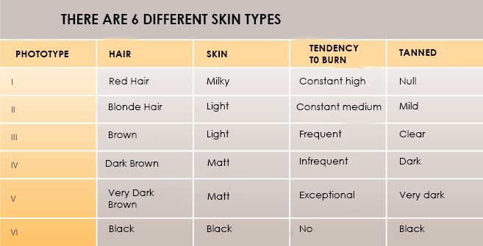
Human skin color is classified according to Fitzpatrick skin phototype
www.steticsensediodolaser.es

Slide 5
Hypopigmentation
Decrease of melanin in the epidermis:
  melanopenic hypomelanosis: a decrease of the production of melanin only (an example is albinism).
  melanocytopenic hypomelanosis: a decrease in the number or absence of melanocytes in the epidermis producing no or decreased levels of melanin (an example is vitiligo).

Slide 6
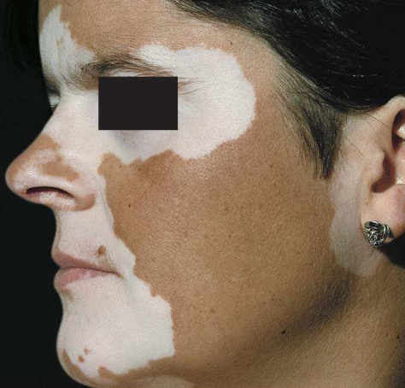
VITILIGO

Slide 7
Vitiligo
A chronic autoimmune disease with genetic predisposition
Complete absence of melanocytes
Incidence 1%
Early onset
Rarely could be associated with: alopecia areata, thyroid disease, pernicious anemia, diabetes mellitus

Slide 8
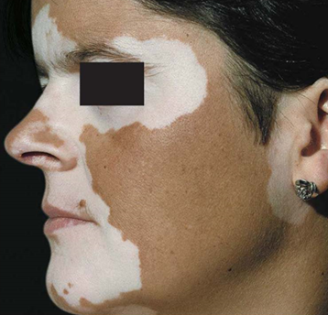
Vitiligo
Ivory white macules and patches with sharp convex margins
Koebner phenomenon
Could affect skin, hair, retina, but Iris color no change

Slide 9
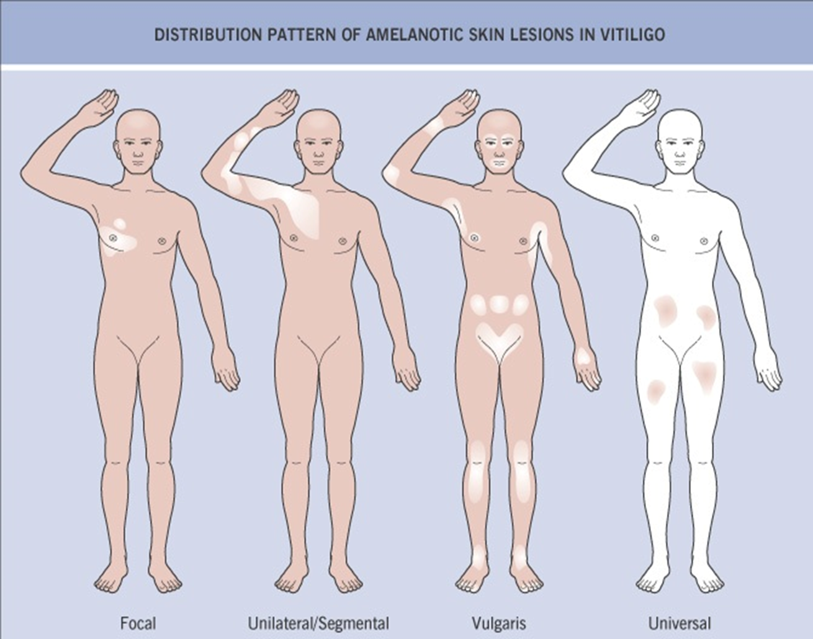
Types:
  Generalized (commonest)
  Focal
  Segmental
  Trichrome
  Acral

Slide 10
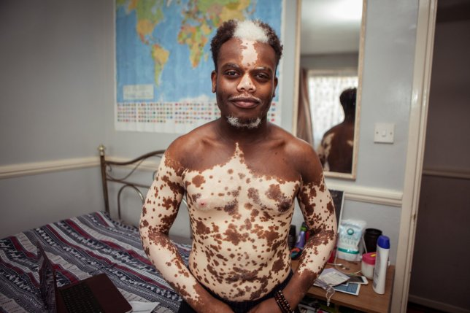
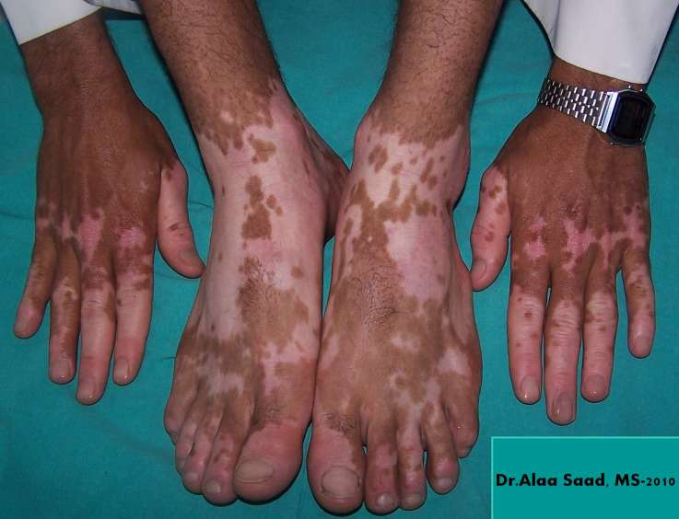
www.metro.co.uk
www.dermrounds.com

Slide 11
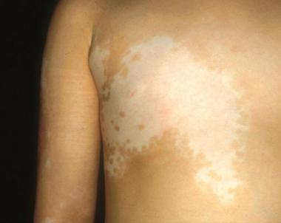
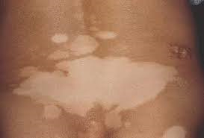
www.medscape.com
www.jaad.org

Slide 12
Vitiligo
Diagnosis usually clinically
Wood’s lamp for early vitiligo, white person
Pathology shows normal skin with no melanocytes

Slide 13
Vitiligo Management
Sun protection: sun-avoidance, clothes, hats, sunscreens
Make up
Tattoo
Psychological Support

Slide 14
Vitiligo Management
Focal disease:
Corticosteroids
Tacrolimus
8-MOP topical phototherapy
Excimer laser
Localized NB-UVB
Surgical (stable disease for 2 years) : melanocytes transfer, blister graft, punch graft

Slide 15
Vitiligo Management
Generalized:
NB-UVB
Oral PUVA
Systemic therapy: oral corticosteroids, methotrexate, cyclosporine, mycophenolate mofetil, azathioprine
Depigmentation with 20% monobenzylether of hydroquinone cream
Depigmentation with Q-switched laser and cryotherapy

Slide 16
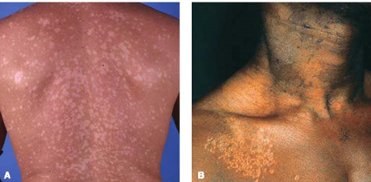
Post Inflammatory Hypopigmentation
Could happen after any inflammatory dermatosis
Pityriasis versicolor hypopigmentation
Post chemical peel or laser
Post intralesional corticosteroid injection
Treatment: make up, tattoo, Excimer laser, NB-UVB

Slide 17
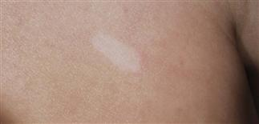
Nevus Depigmentosus
Congenital, solitary depigmented patch
Cutaneous mosaicisim with altered clones of melanocytes with decreased ability to produce melanin
Stable
Mostly in trunk and extremities
Treatment: make up, tattoo, melanocyte transfer

Slide 18
Hyperpigmentation
Increase of melanin in the epidermis:
  melanocytic hypermelanosis: An increase in the number of melanocytes in the epidermis (melanin) (an example Is lentigo).
  melanotic hypermelanosis: No increase of melanocytes but an increase in the production of melanin only (an example Is melasma).

Slide 19
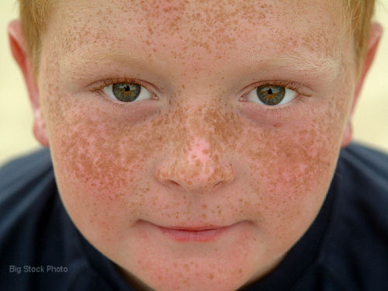
Freckle
(Lentigo)
Overactivity of an increased no. of melanocytes.
Fair individuals
Sun exposure in genetically predisposed individuals
Sun block
Pigmented laser
bleaching cream

Slide 20
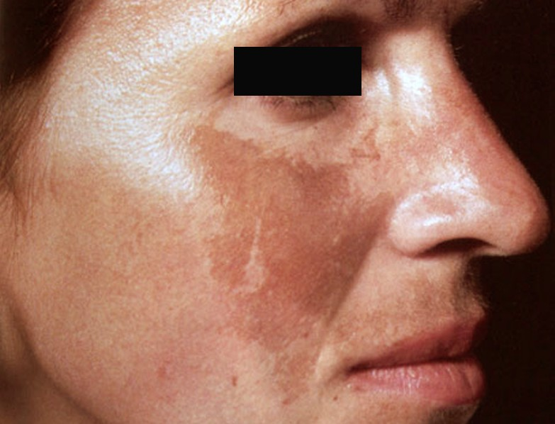
Melasma

Slide 21
Melasma
Acquired symmetrical blotchy hyperpigmentation mostly on face
Mostly in young females(20-40), only 10% males
Genetic predisposition, excessive sun exposure, pregnancy, oral contraceptives, hypothyroidism can trigger the disease
Present as sharply marginated macules and patches with irregular borders on cheeks and forehead

Slide 22
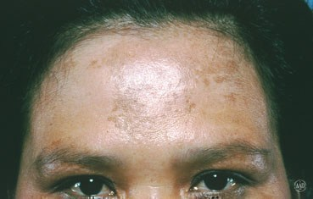
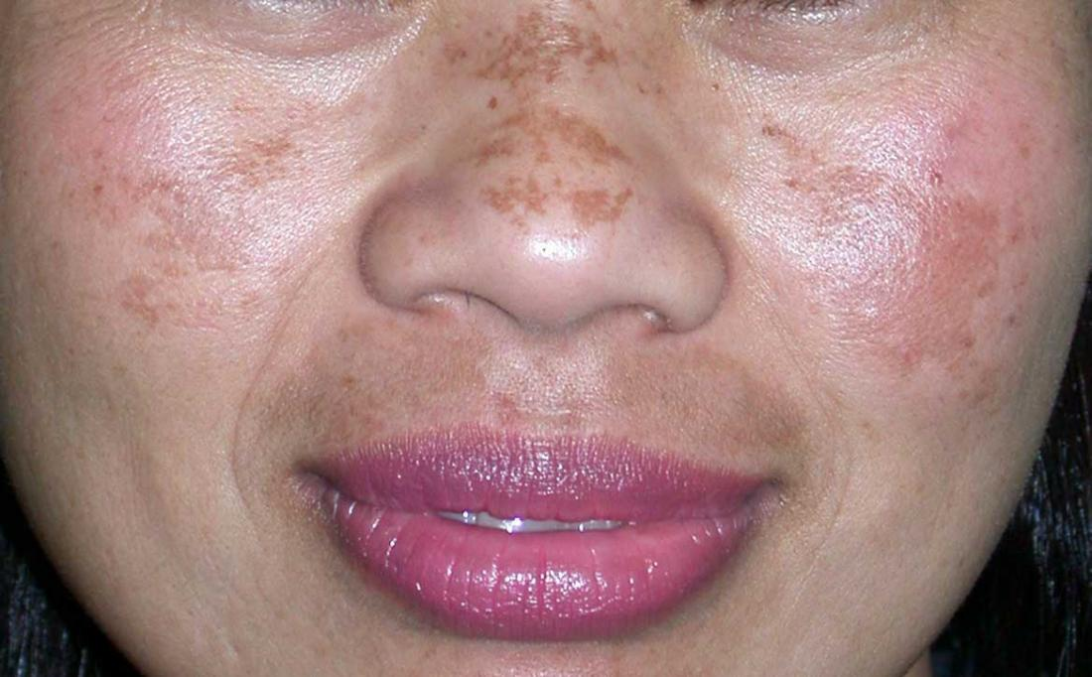
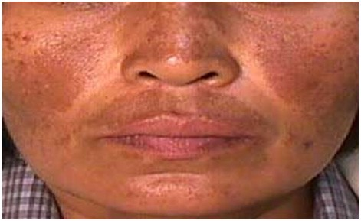
www.aad.org
www.medicalnewstoday.com
www.aesthetics.venkatcenter.com

Slide 23
Melasma Management
Sun protection
Kligman’s formula: Hydroquinone+Tretinoin+corticosteroid
Hydroquinone 4% cream
Glycolic acid, azelaic acid, kojic acid
Chemical peels: glycolic acid, TCA, phenol, resorcinol
Fractional laser

Slide 24
Post Inflammatory Hyperpigmentation
Any inflammatory disease can cause it
Acne, eczema, psoriasis, trauma, laser hair removal, burns, etc.
More severe with lichen planus
Improve with time but may persist for years
Treatment as melasma

Slide 25
Disorders of Hair Follicle

Slide 26
Hair Follicle Cycle
Anagen
Growth phase
Determines the ultimate length of the hair
85% of hair
2-7 years
Telogen
Resting phase
5-15%
3-4 months
Catagen
Transitional phase between anagen and telogen (apoptosis driven)
1% of hair
1-2 weeks
Exogen

Slide 27
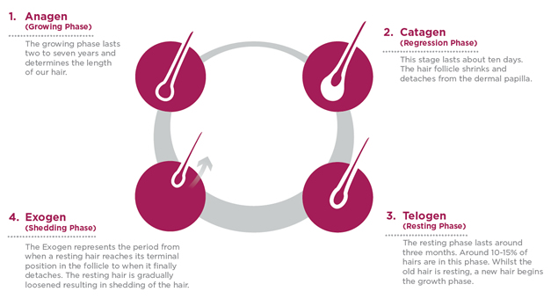
www.viviscal.com.au

Slide 28
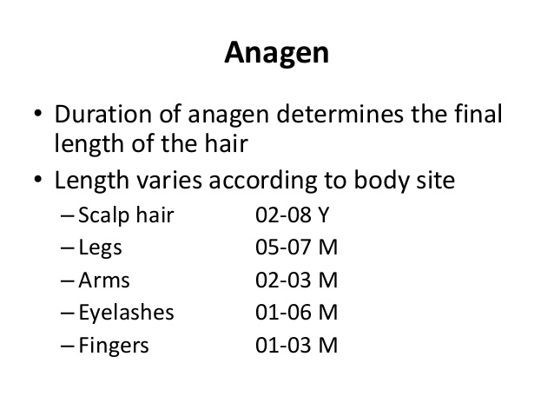
www.pt.slideshare.net

Slide 29
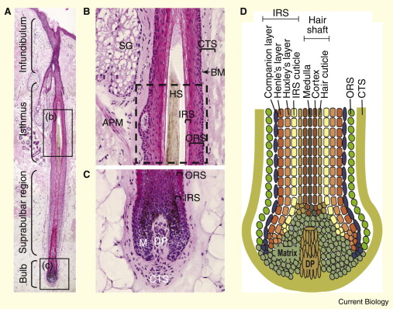
www.sciencedirect.com

Slide 30
Types of Hair
Lanugo hair: fetus, shed before birth
Vellus hair: fine, non-pigmented hair
Terminal hair: Thick. pigmented hair found on scalp, eyebrow/eyelashes, beard, axillae, pubic area; growth is influenced by hormones.

Slide 31
Diagnosis
Hair pull test: 6+ is positive
Trichogram: 50 hair pull for anagen/telogen hair ratio
Trichoscopy: dermatoscope
Scalp biopsy
Scanning Electron Microscopy

Slide 32
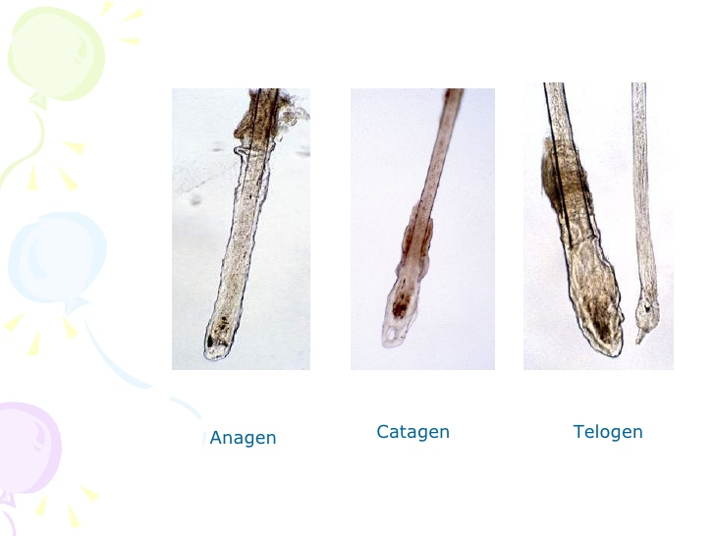
www.slideshare.net

Slide 33
Alopecia classified into:
• Noncicatricia/ alopecia: No clinical sign of tissue inflammation, scarring, or atrophy of skin.
• Cicatricial alopecia: Evidence of tissue destruction such as inflammation, atrophy, and scarring may be apparent.

Slide 34
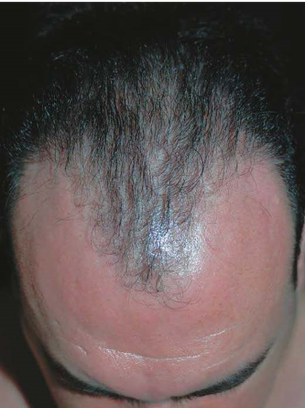
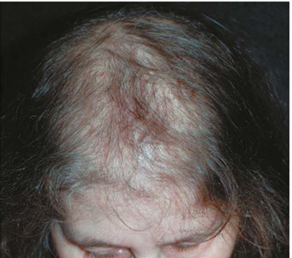
Pattern hair loss

Slide 35
Male Pattern Hair Loss
Most common type in adult men
Genetic predisposition (Autosomal dominant)and androgen hormones
Susceptibility genes inherited from both mother and father
Genetic sensitivity of hair follicle receptors to Dihydrotestosterone(DHT)
DHT decrease anagen phase from years to months or weeks
DHT is regulated by 5 alpha reductase
Testosterone → 5alpha reductase I&II→ DHT
Type II alpha reductase: scalp&beard hair, seminal vesicle, prostate, epididymis, scrotum

Slide 36
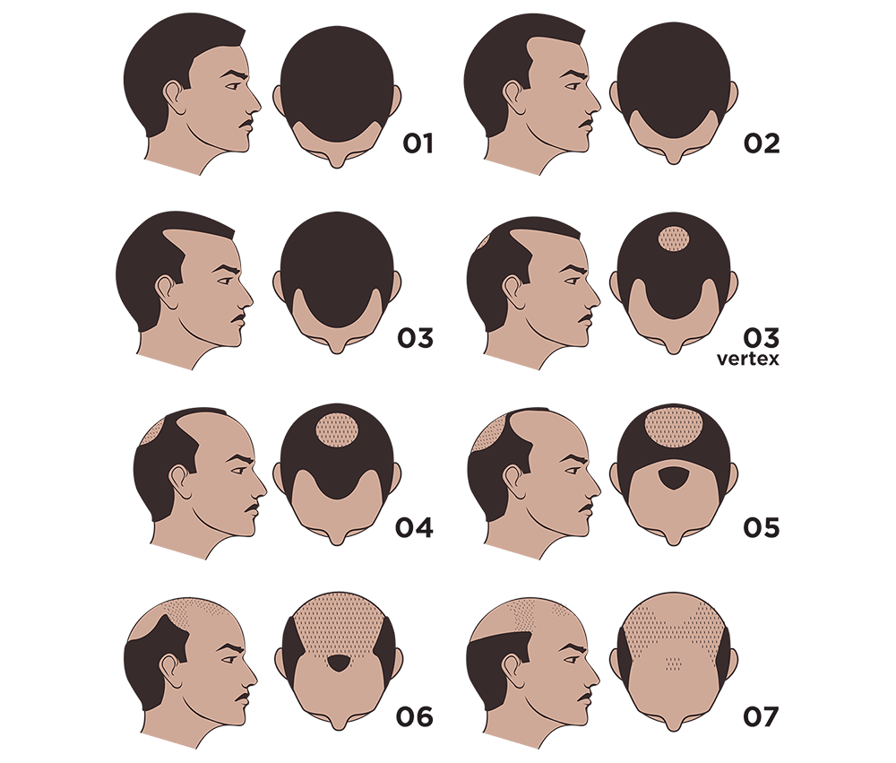
Present as receding hair line
and hair loss on frontal area and vertex

Slide 37
Management
Minoxidil solution 2% and 5%
Finasteride 1mg/d (type II 5 alpha reductase inhibitor)
Dutasteride 2.5mg/d (type I & II)
Hair transplant
Hair piece
Tattoo
powder

Slide 38
Female Pattern Hair Loss
40% of women ages 50 has some hair loss
Diffuse thinning of hair due to shedding and decrease volume
Genetic predisposition, polygenic, either parent
Normal androgen level
More common after menopause, ? Estrogen stimulate hair growth
Polycystic Ovarian Syndrome(PCOS), Congenital Adrenal Hyperplasia(CAH)

Slide 39
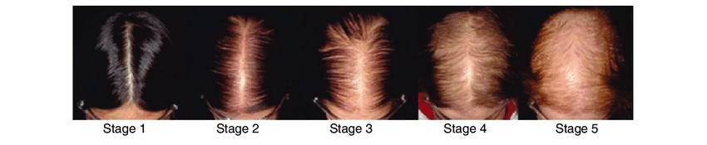
www.researchgate.net

Slide 40
Investigation
Trichogram
DHEAS
Prolactin
Free testosterone
LH/FSH
CBC, Iron, Ferritin, TIBC
Thyroid function test
Scalp biopsy

Slide 41
Management
Minoxidil 2%, 5%(may cause hypertrichosis on face and neck)
Finasteride
Dutasteride
Spironolactone
flutamide
Cyproterone acetate
Hair spray, powder, hair piece
Hair transplant

Slide 42
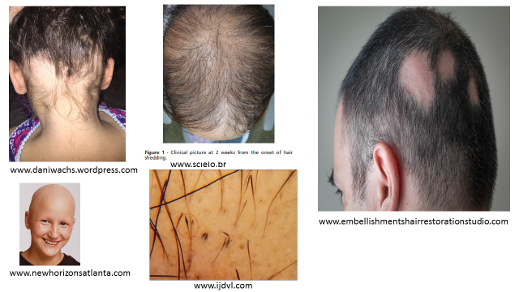
Alopecia Areata

Slide 43
Alopecia Areata
Autoimmune with T-cells around hair follicles
50% in childhood, 80% before age of 40
Genetic predisposition, 10-20% positive family history
Association with vitiligo, thyroid disease, atopic dermatitis and Down syndrome
Triggers: viral infection, trauma, hormonal changes, severe emotional stress

Slide 44
Alopecia Areata
Patchy AA ( the most common)
Patchy hair loss of scalp, beard, eyebrow, eyelash hair
Sudden onset
Regrowth of white hair then pigment comes back
Exclamation marks are 2-3 mm broken hair with distal end broader than proximal ! at the margin of the hairless patch
Nail pitting and ridging in 10-50% of patients

Slide 45
Types of Alopecia Areata
Localized AA.
Alopecia totalis: all scalp hair
Alopecia universalis: whole body
Ophiasis: occipital and lateral scalp
Diffuse alopecia areata:

Slide 46
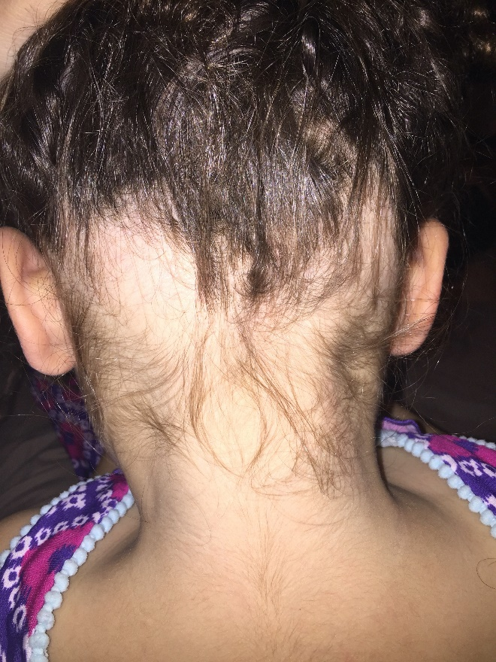
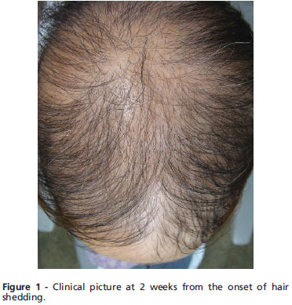
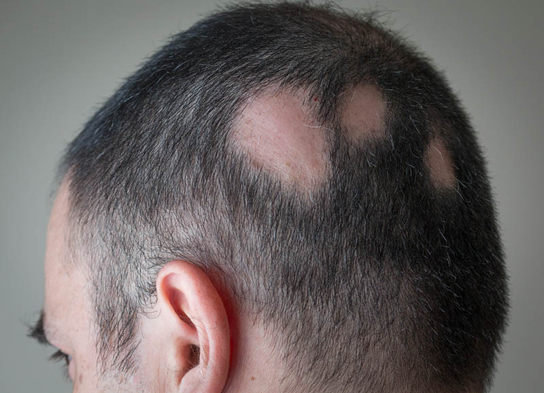
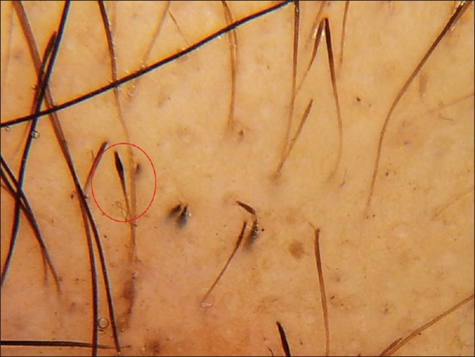
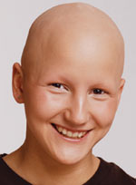
www.daniwachs.wordpress.com
www.scielo.br
www.embellishmentshairrestorationstudio.com
www.newhorizonsatlanta.com
www.ijdvl.com

Slide 47
Management
Intralesional corticosteroids
Minoxidil solution
Dithranol
Diphencyprone (DPCP)
phototherapy
Systemic corticosteroids, pulse therapy
Methotrexate, azathioprine
JAK inhibitors (Tofacetinib, Ruxolitinib)
Artificial eyelashes, eyebrow tattoo, hair piece

Slide 48
Prognosis
Single patch: 80% resolution in 1 year
Poor prognostic factors:
Extensive disease
Duration >1 year
Ophiasis pattern
Nail involvement
Childhood onset
Positive family history
Other concomitant autoimmune diseases
Atopy
Down syndrome

Slide 49
Telogen Effluvium
Temporary hair loss of telogen hair
System shock: change anagen hair to telogen
Might take 2 months after shock to start losing hair
Usually last for 6-9 months with incomplete recovery
Could be chronic, but doesn’t cause complete baldness
Fever, surgery with general anesthesia, childbirth, severe emotional trauma, severe weight loss
Drugs: heparin, warfarin, B-blockers, Ace-inhibitors, lithium, anticonvulsants(especially valproic acid)

Slide 50
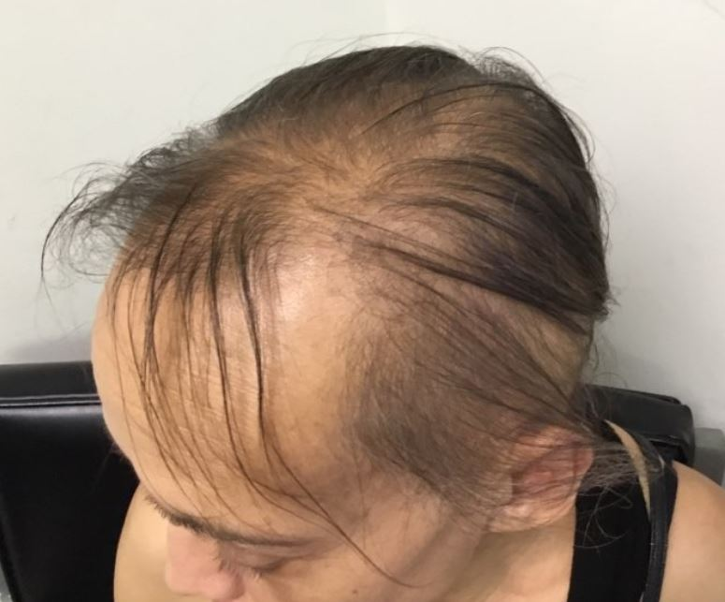
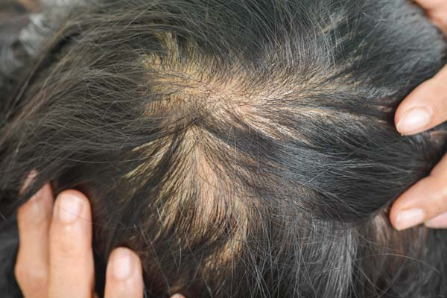
www.clinicaladvisor.com
www.embellishmentshairrestorationstudio.com

Slide 51
Diagnosis
HAIR PULL: +ve with reduced percentage of anagen hair.
CBC, Serum iron, & iron-binding capacity.
TSH Rule out thyroid disease.
Vitamin D level

Slide 52
Treatment
Treat the cause
Minoxidil 2 %

Slide 53
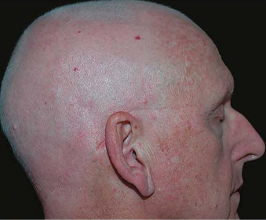
Anagen Effluvium

Slide 54
Anagen Effluvium
Etiology: Radiation therapy to head; chemotherapy with alkylatlng agents; Intoxications.
Onset is usually rapid and extensive
Pathogenesis: Occurs after any insult to the hair follicle that impairs its mitotic/metabolic activity.
Regrowth is usually rapid after discontinuation of chemotherapy.

Slide 55
Scarring Alopecia
Lichen planopilaris LPP
Frontal fibrosing alopecia: post menopausal women
Central centrifugal cicatricial alopecia
Discoid lupus erythematosus of scalp
Traction alopecia
Trichotillomania
Acne keloidalis nuchae
Kerion ( tinea capitis)

Slide 56
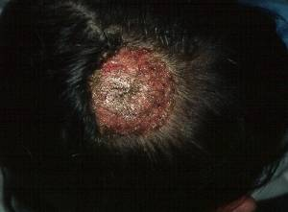
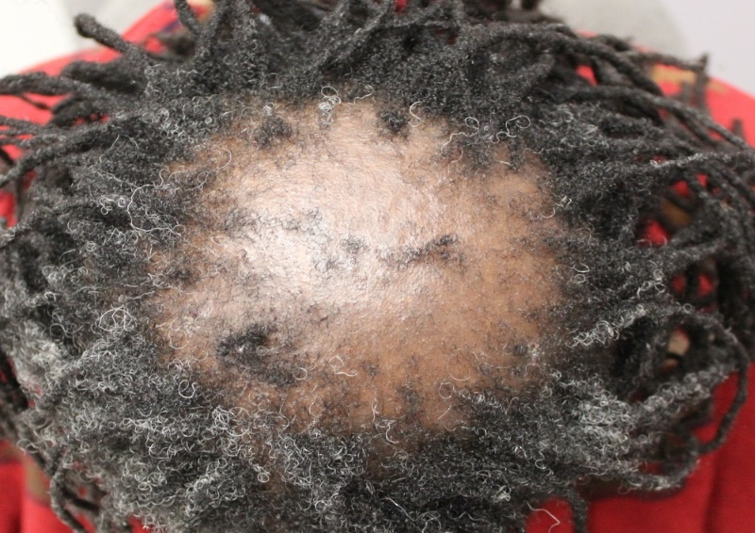
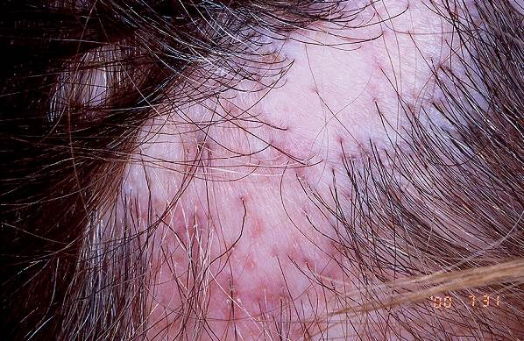
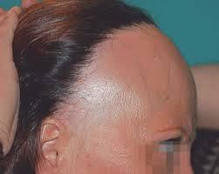
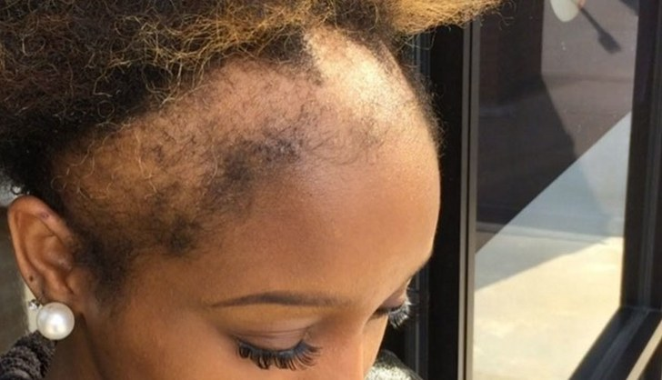
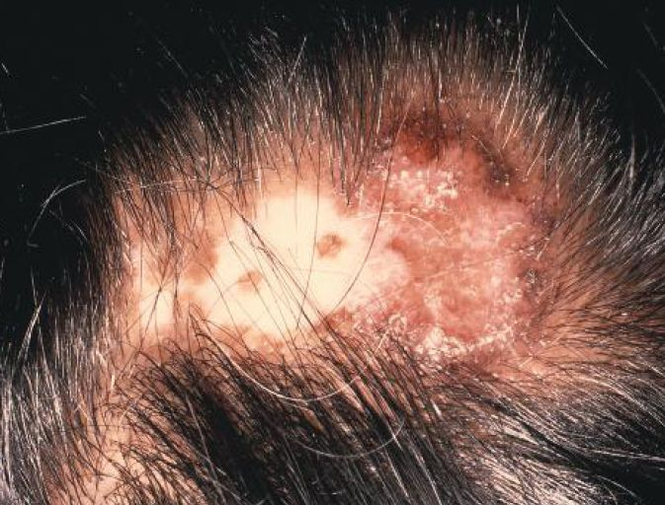

Slide 57
Hirsutism
Male pattern hair growth in women (Facial hair, below umbilicus, around nipple, upper back, inner thighs)
Associated findings:
Acanthosis nigricans, galactorrhea, striae, acne, virilization(increase muscle bulk& size of clitoris, deep voice, baldness, menstrual irregularities
Causes:
  Genetically determined, 10% of women affected
  Increase androgen and testosterone
  PCOS
  Weight gain
  Stopping oral contraceptives
  Cushing syndrome
  CAH ( 21 hydroxylase deficiency)
  Tumors of adrenal glands (almost always malignant)
  Ovarian tumors (arrhenoblastoma)
  Pituitary gland (ACTH dependent)

Slide 58
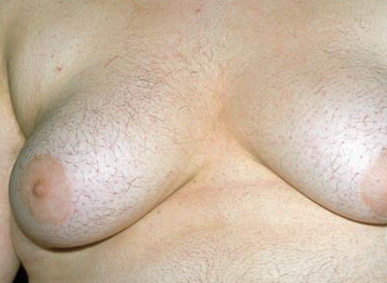
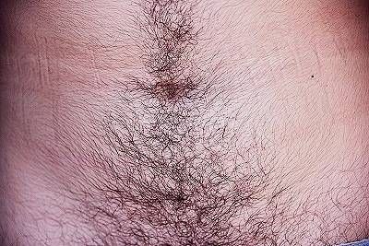
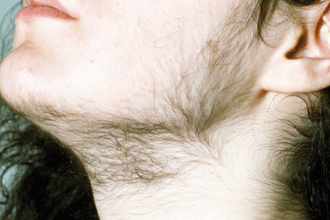
kinleymbbsmed.blogspot.com
www.pcds.org.uk
www.gponline.com

Slide 59
Investigation
Initial screening: Free testosterone, Dihydroepiandrosterone sulfate (DHEAS)
Adrenal (↑testo+↑DHEAS)
Ovary (↑testo + normal DHEAS)
Thyroid function, prolactine
LH/FSH ratio: PCOS
17-hyroxyprogesterone: CAH
Urinary and serum cortisol
Dexamethasone suppression test: to exclude ACTH dependent hirsutism
Prostate specific antigen(PSA): a marker for increase androgens
U/S pelvis, CT-Scan, MRI

Slide 60
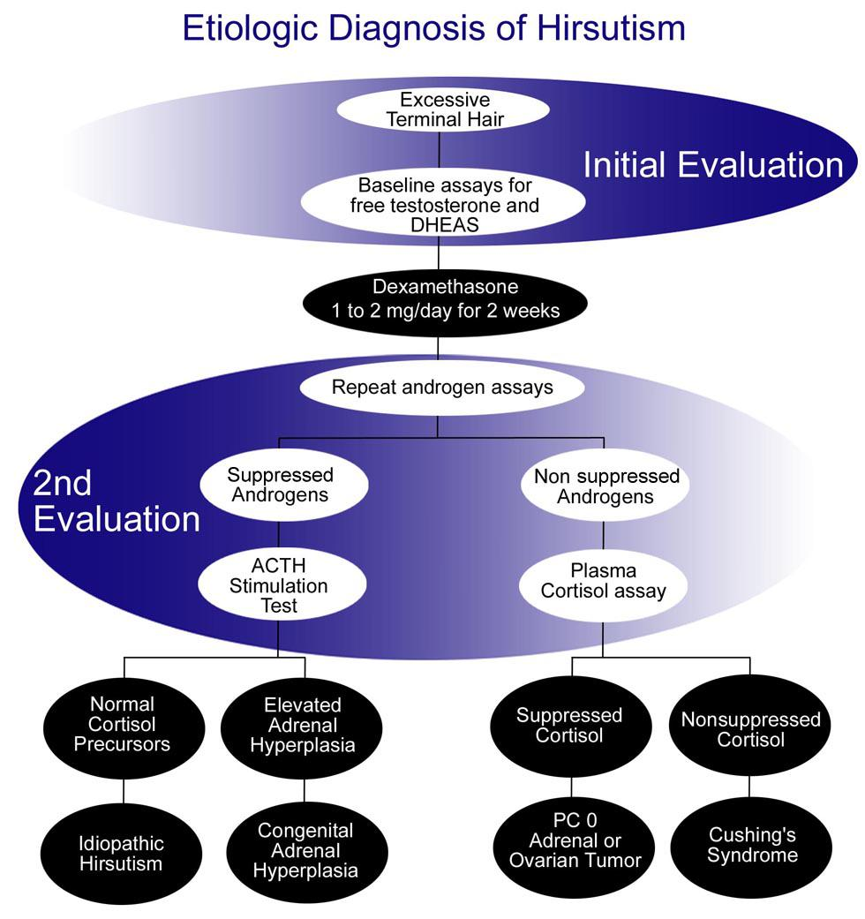

Slide 61
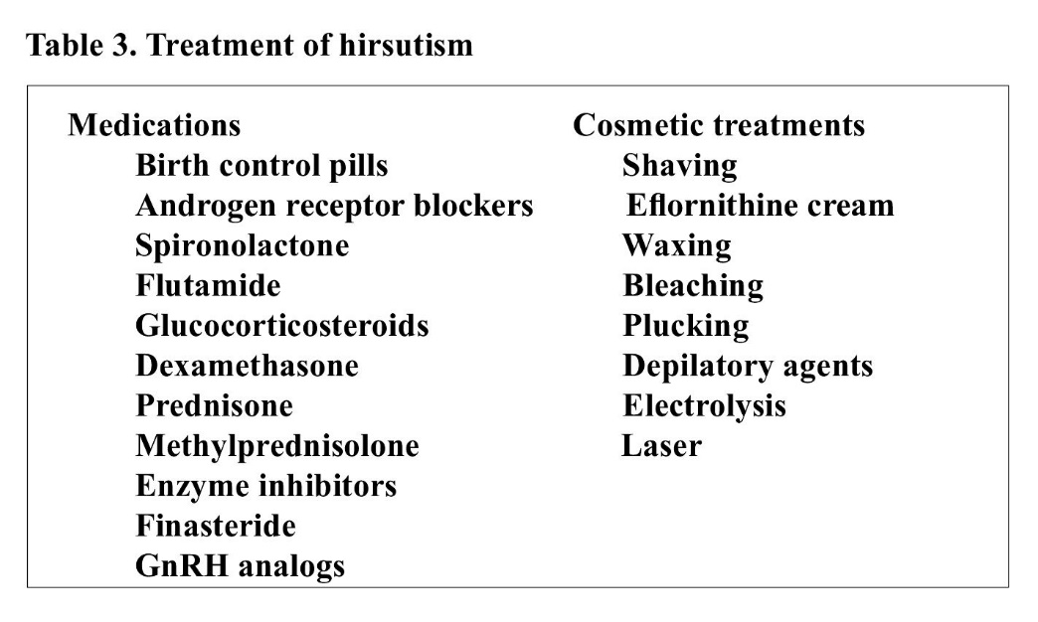
www.reproductivefacts.org

Slide 62
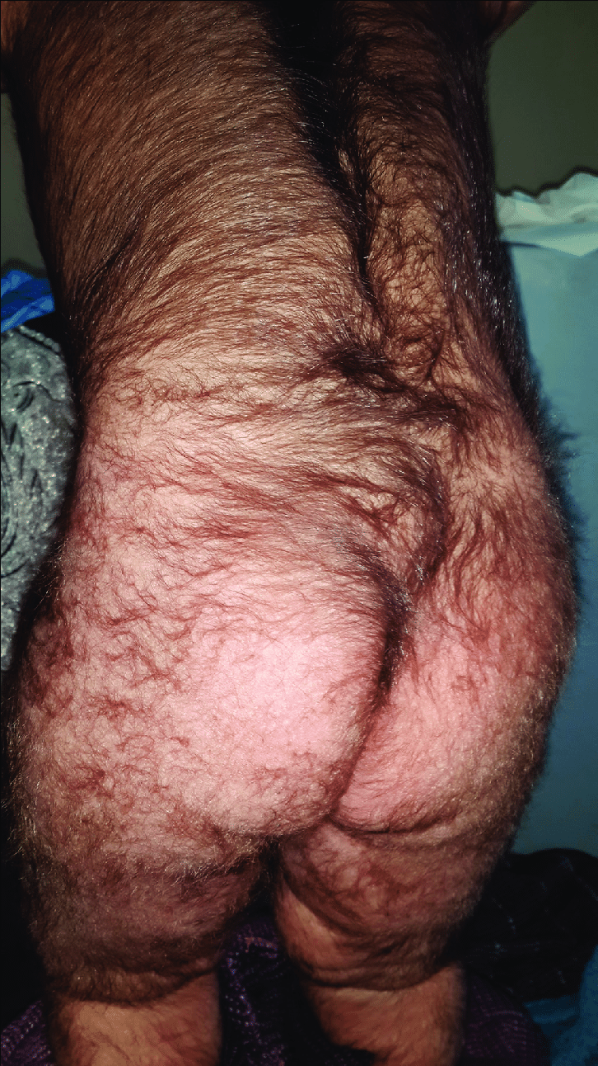
Hypertrichosis

Slide 63
Hypertrichosis
Excessive growth of lanugo, vellus, or terminal hair
Congenital or acquired
Generalized hypertrichosis: porphyria cutanea tarda, malnutrition, malignancy, hypothyroidism, drugs(minoxidil, cyclosporine, phenytoin, androgenic steroids, Oral corticosteroids).
Localized: chronic itching and rubbing, topical minoxidil, topical corticosteroids, PUVA
Hypertrichosis associated with nevi: congenital melanocytic nevus, Becker’s nevus, vascular malformation
Trichomegaly (Bimatoprost)

Slide 64
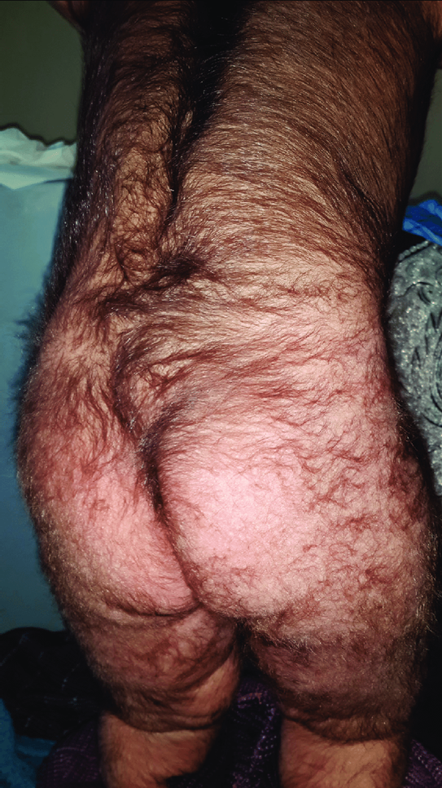
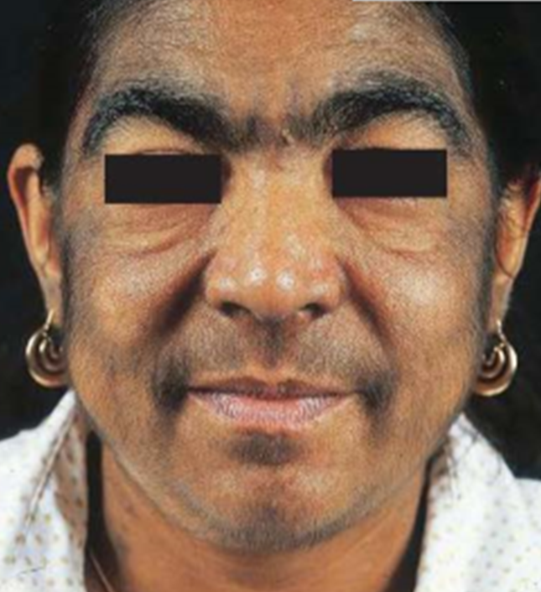

Slide 65
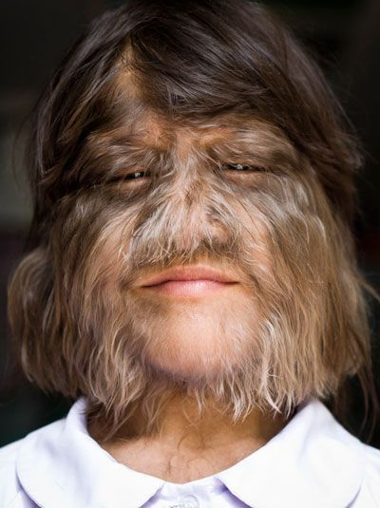
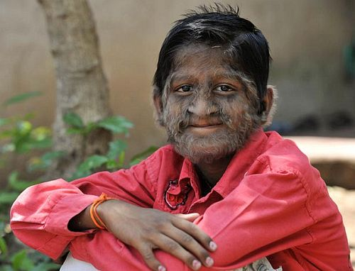
Werewolf syndrome
www.pinterest.com

Slide 66
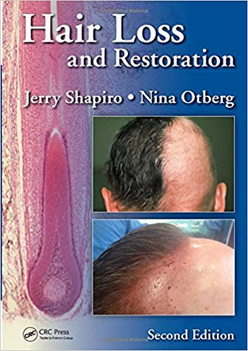
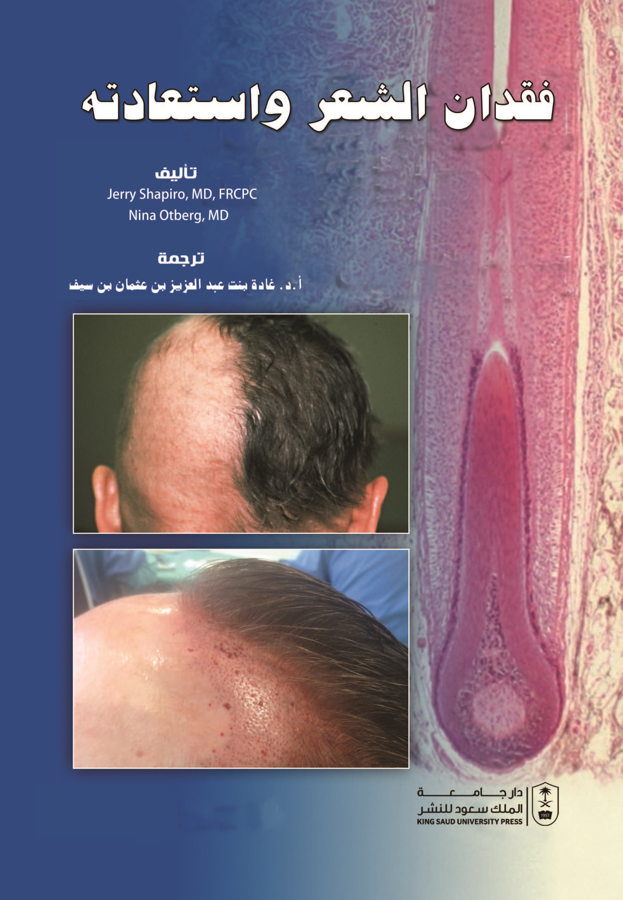

Slide 67
Questions

