Slide 1
Cutaneous manifestations of SLE and other CTD ( dermatomyositis , scleroderma)

Slide 2
Objectives
At the conclusion of these lectures the student will be able to:
• Differentiate between the various types of Lupus
• Recognize how Lupus affects the various systems of the body
•Identify all of the current treatment options available for Lupus

Slide 3
Objectives
To learn how to diagnose and investigate dermatomyositis.
• How to manage dermatomyositis.
• To learn the presentation of morphea and systemic sclerosis and ways to manage them.
• This lecture is not meant to be inclusive of all the information about these diseases but to highlight important aspects in their diagnosis and management.

Slide 4
LUPUS ERYTHEMATOSUS

Slide 5
LUPUS ERYTHEMATOSUS
It’s a designation of a spectrum of diseases that are linked by distinct clinical findings and distinct patterns of polycolonal B cell immunity.
It ranges from life threatening manifestations of SLE to the limited and exclusive skin involvement in CCLE.
More than 85% of patients with LE have skin lesions, which can be classified into LE-specific & non-specific*.

Slide 6
Revised ACR’s Criteria for Classification of SLE
Any 4 of the following criteria are required to make the diagnosis:
Malar rash
Discoid rash
Photosensitivity
Oral ulcer
Arthritis
Serositis
Renal dis.
Neurological dis.
Hematological inv.
Immunological dis.
ANA

Slide 7
Classification of Cutaneous Disease in Lupus Erythematosus
Lupus Specific eruptions Lupus- nonspecific eruptions
1 . Acute cutaneous LE (ACLE) Nonscarring alopecia
Localized, generalized Telangiectasia
Livedo Reticularis
2. Subacute cutaneous LE ( SCLE) Palpable Purpura
A. Annular Periungual erythema
B. Papulosqamous Urticarial vasculitis
C. Syndromes commonly exhibiting similar morphology Raynaud’s syndrome
1. Neonatal LE (NLE) Photosensitivity
2. Complement deficiency syndromes
3. Drug induced
3. Chronic Cutaneous LE
A. Discoid LE (DLE)
1. Localized, head and neck
2. Disseminated
3. Verrucous ( hypertrophic) DLE
B. Tumid Lupus
C. Lupus panniculitis
D. Chilblain LE
4. Other variance
Bullous SLE
Rowell’s syndrome

Slide 8
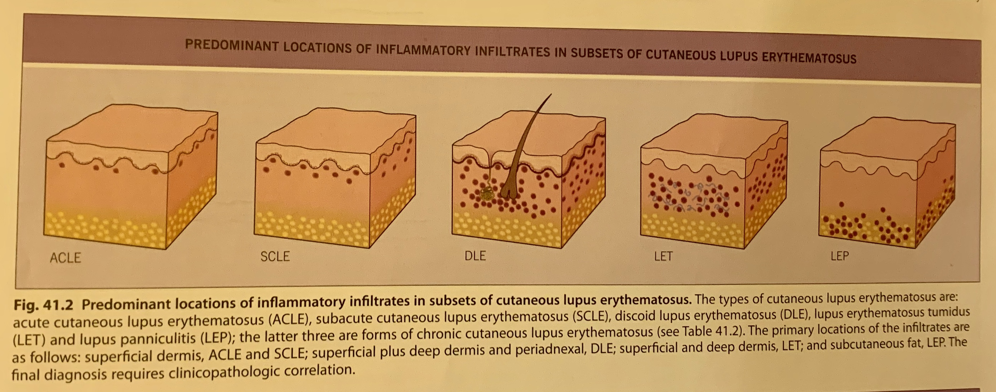
Classification of Cutaneous Disease in Lupus Erythematosus

Slide 9
Acute Cutaneous Lupus Erythematosus
What is Acute Cutaneous Lupus Erythematosus?

Slide 10
Acute Cutaneous Lupus Erythematosus
Acute malar “ butterfly rash” or more generalized photodistributed eruption.
Nearly ALL patients presenting with ACLE will have systemic lupus erythematosus ( SLE ), often in an acute flare.
Patients with ACLE will nearly always have a +ve ANA
ACLE is transient, improves with improvement of the SLE
Non scarring

Slide 11
Acute Cutaneous Lupus Erythematosus
- Are there any common skin eruptions that may be confused with acute coetaneous lupus erythmeatosus?
Seborrheic dermatitis
Vascular type of rosacea
Polymorphous light eruption
Photo reaction to systemic medications and topical products
Certain types of porphyria

Slide 12
Acute Cutaneous Lupus Erythematosus
What is the initial workup of ACLE?

Slide 13
Acute Cutaneous Lupus Erythematosus
History & Physical examination
Skin Biopsy
Serology
CBC, ESR
Urine analysis
C3,C4: : low levels indicate active disease, often with renal involvement.
Lupus Band Test

Slide 14
Acute Cutaneous Lupus Erythematosus
Serology:
ANA :+ve in 95% ,VERY SENSITIVE BUT NOT SPECIFIC
Anti-dsDNA (anti- native DNA): Specific but not very sensitive, indicates high risk for renal disease.
Anti-smith : most specific +ve in 30%
Anti-histone Ab ( drug induced lupus)
Rheumatoid factor : +ve in 30%

Slide 15
Lupus Band Test
It’s preferred to be done on nonlesional nonexposed skin, but can be performed on lesional skin.
Positive DIF supports the diagnosis of Cutaneous LE, negative DIF does not exclude the diagnosis.
Clinical, histopathology, serology are more important.
Positive antibody of normal appearing skin correlates with SLE.
Granular deposits of immunoglobulins and complement are detected in a band-like pattern at the dermal-epidermal junction.

Slide 16
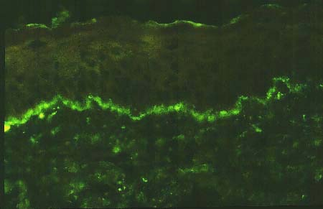
Lupus Band Test

Slide 17
Acute Cutaneous Lupus Erythematosus
How is ACLE managed ?

Slide 18
Acute Cutaneous Lupus Erythematosus
The aim of treatment for cutaneous LE is to alleviate symptoms and to prevent scarring.
Sun protective measures
Potent topical steroids
Antimalarial drugs.
Oral steroids.
Methotrexate, azathioprin, mycophenolate mofetil, cyclosporine, cyclophosphamide, IVIG, and Rituximab.

Slide 19
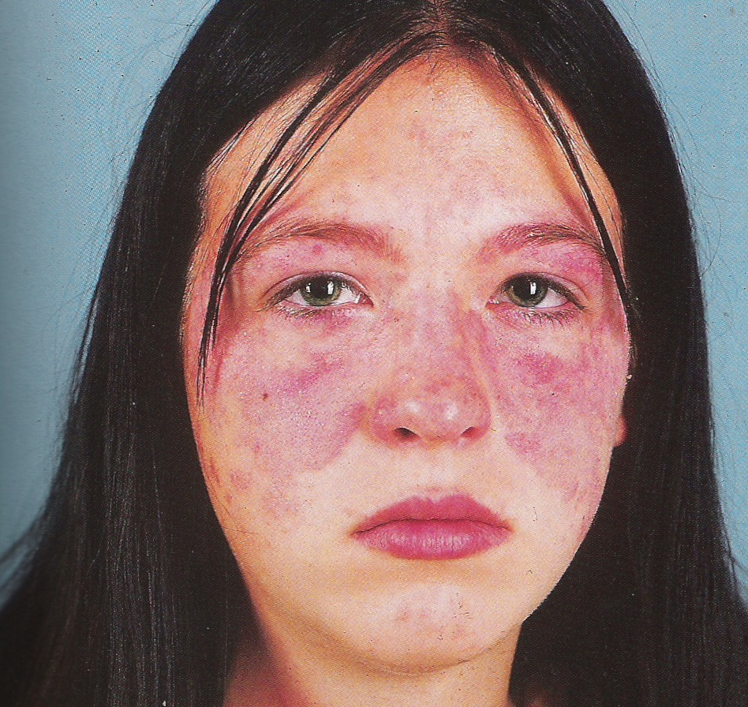
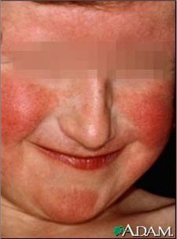
Acute Cutaneous Lupus Erythematosus

Slide 20
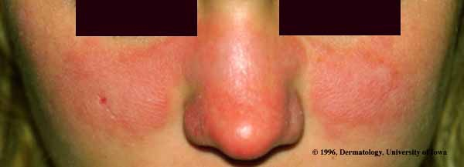
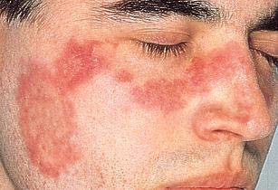
Acute Cutaneous Lupus Erythematosus

Slide 21
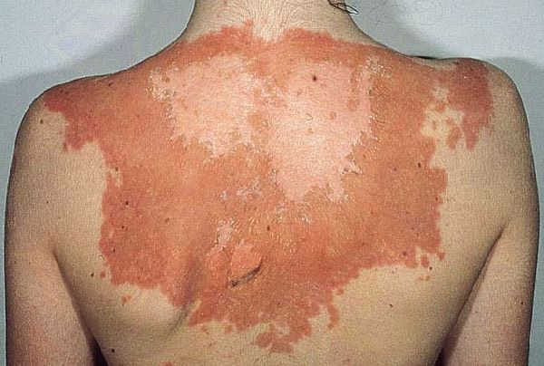
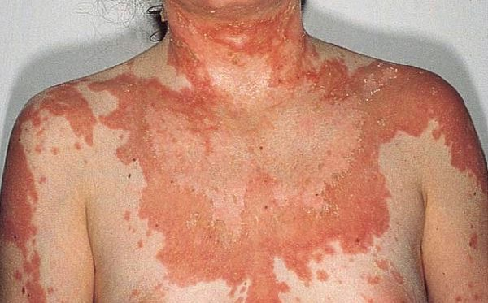
Acute Cutaneous Lupus Erythematosus

Slide 22
Subacute Cutaneous Lupus Erythematosus
What is subacute cutaneous lupus erythematosus?

Slide 23
Subacute Cutaneous Lupus Erythematosus
More persistent than those of ACLE ( weeks- months)
Scaly, superficial, inflammatory macules, patches, papules and plaques that are photodistributed, particularly on the upper chest & back, lateral neck, and dorsal arms & forearms.
Morphologic subtypes:
Annular/polycyclic lesions “ ring-shaped”
Papulosquamous lesions:
psoriasiform
pityriasiform

Slide 24
Subacute Cutaneous Lupus Erythematosus
Do patients with SCLE have SLE?

Slide 25
Subacute Cutaneous Lupus Erythematosus
About 1/2 patients with SCLE will have 4 or more criteria for the classification of SLE
Skin disease, photosensitivity, musculoskeletal complaints
60-100% have anti Ro antibody.
10-15% develop significant internal disease including nephritis.
SCLE could occur in patients with Sjögren syndrome, deficiency of the second component of complement (C2).
Drug induced SCLE: hydrochlorothiazide, terbinafine, calcium channel blockers, NSAI.

Slide 26
Subacute Cutaneous Lupus Erythematosus
How do you make the diagnosis of SCLE?

Slide 27
Subacute Cutaneous Lupus Erythematosus
SCLE is a clinical diagnosis based on presence of:
typical photodistributed eruption
skin biopsy
Direct Immunofluorescence
A strong association exists with anti-Ro/SS- A autoantibodies, and a lesser extent will have anti-La/SS-B

Slide 28
Subacute Cutaneous Lupus Erythematosus
What is the initial workup of SCLE?

Slide 29
Subacute Cutaneous Lupus Erythematosus
History & Physical examination
Laboratory testing
Medication History

Slide 30
Subacute Cutaneous Lupus Erythematosus
How is SCLE managed ?

Slide 31
Subacute Cutaneous Lupus Erythematosus
Broad-spectrum sunscreens
Sun-protective measures
Topical steroids
Antimalarial drugs

Slide 32
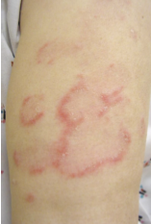
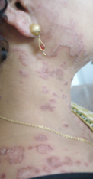
Subacute Cutaneous Lupus Erythematosus

Slide 33
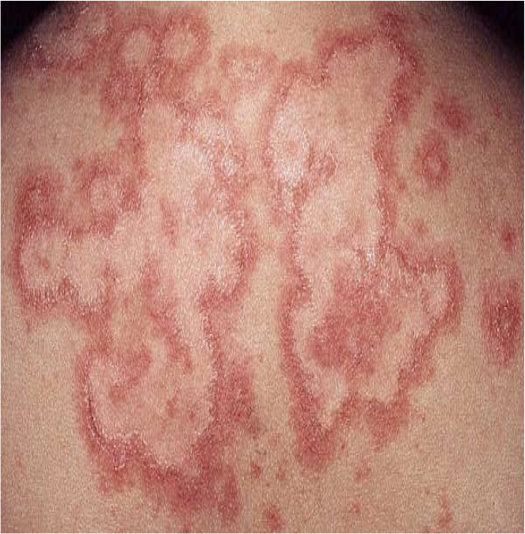
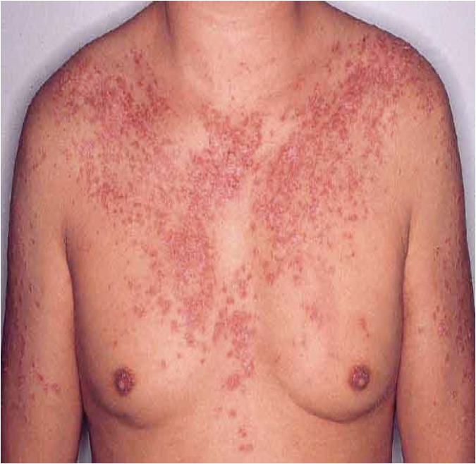
Subacute Cutaneous Lupus Erythematosus

Slide 34
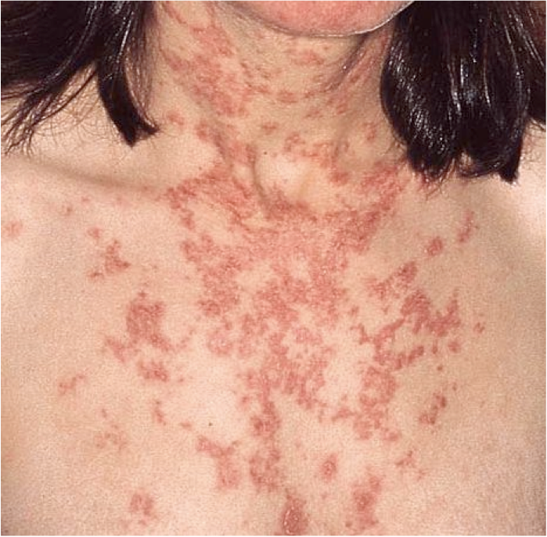
Subacute Cutaneous Lupus Erythematosus

Slide 35
Neonatal Lupus Erythematosus
The skin lesions occur on the face and head, morphologically resemble SCLE lesions, they are transient, resolving within a few months*.

Slide 36
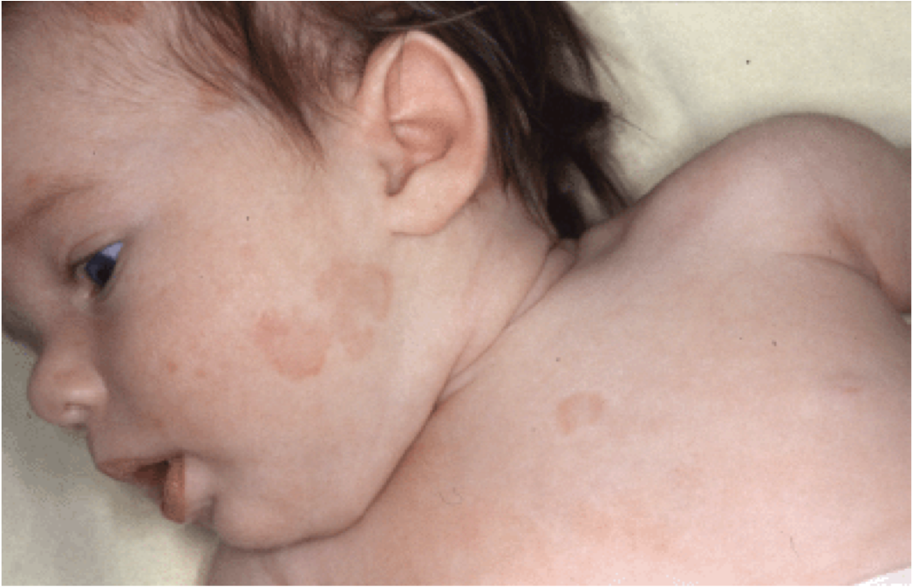
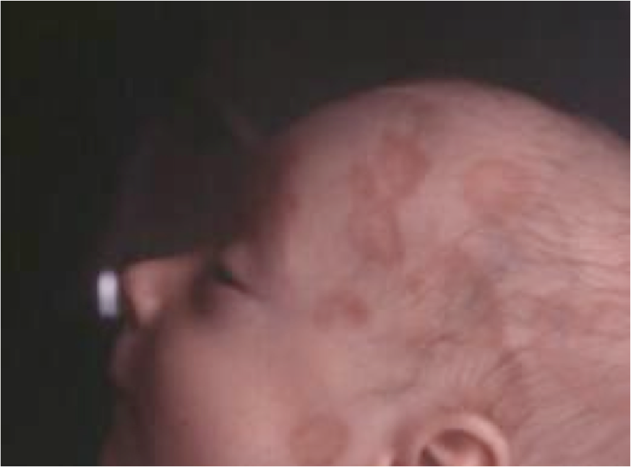
Neonatal Lupus Erythematosus

Slide 37
Neonatal Lupus Erythematosus
In NLE , infants develop skin disease (50%), congenital heart block (50%), or both (10%).
It’s usually permanent and may require a pacemaker.
10% of infants with NLE and heart disease die from cardiac complications.
Thrombocytopenia/ liver disease.
anti-Ro (100%) and other antibodies as well as the mother.

Slide 38
Chronic Cutaneous Lupus Erythematosus
What is chronic cutaneous lupus erythematous ?

Slide 39
Chronic Cutaneous Lupus Erythematosus
Several types of cutaneous LE that are very persistent are termed Chronic cutaneous lupus erythematosus.
The most common of these chronic forms is Discoid lupus erythematosus “ DLE”
Serologic abnormalities are uncommon

Slide 40
Chronic Cutaneous Lupus Erythematosus
Describe the skin changes that occur with discoid lupus erythematosus?

Slide 41
Chronic Cutaneous Lupus Erythematosus
Discoid lupus erythematosus:
Localized or generalized
Chronic, fixed, indurated, erythematous papules and plaques often distributed over the head& neck.
Scarring
Pigmentary changes ( hypo/hyperpigmentation)
Epidermal changes: scales, keratotic plugging of hair follicles, crusting
External ears

Slide 42
Chronic Cutaneous Lupus Erythematosus
Do patients with DLE develop systemic lupus erythematosus?

Slide 43
Chronic Cutaneous Lupus Erythematosus
Risk of developing SLE is 5%-15% ( slightly higher risk if DLE is generalized ).
25% of SLE patients will develop lesions of DLE at some time during the course of their disease.

Slide 44
Chronic Cutaneous Lupus Erythematosus
How is Discoid Lupus treated?

Slide 45
Chronic Cutaneous Lupus Erythematosus
Sunscreens
Sun-protective measures
Potent topical steroids/ intralesional steroids
Antimalarial drugs

Slide 46
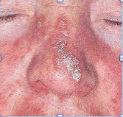
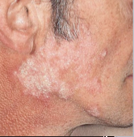
Chronic Cutaneous Lupus Erythematosus

Slide 47
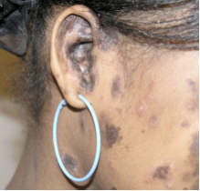
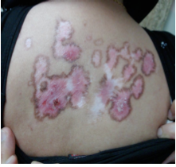
Chronic Cutaneous Lupus Erythematosus

Slide 48
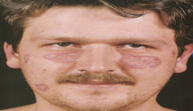
Chronic Cutaneous Lupus Erythematosus

Slide 49
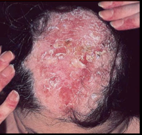
Chronic Cutaneous Lupus Erythematosus

Slide 50
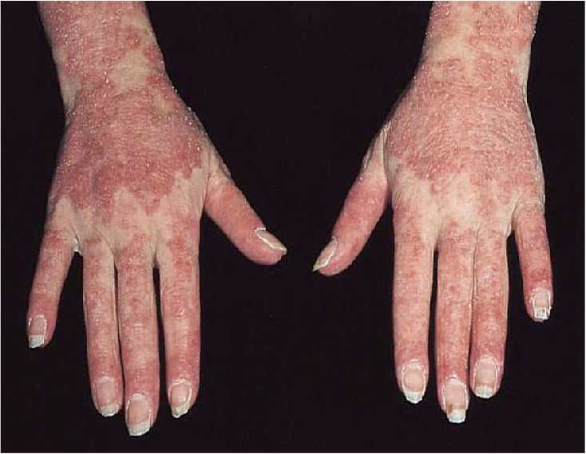
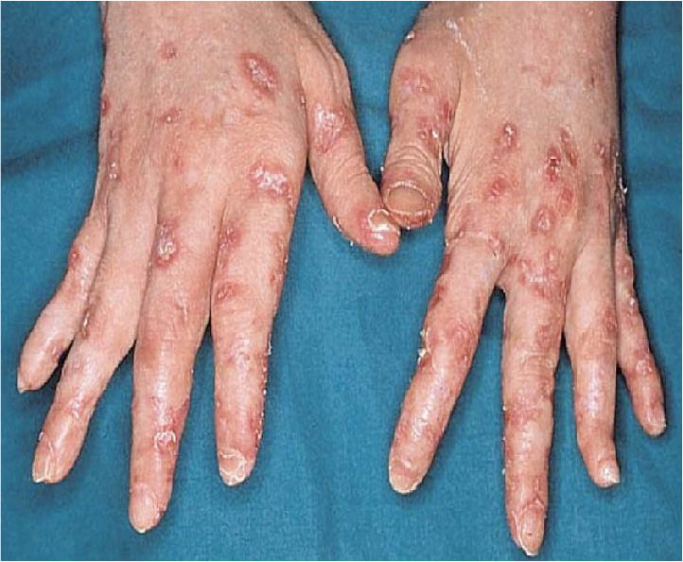
Chronic Cutaneous Lupus Erythematosus

Slide 51
Drug-Induced Lupus Erythematosus
Drug-induced lupus differs from SLE by the following features:
Sex ratios are nearly equal.
Arthralgia, myalgia, pleuritis, fever, lacking nephritis, CNS disease.
Procainamide, hydralazine.
Antihistone antibodies.
No antibodies to native DNA or hypocomplementemia are present.
When the drug is discontinued, the patient has resolution of clinical manifestations and reverting of abnormal laboratory values to normal.

Slide 52
Drug-Induced Lupus Erythematosus
What is minocycline-induced lupus?
- Polyarthralgia, fatigue, fever, elevated liver enzymes, pneumonitis, anemia, lupus specific skin eruption have not been reported
all patients have positive ANA

Slide 53
Drug-Induced Lupus Erythematosus
Drugs associated with lupus erythematosus:
Chlorpromazine | Isonizide
Hydralazine | procinamide
Methyldopa | Quinidine
Anti- TNF | Minocyclin
Penicillamin | IFN-alpha, IFN-beta

Slide 54
DERMATOMYOSITIS

Slide 55
Dermatomyositis
Autoimmune disease of uncertain etiology.
Involving skin and proximal muscle weakness.
Juvenile, adult onset.
Amyopathic dermatomyositis- in some instances, muscle involvement may not be detectable.
Making early diagnosis is important because it is a serious but treatable multi system disease

Slide 56
Dermatomyositis
Criteria for diagnosing dermatomyositis:
Progressive proximal symmetrical weakness
Elevated muscle enzyme levels
Abnormal findings on electromyograms
Abnormal findings from muscle biopsy.
Compatible cutaneous disease.
Diagnosis :
Proximal muscle weakness with two of the three laboratory criteria

Slide 57
Dermatomyositis
Are there skin changes that are diagnostic of dermatomyositis?

Slide 58
Dermatomyositis
Two cutaneous findings have been describes as “pathognomonic” of dermatomyositis:
Gottron’s papules
Gottron’s sign

Slide 59
Dermatomyositis
What is the difference between Gottron’s papules and Gottron’s sign?

Slide 60
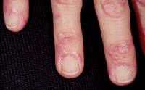
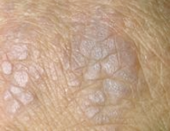
Dermatomyositis
Gottron’s papules- are erythematous to purplish flat papules on the extensor surfaces of the interphalangeal joints

Slide 61
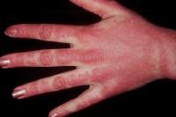
Dermatomyositis
Gottron’s sign- consist of symmetric violaceous erythema, sometimes with edema, over the dorsal knuckles of the hands, elbows, knees, and medial ankles.

Slide 62
Dermatomyositis
Are there other skin findings that are characteristic of dermatomyositis?

Slide 63
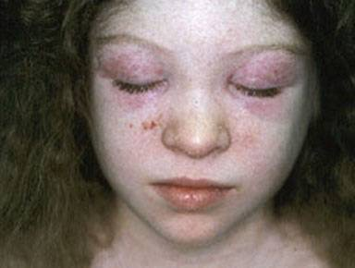
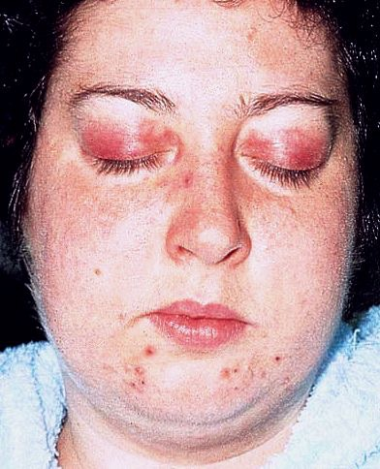
Dermatomyositis
Heliotrope rash- symmetrical periorbital edema with a violaceous (lilac) dusky erythema

Slide 64
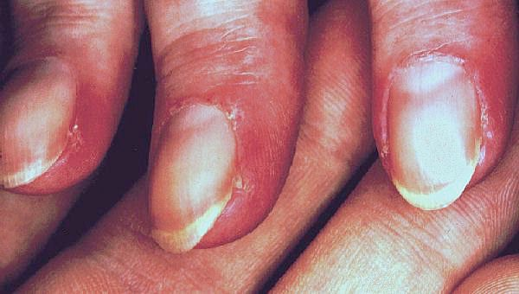
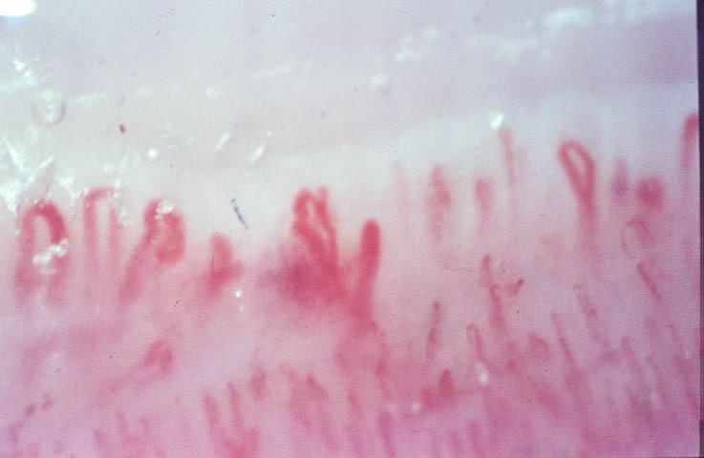
Dermatomyositis
Periungual talangiectasia with cuticle atrophy

Slide 65
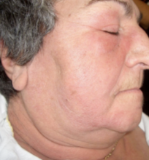
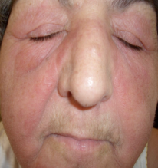
Dermatomyositis
Photodistrbuted violaceous erythema of the face, sun-exposed areas of the neck, upper chest, shoulders, dorsal arms, forearms, and hands.

Slide 66
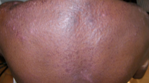
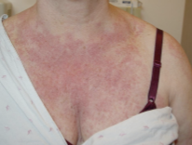
Dermatomyositis
Shawl sign- highly associated with interstitial lung disease

Slide 67
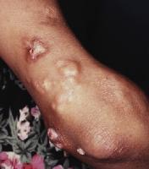
Dermatomyositis
Calcinosis- of the skin or the muscle.
manifests as firm, yellow or flesh-colored nodules, often over bony prominences. (juvenile DM) in 25%-70% of patients

Slide 68
Dermatomyositis
Are there any diseases associated with dermatomyositis?

Slide 69
Dermatomyositis
It can be associated with other connective tissue diseases such as lupus, rheumatoid arthritis, scleroderma and Sjogren's syndrome.
25% of adults with DM have associated malignancy.
Female patients should be carefully screened for ovarian cancer.
Juvenile type associated with calcinosis cutis.
Fulminant lung disease is reported in amyopathic DM and underlying malignancy, therefore both malignancy screening and systemic involvement are recommended irrespective of muscle involvement.

Slide 70
Dermatomyositis
Oropharyngeal and upper esophageal muscle involvement may lead to dysphagia, nasal regurgitation or aspiration.
Respiratory failure due to weakness of the diaphragm and chest wall muscles.

Slide 71
Dermatomyositis
What is a serious complication in DM?
ILD in 10% of cases
often occurs with antisynthetase antibodies (t-RNA) antibodies to aminoacyl-transfer ribonucleic acid synthetase enzymes
30% of DM have antisynthetase syndrome (ILD raynaud’s phenomenon, arthritis, mechanics hands)

Slide 72
Dermatomyositis
How do you diagnose dermatomyositis?

Slide 73
Dermatomyositis
History & Physical examination
Serum levels of muscle enzymes- creatine phosphokinase (CPK) level is most reliable indicator of disease activity. Other muscle enzymes: aldolase, AST, ALT, LDH.
Serology-
ANA in < 60%
Anti-Jo-1 (anti-histidyl-t-RNA synthase) in 30%
Anti-Mi-2 (highly specific), but it lacks sensitivity because its present in only 25% of patients, indicates good prognosis.
Magnetic resonance imaging (MRI), sensitive, not specific.
U/S of muscle.
Electromyogram, sensitive. Not specific. Normal in 10% of patients
Muscle biopsy- Inflammatory cell infiltrations & necrosis of muscle cells. Best to choose biopsy side based on MRI findings.
Skin biopsy- suggestive but not diagnostic, shows interface dermatitis.

Slide 74
Dermatomyositis
PFTs, Co diffusion
CXR, high resolution chest CT
ECG
GIT symptoms, barium swallow
CMP, CBC, diff, ESR
Malignancy screen for adults

Slide 75
Dermatomyositis
What are the indicators of poor prognosis?
Malignancy
Cardiac involvement
Older age
Progressive disease
initiation of therapy after 24 months of muscle weakness
Longer duration of symptoms before diagnosis
Pulmonary disease
Dysphagia
Extensive cutaneous involvement of the trunk

Slide 76
Dermatomyositis
How is dermatomyositis treated?

Slide 77
Treatment of Dermatomyositis
Oral steroids are the mainstay treatment.
Steroid sparing agents- Methotrexate, azathioprin, mycophenolate mofetil, cyclosporine, cyclophosphamide, IVIG, and Rituximab.
Topical steroids and antimalarial medications are used to improve the cutaneous rashes.
Physiotherapy to improve strength and flexibility of the muscles.
For Calcinosis cutis: diltiazem and or surgical excision, low dose warfarin

Slide 78
Scleroderma

Slide 79
Scleroderma
What is scleroderma?

Slide 80
Scleroderma
An autoimmune connective tissue disease of unknown etiology
Chronic disease that involves the microvasculature and connective tissue and results in fibrosis.
There is an increase in dermal collagen & decrease in the elastic tissues which leads to typical thickening & immobility
It may be localized, as in morphea, or more generalized and involving visceral organs, as in progressive systemic sclerosis.

Slide 81
Scleroderma
SCLERODERMA
Localized scleroderma
systemic scleroderma
Limited
systemic
sclerosis
Diffuse
systemic
sclerosis
Systemic
sclerosis sine
scleroderma
Linear
scleroderma
Morphoea

Slide 82
Morphea
Describe the skin changes that occur with morphea?

Slide 83
Morphea
Sclerotic, indurated plaques that may be solitary, multiple, linear, or generalized.
The surface is usually smooth, with the center of the lesion a whitish or ivory color, whereas the border of active lesions is usually violaceous.
It usually involves the skin and subcutaneous tissues but involve deeper structures, even bone.

Slide 84
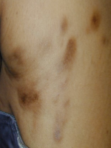
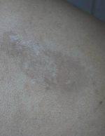
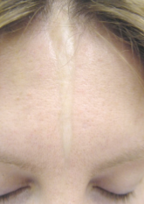
Morphea

Slide 85
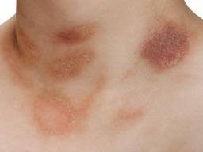
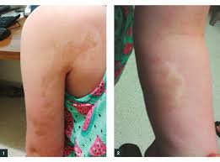
Morphea

Slide 86
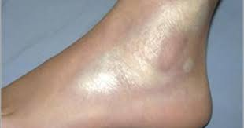
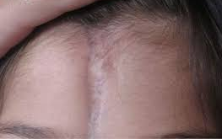
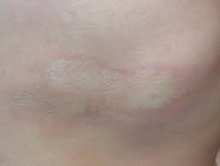
Morphea

Slide 87
Morphea
Do patients with morphea develop systemic sclerosis?

Slide 88
Morphea
How is morphea treated ?

Slide 89
Morphea
Morphea has no known cure.
Treatment of morphea focuses on controlling signs and symptoms and slowing spread.
Topical and intralesional steroids , phototherapy, systemic steroids, azathioprine, methotrexate, and cyclosporine might be used in severe cases.
Physical therapy could be of help if the involvement is close to joints and cause contracture and difficulty in movement.

Slide 90
CREST Syndrome
What is CREST syndrome?

Slide 91
CREST Syndrome
It’s considered a type of limited systemic scleroderma
Most patients with CREST syndrome have circulating antibodies to centromeres, called “ anti-centromere antibodies”
C = Calcinosis cutis
R = Raynaud’s phenomenon
E = Esophageal dysfunction
S = Sclerodactyly
T = Talangiectasia

Slide 92
CREST Syndrome

Slide 93
Progressive Systemic Sclerosis
What are the cutaneous findings in progressive/diffuse systemic sclerosis?

Slide 94
Progressive Systemic Sclerosis
Swelling of the hands and feet and/or Raynaud’s phenomenon
Telangiectasia
Proximal nail fold changes ( avascular areas)
Thickening and sclerotic changes involving the face& extrimities- progressive
Sclerodactyly- tapering of fingers, with waxy , shiny hardened skin,which is tightly bound down & doesn’t permit folding or wrinkling
Loss of normal facial lines ( mask like ) patient looks younger than they are
Thinning of lips, microstomia, radial perioral furrowing , small sharp nose
Digital ulcers +/- loss of digits

Slide 95
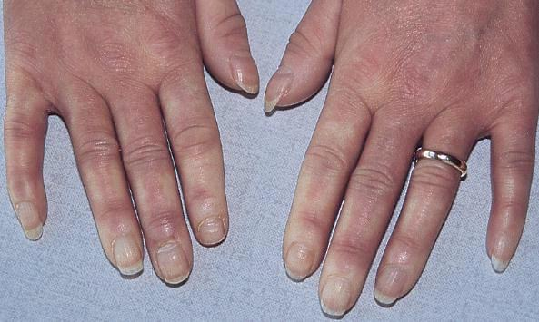
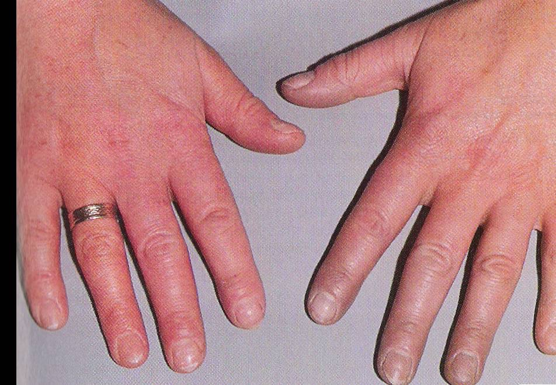
Progressive Systemic Sclerosis

Slide 96
Raynaud’s Phenomenon
It is digital ischemia that occurs on exposure to cold and/ or as a result of emotional stress.
Causes:
1- Rheumatic disorders( SS 85%,SLE 35%, DM 30%, RA, PAN)
2- Diseases with abnormal blood proteins ( cryoprotein, macroglobulins)
3- Drugs ( b-adrenergic blockers, nicotine,cyclosporine)
4- Arterial disease (atheriosclerosis obliterans)

Slide 97
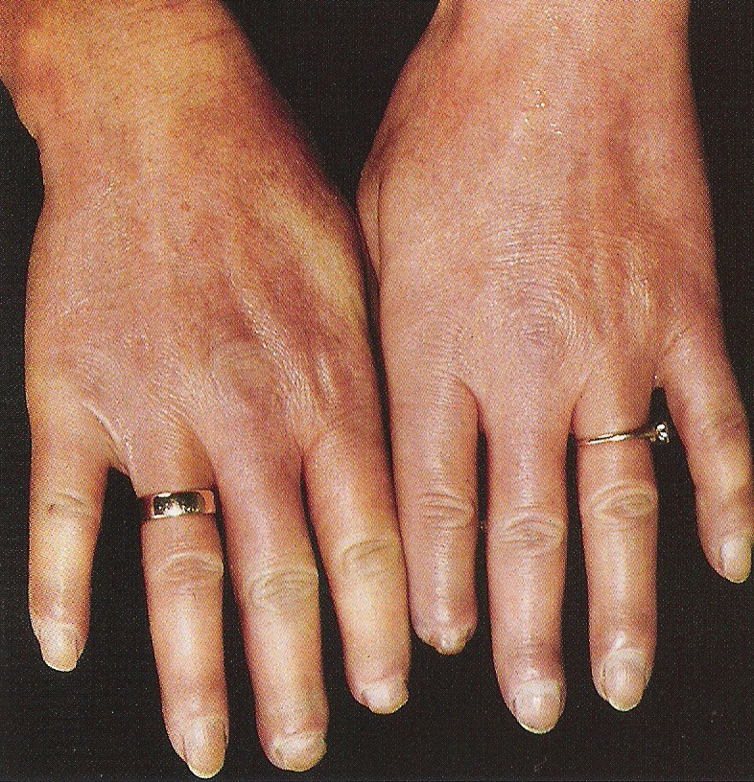
Progressive Systemic Sclerosis
Nonpitting edema of the hands & feet.

Slide 98
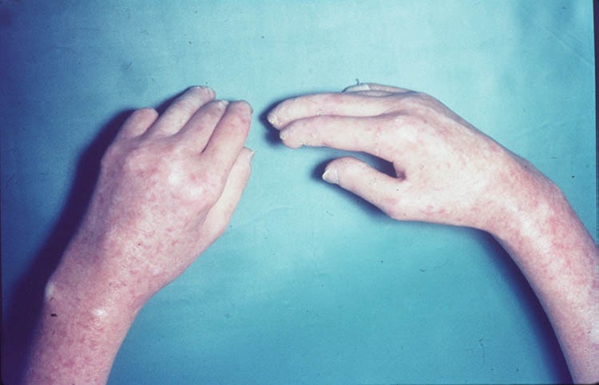
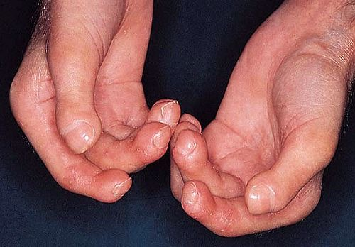
Progressive Systemic Sclerosis

Slide 99
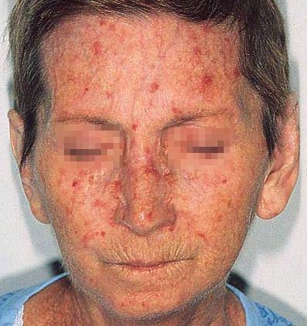
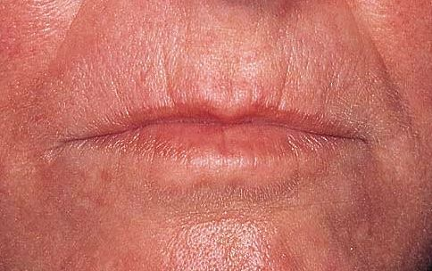
Progressive Systemic Sclerosis

Slide 100
Progressive Systemic Sclerosis

Slide 101
Scleroderma
How do you diagnose scleroderma?

Slide 102
Scleroderma
History & physical examination- characteristic skin changes
Serology
ANA ( often +ve)
Anti-centromere antibodies 71% LSSc “ CREST”
21% of DSSc “ progressive”
Anti-Scl-70 “ anti-topoisomerase I” 33% of dSSc
18% of CREST
3. Skin biopsy- skin atrophy with preservation of skin appendages.

Slide 103
Scleroderma

Slide 104
Scleroderma
How do you manage a patient with scleroderma?

Slide 105
Scleroderma
Treatment is symptomatic.
Raynaud's phenomena:
Stop smoking
keep hands warm and decrease trauma
calcium channel blockers* ( nifedipine)
aspirin and
vasodilating drugs ( iloprost )
Calcinosis cutis: nifedipine, surgical or laser excision.
Skin sclerosis: physiotherapy, phototherapy.
GI: proton pump inhibitor, surgery for strictures.
Kidney: ACE inhibitors.
In severe cases: immunosuppressant , D-Penicillamine might be used ( blocks aldehyde groups involved in intermolecular cross-links in collagen)

Slide 106
LSA
Lichen Sclerosus Atrophicus
- Sclerotic, ivory white, flat papule and plaques with epidermal atrophy and in extra mucosal sites, follicular plugging .
- Most commonly affects female or male genitalia, less often extra genital skin may cause scarring of the vaginal introitus or phimosis if not diagnosed and treated early
- Vulval pruritus
- No systemic manifestations
- Diagnosed by skin biopsy
- Treatment of choice potent topical steroids (clobetasone dipropionate for longer period to prevent scarring)

Slide 107
LSA

Slide 108
Thank You

