Slide 1
PAPULOSQUAMOUS DISORDERS
بسم الله الرحمن الرحيم
PSORIASIS
LICHEN PLANUS
PITYRIASIS ROSEA
Dr. AMAL ALBALBEESI

Slide 2
OBJECTIVE OF THE LECTURE
To know the definition of papulosquamous pattern.
To know the group of diseases known as papulosquamous diseases.
Psoriasis pathogenesis, clinical presentation, and management.
Lichen planus pathogenesis, clinical presentation, and management.
Pityriasis rosea pathogenesis, clinical presentation, and management.

Slide 3
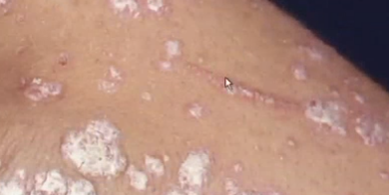
PAPULOSQUAMOUS DISEASES
The term squamous refers to scaling that represents thick Stratum Corneum and thus implies an abnormal keratinization process.
Papulosquamous diseases are typically characterized by scaly papules.

Slide 4
PSORIASIS

Slide 5
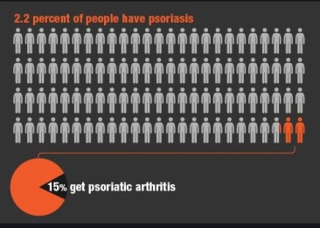
PSORIASIS
Chronic non contagious polygenic multisystem inflammatory disease.
Psoriasis can be triggered by infections, trauma, stress and medication.
The characteristic lesion is a sharply demarcated erythematous scaly plaque that may be localized or generalized.
The natural history follows a chronic course with intermittent remissions.
Has two peaks in age of onset: one at 20-30 years and a second at 40-50.

Slide 6
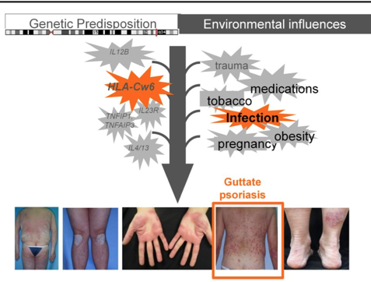
PSORIASIS
Genetic factors play a role in psoriasis proved by:
Positive family history by 36-91%.
HLA studies showed high risk of psoriasis with HLA-Cw6.

Slide 7
PSORIASIS
HLA type influences the type of psoriasis and the course of the disease.
TYPE | HLA
Pustular psoriasis | B27
Guttate psoriasis | B13, B17
erythrodermic | B13, B17
COURSE | HLA
Early onset (positive family history). Late onset (negative family history, negative Cw6). | Cw6 ( type 1 psoriasis) ( type 2 psoriasis)

Slide 8
PSORIASIS
One affected parent:16%.
Both parents :50%.
Non-psoriatic parents with sibling: 10%.
Monozygotic twins :70%.
Dizygotic twins:20%.

Slide 9
PSORIASIS
Triggering factors:
Trauma (25% of patients) sunburn, viral exanthem.
Infections ( streptococcal pharyngitis).
Drugs (lithium, β-blockers, antimalarials, IF).
Irritating topicals like tar and dithranol.
Hypocalcemia .
Pregnancy.
Obesity.

Slide 10
PSORIASIS

Slide 11
PSORIASIS
Epidermal cell kinetics
The growth fraction of basal cells is increased to almost100% compared with 30% in normal skin.
The epidermal turnover time is shortened to less than 10 days compared with 30 to 60 days in normal skin.

Slide 12
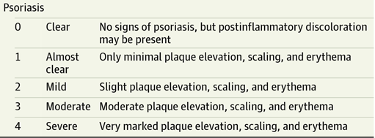
PSORIASIS
Tools to measure severity index:
Psoriasis Area and Severity Index (PASI)
Physician global assessment (PGA)
Dermatology life quality index (DLQI )

Slide 13
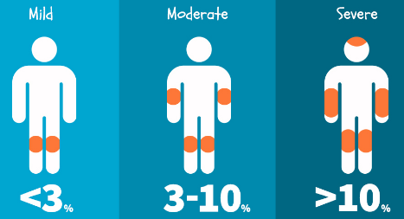
PSORIASIS
Body surface area (BSA) affected: role of hand.
Hand = Equal 1% BSA).

Slide 14
PSORIASIS
There are five types of psoriasis:
Plaque. (most common)
Guttate.
Pustular.
Erythrodermic.
Psoriatic arthritis.
Special locations:
Nail psoriasis.
Flexural psoriasis.
Oral psoriasis.
Napkin psoriasis.
At any point of time different variants may coexist.

Slide 15
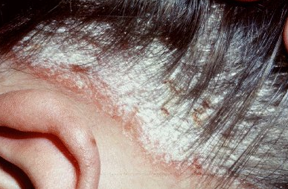
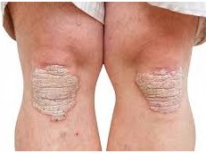
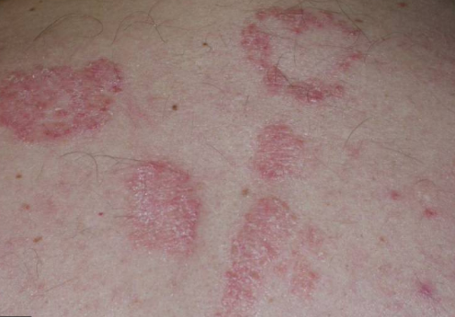
PSORIASIS
Chronic plaque psoriasis:
Characterized by sharply demarcated scaly erythematous plaques.
Relatively symmetric distribution.
Scalp, elbows, knees and presacrum are sites of predeliction.
When healing occurs it starts in the center producing annular lesions.

Slide 16
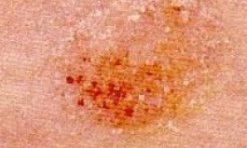
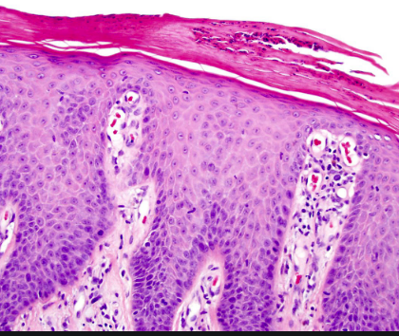
PSORIASIS
Auspitz sign is positive
The appearance of small bleeding points after removal of scale from the surface of psoriatic papules or plaques.
It is a reflection of dilated vessels of the papillary dermis and thinning of the suprapapillary epidermis.

Slide 17
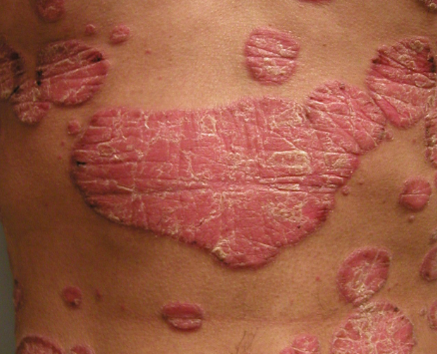
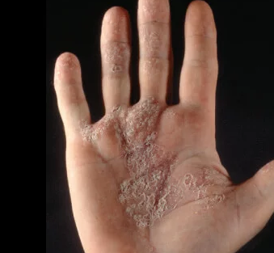
PSORIASIS
Chronic plaque psoriasis:
The most common type of psoriasis ranges from mild to severe.
65% complain of itching.
The disease may worsens in winter improve in summer.
The major symptom is disfigurement that affects the quality of life.

Slide 18
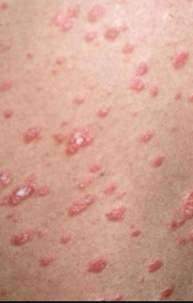
PSORIASIS
Guttate psoriasis
Small papules over the trunk and extremities.
Seen commonly in children and adolescent preceded by URTI.
In over half of patients an elevated antistreptolysin O titer indicating recent streptococcal infection.

Slide 19
PSORIASIS
Pustular psoriasis
GENERALIZED
LOCALIZED
PALMOPLANTAR PUSTULOSIS
ACRODERMATITIS CONTINUA OF HALLOPEAU

Slide 20
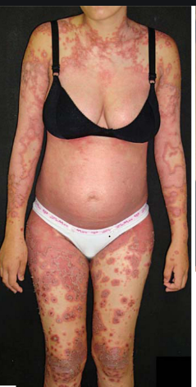
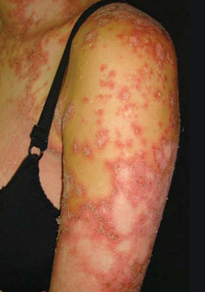
PSORIASIS
Pustular psoriasis
Generalized
Von Zumbusch
Impetigo Herpitiformis in pregnancy.

Slide 21
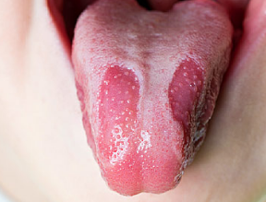
PSORIASIS
Generalized pustular psoriasis Von Zumbusch:
Pustules over the body including nail beds, palms, soles.
Skin is tender and may proceed to erythroderma.
Fever, malaise and leukocytosis occurs.
May form annular plaques.
Resolves with extensive scaling.
Onycholysis , shedding of the nails and hair loss may follow 2-3 months later.
Tongue may show circinate desquamation.

Slide 22
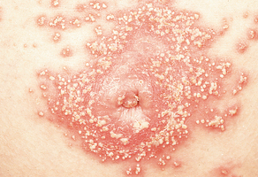
PSORIASIS
Generalized pustular psoriasis Impetigo Herpitiformis:
Acute onset of pustules with annular configuration during the third trimester associated with hypocalcemia.
There is no personal history or familial psoriasis.

Slide 23
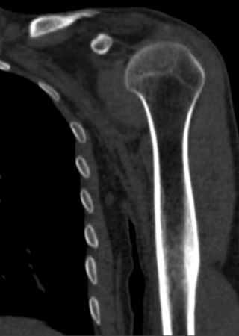
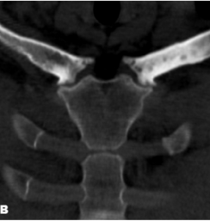
PSORIASIS
Localized pustular psoriasis
Palmoplantar Pustulosis.
Sterile pustules admixed with yellow brown macules.
Triggered by stress or infection.
May be associated with bone lesions SAPHO syndrome (Synovitis, Acne, Pustulosis, Hyperostosis, Osteitis).
Minority of patients have plaque or pustular psoriasis.
Hyperostosis

Slide 24
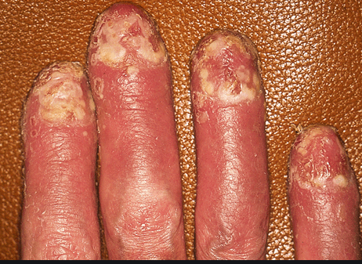
PSORIASIS
Acrodermatitis Continua of Hallopeau
Pustular eruption of distal portions of fingers or toes that extends proximally.
Most commonly affects the thumb.
The phalanx becomes red, scaly and studded with pustules. Later the pustules burst leaving glazed painful skin and another bout of pustules appear.
Can result in nail dystrophy or loss of nail.

Slide 25
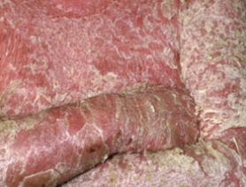
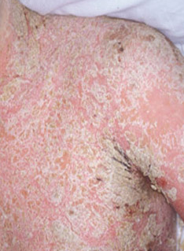
PSORIASIS
Erythrodermic psoriasis
It affects all body sites ≥90% .
Erythema is most prominent feature with scaling.
Patients suffer from hypothermia due to vasodilation.
Lower limb edema secondary to vasodilatation and loss of proteins.
High -output cardiac failure and impaired liver and renal functions also occur.
Onset may be gradual or acute.
Clues to diagnosis of psoriatic erythroderma include facial sparing, characteristic nail changes and previous plaques in classic location.

Slide 26
PSORIASIS
Psoriatic arthritis
5 types:
Mono- and asymmetric oligo arthritis.
Arthritis of distal interphalangeal joints
Rheumatoid arthritis like.
Arthritis mutilans.
Spondylitis and sacroilitis.
The most common presentation is inflammation of the distal (DIP mainly) and proximal (PIP) interphalangeal joints.
Sausage digit if both DIP&PIP affected.

Slide 27
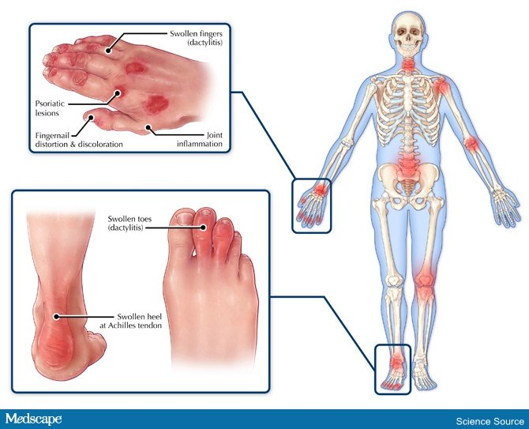
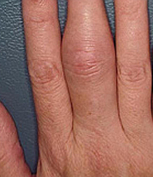
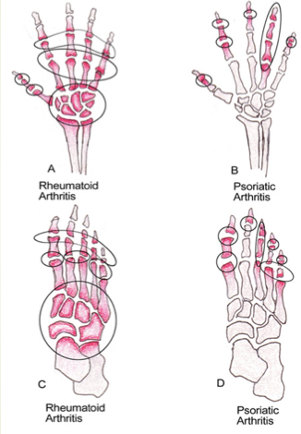
PSORIASIS
Plantar fasciitis

Slide 28
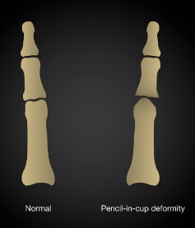
PSORIASIS
Early diagnosis is important to avoid loss of function .
Radiology shows:
Enthesitis (inflammation of the tendon insertion points).
Periosteal bone formation and erosions.
Pencil in cup deformity.

Slide 29
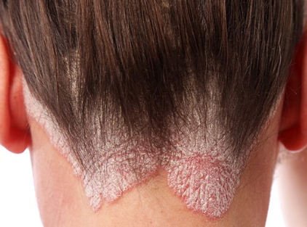
PSORIASIS
Scalp psoriasis
The back of the head is a common site.
May involve the whole scalp.
Appears as well defined erythematous plaques with silvery scale.
May extend beyond the hairline.
May coexist with seborrheic dermatitis called sebopsoriasis.
Sebopsoriasis the lesions are localized to seborrheic areas.

Slide 30
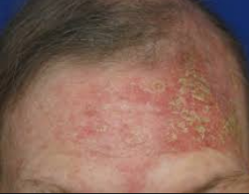
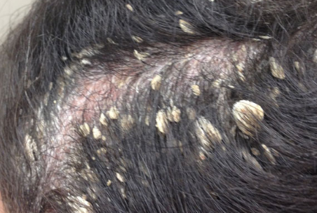
PSORIASIS
Scales sometimes are asbestos like and attached to the hairs (Pityriasis amintecea).
Pityriasis amintecea can be seen in seborrheic dermatitis; secondary infected atopic dermatitis and T.capitis.

Slide 31
PSORIASIS
Nail psoriasis
Psoriatic nail disease occurs in 10-70% of all patients with psoriasis.
Less than 5% of psoriatic nail disease cases occur in patients without other cutaneous findings.
Fingernails are more affected than toenails.
Psoriasis affects nail matrix (pitting), nailbed (oil drop) and hyponychium (subungual hyperkeratosis).

Slide 32
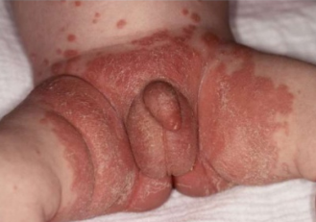
PSORIASIS
Inverse psoiasis
Napkin psoriasis

Slide 33
PSORIASIS PATHOLOGY
Parakeratosis (nuclei retained in the horny layer).
Irregular thickening of the epidermis over the rete ridges but thinning
over dermal papillae
Epidermal polymorphonuclear leucocyte infiltrates (munro micro abscesses)
Dilated capillary loops in the dermal papillae
T-lymph infiltrate in the upper dermis

Slide 34
DIFFERENTIAL DIAGNOSIS
Localized plaques
Tinea
Eczema
Seborrhoeic dermatitis
Guttate
Pityriasis rosea
Drug eruption
Secondary syphilis
Flexural
Tinea
Eczema
Candidiasis
Seborrhoeic dermatitis
Erythrodermic
Eczema
Lichen planus
Drug
Palmoplantar
Tinea

Slide 35
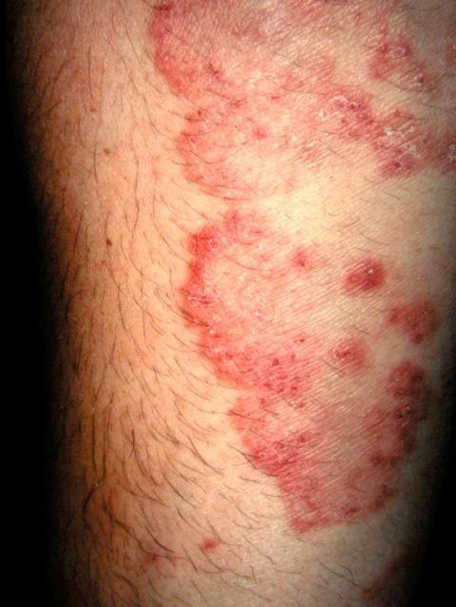
LOCALISED PATCHES/PLAQUES
Tinea corporis
Affects body
Lacks symmetrical lesions.
Presence of peripheral scale
and central clearing.
Psoriasis
Tinea corporis

Slide 36
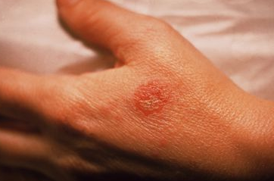
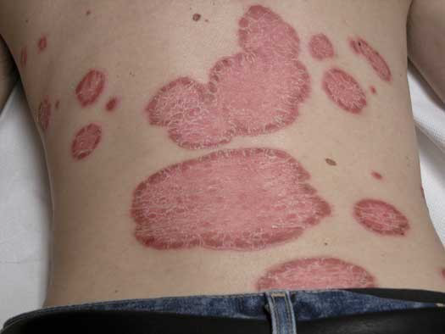
LOCALISED PATCHES/PLAQUES
Discoid eczema
Individualized plaques
more pruritic than
Psoriasis.
Lacks silvery scale.
Less vivid color than
psoriasis.
Discoid eczema
psoriasis

Slide 37
LOCALISED PATCHES/PLAQUES
Seborrhoeic dermatitis
Characterized by yellowish scaling and erythema.
Localized to many of the
same areas as psoriasis.
Affects furrows of face
Generally restricted to hairline.
Seborrhoeic dermatitis
psoriasis

Slide 38
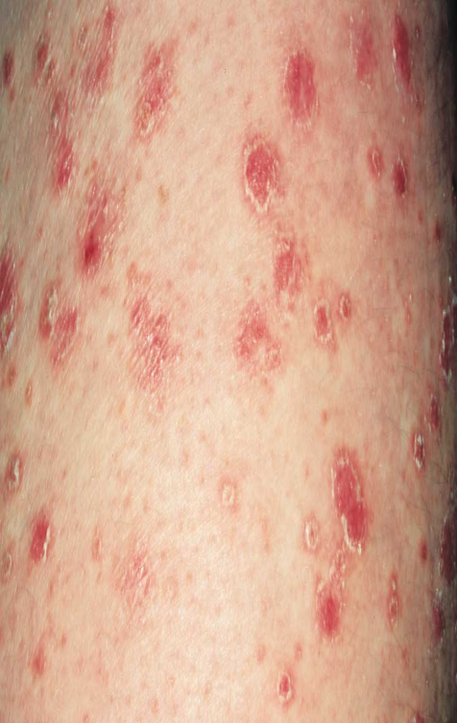
GUTTATE PSORIASIS
Pityriasis rosea
Difficult to distinguish from acute guttate psoriasis.
Presents first as single large patch called herald patch.
progresses to a truncal rash of
multiple red scaly plaques
(‘Christmas tree’ distribution)
Guttate psoriasis pityriasisrosea

Slide 39
GUTTATE PSORIASIS
Secondary syphilis
Search for characteristic primary syphilitic lesion, lymphadenopathy,
and lesions on face, palm
and soles.
Conduct serology and
skin biopsies to confirm
Diagnosis.
Guttate psoriasis secondary syphilis

Slide 40
FLEXURAL PSORIASIS
Tinea cruris
Affects groin area.
Characterised by central clearing with advancing edge
with fine scale.
Flexural psoriasis Tinea cruris

Slide 41
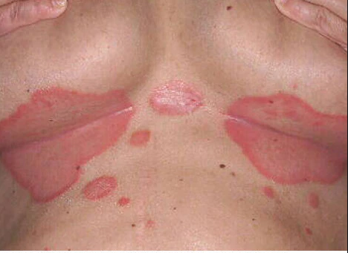
FLEXURAL PSORIASIS
Candidiasis
Characteristic peripheral pustules and scaling different from psoriasis.
Yeast cultures are
Diagnostic.
Candida intertrigo Psoriasis

Slide 42
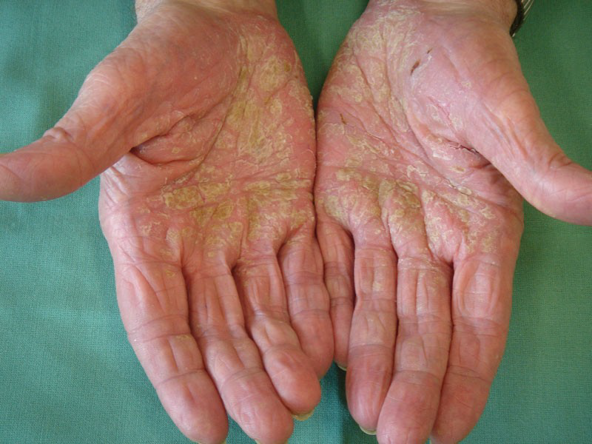
PALMOPLANTAR PSORIASIS
Tinea manum
Ringworm of hands.
Fine powdery scale,
particularly involving
palms and palmar
Creases.
Usually asymmetrical.
Tinea manum Palmoplantar psoriasis

Slide 43
PALMOPLANTAR PSORIASIS
Hand and foot eczema
Hyperkeratotic forms
difficult to distinguish
from psoriasis.
Biopsies may assist
diagnosis.
Look for history of
atopy, a lack of psoriasis
elsewhere on body, and
evidence of eczema
elsewhere on skin.
Hand eczema Palmoplantar psoriasis

Slide 44
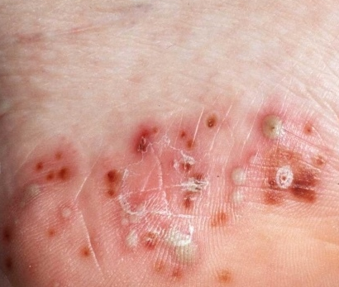
PALMOPLANTAR PSORIASIS
Pompholyx of palms
and soles (dyshidrotic
eczema).
Presents as clear vesicles
contrast to white/yellow pustules
in pustular psoriasis.
Accompanied by intense pruritus.
Pompholyx Pustular psoriasis

Slide 45
COMORBEDITIES
Cardiovascular disease.
Metabolic syndrome and its individual components (i.e., hypertension, obesity, impaired glucose regulation, and low HDL levels).
Malignancies including lymphoma, and nonmelanoma skin cancer (PUVA, systemic therapy).
Autoimmune diseases (e.g., inflammatory bowel disease, multiple sclerosis).
Psychiatric conditions including anxiety and depression.

Slide 46
TREATEMENT
Psoriasis
Topical
Corticosteroids
=Vitamin D analogs
=Retinoids
=Calcineurin inhibitors
=Anthralin
=Coal tar
Biologic therapy
=TNF inhibitors
Adalimumab , Etanercept, Infliximab
=IL-12/IL-23
Ustekinumab
Phototherapy
=UVB
=UVA
=PUVA
Systemic
=Acetretin
=MTX
=cyclosporin

Slide 47
PSORIASIS TOPICAL THERAPY
Topical Corticosterds:
Indication: Plaque psoriasis.
Dosing: monotherapy1-2 times daily.
Combined with other topical agents, UV light, and systemic agents.
Toxicity of topical steroid:
Local—skin atrophy, telangiectasia, striae, purpura, contact dermatitis, rosacea.
Systemic—HPA axis suppression may occur with use of medium- and high-potency topical steroids. This will be lessened by intermittent or localized use.
Increased IOP, glaucoma, and cataract have been reported with use around eye.

Slide 48
PSORIASIS TOPICAL THERAPY
Vitamin D analogues
Indication: Plaque-type psoriasis
Dosing: Twice daily. Combination of calcipotriene and betamethasone ointment available.
Adverse reactions:
Transient irritation in lesional and perilesional skin.
Elevation of serum calcium more likely to occur in patients treated with > 100 g/wk and 50g/wk in children.
Photosensitivity.
Since calcipotriene is inactivated by UVA, it is important to apply calcipotriene after and not before UVA exposure.

Slide 49
PSORIASIS TOPICAL THERAPY
TAZORETENE
Best used in combination with topical corticosteroids. Once daily for 12 weeks
Probably best reserved for thick, recalcitrant plaques of psoriasis.
Adverse reactions:
skin irritation in lesional and perilesional skin
Photosensitizing.
Pregnancy and nursing: Category X.

Slide 50
PSORIASIS TOPICAL THERAPY
Calcinurin inhibitors (tacrolimus and pimecrolimus)
Indication: Intertriginous and facial psoriasis.
Side effects: stinging, burning, itching.
Better not used below 2 years of age.
Anthralin
Indications: Use has been declined these days.
Dosing: short-contact therapy for 2 h once daily .
Adverse reactions: skin irritation and staining of skin and clothing.

Slide 51
PSORIASIS SYSTEMIC THERAPY
Agent | Administration (route; frequency) | Side effects
Acitretin | Oral; once daily | Mucocutaneous changes; hypertriglyceridemia, elevated LFT Enhanced efficacy when combined with UVB/ PUVA Pregnancy category X
Cyclosporine | Oral; twice daily | Nephrotoxicity, hypertension Limited duration of continuous treatment (1 year) Risk of skin cancer if history of PUVA Reversible changes in serum lipids Pregnancy category C
Methotrexate | Oral, SC, or IM; once weekly | Myelosuppression, hepatotoxicity, pulmonary fibrosis Parenteral administration may minimize GI side effects Folate supplementation may be recommended Pregnancy category X

Slide 52
PSORIASIS SYSTEMIC THERAPY
Retinoids /Acitretin:
VIT. A analogue.
Inhibits abnormal keratinization.
Indication:
Severe plaque type psoriasis.
HIV-positive patients with severe psoriasis.
10-75 mg/d given as a single dose.
The preferred schedule is acitretin monotherapy for 2 weeks followed by the addition of phototherapy.
Adverse events:
Dry eyes and lips, lipid derangements, pancreatitis, hyperostosis, pseudo tumor cerebri, hepatotoxicity, and teratogenicity (only female:3 years for wash out).

Slide 53
PSORIASIS SYSTEMIC THERAPY
Methotrexate
Folic acid antagonist blockes dihydrofolate reductase leading to inhibition of folic acid metabolism.
Antiproliferative, induces apoptosis and an immune and anti-inflammatory modulator.
Indication:
Severe, recalcitrant, disabling psoriasis not adequately responsive. Often used as the primary agent to treat psoriatic arthritis.
Dosing: weekly single oral dose,
Low-dose folate supplementation may reduce the hematologic, GI, and hepatic side effects of methotrexate without decreasing the efficacy.

Slide 54
PSORIASIS SYSTEMIC THERAPY
Toxicity of methotrexate
Elevated LFT results - Minor elevations of LFT results are common; if elevation exceeds 2xnormal, must check more frequently; if exceeds 3xnormal, consider dose reduction; if exceeds 5 Discontinue.
Anemia, aplastic anemia, leukopenia, thrombocytopenia
Interstitial pneumonitis.
Ulcerative stomatitis. GI ulceration and bleeding.
Nausea, vomiting, diarrhea.
Alopecia
Pregnancy: category X; men and women considering conception should be off methotrexate for 3 months before attempting to conceive.
How to monitor for methotrexate induced liver fibrosis:
Procollagen 3 N terminal peptide(P3NP) unreliable in PsA .
Liver biopsy. High risk and low risk?

Slide 55
PSORIASIS SYSTEMIC THERAPY
Cyclosporin
Inhibits calcineurin phosphorylation
2 to 5mg/kg/day for 12 to 24 weeks to limit cumulative nephrotoxicity.
Indication:
Erythrodermic psoriasis, Generalized pustular psoriasis, and Palmoplantar psoriasis, Severe, recalcitrant plaque psoriasis.
Do baseline creatinine repeat twice.
Monitor creatinine.
Monitor blood pressure.

Slide 56
PSORIASIS SYSTEMIC THERAPY
Phototherapy
Narrowband ultraviolet B: 311 nm.
PUVA: 320-400 nm.
NB-UVB most commonly used due to: easier use, and fewer side effects when compared with PUVA.
NBUVB leads to rapid clearance of lesions than BB-UVB.
Indications:
Unresponsive generalized psoriasis (including guttate and seborrhoeic).
May aggravate psoriatic erythroderma and generalized pustular psoriasis.
Contraindications: Patients with known LE, H/O melanoma or NMSC.

Slide 57
PSORIASIS SYSTEMIC THERAPY
Toxicity of NBUVB:
Acute:
Erythema, pruritus, burning, blister( NBUVB).
Long term:
Photoaging, lentigines, telangiectasias, cataract.
Advise use of protective goggles and genital shields during treatment.
NB-UVB therapy should be considered first-line therapy in pregnant patients with plaque and guttate psoriasis who need systemic therapy.
Can be used with emollients, topical corticosteroid or VIT D analogues or systemic treatment like retinoids and MTX.

Slide 58
PSORIASIS SYSTEMIC THERAPY
PUVA:
Dosing: 8-MOP 0.4-0.6 mg/kg, taken 1-2 h before exposure to UVA. Treatment 2-3 times/wk
UV protective eye wear when outdoors for 12 hrs post ingestion.
Combination therapy with cyclosporin increases risk of squamous cell carcinoma.
Topical PUVA
For localized psoriasis to palms and feet.
Use 0.1% 8-methoxypsoralen in emollient and treat 2-3 /wk.
Apply 30 min before UVA.
Bath PUVA-50 mg of 8-Methoxypsoralen in 100 L of water, 20-30 min pre-exposure.

Slide 59
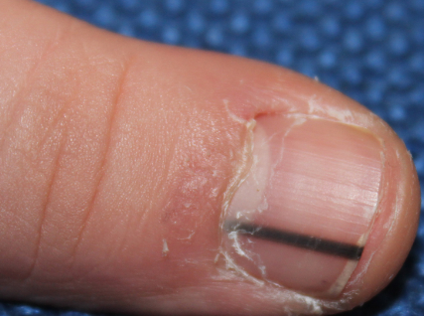
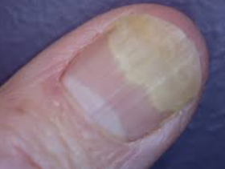
PSORIASIS SYSTEMIC THERAPY
Toxicity of PUVA:
Acute:
Nausea and vomiting are common.
Dizziness and headache are rare.
Erythema: peaks at 48-96 h
Pruritus.
Tanning: starts 1 wk after PUVA.
Blisters, photo-onycholysis, melanonychia.

Slide 60
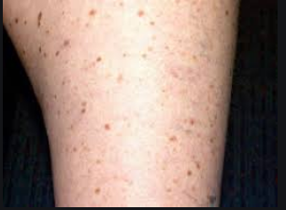
PSORIASIS SYSTEMIC THERAPY
Chronic:
Photocarcinogenesis (SCC, BCC, and possible melanoma).
Increased risk of photocarcinogenesis in Caucasians with skin types I-III after 200 treatments; this risk not present for non- Caucasians.
Photoaging and lentigines are common, especially in patients of skin types I-III and are cumulative UVA dose dependent.
Excimer laser
Used for resistant localized psoriasis such
as scalp and palmoplantar psoriasis.

Slide 61
PSORIASIS SYSTEMIC THERAPY
New oral medications
Apremilast:
Is a phosphodiesterase 4 (PDE4) inhibitor.
Promotes anti-inflammatory processes.
Used for moderate-to-severe plaque psoriasis.
30mg BID for 16 weeks.
Adverse events: nausea, diarrhea, nasopharyngitis, headache, suicidal thoughts, depression.

Slide 62
PSORIASIS SYSTEMIC THERAPY
Biologic therapy

Slide 63
PSORIASIS SYSTEMIC THERAPY
Indications of biologics:
Severe disease: Psoriasis Area Severity Index (PASI) score of 10 or more (or a body surface area (BSA) of 10% or greater) AND a Dermatology Life Quality Index (DLQI) of >10.
Phototherapy and alternative standard systemic therapy are contraindicated or cannot be used.
Unresponsive to standard systemic therapy.

Slide 64
PSORIASIS SYSTEMIC THERAPY
Complete blood cell count including platelet count.
Liver function tests.
Renal panel.
Hepatitis panel.
Tuberclin test or Quantiferon Gold assay.
HIV.
Pregnancy test.
Avoid vaccination with live vaccines ( varicella ;mumps; measles; rubella; oral typhoid; yellow fever).
Avoid live-attenuated vaccines (including intranasal influenza and the herpes zoster vaccine).

Slide 65
PSORIASIS SYSTEMIC THERAPY
Biologic therapy:
Target key parts of immune system that drive psoriasis.
Biological agents include:
Tumor necrosis factor-αinhibitors
Etanercept.
Adalimumab.
Infliximab.
Non TNF inhibitors- αinhibitors
Interleukin (IL-12 / IL-23) inhibitor (Ustekinumab).
Interleukin (IL-17) nhibitor (Secukinomab).

Slide 66
PSORIASIS SYSTEMIC THERAPY
Biological therapies:
Contraindications:
Patients with active, serious infections.
New York Heart Association class III or higher congestive heart failure.
History of demyelinating disease (e.g. multiple sclerosis).
Serious hematologic disease (e.g. aplastic anemia).
Current malignant tumor or prior malignant disease.
Immune-compromised by congenital or acquired immunodeficiency syndrome.

Slide 67
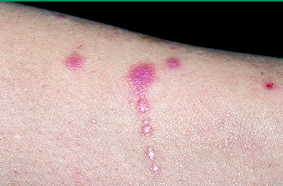
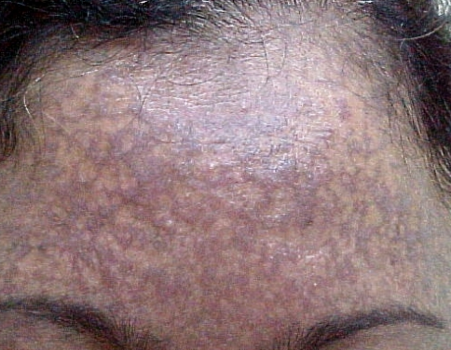
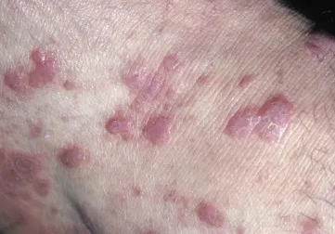
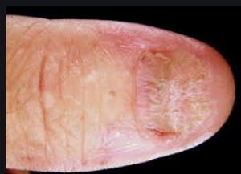
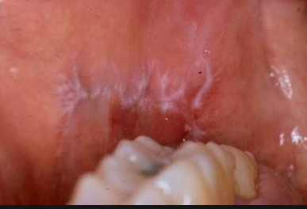
LICHEN PLANUS
Koebner phenomenon
variants
classical
Nail LP
oral

Slide 68
LICHEN PLANUS
An idiopathic inflammatory disease of the skin and mucous membranes.
Classic LP is characterized by pruritic,
violaceous papules that favor the extremities.
The onset of LP occurs most commonly during
the 5-6th decade. 2/3rd of patients developing the disease between the ages of 30 and 60 years.
Increased prevalence of Hepatitis C.

Slide 69
LICHEN PLANUS
Causes
Idiopathic complex polygenic condition
Genetic predisposition.
(HLA-A5, HLA-A3, 147,148, HLA-B7,143, HLA-DR1, 149,150 in the Arab population).
Liver disease like sclerosing colangitis, chronic liver disease, Hepatitis C.
Vaccination and drugs (IF, Antimalarials ).
Contact sensitizer(mercury amalgam, color film developers, methylacrylic esters).

Slide 70
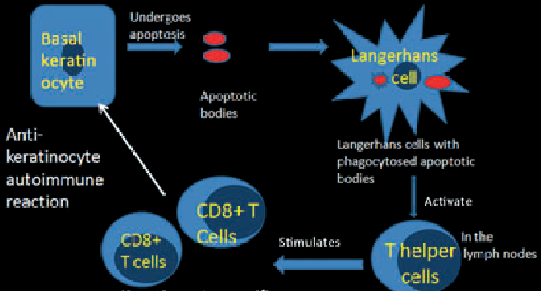
LICHEN PLANUS
The etiology of lichen planus is unknown.
An immune-mediated mechanism involving activated T cells, particularly CD8+ T cells, directed against basal keratinocytes has been proposed .
Upregulation of intercellular adhesion molecule-1 (ICAM-1) and cytokines associated with a Th1 immune response, such as interferon (IFN)-gamma, tumor necrosis factor (TNF)-alpha, interleukin (IL)-1 alpha, IL-6, and IL-8, may also play a role in the pathogenesis of lichen planus.

Slide 71
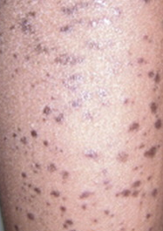
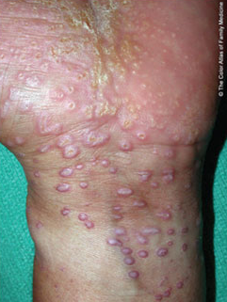
Clinical presentation of lichen planus
The extremities, particularly the ankles and the volar surface of the wrists, are common sites for cutaneous involvement.
Lesions heal with postinflammatory
hyperpigmantation.

Slide 72
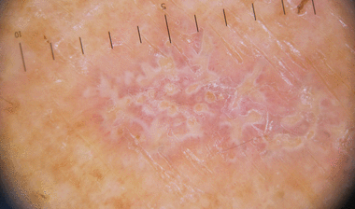
LICHEN PLANUS
Dermoscopy showing Wickham’s striae (WS)
Flat topped polygonal violaceous papules

Slide 73
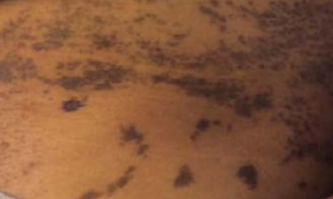
LICHEN PLANUS
Clinical Variants of lichen planus:
Lichen planus pigmentosus
Presents with gray-brown or dark brown macules or patches that are most commonly found in sun-exposed or flexural areas.
Pruritus is minimal or absent. The term “lichen planus pigmentosus-inversus” is used to describe patients with primarily flexural involvement .

Slide 74
LICHEN PLANUS
Inverse lichen planus –
Characterized by erythematous to violaceous papules and plaques in intertriginous sites, such as the axillae, inguinal creases, inframammary area, or limb flexures.
Associated hyperpigmentation is common.

Slide 75
LICHEN PLANUS
Hypertrophic lichen planus
Characterized intensely pruritic, flat-topped plaques.
Involving typically the anterior lower legs.
Cutaneous squamous cell carcinoma has been reported in patients with longstanding hypertrophic lichen planus lesions.

Slide 76
LICHEN PLANUS
Additional variants include
palmoplantar lichen planus (a variant that may demonstrate ulceration)
perforating lichen planus.

Slide 77
LICHEN PLANUS
Lichen planopilaris (follicular lichen planus)
The scalp is the classic site for lichen planopilaris.
However, other body sites, particularly in patients with the Graham-Little-Piccardi-Lasseur syndrome.
GLPL presents with:
multifocal cicatricial alopecia of the scalp. Noncicatricial alopecia of axilla and groin.
follicular lichen planus eruption on the body, scalp, or both.

Slide 78
LICHEN PLANUS
Atrophic lichen planus
Violaceous, round or oval,
atrophic plaques.
The legs are a common site of
involvement.
Annular lichen planus
Characterized by the development of violaceous plaques with central clearing
The penis, scrotum, and intertriginous areas are common sites of involvement.
Annular lesions may occur in other areas.
Central atrophy may be present.

Slide 79
LICHEN PLANUS
Actinic lichen planus
known as lichen planus tropicus) presents with a photodistributed eruption of hyperpigmented macules, annular papules, or plaques .
Most commonly seen in the Middle East, India, and east Africa.

Slide 80
LICHEN PLANUS
Bullous lichen planus
Vesicles or bullae within the sites of existing cutaneous lichen planus lesions.
The legs are a common site of lesion development.

Slide 81
LICHEN PLANUS
Nail lichen planus:
Longitudinal ridging.
Fissuring.
Pterygium.
Thinning
20 nail dystrophy.

Slide 82
LICHEN PLANUS
When nails are involved, the disease spectrum varies from minor dystrophy to total nail loss
The disease process in lichen planus of the nails primarily occurs in the nail matrix.
pterygium

Slide 83
LICHEN PLANUS
Oral lichen
Lichen planus of the mucous membranes can occur in conjunction with cutaneous disease or independently.
Mucous membrane disease may consist solely of lacelike Wickham's striae (reticular type) that are particularly evident on the buccal mucosa .
Papular
Atrophic may lead to (desquamative gingevitis)
Erosive lesions.

Slide 84
LICHEN PLANUS
Ulcerative LP
Lace like
Atrophic erythematous

Slide 85
LICHEN PLANUS
Overlap syndromes
Are disorders that are characterized by the presence of features of cutaneous lichen planus and a second disease.
Lichen planus pemphigoides and lichen planus-lupus erythematous overlap syndromes.

Slide 86
LICHEN PLANUS/OVERLAP SYNDROMES
Lichen planus-lupus erythematosus overlap syndrome
Rare condition, patients develop skin lesions with clinical, histologic, and/or immunopathologic features of both diseases.
Clinically, patients often present with discoid lupus erythematosus and cutaneous lichen planus.

Slide 87
LICHEN PLANUS
Lichen planus pemphigoides overlap syndrome
Patients develop bullae in normal appearing skin and on top of lesions of lichen planus.
Similar to bullous pemphigoid, direct immunofluorescence studies of LPP demonstrate linear deposition of IgG and C3 at the dermal-epidermal junction.

Slide 88
LICHEN PLANUS
The natural history of most cases of cutaneous lichen planus is to remit within one to two years in up to two thirds of patients.
Oral, genital, scalp, and nail lichen planus tend to be more persistent.
Complication of lichen planus:
Squamous cell carcinoma in oral erosive LP.
Scaring alopecia in lichen planopilaris.
Post inflammatory hyperpigmentation.

Slide 89
LICHEN PLANUS
Histopathological features:
Hyperkeratosis without parakeratosis
Vacuolization of the basal layer.
Civatte bodies (apoptotic keratinocytes) in the lower epidermis.
Wedge-shaped hypergranulosis, "saw-tooth" shaped rete ridges.
Small clefts at the dermal-epidermal junction (Max-Joseph spaces).
Band-like lymphocytic infiltrate at the dermal-epidermal junction.

Slide 90
LICHEN PLANUS
Eosinophilic colloid bodies (apoptotic keratinocytes) in the papillary dermis.
Pigment incontinence (most prominent in dark-skinned individuals).
Pigment incontinence

Slide 91
LICHEN PLANUS
DIFFERENTIAL DIAGNOSIS
Lichenoid drug eruption (drug-induced lichen planus) should always be considered so that the offending agent can be withdrawn when possible.
The cutaneous manifestations closely resemble idiopathic lichen planus.
The patient’s history of drug exposure and a skin biopsy can aid in distinguishing lichenoid drug eruptions from idiopathic lichen planus.
Lichenoid drug eruptions usually develop insidiously and can affect any area of the body surface.

Slide 92
LICHEN PLANUS

Slide 93
LICHEN PLANUS
Chronic graft-versus-host disease
Chronic graft-versus-host disease can produce a lichenoid eruption with clinical and histologic findings similar to lichen planus. The history of preceding hematopoietic cell transplant is helpful for diagnosis.

Slide 94
LICHEN PLANUS TREATMENT
Treatment: The standard therapies include topical, intralesional, systemic corticosteroids, Phototherapy, retinoids.
Topical corticosteroids
Are the mainstay of treatment for patients with localized disease. Efficacy should be assessed after two to three weeks.
Cutaneous lesions on the trunk and extremities use a high potency or super high potency topical corticosteroid (eg, 0.05% betamethasone dipropionate.
For intertriginous or facial skin, mid-potency or low-potency corticosteroid creams or ointments should be used.

Slide 95
LICHEN PLANUS
Golden role for topical steroid usage
For thick skin use potent to super potent.
For thin skin like eyelids use least potent.
Maximum use of steroid is 2 weeks.

Slide 96
LICHEN PLANUS
Side effects of topical steroid
1 finger tip unit weighs 0.5 gr

Slide 97
LICHEN PLANUS
Oral glucocorticoid
Short course of an oral glucocorticoid when acute control of cutaneous lichen planus is necessary for patients with extensive disease.
Intralesional corticosteroids
For the thick lesions of hypertrophic lichen planus.
Triamcinolone acetonide in a concentration of 2.5 to 10 mg/mL. Repeated after four to six weeks.

Slide 98
LICHEN PLANUS
Side effects of systemic corticosteroids:

Slide 99
LICHEN PLANUS
Phototherapy
Narrowband UVB (three times per week for six weeks).
If no response is observed after three to four months, discontinue treatment.
PUVA
Contraindication to phototherapy
Xerodema pigmentosum.
Systemic lupus erythematosus.
History of skin cancer.
Acitretin.

Slide 100
LICHEN PLANUS
Other treatments
Oral antihistamines (eg, Hydroxyzine hydrochloride 10 to 50 mg four times a day, as necessary) to control pruritus.
Other medications that have been reported to be of benefit in some patients with cutaneous lichen planus include:
Methotrexate, Thalidomide,Cyclosporin, Dapsone/ sulfasalazine, Hydroxychloroquin, Mycophenolate mofetil .

Slide 101
LICHEN PLANUS
Genital lichen planus
Topical corticosteroids or topical calcineurin inhibitors are often used in the treatment of genital lichen planus.
Oral lichen planus
High potency topical corticosteroid.
Topical calcineurin inhibitors . Pimecrolimus 1% and Tacrolimus 0.03, 0.1% are effective for oral LP.
Side effects: Burning sensation.
Oral elixirs or suspensions:
5 mL dexamethasone [0.5 mg/5 mL] used as a mouth rinse up to six times per day
Side effects:
Oropharyngeal candidiasis is a common side effect . Can be prevented or treated with antifungal therapy
Topical cyclosporine
Topical cyclosporine (5 mL of a 100 mg/mL solution, swished for five minutes and then spit) three times daily.
.

Slide 102
LICHEN PLANUS
PAIN MANAGEMENT
Nonsteroidal anti-inflammatory agent or actaminophen
Intraoral topical anesthetics (viscous lidocaine 2% solution, lidocaine 2% gel) before meals.
Potential risks of topical anesthetics include systemic absorption with potential toxicity and suppression of gag reflex with increased risk of aspiration.
Lichen planopilaris
Topical corticosteroids or intralesional corticosteroids are often used as first-line therapies.

Slide 103
PITYRIASIS ROSEA
Herald patch
Distributed bilaterally over trunk and proximal extremities in christmas tree pattern

Slide 104
PITYRIASIS ROSEA
Common, “acute”, self-limited papulosquamous eruption that favors healthy adolescents and young adults.
The classic presentation is readily recognized.
Generally, it only appears once throughout life.
Atypical forms may present a greater challenge.
Persistent PR up to 6months.
Relapsing PR: 5%, mild shorter course, few attacks over 3-5 years.
A viral etiology has been postulated, but this remains unproven.
Seasonal variation .

Slide 105
PITYRIASIS ROSEA
Pathogenesis
The precise cause of pityriasis rosea unknown.
A viral etiology is frequently proposed.
Human herpesvirus-7(HHV-7) and, less so, on HHV-6.
Attempts to identify HHV-7 DNA within cutaneous lesions have been unsuccessful.

Slide 106
PITYRIASIS ROSEA
Clinical presentation
Most patients with pityriasis rosea are asymptomatic.
However 25% of patients, pruritus ranges from mild to severe.
Mild prodrome with headache, malaise, fever, arthralgia in 5% of patients.
The classic situation, a solitary lesion “herald patch” appears on the trunk and enlarges over several days.
Less often, this initial lesion is seen on the neck or proximal extremities.
It predates the remainder of the eruption by hours to days.

Slide 107
PITYRIASIS ROSEA
The herald patch incidence varies from 12% to 94%, but in most series it has been seen in over 50% of cases.
Multiple herald patches have also been reported.
The herald patch is a skin- to pink- to salmon-
colored patch or plaque with a slightly raised advancing
margin.
The size of herald patch varies from 2 -4 cm, but it can be as small as 1 cm or large as 10 cm.

Slide 108
PITYRIASIS ROSEA
Within the next few days, there is a blossoming of lesions on the trunk and proximal extremities. The lesions are usually round to oval papules or plaques, with their long axis following Langer’s lines of Cleavage, characteristic collarette scale.
On the posterior trunk, the lesions show a “fir tree” or “Christmas tree "pattern.
Minute pustules can also be seen during this initial phase of pityriasis rosea.
The face, palms and soles are usually (but not always) spared.
Oral lesions are uncommon.

Slide 109
PITYRIASIS ROSEA

Slide 110
PITYRIASIS ROSEA
The eruption of pityriasis rosea usually persists for 6–8 weeks and then spontaneously resolves; however, occasional patients have lesions that may last 5 months or longer.
Atypical forms of pityriasis rosea .
Lacks herald patch, different morphology (purpuric; targetoid,) and distribution ( inverse over axilla or groin; distal extremities).

Slide 111
PITYRIASIS ROSEA
Urticarial.
Erythema multiforme like
(Targetoid).

Slide 112
PITYRIASIS ROSEA
Vesicular.
Pustular.
Purpuric.

Slide 113
PITYRIASIS ROSEA
Differential Diagnosis :
Secondary syphilis.
Meticulous history taking
, history of chancre,
Lymphadenopathy
Lesions are monomorphous and always
asymptomatic; almost always affect
palms and soles.
Positive VDRL test
Histology showing plasma cells.
Condyloma lata
Condyloma lata

Slide 114
PITYRIASIS ROSEA
Dermatophytosis:
Difficult to differentiate from herald patch. However, a mycotic lesion expands progressively and shows a clear center.
Positive KOH mount.

Slide 115
PITYRIASIS ROSEA
Guttate psoriasis:
History of sore throat.
Presence of rain-drop pattern and histology are important clues.
Scales are thicker and silvery-white.
PS
PR

Slide 116
PITYRIASIS ROSEA
PR like drug eruption
Ac converting enzyme (ACE) inhibitors, metronidazole, isotretinoin, gold, arsenic, non steroidal antiinflammatory, terbinafin, omeprazole. , bismuth, imatinib and clonidine,, etanercept, tripelennamine, ketotifen, salvarsan and BCG vaccine.
The lesions are usually monomorphic and lack herald patch.
Slower to resolve than the idiopathic form

Slide 117
PITYRIASIS ROSEA
Most patients with pityriasis rosea don’t have biopsies because the clinical picture is characteristic and
the histopathology is relatively nonspecific.
Small mounds of parakeratosis, spongiosis, and
a mild lymphohistiocytic perivascular and
interstitial papillary dermal infiltrate .
There may be mild erythrocyte extravasation.

Slide 118
PITYRIASIS ROSEA
Treatment
Because pityriasis rosea is often asymptomatic and self-limited, patient education and reassurance is sufficient.
Symptomatic treatment with antihistamines and topical steroid.
NBUVB.
Acyclovir 400mg TDS x7 days. When to use?
Persistent PR.
Relapsing PR.
PR occurring in the 1st trimester of pregnancy.
Short course oral steroids in severe cases.

