Slide 1
Brief ear anatomy
Otitis Externa
Acute Otitis media

Slide 2
Objectives
Gross applied anatomy of the ear
Nerve supply of the external and middle ears and the principles of referred earache
Central connection of the vestibulo- cochlear nerve
Physiology of the external, middle and inner ears

Slide 3
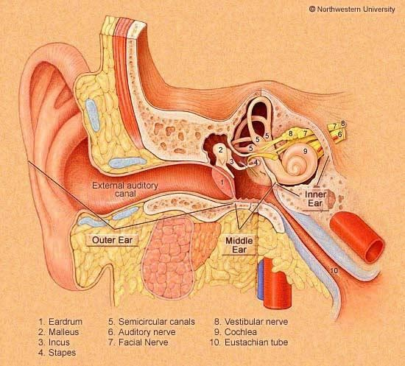
ANATOMY OF THE EAR

Slide 4
ANATOMY OF THE EAR
External Ear
Middle Ear Cleft
Inner Ear

Slide 5
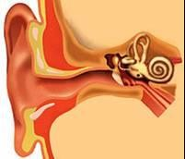
EXTERNAL EAR
Auricle
External Canal

Slide 6
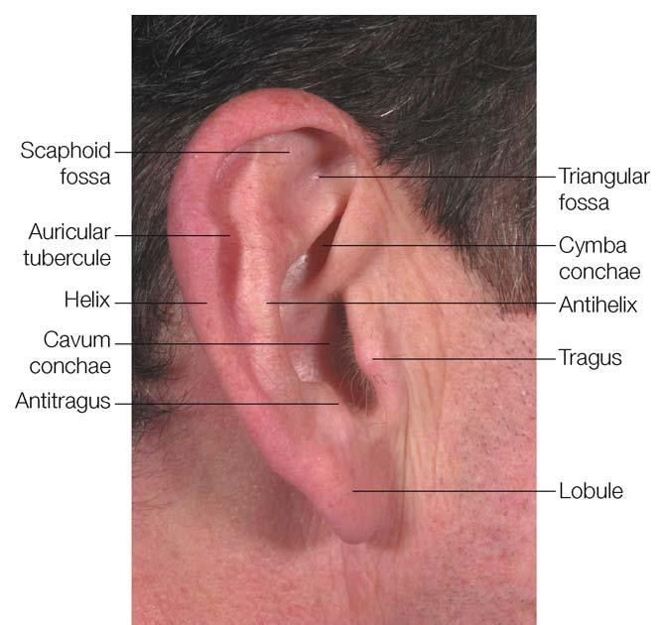
The Auricle

Slide 7
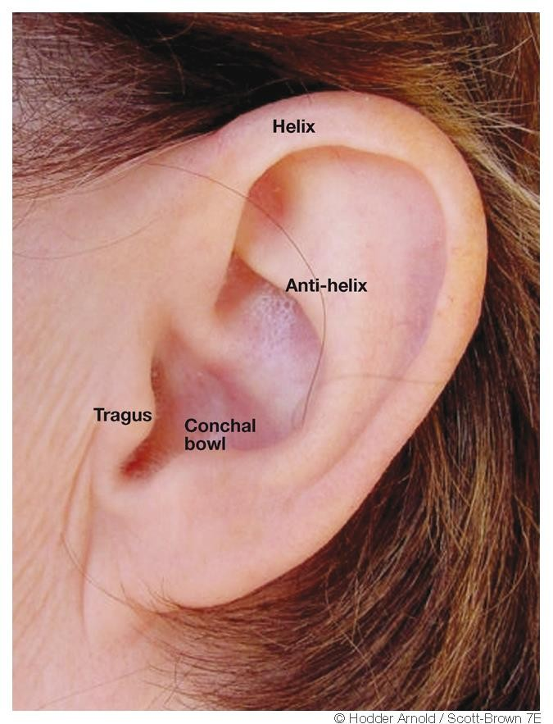

Slide 8
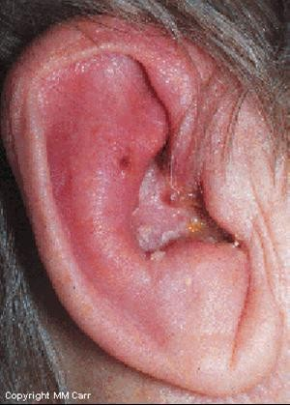
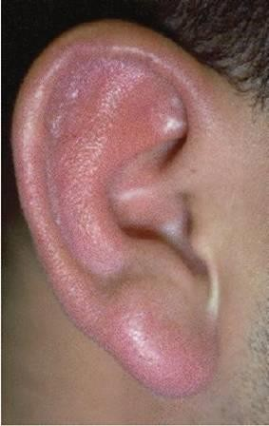
Perichondritis
Erysipelas

Slide 9

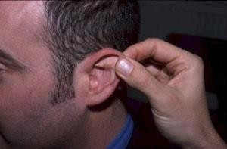
The External Auditory Canal

Slide 10
The External Auditory Canal
Medial Two Thirds:
Lateral Third:
Cartilagenous
Hair follicles
Ceruminous glands
Sebacous glands
Bony
Develops after birth

Slide 11
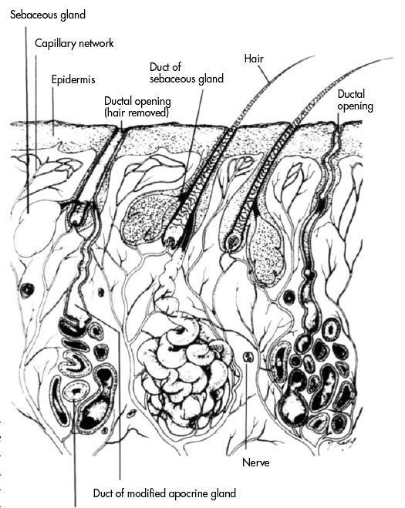

Slide 12
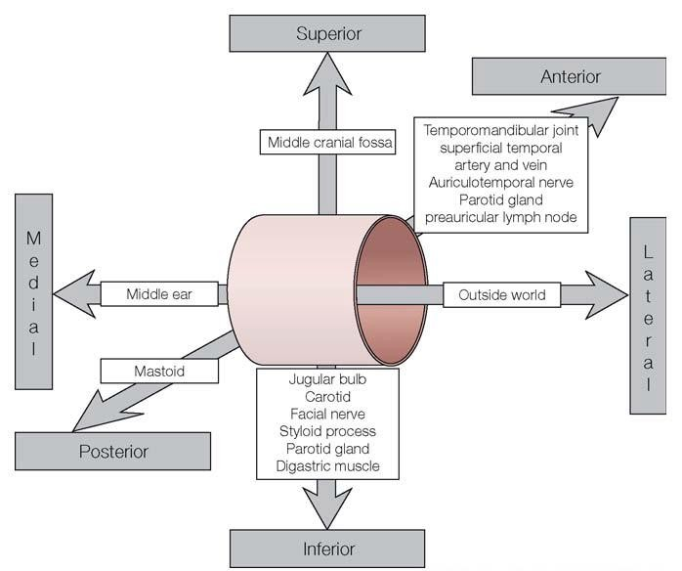
Relations of EAM

Slide 13
ANATOMY OF THE EAR
External Ear
Middle Ear Cleft
Inner Ear

Slide 14
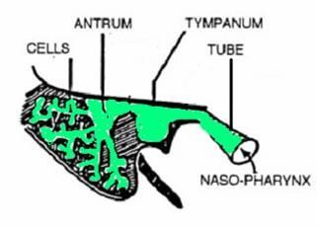
MIDDLE EAR CLEFT
Eustachian (Pharyngo-tympanic) Tube
Tympanum (Middle Ear Cavity)
Mastoid Antrum and Air Cells

Slide 15
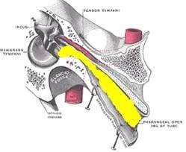
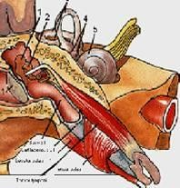
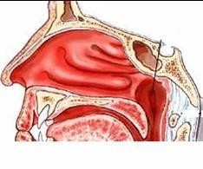
MIDDLE EAR CLEFT
Eustachian (Pharyngo-Tympanic) Tube

Slide 16
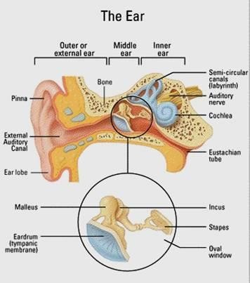
MIDDLE EAR CLEFT
Eustachian (Pharyngo-
Tympanic) tube
Tympanic cavity (Middle ear cavity)

Slide 17
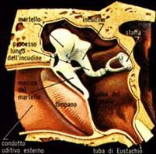
WALLS OF TYMPANIC CAVITY
Roof
Floor
Anterior wall
Posterior wall
Lateral wall
Medial wall

Slide 18
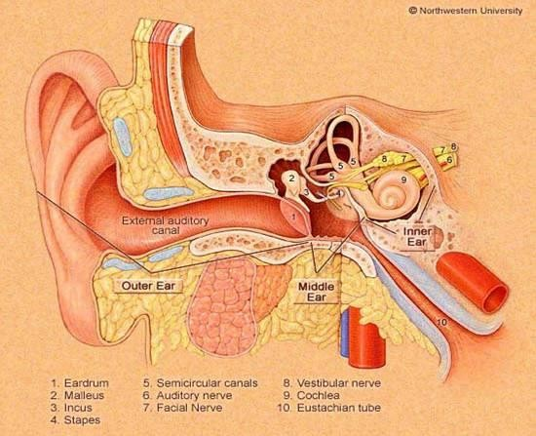
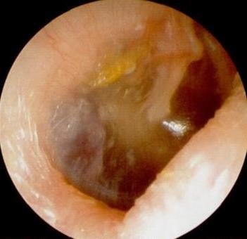
WALLS OF TYMPANIC CAVITY
Tegmen
Roof
Floor

Slide 19
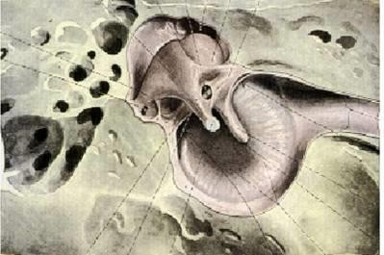
WALLS OF TYMPANIC CAVITY
Roof
Floor
Anterior wall
Posterior wall

Slide 20
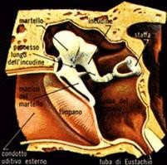
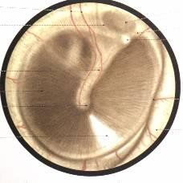
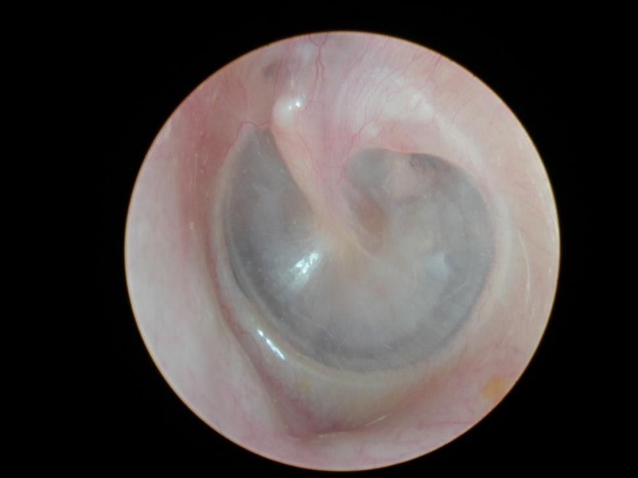
WALLS OF TYMPANIC CAVITY
Roof
Floor
Anterior wall
Posterior wall
Lateral wall
Membrana Flaccida
Membrana Tensa

Slide 21
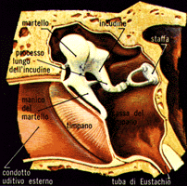
WALLS OF TYMPANIC CAVITY
Roof
Floor
Epitympanum(attic)
Anterior wall
Mesotympanum
Posterior wall
Lateral wall
Hypotympanum

Slide 22
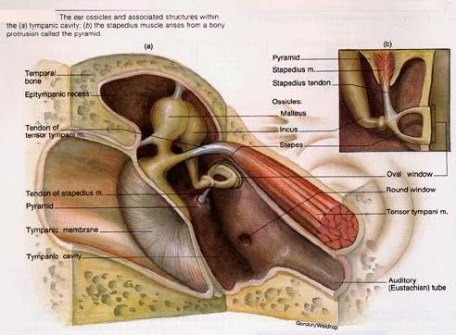
WALLS OF TYMPANIC CAVITY
Roof
Floor
Anterior wall
Posterior wall
Lateral wall
Medial wall

Slide 23
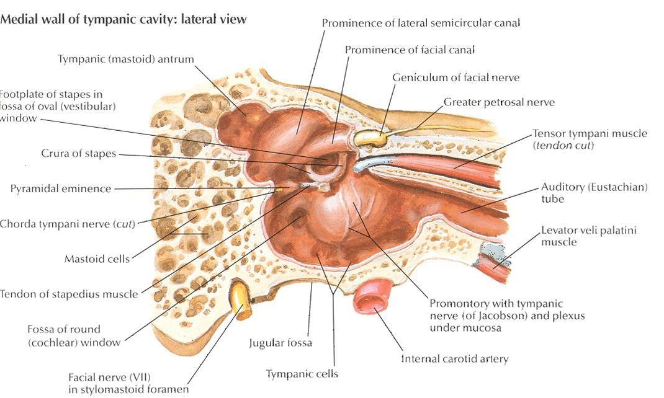

Slide 24
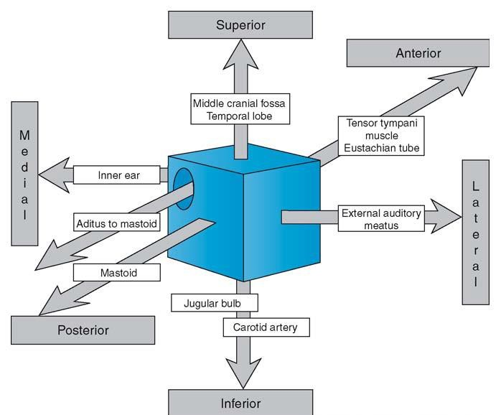

Slide 25
MIDDLE EAR CLEFT
Eustachian (Pharyngo-tympanic) Tube
Tympanic (Middle Ear) Cavity
Mastoid antrum and air cells

Slide 26
Mastoid Antrum & Air cells

Slide 27
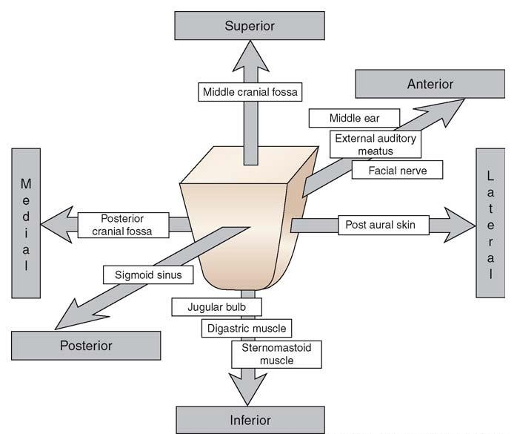
Relationships of the mastoid antrum.

Slide 28
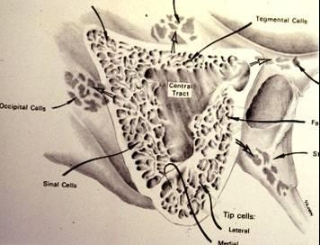
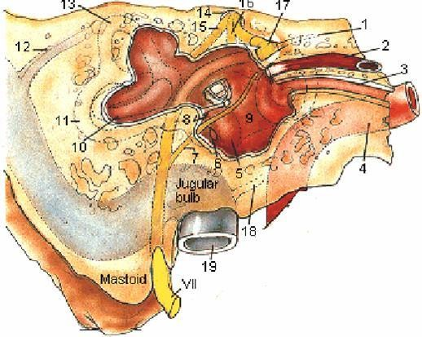
Mastoid Antrum & Air cells

Slide 29
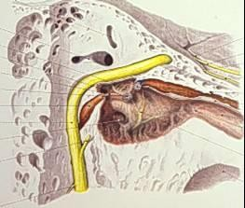
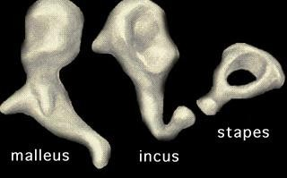
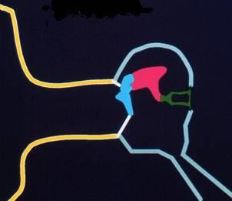
CONTENTS OF MIDDLE EAR CAVITY
Air
  Ossicles
Malleus, Incus, & Stapes
    Muscles
Tensor Tympani & Stapedius
  Nerves
Chorda Tympani & Tympanic Plexus

Slide 30
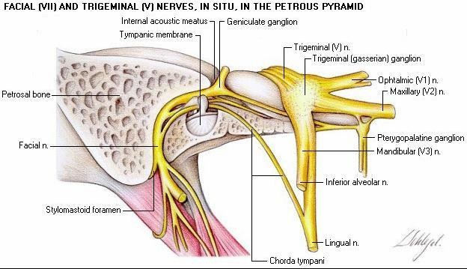

Slide 31
LINING OF MIDDLE EAR
Mucous membrane : ciliated columnar
anteriorly and cuboidal or flat elsewhere

Slide 32
SENSARY SUPPLY OF MIDDLE AND EXTERNAL EAR
Cervical II & III ( great auricular and lessor occipital)
V cranial nerve ( auriculotemporal)
IX cranial nerve (tympanic or Jacobson’s)
X cranial nerve ( auricular or Arnold’s)
? VII cranial nerve

Slide 33
Referred Earache
Pain in the ear due to a disease in an area supplied by a nerve that also supply the ear.

Slide 34
Referred Earache
Cervical II & III
  Cervical spondylosis, neck injury etc.
V cranial nerve
  Dental infections, sinonasal diseases etc.
IX cranial nerve
  Tonsillitis, post-tonsillectomy, carcinoma etc.
X cranial nerve
  Tumors of hpopharynx, larynx & esophagus

Slide 35
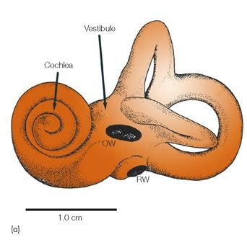
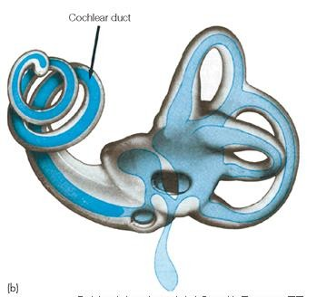
ANATOMY OF INNER EAR

Slide 36
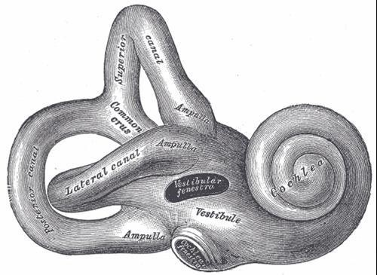
Osseous Labyrinth
Bony Cochlea
Vestibule
Bony semicircular canals

Slide 37
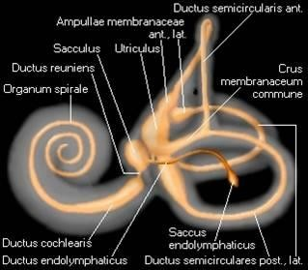
CONTENTS OF THE BONY LABYRINTH
Perilymph
Membranous labyrinth
  Cochlear duct
  Saccule and utricle
  Membranous semicircular ducts

Slide 38
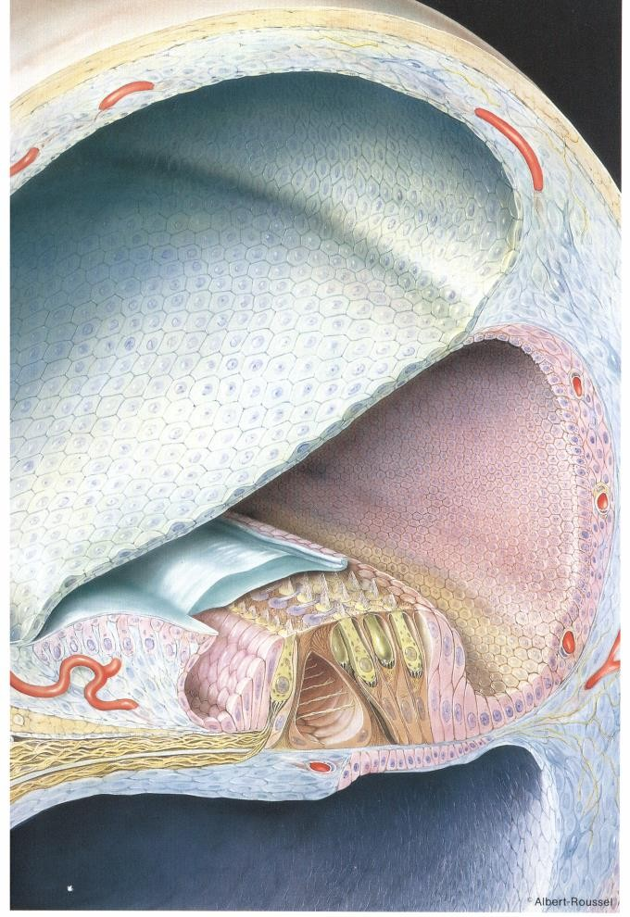
CONTENTS OF MEMBRANOUS LABYRINTH
Endolymph
Sensory epithelium
  Cochlea: organ of Corti
  Utricle & saccule: maculae
  Semicircular canals: cristae

Slide 39
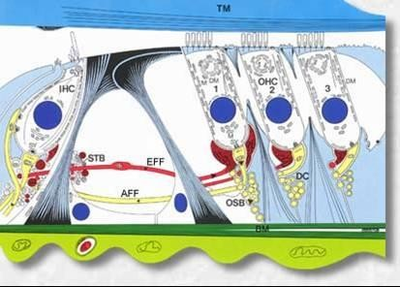
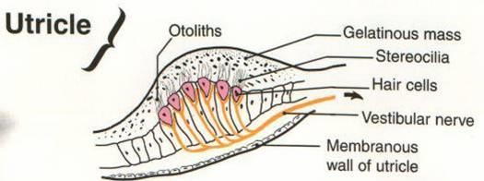
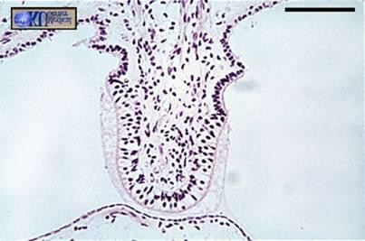
INNER EAR SENSORY EPITHELIUM
Cochlea: organ of Corti
Utricle & saccule: maculae
Semicircular canals: cristae

Slide 40
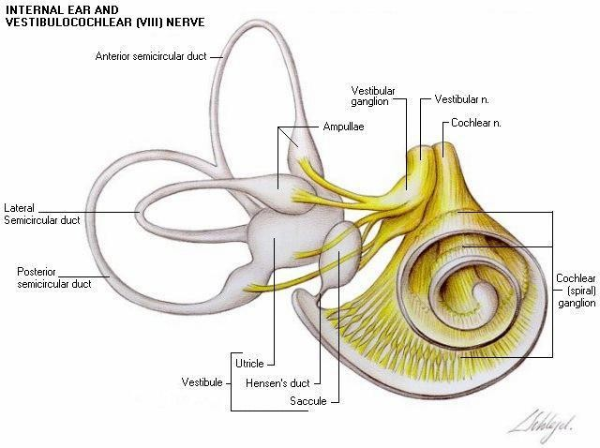
THE VESTIBULO-COCHLEAR NERVE

Slide 41
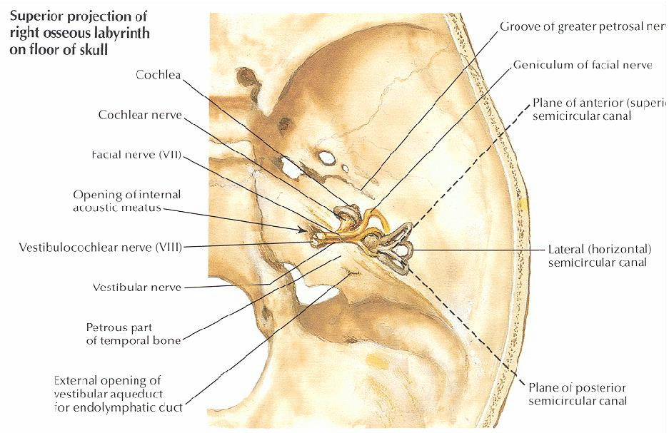

Slide 42
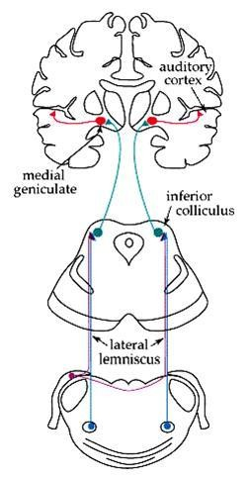
CENTRAL CONNECTIONS OF COCHLEAR NERVE

Slide 43
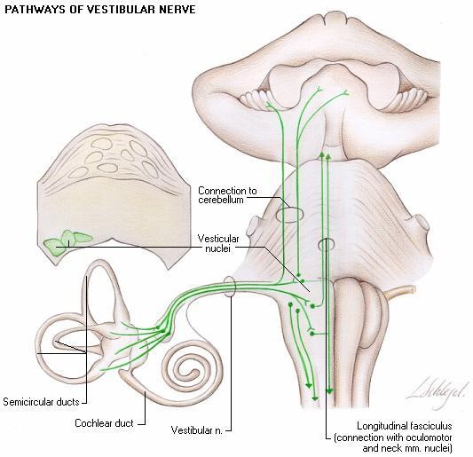
CENTRAL CONNECTIONS OF VESTIBULAR NERVE

Slide 44
PHYSIOLOGY OF THE EAR

Slide 45
FUNCIONS OF THE EXTERNAL EAR
Protection of the middle ear
  Curvature
  Cerumen
Auditory functions:
  Sound conduction
  Increase sound pressure by the resonance function

Slide 46
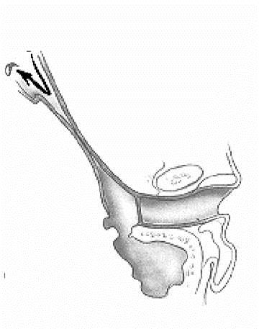
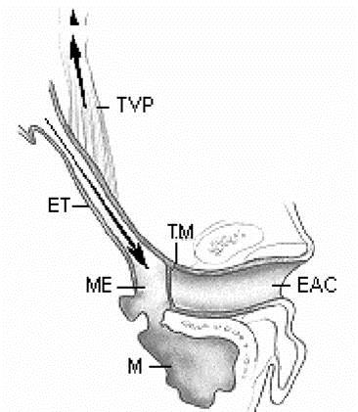
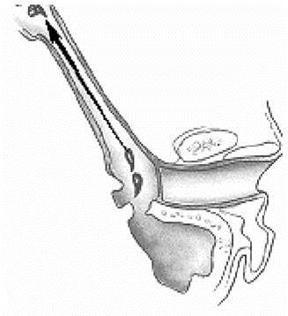
FUNCTIONS OF THE EUSTACHIAN TUBE
Protection
Ventilation
Drainage

Slide 47
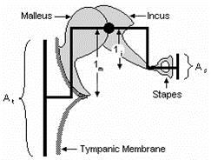
FUNCIONS OF THE MIDDLE EAR
Conduction of sound
Transformer mechanism
  Hydraulic action
  Ossicular leverage

Slide 48
FUNCIONS OF THE MIDDLE EAR
Conduction of sound
Transformer mechanism
  Hydraulic action
  Ossicular leverage
Protection to the inner ear
  stapedial reflex

Slide 49
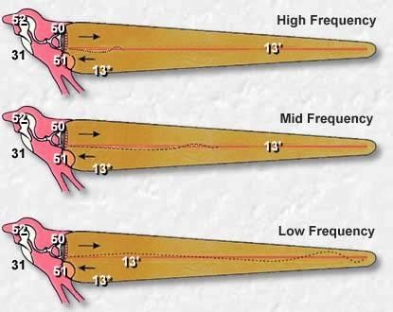
FUNCIONS OF THE INNER EAR
Hearing Function:
– Transduction of sound
to action potentials

Slide 50
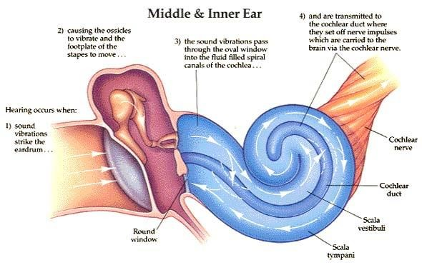

Slide 51
FUNCIONS OF THE INNER EAR
Hearing Function:
– Transduction of sound
to action potentials
Vestibular Function:
– Participate in maintaining body balance

Slide 52
THE BALANCE SYSTEM
C. Cortex
BRAIN-STEM
Cerebellum

Slide 53
THE BALANCE SYSTEM
Vestibular
Proprioceptive
Visual
INPUT
C. Cortex
BRAIN-STEM
Cerebellum

Slide 54
THE BALANCE SYSTEM
Vestibular
Proprioceptive
Visual
INPUT
C. Cortex
BRAIN-STEM
Cerebellum
OUTPUT
Ocular muscles
Postural muscles

Slide 55


Slide 57
Objectives
Recognize the congenital anomalies of the external ear
Diagnose and treat wax accumulation
Diagnose and treat the common external ear inflammatory conditions
Discuss the pathology, clinical features and management of AOM

Slide 58
DEVELOPMENT OF THE EAR
External ear: 1st pharyngeal cleft & arch
Middle ear: 1st pharyngeal pouch & 1st and 2 ^{nd} arches

Slide 59



Slide 60
DEVELOPMENT OF THE EAR
External ear: 1st pharyngeal cleft & arch
Middle ear: 1st pharyngeal pouch & 1st and 2 ^{nd} arches
Inner ear: Ectoderm of hindbrain

Slide 61


Slide 62
DISEASES OF THE EXTERNAL EAR

Slide 63







CONGENITAL MALFORMATIONS
Anotia & microtia
Accessory auricle
Preauricular sinus
Protruding ear

Slide 64



Slide 65


TRAUMA TO THE AURICLE
Lacerations
Hematoma auris

Slide 66


Complication
Cauliflower ear

Slide 67


PERICHONDRITIS OF THE PINNA
Usually follow trauma (hematoma
auris, surgical, frostbite, burn) or otitis externa
Commonly caused by
Pseudomonas
Fever, pain, redness and swelling
Treatment is by antibiotics
.

Slide 68


Slide 69
OTITIS EXTERNA

Slide 70
DEFINITION
An acute or chronic infection of the whole
or a part of the skin of the external ear canal

Slide 71
CAUSES OF OTITIS EXTERNA

Slide 72
CAUSES OF OTITIS EXTERNA
INFECTIVE
REACTIVE

Slide 73
CAUSES OF OTITIS EXTERNA
INFECTIVE
REACTIVE
Bacterial
Fungal
Viral

Slide 74
CAUSES OF OTITIS EXTERNA
INFECTIVE
REACTIVE
Bacterial
Fungal
Viral
Eczematous
Seborrheic

Slide 75
CAUSES OF OTITIS EXTERNA
INFECTIVE
REACTIVE
Bacterial
Fungal
Viral
Eczematous
Seborrheic
Staph. arues
Pseudomonos
Others

Slide 76
CAUSES OF OTITIS EXTERNA
INFECTIVE
REACTIVE
Bacterial
Fungal
Viral
Eczematous
Seborrheic
Staph. arues
Aspirigillus Niger
Pseudomonos
Candida Albicans
Others

Slide 77
CAUSES OF OTITIS EXTERNA
INFECTIVE
REACTIVE
Bacterial
Fungal
Viral
Eczematous
Seborrheic
Staph. arues
Aspirigillus Niger
Herpes zoster
Pseudomonos
Candida Albicans
Others
Others

Slide 78
CLINICAL FEATURES OF OTITIS EXTERNA
Itching
Pain
Tenderness and swelling
Otorrhea
Deafness
Changes in the lumen and skin of EAM

Slide 79

CLINICAL TYPES OF OTITIS EXTERNA
Localize O.E ( furuncle)

Slide 80

CLINICAL TYPES OF OTITIS EXTERNA
Localize O.E ( furuncle)
Diffuse infective O.E.

Slide 81



CLINICAL TYPES OF OTITIS EXTERNA
Localize O.E ( furuncle)
Diffuse infective O.E.
Otomycosis

Slide 82

CLINICAL TYPES OF OTITIS EXTERNA
Localize O.E ( furuncle)
Diffuse infective O.E.
Otomycosis
Bullous myringitis

Slide 83

CLINICAL TYPES OF OTITIS EXTERNA
Localize O.E ( furuncle)
Diffuse infective O.E.
Otomycosis
Bullous myringitis
Herpetic O.E.

Slide 84


CLINICAL TYPES OF OTITIS EXTERNA
Localize O.E ( furuncle)
Diffuse infective O.E.
Otomycosis
Bullous myringitis
Herpetic O.E
Eczematous and seborrheic O.E.

Slide 85
CLINICAL TYPES OF OTITIS EXTERNA
Localize O.E ( furuncle)
Diffuse infective O.E.
Otomycosis
Bullous myringitis
Herpetic O.E
Eczematous and seborrheic O.E.

Slide 86




MANAGEMENT OF OTITIS EXTERNA
Swab for culture and sensitivity
Ear toilet
Keep the ear dry
Local medications
Systemic medications
Surgery may be required in chronic cases

Slide 87
NECROTIZING (MALIGNANT) OTITIS EXTERNA
An acute Pseudomonas infection of the
skin of the external ear canal which has spread to the adjacent bone. It occurs mostly in elderly diabetic patients.

Slide 88

Complications

Slide 89

DIAGNOSIS
Diabetes
Advanced age
Severe otalgia
Granulation tissue
Cranial nerve involvement
Radiology

Slide 90



Slide 91
TREATMENT
Control of diabetes
Anti Pseudomonas antibiotics
Local treatment and debridement
The role of surgery remains controversial

Slide 92
MISCELLANEOUS CONDITIONS OF THE EXTERNAL EAR

Slide 93
WAX
Mixture of ceruminous and sebaceous glands secretion
Normally is expelled from the canal aided by movements of the jaw
When accumulated it may cause deafness, earache or tinnitus

Slide 94





Slide 95
WAX
Treatment is by removal using syringing,
suction or instrumentation

Slide 96




Slide 97



Slide 98


KERATOSIS OBTURANS
Accumulation of desquamated epithelium in the bony canal
It may be associated with sinusitis, bronchiectasis or primary ciliary dyskinesia
Usually cause deafness and pain
Treatment is periodic removal

Slide 99
ACUTE OTITIS MEDIA

Slide 100
DEFINITION
Acute infection of the mucous membrane
lining of the middle ear cleft

Slide 101

PREDISPOSING FACTORS
Age
Maleness
Bottle feeding
Climate
Crowded living conditions
Heredity
Associated conditions: cleft palate, immuno-deficiency, down syndrome, cystic fibrosis , and ciliary dyskinesia
,

Slide 102
ROUTE OF INFECTION
Eustachian tube
External auditory canal
Blood borne

Slide 103
BACTERIOLOGY
Streptococcus pneumonia
Haemophilus influenzae
Branhamella catarrhalis
Streptococcus pyogens
Staphylococcus aureus

Slide 104

PATHOLOGY

Slide 105
CLINICAL PICTURE
Tubal occlusion
Suppurative inflammation
Tympanic membrane rupture
Resolution

Slide 106

CLINICAL PICTURE
Tubal occlusion
Discomfort, autophony, retracted
drum
Suppurative inflammation
Tympanic membrane rupture
Resolution

Slide 107


CLINICAL PICTURE
Tubal occlusion
Discomfort, autophony, retracted
drum
Suppurative inflammation
Fever, sever earache, deafness,
bulging drum
Tympanic membrane rupture
Resolution

Slide 108

CLINICAL PICTURE
Tubal occlusion
Discomfort, autophony, retracted
drum
Suppurative inflammation
Fever, sever earache, deafness,
bulging drum
Tympanic membrane rupture
– Otorrhea... temp. & earache
subside
Resolution

Slide 109


CLINICAL PICTURE
Tubal occlusion
Discomfort, autophony, retracted
drum
Suppurative inflammation
Fever, sever earache, deafness,
bulging drum
Tympanic membrane rupture
– Otorrhea... temp. & earache
subside
Resolution

Slide 110



Slide 111


TREATMENT
Symptomatic
Antimicrobials
  Amoxycillin/clavulanic acid
  Tri-methoprim- sulphamethoxazole
  Cefaclor, cefixime
  Erythromycin-sulfisoxazole
Decongestant
Myringotomy
Ear toilet and local antibiotics

Slide 112
RECURRENT ACUTE OTITIS MEDIA

Slide 113
DEFINITION
Three or more attacks over a 6-months period

Slide 114


TREATMENT
Long-term low dose antimicrobials
Ventilation tube insertion

Slide 115


Slide 116
THANK YOU

