Slide 1
Approach to Neuro-Emergencies
Fahad Abuguyan
MBBS MBA dABEM FRCPC

Slide 2
Objectives
ED approach to headache
ED approach to seizures
ED approach to CVA

Slide 3
Headache

Slide 4
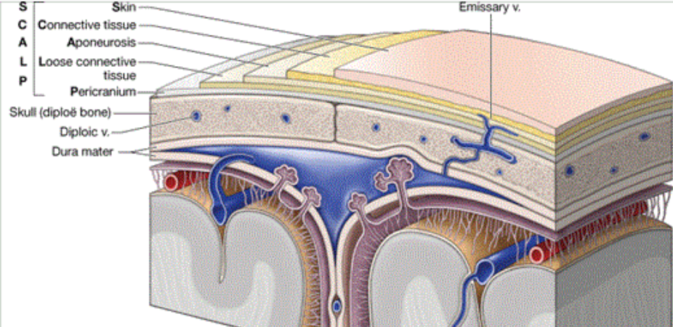
Pathophysiology
Brain parnychyma is NOT sensitive to pain.
What is?
Meninges.
Vessels.
Various tissues lining the skull.
Pain in head and neck may overlap.

Slide 5
Headache in the ED
3-5% of all ED visits
50% - Tension headache.
30% - Unidentified origin.
10% - Migraine-type.
8% - Potential serious causes.
1% - Life-threatening disease.

Slide 6
Hx
Onset & Pattern.
Activity at time of onset.
Trauma?
Intensity.
Character.
Location.
Exacerbating or relieving factors.
Associated symptoms.
Prior history?

Slide 7
Physical Examination
General appearance
Vitals
HEENT
Fundi
Neurological

Slide 8
Symptom | Finding | Possible Diagnosis
Suddent onset | Lightning strike, thunderclap, with ALOC, FND or intractable pain | SAH
”Worst headache of my life” | Sudden onset | SAH
Near syncope or syncope | Suddent onset | SAH
Increase with movement | Clicking or snapping, tenderness over jaw | TMJ disease
Facial pain | Pain of forehead or maxillary sinus, nasal congestion | Sinusitis, Dental infection
Temportal or forehead pain | Temporal tenderness | Temporal arteritis (GCA)
Periorbital or retroorbital pain | Sudden onset with tearing | Temportal arteritis or Acute angle-closure glaucoma

Slide 9
DDx
Organ system | Critical Diagnosis | Emergent Diagnosis | Non-Emergent Diagnosis
Neuro, CNS, Vessels | SAH | Shunt failure Traction headaches SDH/EDH Tumor | Migraine Vascular headaches Trigeminal neuralgia Post LP Post-traumatic
Toxic or Metabolic | CO poisoning
Environmental |  | Mountain sickness
Collagen Vascular Disease | Temporal Arteritis
Eye / ENT |  | Glaucoma Sinusitis | Dental, TMJ
MSK |  |  | Tension headache Cervical strain

Slide 10
DDX
Organ system | Critical Diagnosis | Emergent Diagnosis | Non-Emergent Diagnosis
Allergy |  |  | Cluster or histamine headache
Infectious Disease | Bacterial Meningitis Encephalitis | Brain abscess | Non-neurologic source of infection
Pulmonary or O₂ |  | Anoxic headache Anemia
Cardiovascular |  | Hypertensive crisis | Hypertension
Unspecified |  |  | Effort-dependent Coital

Slide 11
Ivestigations
CBC
ESR
ECG
CT head
LP & CSF analysis

Slide 12
Investigations
Test | Findings | Diagnosis
CBC | Severe anemia | anoxia
ESR | Significant elevation | Temportal arteritis
ECG | Non-specific ST/T changes | SAH, increase CSF pressure
CT head | Increased ventricle size Blood in subarachnoid space Blood in epidural or subdural space Blood in brain parynchyma Areas of poor vascular flow Mass | Increased CSF pressure SAH EDH, SDH IPH Ischemic Stroke Tumor/abscess
LP | Increased pressure Increased protein Increased RBCs Increased WBC, decreased glucose, Gram stain + | Pseudotumor cerebrii Mass Shunt failure Tumor/lesion SAH Infection

Slide 13
Management
Treat the underlying cause.

Slide 14
Migraine
Chronic, recurrent
Genetic predisposition, F>M
With or without aura
Unilateral (Bilateral in 40%), pulsating
Moderate to severe
Excacerbated by routine activities

Slide 15
Migraine
Associated with N, V, photo/phono/osmo-phobia, blurred vision, lightheadedness, nasal congestion
Gradual onset, lasting 4-72 hours
Aura: FND that precede and are during the attacks, last 10 to 20-60 minutes, FULLY reversible

Slide 16
Migraine
Sleep deprivation
Stress
Hunger
Hormonal changes
OCPs
NTG
Notes:
Ophthalmoplegic: rare, one or more of the ocular nerves, typically the 3rd cranial nerve. Pupillary changes of ocular muscle paralysis.
Hemiplegic: motor aura with hemiplegia or paraplegia
Basilar-type: aura from brainstem,

Slide 17
Migraine
Ophthalmoplegic
Hemiplegic
Basilar-type
Status Migrainosus (more than 72h)
Notes:
Ophthalmoplegic: rare, one or more of the ocular nerves, typically the 3rd cranial nerve. Pupillary changes of ocular muscle paralysis.
Hemiplegic: motor aura with hemiplegia or paraplegia
Basilar-type: aura from brainstem,

Slide 18
Migraine
DDx
Diagnosis
Mx
Notes:
Ophthalmoplegic: rare, one or more of the ocular nerves, typically the 3rd cranial nerve. Pupillary changes of ocular muscle paralysis.
Hemiplegic: motor aura with hemiplegia or paraplegia
Basilar-type: aura from brainstem,

Slide 19
Tension
Most common type of headaches (50%)
Not a frequent cause of ED visits
Tight, band-like discomfort, dull, non-pulsating
Usually mild
Simple analgesics

Slide 20
SAH
Blood in subarachnoid space
Ruptured saccular aneurysm*
Occipital pain +/- meningismus
<1% of all headaches presenting to ED
10% of all strokes
Most common cause of death from stroke
Notes:
*= this accounts for about 80% of all SAH
Other causes include AV malformation, cavernous angiomas, mycotic aneurysm, neoplasm, bleeding disorders

Slide 21
SAH
Sudden onset headache
“Thunderclap” headache
“Worst headache of my life”
Exertion, valsalva, sexual intercourse → 20%
Peak in seconds to minutes

Slide 22
SAH
Nausea, vomiting → 75%
Meningismus → 50%
Neck stiffness → 25%
FND → 20%
Seizures → 17%

Slide 23
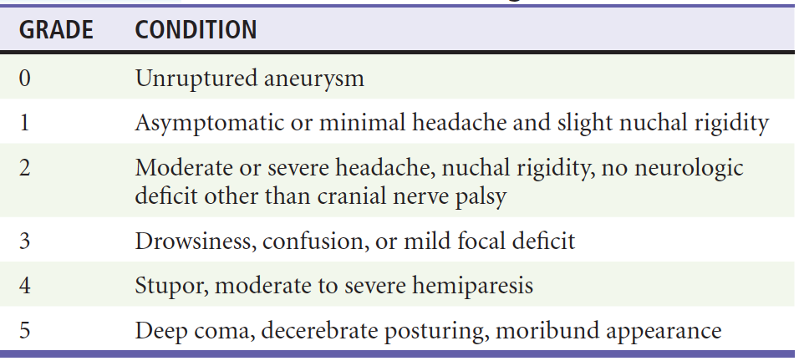
SAH
Prognosis depends on grade on admission to hospital

Slide 24
SAH
CT
LP with CSF analysis*
Mx
Notes:
*Xanthocromia
May be falsely positive
Mx:
Early neurosurgical consultation
Goals: treat medical and neurological complications, prevent recurrent hemorrhage, prevent complications of vasospasm
Airway management for grade 3 and higher
Nimodipine, a CCB
BP management with goal SBP <160
Analgesia

Slide 25
Neoplasm
Most common presenting complaint = headache
Weeks to months → worsening
Sleep disturbance, severe pain, N/V
Primary benign or malignant
Secondary (mets) → Lung, Breast, melanoma, GI carcinomas
Neurosurgery

Slide 26
GCA
Systemic inflammatory process of small and medium vessels
Extra-cranial branches of aortic arch and ophthalmic vessels most common
Rare <50 years
F>M
Notes:
*

Slide 27
GCA
Headache, weeks to month
Worsening
Sharp, throbbing, aching
Temporal region
Worse at night and with cold
+/- jaw claudication, fever, anorexia, weight loss
PERMANENT VISUAL LOSS
ESR, CRP, biopsy
Steroids
Notes:
*

Slide 28
Carotid & Vertebral Artery Dissection
Most common cause of stroke in <45 years
Spontaneous but often a risk factor*
Sudden onset face or neck pain
CT/CTA/MRI
Antiplatelet therapy
Notes:
*Neck trauma or movement: chiropracter, MVC, roller-coaster
The classic triad of symptoms for carotid dissection includes unilateral headache, ipsilateral Horner’s syndrome, and contralateral hemispheric findings that may include aphasia, neglect, visual disturbances, or hemiparesis.
Vertebral artery dissections are LESS common than carotid dissections. The classic presentation is that of a relatively young person with severe, unilateral posterior headache and neurologic findings

Slide 29
CVST
Headache
Seizures
Decreased LOC
FND
Ocular findings*
Notes:
* = mainly with Cavernous sinus thrombosis

Slide 30
CVST
Hypercoagulable states*
CTA/MRI/MRV
Anticoagulation
Notes:
* = genetic and hypercoagulable disorders, pregnancy and the puerperium, inflammatory systemic disorders including vasculitis, connective tissue disorders, and medications such as oral contraceptives. Other risk factors include head trauma, head and orofacial infections, and neurosurgical procedures

Slide 31
PTHA
Common after simple trauma
+/- other symptoms
Simple analgesia
Notes:
Common ED presentation
Ensure instructions and follow up
Return precautions

Slide 32
Glaucoma
Sudden onset
Localized to eye
May radiate to teeth, ear, sinuses, forehead
Visual symptoms
Nausea / vomiting
Notes:
The underlying pathophysiology is congenital narrowing of the anterior chamber angle, which under certain conditions leads to closure and a sudden rise in IOP.
Can be precipitated by entering a low-light environment such as a movie theater, with resultant pupillary dilation, or by the use of medications such as mydriatics (e.g., for dilated ocular examination), sympathomimetics (e.g., pseudoephedrine), or agents with anticholinergic properties (e.g., antiemetics, antihistamines, antipsychotics, antidepressants).
Treatment includes:
1- Topical miotics (Pilocarpine)
2- Topical beta blockers (Timolol)
3- Carbonic anhydrase inhibitors (Acetazolamide, Mannitol)
4- Emergent Ophthalmology referral

Slide 33
Post-LP Headache
Most common complication of LP
Notes:
*Onset may be immediate or delayed. Typically doesn’t last more than 5 days
The most likely explanation is a persistent CSF leak that exceeds CSF production, resulting in CSF hypotension.
Remember that epidurals can cause this.
Mx:
-Typically resolves spontaneously
-Bed rest
-Analgesia
-Caffeine
-Blood patch

Slide 34
Intracranial Infection
Meningitis, abscess, encephalitis
Headache + associated symptoms
Notes:
In a majority of cerebral infections, the mechanism of head pain includes meningeal irritation and increased ICP.

Slide 35
Hypertensive Headache
Notes:
Typically needs to decrease the BP to improve
Add simple analgesia
Ensure HTN encephalopathy isnt present, during which a headache may be there for days until the brain edema subsides.
Ensure no associated symptoms indicating CVA are present.

Slide 36
Conclusion
Careful history and physical examination can lead to the correct cause of the patient’s headache.

Slide 37
Seizures

Slide 38
Definition
Episodes of abnormal neurologic functioning caused by pathologically excessive activation of neurons
Cerebral cortex or in the deep limbic system
Notes:
Epilepsy is defined as recurrent unprovoked seizures caused by a genetically determined or acquired brain disorder1; it is not an appropriate term for seizures that occur intermittently or predictably after a known insult, such as alcohol intoxication and withdrawal.

Slide 39
Epidemiology
1% of all ED visits
2% of peds ED visits
3% of all EMS transports
Febrile seizures –> Most common in peds
7% → status epilepticus
Notes:
These are US numbers
Status: a seizure or multiple seizures for more than 5 minutes without return of mental status to baseline.

Slide 40
Status Epilepticus
Etiology | % of cases
AED non-compliance | 25-26
Alcohol-related | 15-24
Drug toxicity | 2-10
Infection | 8
Tumor | 5-6
Trauma | 3-5
Cerebrovascular disease | 4-23
Metabolic | 4-13
Hypoxia or cardiac arrest | 4-12
Idipathic | 4-5

Slide 41
Classification
Cause
Effect on mentation
Motor activity
Notes:
Cause: primary or secondary
Effect: Generalized or focal
Motor activity: convulsive or non-convulsive. Convulsive seizures are characterized by uncontrolled, rhythmic motor movements and can affect part or all of the body. Nonconvulsive seizures do not result in abnormal motor activity; patients may display confusion, altered mental status, abnormal behavior, or coma.

Slide 42
Approach
Hx: Was this truly a seizure?
Physical examination*
Management
Diagnostic testing
Notes:
Can be pseudoseizure, presyncope/syncope. Extremely important to clarify.
Details of the event: LOC? Movements? Tongue biting? Loss of continence?
1. Abrupt onset: Generalized seizures typically occur without an aura.
2. Brief duration: Seizures rarely last longer than 90 to 120 seconds, although bystanders may overestimate the duration.
3. Loss of consciousness: Present by definition, except for focal seizures.
4. Purposeless activity: For example, automatisms and undirected tonic-clonic movements.
5. Unprovoked: Especially with regard to emotional stimuli; fever in children and substance withdrawal in adults are notable exceptions.
6. Postictal state: An acute confusion state that typically occurs with all seizure types except focal and absence.
Examination: for signs of above
Mx:
Vital signs, monitored bed, IV access, ABCs
Dx:
Glucose levels
Lactate
CT brain

Slide 43
CT Indications
First seizure
Hx of trauma
Hx of malignancy
Immunocompromised
Fever
Persistent headache
Anticoagulation
New FND
>40 without hx of epilepsy
Prolonged post-ictal state

Slide 44
Seizure Management
Airway control
Benzodiazepines
Phenytoin
Phenobarbital
Propofol
Isoflurane
Notes:
Lorazepam preferred initial due to long half-life.
If no IV → IM/IN Midazolam

Slide 45
Dispo
Admission to ICU if status
EEG
Treat underlying cause
Driving??
Notes:
Lorazepam preferred initial due to long half-life.
If no IV → IM/IN Midazolam
Driving??

Slide 46
CVA

Slide 47
Definition
Any vascular injury that leads to a reduction in cerebral blood flow to a specific region of the brain, leading to neurological impairment.

Slide 48
Epidemiology
3rd leading cause of death in the US.
Leading cause of impairment.
87% → Ischemic → thrombus vs embolus
13% hemorrhagic → ICH vs SAH

Slide 49
Ischemic
Anterior vs Potserior circulation
Presentation depends on the area involved
Notes:
Anterior circulation: ACA, MCA, Anterior choroidal artery
Posterior circulation: Vertebral artery, basilar artery, PCA
Consider vertebral artery dissection/carotid artery dissection if young, history of manipulation, trauma, neck pain
NIHSS and GCS with frequent neurological examination to assess for changes / deterioration
NIHSS can also identify those needing fibrinolytic therapy or those with potential hemorrhagic transformation

Slide 50
Hemorrhagic
Notes:
Classic triad:
Headache
Vomiting
Severely elevated BP
Poor prognostic factors include:
Decreased LOC on arrival
Interventricular hemorrhage
Large ICH
NIHSS
ICH score
Trauma?

Slide 51
Traumatic
 | Epidural | Subdural
Timing | Lucid Interval | Immediate/Progressive
Shape | Biconvex | Crescent
Vessel | Middle meningeal artery | Bridging veins
Sutures | Crosses | Does not cross
Notes:
Typically SDH or EDH
Can be IVH, ICH or SAH

Slide 52
GCS

Slide 53
DDx
Notes:
TIA → arrange for carotid doppler, CTA, MRI
Migrain with aura
Meningitis
Cerebral abscess
Seizure
Hypoglycemia
Tumor
HTN encephalopathy

Slide 54
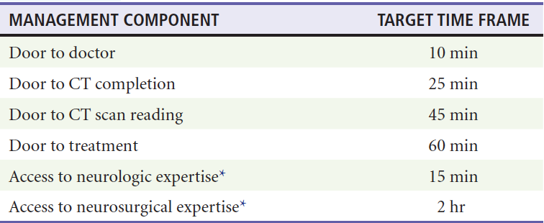
Dx/Mx Ischemic
Examination
Airway Control
BP management as needed
CT → CTA / MRI
Notes:
Does a negative CT rule out stroke?
What’s the problem with MRI?
Very important to clearly document the time of symptom onset.
tPA can be given within 4.5 hours of symptom onset.
LVO = Can get a neuro interventionalist to retrieve the clot. Can be done within 24 hours of symptoms onset.
Those not requiring fibrinolytic therapy or clot retrieval can get started on treatment with ASA/Plavix as recommended by a neurologist.
Rehab is key in improving quality of life post CVA.

Slide 55
Dx/Mx Hemorrhagic
Examination
Airway Control
BP management as needed
CT → CTA / MRI
Notes:
Early neurosurgical consultation for possible
EVD
Craniotomy
Evacuation

Slide 56
Conclusion
Patients with signs and symptoms of an acute ischemic stroke within 4.5 hours of the last time they were known to be at their neurologic baseline should be evaluated for thrombolytic therapy with the appropriate inclusion and exclusion criteria.
Carotid Doppler, MRA, or CTA studies are recommended before discharge of a patient with TIA from the ED.
Overly aggressive blood pressure management should be avoided in patients with acute ischemic stroke.
Accurate identification of the last time a patient was known to be at his or her neurologic baseline should be documented in all patients with stroke.
Assessment of gait is essential to rule out posterior circulation stroke in patients with vertigo.
The possibility of carotid or vertebral dissection should be considered in young patients with stroke and in patients with headaches and neck pain with acute stroke.

Slide 57
?

Slide 58
Thank you

