Slide 1
Triage
“Not all patients are as well as they appear and not all patients are as sick as they think.”

Slide 2
triage
Why we do triage?
How many triaging systems we have?
what system we usually use?

Slide 3
The Process of the triage
Critical first look
Screening for infectious disease
Interviewing the patient
Objective assessment
Making the triage decision

Slide 4
CTAS
Level 1 | Resuscitations
Level 2 | Emergent
Level 3 | Urgent
Level 4 | Less urgent
Level 5 | Non-urgent

Slide 5
Level 1 – Continuous nursing care
Level 2 – Every 15 minutes
Level 3 – Every 30 minutes
Level 4 – Every 60 minutes
Level 5 – Every 120 minutes

Slide 6
Let’s summarize
Triage is a systemic and standardized way to assess patients’ needs, sickness and priorities
The first rule is to protect yourself
Over triage than undertriage
Ask for help

Slide 7
Disaster
Do the most good for the most

Slide 8
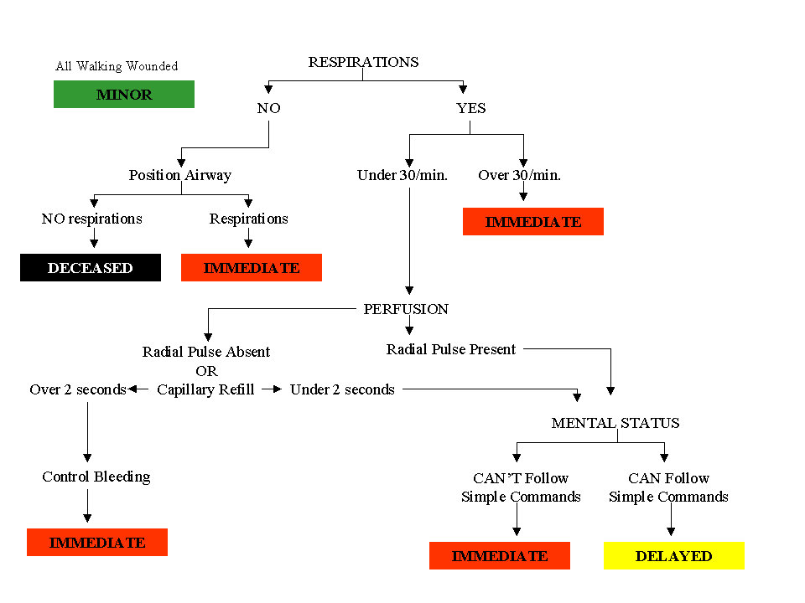

Slide 9
Questions?

