Slide 1
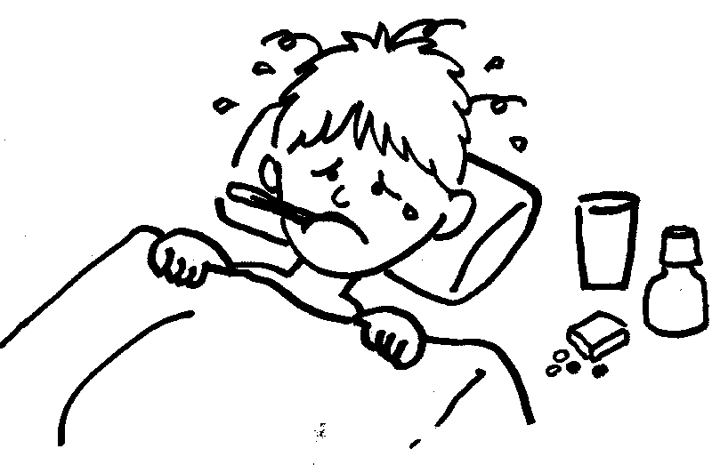
Approach to Fever in Children
Hashim Bin Salleeh
Associate Professor of Emergency Medicine
Consultant Pediatrician & Pediatric Emergency Medicine
KSU

Slide 2
Educational Objectives
  By the end of this session, audience should be able to:
Know the definition of Fever, FWS, & SBI
Know the impact of this topic on PEM practice
Stratified febrile children according to their risk factors
Know the guidelines for management of children with FWS

Slide 3

Case # 1
4 days old baby boy brought by his parents with H/O fever since last night clinically looks well temp 38.5 C rectal
How would you approach this child ?

Slide 4
Case # 2
3 weeks old baby girl brought by her grandmother complaining of fever for 2 days. Clinically looked well temp 37.5 C rectal
How would you approach this child ?

Slide 5
Case # 3
6 month old boy brought to ED with H/O fever for 3 days associated with skin rash clinically looked sick lethargic temp 40 C rectal
How would you approach this child ?

Slide 6
Case # 4
2 months old baby girl presented with fever for 3 days. Clinically looked well temp 38.9 C rectal
How would you approach this child ?

Slide 7
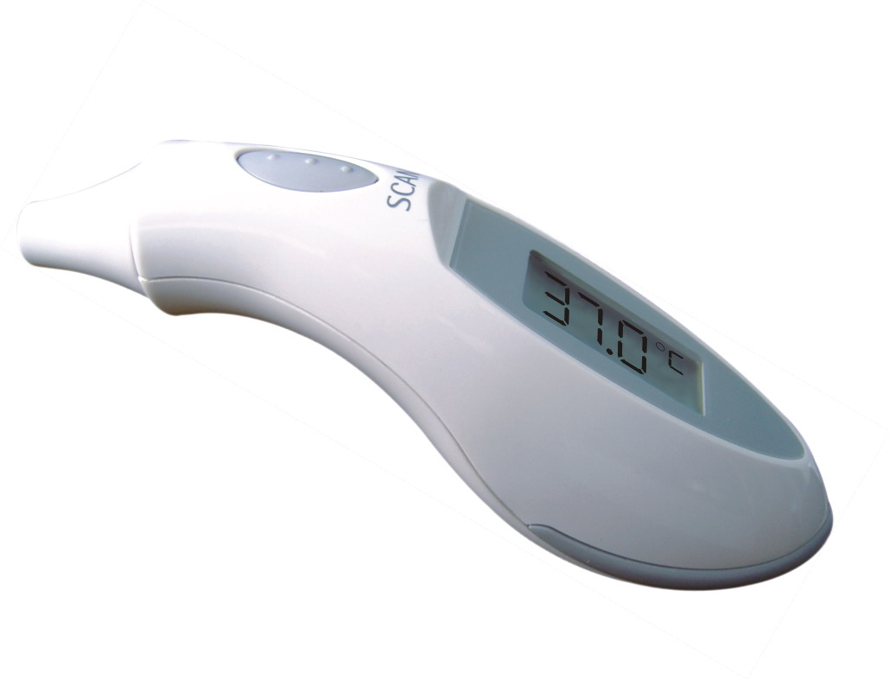
Definitions
Temperature > 38 C (100.4 F) rectal
Fever due to an infectious origin in children are rarely above 42 C
Serious bacterial infection
  Bacteremia
  Meningitis
  Osteomyelitis
  Septic arthritis
  UTI
  Bacterial enteritis
  Periorbital cellulitis
  Abscess
  Cellulitis

Slide 8
What is the normal temperature?
Rectal 36.6 to 38 ° C
Ear 35.8 to 38 ° C
Oral 35.5 to 37.5 ° C
Axillary 34.7 to 37.3 ° C
Canadian pediatric society statement, Pediatric Child Health 2000

Slide 9
Measurement sites
Child's age | Rectal | Oral | Axillary
Newborn to 3 months | x
3 months to 3 years | x |  | x
4 to 5 years | x | x | x
5 years and older |  | x | x

Slide 10
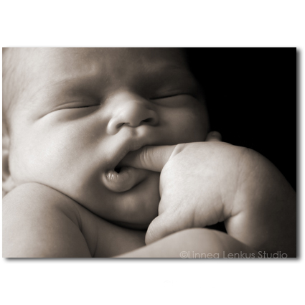
Definitions cont’d
Fever without a source (FWS)
  No apparent etiology from history and physical examination

Slide 11
Pathophysiology
Raising of hypothalamic set point in CNS
  Infection
  collagen vascular disease
  malignancies
  lowered by antipyretic medication and removing heat
Heat production exceeding heat loss
  salicylate overdose
  Hyperthyroidism
  environmental heat
Defective heat loss
  ectodermal dysplasia
  heat stroke
  poisoning with certain drugs

Slide 12
Epidemiology
65% of children 0-2 years visit a physician for a febrile illness
  10 to 20% of all pediatric visits to EDs
  20 to 30% of pediatric office visits
Fever without a source accounts for as many as 50% of these visits
A self limited illness in the vast majority
A small percentage will have a SBI

Slide 13
Approach to febrile child ….
Age dependant
Documentation of fever
Detailed History
Duration of fever
Associated symptoms
Look for the focus
  History
  Physical exam
  Investigations
Management options
  Age
  General condition
  Focus of the fever

Slide 14
Approach to sick young febrile child …
Acute care area
ABC
Quick IV access is important
Consider all of the following
  Infection
  Metabolic
  Cardiac
  Abuse
Abx should be given even before definitive C/S

Slide 15
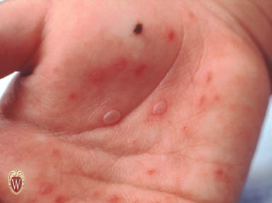

Slide 16
What is the science ?

Slide 17
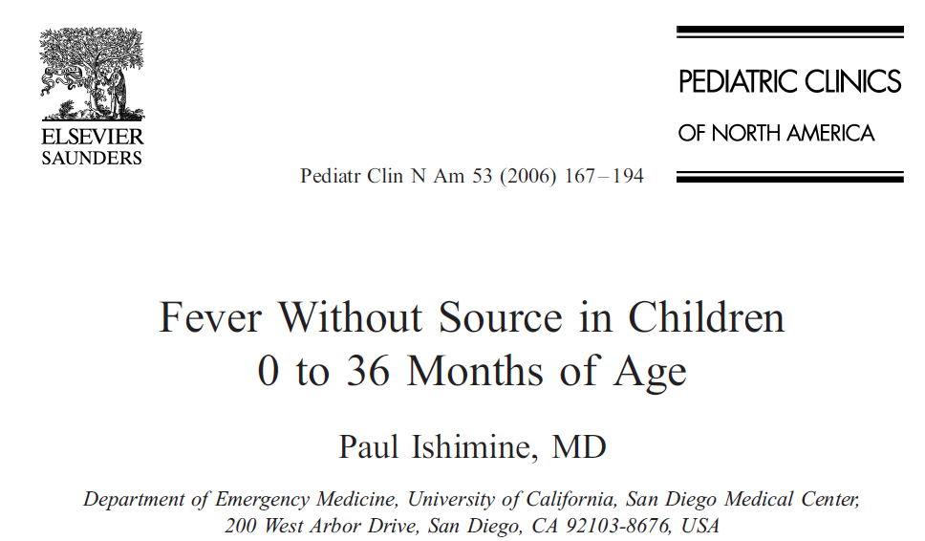
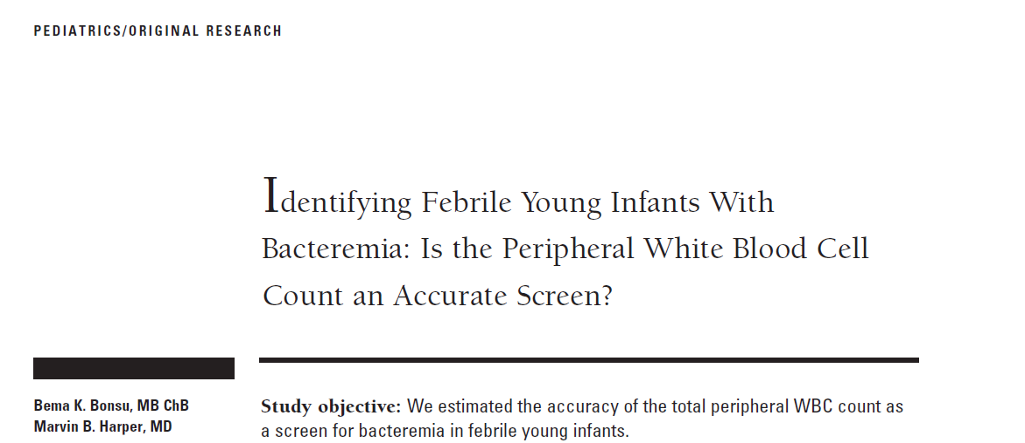
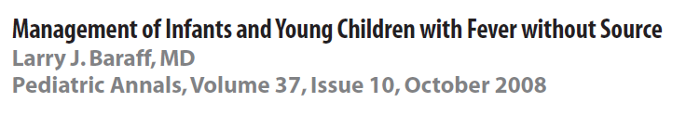
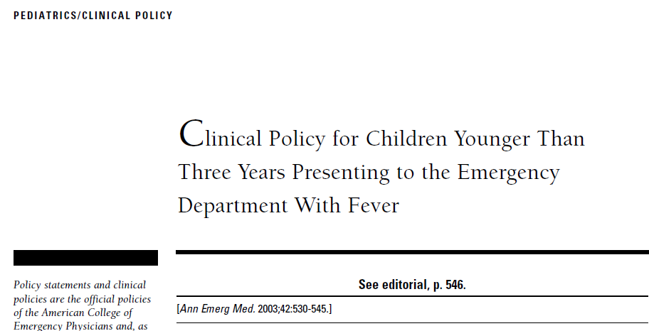
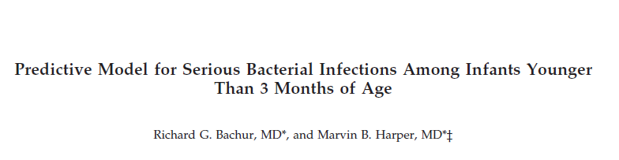
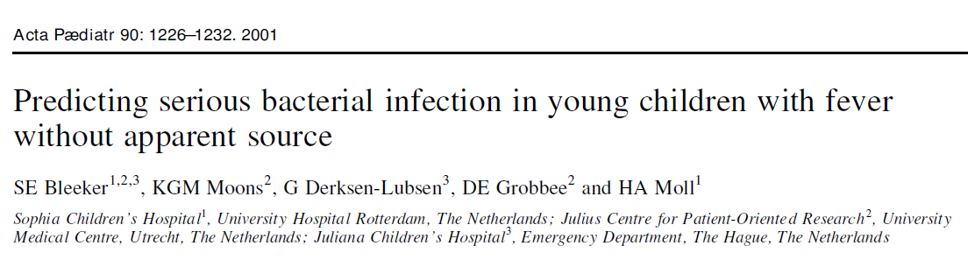
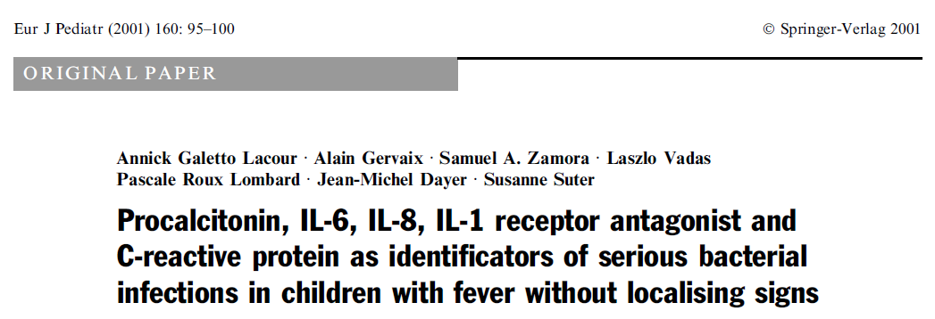

Slide 18
Fever in Children 0-36 months

Slide 19
Relevant Age Groups and development
Age stratification of risk for SBI
0………4w
0………………..8w
0……….……………….12w
0……….…………………………………..3y
> 3 years old
Why?

Slide 20
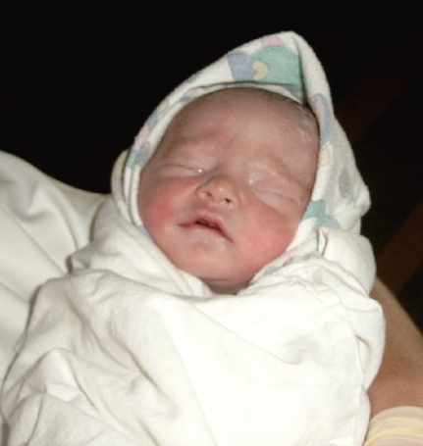
0- 1 month
Clinical judgment and febrile infant protocols do not work in neonates

Slide 21
Bacteriology /Virology
GBS
E.coli
Enterococcus
Staph.aureus
Listeria monocytogenes
HSV
Enterovirus
RSV

Slide 22
Management
CBC with diff
UA and cath culture
Blood C/S
CSF
Chest X ray if symptomatic
Rx IV Abx & Admission

Slide 23
Treatment options
Ampicillin 200 mg/kg/ day q 6h
Gentamycicn 7.5 mg/kg/day q 8h
(if CSF negative)
OR
Ampicillin 200 mg/kg/ day q 6h
Cefotaxime 200 mg/kg/day q 6h

Slide 24
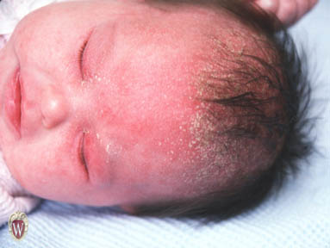

Slide 25
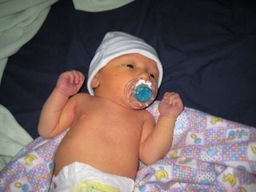
1 – 3 months

Slide 26
Low risk infants 29- 90 days
Non-toxic, normal exam
No focus of infection
Negative past history
WBC 5- 15,000/mm
Band <1500/mm
Normal UA

Slide 27
Components of Fever Protocols
Avner J, Baker MD: EMCNA 2002; 20:49

Slide 28
Risks in infants <12 weeks
Problem | Toxic | Non-toxic | Low risk
Bacteremia | 11% | 2% | 1.1% (0.2-2.6)
Meningitis | 4 % | 1 % | 0.5 % (0.0-1.0)
SBI | 17% | 8.6% | 1.4 % (0.4-2.7)

Slide 29
Consensus Panel Guidelines
Low-Risk Infants 28-90 Days of Age
    Obtain urine culture and provide close follow-up
    - OR -
    Full sepsis evaluation (blood, urine, CSF) and treat with IM ceftriaxone
    All children who receive presumptive therapy should have an LP

Slide 30
Treatment options in low risk group
Option one
No Abx and return in 24 – 48 hour
Option tow
Ceftriaxone: 50 mg/kg and repeat examination at 24 h and 48 h

Slide 31
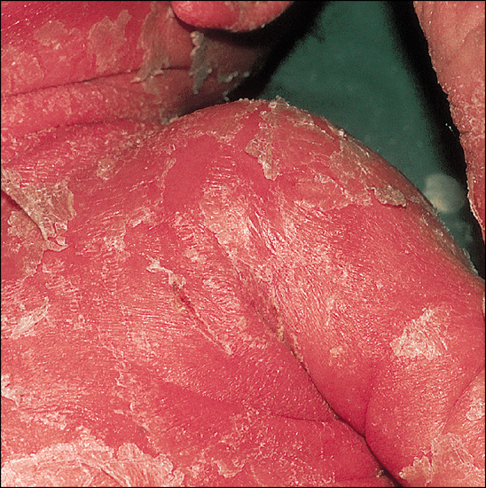

Slide 32
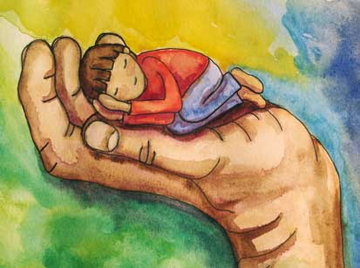
3 - 36 months

Slide 33
Overall rate of bacteremia if fever> 39 C is 4-7%
Increases percent as temperature increases
Most common organism of sepsis is S. pneumoniae
Treatment of the focus e.g. OM, UTI

Slide 34
      Antibiotics options
IV ANTIBIOTICS | ETIOLOGIC AGENTS | Age Group
Ampicillin 50 mg/kg/dose q 4-6 hrs +Cefotaxime 50 mg/kg/dose q 12 hrs or Gentamicin 2.5 mg/kg/dose q 8 hrs | E. coli. Group B streptococci Listeria | Neonate< 2 months
Cefotaxime 50 mg/kg/dose q 6 hrs Ampicillin 50 mg/kg/dose q 4-6 hrs | N. Meningitidis S. Pneumoniae Group A Strep H. Influenzae (rare) | 2 months – 9 years
Penicillin G250,00 u/kg/24 hrs q 4 hrs or Cefotaxime50 mg/kg/dose q 6 hrs | N. Meningitidis S. pneumoniae | > 9 years
Note: any third generation cephalosporin can substitute for cefotaxime

Slide 35
Common bugs of OB
S.pneumoniae
Salmonella non-thyphoïd
N.meningitidis

Slide 36
Consensus Panel Guidelines
Toxic-Appearing Infants and Children
    Hospitalize, evaluate and treat for presumed sepsis, meningitis, or SBI
    This holds for all age groups
    THIS SHOULD BE A NO BRAINER

Slide 37
Consensus Panel Guidelines
Low-Risk Infants 3-36 Months of Age
    Urine culture for males < 6 mo & females < 2 yrs
    Stool culture if blood or mucus or > 5 WBC/hpf
    Chest x-ray if decreased breath sounds or SOB
    Blood culture if T > 39.0 ⁰C and WBC > 15,000
    Empiric therapy if T > 39.0 ⁰C and WBC > 15,000
    No diagnostic tests or antibiotics if T < 39.0 ⁰C

Slide 38

Thank you…..

