Slide 1


Toxidromes and Antidotes
Bader Alyahya, MD, FRCPC (EM,CPT), DABEM

Slide 2

1. To discuss the identification and therapeutic approach to common toxidromes:
  Anticholinergic
  Sympathomimetic
  Opioids
  Sedative hypnotic
  Serotonin
  Neuroleptic malignant syndrome
  Cholinergic
  2. To Discuss common Antidotes and their indications

Slide 3
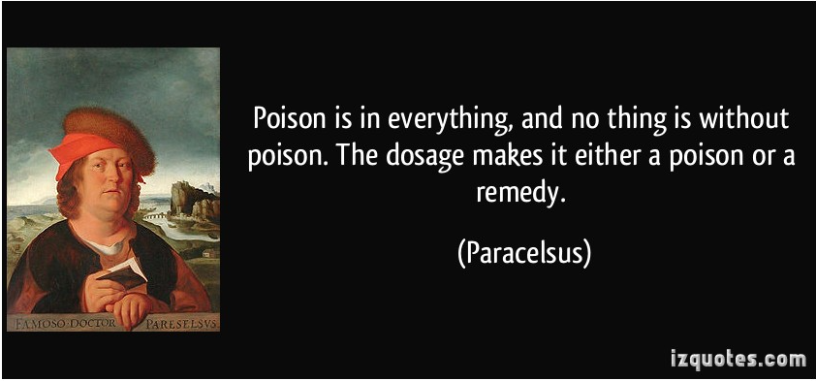
The Dose Makes The Poison

Slide 4
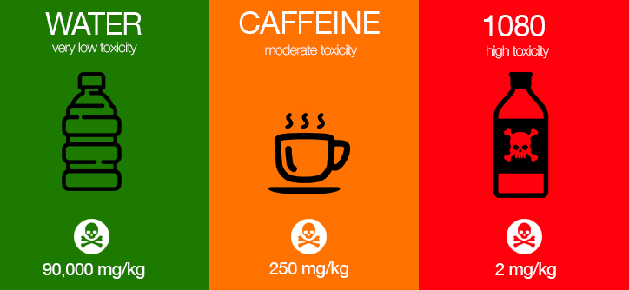
The Dose Makes The Poison
Notes:
1080 Sodium Fluoroacetate (lethal dose in human)

Slide 5
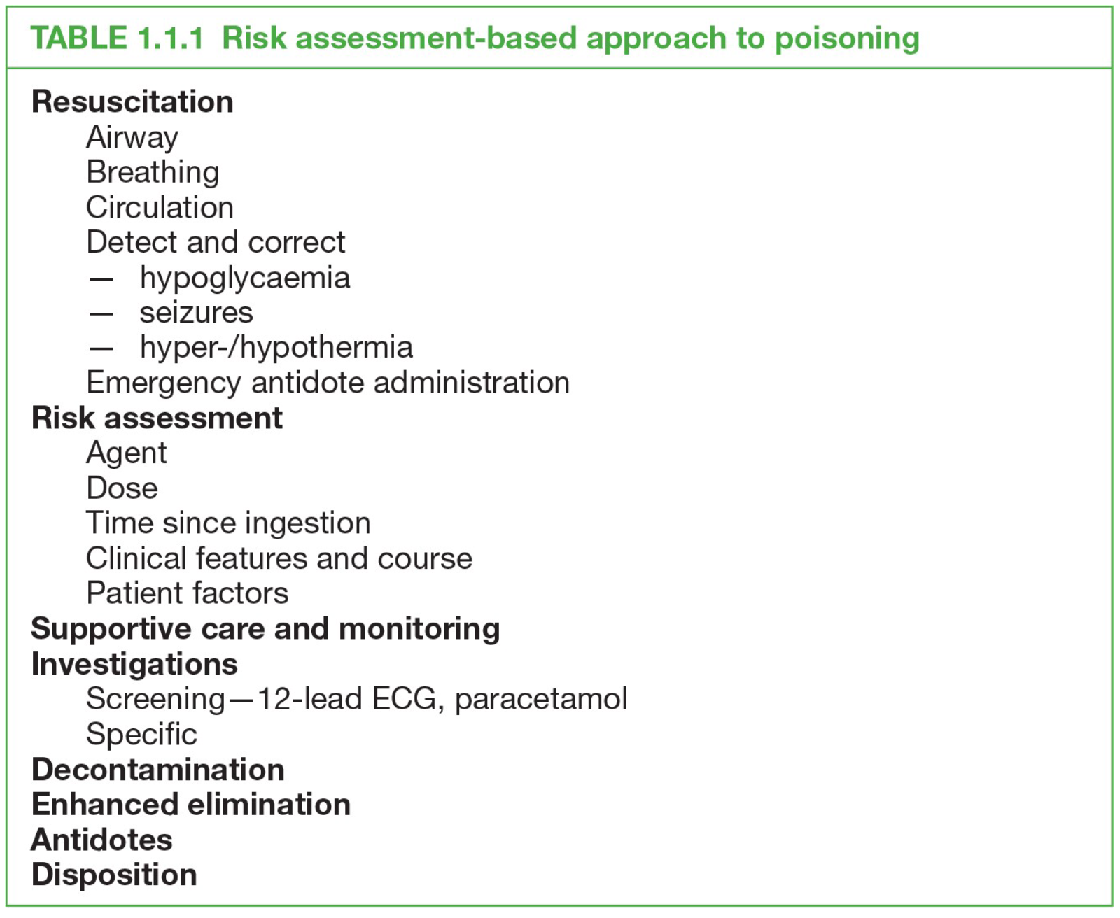
Toxicology Handbook, Lindsay Murray
Second edition

Slide 6
What is a Toxidrome
A toxidrome is a constellation of signs and symptoms that help narrow the differential diagnosis to certain toxin and thus guides therapy
i.e A clinical picture that suggests exposure to certain class of poisons

Slide 7
Toxidromes Vs urine drug screen (UDS)
Urine drug testing: tests for specific class of xenobiotic, commonly (opioids, BDZ, amphetamines, cannabis, …)
Significant rates of false positive and false negative results
If truly positive, it indicates exposure to the substance at some point in time and not necessary indicates toxicity

Slide 8
Factors That Influence The Results Of UDS
McMillin et al. Journal of Pain & Palliative Care Pharmacotherapy. 2013;27:322–339.

Slide 9
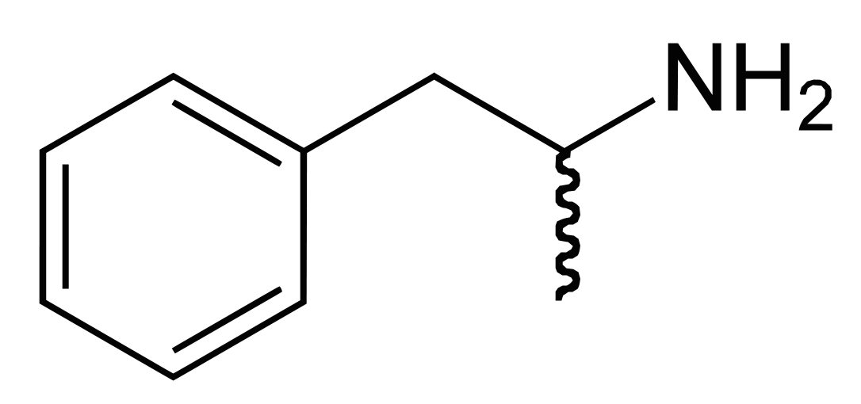
Amphetamines
Owen et al. Pain physician July 2012
Notes:
Almost useless.
Very high rates of false positives.
It is known that a metabolite of trazodone, meta-chlorophe- nylpiperazine (m-CPP) can cross-react with the amphetamine assay and cause a false-positive enzyme immunoassay screen.

Slide 10
Toxidrome # 1
25 year-old male, Ingested 25 tablets (50 mg each) of diphenhydramine, 2 H ago
He is drowsy and his skin is dry
BP= 135/85, HR= 130, RR=18
He is trying to catch something in the air

Slide 11
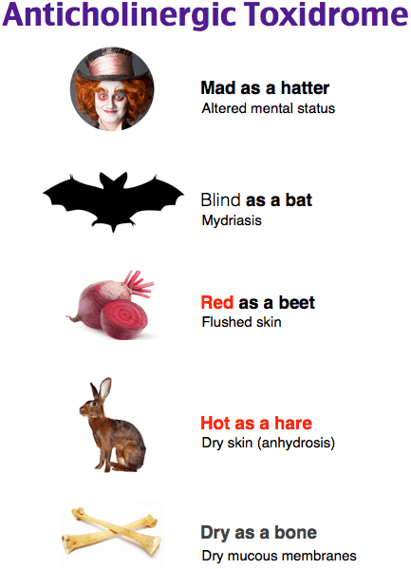
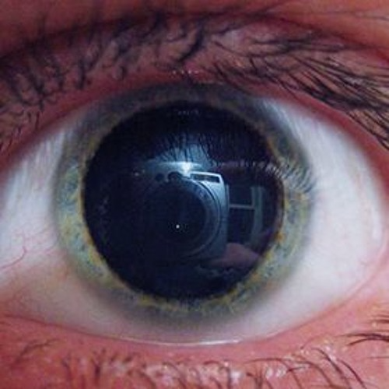
Anticholinergic

Slide 12
Anticholinergic Toxidrome

Slide 13
Anticholinergic Toxidrome
Management:
ABCDE
Supportive care: fluid, cooling if needed,….
Physostigmine: in moderate to severe toxicity, if No TCA overdose, no wide QRS, no seizure, no bradycardia
If physostigmine is contraindicated, then just use supportive care and benzodiazepines for agitation or seizure

Slide 14
Notes:
What is the easiest way to differentiate Anticholinergic from sympathomimetic toxidromes?
Dry Vs wet skin.

Slide 15
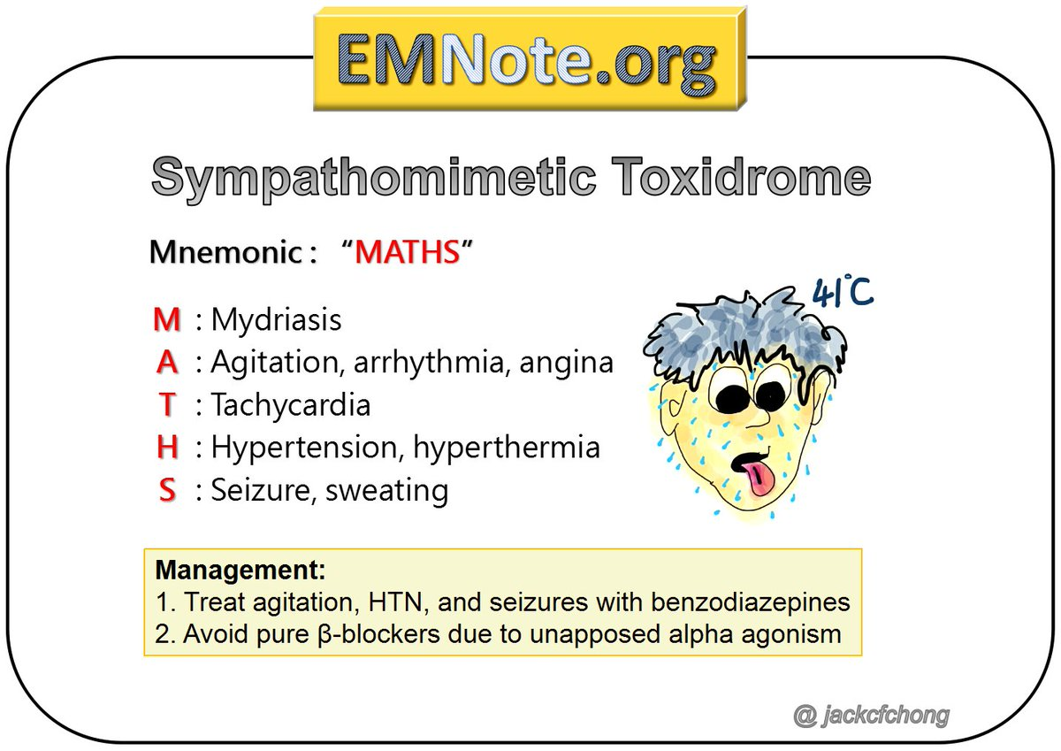
What is a Toxidrome

Slide 16
Sympathomimetic toxidrome
Excessive Sympathetic nervous system stimulation
Tachycardia
Hypertension
Mydriasis
Tachypnea
Sweating (as opposed to dry skin in anticholinergic syndrome!)
Hyperthermia
Seizures
Stroke
MI
Meds:
  Decongestants (Pseudoephedrine)
  Ritalin, Adderall
  Cocaine, amphetamines
Treatment:
  Benzodiazepines
  Supportive care (cooling, IVF…)

Slide 18
Opioid toxidrome
Excessive stimulation of mu receptors in the CNS from opioid agonists.
Meds:
  Morphine
  Fentanyl
  Hydromorphone
  Codeine
  Oxycodone
Recreational drugs:
  Heroin

Slide 19
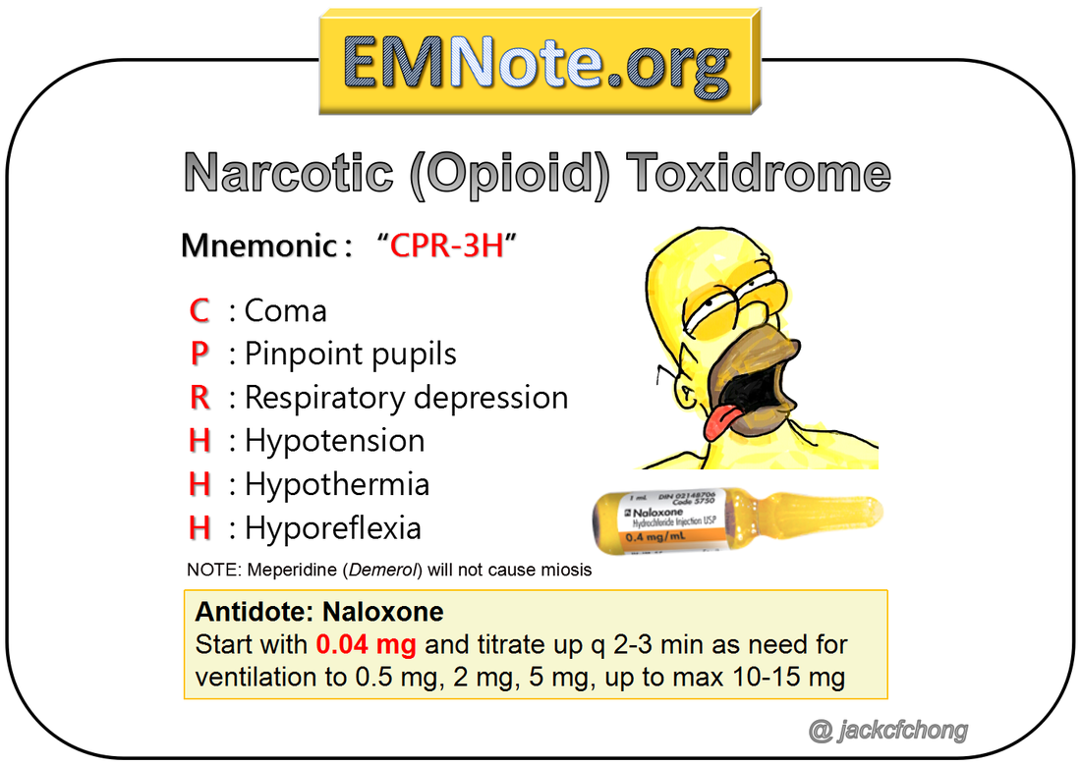
Opioid Toxidrome
Notes:
Good supportive care is very important: open the airway and provide ventilatory (e.g. BVM ventilation) support

Slide 21
Sedative-hypnotic Toxidrome

Slide 22
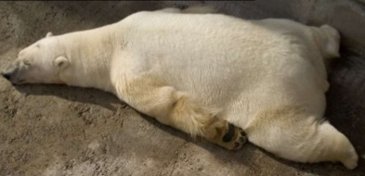
Sedative-hypnotic Toxidrome
Usually from excessive stimulation/potentiation of GABA receptors in the CNS.
Can happen with H1 blockade in the CNS
Meds:
  Benzodiazepines (GABA agonism)
  Antipsychotics (H1 blockade)
  ETOH (GABA agonism)
Treatment:
  Supportive
  Flumazenil??

Slide 24
Toxidrome # 5
20 year old female presented with confusion, diarrhea and agitation
Vital signs: HR 130, BP: 150/90, T: 37.9, RR: 18
Hx: Patient on Fluoxetine (SSRI) for depression. Lately was prescribed tramadol for pain following a dental procedure
Physical exam: Agitated, exaggerated bowel sounds, has tremor, hyperreflexia with clonus

Slide 25
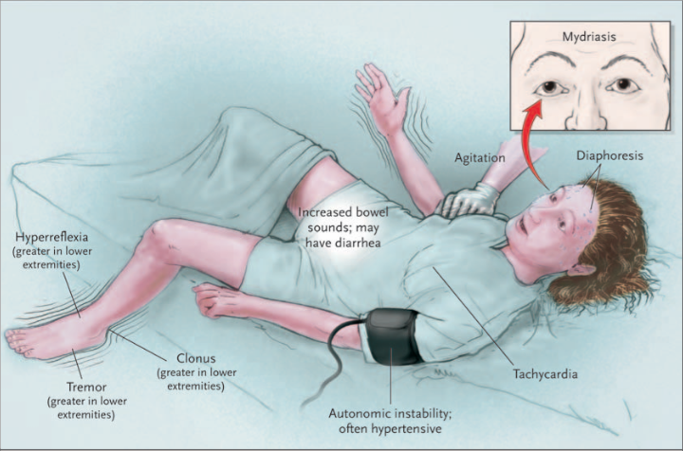
Serotonin Toxicity

Slide 26
Serotonin toxidrome
Excessive activity at the serotonin receptor (5HT) in the CNS and peripherally
Usually results from a drug-drug interaction of two serotonergic agents.
In this case the two serotonergic agents were:
  Fluoxetine (SSRI)
  Tramadol
Treatment:
  Benzodiazepines
  Supportive care (cooling, IVF…)
  Cyproheptadine

Slide 27
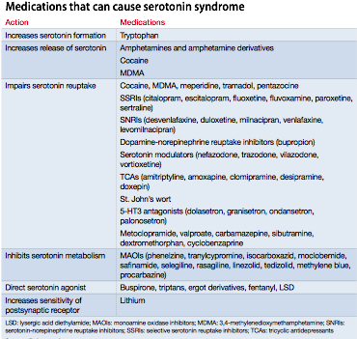


Slide 28
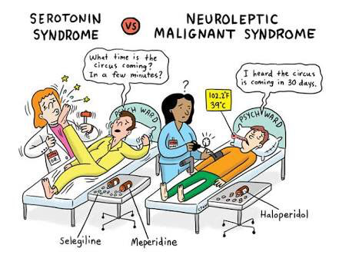

Slide 30
Neuroleptic Vs Serotonin

Slide 32
Goldfrank’s Toxicologic emergencies 10th edition

Slide 33

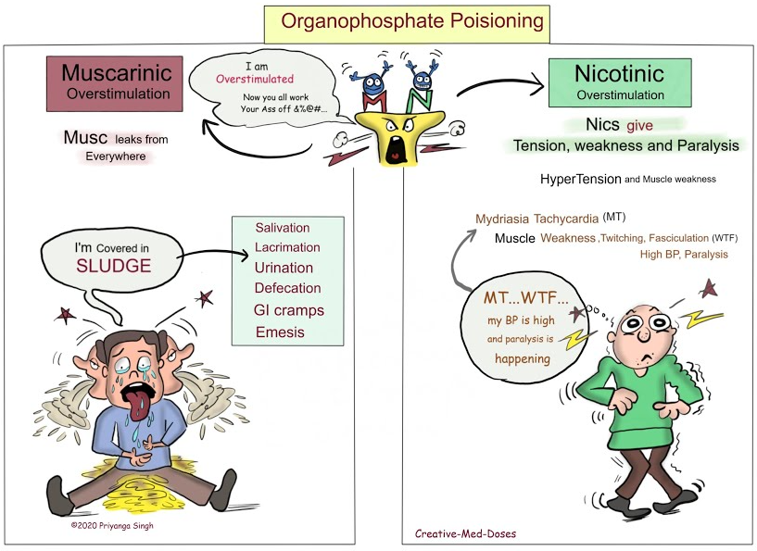

Slide 35
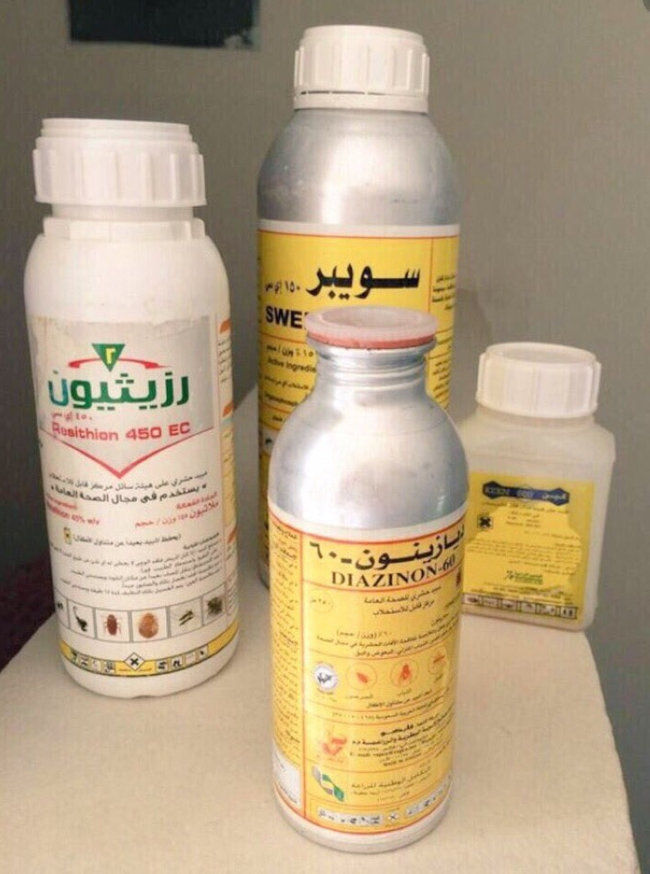
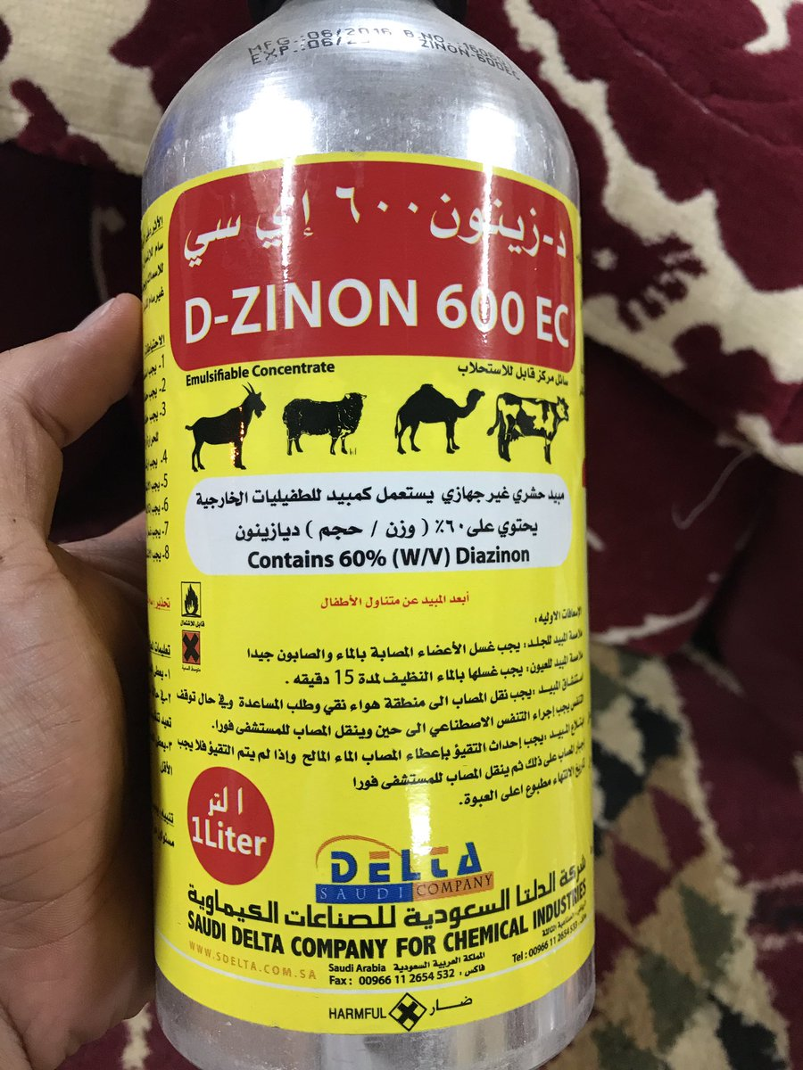
Cholinergic toxidrome
Excessive stimulation of nicotinic and muscarinic acetylcholine receptors
Usually from blockade of acetylcholinesterase leading to excessive free acetyl- choline molecules acting on the receptors

Slide 36
Cholinergic toxidrome
Medication:
  Alzheimer's meds (donepezil)
  Myasthenia gravis meds (pyridostigmine)
Chemicals:
  Organophosphates
  Carbamates
Treatment:
  Antidote: Atropine, 2PAM
  Supportive care

Slide 37
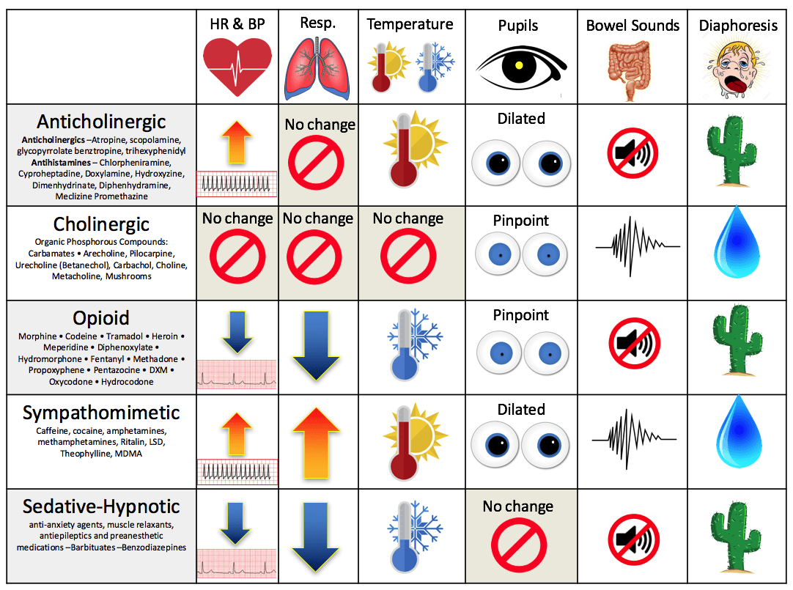

Slide 38
Antidote

Slide 41

THANK YOU

