Slide 1

Airway
Mohammed Saud Arafat
Emrgency Medicine consultant
King Saud University medical City

Slide 2
Endotracheal intubation
Is a procedure by which a tube is inserted through the mouth down into the trachea (the large airway from the mouth to the lungs).

Slide 3
Indications for intubation

Slide 4
Indications for intubation
Failure to Maintain or Protect the Airway.
Failure of Ventilation or Oxygenation
Anticipated Clinical Course
Notes:
Gag reflex is absent in 12 to 25% of normal adults
The patient’s ability to swallow or handle secretions is a more reliable indicator
If the patient required maneuver to establish a patent airway or who easily tolerates an oral airway ➔intubation
Hypoxemia not responsive to oxygen
ABG not required

Slide 5
Failure to protect or maintain airway
Altered mental status
Excessive Secretions
Bleeding
Hematoma
Angioedema
Others

Slide 6
Failure to Ventilate
Inability to remove pCO2
COPD
Narcotic OD
Myasthenia Gravis
Stroke
Other

Slide 7
Failure to Oxygenate
Inability to maintain pO2 > 60
CHF
Pneumonia
ARDS
Pulmonary Embolism
Other

Slide 8
Difficulty of maneuvers should be assessed preintubation
Notes:
Difficult Direct Laryngoscopy (Intubation)
Difficult BVM
Difficult Extraglottic Device Placement (LMA)
Difficult cricothyrotomy

Slide 9
Evaluation of Difficult Direct Laryngoscopy
LEMON
  Look externally ➔ 90% specific
  Evaluate the “3-3-2 rule”
  Mallampati
  Obstruction/Obesity
  Neck mobility A study showed “extension-extension” position ➔ superior to sniffing

Slide 10
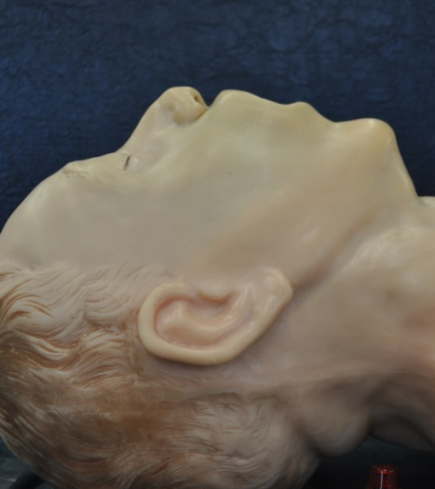
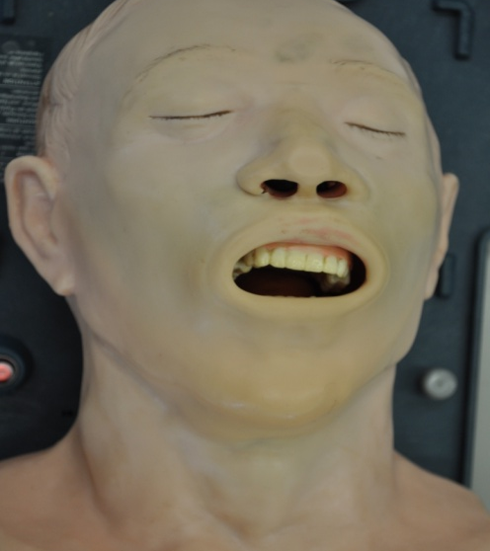
Look Externally
abnormal face shape
sunken cheeks
edentulous
"buck teeth"
receding mandible
"bull-neck"
narrow mouth
obesity
face or neck pathology

Slide 11
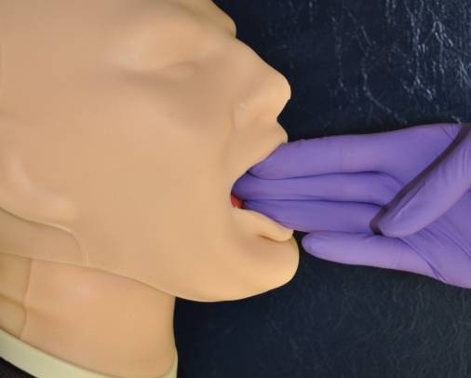
Evaluate the 3-3-2 Rule
Mouth opening > 3F
(F=fingerbreadths)

Slide 12
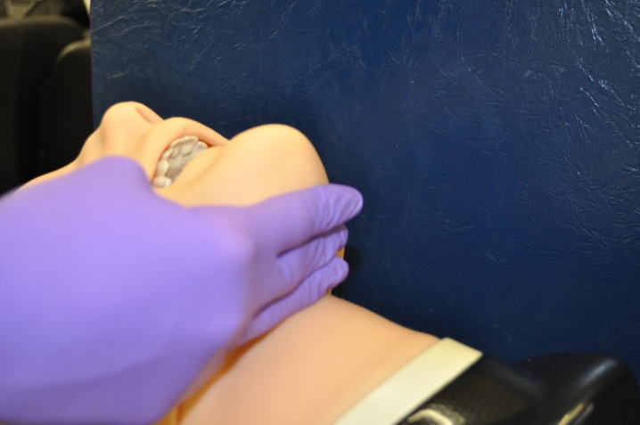
Evaluate the 3-3-2 Rule
Hyoid-chin distance > 3F
(F=fingerbreadths)

Slide 13
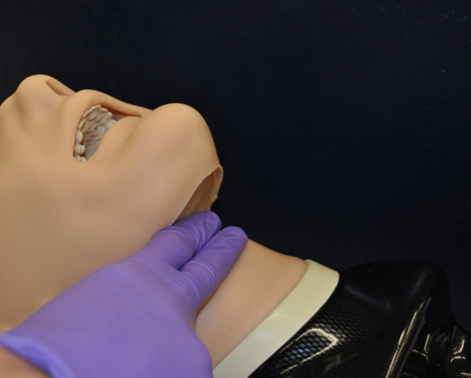
Evaluate the 3-3-2 Rule
Thyroid cartilage - mouth floor distance > 2F
(F=fingerbreadths)

Slide 14
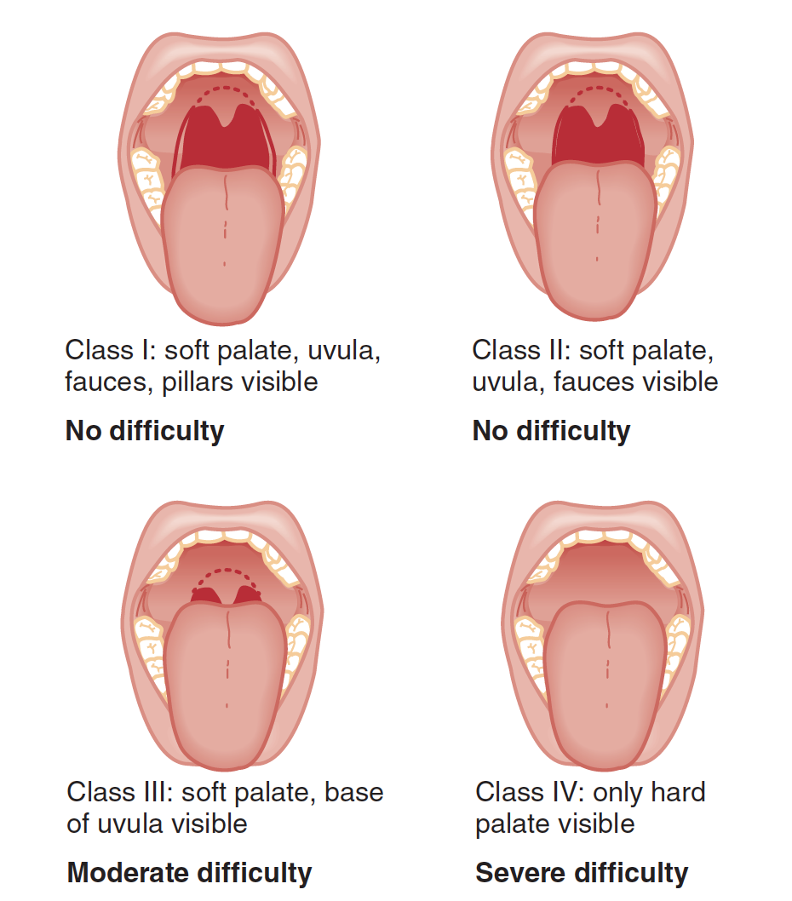
Mallampati
Not Sufficient predictor alone

Slide 15
Obstruction
Peri-tonsillar abscess
Epiglottitis
Retro-pharyngeal abscess
Blood
Tumor

Slide 16
Neck Mobility
Extension of the neck at the atlanto-occipital joint brings the oral, pharyngeal, and laryngeal axes into alignment.

Slide 17
Difficult Bag-mask Ventilation:
MOANS
  Mask seal
  Obstruction or obesity
  Aged >55
  No teeth
  Stiffness (resistance to ventilation)
    Asthma/ COPD
    Pulmonary edema
    Restrictive lung disease
    Term pregnancy

Slide 18
Difficult Extraglottic Device Placement:
RODS
  Restricted mouth opening
  Obstruction or obesity
  Distorted anatomy
  Stiffness (resistance to ventilation)

Slide 19
Evaluation of Difficult Cricothyrotomy
SMART
  Surgery
  Mass (abscess, hematoma)
  Access/anatomy problems (obesity, edema)
  Radiation
  Tumor

Slide 20
Grading laryngoscopic view of the glottis is that of Cormack and Lehane (CL)
Grade 1: all or nearly all of the glottic aperture
Grade 2: only a portion of the glottis
  Grade 2a: arytenoid cartilages & part of vocal cords
  Grade 2b: arytenoid cartilages alone or
Grade 3: only the epiglottis.
Grade 4: not even the epiglottis is visible.

Slide 21
Measurement of Intubation Difficulty
Cormack and Lehane

Slide 22
Confirmation of Endotracheal Tube Placement
Repeat laryngoscopy is not enough
Colorimetric ETco2
  six manual ventilations to confirm
  Yellow ➔ Yes

Slide 23
Confirmation of Endotracheal Tube Placement
Gold standard ➔ a fiberoptic scope vs. ETCo₂

Slide 24
Colorimetric ETCO2
False positive
False negative
Failure to measure before 6 breaths are given
Carbonated beverages
Air in stomach – secondary to bagging
Bicarb administration
Contact with gastric contents
Contact with acidic drugs like lidocaine and epi
Failure to measure before 6 breaths are given
Cardiac arrest
Device or ETT clogged with secretions
Severe airway obstruction
Pulmonary edema
Severely hypocarbic (must have at least ETCO2 of 2%)

Slide 25
Approach
Failed intubation
  Failure to maintain oxygenation by BVM (2 person & two hand)
  > 3 attempts by experienced operator best position and Technique
  Single attempt if clinician ascertain this impossible
The difference between the difficult airway and the failed airway is that the difficult airway is planned for, and the standard is to place a cuffed ETT in the trachea. The failed airway is not planned for, and the standard is to provides adequate oxygenation

Slide 26
rapid sequence intubation (RSI)
Success rate for ED RSI of 99%
7 P’s (Steps)

Slide 27
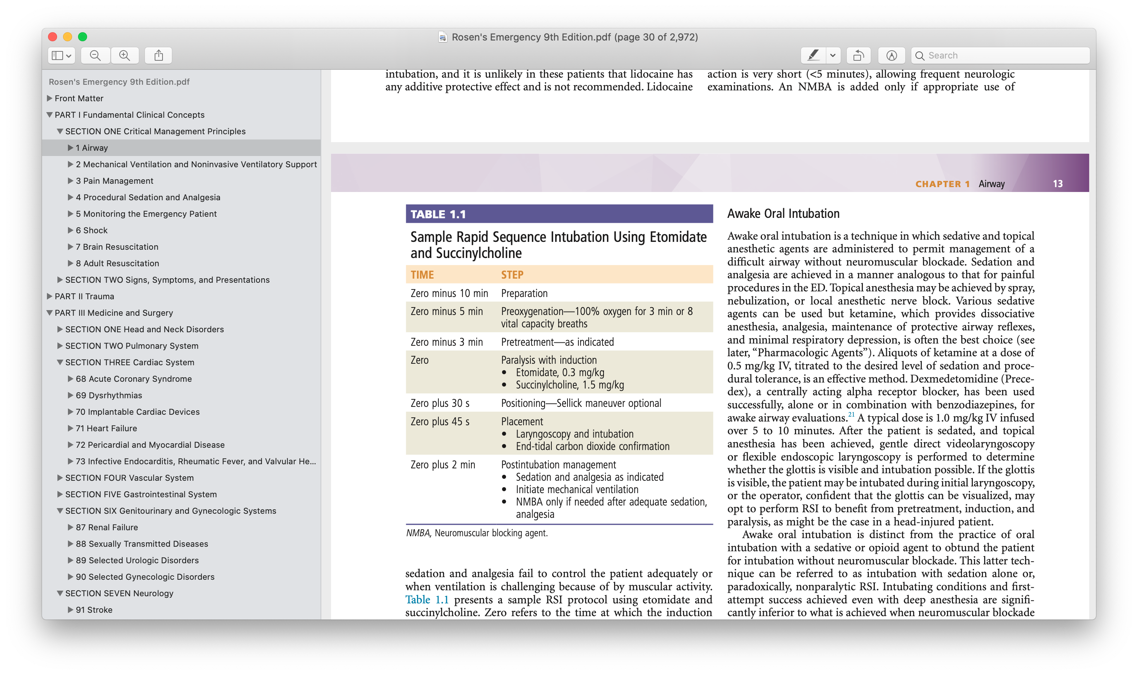

Slide 28
Pretreatment
Drugs are administered 3 minutes before administration of the succinylcholine and induction agent.
Reactive airways disease:
  Lidocaine 1.5 mg/kg IV, to mitigate bronchospasm.
  Albuterol 2.5 mg by nebulizer (if time permits and not already given).
Cardiovascular disease:
  Fentanyl 3 μg/kg to mitigate sympathetic discharge.
Elevated ICP:
  Fentanyl 3 μg/kg to mitigate sympathetic discharge and attendant rise in ICP.

Slide 29
Crash airway algorithm
Main emergency airway
management algorithm

Slide 30
Difficult airway algorithm
Failed airway algorithm

Slide 31
Other intubation technique
Awake Oral Intubation
  With local anesthesia
  Sedation without paralysis called non paralytic RSI
Crash intubation
  unconscious, unresponsive
  If unable to visualize single dose succinylcholine may help

Slide 32
Neuromuscular Blocking Agents
The depolarizing agent
  succinylcholine,
  binding noncompetitively with ACh
the competitive, or nondepolarizing,
  bind competitively to ACh receptors
  No histamine or cardiac effect

Slide 33
Succinylcholine (depolarizing)
  rapid onset
  complete reliability
  short duration of action
  absence of common serious side effects
Dose:
  1.5 mg/kg IV
  3 – 4 mg/kg IM
Wait 45 seconds
Clinical duration of action before spontaneous respiration: 6 - 10 minutes
Full recovery of normal neuromuscular function: within 15 minutes

Slide 34
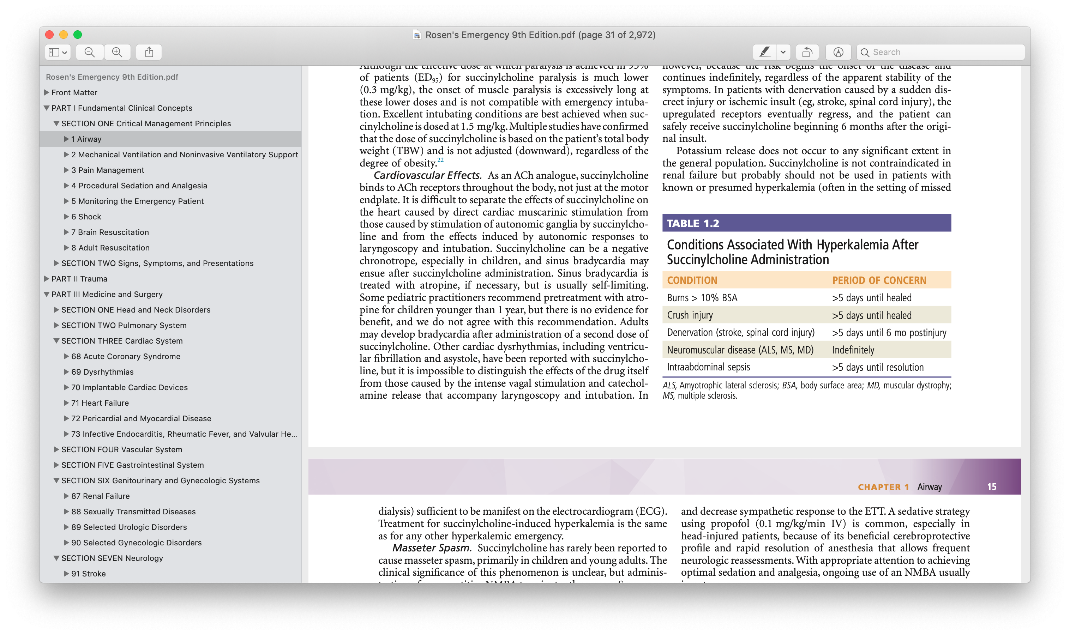
Succinylcholine
Masseter Spasm
  Rare
  Administer a competitive NMBA
  If persists, suspect malignant hyperthermia
Cardiovascular Effects
  can be a negative chronotrope ➔ sinus bradycardia
  self-limiting
  atropine if necessary

Slide 35
Rocuronium (competitive, nondepolarizing)
Dose: 1.0 mg/kg IV
Wait 60 seconds
Lasts approximately 50 minutes
sugammadex (a nondepolarizing reversal agent)

Slide 36
Vecuronium
Dose:
  First, 0.01 mg/kg “priming” dose.
  After 3 minutes, 0.15 mg/kg is given for paralysis.
Paralysis achieved in about 75 - 90 seconds

Slide 37
Induction Agents
Etomidate
  decrease ICP, cerebral blood flow, and cerebral metabolic rate
  Not affecting systemic mean arterial blood pressure and CPP
  Recent RCT showed adrenal suppression has no effect on clinical
Barbiturates.
  Thiopental is a negative inotrope and a potent venodilator
Benzodiazepines
  Negative inotrope
Ketamine.
  Reserve protective reflex
  Used in bronchial asthma and hemodynamically unstable (direct bronchodilator and release catecholamine)
  High ICP in trauma ➔ controversy use if patient hypotensive

Slide 38
Drug | Dose | Induction | Duration | Benefits | Caveats
Etomidate | 0.3 mg/kg | < 1 min | 10 – 20 min | -Decrease ICP -Neutral BP | -Myoclonus -Adrenal supp. -Vomiting -No analgesia
Ketamine | 1-2 mg/kg IV 6.5 – 13 mg/kg IM | 30 sec Peak: 1 min | 10 - 15 min | -Bronchodilator -Dissociative amnesia | -Increased secretions -Emergence phenomenon -May inc. BP
Propofol | 1.5 - 2 mg/kg | 20-40 sec | 8 - 15 min | -Antiemetic -Anticonvulsant -Decrease ICP | -Apnea -Decrease BP -Pain at the site of admin. -No analgesia
Midazolam | 0.2 - 0.3 mg/kg | 30 sec | 15 - 20 min | -Anticonvulsant -Decrease ICP | -Decreased BP -No analgesia
Thiopental | 3 mg/kg | < 30 sec Peak: 1 min | 5 - 8 min | -Decrease ICP | -Histamine release (BA) -Decrease BP

Slide 39
Surgical Cricothyrotomy
Contraindicated (relative)
  Distorted neck anatomy
  Preexisting infection in the neck
  Coagulopathy
Contraindicated (absolute)
  Children < 10 years

Slide 40
take home massage
Know when to intubate .
Prepaere your equipment before tgime Zero .
Always have you paln B and call for help .

