Slide 1
King saud university medical city department of obstetrics & gynecology course 482
OPERATIVE VAGINAL DELIVERIES AND
CAESAREAN SECTION (C.S)

Slide 2
Objectives ;
Definition of operative vaginal delivery and caesarian section
Indication of operative vaginal delivery and caesarian section
Conditions that must be fulfilled before the forceps and ventouse application
Different types of c/s
Complications of forceps , ventouse , and c/s
Trial of vaginal delivery after c/s. TOLAC
Care after operative delivery

Slide 3
Definition
It is the delivery of the fetus using an instrument through the vaginal route.
Instruments could be : ➔ Forceps
➔ Vacuum
Incidence of operative deliveries is 3.5 %
Indications of operative delivery
MATERNAL | FETAL
1. Prolonged or arrested 2nd stage | 1. Fetal distress
2. Poor maternal effort | 2. Prematurity (Forceps only)
3. Maternal cardiac disease | 3. Certain malpositions
Patients with retinal detachment or post op for similar ocular conditions

Slide 4
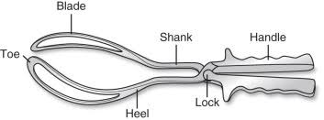

Slide 5
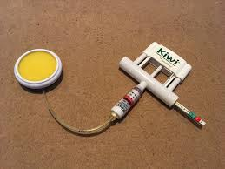

Slide 6
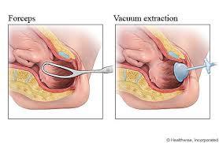

Slide 7
Pre-Requisite for forceps and ventouse
1. Cervix has to be fully dilated
2. Membranes ruptured
3. Head has to be engaged
4. Vertex presentation
5. Head position known (forceps can be applied on the head for cephalic presentation or after coming head for breech presentation)
Ventouse can only be applied on the head.
Conditions to be fulfilled
Adequate analgesia
Empty bladder
Adequate episiotomy

Slide 8
COMPLICATIONS OF INSTRUMENTAL DELIVERIES
MATERNAL | FETAL
Genital tract lacerations, Cx, vagina, Hemorrhage | Skull fractures  Cephalohematoma
 Extensions of episiotomy |  Interacranial hemorrhage
 Sphincter lacerations |  Facial Palsy
Fecal and flatus incontinence or injury to rectal mucosa |  Scalp laceration  Subgalial hemorrhage
 |  

Slide 9
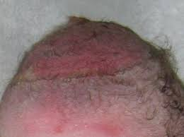

Slide 10
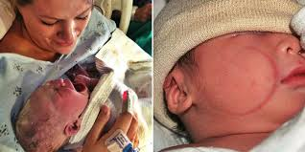

Slide 11
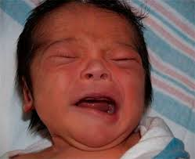

Slide 12
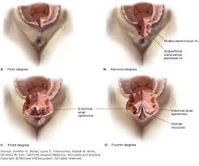

Slide 13
Trial of instrumental delivery
Should be performed in O.R. with anesthetist present + pediatrician to resuscitate.
All teams ready to proceed to C.S. in case failed instrumental delivery

Slide 14
Caesarean Section
Rate : ≈ 25%
Maternal mortality 5 – 6 per 100,000 C/S
Perinatal mortality 3/1000 USA
7/1000 U.K
C. S. Could be:
I. Elective C/S ➔ Planned and timed
II. Emergency C/S ➔ Unplanned during labor or before
the onset of labour

Slide 15
DIFFERENT METHODS OF PERFORMING DIFFERENT TYPES OF C/S
 SKIN INCISION |  UTERINE INCISION
a. Low transverse | Upper Segment (Classical) transverse vertical
b. Midline | b. Lower segment
 | - transverse
 | - vertical

Slide 16
Indication of elective c/s
1-two or more previous lower segment c/s or after previous one upper segment c/s
2- breech presentation
3-placenta previa
4- cephalo-pelvic disproportion
5-triplet or higher order multiple pregnancy
6- infections like HIV or active genital herpes,

Slide 17
Indication of emergency C/S .
Non-reassuring fetal heart . Fetal distress .
Failure of labor progress .
Antepartum hemorrhage , abruptio placenta

Slide 18
COMPLICATIONS OF UPPER SEGMENT C/S
1. Bleeding ⬆⬆
Organ injury ➔ Bowel
➔ Bladder
➔ Ureter
Adhesions formation
Rupture scar in future pregnancy higher than lower segment scar
More difficult to repair

Slide 19
COMPLICATIONS OF LOWER SEGMENT
Haemorrhage
Extension of incision ➔ lateral
➔ downwards
3. Organ injury ➔ bladder
➔ Bowel
➔ Ureter
4. Rupture scar
5. Abnormal placentation in future pregnancy
  Low lying placenta
  Accreta, increta, perceta
6. Adhesions specially bladder

Slide 20
COMMON POST OP COMPLICATIONS
Atelectasis
Infection ➔ Endometritis
➔ Wound
➔ UTI
➔ Pneumonia
3. DVT & PE

Slide 21
When can a trial of labour be offered after c.s.
VBAC can be offered for non recurrent indications e.g., fetal distress, cord prolapse, placental abruption, breech presentation.
Pelvic adequacy is confirmed by proper clinical methods as needed.
Lower Segment scar
Placental localization
Scar integrity is assured by taking proper post op history
Standard of care is to offer VBAC after one previous C/S and not multiple
Safe set up: Tertiary care center which can perform emergency C.S as needed.
Patients approval

Slide 22
Measures to reduce C.S. RATE
 Proper antenatal care
For early detection and management of conditions that lead to ⬆ C.S.
rate e.g. controlling macrosomia in diabetes early detection of HTN.
Post term ect. Performing ECV for breeches.
Prevent infections:
Prophylactic Ab + Aseptic technique
Prevention of anemia
To prevent DVT. : TEDS stocking
Thromboprophylaxis
Early ambulation

Slide 23
POST CARE
VS hourly x 4 hours
I.V. fluids
Analgesia
Checking Fundus + Lochia
Urine output + catheter care
Wound care
Early ambulation
Antibiotics
Thromboprohylaxis
Breast care and breast feeding

