Slide 1
King Saud University Medical City Department of Obstetrics & Gynecology Course 482
Polycystic Ovarian Syndrome
Dr.Reem Alanazy
OBGYN Consultant, Head of MIGS unit
Program director, Residency training program

Slide 2
Objectives
To understand the Pathogenesis of PCOS
Identify the clinical picture of PCOS
The investigations required to diagnose PCOS
The health hazards associated with PCOS
The options of management

Slide 3
Poly cystic ovarian syndrome
Primarily characterized by ovulatory dysfunction and hyperandrogenism
It is a set of symptoms due to elevated Androgens in women.
It is due to a combination of genetic and environmental factors.

Slide 4
It is the most common endocrine disorder amongst women between 18-44 years old.
It affects 2%-20% of this age group
It is one of the leading causes infertility

Slide 5
Epidemiology
In USA, prevalence is 4-12%. Up to 10% of women are diagnosed with PCO during gynecologic visits.
Some European studies reported that prevalence of 6.5-8%
In a study that assessed hirsutism in southern Chinese women, investigators found a prevalence of 10.5%

Slide 6
Pathophysiology
Women with PCOS have abnormalities in the metabolism of androgens and estrogen and in the control of androgen production.
Although the exact etiopathophysiology of PCOS is unclear!! it can result from abnormal function of the hypothalamic-pituitary-ovarian (HPO) axis.

Slide 7
The biochemical features of PCOS:
Raised androgen production such as testosterone, androstenedione, and dehydroepiandrosterone sulfate (DHEA-S) may be encountered in these patients.
However, individual variation is considerable, and a particular patient might have normal androgen levels

Slide 8
Peripheral insulin resistance and hyperinsulinemia, and obesity amplifies the degree of both abnormalities.

Slide 9
Proposed mechanism for anovulation and elevated androgen level is due to increased level of luteinizing hormone (LH) secreted by the interior pituitary gland
simulations of the ovarian theca cells
increase androgen production ( testosterone, androstenedione)
Notes:
his ovarian dysfunction is unique: it appears to be intrinsic and is characterized by abnormal ovarian steroidogenesis [13] and folliculogenesis [8] that are manifested clinically by androgen excess and anovulation.

Slide 10
Decreased level of FSH relative to LH
Lack of aromatization of androgens to estrogens
decreased estrogen levels and hence anovulation

Slide 11
PCOS is a genetically heterogeneous syndrome, however the genetic contributions remain incompletely described
Studies of family members with PCOS indicate that an autosomal dominant mode of inheritance occurs for many families with the disease.

Slide 13
Signs and symptoms
Menstrual dysfunction
Anovulation
Signs of hyperandrogenism (Hirsutism, acne, hair fall)
Infertility
Obesity and metabolic syndrome
Obstructive and sleep apnea

Slide 14
On examination, findings in women with PCOS:
Virilizing signs
Acanthosis nigricans
Hypertension
Enlarged ovaries (may or may not be present)

Slide 15
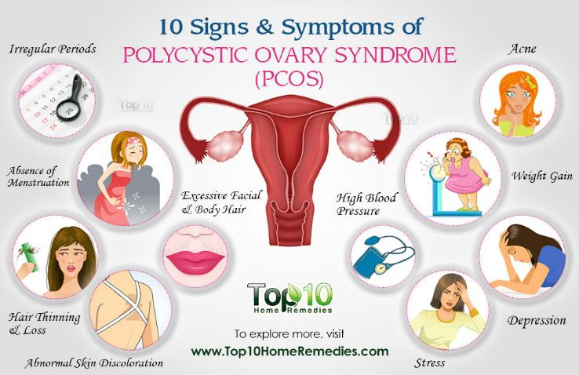

Slide 16
Polycystic ovaries are enlarged bilaterally - have smooth thickened capsule
On cut section, sub-capsular follicles in various stages of atresia are seen at the periphery with hyperplasia of theca stromal cells
On microscopic examination, luteinized theca cells are seen

Slide 18
Investigations Exclude other disorders that can result in menstrual irregularities and hyperandrogenism:
Adrenal tumors
Ovarian tumors
Thyroid dysfunction
Congenital adrenal hyperplasia
Hyperprolactinemia
Acromegaly
Cushing syndrome

Slide 19
Screening labs studies for PCOS:
Cosyntropin stimulation test

Slide 20
Thyroid function tests (TSH, free thyroxine)
Serum prolactin level
Total and free testosterone levels
Free androgen index
Serum hCG level
Serum 17-hydroxyprogesterone (17-OHPG) level
Urinary free cortisol and creatinine levels
Low-dose dexamethasone suppression test
Serum insulin-like growth factor

Slide 21
Other Test
Androstenedione level
FSH and LH levels
GnRH stimulation levels
Glucose level
Insulin level
Lipid level

Slide 22
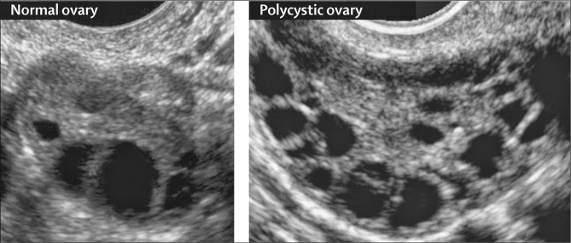
Imaging tests:
Ovarian ultrasonography, preferably using transvaginal approach
Pelvic CT scan or MRI to visualize the adrenals and ovaries

Slide 23
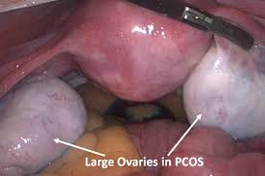
Ovarian biopsy for histologic confirmation of PCOS
Ultrasonographic diagnosis of PCOS
Endometrial biopsy to evaluate for endometrial disease (malignancy)

Slide 24
Prognosis
Approx. 40% of patients with PCOS have insulin resistance hence increased risk of type 2 diabetes and cardiovascular complications.
Increased risk for endometrial hyperplasia and carcinoma (chronic anovulation in PCOS leads to constant endometrial stimulation with estrogen without progesterone, and this increases the risk of endometrial hyperplasia and carcinoma

Slide 25
Management of PCOS
Life style modifications (first-line treatment)
Diet
Exercise
Weight loss

Slide 26
Medical management
Treat metabolic disorders (anovulation, hirsutism, and menstrual irregularities)
Menstrual irregularity:
First-line medical therapy is oral contraceptive pills induce regular menses (eg ethinyl estradiol, medroxyprogesterone)
Notes:
COCs accomplish the first two of these goals. They lower serum free testosterone levels mainly by decreasing ovarian production via suppression of serum gonadotropin levels, and the estrogenic component increases sex hormone binding globulin (SHBG) levels.
COCs can be expected to arrest progression of hirsutism, reduce the need for shaving by approximately one-half, and improve acne within three months.
he estrogen-progestin combination suppresses the hypothalamic-pituitary-ovarian axis and reduces excess androgen production by the ovary, which improves menstrual regularity and decreases anovulatory uterine bleeding, hirsutism, and acne. The progestin component also inhibits endometrial proliferation, preventing hyperplasia and the associated risk of carcinoma. COCs are packaged such that the active ingredients are ordinarily taken once daily for 21 successive days, and withdrawal bleeding is expected during the following week when inert ingredients are taken as a spacer. COCs regulate menstrual periods with a higher degree of reliability than other forms of treatment. Endocrine Society guidelines suggest COCs as first-line pharmacologic therapy of menstrual irregularity

Slide 27
Hyperandrogenism ( hirsutism and Acne vulgaris) :
Reducing androgen production
Reducing serum free androgen levels by increasing androgen binding to plasma-binding proteins
Blocking androgen action at the level of target organs (eg, hair follicle)
Androgen blocking agent (eg spironolactone, leuprolide, finasteride)

Slide 28
Clomiphene citrate or letrozole (selective estrogen receptor modulators) - for ovulation induction, first-line treatment
Hypoglycemic agents (metformin, insulin)

Slide 29
Topical hair-removal agents (eg eflornithine)
Topical acne agents (eg benzoyl peroxide, tretinoin topical cream (0.02-0.1%)/gel (0.01-0.1%)/solution (0.05%))

Slide 30
Surgical management
aim to restore ovulation
Laparoscopically:
Electrocautery
Laser drilling
Multiple biopsy

