Slide 1
HISTORY TAKING & PHYSICAL EXAMINATION OB/GYN Dr. Ghadeer alShaikh Professor

Slide 2
OBSTETRIC HISTORY
General information
History of current pregnancy
Past Obstetric history
Gynecological history
Enquiry about other systems:
Past medical and surgical history
Psychiatric history
Family history
Social history
Drug history
Allergies
Summary

Slide 3
OBSTETRIC HISTORY
General information
Name
Age
Presenting complaint (patients words not medical words)or reason for attending.

Slide 4
History of current pregnancy
Gravidity
The total numbers of pregnancies regardless of how they ended.
Parity
number of live births at any gestation or stillbirths after 24 weeks of gestation
Gestation (GA)
LMP (last menstrual peroid)
EDD “Expected date of delivery” (Naegele’s rule)
 Add 7 days to the first day of LMP , subtract 3 months , add one year
 Example : LMP 27 /8/2014
 EDD : 3/6/2015

Slide 5
Dates as calculated from ultrasound
Single /multiple (chorionicity)
Detailed of presenting problem
Have there been any other problems in this pregnancy ?
Has there been any bleeding , contractions or loss of fluid vaginally ?

Slide 6
Past Obstetric history :
List the previous pregnancies and their outcomes in order
Gynecological history :
Periods: regularity
Contraceptive history
Previous infections and their treatment
When was the last cervical smear? Was it normal? Have there ever been any that were abnormal? If yes, what treatment has been undertaken ?
Previous gynecological surgery ?

Slide 7
Past medical and surgical history:
Relavant medical problems
Any previuos operations; type of anesthetic used, any complications
Psychiatric history :
Post partum blues or depression
Depression unrelated to pregnancy
Major psychiatric illness .

Slide 8
Family history :
Diabetes ,hypertension, thromboembolic disease , genetic problems, psychiatric problems …
Social history:
Smoking, illegal drug used
Marital status
Occupation
Drug history
Allergies
Summary

Slide 9
Obstetrics PHYSICAL EXAMination
General examination
Abdominal examination
Lower limb examination
Pelvic examination

Slide 10
Obstetrics PHYSICAL EXAMination
General exam
Weight
Height
BMI  (weight (kg) /Height (m²)
Vital signs (blood pressure , pulse , respiratory rate , temperature )
Cardiovascular examination (routine auscultation for maternal heart sounds in asymptomatic women with no cardiac history is unnecessary).
Breast examination (Formal breast examination is not necessary, self examination is as reliable as a general physician examination in detecting breast masses.)
Notes:
v

Slide 11
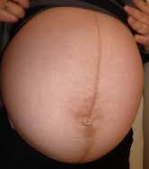
Abdominal exam
Ask about areas of tenderness before start the examination.
Inspection
Assess shape of the uterus
Note any asymmetry
Look for fetal movement
Look for surgical scars
cutaneous signs of pregnancy linea nigra, striae gravidarum, striae albicans, umbilicus flat or everted, superficial veins

Slide 12
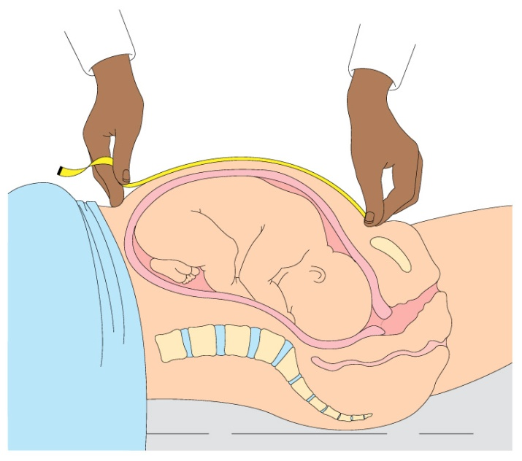
Abdominal exam
Palpation
Uterine size symphysis fundal height in cm = GA in wks
-at 12-14 wks just palpable
-20-22 wks at the umbilicus

Slide 13
Abdominal exam
LEOPOLD maneuvers
The first maneuver (fundal grip): involves palpating the fundus to determine which part of the fetus occupies the fundus
The second maneuver(Lateral grip): involves palpating the either side of the abdomen to determine on which side the fetal back lies.
The third maneuver (Pawlick’s grip) : involves grasping the presenting part between the thumb and third finger just above the pubic symphysis to determine what fetal part is lying above the pelvic inlet or lower abdomen.
The fourth maneuver(Pelvic grip): involves palpating for the brow and the occiput of the fetus determine the fetal position when the fetus is in a vertex presentation.

Slide 14
Fetal lie, presentation and engagement
Lie of the fetus longitudinal axis of the uterus to the longitudinal axis of the fetus(e.g longitudinal, transverse, oblique ).
Presentation the part of the fetus that overlays the pelvic brim (e.g, vertex, breech, shoulder)
Engagement : occurred when the widest part of the presenting part has passed successfully through the pelvic inlet.

Slide 15
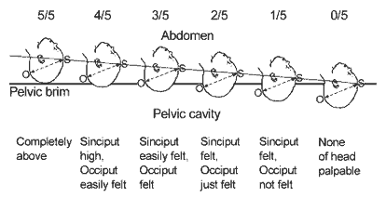
Descent of the fetal head
Assessed abdominally
Using the rule of fifth to assess the engagement
$→$Assess how much of the head
is still felt per abdomen
When only 2/5 or less of the fetal head palpated above the level of symphysis pubis, this implies the head is engaged.
→The vertex has passed or is at the
level of ischial spines

Slide 16
Abdominal exam
Ascultation
Listening for the fetal heart beat.

Slide 17
Lower limbs examination
Swelling (edema)
Varicosities

Slide 18
Pelvic examination
Routine pelvic examination is not necessary.
Circumstances in which a vaginal examination is necessary (in most cases a speculum examination is all that is needed), these include :
Excessive or offensive discharge
Vaginal bleeding ( in the known absence of a placenta previa).
To perform a cervical screen
To confirm potential rupture of membrane

Slide 19
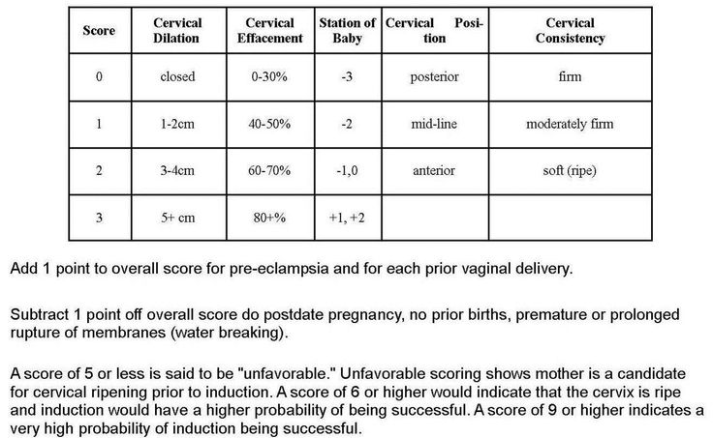
Pelvic examination
A digital examination may be performed:
when an assessment of the cervix is required . This can provide information about the consistency and effacement of the cervix that is not obtainable from a speculum examination (Modified Bishop score).

Slide 20
Pelvic examination
The contraindication to digital examination are :
Known placenta previa or vaginal bleeding when the placental site is unknown and the presenting part unengaged
Prelabor rupture of the membranes (increased risk of ascending infection).

Slide 21
GYNECOLOGIC HISTORY
General information
History of present complaint (e.g,pelvic pain, vaginal discharge).
Menstrual history
Previous gynecological history
Previous obstetrics history
Enquiry about other systems
Past medical and surgical history
Psychiatric history
Family history
Social history
Drug history
Allergies
Summary

Slide 22
GYNECOLOGIC HISTORY
General information
Name
age
Main complaints
History of present complaint
The detailed questions relating to each complaint.

Slide 23
GYNECOLOGIC HISTORY
Pelvic pain
Site of pain , its nature and severity
Any thing that aggravates or relieves the pain-specifically enquire about relationship to menstrual cycle and intercourse
Does the pain radiate anywhere or is it associated with bowel or bladder function

Slide 24
Vaginal discharge
Amount, colour, odour, presence of blood
Relationship to menstrual cycle
Any history of sexually transmitted disease or recent tests
Any vaginal dryness

Slide 25
GYNECOLOGIC HISTORY
Menstrual history:
Age of menarche
Usual duration of each period and length of cycle
First day of the last period
Pattern of the bleeding : regular or irregular and length of the cycle
Amount of blood loss : more or less than usual, number of sanitary towels or tampons used , passage of clots or flooding
Any intermenstrual or postcoital bleeding
Any pain relating to the period, its severity and timing of onset
Any medication taken during the period

Slide 26
Previous gynecological history :
Previous treatment and surgery
Date of the last cervical smear and any previous abnormalities
Sexual active , difficulties or pain during intercourse
The type of contraception used and any problem with it
Menopause:(Date of last period ,any post menopausal bleeding ,any menopausal symptoms)

Slide 27
GYNECOLOGIC HISTORY
Previous obstetrics history
Outcome & details of previous pregnancies
Enquiry about other systems:
(e.g,Appetite, weight loss/gain, bowel function, bladder function)
Past medical & surgical history
Psychiatric history
Family history
Social history
Drug history
Allergies
Summary

Slide 28
GYNECOLOGIC PHYSICAL EXAMINATION
General examination
Abdominal examination
Pelvic examination
Rectal examination

Slide 29
GYNECOLOGIC PHYSICAL EXAMINATION
General exam :
Height
Weight , BMI
Vital signs
Hands , mucous membrane
Supraclavicular area
Thyroid
Chest (CVS ,Respiratory)
Breast

Slide 30
Abdominal exam
1-Inspection
distension  masses
surgical scars
 hernia
2-Palpation
guarding ,
tenderness,
masses
3-Percussion :
useful if free fluid is suspected
4-Auscultation:
not specifically useful for the gynecological examination
, in case of acute abdomen with bowel obstruction or postoperative patient with ileus (listening of bowel sounds)

Slide 31
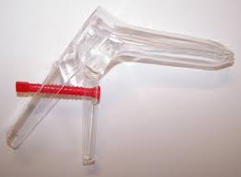
Pelvic examination
Inspection:
External genitalia and surrounding skin
Speculum (bivalve , Or Cusco )

Slide 32
Bimanual examination
Rectal examination:
Used as alternative to a vaginal examination in children and in adults who are not sexually active.

Slide 33
Thank You

