Slide 1
GTD OSCE
Dr Khalid Akkour MD FRCSC
Assistant professor & consultant
Gynecologic Onclogy
college of medicine
King Saud University

Slide 2
A 33yo G2P0 at 10 weeks GA comes to ER with heavy PV bleeding.

Slide 3
1. What are the key elements to ask the patient on history?

Slide 4
Answer :
Identifying data
◻ Age, ethnicity
◻ GPA status
HPI
◻ Bleeding
o How much ( and presence of clots)
o Onset and duration
o Passage of tissue (appearance)
o Instigating event (IC, TVUS, vag exam)
o Associated pain
o Symptoms of anemia (light-headedness, syncope)
◻ Current pregnancy
o How it was confirmed
o Previous bhcg
o Previous u/s
◻ Associated Symptoms
o Headache
o Nausea / vomiting
o Epigastric pain / shoulder tip pain
o Dyspnea / CP
o Fever

Slide 5
ROS (Review of Systems)
◻ Neurological symptoms (including lethargy, coma)
◻ GI
◻ GU
POBHx
◻ Details of previous pregnancy
◻ previous SAB, previous moles, previous ectopic
PGynHx
◻ LNMP, regularity
◻ Pap history
◻ STIs/PID
◻ IUD use
◻ Contraception use
PMHx/PSHx
◻ Medical
◻ Any abdominal/pelvic/tubal surgeries
FHx
Meds/All
◻ Folic acid (0.4-1mg)
◻ ?exposure to teratogens
Soc Hx
◻ Smoke/EtOH/drugs

Slide 6
2. What are the most important components of a physical exam:

Slide 7
Answer:
◻ ABCs, vitals
◻ Weight/Height
◻ HEENT: anemia, goiter / thyroid enlargement/nodules
◻ CVS/Resp
◻ Abdo – inspection (previous scars), size of uterus, tenderness, peritoneal signs, ascites
◻ Pelvic – speculum (to assess bleeding, tissue), V/E to determine cervical dilatation & tenderness
o Black / purple papules or nodules in vagina, cervix
o Tissue in the cervix and appearance
o Cervical cultures

Slide 8
3. What investigations do you order:

Slide 9
Answer:
◻ BHCG
◻ CBC
◻ Coagulation profile
◻ Type and screen
◻ If suspect ectopic add LFTs, Renal function tests
◻ Pelvic ultrasound

Slide 10
4. What is your differential diagnosis of 1st T bleeding?

Slide 11
Answer:
PREGNANCY
◻ Normal pregnancy (implantation bleed)
◻ SA (threatened, inevitable, missed)
◻ Ectopic pregnancy
◻ Molar pregnancy
◻ GTN
Invasive mole
Placenta site trophoblastic tumor
Gestational choriocarcinoma
◻ Cervical polyps
◻ Cervical cancer
◻ Cervicitis (infection)
◻ Vaginal trauma/infections
◻ Fibroids
◻ Bladder / urothelial tumors

Slide 12
Your patient is stable. Her BHCG is 175,000. Her U/S shows the following:

Slide 13
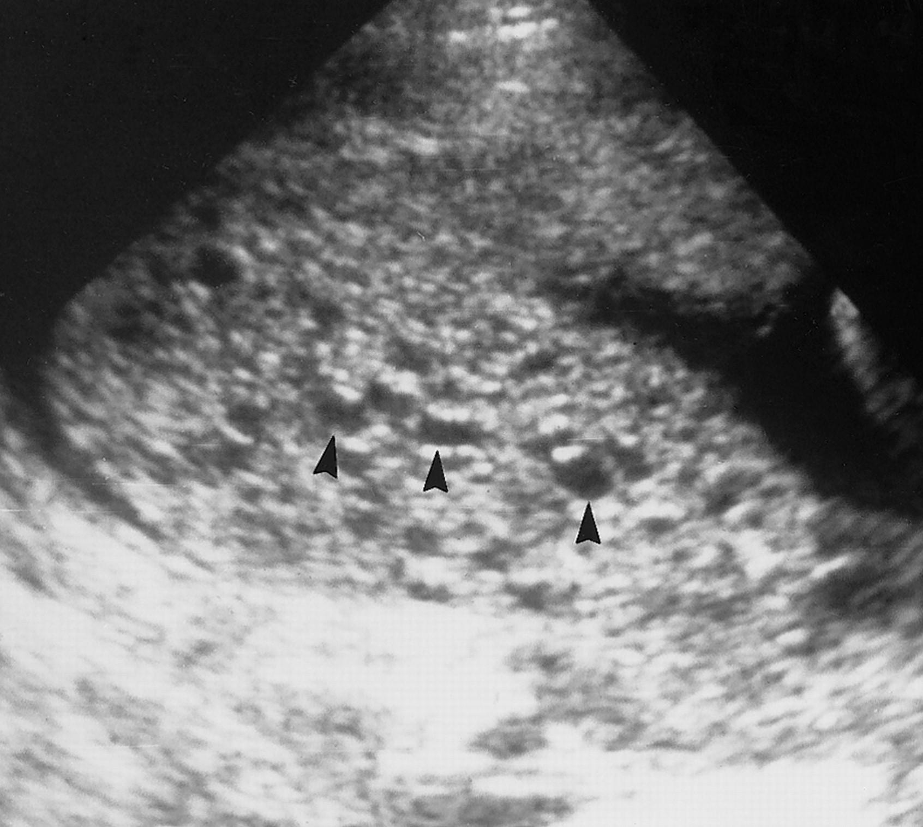
An intrauterine pregnancy with a characteristic snowstorm or vesicular pattern and no identifiable fetal parts.

Slide 15
Partial mole

Slide 16
How good uss in diagnosing molar pregnancy ?

Slide 17
At what gestational age diagnosis of molar pregnancy is made ?

Slide 18
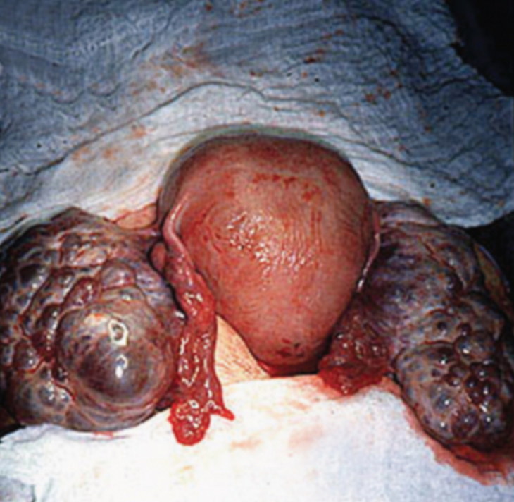
What is this ?

Slide 19
Theca lutein cysts

Slide 20
Complete mole

Slide 21
Complete mole

Slide 22
Complete mole

Slide 23
Partial mole

Slide 24
Partial mole

Slide 25
Partial mole

Slide 26
5. What is your Diagnosis?

Slide 27
GTD VS GTN

Slide 28
Answer:
Complete molar pregnancy

Slide 29
How does molar pregnancy develop?

Slide 30
6. After explaining to the patient that you suspect a complete molar pregnancy. What orders do you write?

Slide 31
Answer:
◻ Admit to GYNE
◻ NPO (for OR)
◻ AAT
◻ VS frequently (depending on blood loss)
◻ IV NS at 125cc/hour + IV Bolus
◻ CBC, G&S, BHCG (already done)
◻ Cross match 2 units (consider)
◻ Rhogam (if indicated)
◻ CXR

Slide 32
7. What are the risk factors for complete molar pregnancy?

Slide 33
Answer:
◻ Previous GTD
◻ Maternal age (upper and lower extremes)
◻ Ethnicity (higher incidence in Asia)
◻ Dietary factors (Vit. A deficiency, low intake of carotene) for complete mole only

Slide 34
8. What are clinical features associated with a complete molar pregnancy:

Slide 35
Answer:
◻ Vaginal bleeding (most common symptoms - 97%)
◻ Excessive uterine size (classic sign but present in only 28% of patients)
◻ Preeclampsia (rare, molar pregnancy should always be considered with PIH occurs early in pregnancy)
◻ Hyperemesis Gravidarum (8%)
◻ Theca Lutein Ovarian cysts (prominent cysts (>6cm) in 50%)
Will usually regress 2-4 months after evacuation
◻ Hyperthyroid (rare)
If hyperthyroid, anesthesia may precipitate thyroid storm (so give B-blockers)
◻ Trophoblastic embolization (extremely rare)
Leads to respiratory distress, resolves within 72 hours of evacuation
Differential should include tyroid storm, preeclampsia, fluid overload

Slide 36
9. What treatment do you recommend?

Slide 37
Answer:
◻ Evacuation of molar pregnancy via suction d&c

Slide 38
10. Are there any other possible treatments?

Slide 39
Answer:
◻ Hysterectomy – if patient desires surgical sterilization
Can be done with mole in situ
Ovaries can be preserved, TL cysts can be decompressed
Mets are still possible so BHCG must be followed

Slide 40
11. The patient decides to proceed with suction D&C. What are the risks that you explain to her?

Slide 41
Answer:
◻ Risks of anesthesia
◻ Risk of surgery
o Bleeding – blood transfusions, hyst
o Infection
o Perforation with damage to intraperitoneal structures, risk of requiring l/s or l/p to repair damage.

Slide 42
12. Describe how the procedure is done.

Slide 43
Answer:
◻ Cervical dilatation (do not give prostaglandins pre-op)
◻ Suction curettage – use large bore suction device (ie. 12mm)
Can do under ultrasound guidance.
◻ Oxytocin infusion
◻ Sharp curettage
◻ Massage fundus

Slide 44
13. There is persistent bleeding during the surgery after evacuation is completed. What is your approach?

Slide 45
Answer:
◻ Increase oxytocin infusion
◻ Massage fundus/Bimanual compression
◻ Uterotonics (ergot, misoprostol, hemabate)
◻ Uterine artery embolization
◻ Uterine artery/Hypogastric artery ligation
◻ Hysterectomy

Slide 46
14.What f/u do you recommend and what are important counseling points? (assuming this is a complete mole).

Slide 47
Answer:
◻ f/u BhCG
o q weekly until 0 for 3 consecutive weeks
o then q monthly x 6
◻ “regular pelvic examinations”
◻ CXR if BhCG rises
◻ Contraception x 6 months – OCP, depot-provera or barrier methods (not IUD)
◻ risk of malignant sequelae (complete = 1-5%, partial = <1%).

Slide 48
14.The pathology report is back. What are 3 pathologic features of a complete mole?

Slide 49
Answer:
Complete Partial
*Fetal and embryonic tissue NO YES
*Hydropic chorionic villi diffuse focal
*Trophoblastic hyperplasia diffuse focal
Scalloping of chorionic villi NO YES
Trophoblastic stromal inclusions NO YES

Slide 50
16. What is the most likely karyotype?

Slide 51
Answer:
◻ 46XX (90%)
◻ 46XY (10%)
◻ 46XX is most likely from an empty ovum fertilized by a haploid sperm which them duplicates its own chromosomes, other possibility is two sperm fertilize one empty ovum

Slide 52
17. What is the possible karyotypes of a partial mole?

Slide 53
Answer:
◻ 69XXY (64%)
◻ 69XXX (33%)
◻ 69XYY (3%)
Diandric vs digynic triploidy

Slide 54
18. What are the 6 indications for therapy after evacuation of a mole?

Slide 55
Answer:
◻ Presence of metastases
◻ Histologic diagnosis of choriocarcinoma or placental site trophoblastic tumor
◻ An abnormal hCG regression pattern (>10% rise in hCG levels or a plateauing hCG of 3 stable values over 2 weeks)
◻ High hCG level at 4 weeks post-evacuation (>20,000 mIU/mL)
◻ An hCG rebound
◻ Persistently elevated hCG levels six months post-evacuation
*average time to normalization of BHCG: complete mole = 3 months and partial mole = 2 months

Slide 56
19. A complete mole is confirmed on pathology. What is the chance she is having metastasis?

Slide 57
Answer:
◻ 4%

Slide 58
20. Where are the most common sites of metastasis?

Slide 59
Answer
◻ Lung (80%)
◻ Vagina (30%)
◻ Pelvis (20%)
◻ Liver (10%)
◻ Brain (10%)

Slide 60
Staging

Slide 61
21. Your patient’s HCG has an abnormal regression pattern (has hit a plateau for 3 values). You diagnose her with persistent GTN. What do you do next?

Slide 62
Answer:
◻ Refer to Gyne Onc
◻ Complete history & physical (including careful exam of the vagina)
◻ Blood work
hCG
LFTs, TSH, RFTs
CBC (to get baseline before chemo)
◻ Imaging
Chest - CXR or chest CT
Pelvis and Abdomen – u/s or CT
Head – CT or MRI
◻ Other investigations
+/- LP for CSF analysis (plasma: CSF hCG levels >1:60 – more sensitive for cerebral mets)
* when the pelvic exam and CXR are negative, metastatic involvement of other sites is uncommon

Slide 63
22. What are the possible histology of persistent GTN? What is her likely histology?

Slide 64
Answer
GTN after molar pregnancy
Invasive mole (75%)
Choriocarcinoma (25%)
PSTT (rare)
GTN after nonmolar pregnancy (SA, ectopic, preterm or term)
Choriocarcinoma
PSTT (rare)

Slide 65
23. You are going to score her using the WHO scoring system. What 8 factors contribute to this score?

Slide 67
24. Your patient’s score is 3? She has non-metastatic disease. What risk category is she in? How will you treat?

Slide 68
Answer
Low risk (≤ 6), High risk (>7)
Options for treatment
Single agent chemo
Methotrexate (+/- FA rescue) or dactinomycin regime
Hysterectomy + single agent course of chemo (only if nonmetastatic disease)

Slide 69
25. How should the patient be followed?

Slide 70
Answer
hCG
weekly until 0 x 3 consecutive weeks
then monthly x 12 months (in high-risk disease follow for 24 months)
effective contraception

Slide 71
26. What is the chance that the initial regime will be effective?

Slide 72
Answer
85-90%
If hcg plateaus or toxic s/e can change to another single agent
If hcg rises or development of mets should change to combo therapy.

Slide 73
27. What is the treatment for high-risk patients (WHO Score 7 or greater)?

Slide 74
Answer
EMA-CO +/- surgery +/- radiation
(Etoposide, Methotrexate, Adriamycin, Cyclophosphamide, Oncovin (vincristine))

Slide 75
28. What is the recurrence risk of a molar pregnancy?

Slide 76
Answer
1% (baseline risk = 0.1% in North America)
After 2 molar pregnancy = recurrence 23%
She will need an early ultrasound in the next pregnancy to r/o recurrence

