Slide 1
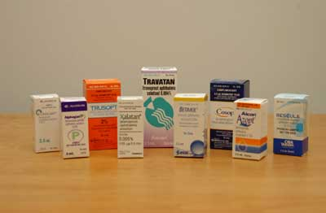
Ocular pharmacology and toxicology
Abdullah Al-Mousa, MD
Assistant Professor, Vitreo-Retinal Surgery
Department of Ophthalmology
College of Medicine
King Saud University

Slide 2
General Pharmacological Principles

Slide 3
The study of ocular pharmacology begins with a review of some general principles of pharmacology, with particular attention to special features of eye.

Slide 4
Pharmaco-dynamics
It is the biological and therapeutic effect of the drug (mechanism of action)
Most drugs act by binding to regulatory macromolecules, usually neurotransmitters or hormone receptors or enzymes
If the drug is working at the receptor level, it can be agonist or antagonist
If the drug is working at the enzyme level, it can be activator or inhibitor

Slide 5
Pharmaco-kinetics
To achieve a therapeutic effect, a drug must reach its site of action in sufficient concentration.
It is the absorption, distribution, metabolism, and excretion of the drug

Slide 6
The concentration at site of action is a function of the following:
Amount administered
Extent and rate of absorption at administration site
Distribution and binding in tissues
Transport between compartments
Biotransformation
Excretions

Slide 7
A drug can be delivered to ocular tissue as:
Locally:
Eye drop
Ointment
Periocular injection
Intraocular injection
Systemically:
Orally
IV

Slide 8
Factors Influencing Local Drug Penetration into Ocular Tissue
Drug concentration and solubility: the higher the concentration the better the penetration e.g pilocarpine 1-4% but limited by reflex tearing
Viscosity: addition of methylcellulose and polyvinyl alcohol increases drug penetration by increasing the contact time with the cornea and altering corneal epithelium
Lipid solubility: because of the lipid rich environment of the epithelial cell membranes, the higher lipid solubility the more the penetration.

Slide 9
Factors Influencing Local Drug Penetration into Ocular Tissue
Surfactants: the preservatives used in ocular preparations alter cell membrane in the cornea and increase drug permeability e.g. benzylkonium and thiomersal
pH: the normal tear pH is 7.4 and if the drug pH is much different, this will cause reflex tearing

Slide 10
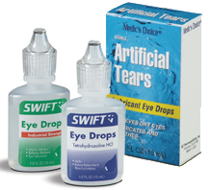
Eye drops
Eye drops- most common
one drop = 50 µl
volume of conjunctival cul-de-sac = 10 µl
20% of administrated drug is retained
Rapid turnover of tears occurs:
50% remains after 4 minutes & only 17% after 10 minutes of the drug that reached the tear reservoir.

Slide 11
Measures to increase drop absorption:
-wait 5-10 minutes between drops
-compress lacrimal sac
-keep lids closed for 5 minutes after instillation

Slide 12
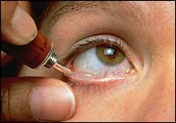
Ointments
Increase the contact time of ocular medication to ocular surface thus better effect
It has the disadvantage of vision blurring
The drug has to be high lipid soluble with some water solubility to have the maximum effect as ointment

Slide 13
Peri-ocular injections
They reach behind iris-lens diaphragm better than topical application
E.g. subconjunctival, subtenon, peribulbar, or retrobulbar
This route bypass the conjunctival and corneal epithelium which is good for drugs with low lipid solubility (e.g. penicillin)
Also steroid and local anesthetics can be applied this way

Slide 14
Intraocular injections
Intracameral or intravitreal:
Intracameral acetylcholine (miochol) during cataract surgery
Intravitreal antibiotics in cases of endophthalmitis
Intravitreal steroids in macular edema
Intravitreal Anti-VEGF for DR

Slide 15
Sustained-release devices
These are devices that deliver an adequate supply of medication at a steady-state level
E.g.
Ozerdex sustained release dexamethasone
Timoptic XE delivering timolol
Ganciclovir sustained-release intraocular device
Collagen shields

Slide 16
Systemic drugs
Oral or IV
Factor influencing systemic drug penetration into ocular tissue:
lipid solubility of the drug: more penetration with high lipid solubility
Protein binding: more effect with low protein binding
Eye inflammation: more penetration with ocular inflammation

Slide 17
Ocular Pharmaco-therapeutics

Slide 18
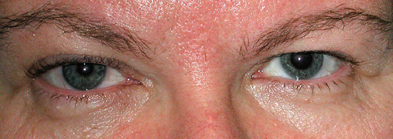
Cholinergic agonists
Directly acting agonists:
E.g. pilocarpine, acetylcholine (miochol), carbachol (miostat)
Uses: miosis, glaucoma
Mechanisms:
Miosis by contraction of the iris sphincter muscle
increases aqueous outflow through the trabecular meshwork by longitudinal ciliary muscle contraction
Accommodation by circular ciliary muscle contraction
Side effects:
Local: diminished vision (myopia), headache, cataract, miotic cysts, and rarely retinal detachment
systemic side effects: lacrimation, salivation, perspiration, bronchial spasm, urinary urgency, nausea, vomiting, and diarrhea

Slide 19
Cholinergic agonists
Indirectly acting (anti-cholinesterases) :
More potent with longer duration of action
Reversible inhibitors
e.g. physostigmine
used in glaucoma and lice infestation of lashes
can cause CNS side effects

Slide 20
Cholinergic agonists
Indirectly acting (anticholinesterases):
Irreversible:
e.g. phospholine iodide
Uses: in accommodative esotropia
side effects: iris cyst and anterior subcapsular cataract
C/I in angle closure glaucoma, asthma, Parkinsonism
causes apnea if used with succinylcholine or procaine

Slide 21
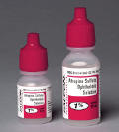
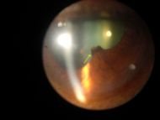
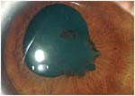
Cholinergic antagonists
E.g. tropicamide, cyclopentolate, homatropine, scopolamine, atropine
Cause mydriasis (by paralyzing the sphincter muscle) with cycloplegia (by paralyzing the ciliary muscle)
Uses: fundoscopy, cycloplegic refraction, anterior uveitis
Side effects:
local: allergic reaction, blurred vision
Systemic: nausea, vomiting, pallor, vasomotor collapse, constipation, urinary retention, and confusion
specially in children they might cause flushing, fever, tachycardia, or delerium
Treatment by DC or physostigmine

Slide 22
Adrenergic agonists
Non-selective agonists
(α₁, α₂, β₁, β₂)
E.g. epinephrine, depevefrin
(pro-drug of epinephrine)
Uses: glaucoma
Side effects: headache, arrhythmia, increased blood pressure, conjunctival adrenochrome, cystoid macular edema in aphakic eyes
C/I in closed angle glaucoma

Slide 23
Adrenergic Agonists
Alpha-1 agonists
E.g. phenylepherine
Uses: mydriasis (without cycloplegia), decongestant
Adverse effect:
Can cause significant increase in blood pressure specially in infant and susceptible adults
Rebound congestion
precipitation of acute angle-closure glaucoma in patients with narrow angles

Slide 24
Adrenergic agonists
Alpha-2 agonists
E.g. brimonidine, apraclonidine
Uses: glaucoma treatment, prophylaxis against IOP spiking after glaucoma laser procedures
Mechanism: decrease aqueous production, and increase uveoscleral outflow
Side effects:
local: allergic reaction, mydriasis, lid retraction, conjunctival blanching
systemic: oral dryness, headache, fatigue, drowsiness, orthostatic hypotension, vasovagal attacks
Contraindications: infants, MAO inhibitors users

Slide 25
Beta-adrenergic blockers
E.g.
non-selective: timolol, levobunolol
selective: betaxolol (beta 1 “cardioselective”)
Uses: glaucoma
Mechanism: reduce the formation of aqueous humor by the ciliary body
Side effects: bronchospasm (less with betaxolol), cardiac impairment

Slide 26
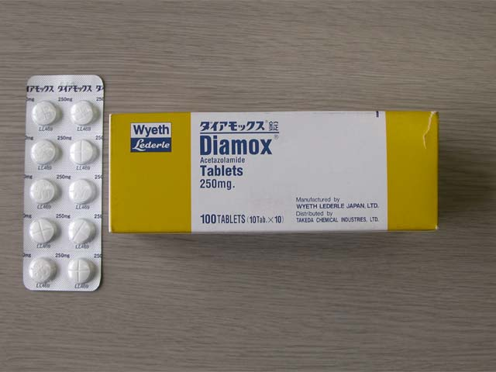
Carbonic Anhydrase Inhibitors
E.g. acetazolamide, methazolamide, dorzolamide, brinzolamide.
Uses: glaucoma, cystoid macular edema, pseudo-tumour cerebri
Mechanism: aqueous suppression
Side effects: myopia, parasthesia, anorexia, GI upset, headache, altered taste and smell, Na and K depletion, metabolic acidosis, renal stone, bone marrow suppression “aplastic anemia”
Contraindication: sulpha allergy, digitalis users, pregnancy

Slide 27
Osmotic agents
Dehydrate vitreous body which reduce IOP significantly
E.G.
Glycerol 50% syrup (cause nausea, hyperglycemia)
Mannitol 20% IV (cause fluid overload and not used in heart failure)

Slide 28
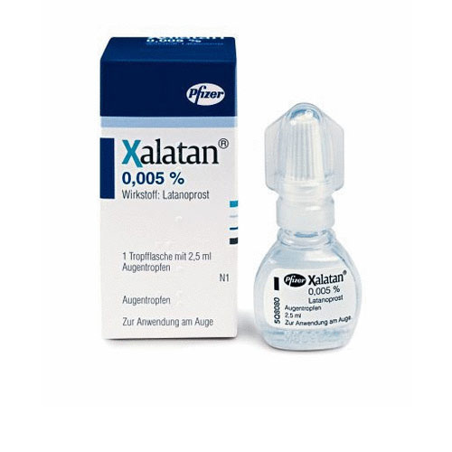
Prostaglandin Analogues
E.g. latanoprost, bimatoprost, travoprost
Uses: glaucoma
Mechanism: increase uveoscleral aqueous outflow
Side effects: darkening of the iris (heterochromia iridis), lengthening and thickening of eyelashes, intraocular inflammation, macular edema

Slide 29
Anti-inflammatory
Corticosteroid
NSAID

Slide 31
Corticosteroids
Topical
E.g. fluorometholone, prednisolone, dexamethasone, hydrocortisone
Mechanism: inhibition of arachidonic acid release from phospholipids by inhibiting phospholipase A2
Uses: postoperatively, anterior uveitis, severe allergic conjunctivitis, vernal keratoconjunctivitis, prevention and suppression of corneal graft rejection, episcleritis, scleritis
Side effects: susceptibility to infections, glaucoma, cataract, scleral melting, skin atrophy

Slide 32
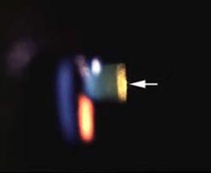
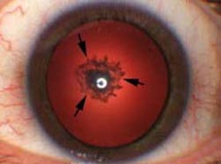
Corticosteroids
Systemic:
E.g. prednisolone, methylprednisolone
Uses: posterior uveitis, optic neuritis, temporal arteritis with anterior ischemic optic neuropathy
Side effects:
Local: posterior subcapsular cataract, glaucoma, central serous retinopathy
Systemic: suppression of pituitary-adrenal axis, hyperglycemia, osteoporosis, peptic ulcer, psychosis

Slide 33
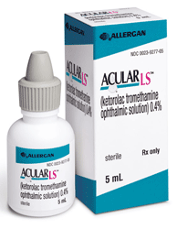
NSAIDs
E.g. ketorolac, diclofenac, nepafenac
Mechanism: inactivation of cyclo-oxygenase
Uses: post-operatively, episcleritis/scleritis, mild uveitis, cystoid macular edema, preoperatively to prevent miosis during surgery
Side effects: stinging and burning. Rarely: corneal erosion or melting

Slide 34
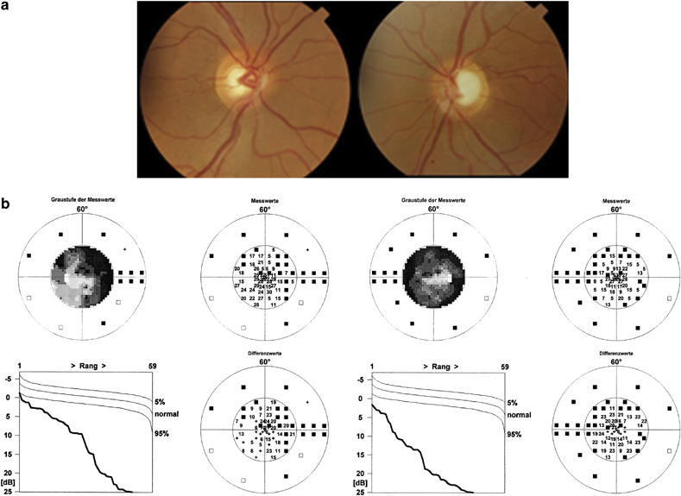
Anti-allergy
Avoidance of allergens, cold compress, lubrications
Antihistamines (e.g.pheniramine, levocabastine)
Decongestants (e.g. naphazoline, phenylepherine, tetrahydrozaline)
Mast cell stabilizers (e.g. cromolyn, nedocromil, olopatadine)
NSAID (e.g. ketorolac)
Steroids (e.g. fluorometholone, prednisolone)
Drug combinations

Slide 35
Antibiotics
Penicillins
Cephalosporins
Sulfonamides
Tetracyclines
Chloramphenicol
Aminoglycosides
Fluoroquinolones
Vancomycin
Macrolides

Slide 36
Antibiotics
Used topically in prophylaxis (pre and postoperatively) and treatment of ocular bacterial infections.
Used orally for the treatment of preseptal cellulitis
e.g. amoxycillin with clavulonate, cefaclor
Used intravenously for the treatment of orbital cellulitis
e.g. gentamicin, cephalosporin, vancomycin, flagyl
Can be injected intravitrally for the treatment of endophthalmitis

Slide 37
Antibiotics
Trachoma can be treated by topical and systemic tetracycline or erythromycin, or systemic azithromycin.
Bacterial keratitis (bacterial corneal ulcers) can be treated by topical fortified penicillins, cephalosporins, aminoglycosides, vancomycin or fluoroquinolones.
Bacterial conjunctivitis is usually self limited but topical erythromycin, aminoglycosides, fluoroquinolones, or chloramphenicol can be used

Slide 38
Antifungals
Uses: fungal keratitis, fungal endophthalmitis
Polyenes
damage cell membrane of susceptible fungi
e.g. amphotericin B, natamycin
side effect: nephrotoxicity
Imidazoles
increase fungal cell membrane permeability
e.g. miconazole, ketoconazole
Flucytocine
act by inhibiting DNA synthesis

Slide 39
Antivirals
Acyclovir
Interact with viral thymidine kinase (selective)
Used in herpetic keratitis
Trifluridine
More corneal penetration
Can treat herpetic iritis
Ganciclovir
Used intravenously for CMV retinitis

Slide 40
Ocular diagnostic drugs
Fluorescein dye
Available as drops or strips
Uses: stain corneal abrasions, applanation tonometry, detecting wound leak, NLD obstruction, fluorescein angiography
Caution:
stains soft contact lens
Fluorescein drops can be contaminated by Pseudomonas sp.

Slide 41
Ocular diagnostic drugs
Rose bengal stain
Stains devitalized epithelium
Uses: severe dry eye, herpetic keratitis

Slide 42
Local Anesthetics
Topical
E.g. propacaine, tetracaine
Uses: applanation tonometry, goniscopy, removal of corneal foreign bodies, removal of sutures, examination of patients who cannot open eyes because of pain
Adverse effects: toxic to corneal epithelium, allergic reaction rarely

Slide 43
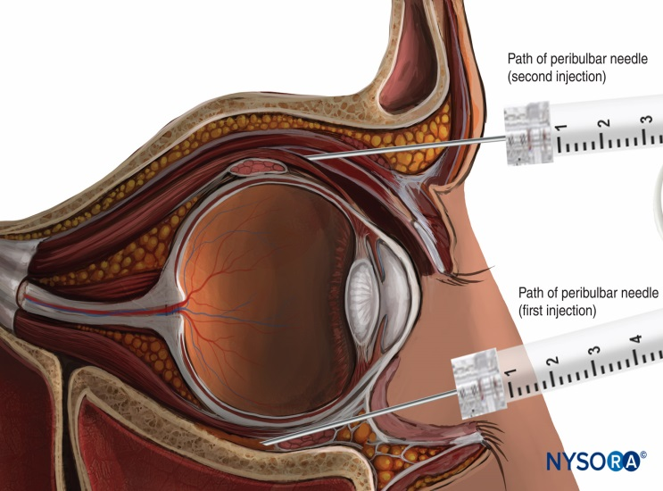
Local Anesthetics
Orbital infiltration
peribulbar or retrobulbar
cause anesthesia and akinesia for intraocular surgery
e.g. lidocaine, bupivacaine

Slide 44
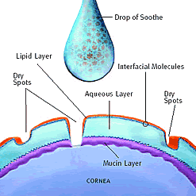
Other Ocular Preparations
Lubricants
drops or ointments
Polyvinyl alcohol, methylcellulose or hyaluronic acid
Preserved or preservative free

Slide 45
Ocular Toxicology

Slide 46
Complications of Topical Administration
Mechanical injury from the bottle e.g. corneal abrasion
Pigmentation: epinephrine-adrenochrome
Ocular damage: e.g. topical anesthetics, benzalkonium preservative
Hypersensitivity: e.g. atropine, neomycin, gentamicin
Systemic effect: topical phenylephrine can increase BP

Slide 47
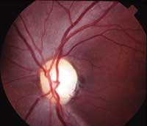
Amiodarone
A cardiac arrhythmia drug
Causes optic neuropathy (mild decreased vision, visual field defects, bilateral optic disc swelling)
Also causes corneal vortex keratopathy (corneal verticillata) which is whorl-shaped pigmented deposits in the corneal epithelium

Slide 48
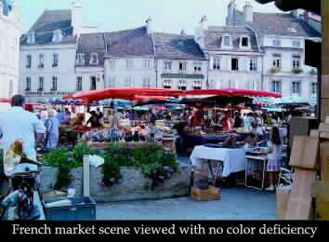
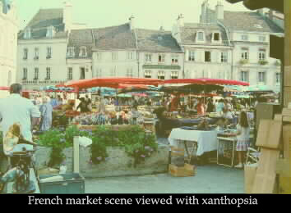
Digitalis
A cardiac failure drug
Causes chromatopsia (objects appear yellow) with overdose

Slide 49
Chloroquines
E.g. chloroquine, hydroxychloroquine
Used in malaria, rheumatoid arthritis & SLE
Cause vortex keratopathy (corneal verticillata) which is usually asymptomatic but can present with glare and photophobia
Also cause retinopathy (bull’s eye maculopathy)

Slide 50
Chlorpromazine
A psychiatric drug
Causes corneal punctate epithelial opacities, lens surface opacities. Reversible with drug discontinuation
Pigmentary retinopathy in high doses

Slide 51
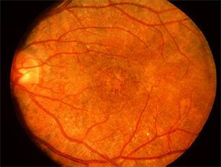
Thioridazine
A psychiatric drug
Causes a pigmentary retinopathy after high dosage

Slide 52
Phenytoin
An epilepsy drug
Causes dosage-related cerebellar-vestibular effects:
Horizontal nystagmus in lateral gaze
Diplopia, ophthalmoplegia
Vertigo, ataxia
Reversible with the discontinuation of the drug

Slide 53
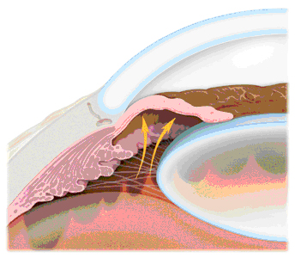
Topiramate
A drug for epilepsy
Causes acute angle-closure glaucoma (acute eye pain, redness, blurred vision, haloes).
Treatment of this type of acute angle-closure glaucoma is by cycloplegia and topical steroids (rather than iridectomy) with the discontinuation of the drug

Slide 54
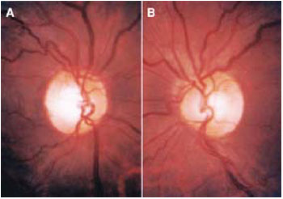
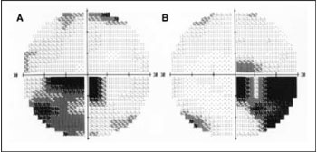
Ethambutol
An anti-TB drug
Causes a dose-related optic neuropathy
Usually reversible but occasionally permanent visual damage might occur

Slide 55
Agents That Can Cause Toxic Optic Neuropathy
Methanol
Ethylene glycol (antifreeze)
Chloramphenicol
Isoniazid
Ethambutol
Digitalis
Chloroquine
Streptomycin
Amiodarone
Quinine
Vincristine and methotrexate (chemotherapy medicines)
High-protein diet
Carbon monoxide
Lead
Mercury
Thallium (alopecia, skin rash, severe vision loss)
Malnutrition with vitamin B-1 deficiency
Pernicious anemia (vitamin B-12 malabsorption
Radiation (unshielded exposure to >3,000 rads)

Slide 56
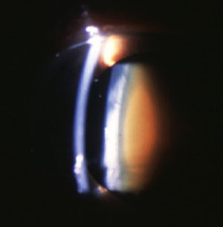
HMG-CoA reductase inhibitors (statins)
Cholesterol lowering agents
E.g. pravastatin, lovastatin, simvastatin, fluvastatin, atorvastatin, rosuvastatin
Can cause cataract in high dosages specially if used with erythromycin

Slide 57
Other agents
methanol – optic atrophy and blindness
Contraceptive pills – pseudotumor cerebri (papilledema), and dryness (CL intolerance)
Hypervitaminosis A – yellow skin and conjunctiva, pseudotumor cerebri (papilledema), retinal hemorrhage.
Hypovitaminosis A – night blindness (nyctalopia), keratomalacia.

Slide 58
Thank you
Any question?

