Slide 1

Orientation
History taking and Examination
Dr.Abdullah Almousa
Dept. of Ophthalmology
College Of Medicine
King Saud University

Slide 2
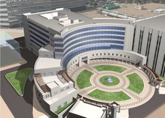
Orientation
OPH 432 Course

Slide 3
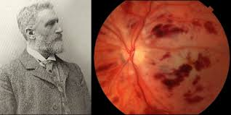
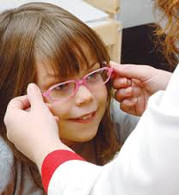
Ophthalmologist
Optometrist

Slide 4
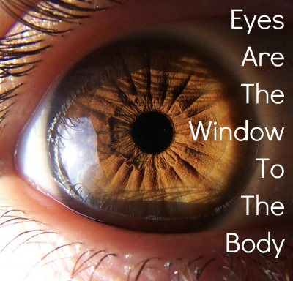
Why should you be interested in the eye?
Internet is a window to the world
Notes:
وش يبي ذا

Slide 5

Why should you be interested in the eye?
Notes:
وش يبي ذا

Slide 6
Objectives of this course
To know the basic ophthalmic anatomy and physiology.
To know how to assess and manage common ophthalmic diseases.

Slide 7
Objectives of this course
To know how to triage and treat common ophthalmic emergencies.
How to use simple ophthalmic diagnostic instruments.
To acquire basic knowledge of some common ophthalmic operations.

Slide 8
Components of the course
Lectures
Clinics
Clinical sessions
ER

Slide 9
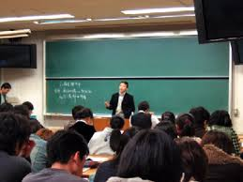
Lectures
History taking and ophthalmic exam
Basic anatomy and physiology of the Eye
Lid, Lacrimal, and Orbit Disorders
Ocular emergencies and red eye
Strabismus, Amblyopia and Leukocoria
Acute Visual Loss

Slide 10
Lectures
Chronic Visual Loss
Refractive Errors
Ocular manifestations of systemic diseases
Neuro-ophthalmology
Ocular Pharmacology and Toxicology

Slide 11
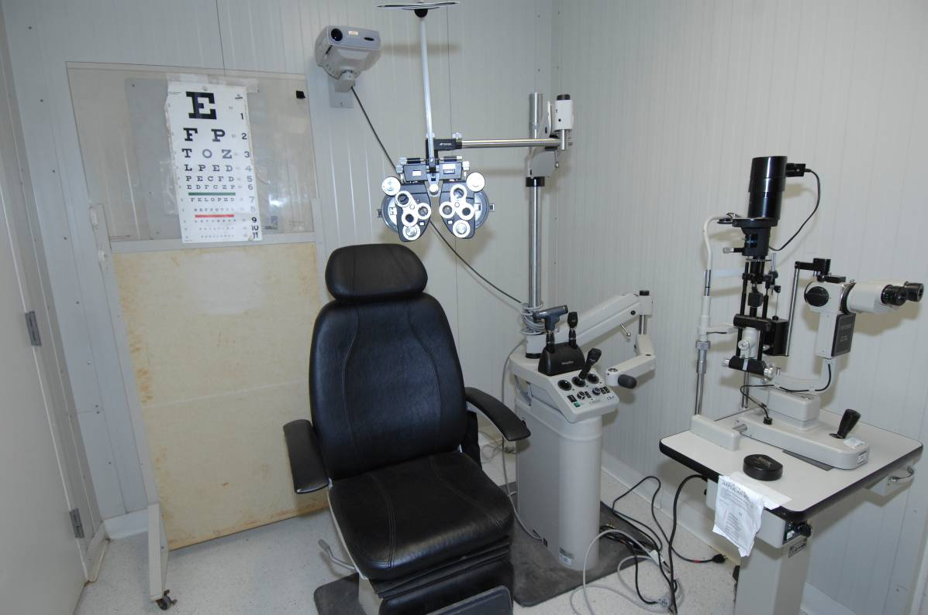
Clinic

Slide 12
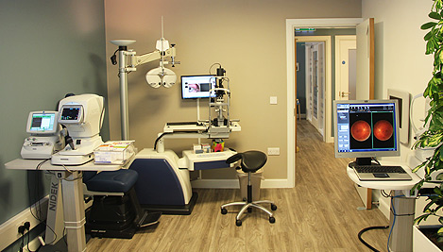
Clinic

Slide 13
Clinical skill sessions
  Ocular motility, alignment and external Ocular Examination
  Visual acuity and Ophthalmoscopy
  Visual field, Tonometry and Pupil Examination

Slide 14
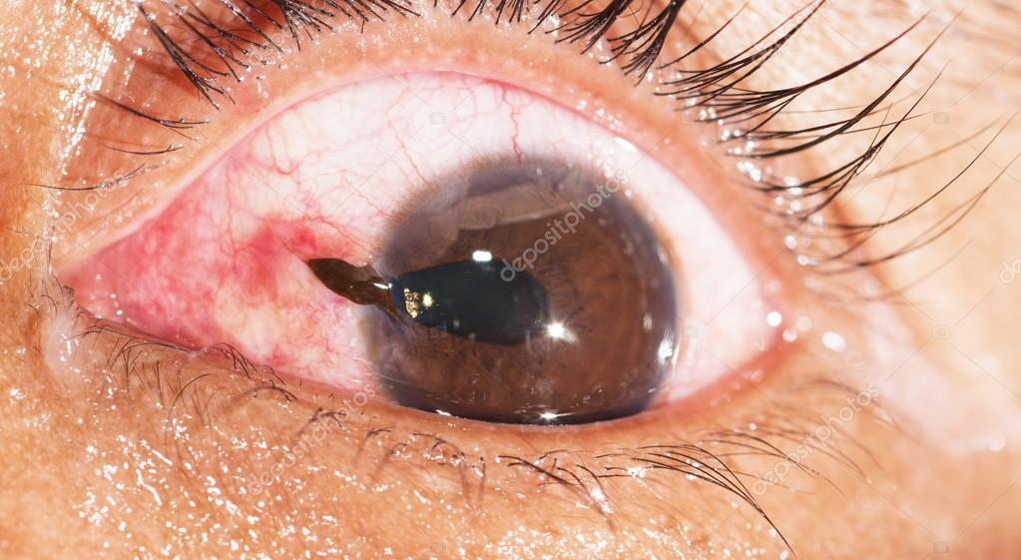
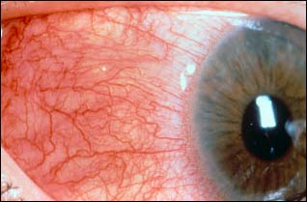
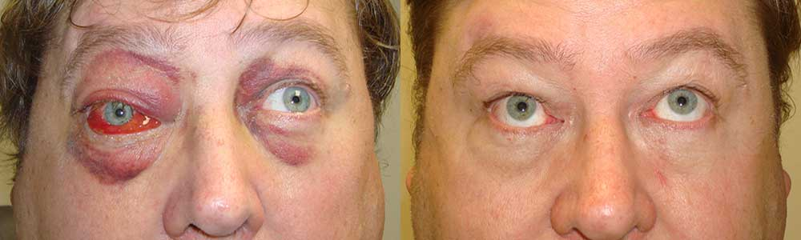
Emergency room

Slide 15
Marks distribution
30 MCQs
40 short answer question
20 OSCE
10 attendance in clinical sessions, clinics & ER

Slide 16
Recommended textbooks
1. Required Text(s)
a. Lecture notes in Ophthalmology (latest edition)
By: Bruce James (published by Blackwell Science)
b. Basic Ophthalmology (latest edition)
By: Cynthia A. Bradford
(published by American Academy of Ophthalmology)
c. Practical Ophthalmology: A manual for Beginning Residents (latest edition)
By: Fred M. Wilson (published by AAO)

Slide 17
2. References
Vaughan and Asbury’s general Ophthalmology
By: Paul Riordan-Eva (published by LANGE)
Clinical Ophthalmology: A Systematic Approach
By : Jack T. Kanski (published by Butterworth Heinemann)

Slide 18
c. Electronic Materials, Web Sites
University and KKUH/KAUH Library
Audiovisual Unit of the Ophthalmology Department
PubMed
Medscape
The digital journal of ophthalmology (www.djo.harvard.edu)
up to date.com
E medicine

Slide 19
The EYE

Slide 20
The Visual Pathway
Cornea
Anterior Chamber
Lens
Vitreous
Retina
Iris
Notes:
Let us recall the visual pathway. Light enters the eye via the refractive media, namely the cornea, anterior chamber, lens, and vitreous, and stimulates the retina posteriorly.

Slide 21
The Visual Pathway
RGCs
*Phototransduction:
photoreceptors (rods and cones)
*Image processing:
By horizontal, bipolar, amacrine and RGCs
*Output to optic nerve:
Via RGCs and
nerve fiber layer
Nerve Fibers
Notes:
Light stimulates the photoreceptors, ie., the rods and cones. Through a series of other retinal nerve cells, the end result is that the RGC is stimulated. The RGC sends its axon, or fiber, in the nerve fiber layer to the optic disc and then down the optic nerve.

Slide 22
The Visual Pathway
Retina
Optic Nerve
Optic Chiasm
Optic tract
Lateral Geniculate
Nucleus
Primary Visual Cortex
Notes:
From the optic nerve, about half of the fibers cross over at the chiasm to the opposite optic tract, and the other half remain on the same side. The fibers in the optic tract synapse in the lateral geniculate nucleus of the thalamus. Neurons in the lateral geniculate nucleus then project to the occipital lobe, to the primary visual cortex. From there, there is further processing with projections to other cells in the visual cortex and elsewhere, resulting in conscious visual perception.
Now that we know how visual information is normally transmitted to the brain, what happens with a disease like glaucoma?

Slide 23
“The eye is the window to the body”
The eye is so intimately connected with the rest of the body that it reveals enormous amount of general information.
Eye is the only part of the body where blood vessels and central nervous system tissues can be viewed directly.

Slide 24
Examples

Slide 25
Neurological connections

Slide 26
    The 12 cranial nerves provide us with a large amount of information about the brain.
          Of these , the eye examination evaluates CN II, III, IV, V, VI, VII, VIII.
    In addition, they provide information about the autonomic pathways. (sympathetic /parasympathetic)

Slide 27
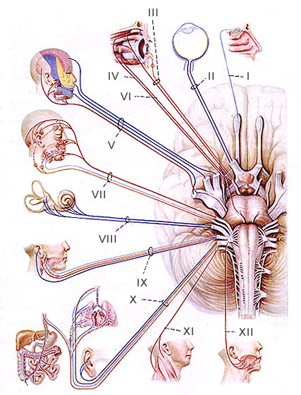

Slide 28
The retina and optic nerve
    Are physical extensions of the brain.
The visual pathways:
    Extends from front to back across the brain can be studied easily and safely using perimetry.
    Perimetry can differentiates accurately between lesions of the temporal, parietal, and occipital lobes.

Slide 29
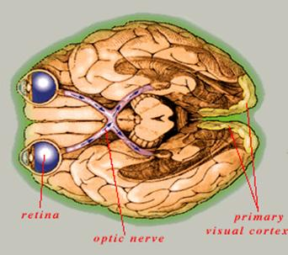

Slide 30
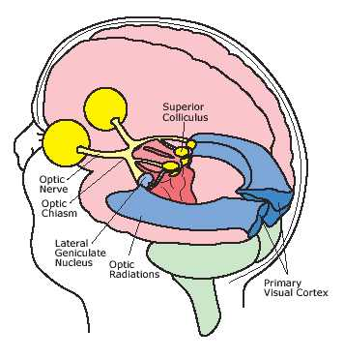
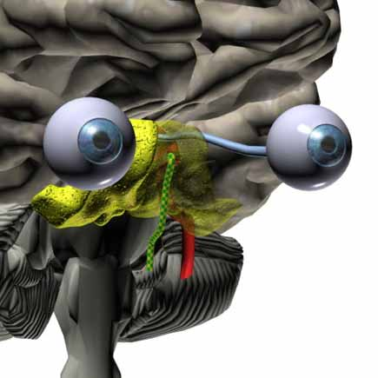
In addition,
  the ON has important clinical relationships to the pituitary gland, the middle ventricles, the venous sinuses, the meningeal and bony structures of base of the skull.

Slide 31
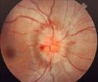
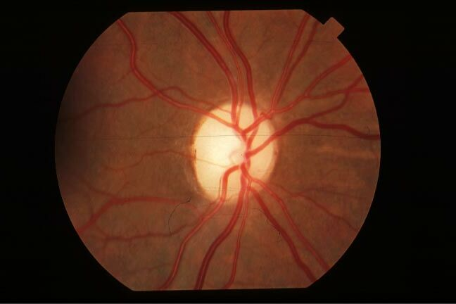
ON has the diagnostically useful capability of swelling with ↑ ICP (papilledema).
OR
visibly pale (optic atrophy) when its nerve fibers damaged at any point from Retina → LGB.

Slide 32
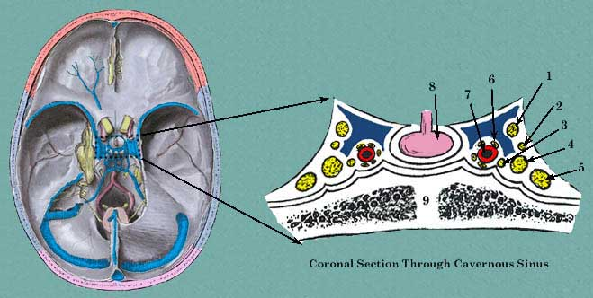
The study of CN III, IV, V, VI
a clinician can evaluate:
    The brain stem
    Cavernous sinus
    Orbital apex

Slide 33
Unilateral dilated pupil after head injury can occur due to pressure on pupil constrictor fibers of CN III.
CN VI involved in mastoid infection (petrous ridge)
Parotid gland, Inner ear disease → CN VII.
Nystagmus → CN VIII

Slide 34
Vascular connections

Slide 35
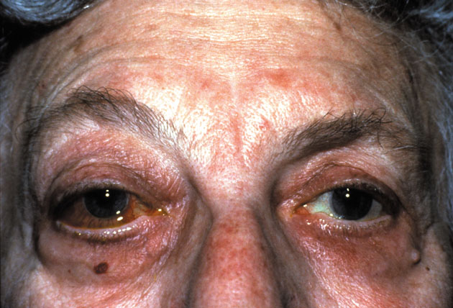
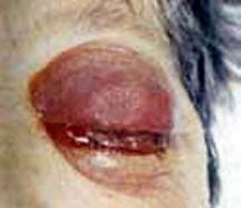
Venous flow disorders:
cavernous sinus thrombosis
OR
carotid cavernous fistula
(orbital congestion)

Slide 36
Arterial emboli
  can reach the retina from carotid artery, heart valves, subacute endocarditis.
Hypertension
Systemic vasculitis:
PAN, temporal arteritis & SLE

Slide 37
Hematological disorders of all types can manifest in the fundus.
Metabolic disorders can affects the eye:
DM :DR, cataract, refractive error, ophthalmoplegia.
Hyperthyroidism : Graves disease
Wilson’s disease. KF ring

Slide 38
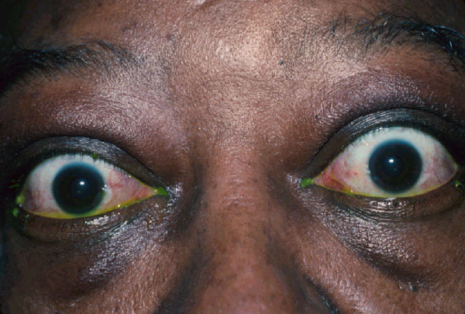
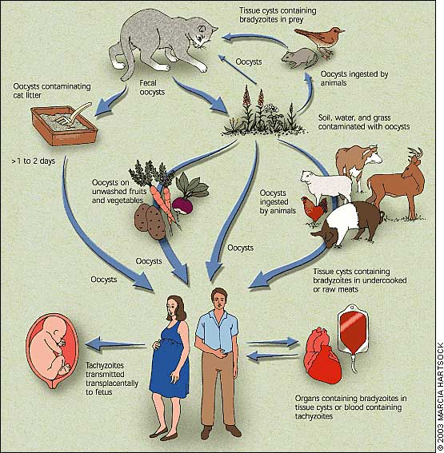
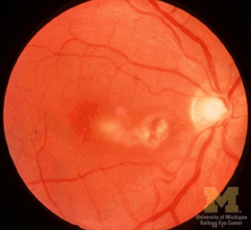
Thyroid eye disease:
Exophthalmos, Lid retraction.
Infections:
(Syphilis, Toxoplasmosis & Rubella)

Slide 39
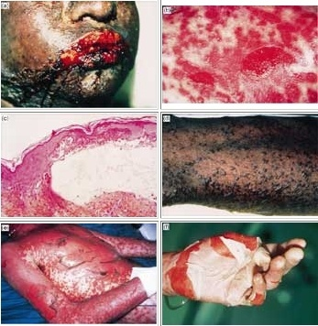
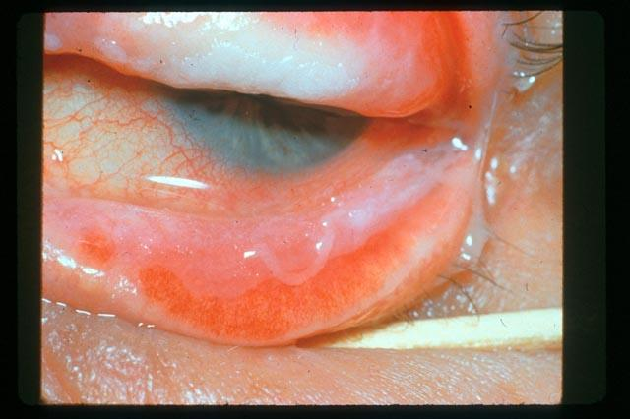
Mucocutaneous disorders:
SJS, pemphigus
Elastic tissue disorders:
(Pseudoxanthoma elasticum)
Allergy disorders:
Vernal keratoconjuctivitis

Slide 40
Chromosomal abnormalities:
Trisomy: 13,15, 18 & 21.
The eye is a delicate indicator of poisoning:
-Morphine addict → miotic pupil
-Lead poisoning, vitamin A intoxication
→ papilledema

Slide 41
90% of our information reaches our brain
via sight.
Unfortunately, of all the parts of the body,
the eye is the most vulnerable to minor
injury.

Slide 42
What are the components of a comprehensive ophthalmic evaluation?

Slide 43
Obtain an ocular and systemic history.
Identify risk factors for ocular and systemic disease.
look for symptoms and signs of ocular or systemic disease.
Determine the optical and health status of the eye and visual system.

Slide 44
reach a provisional diagnosis
Initiate an appropriate response:
e.g. further diagnostic tests, treatment,
or referral.

Slide 45

HISTORY

Slide 46
History by skilled person can arrive at the proper diagnosis in 90% of patients

Slide 47
It gives vital guidance for:
(a) physical examination
(b) laboratory work
(c) Therapy
Failure to take history can lead to missing vision or life-threatening conditions.

Slide 48
Chief complaint:’’The patient’s own words’’
‘’she cannot see with the RE’’
You should not come to conclusion that her problem is nearsightedness and write down “Myopia of RE”.
The patient needs will not be satisfied until he/she has received an acceptable explanation of the meaning of the chief complaint and its proper management.

Slide 49
History of the Present Illness:
Detailed description of the chief complaint to understand the symptoms and course of the disorder.
Listen and question and then write down in orderly sequence that make sense to you.

Slide 50
* The time sequence
when, How fast, what order did events occur?
* Frequency, intermittency
* location, Laterality
* Severity
* Associated symptoms * Documentation (old records, photo)
e.g ptosis, proptosis, VII N palsy.
Gradual painless decrease vision both eyes for 1y.
Sudden painless decrease vision re for 10 min.

Slide 51
“cannot see with RE”!!
? Only distance vision blurred.
? Blind spot is present in the center of VF
? Right side of VF of the RE lost
? Right VF of both eyes lost
? A diffuse haze obscures the entire field of RE
Each of these has different diagnostic implication
Most pt. has difficulty providing precise and concise description

Slide 52
Disturbances of vision:
Blurred or decreased central vision
Decreased peripheral vision. (glaucoma)
Altered image size.
(micropsia, macropsia, metamorphopsia).
Diplopia (monocular, binocular)
Floaters
Photopsia (flash of light)

Slide 53
Color vision abnormalities.
Dark adaptation problems.
Blindness
(ocular, cortical).
Oscillopsia
(shaking of images).

Slide 54
Ocular pain or discomfort:
Foreign body sensation
Ciliary pain
  (aching, severe pain in or around the eye, often radiating to the ipsilateral forehead, molar area)
Photophobia
Headache
Burning
Dryness
Itching: patient rub the eye vigorously (allergy)
Asthenopia (eye strain)

Slide 55
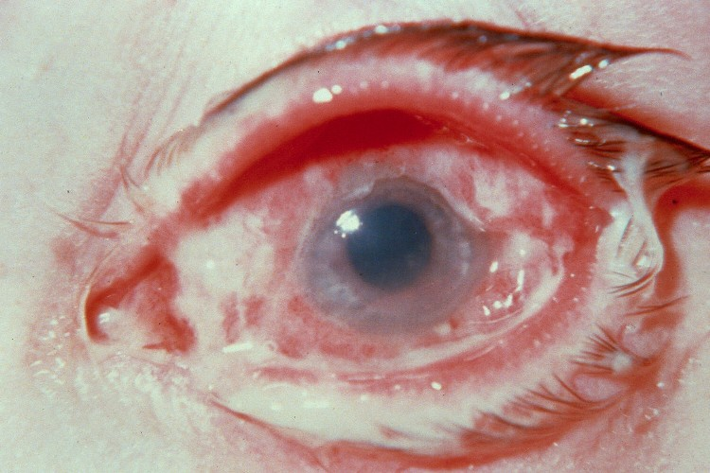
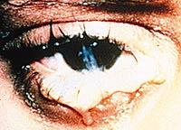
Abnormal ocular secretions:
Lacrimation, epiphora
Dryness
Discharge
(purulent, mucopurulent, mucoid,
watery)

Slide 56
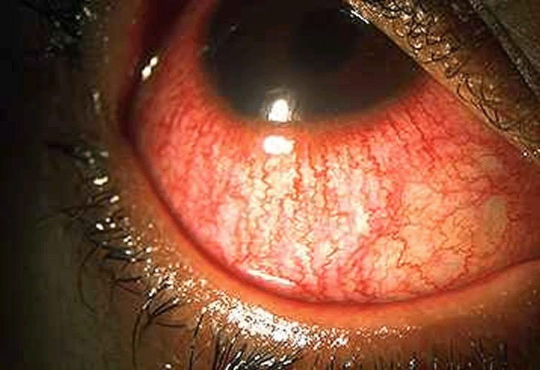

Redness, opacities, masses
Anisocoria

Slide 57
Family history:
Many eye conditions are inherited
Refractive error, glaucoma, strabismus, retinoblastoma, neoplasia & vascular disorders
Familial systemic disease can be helpful in ophthalmic evaluation and diagnosis
Atopy, thyroid diseases, DM, some malignancies.

Slide 58
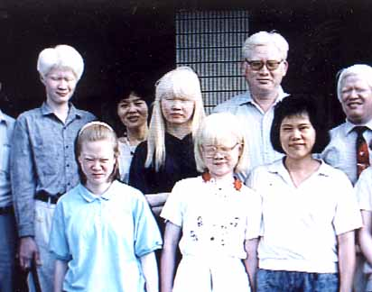
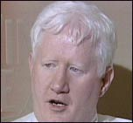
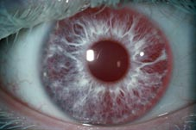
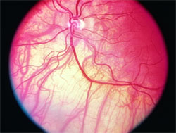
Ask about any eye problem in the family background?
Ask specifically about corneal diseases, glaucoma, cataract, retinal diseases or other heritable ocular conditions.

Slide 59
Ask questions designed to confirm or exclude your tentative diagnosis
- significant positive
- significant negative
predict the physical and lab. finding likely to be
present.
any discrepancy between the history and physical examination requires explanation

Slide 60
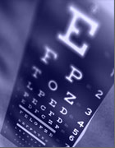
Ophthalmic examination
Ophthalmic examination

Slide 61
Ophthalmic examination
Visual acuity
External examination
Motility and alignment
Pupil examination
Slit lamp biomicroscopy
Tonometry
Ophthalmoscopy
Gonioscopy
Retinoscopes

Slide 62
Visual acuity:
It is a vital sign (MUST)
Good vision intact neurological visual pathology
structurally healthy eye
Proper focus
Subjective

Slide 63
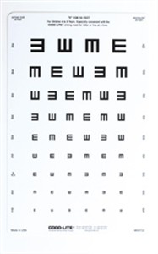
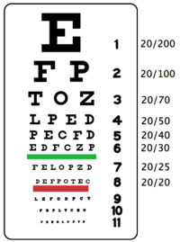

How to test vision?
  Display of different –sized targets shown at a standard distance from the eye.
  Snellen chart.
  20/20, 6/6
  Uncorrected, corrected

Slide 64
Testing poor vision:
  If the patient is unable to read the largest letter <(20/200)
  Move the patient closer e.g. 5/200
  If patient cannot read:
  - count fingers (CF)
  - hand motion (HM)
  - Light perception (LP)
  - No light perception (NLP)

Slide 65
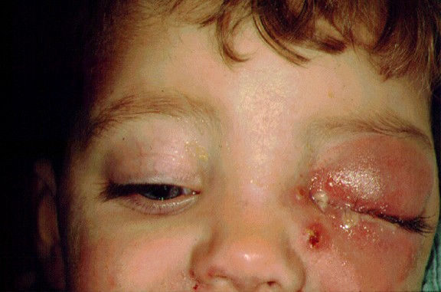
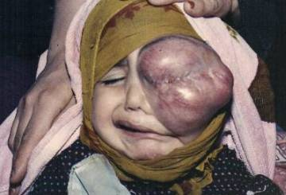
External examination:
  Evaluate by gross inspection and palpation.
  Ocular adnexa. (lid, periocular area)
  Skin lesions, growths, inflammatory lesions.

Slide 66
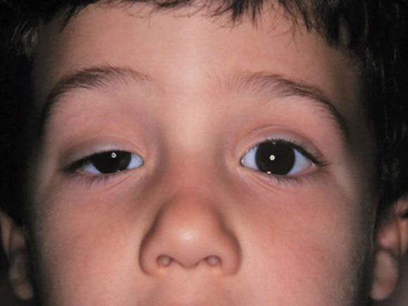
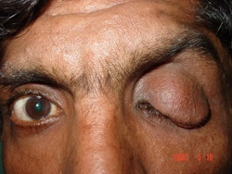
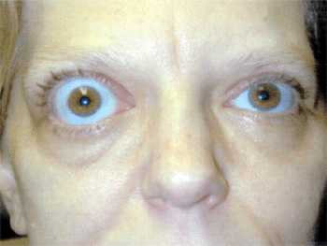
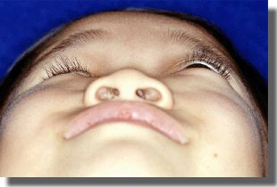
Ptosis
Proptosis, exophthalmos, enophthalmos

Slide 67
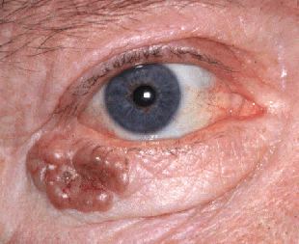
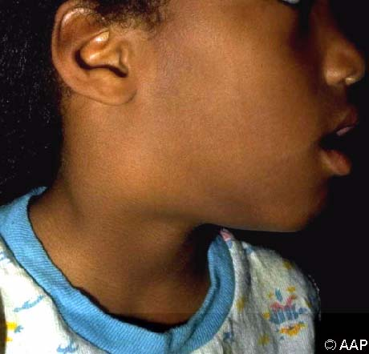
  Palpation of bony rim, periocular soft tissue.
  General facial examination e.g. enlarged preauricular lymph node, temporal artery prominence.

Slide 68
Ocular motility:
  Evaluate - Alignment
  - Movements

Slide 69
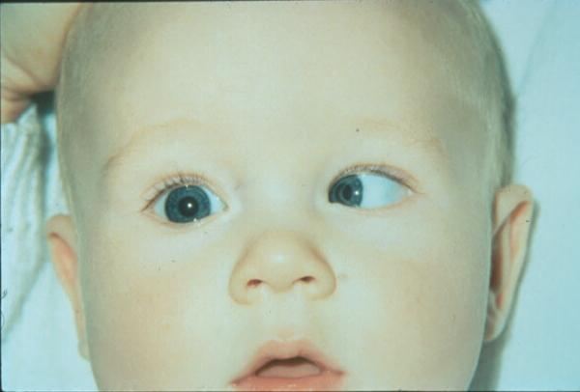
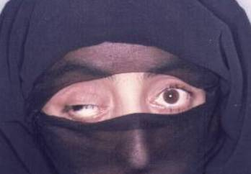
Misalignment of the eyes

Slide 70
  Movement:
  Follow a target with both eyes in each of the four cardinal directions of gaze.
  Note - speed
  - smoothness
  - range
  -symmetry
  -unsteadiness of fixation
  e.g nystagmus

Slide 71
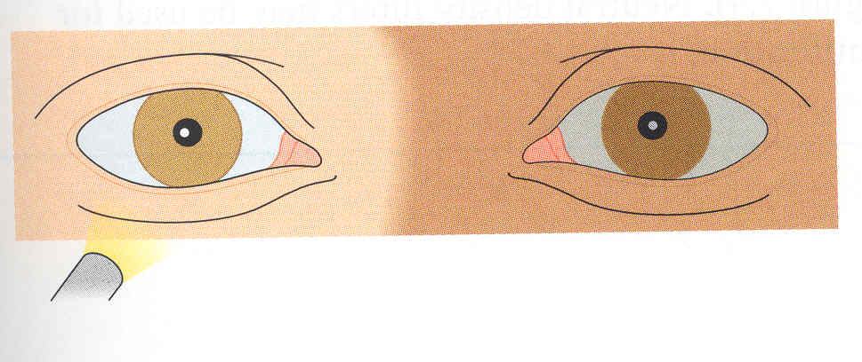
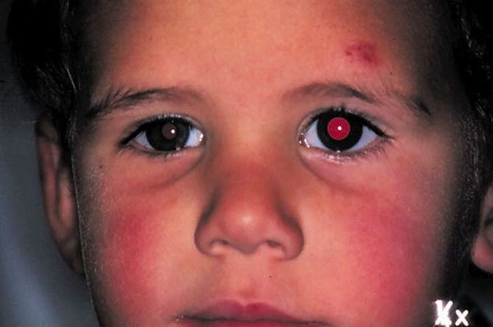
Pupils:
Examine for size, shape, reactivity to both light and accommodation.
  Direct response and consensual response.
  Afferent pupillary defect (Marcus Gunn pupil)

Slide 72
  Causes of Pupillary abnormalities:
  - neurologic disease
  - previous inflammation – adhesion
  - acute intraocular inflammation - spasm
  - atony
  - prior surgical trauma
  - effect of systemic or eye medication
  - benign variation of normal

Slide 73
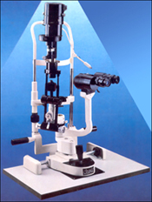
Slit lamp examination:
Is a table-mounted binocular microscope with special illumination source.
A linear slit beam of light is projected onto the globe – optic cross section of the eye.

Slide 74
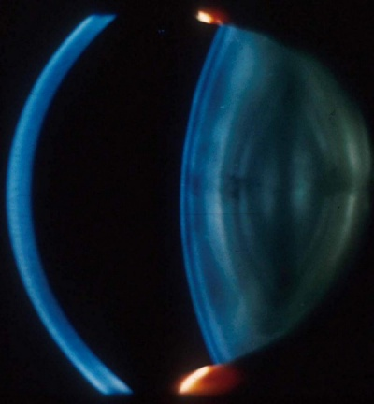
  Slit lamp alone, the anterior half of the global (anterior segment) can be visualized.

Slide 75
Tonometry:
  The globe is a closed compartment with constant circulation of aqueous humor.
  This maintains the shape, and relatively uniform pressure within the globe.
  Normal pressure 10 – 21 mmHg.

Slide 76

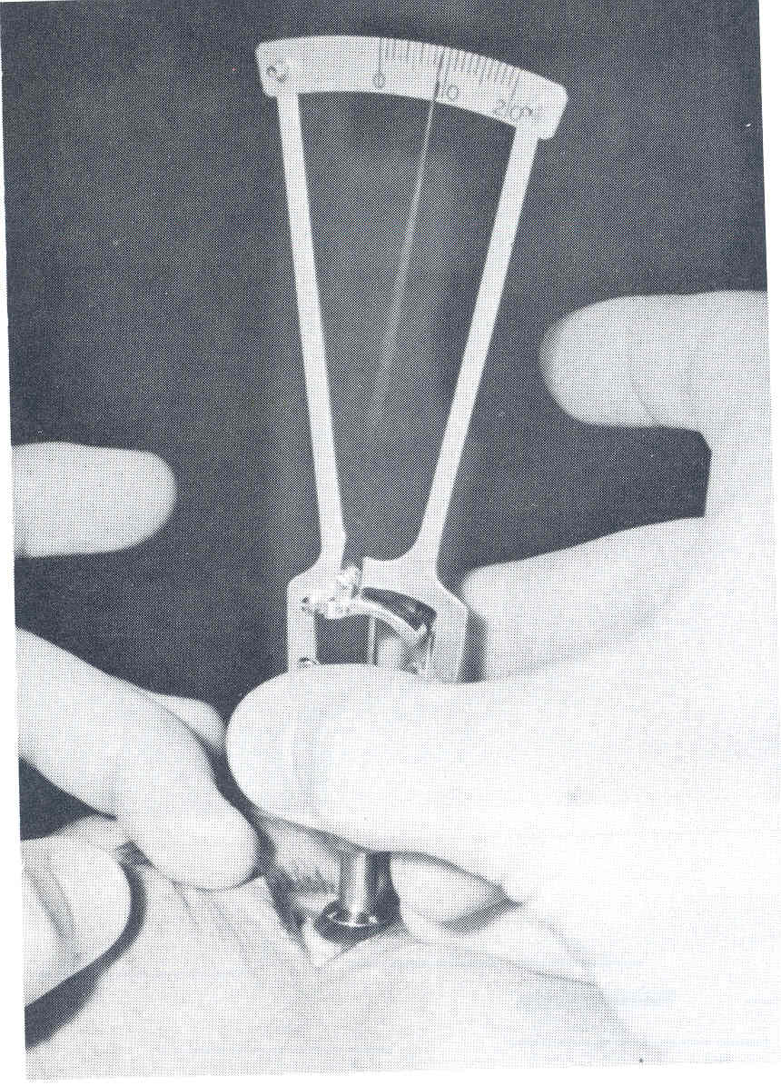
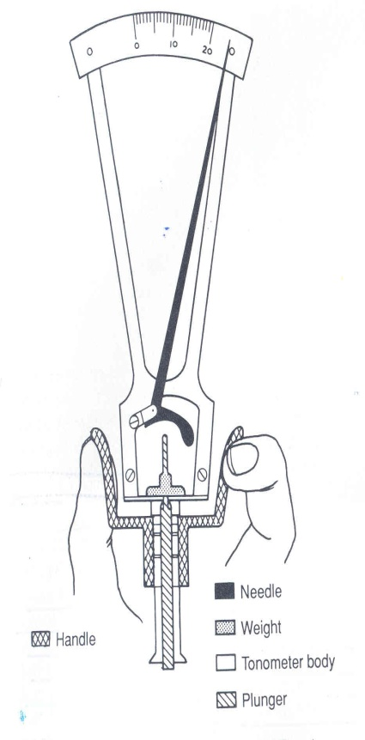

Types of tonometry:
  Schiotz tonometer

Slide 77




  Goldmann applanation tonometer

Slide 78


Tonopen

Slide 79

Ophthalmoscopy:
  Direct ophthalmoscopy:
  handheld instrument.
  standard part of the general
  medical examination.
  Portable

Slide 80

Indirect ophthalmoscope

Slide 81


Slide 82
Indirect Ophthalmoscoy:
  1. provide much wider field of view
  2. less magnification (3.5X with 20D lens)
  3. brighter light source – better view.
  4. Binocular – steroscopic view.
  5. Allow entire retina examination till the
  periphery.

Slide 83





Slide 84
  Disadvantage:
  Inverted retinal image.
  Brighter light is uncomfortable to the patient.

Slide 85


  Special lenses:
  - Gonio lens
  - wide field contact lenses allow evaluation of the posterior segment.

Slide 86



Retinoscope

Slide 87

Retinoscopy

Slide 88

Thank you

