Slide 1
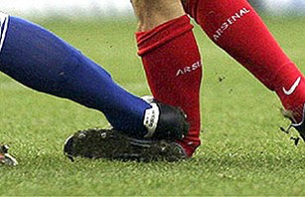
Sports & Soft tissues injuries
Abdulaziz Alomar, MBBS, MSc, FRCSC
Associate Professor of Orthopaedic Surgery
Head of Arthroscopy and Sports Medicine Division
Director, Arthroscopy & Orthopaedic Sports Medicine Fellowship
King Khalid University Hospital, King Saud University
Riyadh, Saudi Arabia

Slide 2
Objectives
By the end of this teaching session the students should be able to
Specify the symptoms, signs and potential immediate complications of common sport and soft tissues injuries involving muscles, tendons, and ligaments for commonly injured joints; like shoulder, knee, and ankle.
Outline the assessment and appropriate investigation and to outline the immediate and long term management of patients with muscles, tendons, ligaments and meniscus
Demonstrate knowledge of indications for non-operative and operative treatment and to know the most common non-operative and operative measurements used for sport/soft tissue injuries.

Slide 3
Soft tissues injuries
Muscle
Tendon
Ligament
Meniscus
Knee
Shoulder
Ankle

Slide 4
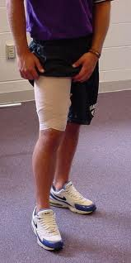
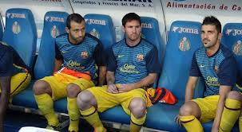
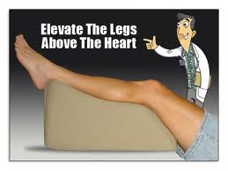
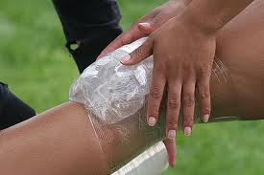
R.I.C.E
Compression
Rest
Elevation
ICE

Slide 5
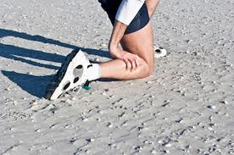
Muscle injury
The muscles most at risk are those in which the origin and the insertion cross two joints.
Frequently injured muscles act in an eccentric fashion (i.e., lengthening as they contract)

Slide 6
Muscle injuries
Muscle strain
Muscle Contusion
Muscle Laceration
Delayed-onset soreness

Slide 7
Muscle Strain
The most common muscle injury suffered in sports.
Immediate pain associated with diminished function.
Both complete and incomplete muscle tears can occur by passive stretch of an activated muscle.
Muscle tears also typically occur at or near to the myotendinous junction
Treatment
RICE
NSAID
physical therapy

Slide 8
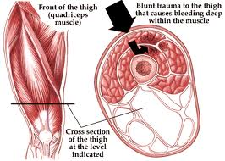
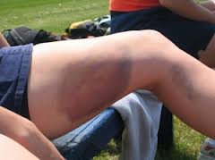
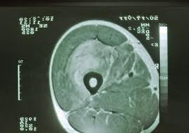
Muscle Contusion
Caused by a nonpenetrating blunt injury (direct blow) to the muscle resulting in hematoma and inflammation.
Quadriceps and Brachialis muscles are common involved regions.
Clinical features:
Pain with active and passive motion +/_ swelling.
Decreased range of motion of joints spanned by the injured muscles.
Occasionally a permanent palpable mass.
Treatment:
Short period of immobilization
Followed by early mobilization and Physiotherapy
NSAID

Slide 9
Muscle injuries
Muscle Laceration
I&D followed by suture repair of the fascia, if possible.
Delayed-onset soreness
Structural muscle injury leads to progressive edema formation and resultant increased intramuscular pressure.
Is primarily associated with eccentric loading–type exercise.
Clinical features: muscular pain that occurs 1-3 days after vigorous exercise.
Treatment :
Will resolve in a few days
NSAID

Slide 10
Complications of muscle injures
Scar formation and muscle weakness.
Compartment syndrome
At the level of the muscle fibers, capillary bleeding and edema can lead to hematoma formation and can cause compartment syndrome in areas in which the volume is limited by the fascial envelope.
Pt with Bleeding disorders is at high risk
Myositis ossificans

Slide 11
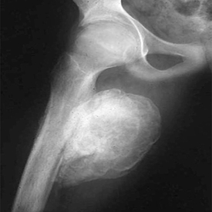
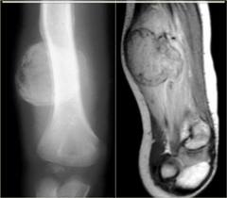
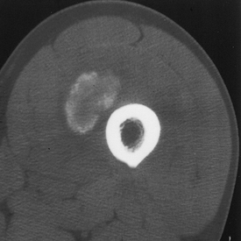
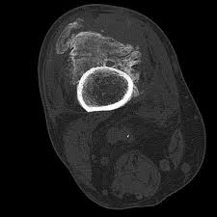
Myositis ossificans
Bone formation within muscle secondary to blunt trauma.
CF:
Early:
Pain, swelling and decreased ROM
Erythema, warmth, induration, tenderness,
Late: painless swelling with decreased ROM
This sometimes mimics osteogenic sarcoma on radiographs and biopsy.
Increased ESR and serum alkaline phosphatase
Myositis ossificans becomes apparent approximately 2 to 4 weeks post-injury.

Slide 12
Overuse Tendon injuries
Function—To transfer force from muscle to bone to produce joint motion.
Type of injuries
Overuse tendinopathies
Tendon rupture

Slide 13
Overuse tendinopathies
Osteotendinous junction is the most common site of overuse tendon injury.
Tendons are relatively hypovascular proximal to the tendon insertion. This hypovascularity may predispose the tendon to hypoxic tendon degeneration and has been implicated in the etiology of tendinopathies.
Tendinopathy not tendenitis

Slide 14
Most Common Diagnoses and Locations of Chronic Tendinopathies
Diagnosis | Location
Rotator cuff Tendinopathy | Supraspinatus tendon insertion
Lateral epicondylosis (tennis elbow) | Common wrist extensor tendon origin (mainly involved ECRB)
Medial epicondylosis (“golfer’s elbow”) | Common wrist flexor tendon origin
Hamstring Tendinopathy | Hamstring tendon origin
Quadriceps Tendinopathy | Quadriceps tendon insertion
Patellar Tendinopathy (jumpers knee) | Patellar tendon origin
De Quervain’s disease | Sheath/pulley of abductor pollicis longus
Achilles Tendinopathy | Sheath, midsubstance, or calcaneal insertion

Slide 15
Overuse tendinopathies treatment
Goal: reduce pain and return function.
Mainly is conservative Rx
Rest
Ice (Cryotherapy)
PT (stretching and eccentric strengthening)
Analgesics
Corticosteroids injection
Orthotics and braces
Other modalities: U/S, ESWT, iontophoresis and phonophoresis.
Surgical treatment:
Failed conservative treatment (at least 3-6 months)
Excision of abnormal tendon tissue and performance of longitudinal tenotomies to release areas of scarring and fibrosis.

Slide 16
Tendon rupture
Knee extensor mechanism
Quadriceps tendon
Patella tendon
Achilles tendon
Partial vs complete

Slide 17
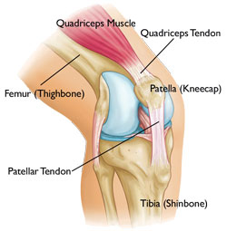
Patella/Quadriceps tendon rupture
Predisposing factors:
Steroid, chronic disease, and tendinopathy
Age: Patella<40>Quads
Location: at the tendon attachment to the patella.

Slide 18
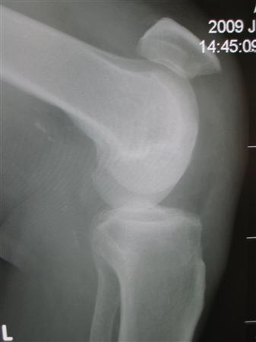
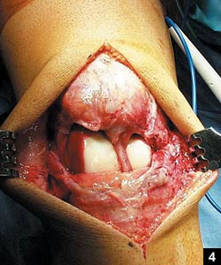
Patella/Quadriceps tendon rupture
Physical examination:
Tenderness at the site of the injury,hematoma, and a palpable defect in the tendon.
Unable to extend the knee against resistance or to perform a straight-leg raise.
Xray
Patella-alta> P.T rupture
Patella-infera> Q.T rupture
Rx: usually surgical
Patella-alta (high riding patella) seen with patella tendon rupture

Slide 19
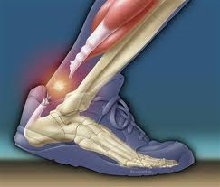
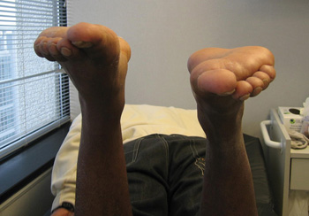
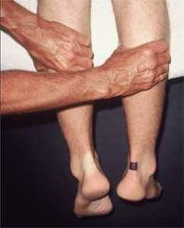
Achilles tendon rupture
Most ruptures (75%) occur during sporting activities.
History:
The patient reports a “pop” or the sensation of being kicked in the heel during the injury.
weakness and difficulty walking.
Examination:
Increased resting dorsiflexion with the knees flexed, a palpable gap, weak plantar flexion, and an abnormal Thompson test (lack of plantar flexion when squeezing the calf).
Diagnosis is clinical, but MRI or ultrasound can confirm.
Rx: usually surgically

Slide 20
Knee
ACL
MCL
LCL
PCL
Menisci
Knee dislocation

Slide 21
Ligament injury

Slide 22
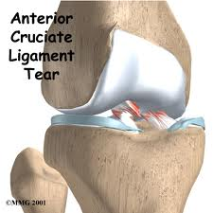
ACL injury

Slide 23
ACL
Anatomy
Mechanism of injury
Diagnosis
Principles of management

Slide 24
ACL Anatomy

Slide 25
Mechanism of Injury
Noncontact (70%)
Cutting or Pivoting
Contact = MCL
Sports-Related (80%)
“Pop” (70%)
Female: 2-4x > Male

Slide 26
Diagnosis
Symptoms:
Instability “giving way episodes”
Swelling (Hemarthrosis) is noted within a 1-2 days of the injury.
Pain if associated with meniscus tear

Slide 27
Diagnosis
Physical examination
The patient need to be relaxed and comfortable.
Must be compared with those of the normal knee.
A moderate to severe effusion is usually present
ROM: in acute injury the range of motion may limited by:
Pain
Effusion
Hamstring spasm,
ACL stump impingement,
Meniscal pathology.
Special tests:
Lachman’s test
ADT
Pivot shift test : is pathognomonic for ACL injury (best in the chronic setting).

Slide 28
Diagnosis
Investigations:
X-ray
MRI
In the skeletally mature patient, the femoral insertion or midsubstance is usually the site of disruption.
In the skeletally immature patient, the tibial attachment may be avulsed with or without a piece of bone.`

Slide 29
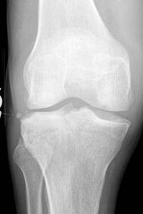
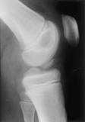
Xray
Segond fracture
Tibial spine avulsion

Slide 30
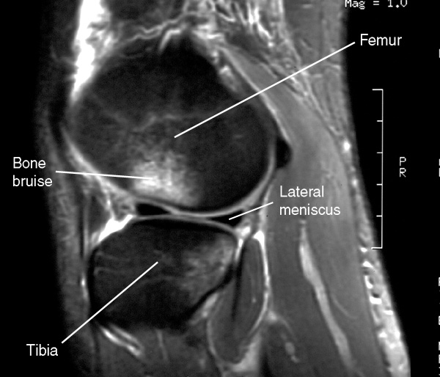
MRI
Normal ACL
Torn ACL
Bone bruise

Slide 31
INJURIES ASSOCIATED WITH ACL DISRUPTION
Injuries of the ACL rarely occur in isolation. The effects of other injuries, including:
Other ligament sprains (MCL)
Meniscal tears
Articular cartilage injuries
Bone bruises ,
Complicate the treatment and eventual outcomes of ACL disruptions.

Slide 32
Treatment
Nonsurgical treatment
Appropriate for asymptomatic patients with partial injuries to the ACL.
Older or less physically active may elect to modify their activities and proceed with nonsurgical treatment.
Nonsurgical treatment involves rehabilitation to strengthen hamstrings and quadriceps, as well as proprioceptive training.
Activity modification is also an important part of nonsurgical management, as patients who avoid cutting and pivoting sports are at lower risk for knee instability.
ACL sports braces have not been shown to prevent abnormal anterior tibial translation.

Slide 33
Treatment Surgical
Athletes with ACL injuries rarely return to cutting and pivoting sports (e.g. basketball, football, soccer) without first undergoing surgery.
For individuals who wish to return to such sports, surgery is generally recommended to avoid instability and secondary meniscal and/or articular cartilage damage.
Individuals who work in occupations that may involve physical combat, such as police officers, or risk, such as firefighters, should have ACL reconstruction before returning to work.
Most patients can function well and perform activities of daily living (ADLs) without instability after a complete ACL injury. However, some have difficulty performing even simple ADLs because of ACL deficiency-related instability, and they may require surgery.
Young patients

Slide 34
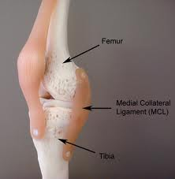
MCL
The main function of this complex is to resist valgus and external rotation loads.

Slide 35
MCL
The tibial MCL is the most commonly injured ligament of the knee.
Usually result from contact injury like a direct blow to the lateral aspect of the knee.
Concomitant ligamentous injuries (95% are ACL)
Concurrent meniscal injuries have been noted in up to 5% of isolated medial ligamentous injuries.

Slide 36
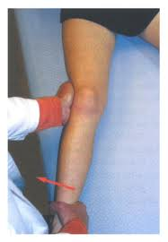
MCL
Physical examination
Valgus stress test should be performed with the knee at 0° and 30° of flexion.
Laxity at 30°: isolated MCL
Laxity at both 0° and 30°: concurrent injury to the posteromedial capsule and/or cruciate ligaments.
R/O associated injuries (ACL and M. Meniscus)

Slide 37
MCL Investigation
Is a clinical diagnosis and most of the time dose not need further investigation.
If the injury is sever or suspecting associated injuries (e.g. significant knee effusion) then the MRI will be modality of choice.
Xray: to R/O fracture (lateral tibia plateau fracture)

Slide 38
MCL Treatment
Conservative Rx
Is the mainstay of treatment for the isolated MCL injuries
Crutches, RICE, and anti-inflammatory/pain medication
No brace is usually required for partial tear
A knee brace is recommended for complete tear.
Surgical Rx:
if failed conservative Rx + complete tear + associated with other ligaments injury

Slide 39
LCL
The LCL is the primary restraint to varus stress at 5° and 25° of knee flexion.
Less commonly injuries than MCL
Injuries to the lateral ligament of the knee most frequently result from motor vehicle accidents and athletic injuries.
Rx:
Isolated injury: non operative
Combined injury: surgical

Slide 40
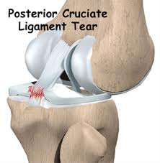
PCL

Slide 41
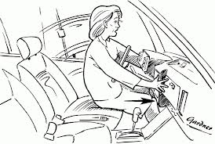
PCL
The PCL is the primary restraint to posterior tibial translation in the intact knee.
Mechanism of injury
A direct blow to the proximal aspect of the tibia is the most common cause of PCL injury.
Dashboard injury
In athletes >a fall onto the flexed knee with the foot in plantarflexion, which places a posterior forces on the tibia and leads to rupture of the PCL.
PCL insuffiency significantly increased the risk of developing medial femoral condyle and patellar cartilage degeneration over time.
Rx
Non operative
Surgical if combined ligamnet injury

Slide 42
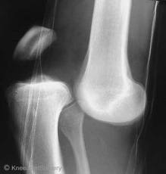
Knee dislocation

Slide 43
Multiligament Knee Injuries Knee dislocation
Multiligament knee injuries are usually caused by high-energy trauma and are often considered knee dislocations.
Less frequently, low-energy trauma or ultra-low-velocity trauma in obese patients can also result in this injury pattern.
A bicruciate (ACL+PCL) injury or a multiligament knee injury involving three or more ligaments should be considered a spontaneously reduced knee dislocation.
A knee dislocation should be considered a limb-threatening injury, and careful monitoring of vascular status after the injury is imperative.
Popliteal artery (estimated at 32%) or peroneal nerve injury (20% to 40%) also can occur.

Slide 44
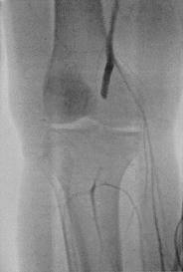
Vascular examination is critical in an acutely dislocated knee.
Pulse and ankle-brachial index (ABI) should be carefully assessed. An ABI of less than 0.90, and most certainly less than 0.80, should be considered abnormal.
If there is any concern about an abnormal vascular examination, there should be a low threshold for ordering an angiogram.
If pulses are still abnormal or absent following reduction of the dislocation, immediate vascular surgery consultation with intraoperative exploration should be the next step in management.
A vascular injury in a knee dislocation is a limb-threatening injury and needs to be corrected within 6 to 8 hours. If not corrected, amputation may be required.
Neurologic examination is also critical, as peroneal nerve injury can occur with multiligament injuries, particularly in concomitant lateral/posterolateral corner injuries.

Slide 45
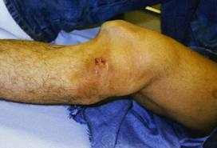
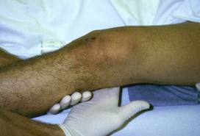
NEED EMERGENT REDUCTION
emergent closed reduction and splinting or bracing should be performed immediately. Postreduction radiographs should be taken to confirm knee reduction.

Slide 46
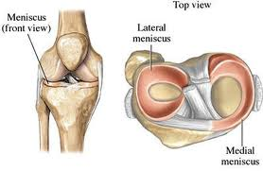
Meniscus anatomy
The menisci are crescent-shaped, with a triangular appearance on cross-section.
The lateral meniscus covers 84% of the condyle surface; it is 12 to 13 mm wide and 3 to 5 mm thick.
The medial meniscus is wider in diameter than the lateral meniscus; it covers 64% of the condyle surface and is 10 mm wide and 3 to 5 mm thick.

Slide 47
Meniscus tear
Meniscus function
The meniscus provides stability, absorbs shock, increases articular congruity, aids in lubrication, prevents synovial impingement, and limits flexion/extension extremes.
The most important function of the meniscus is load-sharing across the knee joint, which it accomplishes by increasing contact area and decreasing contact stress.
Epidemiology of meniscus injuries
Meniscus injuries are among the most common injuries seen in orthopaedic practices.
Arthroscopic partial meniscectomy is one of the most common orthopaedic procedures.

Slide 48
Meniscus tear
Incidence:
Meniscus tears are unusual in patients younger than age 10 years.
Most meniscus tears in adolescents and young adults occur with a twisting injury or with a change in direction.
Middle-aged and older adults can sustain meniscus tears from squatting or falling.
History:
With an acute meniscus tear, an effusion may develop slowly several hours after injury. This differs from an anterior cruciate ligament (ACL) injury, where swelling develops rapidly within the first few hours.
Patients with meniscus injuries localize pain to the joint line or posterior knee and describe mechanical symptoms of locking or catching.
Chronic meniscus tears demonstrate intermittent effusions with mechanical symptoms

Slide 49
Meniscus tear
Physical examination
Small joint effusions and joint line tenderness with palpation are common findings with meniscus tears.
Manipulative maneuvers, including the McMurray and Apley tests, may produce a palpable or audible click with localized tenderness, but they are not specific for meniscal pathology.
Range of motion is typically normal, but longitudinal bucket-handle tears may block full extension of the knee joint.

Slide 50
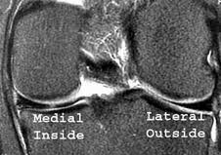
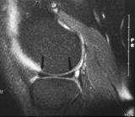
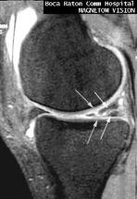
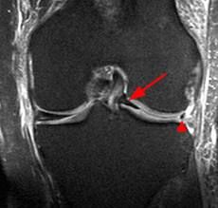
Meniscus tear
Standard knee radiographs should be obtained for evaluating for
Bone injuries or abnormalities.
Osteoarthritis.
MRI remains the noninvasive diagnostic procedure of choice for confirming meniscal pathology.

Slide 51
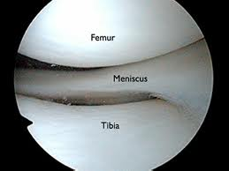
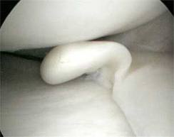
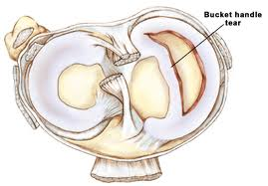
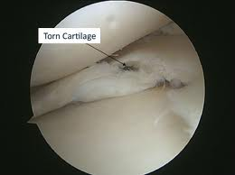

Slide 52
Differential diagnosis
Differential diagnosis Prior to MRI, several large studies demonstrated accuracy of the clinical diagnosis of meniscus tears to be 70% to 75%.
The differential for meniscus tears includes intra-articular and extra-articular diagnoses.
Intra-articular possibilities include osteochondritis dissecans, medial patella plica, patellofemoral pain syndromes, loose bodies, pigmented villonodular synovitis, inflammatory arthropathies, and osteonecrosis.
Extra-articular possibilities include collateral ligament injuries, slipped capital femoral epiphysis, bone or soft-tissue tumors, osteomyelitis, synovial cyst, pes or medial collateral ligament bursitis, injury, reflex sympathetic dystrophy, lumbar radiculopathy, iliotibial band friction, and stress fracture.

Slide 53
Treatment
Nonsurgical Management
Not all meniscus tears cause symptoms, and many symptomatic tears become asymptomatic.
All degenerative meniscus tear
Nonsurgical management can include ice, nonsteroidal anti-inflammatory drugs, or physical therapy for range of motion and general strengthening of the lower extremities.

Slide 54
Treatment
Surgical indications:
Failure of conservative treatment
Locked knee
Concomitant ACL surgery
Type of surgical intervention:
Excision (Arthroscopic partial/subtotal/ or total meniscectomy)
Repair

Slide 55
Ankle sprain
Ankle sprain is a common sports related injury.
Lateral sprains accounting for 85% of all such injuries.

Slide 56
Classification of Acute Lateral Ankle Sprains
Grade | Description
I | Mild injury to the lateral ligamentous complex . No frank ligamentous disruption is present. Mild swelling, little or no ecchymosis on the lateral aspect of the ankle, and no or mild restriction of active ROM. Difficulty with full weight bearing is sometimes seen. No laxity on examination.
II | Moderate injury and partial tear to the lateral ligamentous complex. Restricted ROM with localized swelling, ecchymosis, hemorrhage, and tenderness of the anterolateral aspect of the ankle. Abnormal laxity may be mild or absent. May be indistinguishable from a grade III injury in the acute setting.
III | Complete disruption of the lateral ligamentous complex. Diffuse swelling, tenderness and ecchymosis on the lateral side of the ankle and heel.++ instability

Slide 57
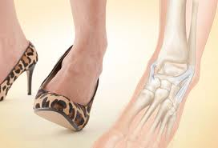
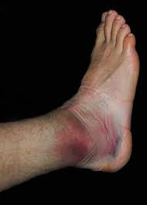
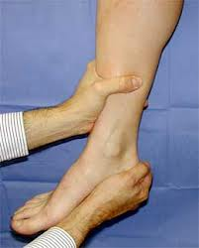
History and physical examination
History suggestive of inversion injury
Localized tenderness, swelling, and ecchymosis over the lateral ankle.
The anterior drawer test may demonstrate anterior talar subluxation.
The talar tilt stress test may demonstrate positive tilt to inversion stress.

Slide 58
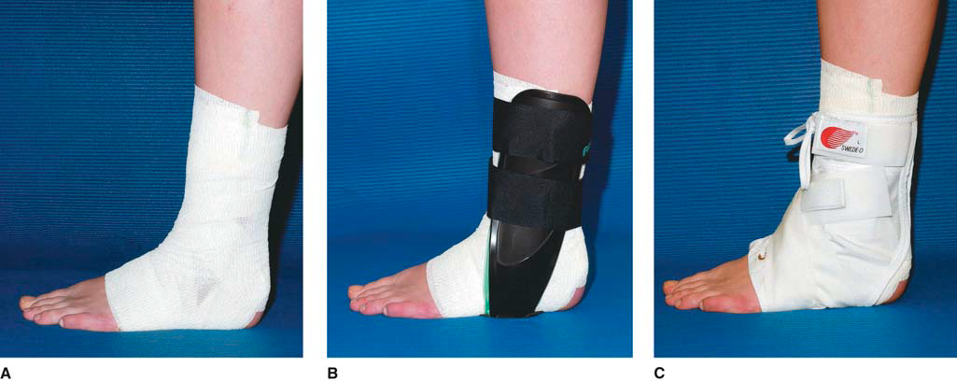
Treatment
Nonsurgical
Initial treatment consists of RICE.
Early weight bearing and use of a protective brace during functional activities facilitates recovery better than non–weight bearing or immobilization.
Functional instability may result and should be treated with a course of physical therapy and proprioceptive training.
Residual mechanical instability may be managed effectively with bracing or taping.
Patients may return to unrestricted activity when cutting, running, and hopping on the affected leg are no longer painful.
Ninety percent of acute ankle sprains resolve with RICE and early functional rehabilitation.
Surgical––Surgery is a reasonable option when an adequate trial of nonsurgical treatment fails to control symptoms for grade III.

