Slide 2
Orthopedic Emergencies: Compartment Syndrome Acute Joint Dislocation
Sultan Aldosari, MD, FRCSC, MBA

Slide 3
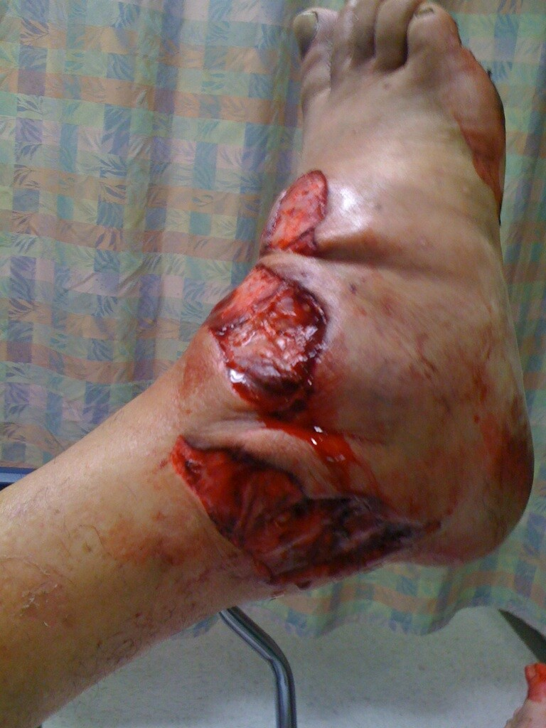
Compartment syndrome

Slide 4
Objectives
To explain the pathophysiology of CS
To Identify patients at risk of developing CS
To be able to diagnose and initially manage patients with CS
To be able to describe the possible complications of CS

Slide 5
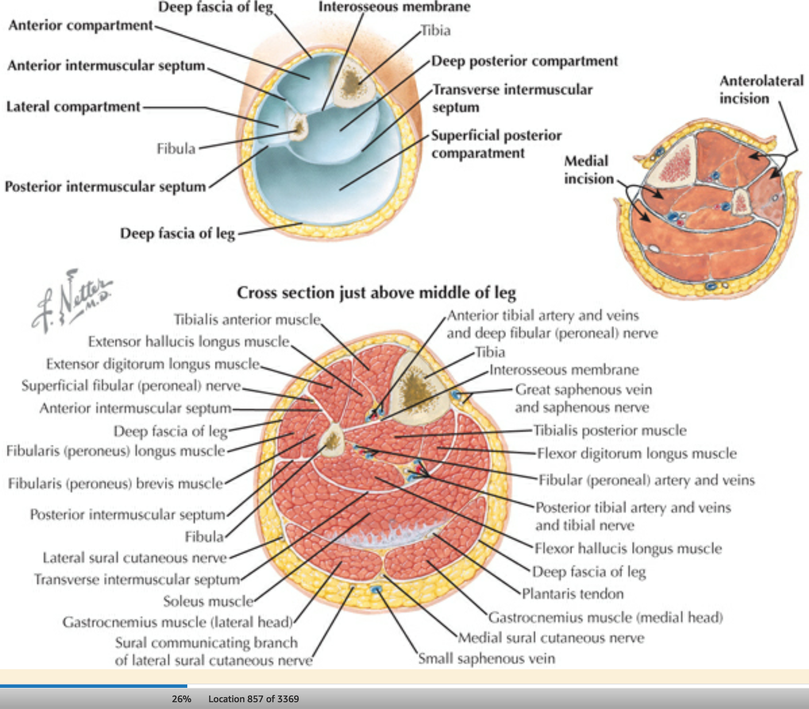
Definition
Orthopedic emergency
Intercompartmental pressure exceeds prefusion pressure
It can develop wherever a compartment is present
Artery> arteriole> capillary bed (diffusion/exchange)> venule> vein

Slide 6
Definition
“Acute compartment syndrome is a potentially devastating condition in which the pressure within an osseofascial compartment rises to a level that decreases the perfusion gradient across tissue capillary beds, leading to cellular anoxia, muscle ischemia, and death”

Slide 7
Pathophysiology

Slide 8
Pathophysiology
Threshold pressure:
30 mm Hg (rigid)
Less than 30 mm Hg difference between compartment pressure and diastolic pressure (clinically relevant)

Slide 9
Etiologies: Increase the Compartment Volume
Close soft tissue injury/ crush injury
Close fracture
Open fracture
Hemorrhage:
Vascular injury
Coagulopathy (anticoagulation therapy)
Increased capillary permeability after burns (especially circumferential)
Infusions or high-pressure injections (eg, regional blocks, paint guns)
Reperfusion after prolonged periods of ischemia

Slide 10
Etiologies: Reduction in Volume of Tissue Compartments
Tight circumferential dressings (eg, can occur with cotton cast padding alone)
Cast or splint
Prolonged limb compression, as in Trendelenburg and lateral decubitus or from alcohol or drug abuse
Risk factors (general):
Head injury
Decreased conciseness (Late diagnosis)
Hypotension

Slide 11
Etiologies: Orthopedics conditions
Underlying Condition | % of Cases
Tibial diaphyseal fracture | 36
Soft tissue injury | 23.2
Distal radius fracture | 9.8
Crush syndrome | 7.9
Diaphyseal fracture forearm | 7.9
Femoral diaphyseal fracture | 3.0
Tibial plateau fracture | 3.0
Hand fracture(s) | 2.5
Tibial pilon fractures | 2.5
Foot fracture(s) | 1.8

Slide 12
Diagnosis: Early
Pain!!!
Pain increase with stretching the involved compartment
Presence of risk factor
High index of suspicion

Slide 13
Diagnosis: Late
Paresthesia
Paralysis
Pallor
Severely high pressure:
Pulselessness (RARE!)

Slide 14
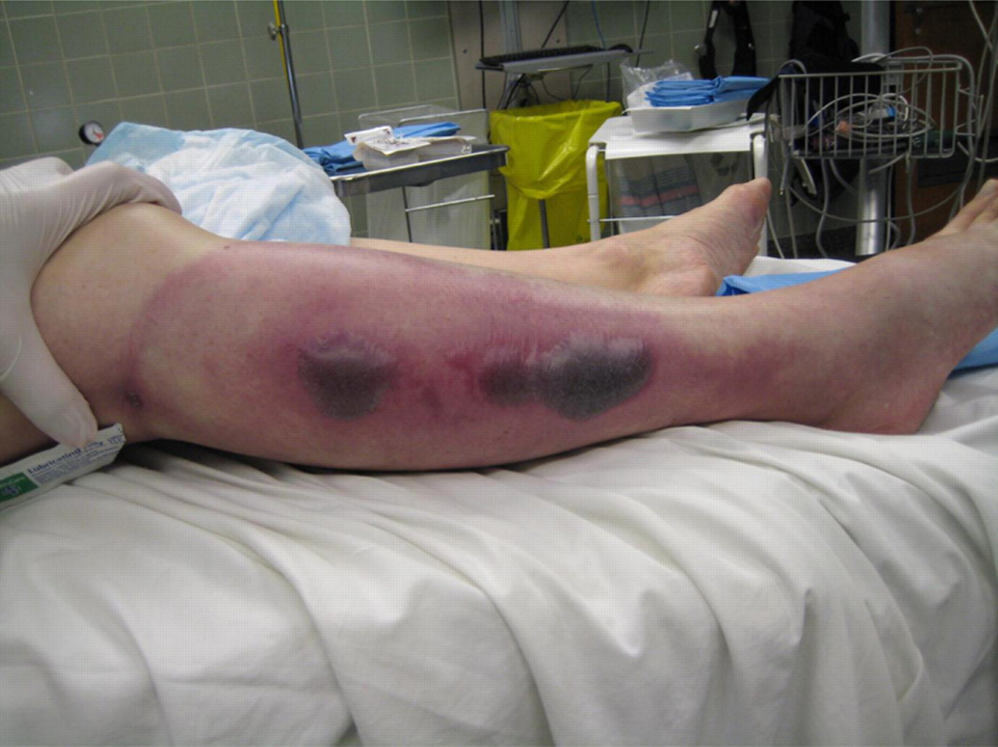
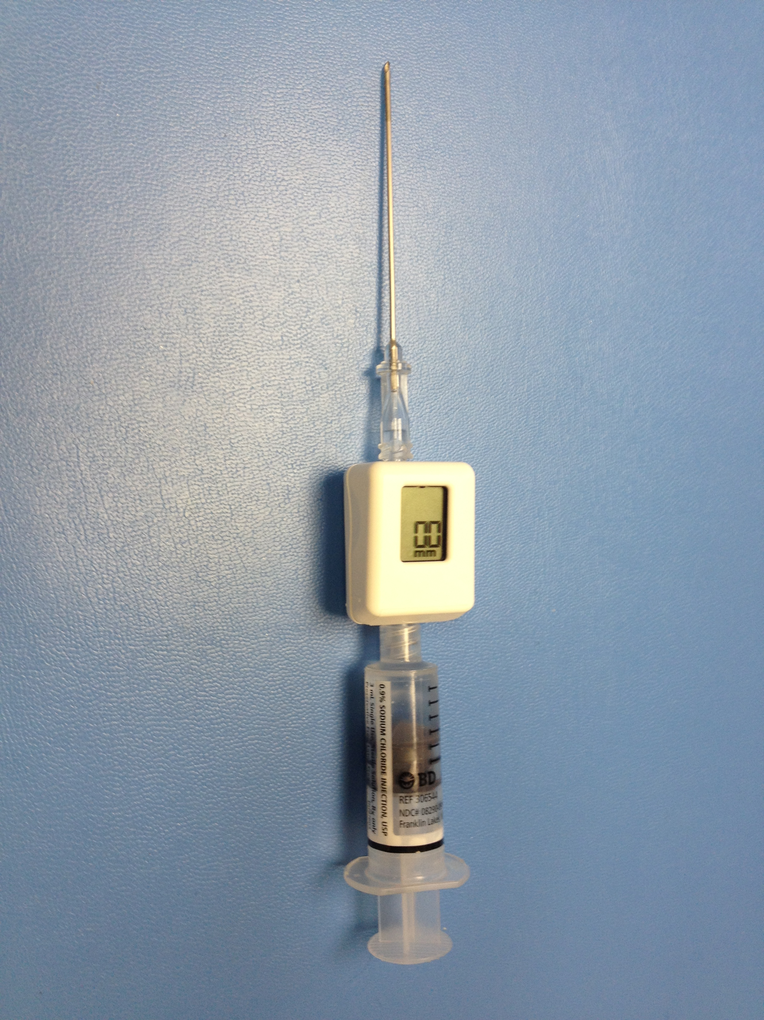
Diagnosis
Tight, woody compartment
Tender compartment
Measurement:
Rarely necessary
Must be done at area of highest expected pressure
May give false low result

Slide 15
Management
Prevention
Maintain normal blood pressure
Remove any constricting bandage
Keep limb elevated
Regular close monitoring
Avoid nerve blocks, sedation and strong analgesia to obtain patients feed back

Slide 16
Management
Fully developed CS
Maintain normal blood pressure
Remove any constricting bandage
Keep limb at heart level
Diuresis to avoid kidney tubular injury if late
Urgent surgical decompression (Fasciotomy)

Slide 17
Fasciotomy
Indications:
6 hours of total ischemia time (ex: arterial embolism)
Significant tissue injury
Worsening initial clinical picture
Delayed presentation with a picture of developed CS
Absolute Compartment pressure >30 mmHg or <30 mm Hg difference from diastolic pressure

Slide 18
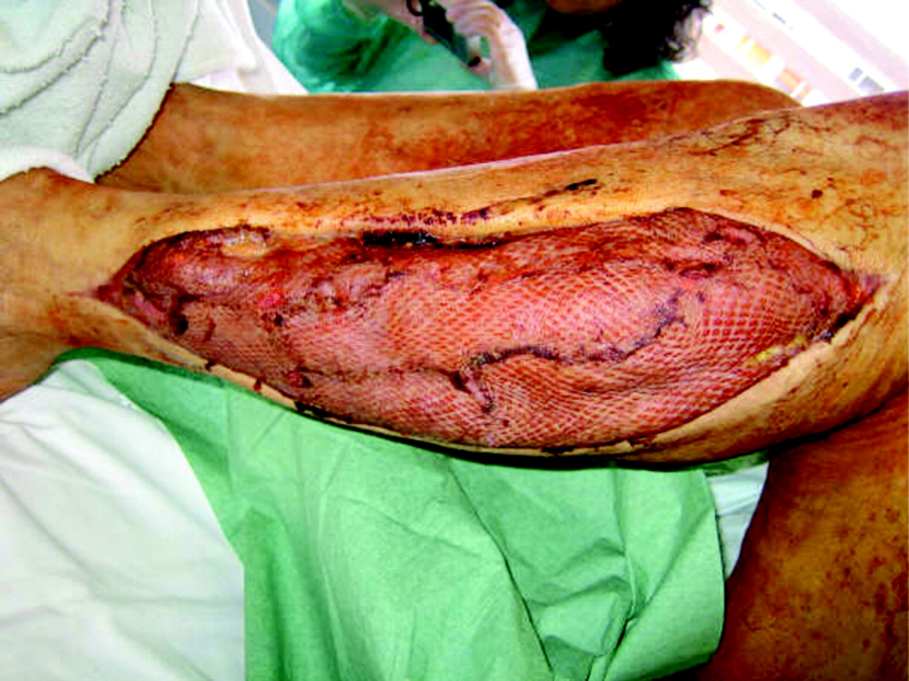
Fasciotomy
Releasing the compartment fascia
Allows swollen muscles to expand in volume
Results in decreased compartment pressure
Avoids further damage
Does not reverse already occurred damage
Ideally should be done as soon as diagnosis is made

Slide 19
Fasciotomy
Should be done as long as there is still viable tissue
Should not be done if there is no expected viable tissue, Otherwise infection is likely
Debridement of all necrotic tissue is necessary
Second and third look surgeries are often required
Closure of skin is usually achieved after swelling has subsided
Skin grafting is often required

Slide 20
Fasciotomy
It is a prophylactic procedure
Does not reverse injury to permanently damaged tissue
so better to have a low threshold!

Slide 21
Complications
Myonecrosis --> myoglobinuria-->myoglobinuria--> kidney tubular damage
Loss of function of the involved compartment:
Flexion contracture
Paralysis
Loss of sensation

Slide 22
Complications
Leg:
Anterior compartment:
Drop foot
Deep posterior compartment:
Claw toes
Loss of sensation in the sole
Forearm:
Volar compartment:
Volkmann's contracture

Slide 23
Acute joint dislocation

Slide 24
Objectives
To describe mechanisms of joint stability
To be able diagnose patients with a possible acute joint dislocation
to be able to describe general principles of managing a patient with a dislocated joint
to describe possible complications of joint dislocations in general and in major joints such as the shoulder, hip and knee

Slide 25
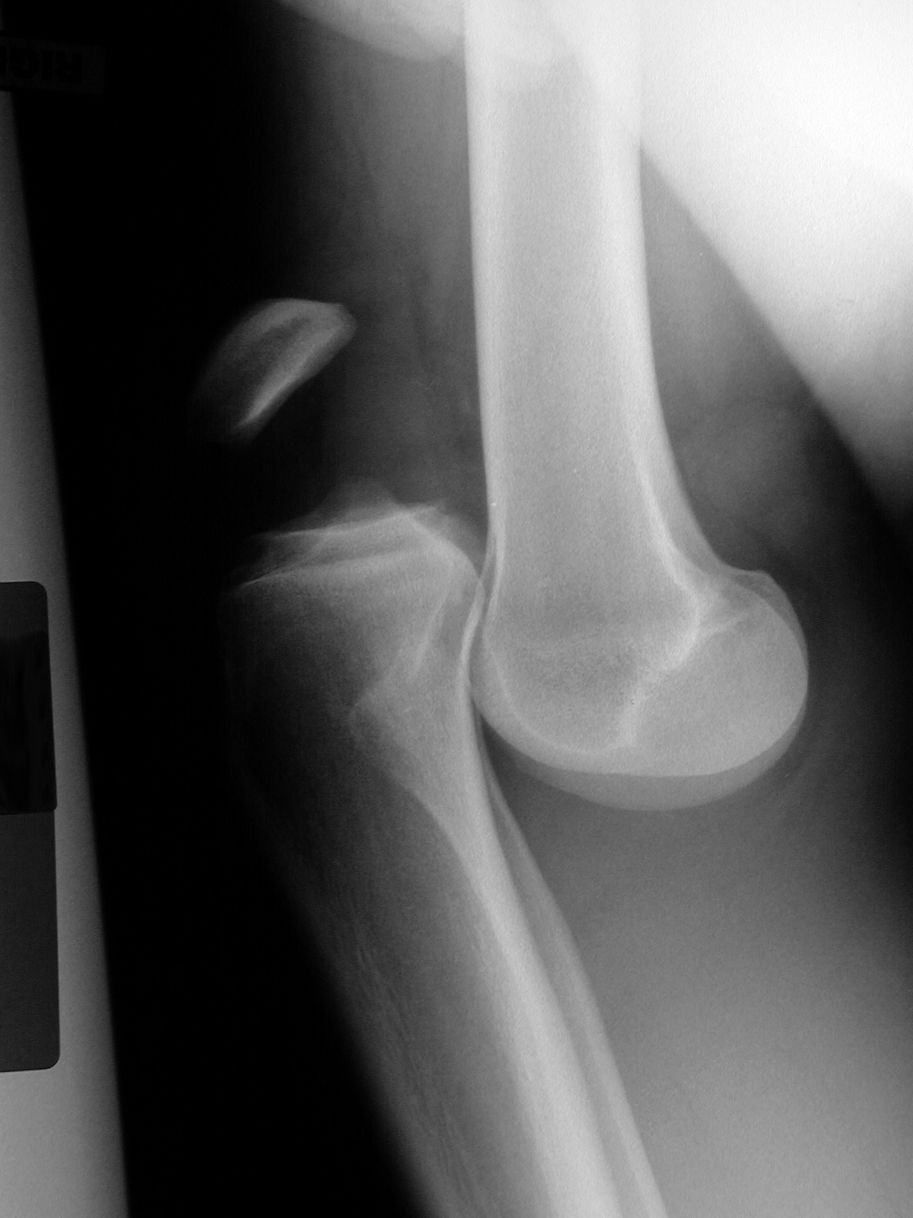
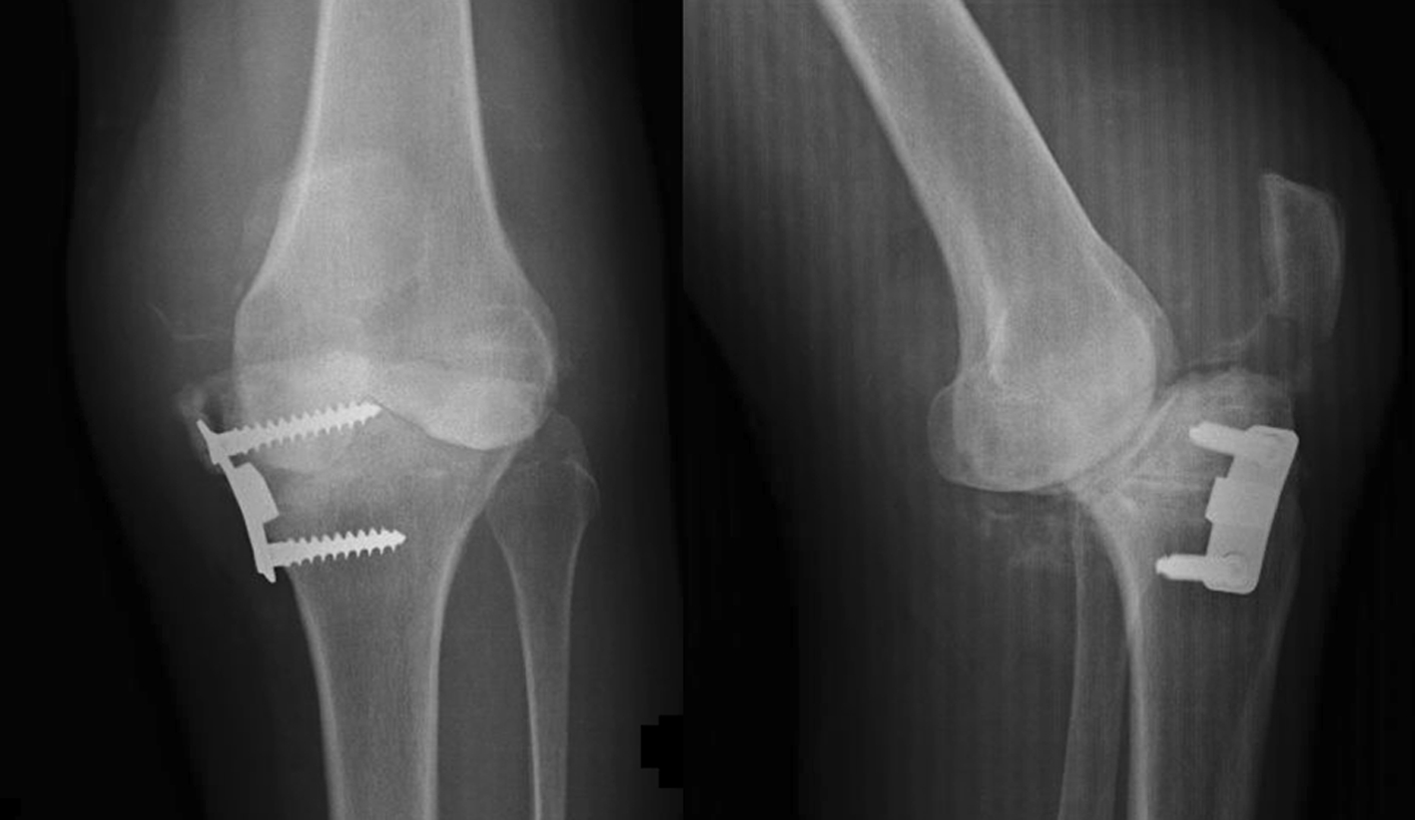
Definition
Dislocation:
Total loss of contact between the articular surfaces of the joint
Subluxation:
partial loss of contact between the articular surfaces of the joint

Slide 26
Definition
A joint dislocation is described by stating the location of the distal segment
Anterior shoulder dislocation: anterior displacement of the humeral head relative to the glenoid
Posterior hip dislocation: posterior displacement of the femoral head relative to the acetabulum

Slide 27
Joint stability
Bony stability
Shape of the joint (ball and socket vs round on flat)
Soft Tissue :
Dynamic stabilizer: Tendons/Muscles
Static stabilizer: Ligaments ± meniscus/labrum
Complex synergy leading to a FUNCTIONAL and STABLE joint

Slide 28
Pathophysiology
It takes higher energy to dislocate a joint with bony stability than a joint with mainly soft tissue stability
Connective tissue disorders may lead to increased joint instability due to abnormal soft tissue stabilizers.
Dislocation of a major joint should lead to considering other injuries.

Slide 29
Pathophysiology
When a joint is subjected to sufficient force in certain directions it might sustain a fracture, a dislocation or a fracture dislocation
Different joints have different force victors that may lead to a dislocation
A joint might dislocate in different directions

Slide 30
At risk groups
Major trauma victims
Athletes and sport enthusiasts
Connective tissue disorder patients

Slide 31
Diagnosis
History of a traumatic event ( major trauma or any trauma with the limb in high risk position)
Pain and inability to use the limb
Deformity
Shortening
Malalignment
Malrotation

Slide 32
Diagnosis
Should check for other injuries (distracting injury)
Should always check the distal neurovascular status.
Should check for compartment syndrome

Slide 33
Diagnosis
X-rays:
Should be done urgently without delay if dislocation is suspected
Two perpendicular views of the involved joint
Occasionally, special views are required such as the axillary view for shoulder dislocation
X-rays to the joint above and below

Slide 34
Management principles
Must rule out other injuries
Pain relief
Urgent reduction
Check stability and safety zone
Check neurovascular status after reduction
X-rays after reduction
Protect the joint
Rehabilitation
Follow for late complications

Slide 35
Management principles: Reduction
Monitor vitals
IV analgesia (opioid)
IV sedation (to relax the muscles)
Gradual traction to distract the joint
Realignment and rotation to reduce the joint based on direction of dislocation
A palpable clunk well be felt
Check ROM and stability of the joint

Slide 36
Management principles: Reduction
Once joint is felt to be reduced, check distal NV status
If it was intact before but not after, farther urgent management is needed
If it was not present before but intact after, check again later to confirm
Observe patients vitals until medications wear out
Stabilize joint and get X-rays

Slide 37
Management principles: Reduction
If irreducible or partial reduction only
Urgent closed reduction under general anesthesia and possible open reduction if closed reduction fails
Usually due to:
insufficient muscle relaxation
Entrapment of soft tissue

Slide 38
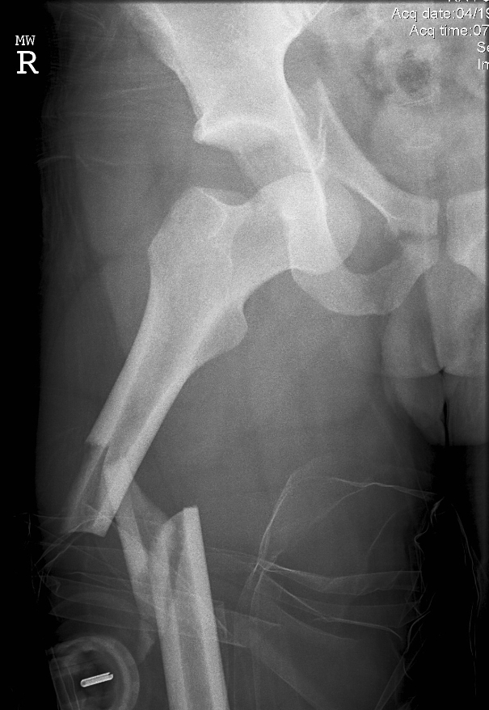
Special considerations
A fracture dislocation is usually reduced in an open fashion in the operating room
Must confirm concentric reduction on the x-rays, otherwise an open reduction should be performed

Slide 39
Early Complications
Heterotopic ossification
Neurological injury (reversible or irreversible)
Vascular injury
Compartment syndrome
Osteochondral fracture/injury

Slide 40
Late complications
Stiffness
Heterotopic ossification
Chronic instability
Avascular necrosis
Osteoarthritis

Slide 41
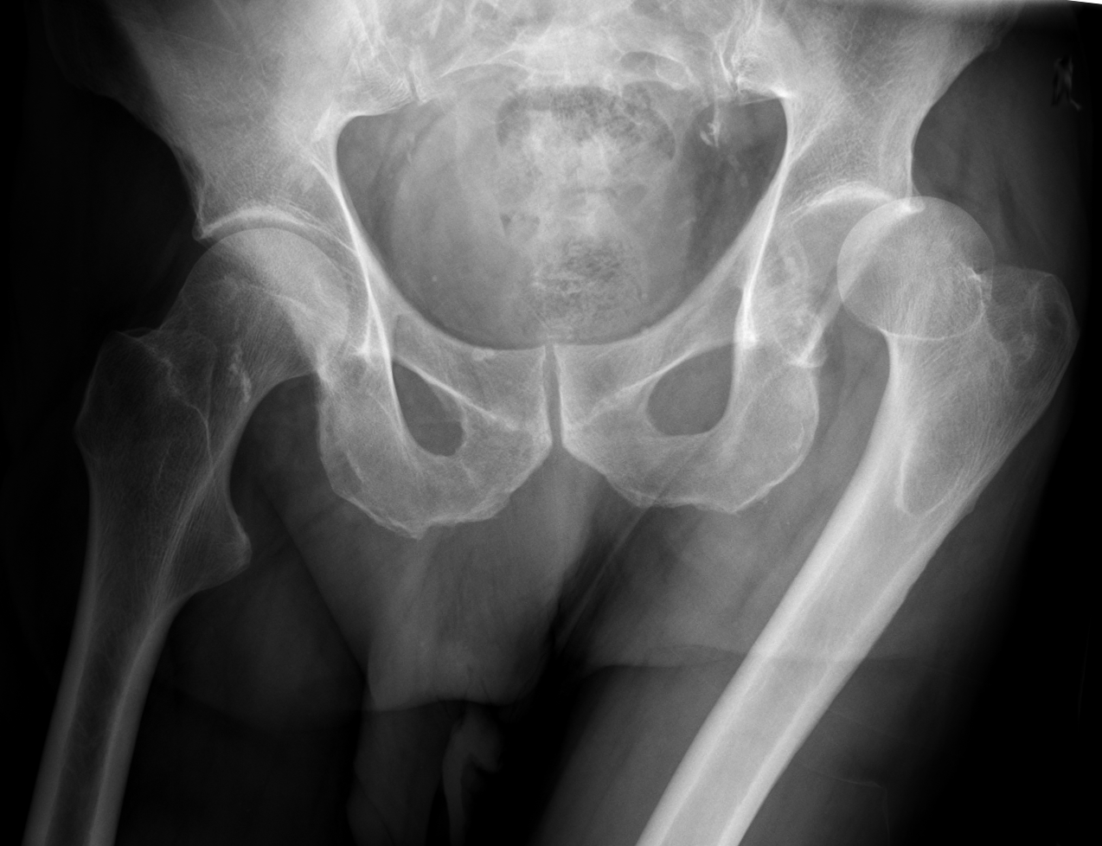
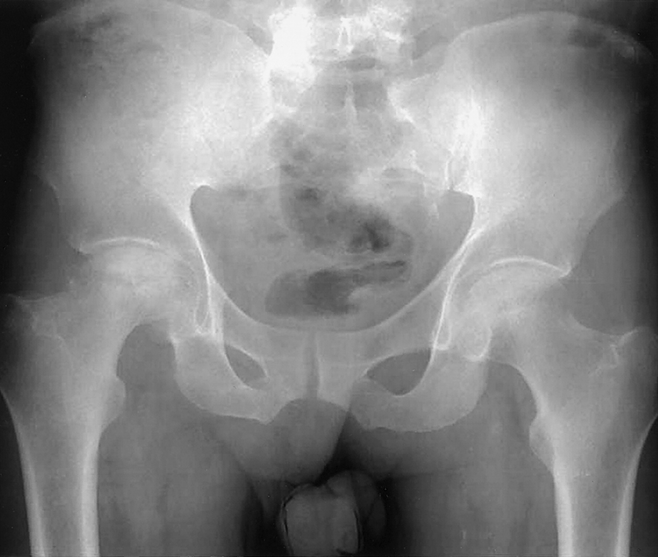
Acute hip joint dislocation
Posterior dislocation is commonest
Major trauma with hip flexed (dashboard injury)
Sciatic nerve injury common
High incidence of late avascular necrosis
An orthopedic emergency!!

Slide 42
Acute should joint dislocation
common
Anterior dislocation is more common
Patients with seizures prone to posterior dislocation
May cause chronic instability
Can result in axillary nerve injury

Slide 43
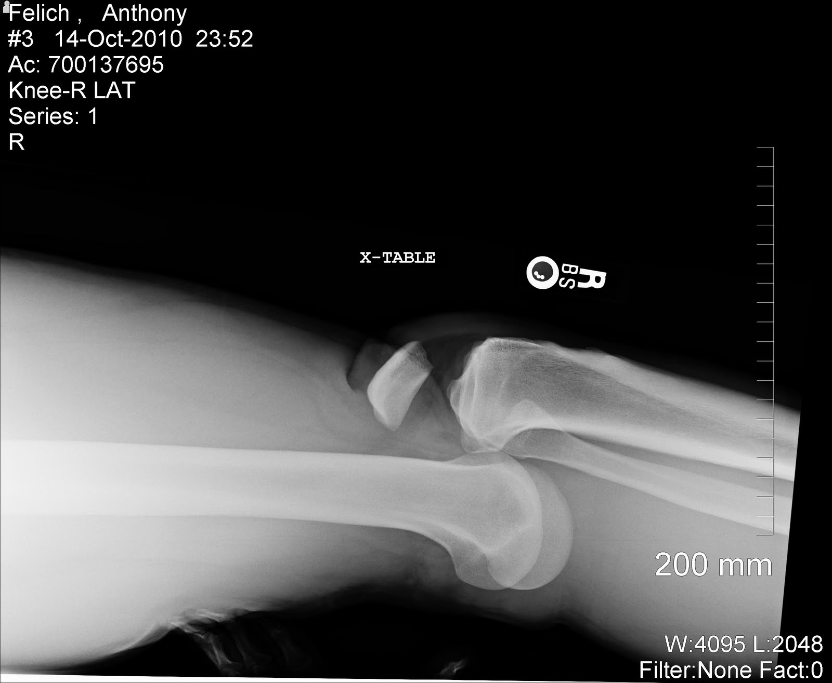
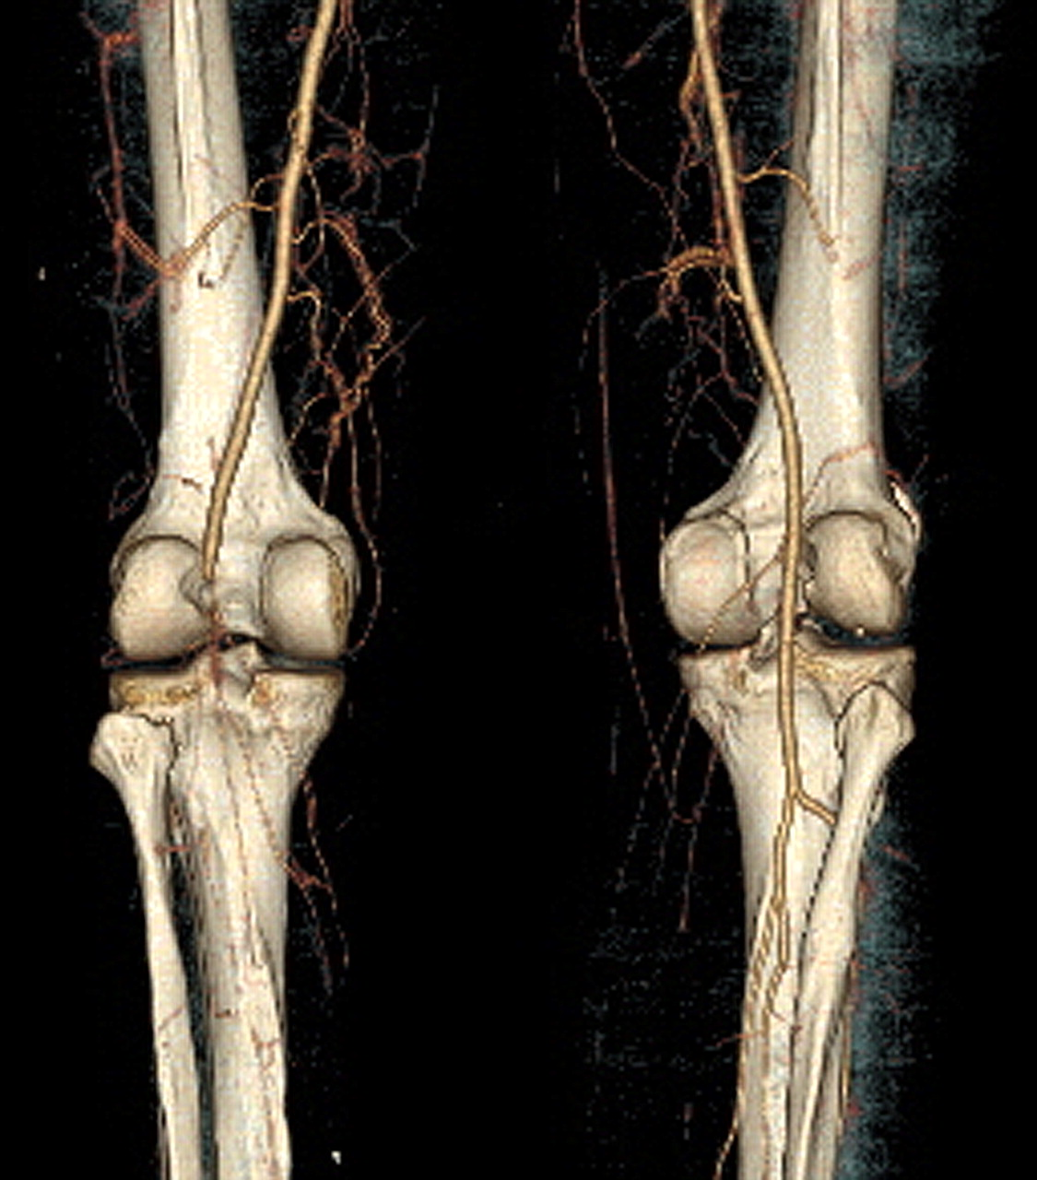
Acute knee joint dislocation
Three or more ligaments
Severe (high energy) trauma
May be associated with popliteal artery injury---- Limb threatening
Very serious
Needs accurate vascular assessment
May be associate with peroneal nerve injury
May be associated with fracture/ compartment syndrome
Most require surgery either early or late or both

Slide 44
Take home messages
High index of suspension is needed to make diagnosis of compartment syndrome
Pain is the most sensitive symptom/sign for compartment syndrome
Early intervention can save limb suffered from compartment syndrome
Joint dislocation is an emergency
Prompt reduction should be performed
Check neurovascular status pre and post reduction

