Slide 1
Orthopedic Emergencies 2
Abdulaziz Aljurayyan, MBBS,MSc, FRCSC
Assistant Professor
Course 452
College of Medicine
KSU

Slide 2
Open Fractures
Fractures with neurovascular Injuries
Unstable Polytrauma Patients With A Pelvic Fracture

Slide 3
Objectives
To be able to identify and diagnose patients with an open fracture, a fracture with nerve or vascular injury and poly-trauma patients with pelvic injuries
To be knowledgeable about the pathophysiology and morbidity associated with these injuries
To be able to apply the principles of management of these injuries at the site of accident and in the emergency room

Slide 4
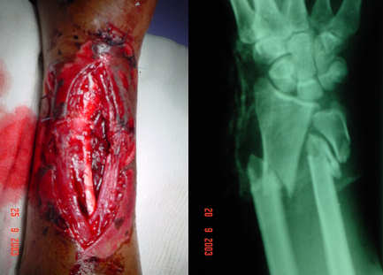
Open Fractures
Definition:
A fracture that that at some point communicated with the environment
An open joint is managed similarly

Slide 5
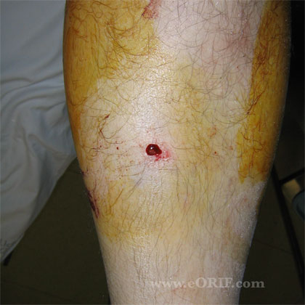
Open fracture
Usually requires higher injury
Not always!
Sometimes can be missed

Slide 6
Open fractures
Commonly occurs in bones with minimal soft tissue coverage
Usually higher energy is required in deep bones

Slide 7
Open fractures
Pathology:
Traumatic energy to the soft tissue and bone
Inoculation of organisms
Necrotic tissue
Injury to vessels and microvasculature
Raised compartment pressure
Ischemia and lack of immune response
INFECTION

Slide 8
OPEN fractures
Infection in the presence of a fracture
Difficult to eradicate
Prolonged antibiotics
Multiple surgeries
Significant morbidity
Significant costs

Slide 9
Open fractures
An open fracture is a usually a “red flag” warning of significant trauma
Detailed assessment of the patient is necessary
An open fracture is associated with significant morbidity
Must act quickly

Slide 10
Open fractures
A delay in management is proven to increase the likelihood of complications
Give urgent priority while triaging, provide initial management and consult urgently

Slide 11
Open fractures Diagnosis
Some times obvious!
Other times, settle,,, be observant
A wound close to a fracture is an open fracture until proven otherwise!
Whenever a fracture is diagnosed, go back and check the skin

Slide 12
Open fractures Diagnosis
A small wound continuously oozing blood, especially, if you see fat droplets within the blood, is an open fracture!
Not always close to the fracture
Don’t probe!!
If in doubt, use good light, if there is a break in the dermis or fat is seen, call it an open fracture
Better to overcall than miss it !

Slide 13
Open fractures Algorithm
Assess and stabilize the patient, ATLS principles
Assess the condition of the soft tissue and bone to help grade the open fracture
Manage the wound locally
Stabilize the fracture
IV antibiotics
Tetanus status

Slide 14
Open fractures Algorithm
Assess and stabilize the patient, ATLS principles
Assess the condition of the soft tissue and bone to help grade the open fracture
Manage the wound locally
Stabilize the fracture
IV antibiotics
Tetanus status

Slide 15
Open fractures Assessment
If polytrauma, apply ATLS principles
If isolated injury:
Mechanism and circumstances of injury
Time since injury
PMH/PSH/Allergy/Drugs/Smoking
Tetanus vaccination status

Slide 16
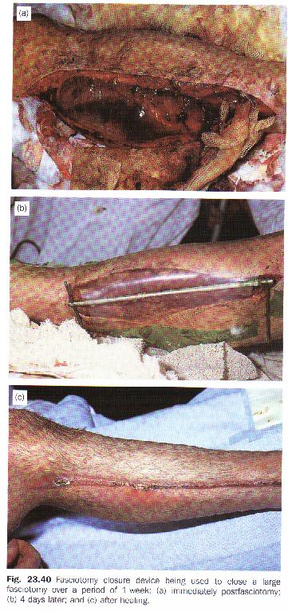
Open fractures Assessment
Examine the affected region for:
Soft tissue:
Degree of contamination
Necrotic and devitalized tissue
Size of wound
Coverage loss
Compartment syndrome

Slide 17
Open fractures Assessment
Bone:
Comminution
Stripping of bone periosteum
Away from injury to joint above and below
X-rays to joint above and below

Slide 18
Open fractures Assessment
Neurovascular status distally:
On arrival and post reduction and splinting later

Slide 19
Open fractures Assessment
Open fracture grade:
Grade 1:
Less or equal to 1 cm, clean, non segmental nor severely comminuted fracture, less than 6 hours since injury

Slide 20
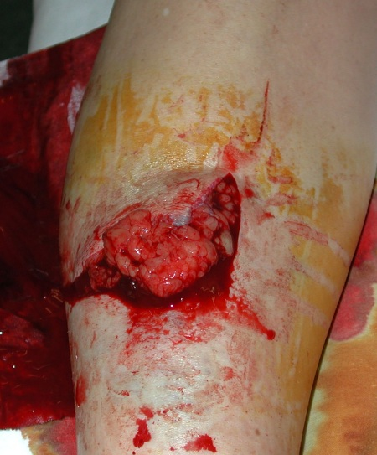
Open fractures Assessment
Grade 2 open fracture:
>1cm wound, not extensive soft tissue injury or contamination, non segmental nor severely comminuted fracture, no bone stripping and with adequate soft tissue coverage

Slide 21
Open fractures Assessment
Grade 3 open fracture:
3A: Any size with extensive soft tissue contamination or injury but not requiring soft tissue coverage procedure, or with a segmental or severely comminuted fracture, or late presentation more than 6 hours
3B: Any open fracture that requires soft tissue coverage procedure
3C: Any open fracture that requires vascular repair

Slide 22
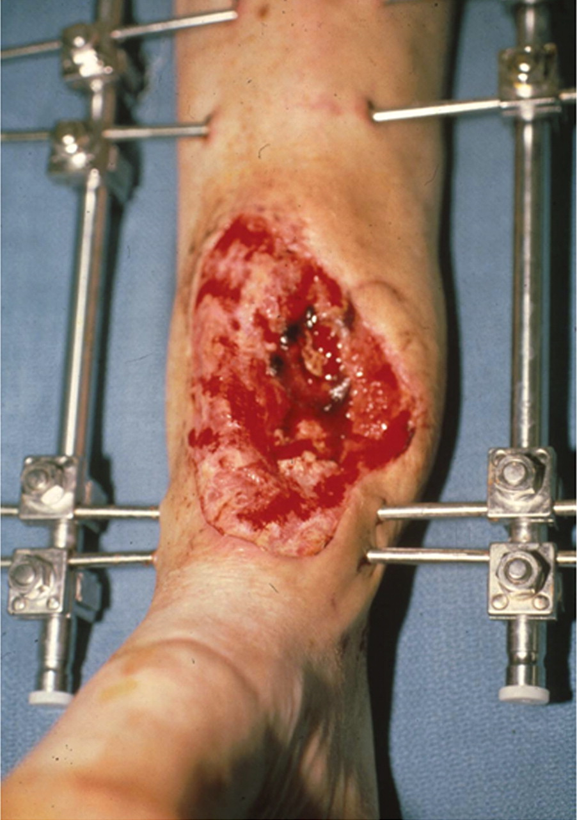
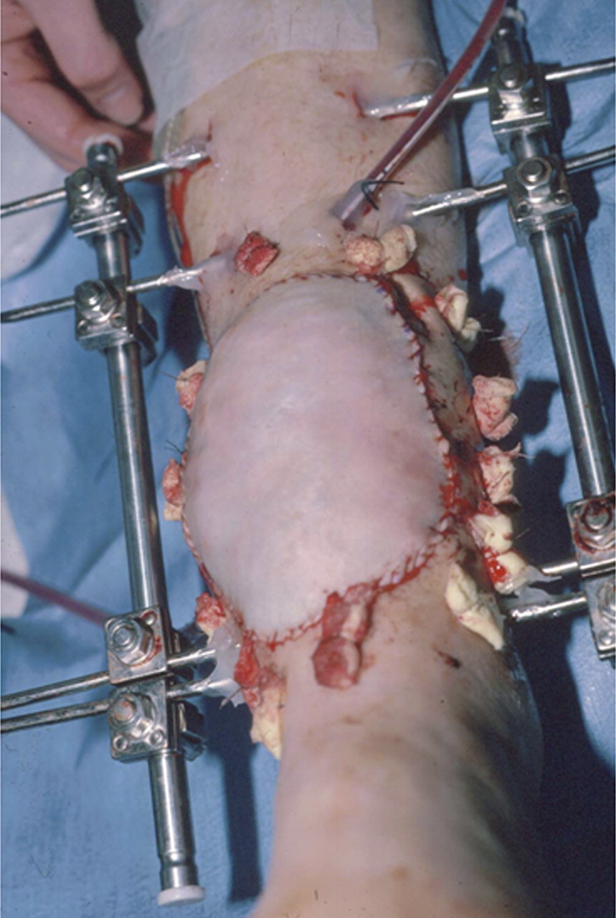
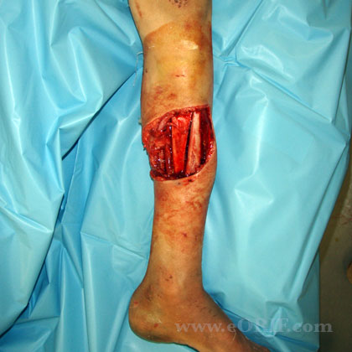
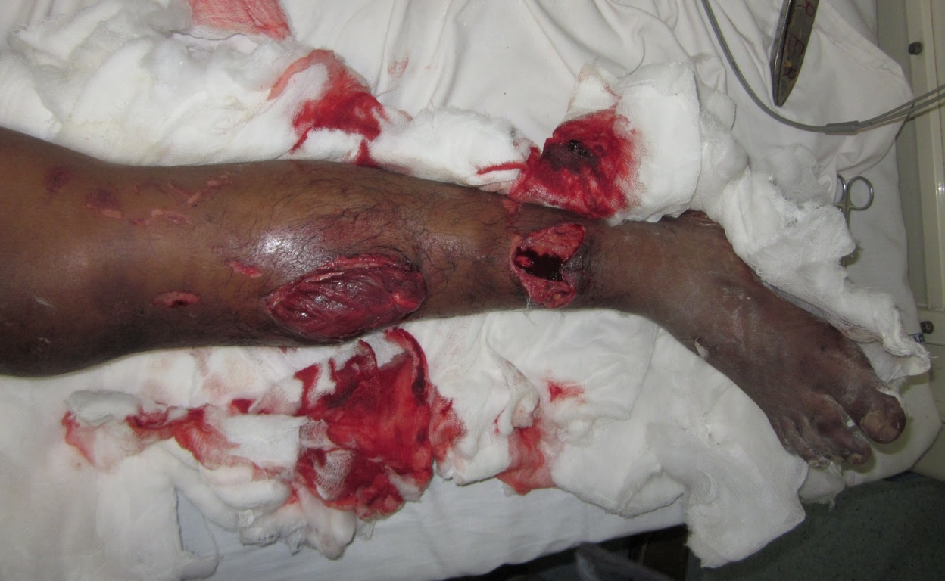
Open fractures Assessment

Slide 23
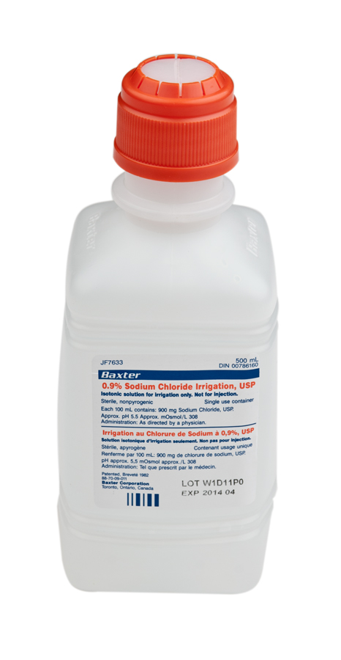
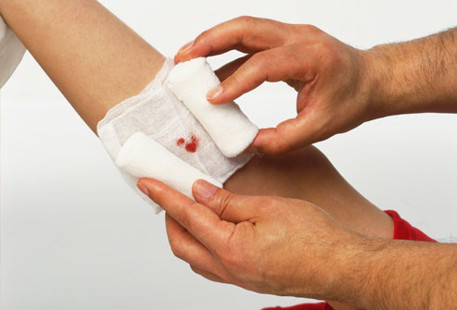
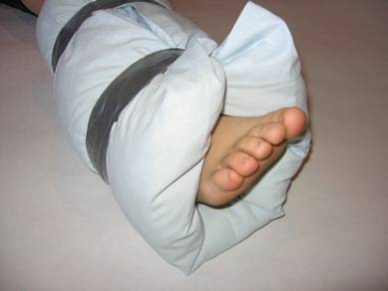
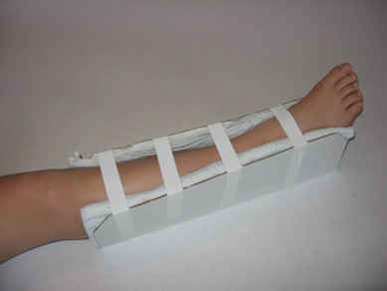
Open fractures Management
Local:
Take a picture!
If dirty, irrigate with normal saline to remove gross contamination
If bone sticking out try to reduce gently then immobilize and re-check neurovascular status
Cover with sterile wet gauze
If bleeding apply direct pressure on wound
No culture swabs in ER

Slide 24
Open fractures Management
Antibiotics:
First generation Cephalosporin for gram positives (Ex: Cefazolin) in all open fractures
Aminoglycoside to cover gram negatives ( Ex: Gentamicin) sometimes not required in grade 1 but in general it is safer to give in all grades
Add penicillin or ampicillin or clindamycin for clostridium in grade 3 open fractures and all farm and soaked wounds

Slide 25
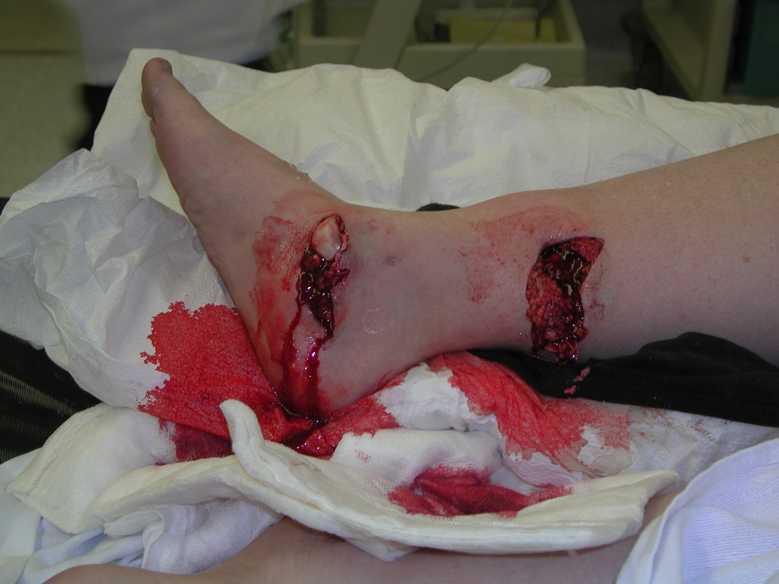
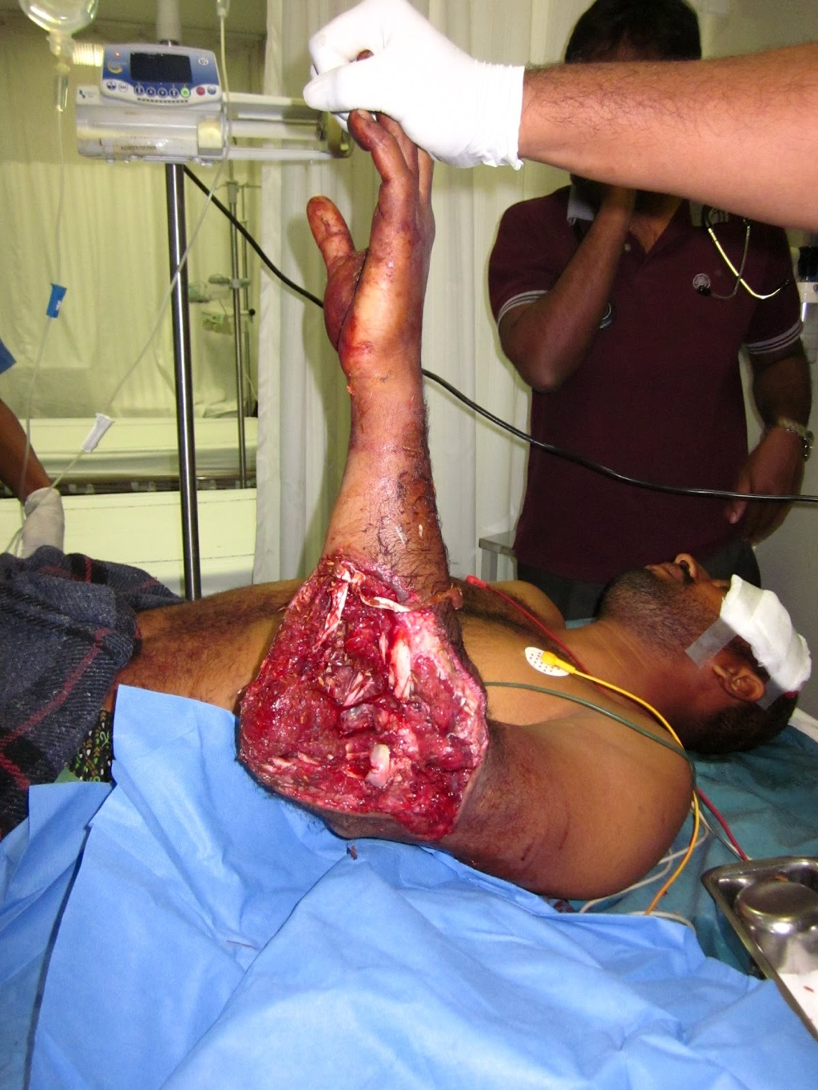
Open fractures Management
Tetanus prevention:
Wound types:
Clean wounds:
<6 hours from injury
Not a farm injury
No significant devitalized tissue
Non immersed wound
Non contaminated wound
Other wounds

Slide 26
Open fractures Management
Tetanus prevention:
Clean wounds |  |  | Other wounds
Completed vaccination |  | Not completed or unknown | Completed vaccination |  | Not completed or unknown
Booster < 10 years | Booster >10 years | Td 0.5ml IM | Booster < 5years | Booster > 5 years | TIG 250U And Td 0.5ml IM
nothing | Td 0.5 ml IM |  | nothing | Td 0.5ml IM

Slide 27
Open fractures Management
As soon as patient is stable and ready, alert the OR, and consent for surgery
Plan: Irrigation, debridement and fracture stabilization
The sooner the less risk of further morbidity

Slide 28
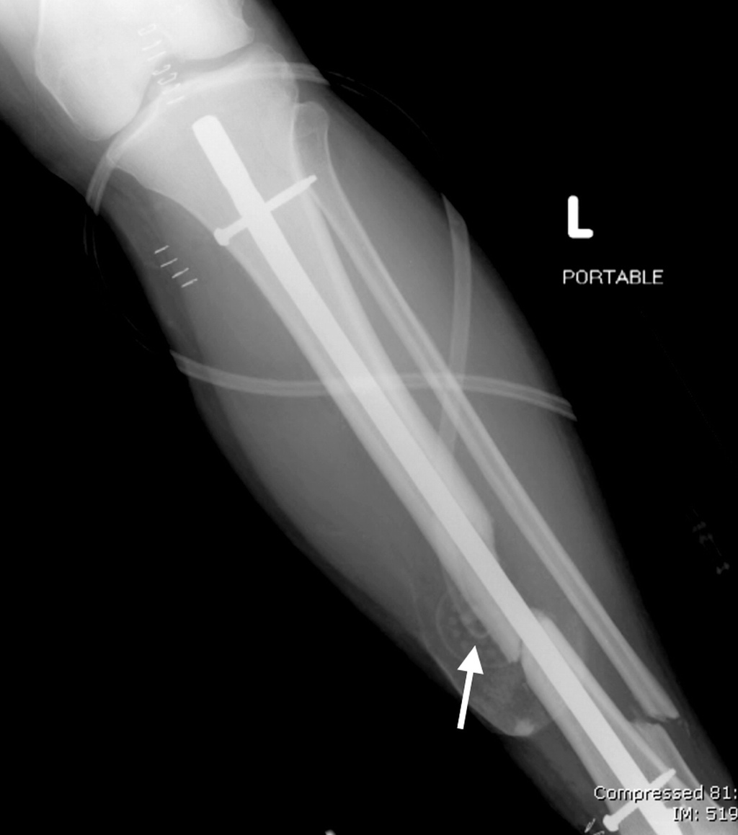
Open fractures Management
In the OR:
Extend wound if necessary
Thorough irrigation
Debride all necrotic tissue
Remove bone fragments without soft tissue attachment except articular fragments
Usually requires second look or more every 48-72 hours
Generally do not close open wounds on first look

Slide 29
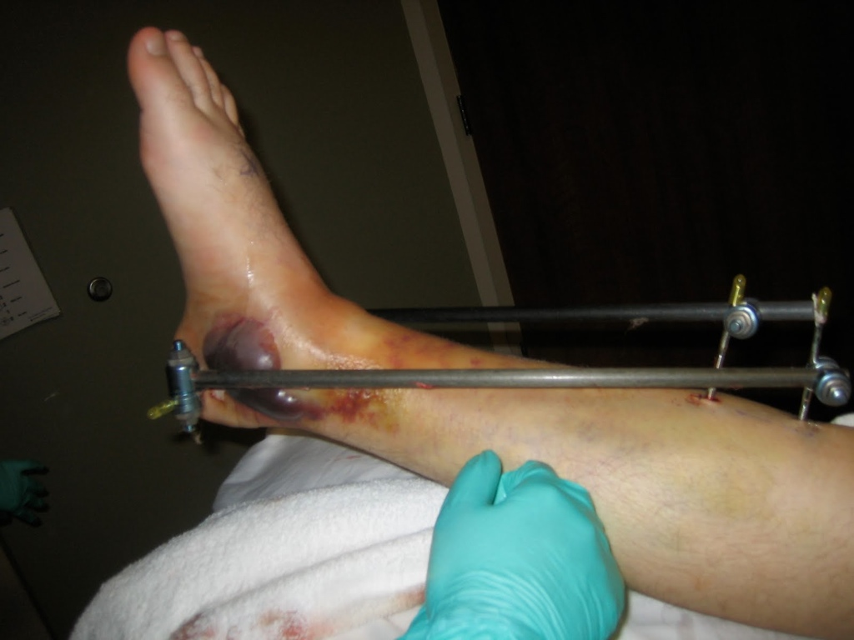
Open fractures Management
Fracture management:
Generally avoid internal fixation (plate and screw)
Generally external fixator is used.
Femur and tibia fractures can usually be treated immediately with IM nail except severe injuries and contamination
Observe for compartment syndrome post- operatively

Slide 30
Open fractures Results
If all principles applied:
2% complication rate in grade 1
10% complication rate in grade 2
Up to 50% complication rate in grade 3

Slide 31
Fractures with nerve or vascular injuries
Don’t miss it !!!!
Always perform an accurate assessment at presentation, post manipulation and reduction, post surgical fixation, serially until condition stabilizes
Serial examination helpful in deciding line of treatment
Serial examination helps avoid confusion

Slide 32
Fractures with nerve or vascular injuries
High correlation between vascular injury and nerve injury
Proximity

Slide 33
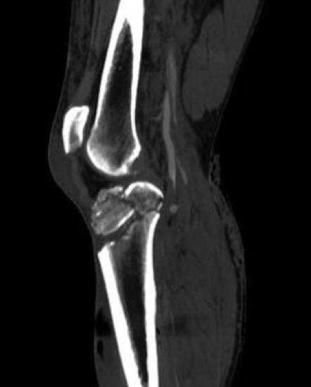
Fractures with nerve or vascular injuries
Mechanisms:
Penetrating trauma
High energy blunt trauma
Significant fracture displacement
Keep in mind tissue recoil at presentation

Slide 34
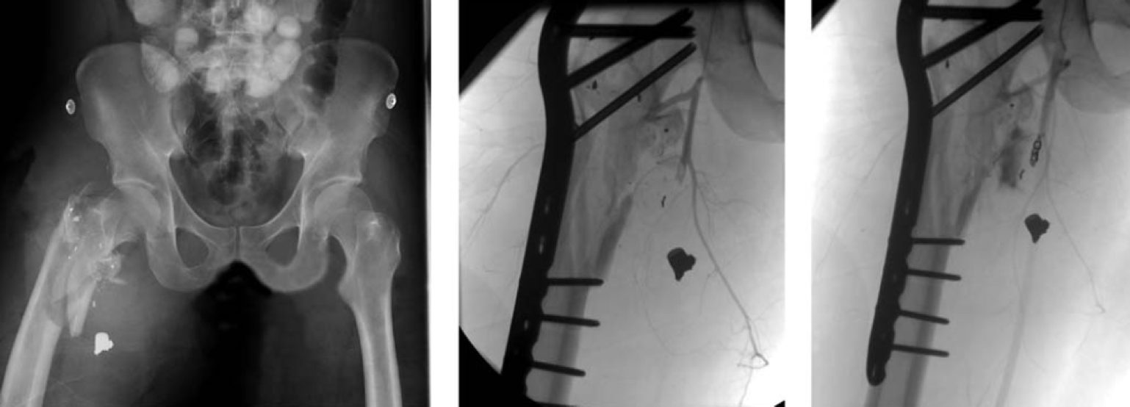
Vascular injuries
Direct laceration
Traction and shearing

Slide 35
Vascular injuries Assessment
Always check:
Pulse, Color, Capillary refill, Temperature, compartment pressure
Keep high index of suspicion:
High energy trauma
Associated nerve injuries
Fractures/ Dislocations around the knee

Slide 36
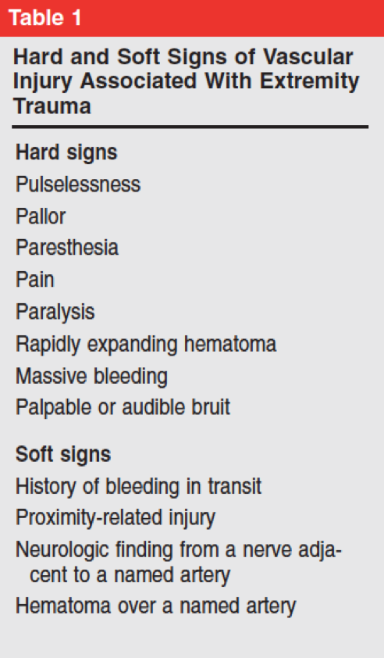
Vascular injuries Assessment

Slide 37
Vascular injuries Assessment
Hard signs > realignment of limb > if persistant >
vascular intervention
Hard signs > realignment of limb > improved >
Close observation
Realignment can result in unkincking of vessels, lowering compartment pressure, relaxation of arterial spasm

Slide 38
Vascular injuries Assessment
ABI
< 0.9 associated with vascular pathology
Rarely can give false negative result (Ex. Profunda femoris)
Always used in high risk fractures (knee)
If positive > Urgent vascular intervention

Slide 39
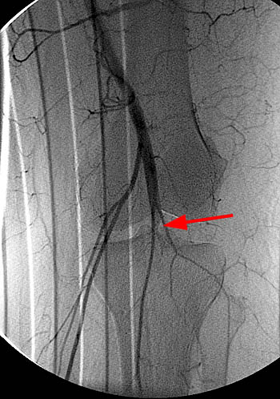
Vascular injuries Assessment
Angiography, CT angiography
Gold standard
Not without risks
Vascular surgeon to arrange with interventional radiologist

Slide 40
Vascular injuries Management
Once vascular injury is confirmed:
Coordination between:
Vascular surgeon
Orthopedic surgeon
General surgeon
To emergently re-establish perfusion and protect repair with skeletal stabilization

Slide 41
Vascular injuries Management
Warm ischemia time dictates treatment
Most times, a quick external fixator is applied, followed by vascular repair
Avoid prolonging warm ischemia to do

Slide 42
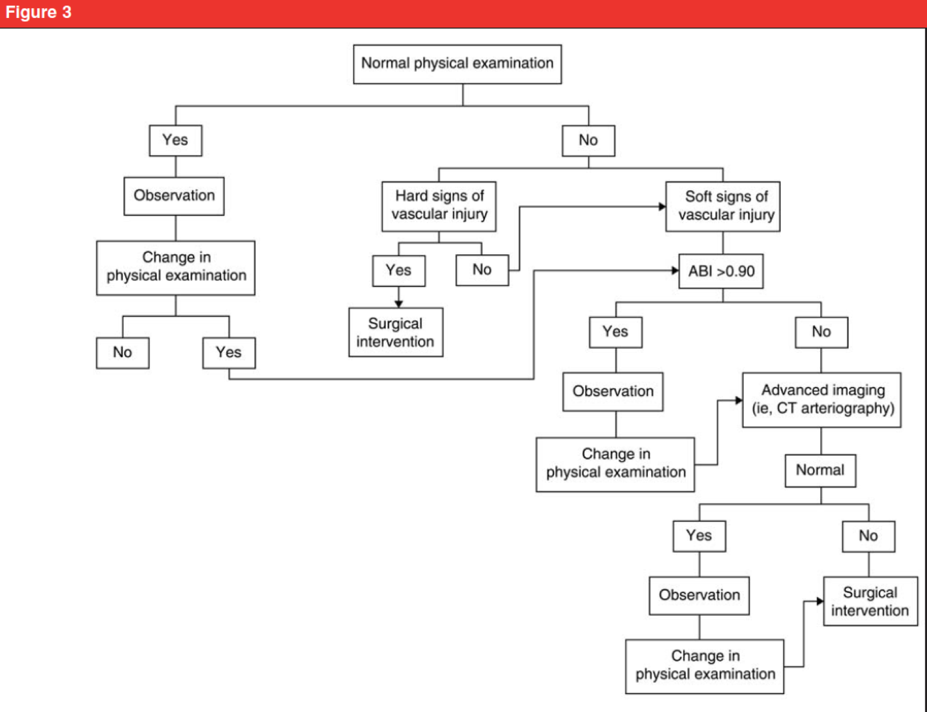
Vascular injuries Management

Slide 43
Vascular injuries Management
Prolonged warm ischemia >6 hours
Prophylactic fasciotomy
Grade 3C open fractures have the worst outcome
Amputation may be necessary in severe cases

Slide 44
Nerve injuries
Cause of medico-legal concern
Accurate assessment and documentation at presentation, post reduction, post surgery is essential
Remember to examine for motor and sensation prior to sedation

Slide 45
Nerve injuries
Closed fractures not requiring surgery with nerve injuries:
Usually good outcome >80%
Usually managed conservatively in the early stages
Recovery may take more than 6 months

Slide 46
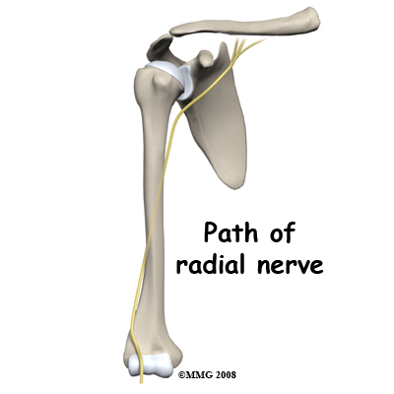
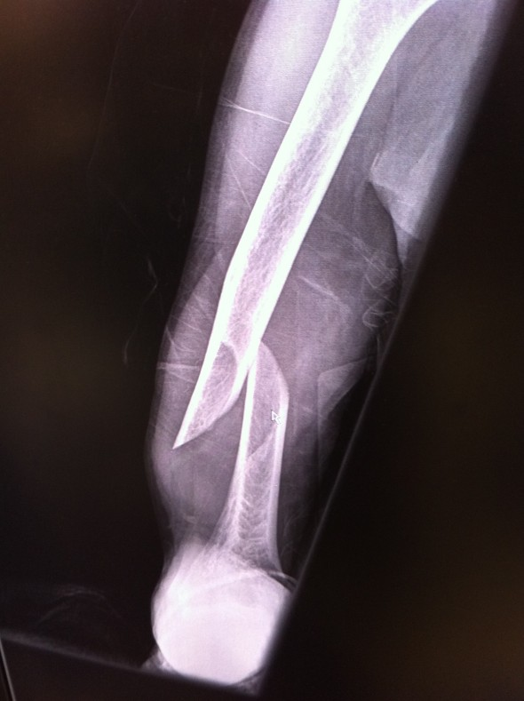
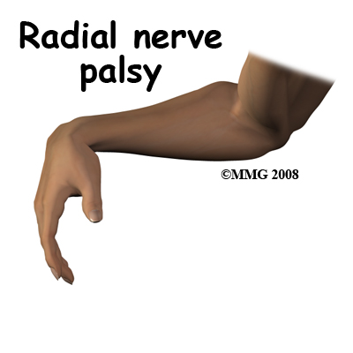
Nerve injuries
Intact nerve before reduction, absent after reduction:
Controversial management
Usually observe

Slide 47
Nerve injuries
Fracture requiring surgery with nerve injury:
Limited exploration

Slide 48
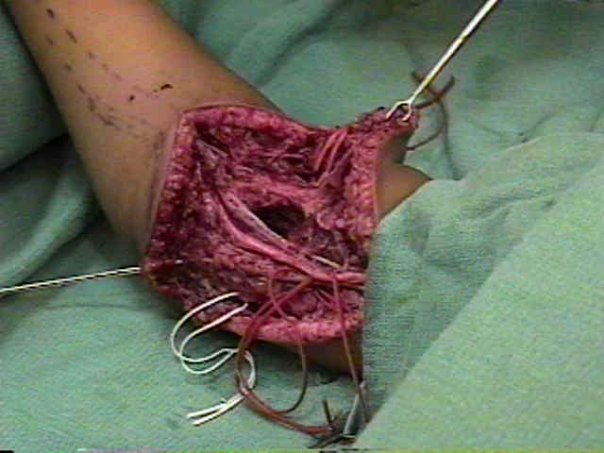
Nerve injuries
Open fracture with nerve injury:
Explore, tag nerve ends for later repiar

Slide 49
Nerve injuries
Follow up:
Clinically
Electrodiagnostic assessment start at 6 weeks then serially every 6 weeks
If no improvement:
Nerve exploration: neurolysis / repair / grafting
Tendon transfers to preserve function

Slide 50
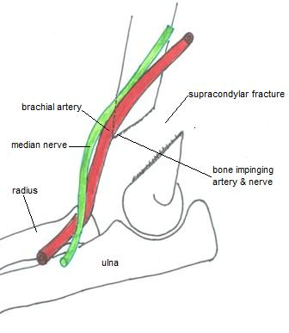
Nerve injuries Common sites
Shoulder fracture / dislocation > Axillary nerve
Distal humeral shaft fracture > Radial nerve
Elbow fracture / dislocation > Median>>radial>>ulnar
Hip fracture / dislocation > Sciatic nerve
Knee fracture / dislocation > Peroneal nerve

Slide 51
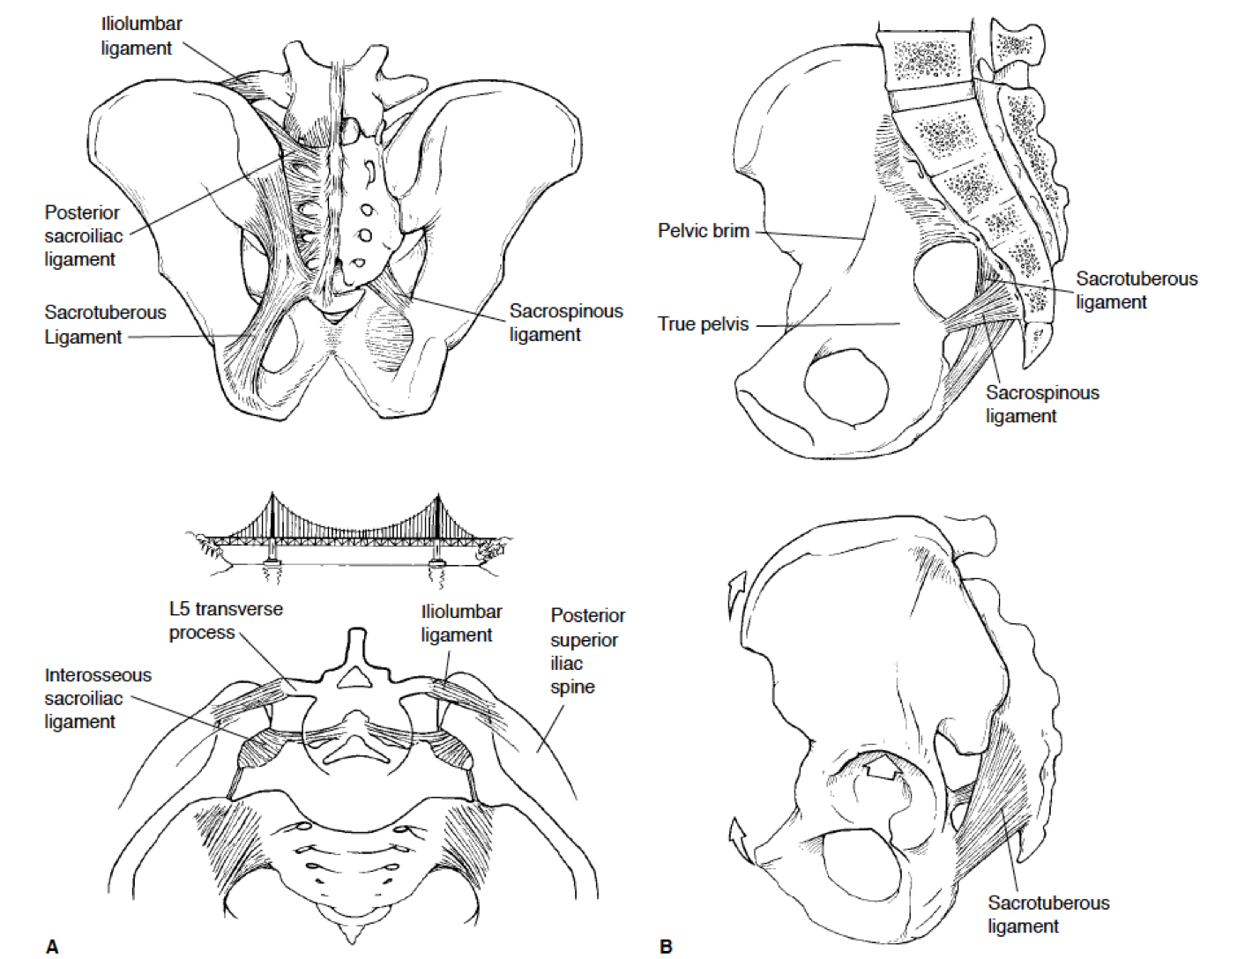
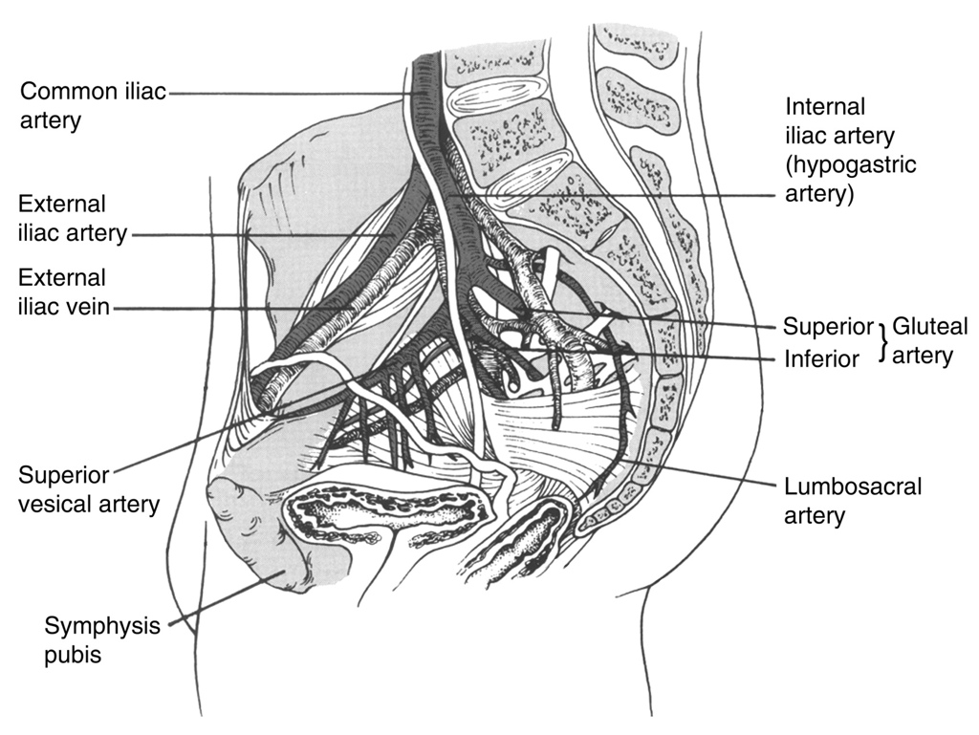
Pelvic trauma In the poly trauma patient
PELVIS ANATOMY

Slide 52
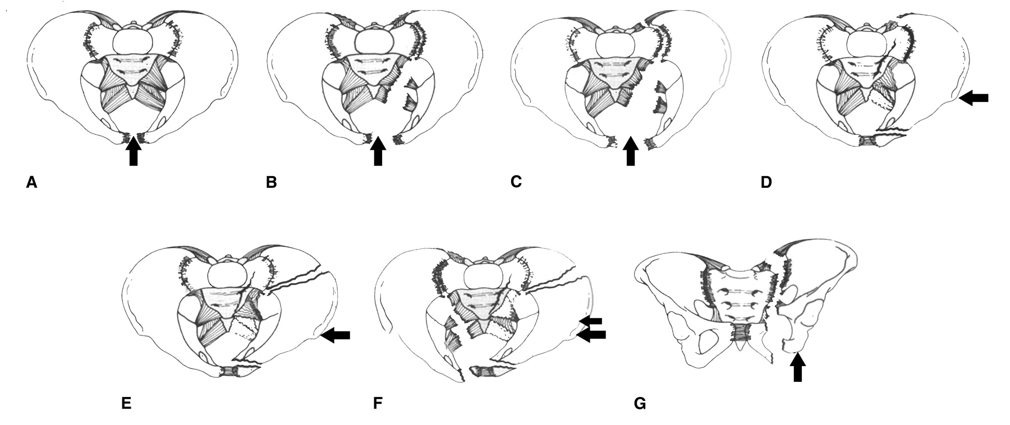
Pelvic trauma In the poly trauma patient
Pathology

Slide 53
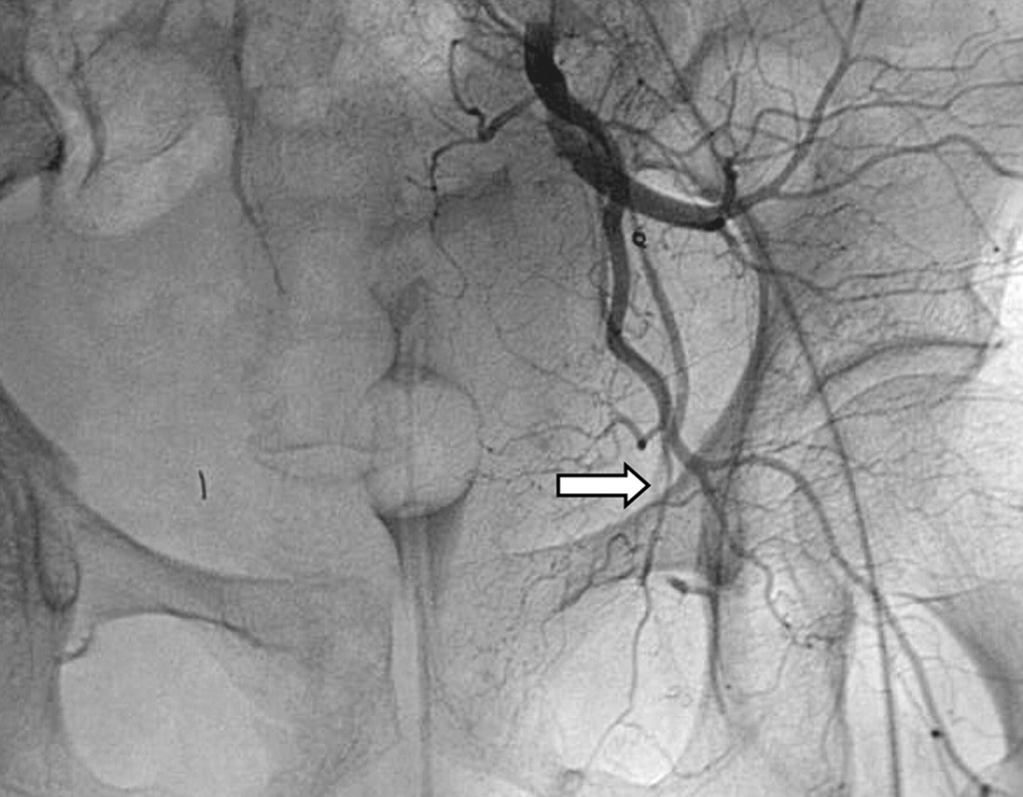
Pelvic trauma In the poly trauma patient
Pelvic fractures / instability may cause life threatening bleeding
Diagnosing pelvic instability can save lives

Slide 54
Pelvic trauma In the poly trauma patient
Diagnosis:
History: High vs. Low eneregy trauma
Mechanism of injury: Anterior vs. Lateral vs. Axial force
Pelvic skin contusion, bruising
Short extremity
Careful neurologic assessment

Slide 55
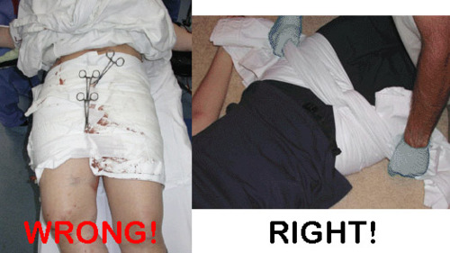
Pelvic trauma In the poly trauma patient
Diagnosis:
Primary survey : part of “C”
Assess stability by gentle compression on the ASIS
Traction on the leg and assess pelvic instability
If unstable or painful:
Apply sheet around hips and close the pelvis gently
This results in decreased intra-pelvic volume leading to tamponading the bleeding
Traction on the leg to stabilize vertical instability
This minimizes ongoing vasculature injury and bleeding

Slide 56
Pelvic trauma In the poly trauma patient
Diagnosis:
Rectal exam:
Bone fragments ( be careful)
High riding prostate
bleeding
Blood at the meatus
Labial or scrotal echymosis
Vaginal exam

Slide 57
Pelvic trauma In the poly trauma patient
Management:
Stabilize pelvis with binder
If vertically unstable apply traction
IV resuscitation
Look for other injuries
Check response

Slide 58
Pelvic trauma In the poly trauma patient
Management:
If partial response, may require angiography for embolization of bleeders
May require external fixator and/or pelvic clamp

Slide 59
Pelvic trauma In the poly trauma patient
Early diagnosis
Aggressive resuscitation
Coordinated team effort
Save lives

Slide 61
