Slide 1
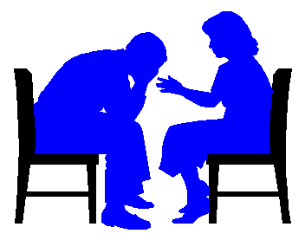
COUNSELLING IN FAMILY MEDICINE
PROF.JAMAL S ALJARALLAH

Slide 2
OBJECTIVES
RECOGNIZE WAHT IS COUNSELLING
APPRECIATE THEORIES AND APPROACHES TO COUNSELLING
RECOGNIZE VALUES IN COUNSELLING
APPLICATION OF KNOWLEDGE ON AN EXAMPLES

Slide 3
OVERVIEW
DEFINITION OF COUNSELLING
AIMS OF COUNSELLING
DIFFERENT APPROACHES
*PSHYCODYNAMIC
* HUMANISISTIC
*BEHAVIORAL
PHASES OF COUNSELLING
VALUES IN COUNSELLING
COUNSELLING IN PRACTICE

Slide 4
WHAT IS COUNSELLING?

Slide 5
IS T?
AN ADVICE
MOTIVATION
JUDGMENT ABOUT BEHAVIOR
HELPING OTHERS
INTERACTION
INTERVIEW
CONFRONTATION
CONVERSATION
FACILITATION
EMPATHY

Slide 6
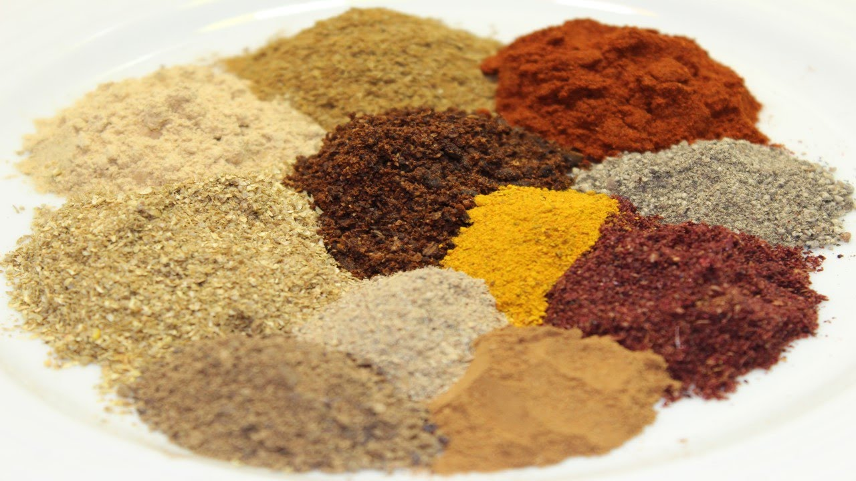


Slide 7


Advice given to someone
Simple Definition of counseling
advice and support that is given to people to help them deal with problems, make important decisions, etc.
To give advice, especially on social or personal problems

Slide 8
Counselling is an interactive process between the skilled attendant/ health worker/counselor and a client/patient during which information is exchanged and support is provided so that the client , design a plan and take action to improve their health.

Slide 9
According to the Psychotherapy and Counselling Federation of Australia (PACFA):
“Psychotherapy and Counselling are professional activities that utilise an interpersonal relationship to enable people to develop self understanding and to make changes in their lives.”

Slide 10
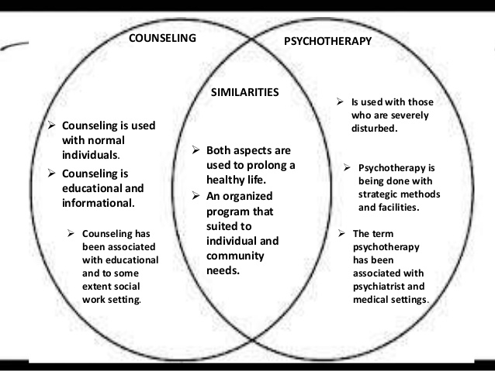
https://www.slideshare.net/shnbltzr25/distinction-between-counseling-and-psychotherapy

Slide 11
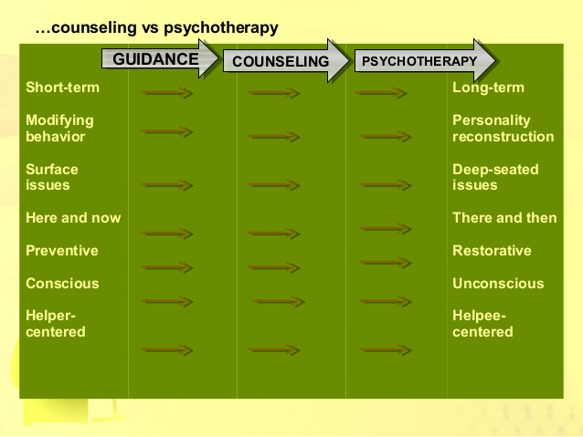
https://www.slideshare.net/chesteraseducator/counseling-and-psychotherapy?next_slideshow=1

Slide 12
“Counselling is a structured conversation aimed at facilitating a client’s quality of life in the face of adversity”.
Structured :Not social
Conversation: Dialouge and interaction
Facilitative: Rather than prescriptive
https://repository.up.ac.za/bitstream/handle/2263/25963/00dissertation.pdf;sequence=1

Slide 13
AIMS OF COUNELLING
HELP PEOPLE UNDERSTAND THEIR PROBLEMS BETTER
HELP PEOPLE MANAGE THEIR PROBLEMS
HELP TO IMPOWER CLIENTS/PATIENTS
HELP PEOPLE TO THINK POSITIVELY ABOUT THEIR PROBLEMS
HELP IN CHANGING BEHAVIOR POSITIVELY

Slide 14


Slide 15
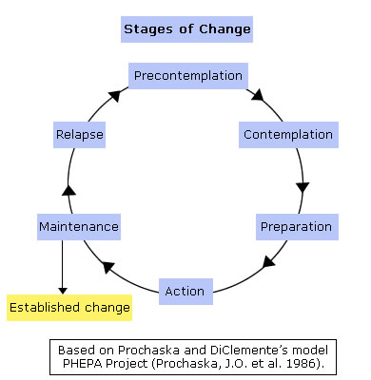
STAGES OF CHANGE

Slide 16
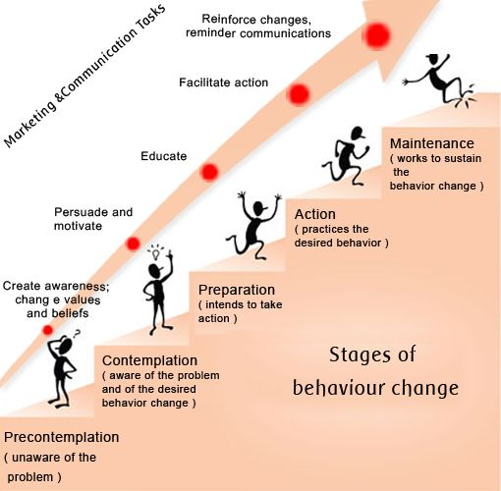

Slide 17
APPROACHES/THEORIES

Slide 18
DIFFERENT APPROACHES / THEORIES
* HUMANISISTIC
*BEHAVIORAL
*PSHYCODYNAMIC
https://www.skillsyouneed.com/learn/counselling-approaches.html

Slide 19
HUMANISTIC
RECOGNIZE THE UNIQUENESS OF EVERY INDIVIDUAL
EVERYONE HAS A CAPACITY TO GROW EMOTIONALLY AND PSYCHOLOGICALLY TAWARDS PERSONAL FUFILMENT
MAKE DISTINCTION BETWEEN LIFE EVENTS VS RESPONSE TO LIFE EVENTS
HELP PEOPLE TO EXPLORE TEIR OWN THOUGHTS AND WORK ON THEIR SOLUTIONS
ENCOURAGES SELF-AWARENESS AND SELF-REALIZATION

Slide 20
BEHAVIORAL APRPROACH
ENVIRONMENT DETERMINES BEHAVIOR
REPONSES TO A GIVEN SITUATION IS DUE TO BEHAVIOUR THAT HAS BEEN REINFORCED AS A CHILD
Is based on the belief that behavior is learned
and can be changed
The initial concern in therapy is to help the client analyze behavior, define problems, and select goals.

Slide 22
PHASES OF COUNSELLING
DEFINING THE RELATIONSHIP
GATHERING INFORMATION
DESCRIBING THE PROBLEM DYNAMIC
MAKING INTERVENTION AND ACTION

Slide 23
DEFINING THE RELATIONSHIP
INTRODUCE YOUSELF/ESTABLISH RAPPORT
DEFINING THE OBJECTIVES AND ROLES
THE SETTING AND SEATING
ALLOW THE CLIENT/ PATIENT TO NEGOTIATE
OSERVATION SKILLS:
VERBAL AND NONVERBAL CUES
SNSITIVITY AND RESPONSE TO EMOTIONS

Slide 24
PHASES OF COUNSELLING
DEFINING THE RELATIONSHIP
GATHERING INFORMATION
DESCRIBING THE PROBLEM DYNAMIC
MAKING INTERVENTION AND ACTION

Slide 25
GATHERING INFORMATION
OBTAIN INFORMATION ABOUT THE CLIENT/PATIENT
ATTEMPTED INTERVENTION
ALLOW PATIENT/CLIENT TO TALK FREELY AND EXPRESS HIMSELF
USE FACLITATIVE QUESTIONS (OPEN-ENDED)
GIVE FEEDBACK WHEN APPROPRIATE
UNDERSTAND THE PTIENT,S WORLD

Slide 26
PHASES OF COUNSELLING
DEFINING THE RELATIONSHIP
GATHERING INFORMATION
DESCRIBING THE PROBLEM DYNAMIC
MAKING INTERVENTION AND ACTION

Slide 27
DESCRIBING THE PROBLEM DYNAMIC
THE FORMAL PHASE
EXPLAIN YOUR UNDERSTANDING OF THE PROBLEM
SHARING INFORMATION/UNDERSTANDING

Slide 28
PHASES OF COUNSELLING
DEFINING THE RELATIONSHIP
GATHERING INFORMATION
DESCRIBING THE PROBLEM DYNAMIC
MAKING INTERVENTION AND ACTION

Slide 29
MAKING INTERVENTION AND ACTION
HELP THE PATIENT/ CLIENT TO ANSWER THE QUESTIONS:
WHAT DO I DO TO SOLVE THE PROBLEM?
HOW DO I MAKE IT HAPPEN?
AND ALSO ….
COUNSELOR IS SUPPORTIVE/ AGENT OF CHANGE….BUT NON-DIRECTIVE

Slide 30
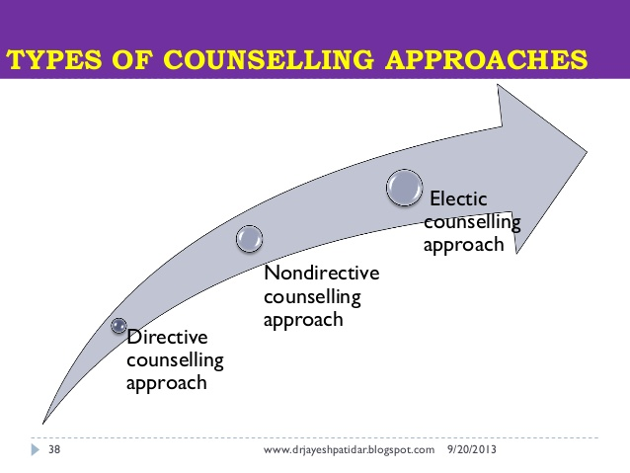
STYLES OF COUNSELLING
DIRECTIVE
NON-DIRECTIVE
ECLETIC(SELECTIVE)/COMBINATION

Slide 31
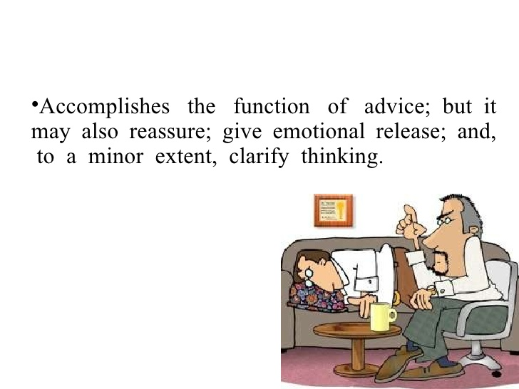
DIRECTIVE
COUNSELLOR-CENTERED
THE COUNSELOR DIRECT THE PATIENT/CLIENT
ALLOW THE COUNSELOR TO CONTROL THE SITUATION ALL THE WAY THROUGH

Slide 32
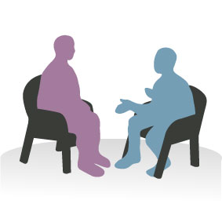
NON-DIRECTIVE
PATIENT/CLIENT-CENTERED
ALLOW CLIENT/PATIENT TO TELL HIS STORY IN HIS OWN WAY
THE ROLE OF THE COUNSELLOR IS TO CREATE AN ATMOSPHERE IN WHICH THE CLIENT CAN EXPRESS HIMSELF MORE FREELY
STRESS ON EMOTIONAL ELEMENTS AND DEVELOPMENT OF INSIGHT

Slide 33
ECLETIC(SELECTIVE)/COMBINATION
ALTERNATING BETWEEN PATIENT-CENTERED AND COUNSELLOR-CENTERED STYLES
CLIENT-SPECIFIC ( TAILORED ACCORDING TO SITUATION AND CLIENT)

Slide 34
VALUES IN COUNSELLING
RESPECT
ACCEPTANCE
RESPECT RIGHTS: PRIVACY,CONFIDENTIALITY
RESPECT UNIQUENESS OF EACH CLIENT
HONESTY
REFRAIN FROM JUDGMENT ????

Slide 35

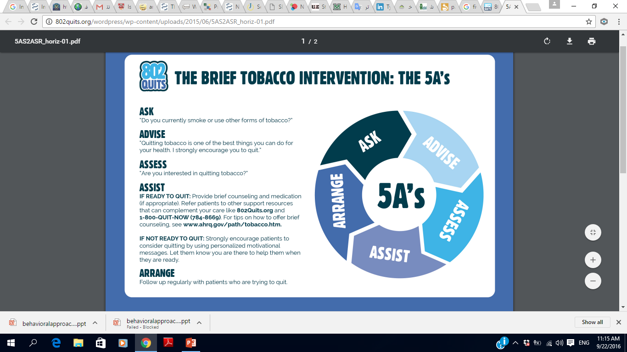

Slide 36
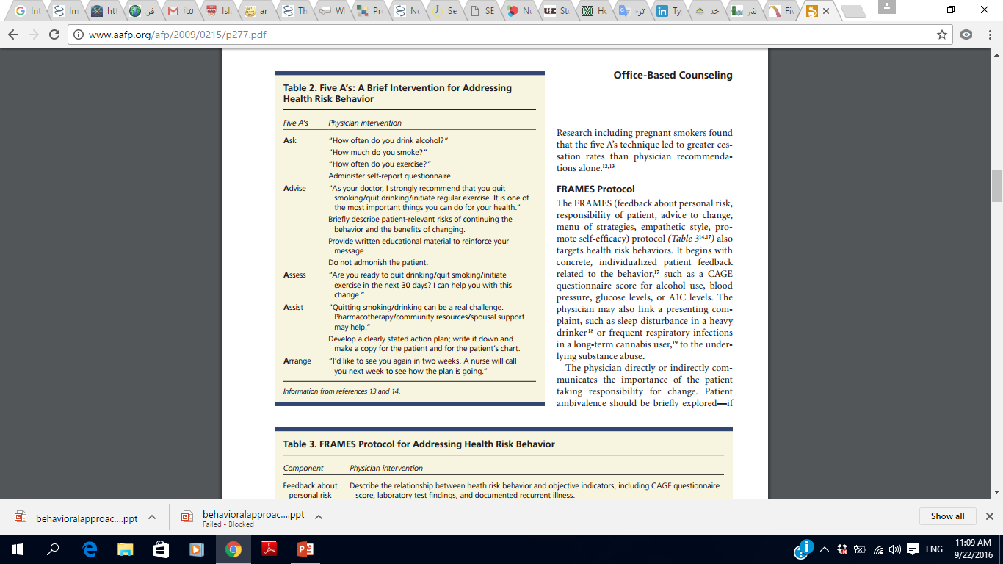

Slide 37
COUNSELLIING IS NOT…
ADVICE
JUDGMENT
GETTING EMOTIONALLY INVOLVED
LOOK AT THE PROBLEM FROM YOUR PERSPECTIVE
IS NOT MAGIC THAT WILL RESOLVE ALL THE PROBLEMS

Slide 38

COUNSELLING IN PRACTICE

Slide 39



Slide 40



