Slide 1
IHD, Dyslipidemia, and CVD risk assessment
Dr Mohammed Batais
Associate Professor & Consultant , Family Medicine, Diabetes and Chronic Disease Management
King Saud University

Slide 2
Objectives
CVD risk factors and assessment tools
Cardiovascular disease
Dyslipidemia and Introduction to new guidelines on lipid management

Slide 3
Primary prevention of CVD
The achievement and maintenance of good health is being emphasized in programs from The American Heart Association that promote seven ideal cardiovascular health metrics, including :
Not smoking
Being physically active
Having a normal blood pressure
Having a normal blood glucose level
Having a normal total cholesterol level
Being normal weight
Eating a healthy diet
-
Lloyd-Jones DM, Hong Y, Labarthe D, et al. Defining and setting national goals for cardiovascular health promotion and disease reduction: the American Heart Association's strategic Impact Goal through 2020 and beyond. Circulation 2010; 121:586.

Slide 4
CVD risk factors & FRS

Slide 5
CAD risk factors
Modifiable
Non-Modifiable
Cigarette and tobacco smoke
High blood cholesterol
High blood pressure
Physical inactivity
Obesity
Diabetes
Age
Gender
Family history of CVD

Slide 6
Emerging risk factors for CAD
Table 2. Emerging Risk Factors According to ATP III Final Report Update 2004
1. Elevated high-sensitivity C-reactive protein
2. Coronary artery calcification
3. Elevated lipoprotein (a)
4. Homocysteine
5. Fibrinogin

Slide 7
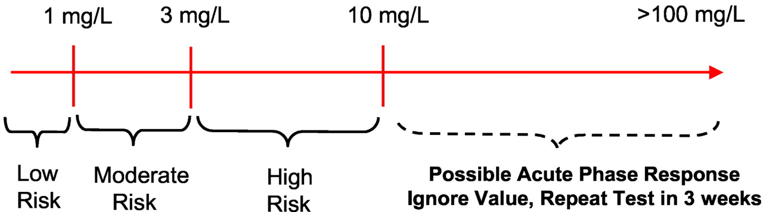

C-reactive protein
A person's baseline level of inflammation, as assessed by the plasma concentration of CRP, predicts the long-term risk of a first myocardial infarction.
In pt with chest pain and C reactive protein level is
Between 3 to 10 : → that indicate the pt is at high risk of develop an attack
If higher than 10 → that indicate that the pt is having an acute attack
Figure 4. clinical interpretation of hs-CRP for cardiovascular risk prediction.
Ridker P M Circulation 2003;108:e81-e85
Copyright © American Heart Association

Slide 8
The Framingham risk score
Scoring system used to calculate a pt’s risk of coronary events
The Framingham Heart Study first introduced the term risk factor to medical literature
The following risk factors are used to assess cumulative risk:
Age
Smoking Status
Systolic BP
HTN treatment
Total cholesterol levels
HDL-C levels

Slide 9
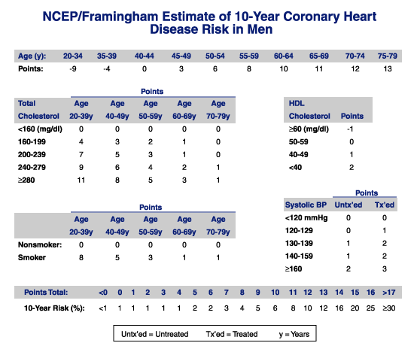

Slide 10
Calculating 10-Year Risk in Women
Age (years) 20-34 35-39 40-44 45-49 50-54 55-59 60-64 65-69 70-74 75-79
Points -7 -3 0 3 6 8 10 12 14 16
Points
Points
Total Age Age Age Age Age
Cholesterol 20-39 40-49 50-59 60-69 70-79
HDL
CHOLESTEROL Points
<160 (mg/dL) 0 0 0 0 0 ≥ 60 (mg/dL) -1
160-199 4 3 2 1 1 50-59 0
200-239 8 6 4 2 1 40-49 1
240-279 11 8 5 3 2 < 40 2
≥ 280 13 10 7 4 2
Systolic BP Untx”ed Tx”ed
Age Age Age Age Age
20-39 40-49 50-59 60-69 70-79
<120 0 0
120-129 3 1
130-139 4 4
140-149 5 3
≥ 160 6 4
Nonsmoker 0 0 0 0 0
Smoker 9 7 4 2 1
Points total: <9 9 10 11 12 13 14 15 16 17 18 19 20 21 22 23 24 ≥25
10 year Risk (%) <1 1 1 1 1 2 2 3 4 5 6 8 11 14 17 22 27 ≥30
Untx”ed = Untreated Tx”ed =Treated

Slide 11
Cases in which you don’t need FRS ?
Patients who already have a high risk due to other diseases:
We don’t need FRS if:
Stroke or TIA
Bypass surgery or balloon angioplasty
Type 2 diabetes
Kidney disease
Abdominal aortic aneurysm
Familial hypercholesterolemia
Peripheral artery disease
Carotid artery disease
They already have HIGH RISK to develop CHD

Slide 12
FRS
Table 3. Classification of Patients based on The Framingham Risk Score
Low risk | <10% coronary heart disease risk at 10 years
Intermediate risk | 10-20% risk of coronary event at 10 years
High risk | >20% risk of coronary event at 10 years

Slide 13
Other CVD risk assessment tools

Slide 14
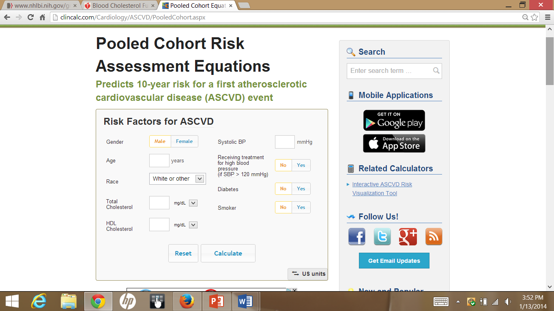
http://clincalc.com/Cardiology/ASCVD/PooledCohort.aspx
Notes:
This is the new equation, the pooled cohort risk assessment equation
As you can see, there are different parameters that you need to plug in to the equation to calculate the risk: gender, age, race, total cholesterol, HDL, systolic BP, whether or not you are on any anti-HTN meds, any history of DM or being a smoker

Slide 15
Pooled Cohort Equations: Criticism
    Estimates of 12 million to 45 million additional candidates for statin therapy based on CV risk estimates
      Pencina* et al. estimated 87.4% of men and 53.6% of women ages 60-75 would now be eligible for statins
    Validation attempts have yielded conflicting results:
      75%-150% when applied to data from the Women’s Health Study and the Physician’s Health Study
      Muntner‡ et al. reported good results in actual vs. predicted 5-year risks in a contemporary cohort of the REGARDS study

Slide 16
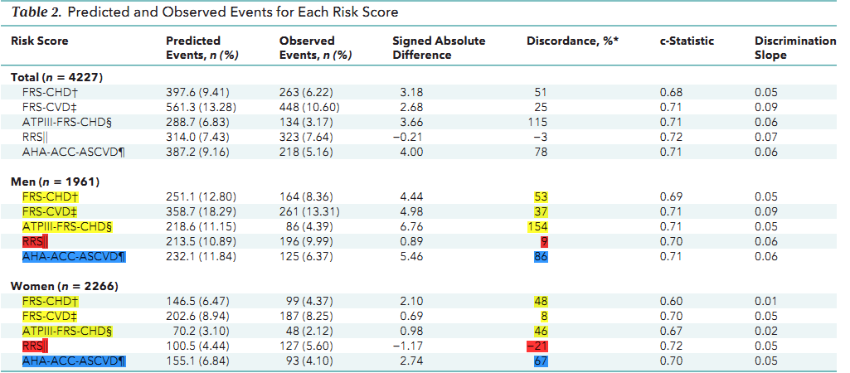
Observed and expected events for different scores were compared in MESA after a 10.2- year follow-up

Slide 17
CAD
Pathogenesis:
CAD is the narrowing of the coronary artery, decreasing the blood supply to the heart, leading to ischemia of the heart muscle cells
Etiology:
CAD is mostly due to Atherosclerosis
Atherosclerosis and thrombosis are the most important pathogenic mechanisms

Slide 18
Major CAD types
Stable Angina; due to atheroma
Acute Coronary Syndrome:
Unstable Angina
Myocardial Infarction (STEMI OR NSTEMI)
 | STEMI | NSTEMI | Unstable angina
ST | ↑ | N-↓ | N-↓
Troponin I,T | ↑ 2 weeks | ↑ | Normal
CK-MB | ↑ 3days | ↑ | Normal

Slide 19
Myocardial infarction
Signs & findings:
Table 4. Findings Indicating Myocardial Infarction According to JAMA 1998; 280: 1256-63 (N=200)
Positive Signs | Negative Signs
ST-segment elevation | Normal ECG
New Q-wave | Pleuritic, sharp or stabbing chest pain
Chest pain radiating to both the right and left arm simultaneously | Pain reproduced on palpation
Added heart sound “S3” | Positional chest pain
Hypotension

Slide 20
Treatment of Acute Coronary Syndrome
Aspirin (proven to prevent recurrent infarction and decreases mortality)
Clopidogrel
β- blockers
ACE inhibitors & ARBs (should be used if there is intolerance of ACE inhibitors)
Nitroglycerin
Heparin
Statins

Slide 21

Care following MI
Risk factor modification
Cessation of smoking.
Control blood sugar and blood pressure.
Physical Rehabilitation and exercise
Long-term medications:
Aspirin
Clopidogrel
β- blockers
ACE inhibitors
Aldosterone blockers
Statins

Slide 22
Dyslipidemia
  A disorder of lipoprotein metabolism, including lipoprotein overproduction or deficiency.
  May be manifested by elevation of the total cholesterol , (LDL) and the triglyceride concentrations, and a decrease in the (HDL) concentration in the blood

Slide 23
Types | Chylomicron | VLDL | LDL | HDL
Made by: | small intestines in the fed stat | the liver from excess dietary carbohydrate and protein along with the Chylomicron remnant | The Liver “VLDL once it has lost a lot of its TG’s” | the Liver and Small Intestine
Absorbed into | the lymph vessels, then into the blood
Rich in | TGs | TGs | Cholesterol
Function | transport fats from the intestinal mucosa to the liver | Deliver TGs to body cells | Deliver cholesterol to all body cells | Pick up cholesterol from body cells and take it back to the liver

Slide 24
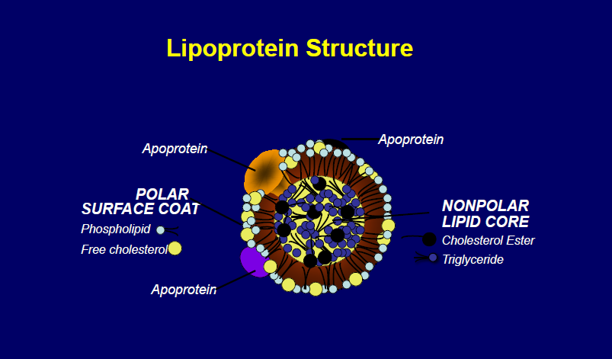

Slide 25
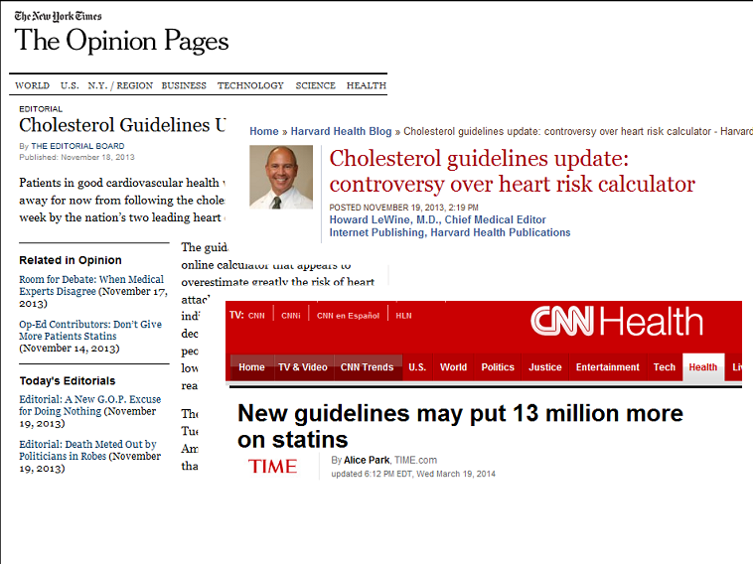

Slide 26















Changes in Lipid Guidelines and Cholesterol Targets
2001
2002
2003
2004
2005
2006
2007
2008
2009
2010
2011
2012
2013
KEY TRIALS
HPS
ASCOT
PROVE-­‐IT TIMI 22
TNT CTTC
CTTC
(14 trials)
CTTC
(27 trials)
JUPITER
CANADIAN GUIDELINES
CCS
< 2.5 mmol/L
and TC:HDL-­‐C <4.0
CCS
< 2 mmol/L
or 50% Reduction
CCS
< 2 mmol/L
or 50% Reduction
CCS
< 2 mmol/L
or 50% Reduction
US GUIDELINES
NCEP ATP III, AHA/ACC
2.6 mmol/L
NCEP ATP III Revised 2.6mmol/L 1.8mmol/L Optional
AHA/ACC
2.6mmol/L 1.8mmol/L Optional
AHA/ACC
EU GUIDELINES
ESC
2nd Task Force
2.6 mmol/L
ESC
3rd Task Force
2.6mmol/L
(2.1 mmol/L if feasible)
ESC
4th Task Force
1.8mmol/L
or 50% Reduction

Slide 27
AHA/ACC vs IAS
International Atherosclerosis Society (IAS)
Apo B-containing lipoproteins is causally associated with ASCVD risk and that lowering “atherogenic cholesterol” (LDL-C and non-HDL-C) will reduce risk
ACC/AHA 2013
ACC/AHA (evolved from ATP IV/NHLBI efforts)
Many areas left to clinical judgment where RCT data were not available or limited
Recommendations based on what has been shown to reduce risk in RCTs
Treat to target
Fire and forget

Slide 28
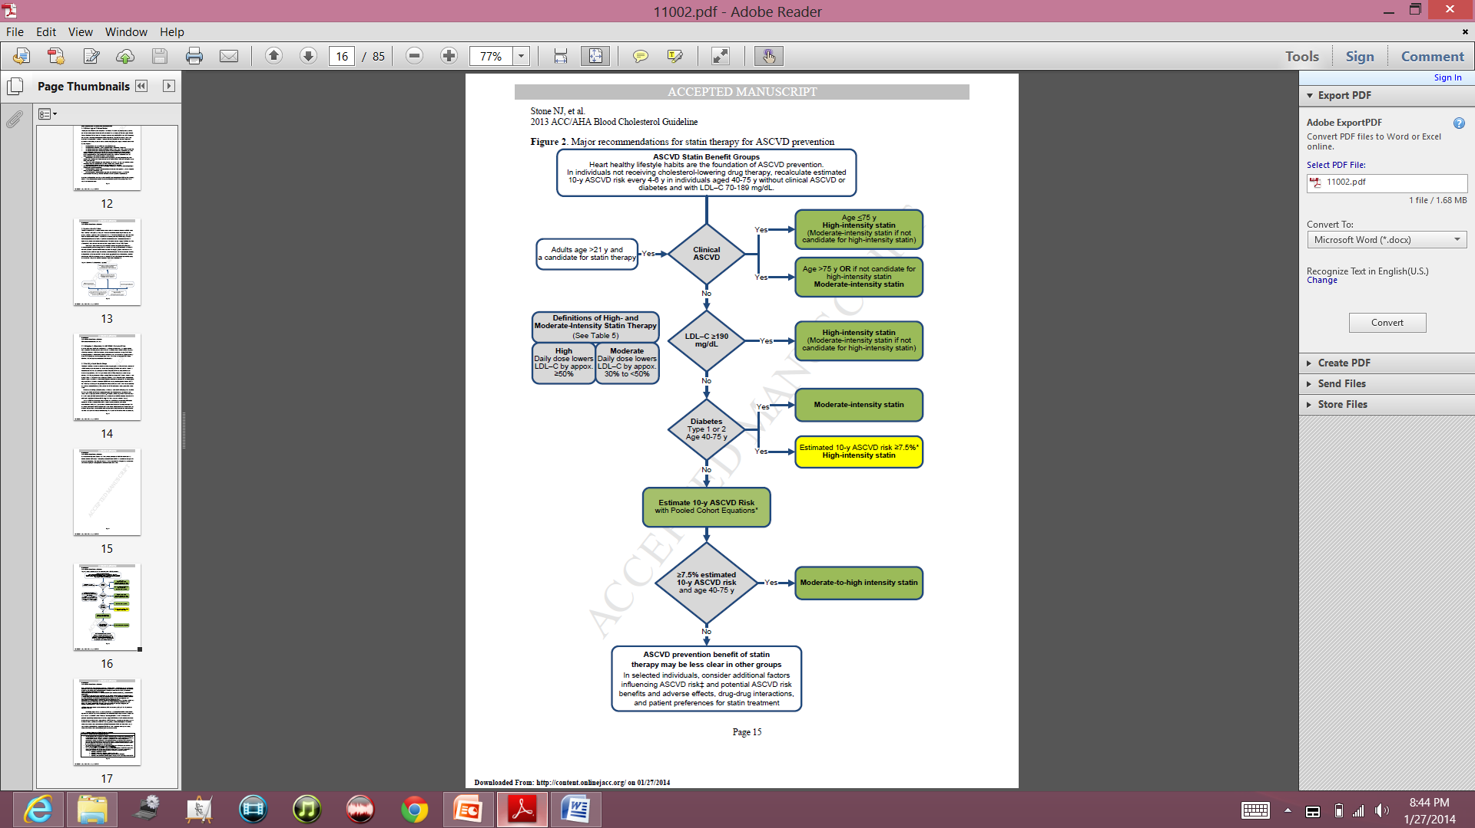
Notes:
This algorithim summarizes the major guidelines in one page
You see the 4 statin benefit groups in the middle: on top, you see the patient’s group with clinical ASCVD, below that you see the group with LDL >190, below that you see the patient’s with history of DM 40-75 years old, and in the bottom, you see patients who don’t have the characteristics of the first 3 groups but their 10 year ASCD risk is greater than 7.5%
For the first group: based on the guidline, if you have clinical ASCD, are younger than 75 and don’t have any history of intolerance to statin, you should be started on high intensity statin. On the other hand, if you are older than 75, or not a candidate for high intensity statin due to lets say intolerance to statins, you are a candidate for moderate-intensity statin
For the second group, if your LDL is greater than 190, you need to be started on high-intensity statin, unless you have contra-indication to high dose →start on moderate dose
For the third group, individuals with diabetes with above mentioned group age, you need to calculate the 10 year ASCVD risk using a new equation/calculater called “pooled Cohort Equations” →if the 10 year risk is greater than 7.5%, start them on high-intensity, otherwise, you can start them on moderate-intensity statin
For the last group, you need to calculate patient’s risk factor and start them on moderate-to-high intensity statin if their estimated 10-y ASCVD risk is greater than 7.5%
Keep that in mind that what we mean by “high intensity” statin, is the daily dose of statin that lowers the LDL by appox greater than 50%, and what we mean by moderate intensity statin, is the daily dose of statin that lowers the LDL by appox 30-50%.

Slide 29
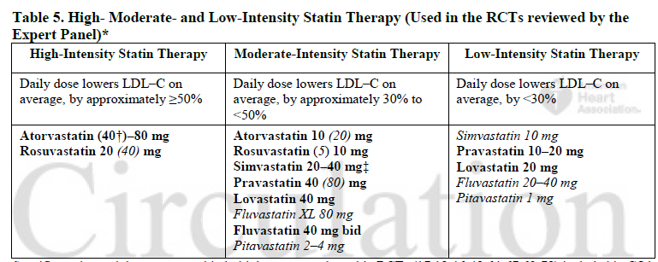
Dosing Statins

Slide 30
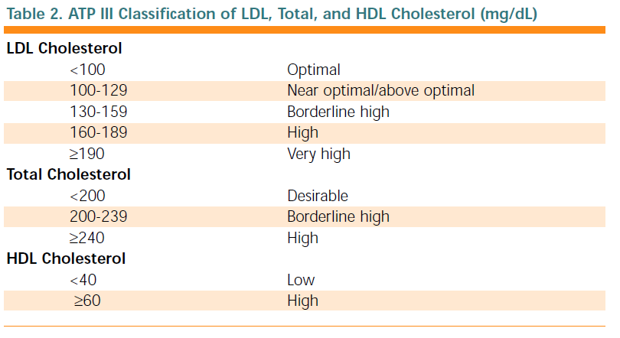

Slide 31
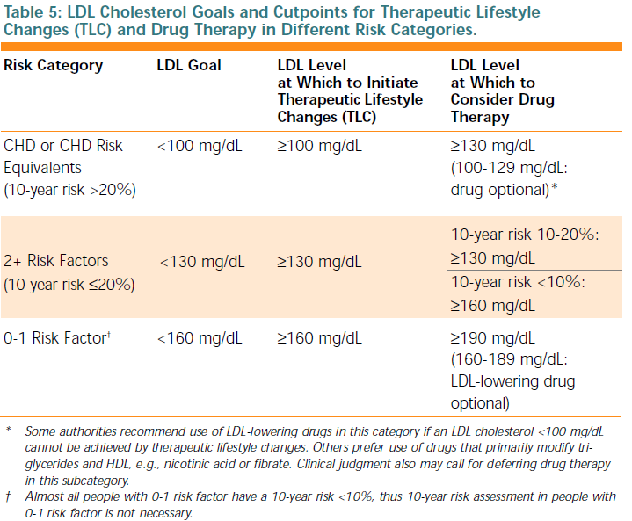

Slide 32
ETIOLOGY

Slide 33
Primary causes
Primary causes are single or multiple gene mutations that result in either overproduction or defective clearance of TG and LDL cholesterol, or in underproduction or excessive clearance of HDL .
Examples:
Familial hypertriglyceridemia .
Familial hypercholesterolemia .
Familial combined hyperlipidemia .
Polygenic hypercholesterolemia .

Slide 34
Secondary causes
Contribute to most cases of dyslipidemia in adults.
The most important secondary cause in developed countries is a sedentary lifestyle with excessive dietary intake of saturated fat, cholesterol, and trans fats.

Slide 35
Other common secondary causes
Diabetes mellitus,
Alcohol overuse,
Chronic kidney disease,
Hypothyroidism,
Primary biliary cirrhosis and other cholestatic liver diseases,
Drugs, such as thiazides , β-blockers, retinoids , highly active antiretroviral agents, estrogen and progestins , and glucocorticoids .
Smoking.

Slide 36

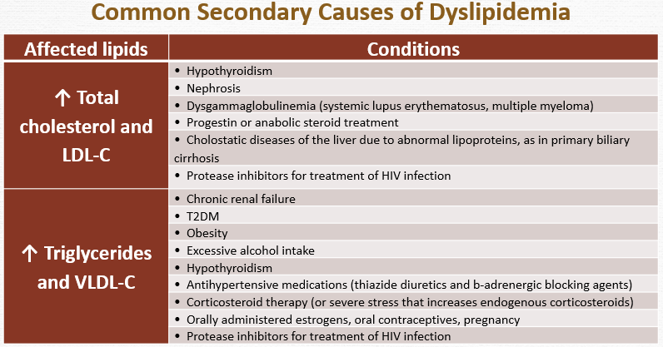

Slide 37
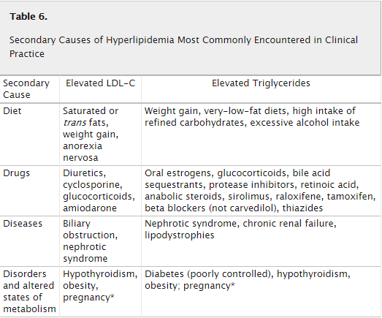

Slide 38
Symptoms and Signs

Slide 39
Symptoms and Signs
Dyslipidemia itself usually asymptomatic but can lead to symptomatic vascular disease, including :
coronary artery disease (CAD)
peripheral arterial disease.
High levels of TGs (> 1000 mg/dL [> 11.3 mmol/L]) can cause acute pancreatitis.

Slide 40
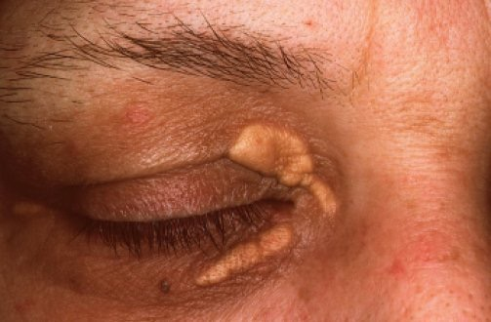
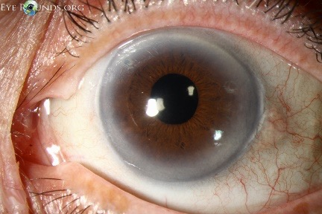
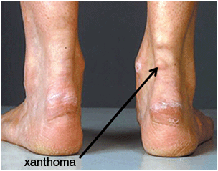
High levels of LDL can cause:
Eyelid xanthelasmas;
Arcus corneae
Tendinous xanthomas at the Achilles, elbow, and knee tendons and over metacarpophalangeal joints.

Slide 41
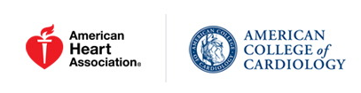
Overview of Primary and Secondary ASCVD Prevention

Slide 42
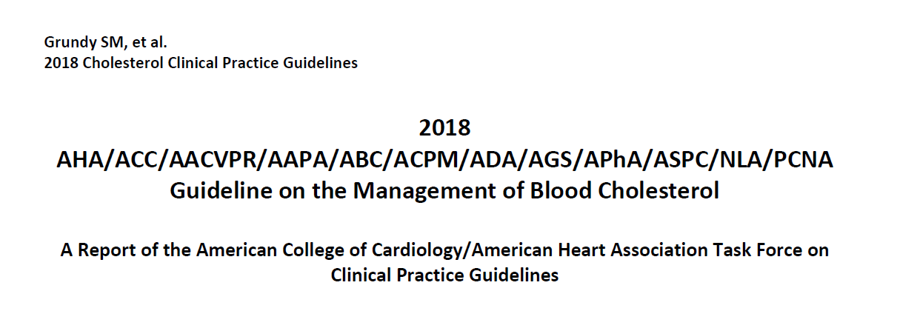

Slide 43
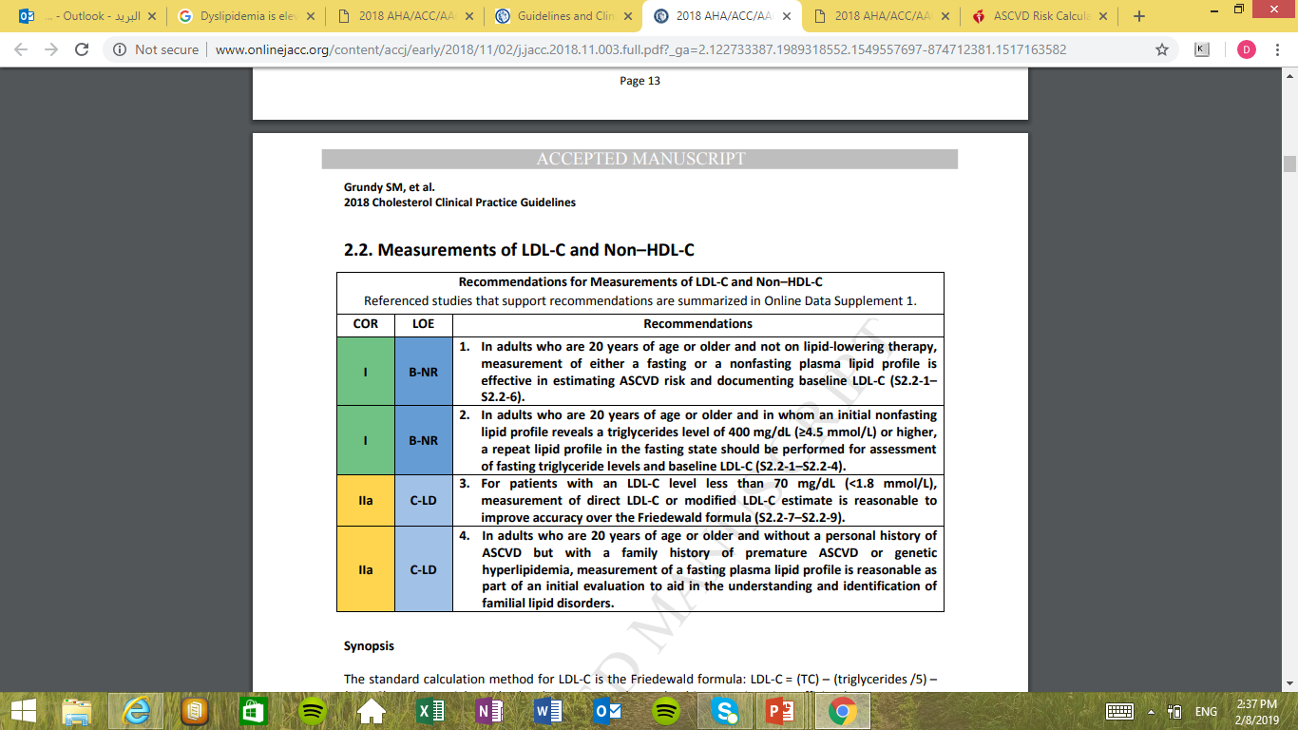
Measurements of LDL-C and Non–HDL-C

Slide 45
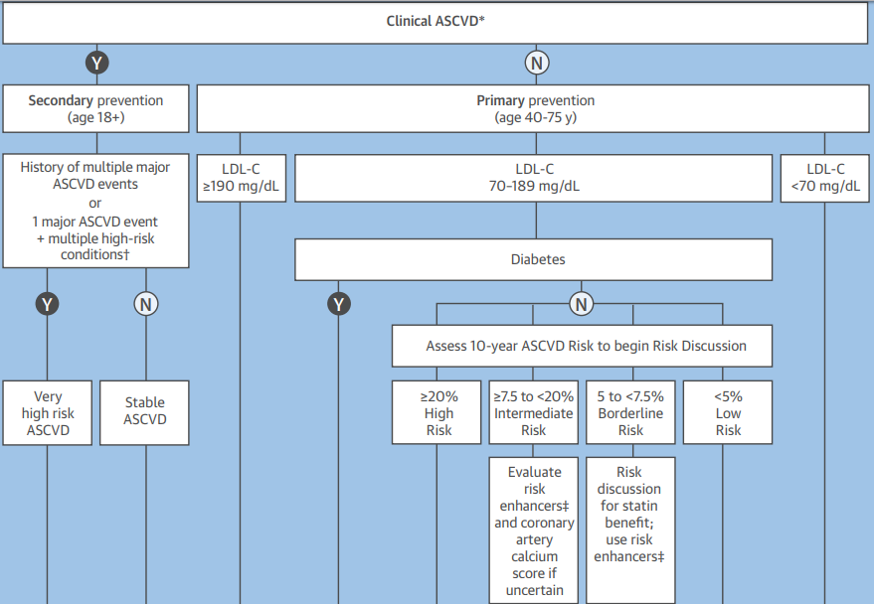

Slide 46
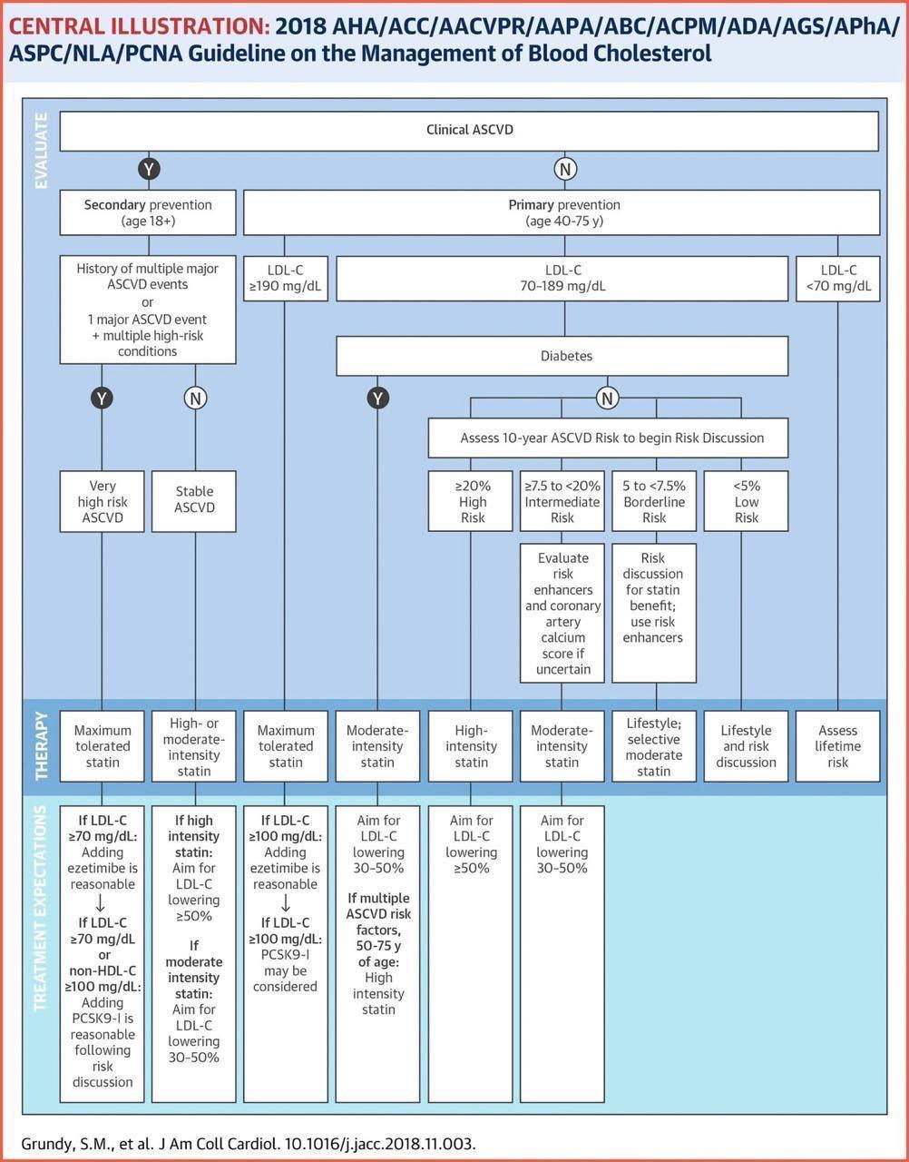

Slide 47
First Group
Secondary Prevention in Patients with Clinical ASCVD

Slide 48
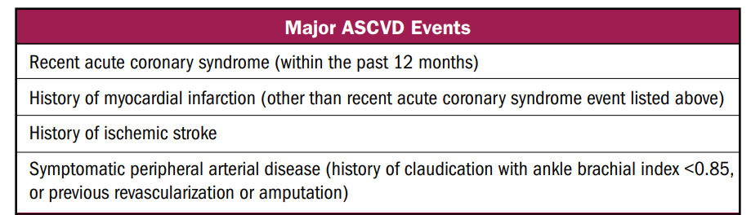

Slide 49
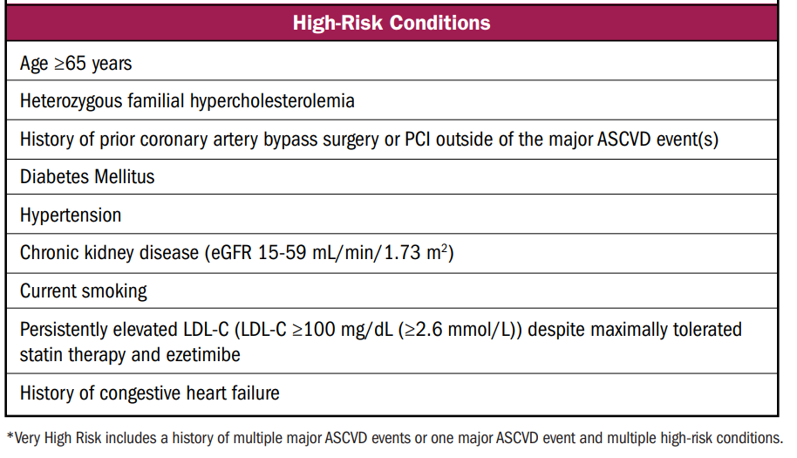

Slide 50
Second group
Severe Hypercholesterolemia [LDL-C ≥190 mg/dL (≥4.9 mmol/L)]

Slide 51
THIRD GROUP
Diabetes Mellitus in Adults

Slide 52
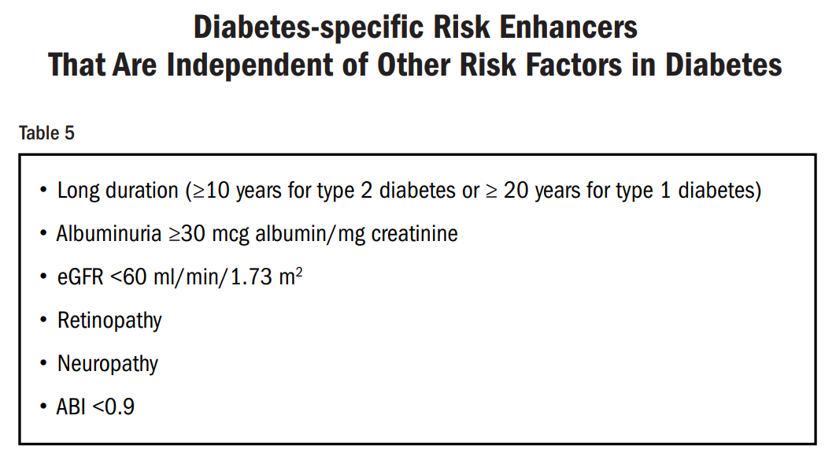

Slide 53
Fourth group
Primary Prevention Over The Life Span

Slide 54
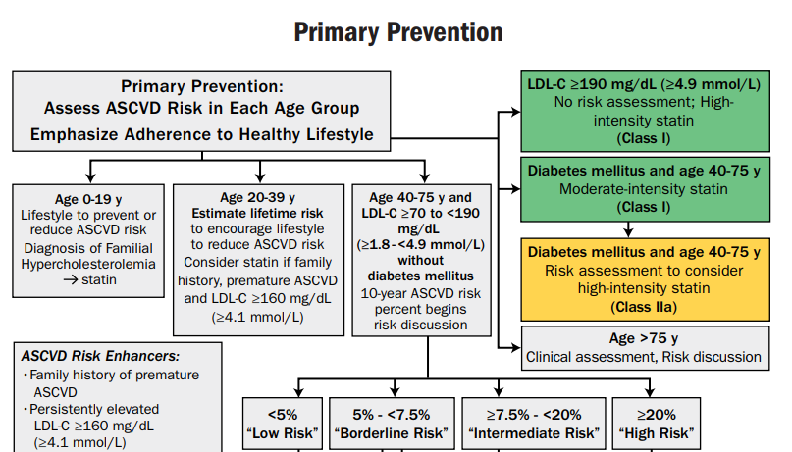

Slide 55
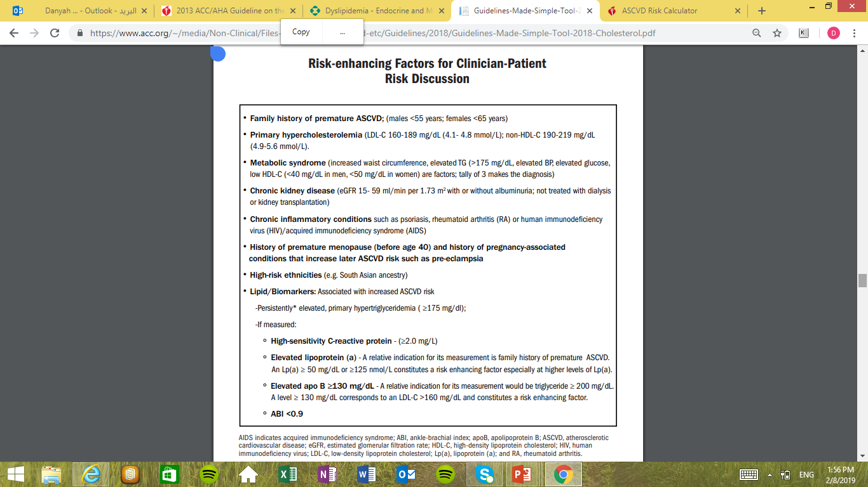

Slide 57
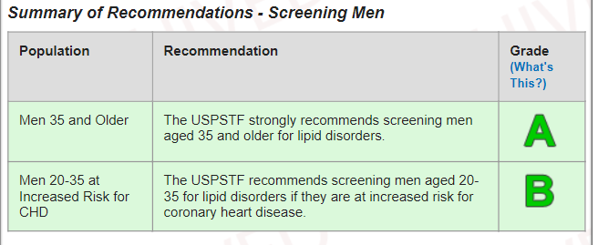
USPSTF Screening for Lipid Disorders in Adults

Slide 58
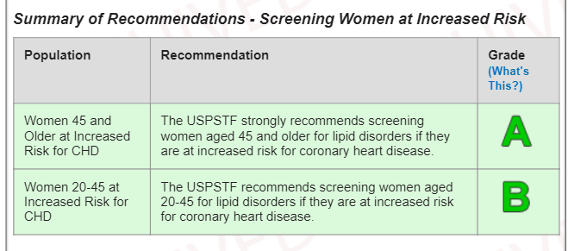

Slide 59
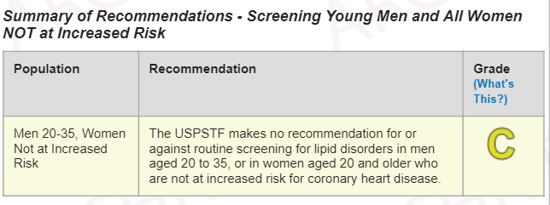

Slide 60

Dyslipidemia
Medical Therapy and Adjustment

Slide 61
Treatment Options for Dyslipidemia
  Lifestyle changes
    Physical activity
    Medical nutrition therapy
    Smoking cessation
  Pharmacologic therapy
    Statins
    Cholesterol absorption inhibitors
    PCSK9 inhibitors
    Fibrates
    Omega-3 fish oil
    Niacin
    Bile acid sequestrants
    MTP inhibitor
    Antisense apo B oligonucleotide
    Combination therapies
Jellinger P, Handelsman Y, Rosenblit P, et al. Endocr Practice. 2017;23(4):479-497.
Abbreviations: CAC Score, Coronary Calcium Score.

Slide 62
Treatment Options for Dyslipidemia
Physical Activity
R48. A reasonable and feasible approach to fitness therapy (i.e., exercise programs that include at least 30 minutes of moderate-intensity physical activity [consuming 4-7 kcal/min] 4 to 6 times weekly, with an expenditure of at least 200 kcal/day) is recommended; suggested activities include brisk walking, riding a stationary bike, water aerobics, cleaning/scrubbing, mowing the lawn, and sporting activities (Grade A; BEL 1).
R49. Daily physical activity goals can be met in a single session or in multiple sessions throughout the course of a day (10 minutes minimum per session); for some individuals, breaking activity up throughout the day may help improve adherence with physical activity programs (Grade A; BEL 1).
R50. In addition to aerobic activity, muscle-strengthening activity is recommended at least 2 days a week (Grade A; BEL 1).
Medical Nutrition Therapy
R51. For adults, a reduced-calorie diet consisting of fruits and vegetables (combined ≥5 servings/day), grains (primarily whole grains), fish, and lean meats is recommended (Grade A; BEL 1).
R52. For adults, the intake of saturated fats, trans-fats, and cholesterol should be limited, while LDL-C-lowering macronutrient intake should include plant stanols/sterols (~2 g/ day) and soluble fiber (10-25 g/day) (Grade A; BEL 1).
R53. Primary preventive nutrition consisting of healthy lifestyle habits is recommended in all healthy children (Grade A; BEL 1).
Smoking Cessation
R54. Tobacco cessation should be strongly encouraged and facilitated (Grade A; BEL 2; upgraded due to potential benefit).
Lifestyle Changes
Jellinger P, Handelsman Y, Rosenblit P, et al. Endocr Practice. 2017;23(4):479-497.
Abbreviation: LDL-C, low-density lipoprotein cholesterol.

Slide 63
Treatment Options for Dyslipidemia
High-Intensity
Atorvastatin (40 mg) 80 mg Rosuvastatin 20 (40 mg)
Moderate-Intensity
Atorvastatin 10 mg (20 mg) Rosuvastatin (5 mg) 10 mg Simvastatin 20–40 mg
Pravastatin 40 mg (80 mg) Lovastatin 40 mg (80 mg) Fluvastatin XL 80 mg Fluvastatin 40 mg BID Pitavastatin 1–4 mg
Low-Intensity
 | Simvastatin 10 mg
Pravastatin 10–20 mg Lovastatin 20 mg Fluvastatin 20–40 mg
Statins
LDL-C Lowering:
  High-Intensity: 50%
  Moderate-Intensity: 30% to 49%
  Low-Intensity: <30%

Slide 64
Treatment Options for Dyslipidemia
Agent | Usual recommended starting daily dosage | Dosage range | Method of administration
Cholesterol absorption inhibitors |  |  | Oral
Ezetimibe | 10 mg | 10 mg
Combination therapies (single-pill)
Ezetimibe/simvastatin | 10/20 mg | 10/10 to 10/80 mg | Oral
Cholesterol absorption inhibitors

Slide 65
Treatment Options for Dyslipidemia
PCSK9 inhibitors
Agent | Usual recommended starting daily dosage | Dosage range | Method of administration
PCSK9 inhibitors
Alirocumab | 75 mg every 2 weeks | 75-150 mg every 2 weeks | SQ
Evolocumab | 140 mg every 2 weeks or 420 mg once monthly | Not applicable | SQ

Slide 66


Statin Associated Side Effects
Statin-Associated Side Effects | Frequency | Predisposing Factors | Quality of Evidence
Statin-associated muscle symptoms (SAMS)
Myalgias (CK Normal) | Infrequent (1% to 5%) in RCTs; frequent (5% to 10%) in observational studies and clinical setting | Age, female sex, low body mass index, high-risk medications (CYP3A4 inhibitors, OATP1B1 inhibitors), comorbidities (HIV, renal, liver, thyroid, preexisting myopathy), Asian ancestry, excess alcohol, high levels of physical activity, and trauma | RCTs cohorts/observational
Myositis/myopathy (CK > ULN) with concerning symptoms or objective weakness | Rare |  | RCTs cohorts/observational
Rhabdomyolysis (CK >10× ULN + renal injury) | Rare |  | RCTs cohorts/observational
Statin-associated autoimmune myopathy (HMGCR antibodies, incomplete resolution) | Rare |  | Case reports
New-onset diabetes mellitus | Depends on population; more frequent if diabetes mellitus risk factors are present, such as body mass index ≥30, fasting blood sugar ≥100 mg/dL; metabolic syndrome, or A1c ≥6%. | Diabetes mellitus risk factors/metabolic syndrome High-intensity statin therapy | RCTs/meta-analyses

Slide 67
Statin Associated Side Effects
Statin-Associated Side Effects | Frequency | Predisposing Factors | Quality of Evidence
Liver
Transaminase elevation 3× ULN | Infrequent |  | RCTs/ cohorts/observational Case reports
Hepatic failure | Rare
Central nervous system
Memory/cognition | Rare/unclear |  | Case reports; no increase in memory/cognition problems in 3 large-scale RCTs
Cancer | No definite association |  | RCTs/meta-analyses

Slide 68
Statin Associated Side Effects
Statin-Associated Side Effects | Frequency | Predisposing Factors | Quality of Evidence
Other
Renal function | Unclear/unfounded
Cataracts | Unclear
Tendon rupture | Unclear/unfounded
Hemorrhagic stroke | Unclear
Interstitial lung disease | Unclear/unfounded
Low testosterone | Unclear/unfounded

Slide 69
Management of adverse effects
  Mild to moderate muscle symptoms
    D/C statin until muscle symptoms resolve
    Re-challenge with a lower dose
    If symptoms resume, D/C statin and re-challenge with lower dose of different statin
    Gradually titrate to target dose
    If symptoms don’t resolve after 2 months, assume it is not statin-related and resume original statin
  New onset diabetes
    Reinforce lifestyle modifications
  Memory impairment
    Consider other potential causes before stopping statin

Slide 70
Non-statin therapies
Non statin therapies, alone or in combination with statins, do not provide acceptable risk reduction benefits compared to adverse effects.
These include:
  Zetia
  Fibrates
  Fish oil
  Niacin
For the most part, these should be avoided with few exceptions

Slide 71
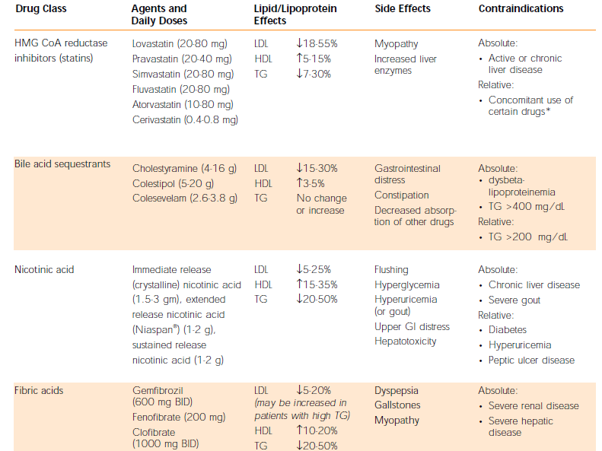

Slide 72
Primary ASCVD Prevention
Abbreviations: CAC Score, Coronary Calcium Score.

Slide 73
Secondary ASCVD Prevention

Slide 74
Secondary ASCVD Prevention

Slide 75
Follow-Up
  Assess adherence and percentage response to LDL-C–lowering medications and lifestyle changes with repeat lipid measurement 4 to 12 weeks after statin initiation or dose adjustment, repeated every 3 to 12 months as needed.

Slide 76
Summary

Slide 77

References
ACC/AHA 2018 Guideline for Blood Cholesterol
UpToDate
Jellinger P, Handelsman Y, Rosenblit P, et al. Endocr Practice. 2017;23(4):479-497.

