Slide 1

Welcome To Course 462-PME

Slide 2

Introduction to Psychiatry
Dr. Ali Bahathig, FRCPC, Assistant Professor and Consultant of Psychiatry & Psychosomatic Medicine
Psychosomatic Unit, Psychiatry Department
King Saud University Medical City (KSUMC)
1440/1441
2019/2020

Slide 3
SPECIAL TAHNKS TO:
Dr. Fahad Alosaimi, MD​, Professor and Consultant​ of Psychiatry & Psychosomatic medicine, ​College of Medicine, King Saud University​.
Dr. Ahmad Alhadi​, MD, Associate Professor and Consultant of Psychiatry and Psychotherapy, College of Medicine, King Saud University.
Dr. Mohammed Al-Sughayir, MD, Professor and Consultant of Psychiatry, College of medicine, King Saud University.

Slide 4
WHO define Health as:
  IS A STATE OF COMPLETE PHYSICAL, MENTAL AND SOCIAL WELL-BEING AND NOT MERELY THE ABSENCE OF DISEASE OR INFIRMITY.

Slide 5
What is Psychiatry ?
Psychiatry is the medical specialty devoted to:
  Diagnose
  Prevent
  Treat mental disorders.
  Treat maladaptation's related to mood, behaviour, cognition, and perceptions​.
Psychiatrists are qualified to assess and treat both mental and physical aspects of psychological problems.

Slide 6

Definition of Mental Disorder
A syndrome characterized by clinically significant disturbance in an individual's cognition, emotion regulation, or behavior that reflects a dysfunction in the psychological, biological, or developmental processes underlying mental functioning. ​
Mental disorders are associated with significant subjective distress or impairment in social, occupational, or other important activities.

Slide 7
MISCONCEPTIONS
Psychiatric patients​
Causes of psychiatric illness
Treatments:​
  Psychotropic drugs​
  ECT​
  Psychotherapy​
PSYCHIATRISTS

Slide 12
"I think psychiatry should be outlawed. Tom Cruise
There is no such thing as a chemical imbalance and that psychiatry is a form of pseudoscience. Tom Cruise

Slide 13
If you Talk to God you are praying, if God talks to you, you have schizophrenia. Thomas Szasz
Labeling a child as mentally ill is stigmatization, not diagnosis.
Giving a child a psychiatric drug is poisoning, not treatment. Thomas Szasz

Slide 16
Psychiatric disorders are both common and serious

Slide 17
Lifetime prevalence of mental disorders is 33% in general population & 42% in patients with chronic medical conditions.​
In patients with short-term medical or surgical conditions, 30-60% of them presented also with a psychiatric condition. ​
Patients with schizophrenia or bipolar disorders may die 15 years younger than general populations because of higher medical co-morbidity. ​
The medical costs are twice higher in depressive patients and they require seven times more frequently the emergency services.

Slide 18
Course 462-PME

Slide 19
462-PME
KNOWLEDGE
SKILLS CLINICAL
ATTIUDE

Slide 20
KNOWLEDGE
Phenomenological psychopathology (signs and symptoms) of psychiatric disorders.
Classification and etiology in clinical psychiatry (bio-psycho-social).
Common psychiatric disorders:
  Clinical features and course.
  Epidemiology and etiology.
  Differential diagnosis.
  Treatment (bio-psycho-social) and prognosis.
Treatment modalities in psychiatry:
  Physical: pharmacotherapy, electroconvulsive therapy
  Psychological: behavioral, cognitive, supportive psychotherapy and others.

Slide 21
CLINICAL SKILLS
To conduct a full psychiatric interview with:
  Proper interview techniques and skills.
  Sufficient psychiatric history.
  Standard “Mental State Examination”.
To set an outline of a management plan for common psychiatric disorders following the Bio-Psycho-Social approach.
To assess and appropriately refer psychiatric patients in the primary care settings.
To assess and deal competently and safely with psychiatric emergencies.
To assess and dispose properly psychosomatic cases.

Slide 22
ATTITUDE
To develop the scientific attitude Towards:
  Psychiatric patients and their family.
  Psychiatric interventions (Bio-Psycho-Social)
  ​
  Mental health and providers.
  Psychiatry as a branch of medicine

Slide 23
462 COURSE OVERVIEW
The course lasts for 3 weeks (3 days each) and contains:
  Lectures in first two days
  Clinical Activities (in-patient, outpatient, consultation-liaison, child psychiatry) include clinical cases logbook.

Slide 24
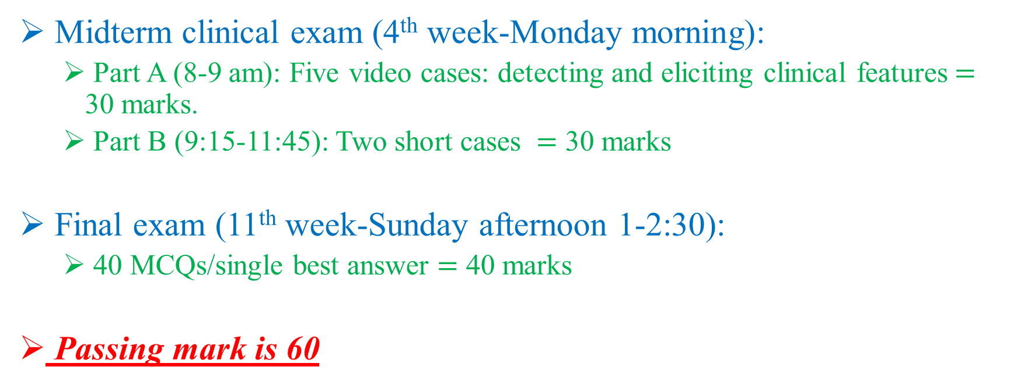
COURSE ASSESSMENT & EXAMINATION
Midterm clinical exam (4th week-Monday morning):
  Part A (8-9 am): Five video cases: detecting and eliciting clinical features$=$ 30 marks.
  Part B (9:15-11:45): Two short cases $=$ 30 marks
Final exam (11th week-Sunday afternoon 1-2:30):
  40 MCQs/single best answer $=$ 40 marks
Passing mark is 60

Slide 25
ATTENDANCE
You have to attend 75% of the course activities.
More than 25% absences will lead to prevent you from attending the exams → F

Slide 26
COURSE REFERENCES
List Required Textbooks:
  Introductory Textbook of Psychiatry, Sixth Edition, by Donald W. Black & Nancy C. Andreasen​
List Recommended Textbooks and Reference Material
  First aids for psychiatry, 5th edition.
  Blueprints psychiatry, 6th edition.
  Basic Psychiatry – Professor M. A. Al-Sughayir
All lectures' content & handouts distributed throughout the course.​
Others:​
  Concise textbook of clinical psychiatry, 4th edition.
  Shorter oxford textbook of psychiatry, 7th edition.
  Psychosomatic medicine, An introduction to CL psychiatry.
  Case files psychiatry, 5th edition.

Slide 27
What are the expectations?
To have safe non-psychiatric doctors who can:
  Identify (common, treatable or serious) and psychiatric co-morbidities.
  Treat or follow up mild/stable psychiatric disorders.
  Refer the patient to psychiatry service whenever needed.
To recruit some medical students to psychiatry speciality.

Slide 28
COURSE EVALUATION
Your evaluation is highly appreciated.
Kindly evaluate both the course & the tutors at the end of the course.
Course organizer will be happy to help you whenever you need.
Abahathig@KSU.Edu.SA

