Slide 1
ETIOLOGY IN PSYCHIATRY, CLASSIFICATION/DIAGNOSIS IN PSYCHIATRY
Dr. Ali Bahathig, FRCPC, Assistant Professor and Consultant of Psychiatry & Psychosomatic Medicine
Psychosomatic Unit, Psychiatry Department
King Saud University Medical City (KSUMC)
1440/1441
2019/2020

Slide 2
SPECIAL TAHNKS TO:
Dr. Fahad Alosaimi, MD​, Professor and Consultant​ of Psychiatry & Psychosomatic medicine, ​College of Medicine, King Saud University​
Dr. Ahmad Alhadi​, MD, Associate Professor and Consultant of Psychiatry and Psychotherapy, College of Medicine, King Saud University
Dr. Mohammed Al-Sughayir, MD, Professor and Consultant of Psychiatry, College of medicine, King Saud University

Slide 3
Objectives:
To discuss the etiology of psychiatric disorders.
To list the main classification systems for Diagnosis in psychiatry.​
To discuss the differences between ICD & DSM ​
To describe the differences between primary and secondary psychiatric disorders.​
To describe the differences between psychosis and neurosis.

Slide 4
Etiology:
The Complexity of etiological factors:
Time factors:
Causes are often remote in time from the effect they produce.
Single cause:
May lead to several psychological effects e.g. deprivation from parental affection may lead to depression or conduct disorder in children and adolescents.
Single effect:
May arise from several causes e.g. depression may be due to accumulation of several causes like endocrinopathies, psychosocial stresses, and side effects of some drugs.
M. Al-Sughayir – Manual of Basic Psychiatry

Slide 5
Etiology in Psychiatry:
Like other branches of Medicine, etiology of primary psychiatric illnesses is usually multifactorial
Etiological factors can be classified into biological, psychological, and social factors: Bio-Psycho-Social Approach (Engel 1977)
Social Factors
Psychological Factors
Biological
Factors

Slide 6
Biological Factors | Psychological factors | Social Factors
Genetic​: e.g. in schizophrenia Neuropathological​: e.g. dementia Endocrinological​: e.g. hyper/hypothyroidism Biochemical: the monoamine neurotransmitters.​ Pharmacological: side effects of medications e.g. steroids Metabolic​: DM Inflammatory/ autoimmune | Thinking distortions​ Emotional dysregulation​ Behavioral problems​ Unconscious conflicts​ Others | Family factors:​ lack of social support, criticism, and over protection within the family.​ Life events : Migration, unhappy marriage, problems of work, school, financial issues.

Slide 7
Predisposing factors
Constitution
Precipitating Factors
Perpetuating Factors
ILLNESS
Maintaining Factors
Recovery

Slide 8
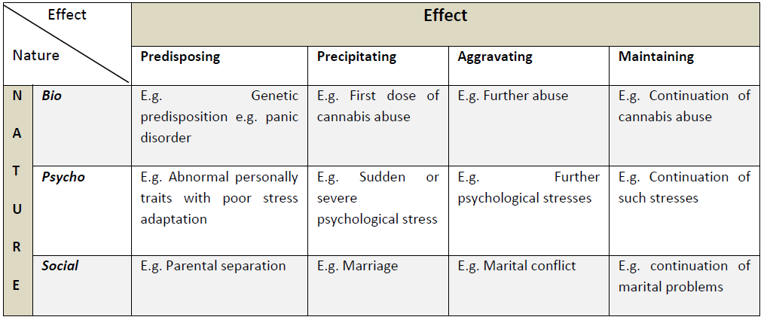
M. Al-Sughayir – Manual of Basic Psychiatry

Slide 9
SUPERNATURAL
Evil eye
Witchcraft
Possession

Slide 10
Islamic concepts | Cultural concepts and practice
The effects of evil eyes, witchcraft and possessions on health in general is proven. They can be one of the major or minor etiological factors for any type of disease.​ The pathophysiology, symptoms and signs are not proven or certain.​ The faith healing (Rogiah) is: ​ One important preventive & treatment modality for all types of diseases. Not a diagnostic tool | Some people deny the effects of evil eyes, witchcraft and possessions on health.​ Others exaggerate their effects and over blame them.​ The pathophysiology, symptoms and signs are related to specific kind of illnesses.​ Some faith healer are ignorant:​ Use faith healing as a diagnostic tool.​ Verbally and physically aggressive with patients​. Advice patients against medical management.

Slide 11
Islamic vs sociocultural concept
النظرة الاجتماعية لا تمثل الشرع
(لا تطابق تماما و لا تخالف تماما )

Slide 12
CLASSIFICATION/DIAGNOSIS IN PSYCHIATRY

Slide 13
Classification & Diagnosis In Psychiatry
Depends mainly on signs & symptoms (psychopathology).
Rarely we use external validation
lab tests , brain imaging , …etc
Clinical skills are essential.

Slide 14
Why to classify ?
Introduces order and structure to our thinking and reduces the complexity of clinical phenomena.
To distinguish one diagnosis/illness from another.
Facilitate communication among clinicians about diagnosis, treatment, & prognosis.
Help to predict outcome (e.g. schizophrenia has chronic course).
Often used to choose an appropriate treatment.
Ensure that psychiatric research can be conducted with comparable groups of patients.

Slide 15
Definition of Mental Disorder
A syndrome characterized by clinically significant disturbance in an individual's cognition, emotion regulation, or behavior that reflects a dysfunction in the psychological, biological, or developmental processes underlying mental functioning. ​
Mental disorders are associated with significant subjective distress or impairment in social, occupational, or other important activities.

Slide 16
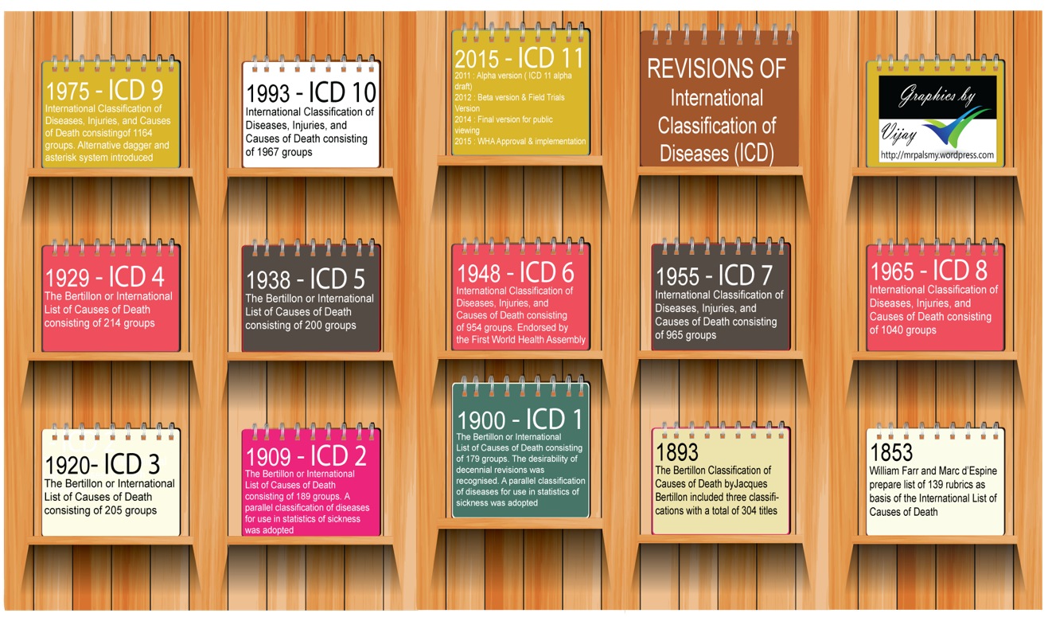
Classifications of diseases​ WHO | International Classification of Diseases (ICD)

Slide 17
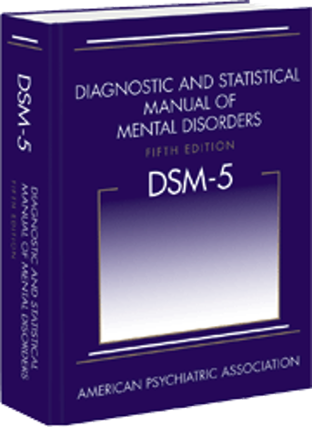
Diagnostic and Statistical Manual of Mental Disorders (DSM)
Published by APA: a common language and standard criteria for the classification of mental disorders.​
The manual evolved from systems for collecting census and psychiatric hospital statistics.​
Developed by the US Army, 1952.​
Five revisions since it was first published.​
The last major revision was the fourth edition ("DSM-IV"), published in 1994, although a "text revision" was produced in 2000. ​
DSM-5 was published in May 2013.

Slide 19
Similarities between DSM-5 and ICD-11
Both are diagnosis and categorizing manuals require two or more symptoms to make a diagnosis. ​
Both are NOT self diagnosis manuals; Intended for use by qualified health professionals, more specifically psychiatrists.
Both are officially recognized manuals used to categorize and diagnose mental disorders.
Attempts are on, to further harmonize between the two systems of disease classification.

Slide 20
Differences between DSM-5 and ICD-11

Slide 21
DSM-5 | ICD-11
DSM used mainly in the USA. DSM is purely for mental disorders. DSM issued by single national professional body-American Psychiatric Association. ​ DSM primary constituency is U.S. Psychiatrists.​ DSM approved by assembly of APA members.​ DSM is copyrighted and generates income for APA. | ICD Internationally. ICD is larger manual, encompasses all types of diseases/disorders; Only chapter V is relevant for mental disorders.​ ICD brought out of international collaboration;​ ICD produced by a global health agency with a constitutional public health mission. ICD primary focus on classification is to help countries to reduce burden of mental disorders. Its development is global, multidisciplinary and multilingual. ICD approved by World Health Assembly comprising of 193 member countries. ICD is low cost and available free on internet.

Slide 22
DSM-5 | ICD-11
DSM criteria very specific and detailed​. DSM always been multi-axial except now.​ DSM used by licensed mental health professionals with advanced degrees. | ​ICD more of prototype descriptions with less detailed criteria and minimum background information to guide diagnosis. ICD always been non-axial.​ ICD accessible to wide rage of health care professionals with wide educational backgrounds.
Conceptual differences; Ex: Bulimia nervosa is characterized by ’morbid dread of fatness’ while DSM requires ‘self evaluation’.
PTSD is much broader in ICD-10 than DSM-5.
Differences can cause problems in research comparisons

Slide 23
Other Classification:

Slide 24
Neurosis Vs. Psychosis Classification
NEUROTIC ILLNESSES | PSYCHOTIC ILLNESSES
Intact insight & reality testing.​ Good judgment.​ Abnormal quantity of symptoms and there are No psychotic features.​ E.g. anxiety disorders​ | Impaired insight & reality testing.​ Impaired judgment.​​ ​Presence of active/positive psychotic features like delusion and hallucinations & negative like poverty of thoughts & speech, lack of ambition, initiation and restricted affect.​ E.g. schizophrenia ​

Slide 25
Primary vs Secondary Psychiatric Disorders

Slide 26
Primary vs Secondary Psychiatric Disorders
Secondary​ | Primary ​
Etiology : one diagnosable systemic medical disease, CNS disease or substance.​ e.g. Depression due to SLE ​or Psychosis due to amphetamine​ ​ | Etiology is: Multi-factorial ​ e.g. schizophrenia​ Major depressive disorder​
In medicine: like secondary HTN due to renal artery stenosis.​ | In medicine: like Essential hypertension ​
Clues suggestive of being secondary:​ Disturbance of consciousness or vital signs​ Presence of :​ non-auditory hallucinations (e.g. visual) Hard neurological signs ​ Physical illness​ old age onset​ | Clues suggestive of being primary : Normal consciousness & vital signs.​ Presence of :​ Auditory hallucinations​ Soft neurological signs ​ No related physical illness Young age onset​

Slide 27
Positive Vs Negative Psychotic Symptoms/Features
Negative Symptoms | Positive Symptoms
Poverty of thoughts & speech. Lack of ambition , interest & initiation. Restricted affect. Self-neglect, Poor self care & hygiene | Perception e.g. hallucination. Thinking e.g. delusions. Mood e.g. extreme euphoria. Behavior e.g. disorganized behaviour.

Slide 28
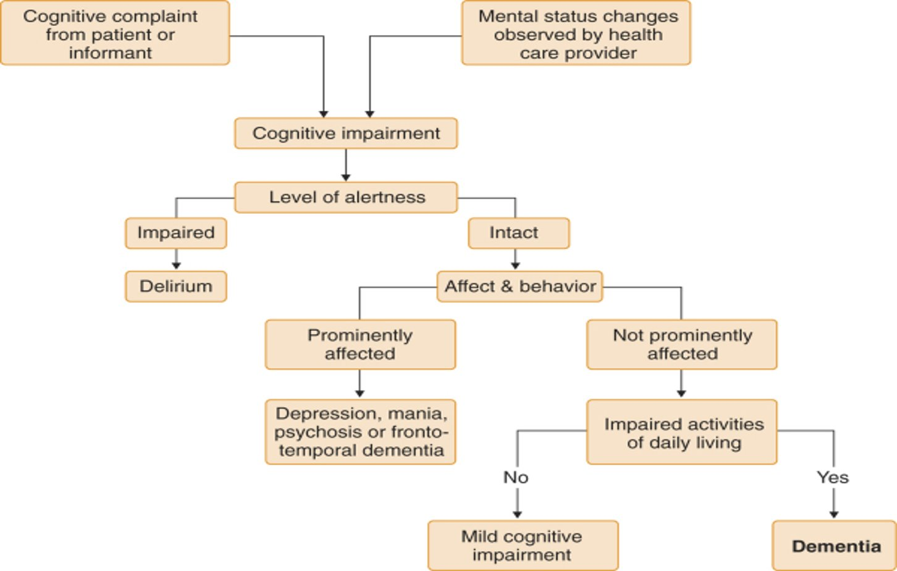
Diagnostic tree for Cognitive Impairment

Slide 29
