Slide 1
Psychopathology (Symptoms and Signs in Psychiatry)
Dr. Mohammed Alblowi
SB-Psych
Consultation Liaison Psychiatry – Queen’s University
Neuropsychiatry – University of Western Ontario

Slide 2
Objectives
To define symptom and sign.
To describe the positive and negative features in psychiatry.
To describe symptoms and signs in psychiatry.

Slide 3
Sign Vs Symptoms
Signs are objective; symptoms are subjective
Signs are the clinician's observations
Symptoms are subjective experiences
In psychiatry, signs and symptoms are not as clearly demarcated as in other fields of medicine; they often overlap.
Disorders in psychiatry are often described as syndromes.

Slide 4
Mental Disorder
Comprise a broad range of problems.
Characterized by some combination of abnormal thoughts, emotions, behavior and relationships with others.
Mental illnesses are associated with distress and/or problems functioning in social, work or family activities.

Slide 5
Sign & symptoms
Sleep or appetite changes.
Mood changes.
Withdrawal —
Recent social withdrawal and loss of interest in activities previously enjoyed
Impairment in functioning —
An unusual drop in functioning, at school, work or social activities, such as quitting sports, failing in school or difficulty performing familiar tasks

Slide 6
Con’t
Problems thinking —
Problems with concentration, memory or logical thought and speech that are hard to explain
Increased sensitivity —
Heightened sensitivity to sights, sounds, smells or touch; avoidance of over-stimulating situations
Apathy —
Loss of initiative or desire to participate in any activity.
Feeling disconnected —
A vague feeling of being disconnected from oneself or one’s surroundings; a sense of unreality

Slide 7
Con’t
Illogical thinking —
Unusual or exaggerated beliefs about personal powers to understand meanings or influence events; illogical or “magical” thinking typical of childhood in an adult
Nervousness —
Fear or suspiciousness of others or a strong nervous feeling
Unusual behavior –
Odd, uncharacteristic, peculiar behavior

Slide 8
How many sx you have?

Slide 9
Facts about sign and symptoms
Could be part of illness. (e.g paranoid delusion, auditory hallucination..etc)
Part of mental status (e.g circumstantiality, restless .. etc)
Description of type of the illness or prominent feature ( schizophrenia with positive or negative feature)

Slide 10
POSITIVE vs NEGATIVE FEATURES
Negative features | Positive features
Poverty of thoughts & speech. Lack of ambition, interest & initiation. Restricted affect. Self-neglect. Poor self care & hygiene | Major disturbances in : perception e.g. hallucination. Thinking e.g. delusions. Mood e.g. extreme euphoria. Behavior e.g. violence

Slide 12
MSE

Slide 14
Mood Vs Affect
Mood | Affect
The long term feeling state through which all experience are filtered. the emotional background Last days to weeks. Changes spontaneously, not related to internal or external stimuli. Symptom (ask patient) | the visible and audible manifestations of the patents emotional response to external and internal events . The emotional foreground Momentary , seconds to hours. Changes according to internal & external stimuli, observed by others (sign)(Current emotional state)

Slide 15
Mood & Affect
Euthymia
Normal range of mood, implying absence of depressed or elevated mood.
Depression
Psychopathological feeling of sadness.
Anhedonia
Loss of interest in, and withdrawal from, all regular and pleasurable activities. Often associated with depression.

Slide 16
Mood & Affect
Elation
Feelings of joy, euphoria, triumph, and intense self-satisfaction or optimism.
Elevated mood
Air of confidence and enjoyment; a mood more cheerful than normal but not necessarily pathological.
Euphoria
Exaggerated feeling of well-being that is inappropriate to real events.
Expansive mood
Expression of feelings without restraint, frequently with an overestimation of their significance or importance.

Slide 17
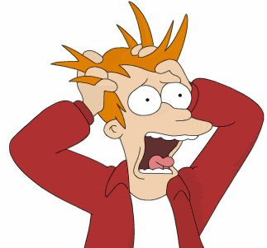
Mood & Affect
Anxiety
Feeling of apprehension caused by anticipation of danger, which may be internal or external.
Agitation
Severe anxiety associated with motor restlessness.
Flat affect
Little to no display of emotion

Slide 18
If you won 1 million $, your reaction will be:

Slide 19
Thought: form & content
Form Vs. content
Types of Formal thought disorders:
Flight of ideas
Rapid, continuous verbalizations or plays on words produce constant shifting from one idea to another
Loosening of associations
Flow of thought in which ideas from one subject to another in a completely unrelated way
Circumstantiality
Indirect speech that is delayed in reaching the point but eventually gets from original point to desired goal
Tangentiality
the train of thought of the speaker wanders and shows a lack of focus, never returning to the initial topic of the conversation

Slide 20
Thought: form & content
Derailment
Gradual or sudden deviation in train of thought without blocking
Blocking
Abrupt interruption in the train of thinking before a thought or an idea is finished
Incoherence
Communication that is disconnected, disorganized, or incomprehensible.
Word salad
Incoherent, essentially incomprehensible, mixture of words and phrases

Slide 21
Content of thought
Poverty
Delusion
Overvalued idea
Preoccupation
Obsession
Compulsion
Suicidal ideation
Homicidal ideations

Slide 22
Content of thought
Obsession
Persistent and recurrent idea, image, or impulse that cannot be eliminated from consciousness by logic or reasoning
Compulsion
Pathological need to act on an impulse that, if resisted, produces anxiety; repetitive behavior in response to an obsession or performed according to certain rules, with no true end in itself other than to prevent something from occurring in the future.

Slide 23
Content of thought
Preoccupation of thought
Centering of thought content on a particular idea, associated with a strong affective tone, such as a paranoid trend or a suicidal or homicidal preoccupation
Overvalued idea
False or unreasonable belief or idea that is sustained beyond the bounds of reason. It is held with less intensity or duration than a delusion, but is usually associated with mental illness

Slide 24
Content of thought
Delusion: False belief, based on incorrect inference about external reality, that is firmly held despite objective and obvious contradictory proof or evidence and despite the fact that other members of the culture do not share the belief.
Delusion of control
Delusion of grandeur
Delusion of infidelity
Delusion of persecution
Delusion of reference
Somatic delusion
Nihilistic delusion

Slide 25
Themes of delusion

Slide 26
Delusion
Passivity Phenomena
Thought insertion
Delusion that thoughts are being implanted in one's mind by other people or forces.
Thought withdrawal
Delusion that one's thoughts are being removed from one's mind by other people or forces.
Thought broadcasting
Delusion that one's thoughts are being broadcast or projected into the environment.

Slide 27
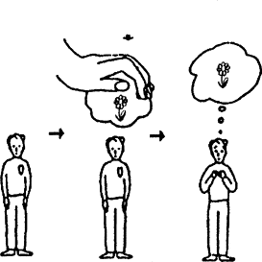
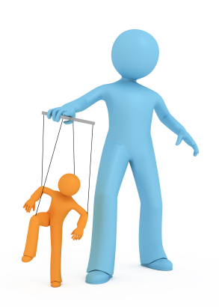
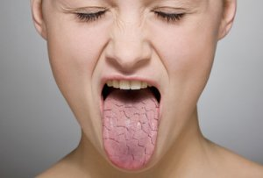
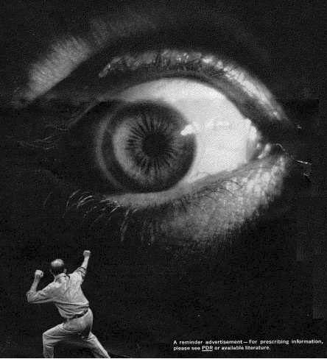
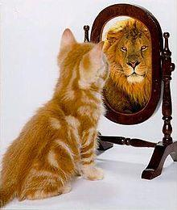
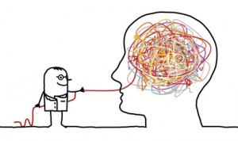

Slide 28
Preoccupation
Overvalued idea
Delusion

Slide 29
Perception
Conscious awareness of elements in the environment by the mental processing of sensory stimuli
Hallucination
False sensory perception occurring in the absence of any relevant external stimulation of the sensory modality involved
Auditory, visual, olfactory, gustatory, tactile.
Illusion
Perceptual misinterpretation of a real external stimulus.

