Slide 1
OCD
Ahmad AlHadi, MD
Associate Professor and Consultant
in Psychiatry and Psychotherapy

Slide 2
Objectives:
List the diagnostic criteria for OCD according to DSM5.
Discuss the prevalence and causes of OCD.
Discuss the treatment plan.

Slide 3
Case Development 2:
Family History:
One of Layla's sisters has recurrent intrusive silly doubts regarding ablutions and praying that she cannot resist. This makes her repeat ablution and praying frequently.

Slide 4
Anxiety Disorders
Panic Disorder
Agoraphobia
Specific Phobia
Social Phobia.
Generalized Anxiety Disorder (GAD)
Obsessive Compulsive Disorder (OCD)
Post Traumatic Stress Disorder (PTSD), Acute Stress Disorder

Slide 5
OCD
Obsessions
Own: thoughts,
Impulses, images
Intrusive, Insisting, Unwanted
Repetitive
Irrational
uncontrollable
e.g. contaminated hands
Compulsions
Irresistible, Compelling Actions or mental acts
Done in response to obsessions or according to rules
to reduce anxiety or prevent dreaded events or situations
e.g. washing hands
repeatedly
Disorder
Time consuming
at least 1 hr/d
Functioning imp.

Slide 6
OCD DSM5
A. Presence of obsessions, compulsions, or both:
Obsessions are defined by (1) and (2):
1. Recurrent and persistent thoughts, urges, or images that are experienced, at some time during the disturbance, as intrusive and unwanted, and that in most individuals cause marked anxiety or distress.
2. The individual attempts to ignore or suppress such thoughts, urges, or images, or to neutralize them with some other thought or action (i.e., by performing a compulsion).
Compulsions are defined by (1) and (2):
1. Repetitive behaviors (e.g., hand washing, ordering, checking) or mental acts (e.g., praying, counting, repeating words silently) that the individual feels driven to perform in response to an obsession or according to rules that must be applied rigidly.
2. The behaviors or mental acts are aimed at preventing or reducing anxiety or distress, or preventing some dreaded event or situation; however, these behaviors or mental acts are not connected in a realistic way with what they are designed to neutralize or prevent, or are clearly excessive. Note: Young children may not be able to articulate the aims of these behaviors or mental acts.

Slide 7
OCD DSM5
B. The obsessions or compulsions are time-consuming (e.g., take more than 1 hour per day) or cause clinically significant distress or impairment in social, occupational, or other important areas of functioning.
C. The obsessive-compulsive symptoms are not attributable to the physiological effects of a substance (e.g., a drug of abuse, a medication) or another medical condition.
D. The disturbance is not better explained by the symptoms of another mental disorder (e.g., excessive worries, as in generalized anxiety disorder; preoccupation with appearance, as in body dysmorphic disorder; difficulty discarding or parting with possessions, as in hoarding disorder; hair pulling, as in trichotillomania [hair-pulling disorder]; skin picking, as in excoriation [skin-picking] disorder; stereotypies, as in stereotypic movement disorder; ritualized eating behavior, as in eating disorders; preoccupation with substances or gambling, as in substance-related and addictive disorders; preoccupation with having an illness, as in illness anxiety disorder; sexual urges or fantasies, as in paraphilic disorders; impulses, as in disruptive, impulse-control, and conduct disorders; guilty ruminations, as in major depressive disorder; thought insertion or delusional preoccupations, as in schizophrenia spectrum and other psychotic disorders; or repetitive patterns of behavior, as in autism spectrum disorder).
Specify if:
With good or fair insight: The individual recognizes that obsessive-compulsive disorder beliefs are definitely or probably not true or that they may or may not be true.
With poor insight: The individual thinks obsessive-compulsive disorder beliefs are probably true.
With absent insight/delusional beliefs: The individual is completely convinced that obsessive-compulsive disorder beliefs are true.
Specify if: Tic-related: The individual has a current or past history of a tic disorder.

Slide 8
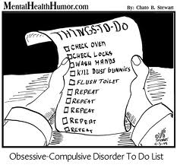

Slide 9
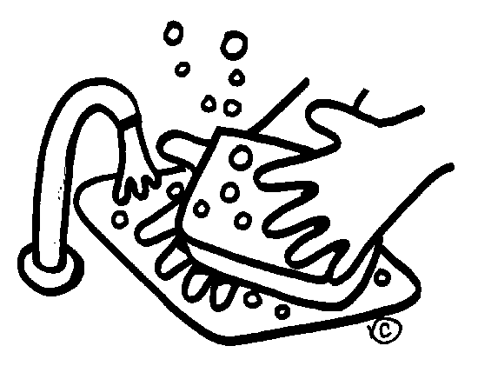
Main themes of OCD
**** sense of danger and/or responsibility.
Contamination ➔ washing.
Religious, e.g. repeating Ablution, prayers, divorce, Blasphemous.
Sexual
Aggression
Symmetry ➔ slowness
Hoarding
Notes:
Pattern of obsessive-compulsive disorder in eastern Saudi Arabia
OM Mahgoub and HB Abdel-Hafeiz Department of Psychiatry, College of Medicine, King Faisal University, Dammam, Kingdom of Saudi Arabia.
In 32 Muslim Saudis with obsessive-compulsive disorder, compulsive acts (78%) and doubts (66%) were the commonest forms. Religious themes predominated in both the obsessions and compulsions.
THE MAIN THEMES OF OCD
Contamination and washing (e.g. contaminated by one’s own excreta, shaking hands with others, etc.)
Repeated doubts concerning actions that may not have been completed adequately (e.g. ablutions, prayers, gas checking).
Insistence on symmetry: needs to have things in a particular order.
Aggressive or horrific impulses (e.g. fear of harming a child).
Sexual imagery (e.g. violent abnormal sexual practices).
Blasphemous thoughts: obsessions about religious matters.
Obsessional ruminations: internal debates in which arguments for and against even the simplest everyday actions are reviewed endlessly.
Obsessional phobias: obsessional thoughts with fearful content such as thoughts of a harmful use of knives.

Slide 10
Course
Gradual > acute
Chronic
Waxing & waning
Notes:
Course and Prognosis:
In most cases onset is gradual but acute cases have been noted.
The majority have a chronic waxing and waning course with exacerbations related to stressful events.
Severe cases may become persistent and drug resistant.
Prognosis is worse when the patient has obsessive compulsive personality disorder.
Patient’s age, sex, age of onset and duration of OCD showed no significant correlation with outcome.
Good lasting outcome was found to be related to compliance with treatment (exposure and drugs), presence of mood component and family support.

Slide 11
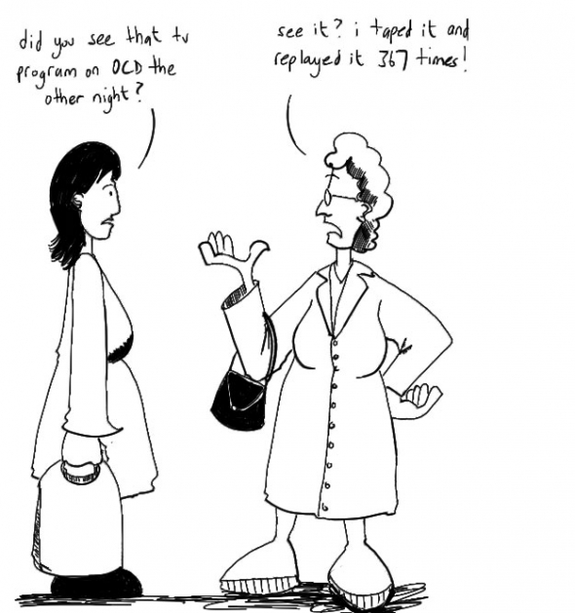

Slide 12
Prognosis
Non – severe
No OCPD
Depressed / anxious mood
Compliance with Tx
Family support
Good p. Factors

Slide 13
video
Video: What is it like to be OCD

