Slide 1
HISTORY TAKING AND MENTAL STATE EXAMINATION (MSE)
Dr. Ali Bahathig, FRCPC, Assistant Professor and Consultant of Psychiatry & Psychosomatic Medicine
Psychosomatic Unit, Psychiatry Department
King Saud University Medical City (KSUMC)
1440/1441
2019/2020

Slide 2
SPECIAL TAHNKS TO:
Dr. Fahad Alosaimi, MD​, Professor and Consultant​ of Psychiatry & Psychosomatic medicine, ​College of Medicine, King Saud University​
Dr. Ahmad Alhadi​, MD, Associate Professor and Consultant of Psychiatry and Psychotherapy, College of Medicine, King Saud University
Dr. Mohammed Al-Sughayir, MD, Professor and Consultant of Psychiatry, College of medicine, King Saud University

Slide 3
Objectives:
To describe History taking in psychiatry.
To see how to take Psychiatric History.
To describe MSE component.​
To see how to do MSE.​

Slide 4
Introduction:
One supreme skill of any physician is active listening.
Physicians should monitor :
The content: of the interaction (what patient and doctor say to each other)
The process: (what patient and doctor may not say but clearly convey in many other ways).
Physicians should be sensitive to the effects of patient history/background, culture, environment, and psychology on the doctor–patient relationship
Because patients are multifaceted people.
Physician should not consider disease/syndromes only.

Slide 5
Models of the doctor–patient relationship include:
The active-passive model
The teacher–student (or parent–child, guidance–cooperation) model.
The mutual participation model.
The friendship (or socially intimate) model.

Slide 6
Introduction:
The more that doctors understand themselves, the more secure they feel, and the better able they are to modify destructive attitudes.
Increased flexibility leads to a responsiveness to the subtle interplay between doctor and patient and also assumes a certain tolerance for the uncertainty present in any clinical situation with any patient.

Slide 7
Goals for Psychiatric Interview:
Obtain the necessary information to make a diagnosis.
Understand the person with the illness.
Understand the circumstances of the patient.
Form a therapeutic relationship with the patient. (rapport).
Provide the patient with information about the illness, recommendation, and prognosis.

Slide 8
Every Interview has three main components:
Beginning
Interview itself
Closing
Balance in monitoring Content Vs Process during the interview

Slide 9
Opening (General advices):
Introduce yourself and greet the patient by name.
Reassure privacy and confidentiality.
separate room.
L-shaped position and private comfortable setting .
Suitable distance (e.g. with geriatric ,with aggressive patient)
Be supportive, attentive, non judgmental and encouraging.
Explain about ,yourself ,the purpose of interview, and expected time needed.

Slide 10
Opening (General advices):
Observe the patient’s nonverbal behavior and Avoid excessive note-taking
With whom you will start (Patient or his/her relative).
Why he come with a relative ? (Psychosis Vs. Neurosis).
Diagnose based on criteria and constellation of symptoms that affect functioning level (e.g. Social phobia Vs. paranoid schizophrenia).
Start with open ended questions.

Slide 11
Six strategies to develop Rapport:
Putting patient at ease.
Finding patient’s pain and expressing compassion.
Evaluating patients' insight and becoming an ally.
Showing expertise.
Establishing authority as physician or therapist.
Balancing the roles of empathic listener, expert, and authority.

Slide 12
Every Interview has three main components:
Beginning
Interview itself
Closing

Slide 13
Interview Techniques:
Bay attention to both content & process.
Open-ended question versus Closed-ended questions.
REFLECTION: In the technique of reflection, a doctor repeats to a patient in a supportive manner something that the patient has said.
FACILITATION: Doctors help patients continue in the interview by providing both verbal and nonverbal cues.
SILENCE.

Slide 14
Interview Techniques:
CONFRONTATION: The technique of confrontation is meant to point out to a patient something that the doctor thinks the patient is not paying attention to, is missing, or is in some way denying.
CLARIFICATION: In clarification, doctors attempt to get details from patients about what they have already said.
INTERPRETATION: The technique of interpretation is most often used when a doctor states something about a patient's behavior or thinking that a patient may not be aware of.

Slide 15
Interview Techniques:
SUMMATION: Periodically during the interview, a doctor can take a moment and briefly summarize what a patient has said thus far.
EXPLANATION: Doctors explain treatment plans to patients in easily understandable language and allow patients to respond and ask questions.
TRANSITION: The technique of transition allows doctors to convey the idea that enough information has been obtained on one subject; the doctor's words encourage patients to continue on to another subject.

Slide 16
Interview Techniques:
SELF-REVELATION: Limited, discreet self-disclosure by physicians may be useful in certain situations, and physicians should feel at ease and should communicate a sense of self-comfort.
POSITIVE REINFORCEMENT.
REASSURANCE.
ADVICE.

Slide 17
Interview Techniques:
Transference:
The patient are transferring feelings toward others in their life onto the physician.
Counter-transference:
Emotional reactions to the patient from the doctor that often involve the doctor past experience.

Slide 18
THE PSYCHIATRIC HISTORY
THE MENTAL STATUS EXAMINATION

Slide 19
THE PSYCHIATRIC HISTORY | THE MENTAL STATUS EXAMINATION
It is the chronological story of the patient’s life from birth to present. It includes information about who the patient is, his problem (Bio-Psycho-Social aspects) and its possible causes and available support. Information elicited both from the patient and from one or more informants. | MSE is a cross-sectional, systemic documentation of the quality of mental functioning at the time of interview. It serves as a baseline for future comparison and to follow the progress of the patient. Observation of patient’s feelings, thoughts, perception, and behavior during the interview.

Slide 20
THE PSYCHIATRIC HISTORY:
Identification data.
Referral Source.
Chief Complaint.
History of present illness.
Past Psychiatric history.
Medical history.
Family history.
Personal and Social history.
Tobacco and substance abuse.
Legal (forensic) problems.
Personality traits.

Slide 21
Structure of History:
Identification of the Patient:
Name, age, gender, marital status, occupation, education, nationality, residency, and religion
Referral Source:
Brief statement of how the patient came to the clinic and the expectations of the consultation.
Chief Complaint:
Exactly why the patient came to the psychiatrist, preferably in the patient’s own words (a verbatim statement).

Slide 22
Structure of History:
History of Present Illness:
Chronological background of the psychiatric problem: Nature, Onset, Course, Severity, Duration, Effects on the patient (social life, job, family…)
Review of the relevant problems.
Symptoms not mentioned by the patient (e.g. Sleep, appetite, …)
Treatment taken so far (nature and effect).
Important –Ve (e.g. history of mania in depressed patient )
Suicide ,homicide, substance abuse, and organic disease.

Slide 23
Structure of History:
Past Psychiatric History:
Any previous psychiatric illness (nature, dates, treatment, outcome).
Medical history:
All major illnesses should be listed
Family History:
Ask about mental illnesses in first and second-degree relatives (grand parents, uncles, aunts, nephews, & nieces).
Mother and father: current age (if died mention age and cause of death, and patient’s age at that time).

Slide 24
Structure of History:
Personal and Social history:
Birth & Early development
School
Occupations
Puberty & Adolescence.
Marital history.
Current social situation.
Tobacco and substance abuse.
Legal (forensic) problems.

Slide 25
Structure of History:
Personality Traits:
Attitude to self (self-appraisal, performance, satisfaction, past achievements, and failures, future).
Moral and religious attitudes and standards.
Prevailing mood and emotions.
Reaction to stress (ability to tolerate frustration and disappointments, pattern of coping strategies).
Personal interests, habits, hobbies and leisure activities.
Interpersonal relationships.

Slide 26
The Mental Status Examination( MSE)

Slide 27
Outlines of MSE:
Appearance , Behaviour & Attitude (Cooperativeness)
Speech
Mood & Affect
Thoughts
Perceptions
Cognitive functions:
Consciousness level
Orientation (Time, Place, Person)
Attention & concentration
Memory
Language and Reading
Visuospatial ability
Abstract thinking
Judgment & Insight

Slide 28
MSE:
Appearance:
Include body build, self-care, clothes ,grooming, hair, nails, facial expressions, and any unusual features (e.g. weight loss)
Behaviour:
Both the quantitative and qualitative aspects.
Note level of activity, posture, eye to eye contact and unusual movements (tics, grimacing, tremor, disinhibited behaviour, hallucinatory gestures,…etc.)
Attitude:
Note the patient’s attitude (verbal& non verbal) during the interview (interested, bored, cooperative, uncooperative, sarcastic, guarded or aggressive)

Slide 29
Impression?!

Slide 30
Impression?!

Slide 31
Impression?!

Slide 32
Impression?!

Slide 33
MSE
Speech:
Speech can be described in terms of its quantity, rate of production, and quality
Listen to and describe how the patient speaks, noting:
Coherence
Spontaneity
Volume, flow & tone
Continuity
Speech impairments (stuttering, dysarthria,. etc)

Slide 34
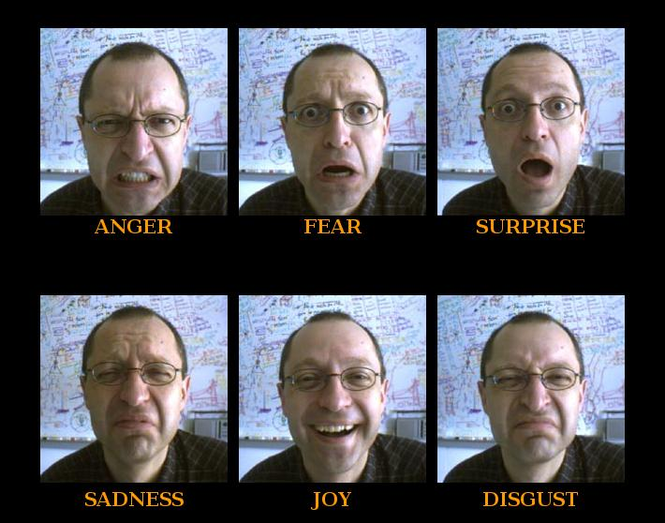
MSE
Mood:
Euthymic
low , depressed.
expansive ,elated
Irritable.
Affect:
Appropriate ,inappropriate
Restricted , blunted ,flat
Labile
Note any affect abnormalities in:
Its nature (e.g. anxiety, depression, elation…)
Its variability (constricted affect, labile affect..).
Its appropriateness whether the affect is to the thought content

Slide 35
Mood | Affect
The long term feeling state through which all experience are filtered The emotional background Last days to weeks Changes spontaneously, not related to internal or external stimuli Symptom (ask patient) | The visible and audible manifestations of the patents emotional response to external and internal events The emotional foreground Momentary, seconds to hours Changes according to internal & external stimuli Observed by others (sign ) (Current emotional state)

Slide 36
MSE
Thoughts:

Slide 37
MSE
Thoughts:
Thought stream:
Pressured thought, poverty of thought, and thought block
Thought form:
Flight of ideas, loss of association, and perseveration.
Thought content:
Delusion, obsession and, overvalued ideas.

Slide 38
MSE
Thoughts:
Thought form:
The way in which a person puts together ideas and associations
Examples:
Goal-directed thinking
Circumstantiality
Tangentiality
Flight of ideas
Loosening of associations or derailment
Word salad or incoherence
Neologisms
Clang associations (Rhyming)
Thought blocking
Most organized
Most disorganized

Slide 39
MSE
Thoughts:
Thought content:
What a person is actually thinking about.
Examples:
Delusions
Preoccupations
Obsessions and compulsions
Phobias
Suicidal or homicidal ideas
Ideas of reference and influence
Poverty of thoughts

Slide 40
Forms (Process) | Contents
The way in which a person puts together ideas and associations. Examples: Goal-directed thinking Circumstantiality Tangentiality Flight of ideas Loosening of associations or derailment Word salad or incoherence Neologisms Clang associations (Rhyming) Thought blocking | What a person is actually thinking about. Examples: Delusions Preoccupations Obsessions and compulsions Phobias Suicidal or homicidal ideas Ideas of reference and influence Poverty of thoughts

Slide 41
MSE
Perception:
Illusion: Misperception of external stimulus.
Hallucinations: No external stimulus
Which sensory system (e.g. auditory, visual..etc...)
Content
Third person Vs Second person
Patient reaction to hallucination
Hypnagogic hallucinations hypnopompic hallucinations
Pseudo hallucinations
Depersonalization and derealization: extreme feelings of detachment from the self or the environment
Formication: The feeling of bugs crawling on or under the skin

Slide 42
MSE
Cognitive functions:
Consciousness level and orientation
Attention and concentration : e.g. Serial 7 test
Memory:
Immediate memory
Short term recall
Recent memory
Remote memory (long-term memory)
Language and Reading: (When brain pathology is suspected)
Nominal aphasia: name two objects (e.g. a pen and a watch )
Expressive aphasia: repeat after you certain words
Receptive aphasia: carry out a verbal command
Reading comprehension: read a sentence with written command (e.g. close your eyes)
Visuospatial Ability: (When brain pathology is suspected): Ask the patient to copy a figure such as interlocking pentagons

Slide 43
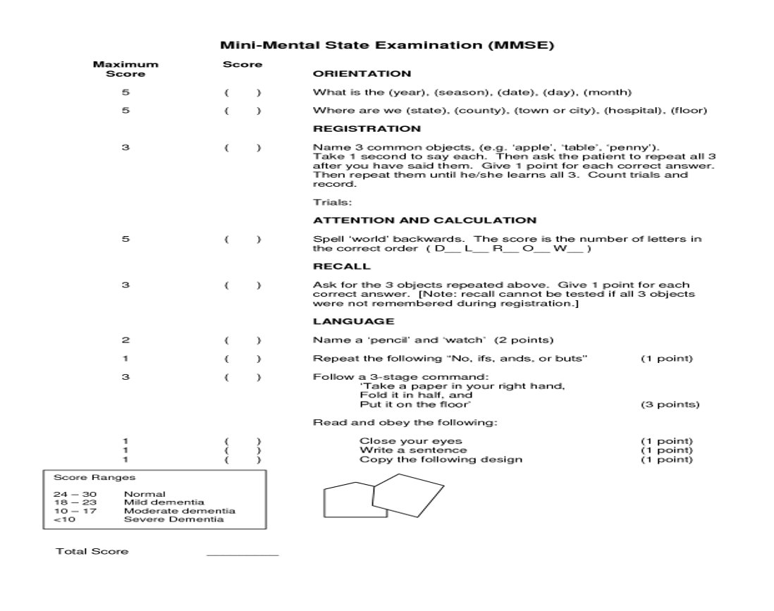
Formal Cognitive testing (MMSE)

Slide 44
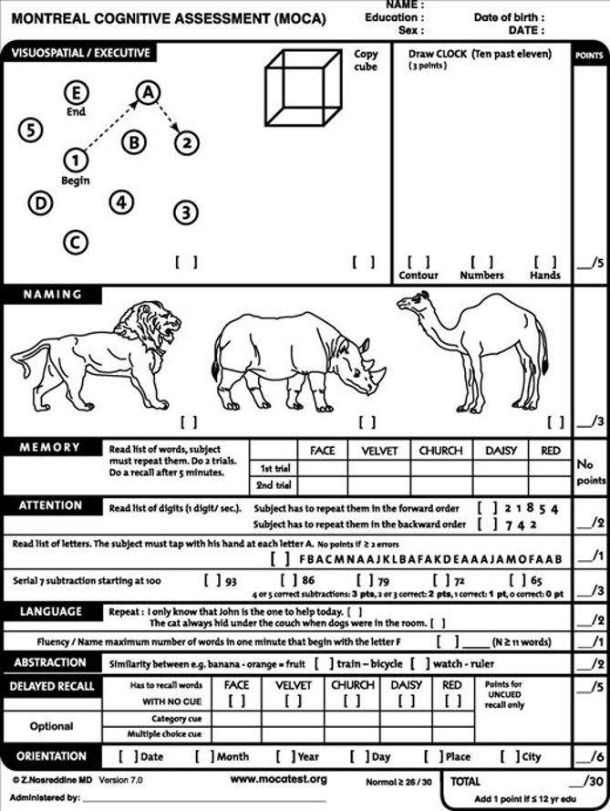
Formal Cognitive testing(MOCA)

Slide 45
MSE
Cognitive functions:
Abstract Thinking:
It is the ability to deal with concepts and to make appropriate inference.
It can be tested by :
Similarities: ask the patient to tell you the similarity between 2 things (e.g. car and train), and the difference between 2 things (e.g. book and notebook)
Proverbs: ask the patient to interpret one or two proverbs (e.g. people in glass houses should not throw stones) the patient may give a concrete answer (e.g. stones will break the glass)

Slide 46
MSE
Judgment: ​
The patient’s predicted response and behaviour in imaginary situation.​
From recent history.​
Insight: ​
The degree of awareness and understanding the patient has that he or she is mentally ill.

Slide 47
MSE
levels of insight:
Complete denial of illness
Slight awareness of being sick and needing help but denying it at the same time
Awareness of being sick but blaming it on others, on external factors, or on organic factors
Awareness that illness is due to something unknown in the patient
Intellectual insight: admission that the patient is ill and that symptoms or failures in social adjustment are due to the patient's own particular irrational feelings or disturbances without applying this knowledge to future experiences
True emotional insight: emotional awareness of the motives and feelings within the patient and the important people in his or her life, which can lead to basic changes in behavior
Patient’s compliance with psychiatric treatment depends on his insight.

Slide 48
Every Interview has three main components:
Beginning
Interview itself
Closing

Slide 49
Closing
Differential diagnoses.
Provisional (working ) diagnosis.
Investigations.
Management:
(Acute Vs .chronic )
Outpatient Vs. inpatient .
Bio-Psycho-Social treatment
Full explanation about the plan (S/E, efficacy, risk of addiction, and any other questions from the patient)
Doctors explain treatment plans to patients in easily understandable language and allow patients to respond and ask questions.
Prognosis.

Slide 50
Professional Boundaries
Difficult Doctor-Patient: (Relationships)
The Seductive Patient.
The “Hateful” Patient.
The Patient With a Thousand Symptoms.
The Patient in the Hospital Setting.
The Mentally Disturbed Patient.
The Dying Patient.

