Slide 1
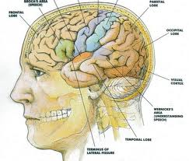
Schizophrenia spectrum & other Psychotic disorders
Dr. Ali Bahathig, FRCPC, Assistant Professor and Consultant of Psychiatry & Psychosomatic Medicine
Psychosomatic Unit, Psychiatry Department
King Saud University Medical City (KSUMC)
1440/1441
2019/2020

Slide 2
SPECIAL TAHNKS TO:
Dr. Fahad Alosaimi, MD​, Professor and Consultant​ of Psychiatry & Psychosomatic medicine, ​College of Medicine, King Saud University​
Dr. Ahmad Alhadi​, MD, Associate Professor and Consultant of Psychiatry and Psychotherapy, College of Medicine, King Saud University
Dr. Mohammed Al-Sughayir, MD, Professor and Consultant of Psychiatry, College of medicine, King Saud University

Slide 3
Objectives
Analyze the symptoms & signs of psychotic disorders
Signs and symptoms usually presented in psychotic disorders
Expected signs & symptoms in Psychotic disorders including mood, thoughts, cognition, perception and physical aspects
Discuss possible etiological reasons
Discuss differential diagnosis
List Treatment options

Slide 4
Introduction
What is Psychosis?

Slide 5
Introduction
Psychosis:
Is an abnormal condition of the mind that results in difficulties determining what is real and what is not
Symptoms may include:
False beliefs (Delusions)
Seeing or hearing things that others do not see or hear (hallucinations)
Other symptoms:
Incoherent speech &/or behavior that is inappropriate for the situation
There may be also be sleep problems, social withdrawal, lack of motivation, & difficulties carrying out daily activities
Wikipedia

Slide 6
Introduction
Psychosis:
Psychosis has many different causes:
These include mental illness, such as schizophrenia or bipolar disorder
Some medical conditions such as Anti-NMDA receptor encephalitis
Certain medications, such high dose of steroids
Drugs/substance such as alcohol or cannabis
Wikipedia

Slide 7
Introduction
Schizophrenia spectrum & other Psychotic disorders
Schizophrenia
Brief Psychotic Disorder
Schizophreniform Disorder
Schizoaffective Disorder
Delusional Disorder
Substance/medication-Induced Psychotic Disorder
Psychotic Disorder Due to Another Medical condition

Slide 8
Case of Mr. M
History of Present illness:
Mr. M is a 28 year-old single male who was brought to Emergency room by his family because of gradual changes in his behavior started 9 months ago
Since then, he became agitated; eat only canned food but not cooked food made by his family (afraid of being poisoned)
He started to talk to himself and stare occasionally on the roof of his room

Slide 9
Case of Mr. M
Past Psychiatric history:
He had two brief psychiatric hospitalizations in last 3 years
Precipitated by anger at his neighbor and voices commenting about his behavior
Past Personal history:
He was a healthy child, but his parents report that he was a bed wetter and seemed slower to develop than his brothers and sisters

Slide 10
Schizophrenia

Slide 11
Schizophrenia
It is not a single disease but a group of disorders/different presentations with heterogeneous etiologies
Found in all societies and countries with equal prevalence & incidence worldwide
A life prevalence of 0.6 – 1.9 %
Annual incidence of 0.5 – 5.0 per 10,000
Peak age of onset are
10-25 years for ♂
25-35 years for ♀

Slide 12
Etiology
Exact etiology is unknown
BUT
There are many theories might explain the possible etiologies

Slide 13
Etiology
1- First theory
Stress-Diathesis Model:
Integrates biological, psychosocial, and environmental factors in the etiology of schizophrenia
Symptoms of schizophrenia develop when a person has a specific vulnerability that is acted on by a stressful influence

Slide 14
Etiology
2- Second theory:
Neurobiology:
Certain areas of the brain are involved in the pathophysiology of schizophrenia:
Limbic system
Frontal cortex
Cerebellum
Basal ganglia

Slide 15
Etiology
Neurobiology:
Dopamine Hypothesis:
Too much dopaminergic activity in mesolimbic area (whether it is ↑ release of dopamine, ↑ dopamine receptors, hypersensitivity of dopamine receptors to dopamine, or combinations is not known)
Serotonin hypothesis:
Abnormal serotonin metabolism in some patients
Disturbed balance between dopamine and serotonin:
Supported by the new generation of antipsychotics (dopamine-serotonin antagonists)

Slide 16
Etiology
Neurobiology:
Glutamate hypothesis:
Glutamate hyperactivity causes glutamate-induced neuro-toxicity
Glutamate hypoactivity It has been implicated because ingestion of phencyclidine (a glutamate antagonist) produces an acute syndrome similar to schizophrenia
GABA hypothesis:
The loss of inhibitory GABAergic neurons
Could lead to the hyperactivity of dopaminergic neurons
Some patients with schizophrenia have a loss of GABAergic neurons in the hippocampus

Slide 17
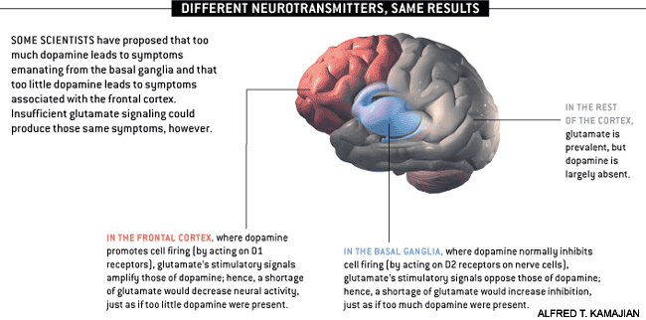
Notes:
http://www.schizophrenia.com/schizpictures.html

Slide 18
Etiology
3- Third theory:
Neuropathology and Neuroimaging:
Neuropathological and neuroimaging abnormalities have been reported in the brain particularly in the limbic system, basal ganglia and cerebellum (Either in structures or connections)
CT scan studies showed:
Cortical atrophy in 10 - 35 % of schizophrenic patients
Enlargement of the lateral and third ventricles in 10 – 50 % of schizophrenic patients
Findings correlate more with negative features and with cognitive impairments
MRI and PET (Positron Emission Tomography) studies showed:
Abnormal frontal, parietal, and temporal lobe structure and metabolism in some schizophrenic patients

Slide 19
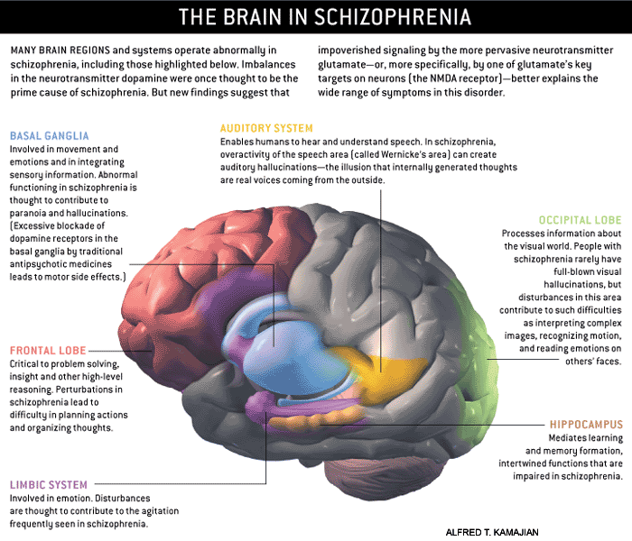
Notes:
http://www.schizophrenia.com/schizpictures.html

Slide 20
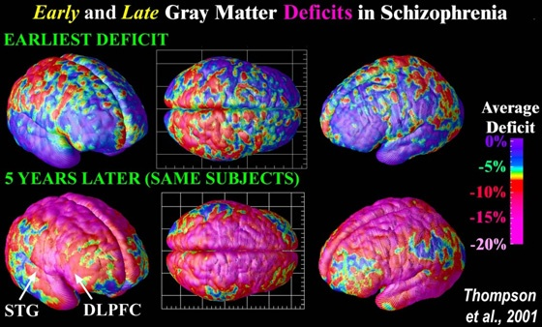
Notes:
Image Source: UCLA Laboratory of Neuro Imaging, UCLA, Derived from high-resolution magnetic resonance images (MRI scans), the above images were created after repeatedly scanning 12 schizophrenia subjects over five years, and comparing them with matched 12 healthy controls, scanned at the same ages and intervals. Severe loss of gray matter is indicated by red and pink colors, while stable regions are in blue. STG denotes the superior temporal gyrus, and DLPFC denotes the dorsolateral prefrontal cortex. Note: This study was of Childhood onset schizophrenia (defined as schizophrenia diagnosed in children under the age of 13 or so) which occurs in approximately 1 of every 40,000 people and is frequently a significantly more aggressive form of schizophrenia (than regular schizophrenia that typically begins when people are aged 15 to 25 (slightly later for women) - and impacts approximatley 1 of every 100 people).

Slide 21
Etiology
4- Fourth theory:
Psychoneuroimmunology:
↓ T-cell interlukeukin-2 & lymphocytes, abnormal cellular and humoral reactivity to neurons and presence of anti-brain antibodies
These changes are due to neurotoxic virus ?
Endogenous autoimmune disorder ?
5- Fifth theory:
Psychoneuroendocrinology:
Abnormal dexamethasone-suppression test
↓ LH/FSH
A blunted release of prolactin and growth hormone on stimulation

Slide 22
Etiology
6- Sixth theory:
Genetic Factors:
A wide range of genetic studies strongly suggest a genetic component to the inheritance of schizophrenia that outweighs the environmental influence
Those genetic studies include:
Family studies
Twin studies
Chromosomal studies

Slide 23
Notes:
http://www.schizophrenia.com/prevention.htm
Before going into the specific risk reduction strategies its important to know the initial risks that a person may face of getting schizophrenia. In the general population, for someone who has no family history of mental illness, the average risk is estimated at approximately 1% (and therefore a 99% probability that the person will not get schizophrenia). If someone who is genetically related to a person in the extended family that does have schizophrenia, then the risk is higher - and the chart below provides a rough estimate of that risk. If, for example, you have an aunt or uncle who developed schizophrenia, then your risk (on average) is estimated at approximately 3% (and therefore there is a 97% probability you won't get schizophrenia). Even for the situation where one parent has schizophrenia the risk is estimated at 13% for a child, which means there is an 87% probability that the person will not develop schizophrenia. If a family has a history of more than one person developing schizophrenia then the risk goes up. People who have a strong history of mental illness in their family may want to consider genetic counseling in addition to the schizophrenia prevention tactics identified below

Slide 24
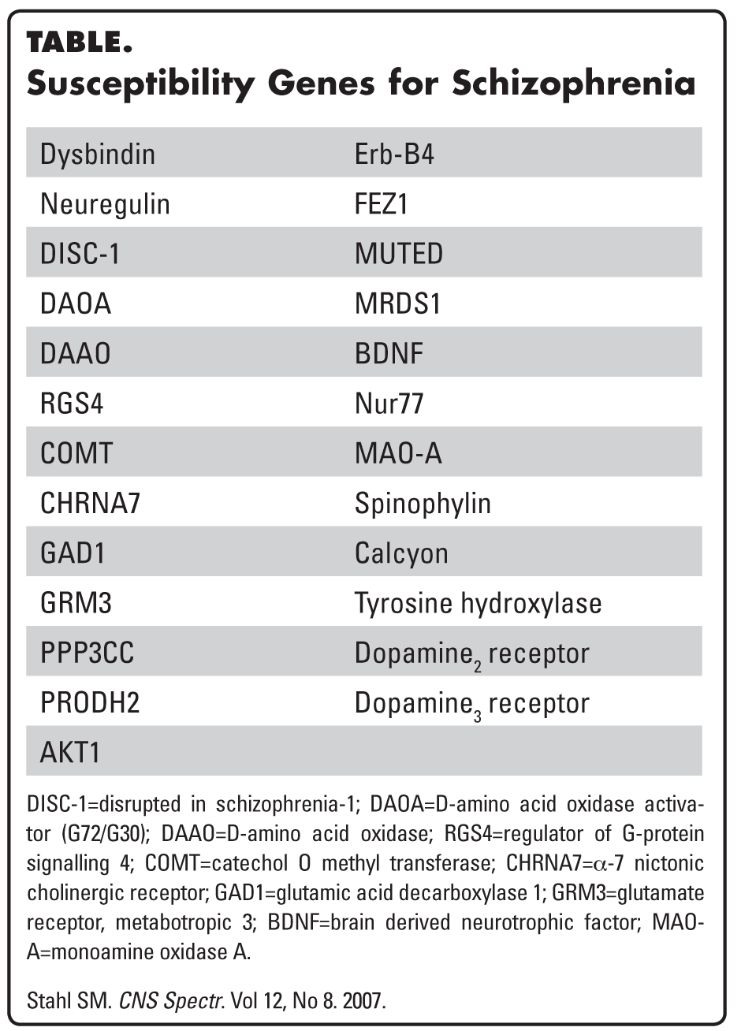
Schizophrenia: Genes plus stressors
Schizophrenia is mostly caused by various possible combinations of many different genes (which are involved in neurodevelopment, neuronal connectivity and synaptogenesis) plus stressors from the environment conspiring to cause abnormal neurodevelopment.
There is also abnormal neurotransmission at glutamate synapses, possibly involving
hypofunctional NMDA receptors
Stephen M The Genetics Of Schizophrenia Converge,Upon,The NMDA Glutamate Receptor, CNS Spectr. 2007

Slide 25
Etiology
7- Seventh theory
Psychosocial Factors:
In family dynamics studies
No well-controlled evidence indicates specific family pattern plays a causative role in the development of schizophrenia
Schizophrenic mother (No evidence)
High Expressed Emotion (High EE) family:
Increase risk of relapse

Slide 26
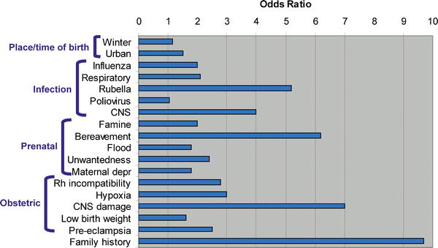
Weight of different RF: Family history comes first
PLOS Medicine
Notes:
Its also important to keep in mind as you read about the risk factors, that most of these risk factors are associated with approximately a doubling of risk (also called the "Odds Ratio") - which might sound high, but that means that overall for someone with no family history of schizophrenia, that the risk goes from about 1% to 2% (with risk of not getting schizophrenia declining from 99% to 98%). Therefore, for the average person with no family history of schizophrenia or mental illness most of these risk factors may not make a significant difference in terms of total risk of schizophrenia which remains low. At the same time good healthcare, nutrition and a positive emotional environment for women during pregnancy are always important factors for the health of a baby and always recommended by doctors. Research also suggests that nurturing, sensitive child care is also important for the healthy emotional development of children
Image: Some of the Schizophrenia Environmental Risk Factors - Source; PLOS Medicine (Note: different studies suggest different risk factors - so you will see some variance in the risk number that we quote below for some environmental factors).
The factors listed below matter most significantly for people who have a history of schizophrenia or other mental illness in their family which suggests that a person may have some of the genes that are associated with schizophrenia risk. At this time little is known about exactly how the environmental exposures identified below increase risk in those with some sort of genetic vulnerability - so don't get too worried if you have in the past experienced a given environmental factor, as its impossible to know for sure how that environmental factor might impact you or your child. Focus on the environmental factors that you still have some influence over.
The take home message is that if you have a family history of mental illness it would probably be beneficial to take some reasonable steps to reduce or avoid exposure to the risk factors -- especially those factors involved in pregnancy, prenatal care and early child care. For teens interested in lowering their risk of schizophrenia, the avoidance of street drugs, maintenance of healthy friendships, and early treatment for any depression, sadness and anxiety is likely to be valuable. At the same time, all of the actions below are likely to help the mental health of any child or person - so the more steps you can take, the better your (or your child's) mental health is likely to be.

Slide 27
Diagnosis

Slide 28
Diagnosis
DSM-5 Diagnostic Criteria for Schizophrenia:
A- Two or more of the following characteristic symptoms for one month, at least one of them is (1), (2) or (3)
Delusions
Hallucinations
Disorganized speech (Frequent derailment or incoherence)
Grossly disorganized or catatonic behavior
Negative symptoms (Diminished emotional expression or lack of drive (avolition)

Slide 29
Diagnosis
B- Social, occupation or self-care dysfunction
C- Duration of at least 6 months of disturbance (include at least one month of active symptoms that meet Criterion A; in addition of periods of prodromal and residual symptoms).
D- Schizoaffective, mood disorder, and other psychotic illnesses should be excluded
E- The disturbance is not due to substance or another medical condition
F- If there is history of autism spectrum disorder or a communication disorder of childhood onset, schizophrenia diagnosis is made only if delusion or hallucinations plus other criteria are present

Slide 30
Clinical Features

Slide 31
Clinical Features
No single clinical sign or symptom is pathognomonic for schizophrenia
Patient's history & mental status examination are essential for diagnosis
Premorbid history includes schizoid or schizotypal personalities, few friends & exclusion of social activities
Prodromal features include obsessive compulsive behaviors, attenuated positive psychotic features

Slide 32
Clinical Features
Picture of schizophrenia includes positive and negative symptoms
Positive symptoms like:
Delusions
Hallucinations
Negative symptoms like:
Affective flattening or blunting
Poverty of speech
Poor grooming
Lack of motivation
Social withdrawal

Slide 33
Clinical Features
Cognitive deficits in schizophrenia

Slide 34
Mental status examination

Slide 35
Mental status examination
Appearance & behavior (Variable presentations)
Mood, feelings & affect (Reduced emotional responsiveness, inappropriate emotion)
Thought Process/form (Looseness of association, thought blocking, poverty of thought content, perseveration)
Perceptual disturbances (Hallucinations, illusions)
Thought content (Delusions, violence, suicide, & homicide)
Cognitive functioning (Poor abstraction)
Poor insight and judgment

Slide 36
Illness course

Slide 37
Course
Common illness Course:
Chronic Illness
Acute exacerbation with increased residual impairment
Full recovery: very rare
Longitudinal course: downhill
Illness course:
Link to prognostic risk factors

Slide 39
Prognostic risk factors
Good Prognostic factors | Poor Prognostic factors
Late age of onset Female Acute onset Obvious precipitating factors Few relapses Presence of mood component Good response to Tx Good supportive system | Young age of onset Male Insidious onset Lack of precipitating factors Multiple relapses Low IQ No Remission in 3 years Poor compliance Poor premorbid personality Negative symptom Positive family history

Slide 40
Differential Diagnosis

Slide 41
Differential Diagnosis
Primary Psychiatric disorders:
Schizophreniform disorder
Brief psychotic disorder
Delusional disorder
Schizoaffective disorder
Mood disorders/depression with psychotic features
Personality disorders (schizoid, schizotypal & borderline personality)
Factitious disorder
Malingering
Secondary psychiatric disorders:
Substance/medication-induced disorders
Psychotic disorders due to another medical disorder: Epilepsy (Complex partial)
CNS diseases
Trauma
Others

Slide 42
Criteria of other Psychotic Disorders
Schizoaffective Disorder
Brief Psychotic Disorder (<1 month of disturbance)
Schizophreniform Disorder (1-<6 months of disturbance)
Delusional Disorder (delusion only > 1month
Substance/medication-Induced Psychotic Disorder
Psychotic Disorder Due to Another Medical condition

Slide 43
DSM-5 Diagnostic Criteria for Schizoaffective disorder
An uninterrupted period of illness that includes either a major depressive disorder or a manic episode along with at least two active symptoms of schizophrenia (hallucinations, delusions, disorganized speech, severely disorganized or catatonic behaviors, negative symptoms like decreased emotional expression or movement)
Delusions or hallucinations occur at least two weeks without major depressive or manic symptoms at some time during the illness
The major mood symptoms occur for most of the duration of the illness.
The illness is not the result of a medical condition or the effects of alcohol, other drugs of abuse, or a medication.
Impairment in function (social, Occupation or self-care dysfunction)

Slide 44
Brief Psychotic Disorder
An acute and transient psychotic condition that last $≥1 day and ≤1 month$
Not induced by an organic cause
Common features include (paranoid delusions, hallucinations, emotional volatility, odd behavior, & screaming)
It may be triggered disorders by stress (e.g. death of a relative)

Slide 45
Brief Psychotic Disorder
Remission is full, and the individual returns to the premorbid level of functioning
It occurs among young (20- 40 years) > old patients
Comorbidity: personality disorders
Most commonly (borderline personality disorders, paranoid, schizoid, schizotypal)
Patients have a biological or psychological (inadequate coping mechanisms) vulnerability for the development of psychotic symptoms

Slide 46
Brief Psychotic Disorder
Differential Diagnosis:
Substance-induced psychosis
Manic episode, and PTSD
Management:
Brief hospitalization for protection & evaluation
Antipsychotic treatment: (e.g. haloperidol 10 mg or olanzapine 10 mg)
Prognosis:
Varies some patients show no further major psychiatric problems and others progress to mood disorders or schizophrenia.
Generally better than other psychotic disorders.

Slide 47
Schizophreniform Disorder
Similar features to those of brief psychotic disorder but the duration is > 1 month & < 6 months
Differential Diagnosis:
Manic episode
Substance-induced psychosis
Management:
Brief hospitalization for protection & evaluation
Antipsychotic treatment
Prognosis:
Recurrence is high as well as progression to schizophrenia

Slide 48
Delusional Disorder
≥ 1- month systematized delusion(s)
Patients usually do not have prominent or sustained hallucinations
Patients' moods are consistent with the content of their delusions (a patient with grandiose delusions is euphoric)

Slide 49
Delusional Disorder
Types systematized delusion:
Persecutory type
Grandiose type
Jealous type
Erotomanic type
Somatic type
Mixed type
Unspecified type

Slide 50
Delusional Disorder
Differential Diagnosis:
Schizophrenia
Schizoaffective
Mood disorder
Psychosis due to another medical problem
Treatment:
In-patient or outpatient
Antipsychotics oral or depot if patient is not compliant with oral medications
Insight-oriented, supportive, and cognitive therapies are often effective
Prognosis:
Varies depending on many factors (type of delusion, personality, psychosocial stresses, and treatment)

Slide 51
Case Development 1
Mr. M smokes tobacco frequently to calm himself.
During his early adolescence he used to smokes Hash heavily plus occasional use of amphetamine
He stopped both Hash and Amphetamine use 5 years ago
His father disclosed to his psychiatrist that that Mr. M used to have brief fixed persecutory (paranoid) ideas towards his brothers associated with the use of amphetamine

Slide 52
DSM-5 Diagnostic Criteria for Substance/medication-Induced psychiatric Disorder
Potentially severe, usually temporary
Context of substances of abuse, medications, or toxins of any of the 10 classes of substances.
Clinically significant presentation of a secondary psychiatric disorder
Evidence in history, physical exam, MSE and labs of:
Develop during or within 1 month of use
Capable of producing mental disorder seen
Not an independent mental disorder
Preceded onset of use
Persists for substantial time after use (more that a month after off of substance use)

Slide 53
Case Development 2
He sees a psychiatrist for 15 minutes every two months but sometimes misses his appointment.
His parents support him financially and he has a social worker whom he sees often.
He was treated with Haloperidol which gave him muscle cramps especially in his neck, he was then treated with Olanzapine and gained 10 kg and developed Diabetes Mellitus.
During his illness course, the patient’s family became less supportive to him & he became less compliant on his treatments.
His psychiatrist would like to switch him to long acting injectable antipsychotic treatment but he is afraid of injections and isn't sure that he needs medication.

Slide 54
Management of schizophrenia

Slide 55
Management of schizophrenia
Discuss management of schizophrenia
Discuss the types of antipsychotics, indication, side effects, etc
Discuss in detail Extrapyramidal side effect and Neuroleptic malignant syndrome (NMS)
Discuss the role of psychotherapy, the role of family and other social approaches

Slide 56
Management of schizophrenia
Schizophrenia is a chronic illness:
Treated as Inpatient Vs Outpatient clinic
Usually when schizophrenic stable, they should be treated and seen frequently at outpatient clinic
But sometimes, when they have a relapse, they should be admitted to psychiatric inpatient unit
Treatment include:
Biological therapies
Psychosocial therapies
Biopsychosocial approach

Slide 57
Management of schizophrenia
What are the indications for hospitalization?
Patient & other's safety
Can’t take care of himself/herself
Initiating or stabilizing medications
Diagnostic purpose
Establishing an effective association between patient & community supportive systems

Slide 58
Biological therapies

Slide 59
Biological therapies
Antipsychotic medications are the mainstay of the treatment of schizophrenia
Generally, they are remarkably safe
Two major classes:
Dopamine receptor antagonists (haloperidol, chlorpromazine)
Serotonin-dopamine receptor antagonists (Risperidone, clozapine, olanzapine)
Depot forms of antipsychotics
Risperidone Consta is indicated for poorly compliant patients
Electroconvulsive therapy (ECT) for catatonic or poorly responding patients to medications

Slide 61
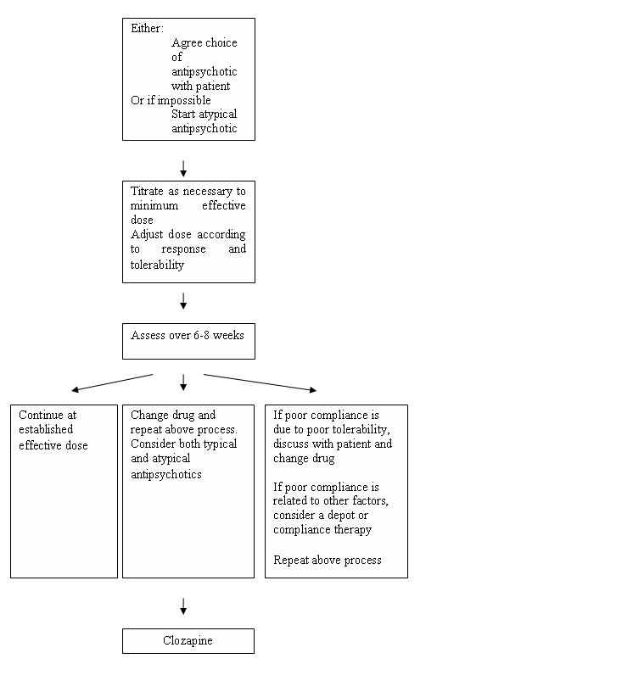
Pharmacological Treatment Algorithm Adapted from the Maudsley prescribing Guidelines (Taylor et al, 2005)

Slide 62
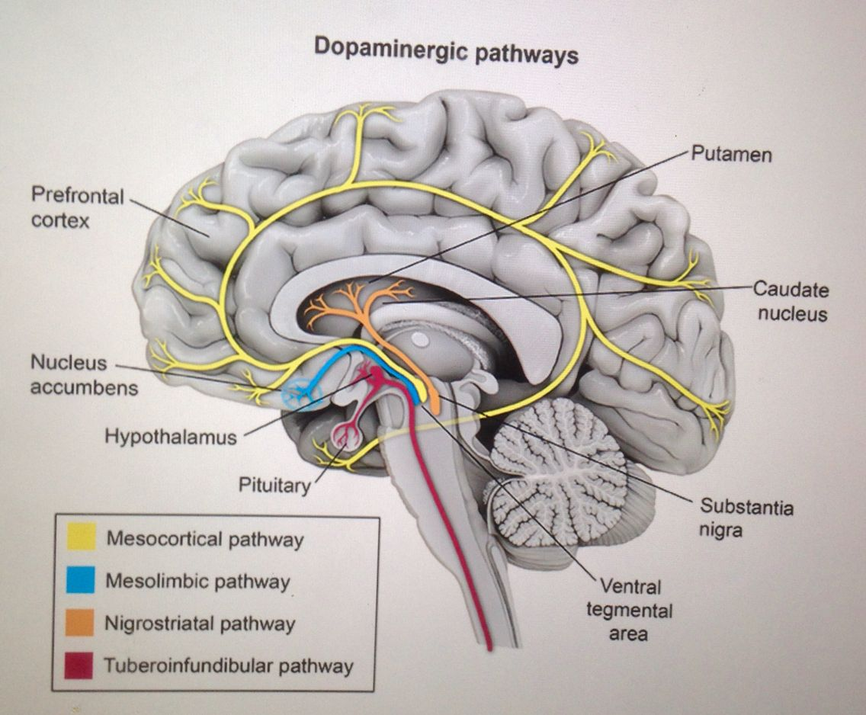
Antipsychotics and dopamine system

Slide 63
Antipsychotics most Common Side Effects
Typical | Atypical
Stiffness and shakiness, like Parkinson's’ disease (Dystonia) Uncomfortable restlessness (Akathisia) Long-term use can produce movements of the face (tardive dyskinesia) and, rarely, of the arms or legs Feeling sluggish, slow in thinking, apathy, low motivation (Negative symptoms) Problems with breast swelling or tenderness and (Galactorrhea) Some can affect blood pressure and make patient feel dizzy Decrease Libido | Sleepiness and slowness Weight gain Increased chance of developing diabetes and metabolic syndrome Decrease Libido Some can affect blood pressure and make patient feel dizzy In high doses, some have the same EPS and Parkinsonian side-effects as the older medications (stiffness of the limbs) but less than typical Problems with breast swelling or tenderness and galactorrhea but less than typical

Slide 64
Side effects of antipsychotics

Slide 65
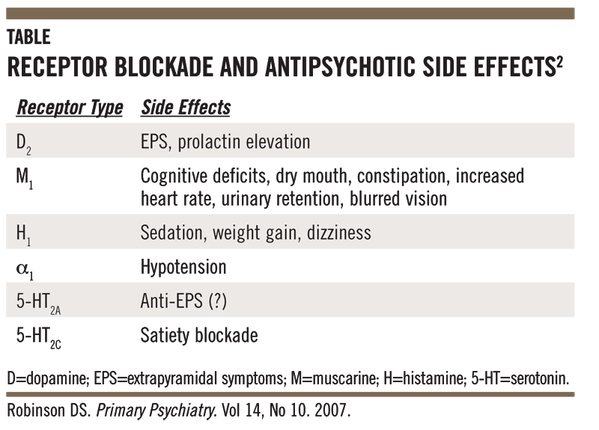
Side effects of antipsychotics
High Potency typical antipsychotics: Neurological side effects
Low Potency typical and atypical antipsychotics: many other side effects

Slide 66
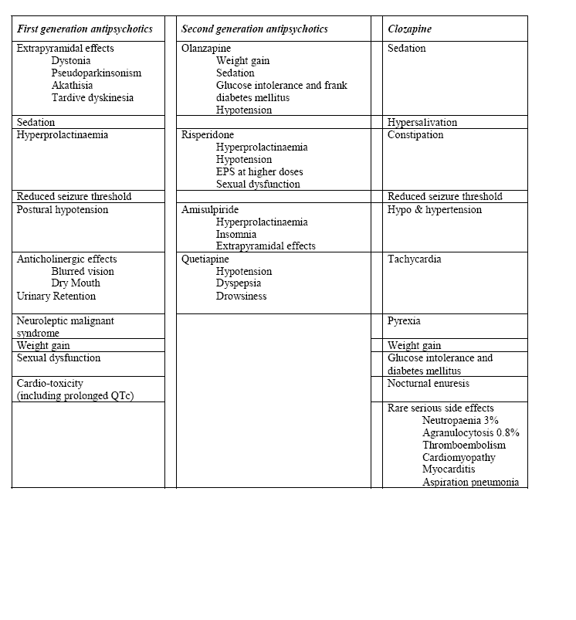
Common side effects of antipsychotic medication (Taylor et al, 2005)
Common side effects of antipsychotic medication (Taylor et al, 2005)

Slide 67
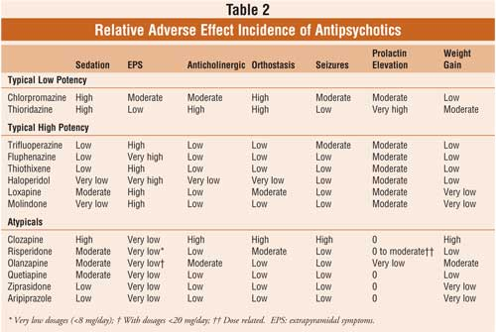
Side effects of antipsychotics

Slide 68
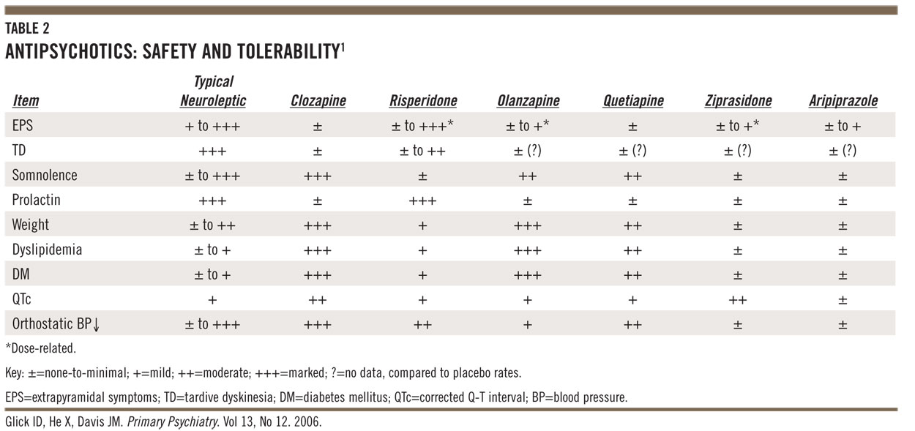
Side effects of antipsychotics

Slide 69
Metabolic effects of atypical antipsychotics

Slide 70
Side effects of antipsychotics
Extra-Pyramidal Symptoms (EPS)
Acute Dystonia (hours)
Akathisia (days)
Psuedoparkinsonism (weeks)
Tardive Dyskinesia (years)

Slide 71
Acute and Chronic EPS
ADVERSE EFFECTS OF ANTIPSYCHOTICS
Maximum
Minimum
HIGH POTENCY RISPERIDONE OLANZAPINE CLOZAPINE
FGAs PALIPERIDONE ZIPRASIDONE
(DOSE-RELATED) QUETIAPINE
ARIPIPRAZOLE*
Acute Dystonia (hours)
Akathisia (days)
Psuedoparkinsonism (weeks)
Tardive Dyskinesia (years)
*Based on clinical trial data

Slide 72
Acute Dystonia
Acute Dystonia (involuntary spasms or stiffness):
Can be terrifying to the patient
Risk is higher in males and at younger age (Blocky muscles)
Is more likely to develop in patients:
Treated with high-potency FGAs with inherently low anticholinergic activity (e.g., haloperidol, fluphenazine)
Include:
Laryngospasm and swelling of the tongue (can close the airway)
Spasmodic torticollis (spasm of cervical muscles of the neck)
Trismus (spasms of the muscles of mastication)
Oculogyric crisis (eyes rolled back in a locked position)
Treatment is by adding an anticholinergic agent:
Benztropine mesylate (Cogentin) 1–2 mg orally bid–tid or 1–2 mg intramuscularly on an as-needed basis
Other options: Trihexyphenidyl, Procyclidine, and Diphenhydramine

Slide 73
Acute Akathisia
Acute akathisia (motor restlessness; inability to sit still):
Typically seen early in treatment or with dosage increases of antipsychotics (typical more than atypical)
Is the most common antipsychotic-induced movement disorder
Symptoms increase in severity with increasing antipsychotic dose
Are a major cause of poor compliance to antipsychotic medications
Treatment is by adding a beta-blocker (effective for akathisia):
Propranolol 20–40 mg bid
Nadolol up to 80 mg/day
Metoprolol up to 100 mg/day

Slide 74
Psuedoparkinsonism
Pseudoparkinsonism (also referred to as parkinsonism):
Symptoms can be identical to those observed in Parkinson’s disease:
Akinesia (absence of movements)
Bradykinesia (slowness of movements)
Rigidity in arms and shoulders
Hypersalivation
Masklike facies
Cogwheel rigidity
Postural difficulties (e.g., shuffling gait)
Treatment is by adding amantadine (a dopaminergic agent) 100 mg orally bid (effective for parkinsonism and dystonia)

Slide 75
Tardive Dyskinesia
Literally means late-appearing (tardive) abnormal involuntary movements (dyskinesia)
Is more likely to develop in patients who have experienced EPS
Presents with involuntary movements characterized by a mix of orofacial dyskinesia, tics, chorea (jerking movements), and athetosis (writhing movements):
Orofacial dyskinesia is the most common presentation and includes rhythmic movements of the lips (e.g., puckering, smacking), tongue (e.g., undulations, rolling motions, protrusions, “fly catching” movements), jaw (e.g., chewing, side-to-side movements, biting), and face (e.g., involuntary blinking, grimacing)
Tongue fasciculations and periorbital movements are common early signs
Involuntary movements of the extremities are less common
Involvement of the esophagus, pectoral muscles, and diaphragm is rare but can be life-threatening
Treatment is by prevention

Slide 76
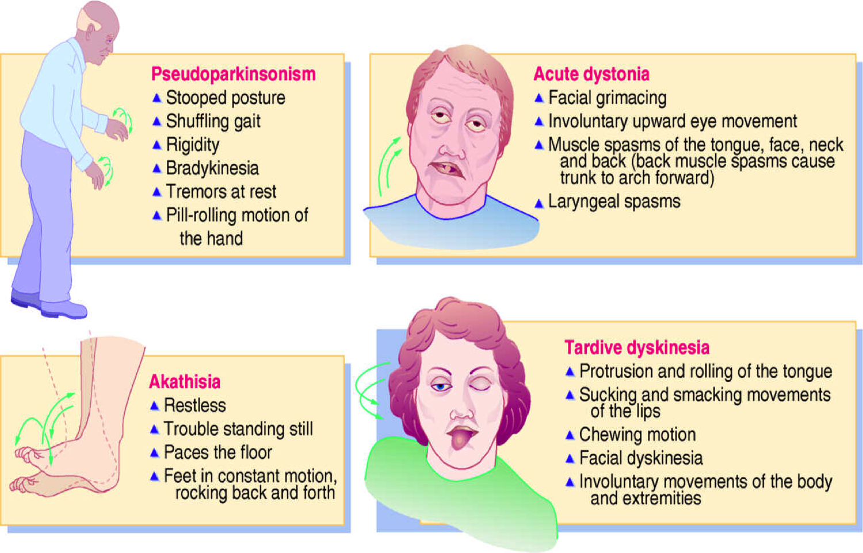
Extra-Pyramidal Symptoms EPS

Slide 78
Neuroleptic malignant syndrome (NMS)
Can conceptually be characterized as “severe EPS (i.e., extreme rigidity) with fever”
Possibly secondary to dopaminergic receptor blockade in the Substantia Nigra producing rigidity and fever
Can develop with any antipsychotic medication.
Presents with symptoms easily recalled with the acronym (F + ARGO)
F Fever.
A Autonomic dysregulation (e.g., hypertension, tachycardia, urinary incontinence, diaphoresis).
R Rigidity (“lead-pipe”).
G Granulocytosis (as well as increased lactic dehydrogenase, liver function tests, creatine phosphokinase [CPK], and myoglobinemia).
O Orientation changes (confusion, coma).
Can additionally present with acute renal failure (due to myoglobinuria), proteinuria, deep vein thrombosis, respiratory distress, and dehydration.

Slide 79
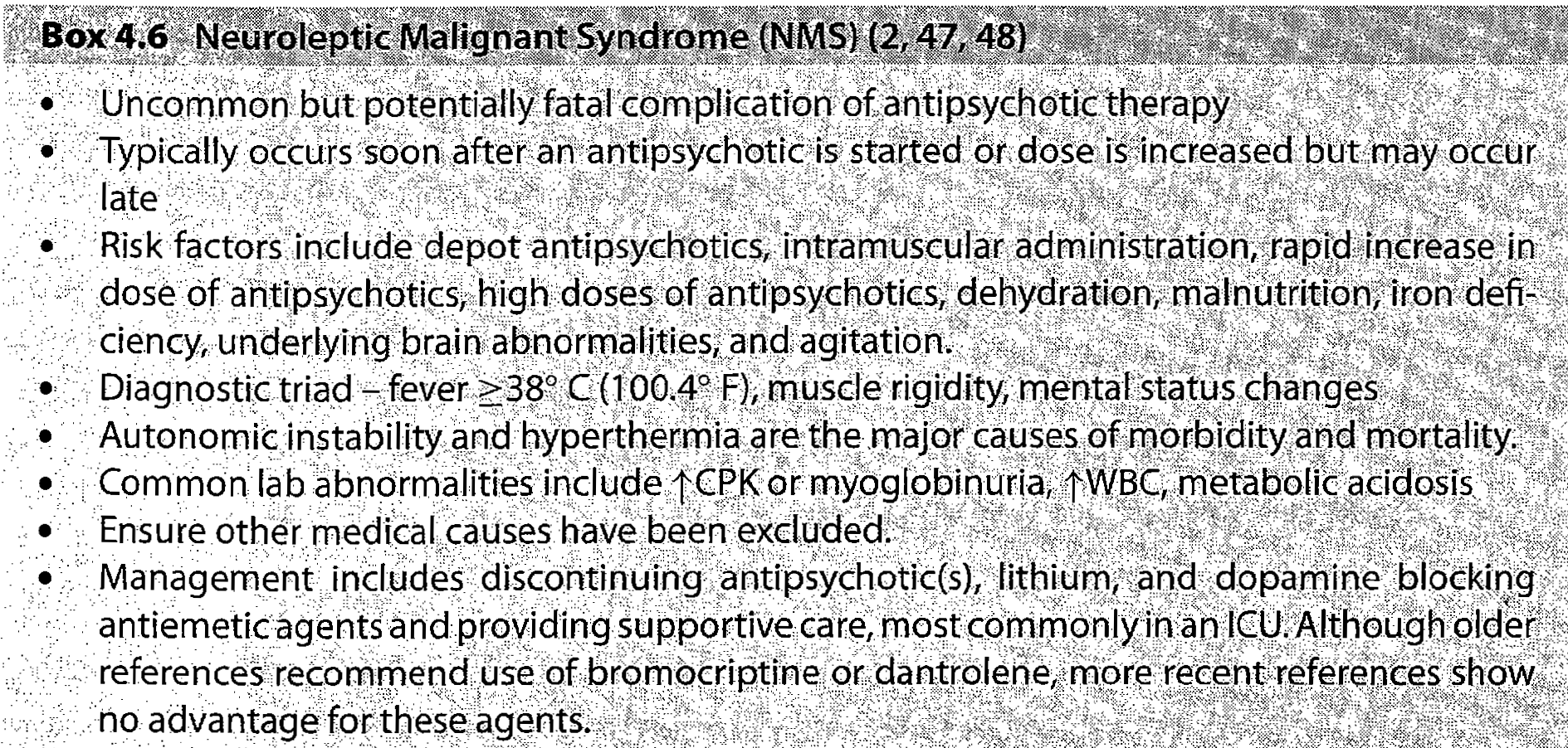
Narcoleptic malignant syndrome
Psychosomatic medicine,, J Amos

Slide 80
Psychosocial therapies

Slide 81
Psychosocial therapies
Social skills training
Family oriented therapies
Group therapy
Individual psychotherapy
Assertive community treatment
Vocational therapy
Notes:
Psychosocial treatments with demonstrated efficacy include family interventions,
supported employment,
assertive community treatment,
social skills training, and
cognitive behaviorally oriented psychotherapy
he defining characteristics of ACT include:
a clear focus on those participants (clients) who require the most help from the service delivery system;
an explicit mission to promote the participants' independence, rehabilitation, and recovery, and in so doing to prevent homelessness and unnecessary hospitalization;
an emphasis on home visits and other in vivo (out-of-the-office) interventions, eliminating the need to transfer learned behaviors from an artificial rehabilitation or treatment setting to the "real world";^{[2]}
a participant-to-staff ratio that is low enough to allow the ACT "core services team" to perform virtually all of the necessary rehabilitation, treatment, and community support tasks themselves in a coordinated and efficient manner -- unlike traditional case managers, who broker or "farm out" most of the work to other professionals;
a "total team approach" in which all of the staff work with all of the participants, under the supervision of a qualified mental health professional who serves as the team's leader;
an interdisciplinary assessment and service planning process that typically involves a psychiatrist and one or more nurses, social workers, substance abuse specialists, vocational rehabilitation specialists, and certified peer specialists (individuals who have had personal, successful experience with the recovery process);
a willingness on the part of the team to take ultimate professional responsibility for the participants' well-being in all areas of community functioning, including most especially the "nitty-gritty" aspects of everyday life;
a conscious effort to help people avoid crisis situations in the first place or, if that proves impossible, to intervene at any time of the day or night to keep crises from turning into unnecessary hospitalizations; and
a promise to work with people on a time-unlimited basis, as long as they demonstrate a continuing need for this highly intensive and integrated form of professional help.^{[3][4][5][6][7]}
In the array of standard mental health service types, ACT is considered a "medically monitored non-residential service" (Level 4), making it more intensive than "high intensity community based services" (Level 3) but less intensive than "medically monitored residential services" (Level 5) on the widely accepted LOCUS utilization management instrument.^{[8]}

