Slide 1
Substance Use Disorders
By: Dr. Majid Al-Desouki
Consultant and Clinical Assistant Professor

Slide 2
Go to:
www.quizizz.com

Slide 3
Introduction
Many implications for brain research & clinical psychiatry.
Affect mental state and behavior.
Sx similar to the psychiatric disorders.

Slide 4
What is addiction?
In Aug 2011, The American Society of Addiction Medicine (ASAM) has officially recognized Addiction as mostly:
a social problem
a moral problem
a criminal problem
a primary chronic brain problem
a behavioral disorder occur as the result of other causes such as emotional or psychiatric problems.
Addiction is not a choice, but choice still plays an important role in getting help.
Notes:
Addiction def
August 31, 2011 — For the first time, the American Society of Addiction Medicine (ASAM) has officially recognized that addiction is not solely related to substance misuse and is, in fact, a chronic brain disease.
"At its core, addiction isn't just a social problem or a moral problem or a criminal problem. It's a brain problem whose behaviors manifest in all these other areas," ASAM Past President Michael Miller, MD, said in a news release.
"The disease is about brains, not drugs. It's about underlying neurology, not outward actions," added Dr. Miller, who oversaw the development of the new addiction definition.
Findings from brain circuitry studies prompted more than 80 experts to come together 4 years ago to begin the process of developing a new definition of addiction.
Previous research has shown that addiction affects neurotransmission in the reward area of the brain, triggers craving of addictive behaviors based on memories of previous experiences, and alters areas that govern impulse control and judgment.
Chronic Condition
Although ASAM adopted aspects of its new definition internally in April, it was recently released to the public with final tweaks based on subsequent discussion by board members.
Highlights include its description of addiction as a primary disease, which means "it's not the result of other causes such as emotional or psychiatric problems." ASAM also notes that addiction is a chronic condition, and so should be "treated, managed, and monitored over a life-time."
Raju Hajela, MD, chair of the ASAM new definition committee and past president of the Canadian Society of Addiction Medicine, said in the release that this disease drives behaviors that others might not understand.
"Simply put, addiction is not a choice[, but] choice still plays an important role in getting help. Because there is no pill which alone can cure addiction, choosing recovery over unhealthy behaviors is necessary," added Dr. Hajela.
David Kupfer, MD, chair of the American Psychiatric Association's Task Force for the upcoming Diagnostic and Statistical Manual of Mental Disorders, Fifth Edition (DSM-5), told Medscape Medical News that "a number of mental disorders" that are currently in the DSM-4 and that will be in the DSM-5 are considered chronic and persistent.
"Addictive disorders, anxiety disorders, certainly depressive or bipolar disorders, schizophrenia, some of the neurocognitive disorders such as Alzheimer's — they are disorders that are no different than cardiovascular disease, or diabetes, or even asthma in many ways," said Dr. Kupfer.
"Thinking about it that way has helped a lot of people trying to revise the current DSM to realize that what we are seeking to do is try and find out the underlying physiology and the underlying psychopathology and etiology of these disorders. There's no question that you have this interaction of what's going on in the brain and what's going on in terms of expression of behavior," he added.
Definition Reduces Stigma
He noted that the new definition is consistent with "parallel developments" currently going on in other areas of psychiatry.
"We're running into the same exciting areas. It doesn't mean we have the answers. It means we have our work cut out for us in terms of how to integrate what we're learning about how the brain functions with what we learn about behavior," said Dr. Kupfer.
"It's very nice to see this society endorsing the fact that in many ways addiction may very well be a chronic brain disorder, and not simply a behavioral disorder. And that I totally agree with."
Overall, he said, it is important to get this information out to the public, to let those affected know that it is okay to come in for treatment.
"The only way that we will really get rid of stigma is to continue to point out and show again and again, hopefully with more science, that these disorders are no different than any of the other disorders that we are treating throughout the rest of medicine. So anything like this new definition helps."
The new, full definition of addiction is available on the ASAM Web site

Slide 5
Terminology
Abuse: self-administration of any substance in a culturally disapproved manner that causes adverse consequences.
Intoxication: the transient effect (physical and psychological) due to recent substance ingestion, which disappears when the substance is eliminated.
Withdrawal: a group of symptoms and signs occurring when the drug is withdrawn or reduced in amount.

Slide 6
Terminology (cont.)
Dependence: the physiological state of neuroadaptation produced by repeated administration of a drug, necessitating continued administration to prevent appearance of withdrawal state.
Addiction: a nonscientific term that implies dependence and associated deterioration of physical mental health as well as high tendency to relapse after discontinuation.

Slide 7
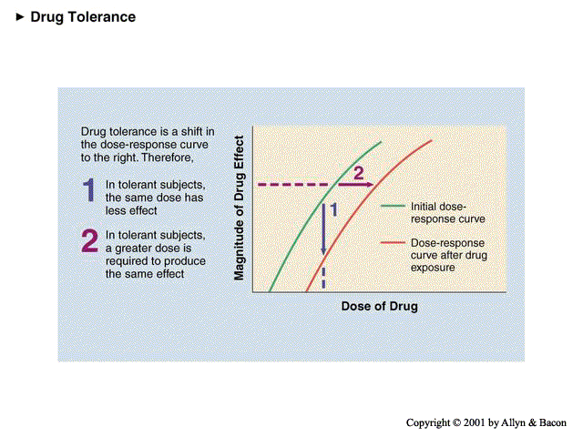

Slide 8
Complications
Psychological
Drugs
Social
Medical

Slide 9
Basic classification
CNS Suppressants
Alcohol – Sedatives – Inhalants – Opioids.
CNS Stimulants: Amphetamine – Cocaine
Cannabis

Slide 10
Assessement
Collateral history.
Urine screening tests.
blood screening tests (alcohol, barbiturates).
Pattern of Abuse:
What? (type, dose, route, effect: nature and duration).
How? (frequency, duration, how long, source, and situation)
Why? (? psychosocial problems).
Dependence?
Complications :
Psychosocial…..
Physical…..
Notes:
Patients usually fear the consequences of acknowledging the problem, are manipulating, and prone to denial. They are often difficult to detect and evaluate and are unreliable. Therefore, it is necessary to obtain information from other sources, such as family members, because these patients are usually unreliable.
Urine and blood screening tests are useful in confirming suspected substance use. Most drugs are well detected in urine and are often positive for up to 2 days after taking most drugs. However, some drugs (e.g. alcohol, barbiturates) are best detected in blood. Screening urine and blood tests, though confirmatory and sensitive, are not specific; many false positives can occur, e.g. in patients using antipsychotics. Substance abusers often abuse multiple substances (e.g. amphetamine, cannabis and alcohol).
For each psychoactive substance consider the following:
What? (type, dose, route, effect: nature and duration).
How? (frequency, duration, how long, source, and situation)
Why? (? psychosocial problems).
Dependence :
persistent abuse despite harmful effects
tolerance
withdrawal on abstinence
reinstatement after abstinence
feeling compelled to abuse substance.
Complications of substance abuse should be carefully considered:
Psychosocial: social isolation, depression, anxiety, psychosis…etc
Physical: concomitant medical conditions are often substance-related, e.g. thrombophlebitis, bacterial endocarditis, acquired immune deficiency syndrome (AIDS), infectious hepatitis, abscesses.

Slide 11
Alcohol and Related Mental Disorders

Slide 12
Alcohol Kills More Than AIDS, TB or Violence-WHO report (Feb 2011)
Alcohol causes nearly 4% of deaths worldwide, more than AIDS, tuberculosis or violence.
Alcohol is the world's leading risk factor for death among males aged 15-59
Alcohol is a causal factor in 60 types of diseases and injuries.

Slide 13
Risk factors of Alcohol abuse
Vulnerable personality: impulsive, gregarious, less conforming, isolated or avoidant persons.
Vulnerable occupation: senior businessmen, journalists, doctors.
Psychosocial stresses: social isolation, financial, occupational or academic difficulties, and marital conflicts.
Emotional problems: anxiety, chronic insomnia depression.
Notes:
Substance abuse frequently coexists with personality disorders (e.g. borderline, antisocial), and with other psychiatric disorders such as depression, anxiety or psychotic conditions

Slide 14
Alcohol abuse
Excessive consumption: harmful use. Problem drinking: drinking that has caused disability, but not dependence. Alcohol dependence: This usually denotes alcoholism. Alcohol-related disability: physical, mental and social.

Slide 15
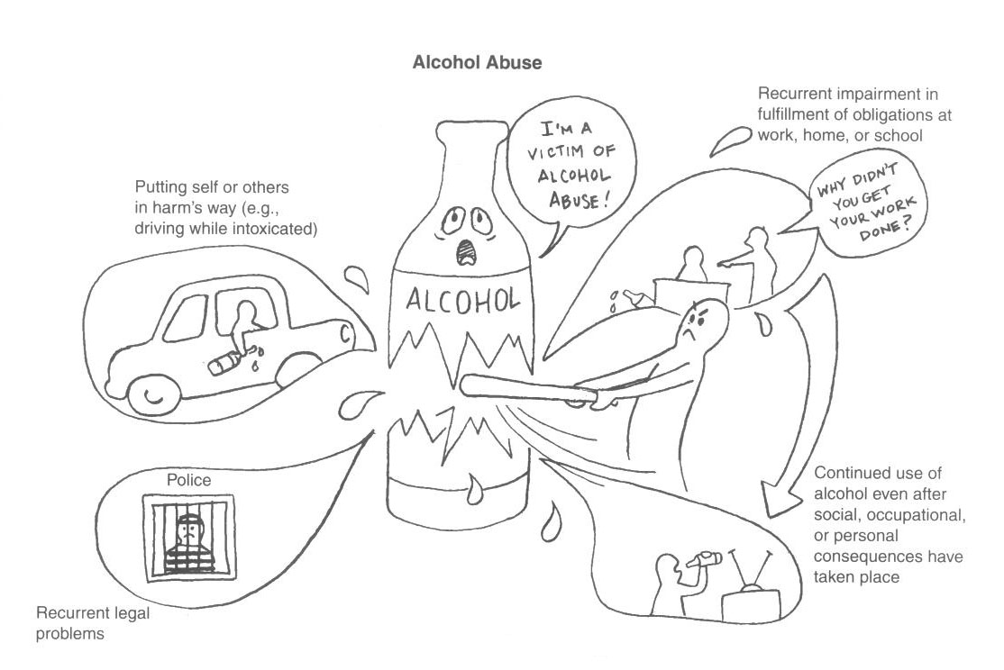

Slide 16
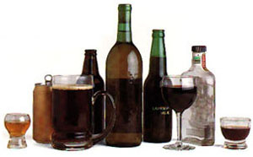

Slide 17
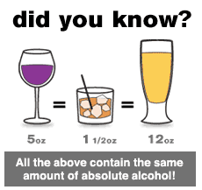
How much is too much?

Slide 18
Clinical presentation
Alcohol intoxication:
  sense of well-being, emotional lability, irritability and incoordination → to ataxia and slurred speech
Heavy intoxication (bl > 300 mg/ml) → alcoholic coma & death
Acute intoxication may mimic:
    panic attacks
    Depression
    acute psychosis with delusions +/- hallucinations

Slide 19
Alcohol intoxication
Ethanol plasma concentrations Vs. CNS effects
Ethanol plasma concentration (mg/dL) | Impairment
 | Feeling of relaxation, euphoria
20-30 | Slowed thinking
30-80 | Motor incoordination
80-200 | Cognition, judgement, labilty
200-300 | Slurring, ataxia, nystagmus, blackouts
>300 | Vital signs, coma, possible death due to the respiratory failure
Notes:
alcohol potentiate the effects of other drugs with central depressant effects – barbiturates, benzodiazepines, H₁-anithistamines
Alcohol intoxication:
Early intoxication includes a sense of well-being, liveliness and a smell of alcohol on the breath, grading into emotional lability, irritability, and incoordination, which grades into apathy, ataxia, and slurred speech. Heavy intoxication (blood alcohol level above 300 mg/ml) can lead to alcoholic coma. Alcohol acute intoxication may mimic many psychiatric conditions (panic attacks, depression, acute psychosis with delusions and / or hallucinations).

Slide 20
Clinical presentation (cont)
Alcohol withdrawal:
  Sx may begin after 6 hours of cessation peak by 48 hours
  Sx subside over the course of 5-7 days
epileptic generalized tonic clonic seizures may develop within 12-24 hours after cessation of alcohol intake
Delirium tremens may develop after about 48 hours

Slide 21
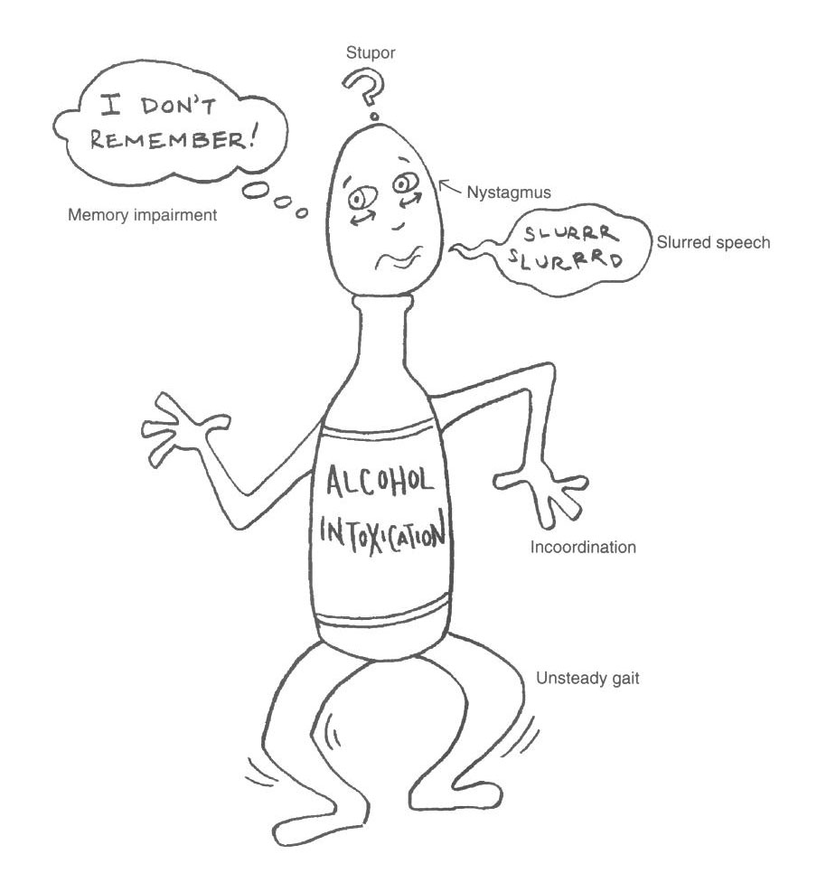

Slide 22
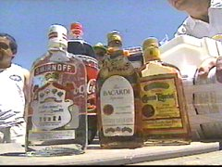
Alcohol dependence
15-20 years before evident
dependence is most common in
those aged 40 – 55 years.
Alcoholics who continue drinking have a shortened life-span of 15 years why?
Notes:
SLIDE 4. Before we discuss these three categories, I would like to start with a few brief words about the scope of the problem of alcohol abuse and dependence; that is, what kind of disorder are we talking about when we talk about alcoholism.
First of all, there are approximately ____ students in this classroom, and if you look around, know that ___ of you (15%, 1/7) roughly will develop alcohol abuse or dependence. So we are talking about a very common illness that affects more people than does diabetes, lung cancer, breast cancer, heart attacks, and is about as common as hypertension is in the general population.
In addition to this relatively high prevalence, alcoholism causes a great amount of morbidity and mortality. First, up to 40% of all general hospital admissions in the U.S. are related to alcohol or drug problems in some way. So the next time you see a patient with an upper GI bleed in the hospital, for example, wonder whether heavy alcohol use has played a role.
Also, alcoholics are twice as likely to be seen by their primary care provider than nonalcoholics, so there is a particular need for you as young physicians-in-training to recognize sequelae of alcoholism in this arena in order to better identify an alcohol dependent person. In fact, a recent study found that physicians are actually not very good at recognizing alcoholics in the outpatient setting (there’s a link to the news story on the web site).
And if alcoholics aren’t recognized and appropriately treated, or even if they are identified but maintain a severe course with few substantial abstinence periods, these people will die – alcoholism is a lethal illness. Over 100,000 people die per year of alcohol or drug related causes in the U.S., and chronic alcoholics will lose roughly 15 years off their average life span.
And here’s what will kill you: accidents (MVAs, overdose), acts of violence (suicide, homicide), and today’s subject, major medical illnesses (like esophageal varices, cancers, heart failure/MIs, cirrhosis).
15% ( 1/7) on people in this room will become alcohol dependent
In the outpatient setting, alcoholics are twice as likely to consult a PCP than nonalcoholics
Here’s what will kill you: accidents (MVAs, OD), major medical illnesses (cirrhosis, MI-CHF, varicies), acts of violence (suicides/homicides)
Alcohol abuse may mean any one of the following specific terms:
Excessive consumption: harmful use.
Problem drinking: drinking that has caused disability, but not dependence.
Alcohol dependence: which usually denotes alcoholism.
Alcohol-related disability: physical, mental and social.
Alcohol is the major substance of abuse all over the world. Mixed abused of alcohol and other substances is very common. Recreational alcohol drinking gradually grades into problem drinking and dependence.
Most alcohol abusers go unrecognized by clinicians until their physical health and psychosocial life have been significantly harmed; therefore, early recognition is important. Many people go through prolonged periods (average 15 – 20 years) of gradual dependence on alcohol before clinical symptoms or signs are evident.
Alcohol depresses the central nervous system. Clinically, it may appear to be a stimulant because of early disinhibition due to suppression of inhibitory control mechanisms.
Alcohol drinking may occur in the late teens but dependence is most common in those aged 40 – 55 years.

Slide 23
Complications of chronic alcohol abuse
Medical | Psychiatric | Social
Neurological Cerebral degeneration Seizures Peripheral neuropathy Optic nerve atrophy Alimentary Tumors (esophagus, liver) Gastritis, peptic ulcer Pancreatitis Hepatitis, liver cirrhosis Cardiomyopathy Anemia Gynaecomastia | Amnestic disorder Delirium Dementia Psychosis Depression Reduced sexual desire Insomnia Personality deterioration Increased risk of suicide Morbid jealousy | Social isolation Job loss Marital conflicts Family problems Legal troubles Social stigma

Slide 24
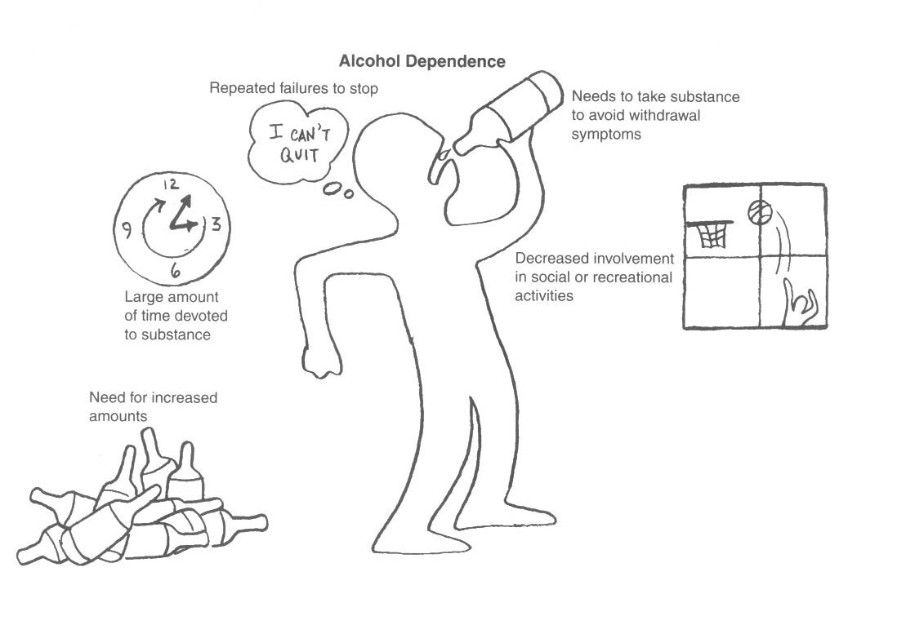

Slide 25
Screening – CAGE questionnaire
Have you ever:
1. Wanted to cut down on your drinking?
2. Felt annoyed by criticism of your drinking
3. Felt guilty about drinking?
4. Take a drink as an “eye-opener” to prevent the shakes?

Slide 26
Stages of alcohol withdrawal
Stages
I (6-8 hours):
II (10-30 hours):
III (12-48 hours):
IV (> 2-3 days):
Symptoms
Autonomic hyperactivity
Hallucinations + above
Grand mal seizures
Delerium tremens (DTs)

Slide 27
Laboratory Tests
Identify acute and/or heavy drinking (> 5 drinks/day):
    Blood Alcohol Levels (BAL).
    Gamma-glutamyltransferase (GGTP > 35 IU/L)
    Erythrocyte mean corpuscular volume (MCV >91.5 μ³)
    High AST/ALT
Notes:
Before we proceed, I wanted to talk a little bit about some strategies to detect a potential problem with alcohol (or drugs) in your patients in your office or in the hospital. First and foremost, TAKE A HISTORY – ASK about life problems (e.g. family/marital, job, accidents, legal – DUIs), and transition into nonthreatening, nonjudgmental questions about alcohol, drug and nicotine use. While the issue of detection of substance problems is a whole lecture unto itself, this is just a reminder that the best diagnosis is obtained through taking a history, and then doing a physical exam.
In addition, some blood tests for state markers of heavy drinking can be useful if you are suspicious of alcohol related problems. GGT has good sensitivity and specificity (around 70-80% sensitive and specific), and generally is the first of the liver enzymes to elevate with heavy drinking (i.e., 6-12 drinks/day for several weeks).
Besides GGT, the CDT (carbohydrate deficient transferrin) test is a more expensive alternative for detecting high levels of drinking, and it is about as sensitive and specific as the GGT .
Reflecting alcohol’s effect on red blood cells, MCV (mean corpuscular volume), a measure of how big the RBCs are, also increases with heavy drinking.
The other liver enzymes are not very helpful if you are suspicious of alcohol dependence, since they only elevate when hepatocytes are damaged, which usually is at a fairly advanced stage of alcoholism. Nevertheless, suspect alcohol related causes in patients with high AST and ALT.
Lastly, a urine toxicology screen is useful in detecting acute intoxication with alcohol or drugs, but in the case of alcohol, only relevant if the patient has ingested alcohol in the last 6-8 hours or so.
Alimentary/stomach – gastritis, PUD – acute GI bleed, Mallory-Weiss tears, cancers
Thus, next time someone comes into your office with GI symptoms
Liver – fatty liver, alcoholic hepatitis, cirrhosis (15%) - > portal HTN - > varices/acute bleeds; hepatocellular cancer
Pancreas – pancreatitis, cancer
CV – can lead to arrhythmias
Thus, the next time a patient comes into your office with chest pain/SOB, among the things that you should consider in the differential is alcoholism. However, cardiac effects not likely detected early.

Slide 28
Treatment
Treating Alcohol Intoxicated Patient:
Conscious : supportive, antipsychotic if agitated. Unconscious: ABC
Treating Alcohol Withdrawal:
Supportive, thiamine & long acting BDZ ± anticonvulsants for seizure.
Maintaining Abstinence:
  Disulfiram – blockade of aldehydedehydrogenase → cummulation of acetaldehyde - nausea, flushing, tachycardia, hyperventilation, panic…
  Naloxone – reduces alcohol-induced reward.
  Acamprosate – anti-craving effects .
Psychological: Individual, group Rx, relapse prevention.
Notes:
The conscious patient:
observation, with protective and supportive approach
In case of agitation, hyperactivity or risk of violence: restrain the patient and give antipsychotic drugs (e.g. haloperidor or droperidol 5 – 10 mg im)
Sedatives are better avoided because they may potentiate depressant effects of alcohol on the central nervous system.
Wait for the alcohol to be metabolized.
The unconscious patient:
hospitalization is required: protection of the airways, vital signs monitoring, prevention of further loss of body heat, correction of hypovolemia, and forced diuresis with maximal alkalinization of the urine. In extreme situation haemadialysis is necessary
Maintaining Abstinence:
Disulfiram – blockade of aldehydedehydrogenase → cummulation of acetaldehyde - nausea, flushing, tachycardia, hyperventilation, panic…
Aim: to make alcohol consumption unpleasant and intolerable
Naloxone – reduces alcohol-induced reward.
Acamprosate – anti-craving effects .
The drugs used to alleviate the acute abstinence syndrome: benzodiazepines, clonidine (inhibits exaggerated neurotransmitter release) and propranolol (blocks excessive sympathetic activity).
To explore the reasons for drinking, alternative ways are worked out. For instance, instead of using alcohol in social situations to reduced anxiety, learn anxiety management and assertiveness techniques.
Provision of information about the hazards of alcohol
Group therapy: about 7-12 patients and a staff member in a specialist unit attend regular meetings. It provides an opportunity for frank feedback from other members of the group concerning the problems that the patient faces and to work out better ways of coping with their problems.
Alcoholics Anonymous (AA) is a voluntary supportive self-help organization of persons with alcohol-related problems. Members attend group meetings (1-2 / week) and obtain support from one another. The meetings involve repeated emotional confession of each person’s problems. The organization works on the firm belief that total abstinence is the aim.

Slide 29
Delerium Tremens (DTs)
Severe form of alcohol withdrawal after 2-3 days:
- gradual onset of delirium and gross tremors
Other features:
- autonomic disturbance
- dehydration and electrolyte disturbance
- insomnia
Peaks on 3rd or 4th day
Lasts 3-5 days
Worse at night and followed by a period of prolonged deep sleep after which the pt has amnesia

Slide 30
Complications include:
  Violent behavior
  Seizures (chest infection & aspiration)
  Coma
  Death (mortality rate: 5-15%)
  Causes:
  Volume depletion
  Cardiac arrhythmias
  Electrolyte imbalance
  Infections

Slide 31
Treatment
DT is a serious MEDICAL emergency → detection and treatment – ICU or medical ward
Avoid antipsychotics
Guard against seizures
Rehydration
Thiamine (B1)
Adjust surroundings

Slide 32
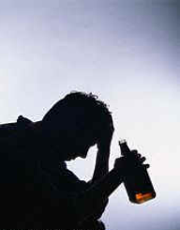

Slide 33
Sedatives, Hypnotics, and Anxiolytics
Similar clinical manifestations and withdrawal to alcohol.
Risk of cross-tolerance and cross-dependence?
Withdrawal depends on substance
BDZ have a large margin of safety & less addiction potentials.
Flumazenil is a BDZ receptor antagonists used in BDZ overdose.
Notes:
This class of substances includes all controlled antianxiety and sleeping medications:
Benzodiazepines ( e.g. diazepam, lorazepam )
Benzodiazepine - like drugs ( e.g. zolpidem, zopiclone )
Barbiturates ( e.g. secobarbital )
Barbiturates - like hypnotics ( e.g. methaqualone )
Carbamates ( e.g. meprobamate )
These substances are brain depressants. Like alcohol, they can produce very significant levels of physiological dependence, marked by both tolerance and withdrawal.
often taken with other brain depressants, like alcohol, which can produce additive serious effects (e.g. respiratory depression).
Abrupt withdrawal may produce seizures, delirium, or psychosis.

Slide 34

OPIOIDS

Slide 35
Opium
Heroin
Morphine
Codeine
Pethidine
Methadone
naturally occurring (e.g. opium, codeine), synthetic or semi-synthetic
medical use - pethidine or substance of abuse - heroin
The medical use - powerful analgesic effect
Abused for - euphorsant effect

Slide 36
Opiod intoxication
Presentation | Treatment
Euphoria Relaxation Anelgesia Disturbed consciousness Small pupil (initially) Bradycardia Reduced appetite Constipation Respiratory depression | ICU: Monitoring Naloxone Open airway – oxygen – IV fluids

Slide 37
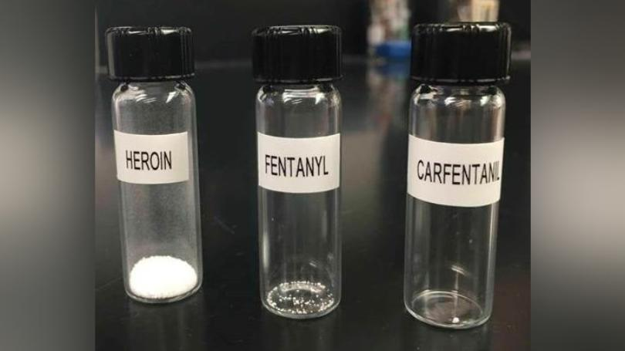
Potency?!

Slide 38
Opioid withdrawal
Presentation | Treatment
Lacrimation, rhinorrhea & yawning Dysphoric mood Insomnia Muscle and joint aches Cold and hot flushes Nausea, vomiting and diarrhea Fever, sweating, piloerection | Short-term: Painkillers, sedatives, observation Clonidine Long-term Harm reduction strategies Methadone Buprenorphine/Naloxone
Intense craving begins 6 hours after the last dose and peaks after 36-48 hours
Untreated withdrawal result in no serious medical sequence - but they cause great distress
Tolerance can develop very rapidly (esp. in IV use) leading to increasing dosage - then it diminishes very rapidly

Slide 39
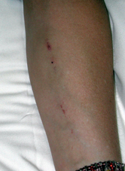
Complications of injecting
Bacterial, local and systemic
Blood-borne viruses
Vascular damage
In this case:
  Track marks
  Early cellulitis
  Multiple injections over a short period suggests cocaine use
Notes:
Clinical photograph taken by P. Haber.

Slide 40
Adeeb is a 16 year old boy who lives with his divorced mother. He presented with slurred speech, facial rashes, incoordination and nausea.

Slide 41
Inhalants
Volatile organic substances –acetone, benzene, etc.
Brain depressants
Adolescents – experimentations
Intoxication – similar to other brain suppressants
Complications:
  Physical: multiple organ damages

Slide 42
Rakan is a 20-year old male brought to the ER by police who arrested him because of reckless driving (drifting with high speed) and violent behavior. He looked over-suspicious, agitated, and over-talkative.

Slide 43
Psychostimulants

Slide 44
Commonly used Stimulants
Nicotine
Caffeine
Cocaine – Freebase/crack
Amphetamine/Methamphetamine
Methylenedioxymethamphetamine (MDMA)
Appetite suppressants
  (e.g. phentermine and diethylpropion)

Slide 45
Psychological FX of non dependent use
Recurrent intoxication
Some users may self-medicate with antidepressants and/or benzodiazepines
After-effects: termed ‘crash’ or ‘come down’
  Dysphoria
  Depressed mood
  Anxiety
  Reduced appetite
  Restlessness

Slide 46
Clinical effects of stimulants
Psychological | Physical
Enhanced cognitive function Elevated mood Over activity Increased confidence, self-esteem and sociability Overtalkativeness Insomnia In high doses/prolonged use: Restlessness, irritability Paranoid psychosis, hallucinations (visual) Aggressiveness, hostility | Reduced sense of fatigue Reduced appetite (anorexia) Dilated pupils Tremors In high doses/prolonged use: Nausea, vomiting, hyperthermia, cardiac arrhythmias, severe hypertension, CVA, seizures Dizziness, respiratory distress,

Slide 47
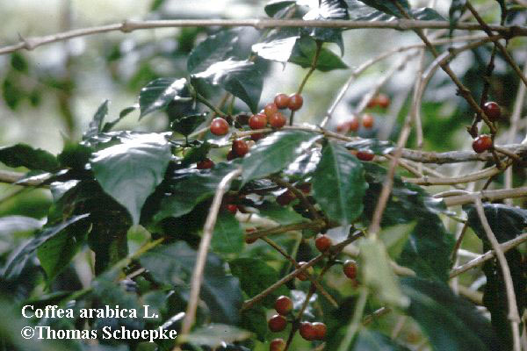
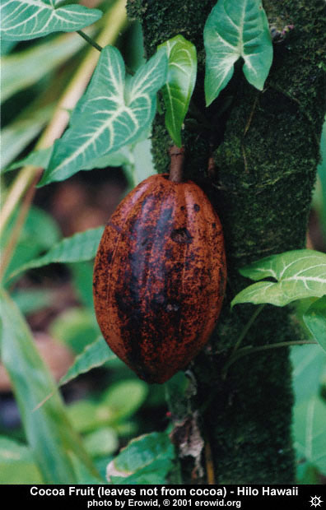

Slide 48
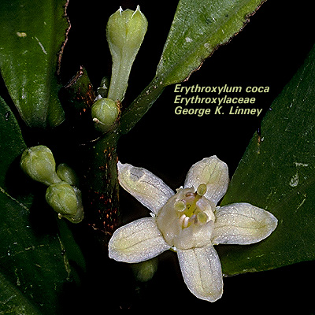

Slide 49
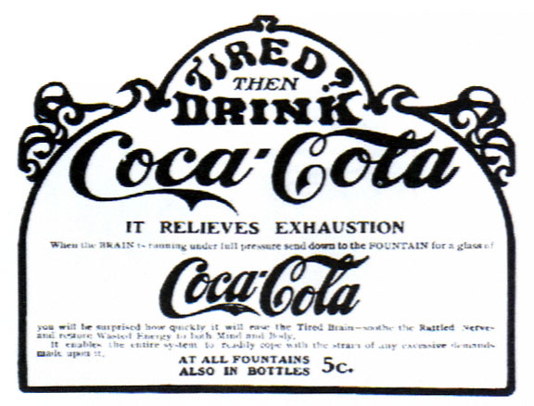
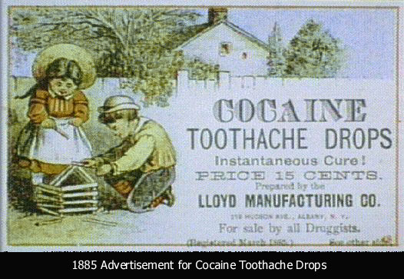

Slide 50
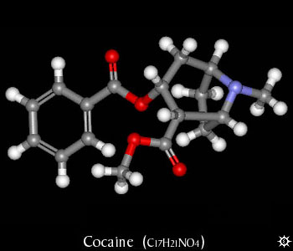
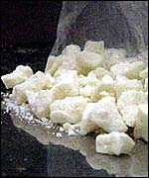
Cocaine
Forms of cocaine:
  Free base
  Crack
Routes of use:
  Intranasal
  Intravenous/SC
Crack cocaine
Notes:
Top photograph taken from www.erowid.com
Second photograph reference to follow.

Slide 51
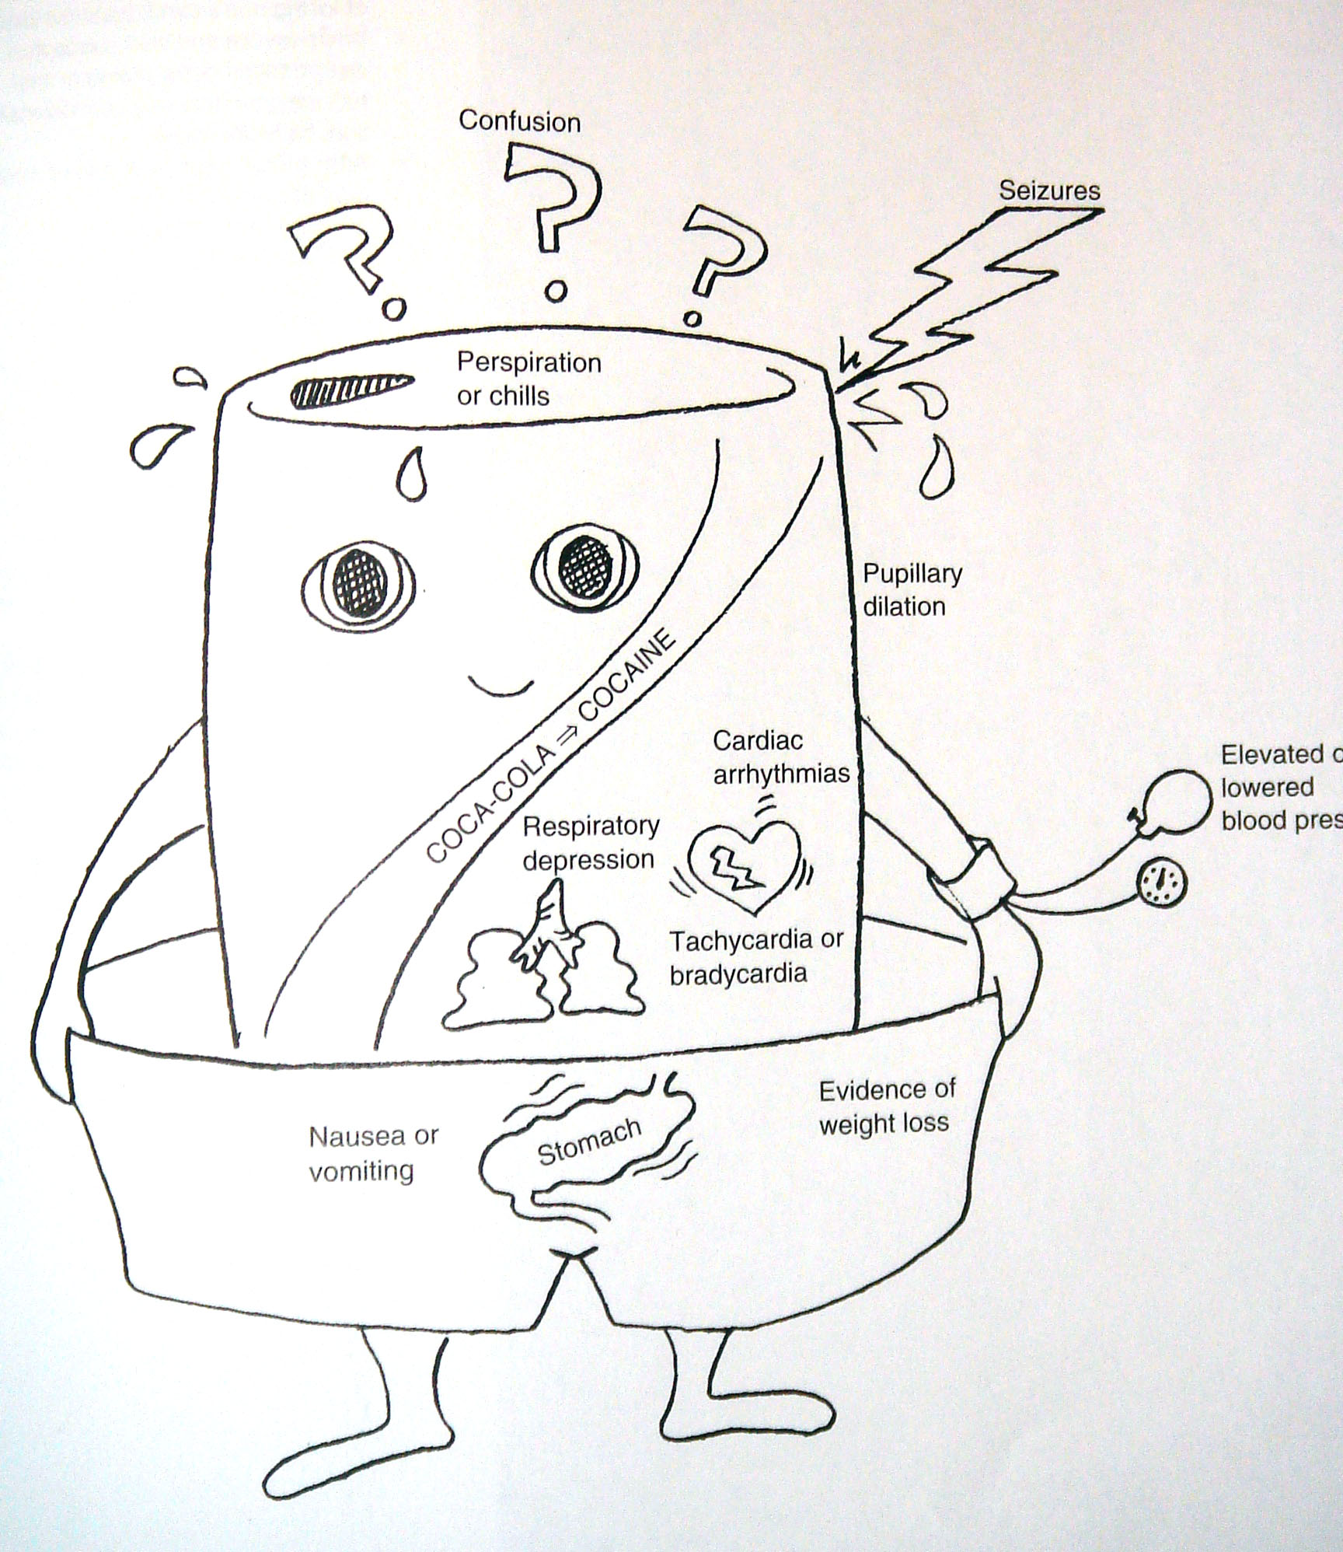

Slide 52
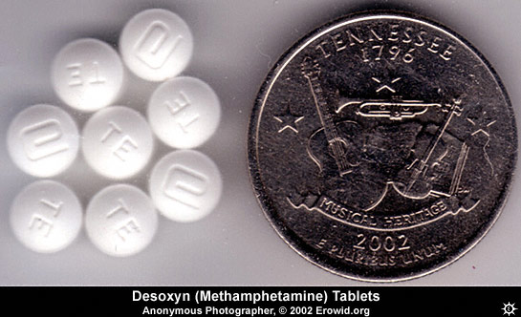
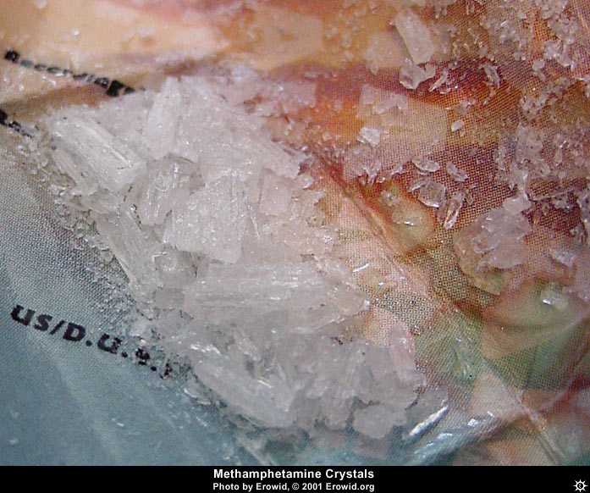

Slide 53
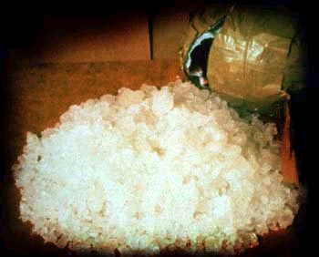
Amphetamines
Ice
L-amphetamine Benzedrine; Speed
D-amphetamine Dexedrine; Speed
Methamphetamine Methedrine; Shabu, Crystal, Ice
MDMA Ecstasy, Pills
Notes:
Photograph acknowledgement to follow.

Slide 54

Captagon (Fenethylline)

Slide 55
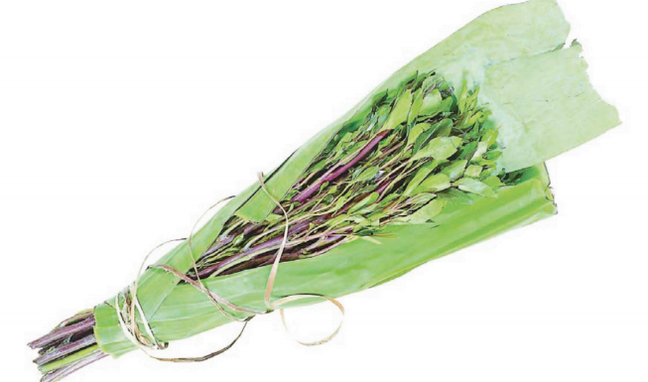

Slide 56
Other uses for amphetamines
Globally and historically, probably most common use crosses social and occupational boundaries
 | Driver | Student | Women | Sports
Euphoria | + | + | + | +
Energy | ++ | ++ |  | ++
Concentration | ++ | ++ |  | ++
Reduction of hunger |  |  | ++
Sexual function/ libido |  |  | ++

Slide 57
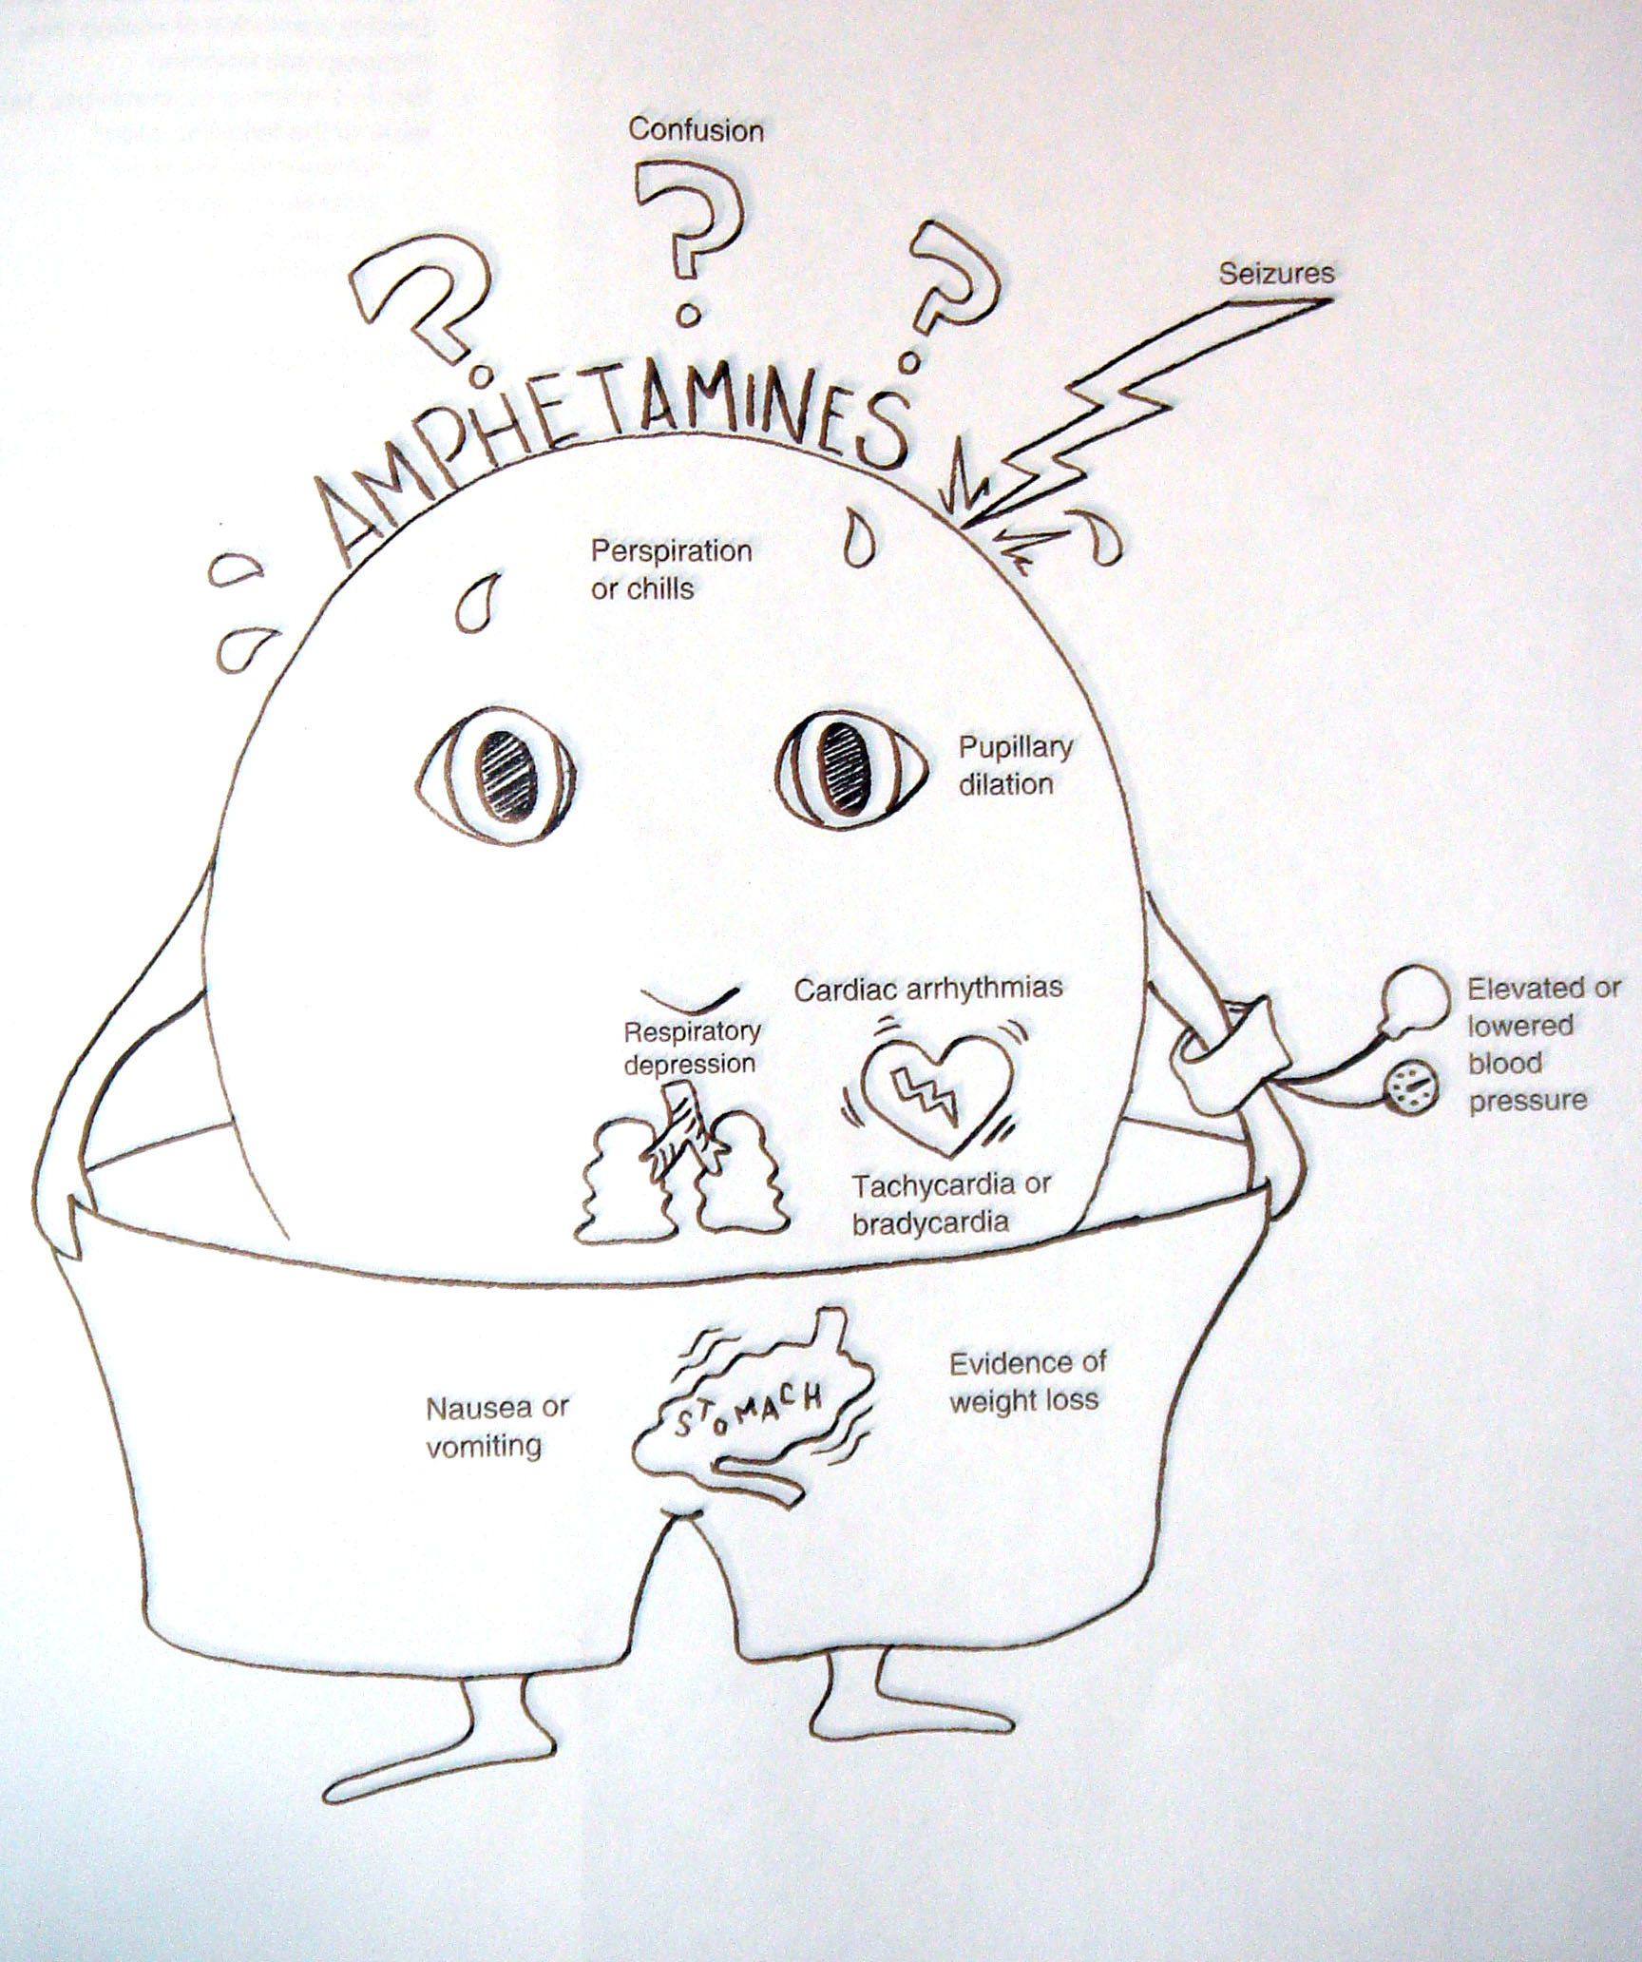

Slide 58
Treatment
Symptomatic use of antipsychotic
Antidepressant sometimes useful
Psychotherapy (individual, family & group)

Slide 59
Hallucinogens
These are group of substances that induce hallucination and produce loss of contact with reality
Natural and synthetic substances that are also called psychedelics or psychotomimetics
Natural e.g. psilocybin (magic mushroom) or synthetic like lysergic acid diethylamide (LSD)
No medical use and high abuse potential

Slide 60
Clinical effects
Psychological | Physical
Marked perceptual distortion (changing shapes and colors) Hallucination (visual and tactile) False sense of achievement and strength Euphoria, anxiety, panic Paranoid ideation Homicide and suicide tendencies Flashbacks Delirium | Tachycardia Hypertension Cerebellar signs Wide pupils Hyperemic conjunctiva Blurred vision Hyperthermia

Slide 61
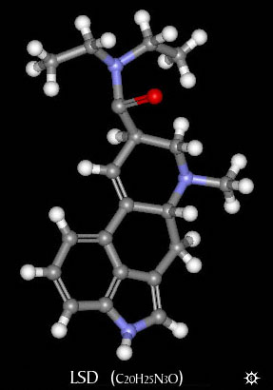
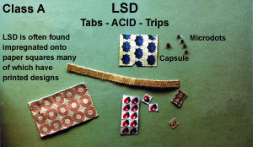
Lysergic Acid Diethylamide (LSD)

Slide 62
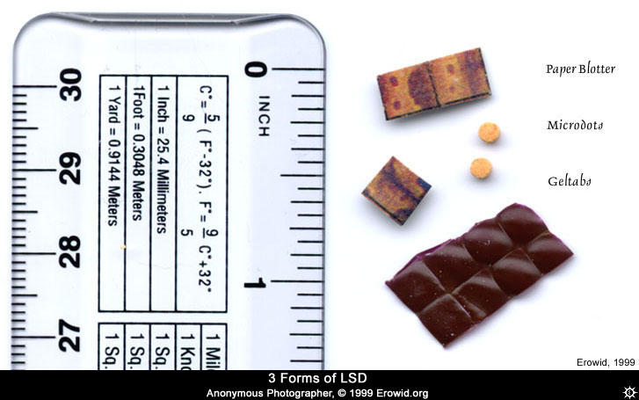

Slide 63
Effects of LSD
Effects of drug come on in about 30 min
first signs are autonomic activation
followed by overt behavioral signs - loosening of emotional inhibitions
  giddiness, laughter for no reason
  mood euphoric and expansive, but labile mood swings notable
abnormal color sensations, luminescence
colors reported as more brilliant

Slide 64
Effects of LSD
space and time disorders
added depth with loss of perspective - up/down altered
close in space influenced more than distant
general slowing of time reported

Slide 65
Tolerance/Dependence
Not significant producers of tolerance or dependence
No withdrawal either
Problems related to the things people do while under the influence
  Accidents
  Suicide
  Aggression/violence
  Toxic reactions

Slide 66
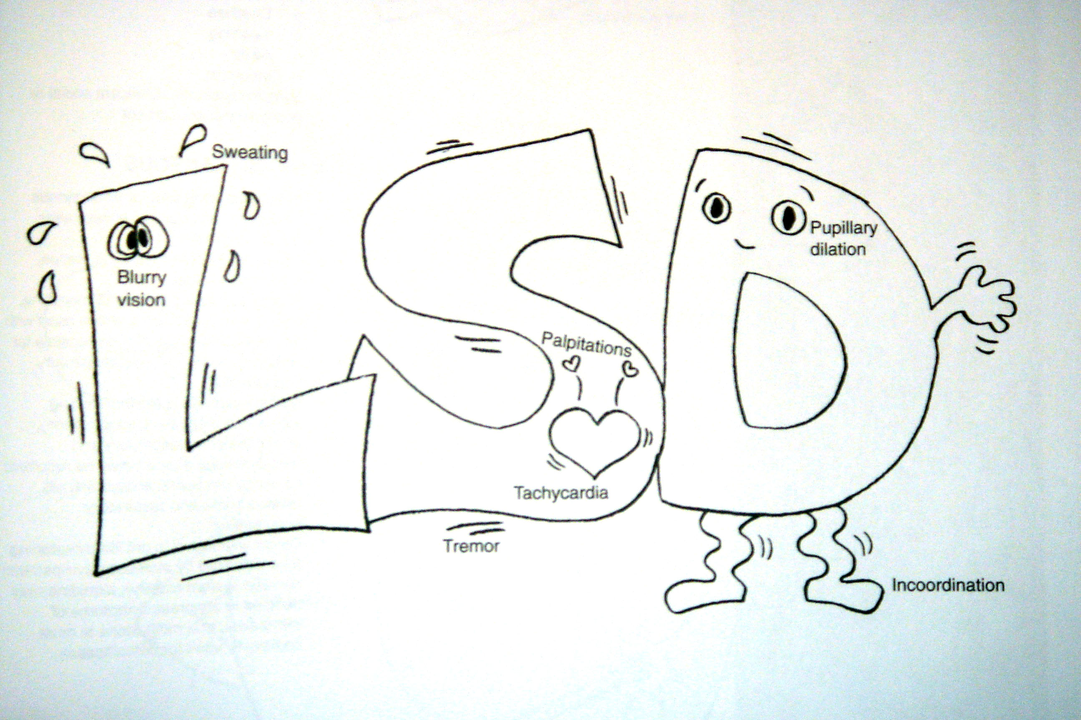

Slide 67
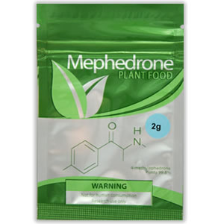
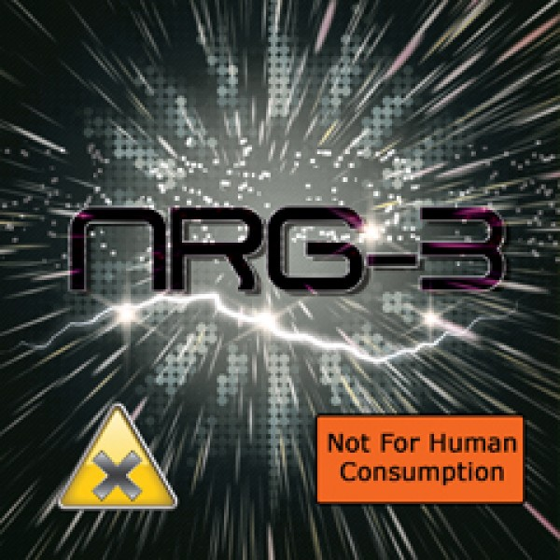
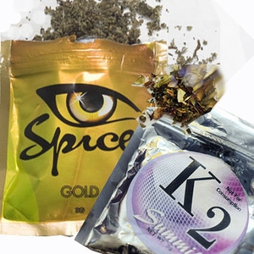

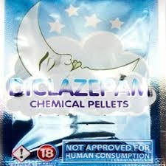
New Psychoactive Substances (NPS)
Variable quantity and potency (up to 10,000 x morphine)
Synthetic Cathinones
Synthetic Cannabis
Synthetic Benzodiazepines

Slide 68
Bandar is a 32-year old male brought to outpatient clinic by his wife because of recurrent periods of being over-suspicious, euphoric, and talkative. He admitted abusing cannabis in the weekends.

Slide 69
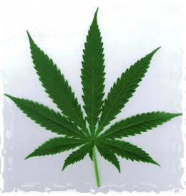
CANNABIS

Slide 70
What is Cannabis (marijuana)?
Cannabis sativa.
psychoactive cannabinoids, (delta9-THC) is most abundant.
From flowering tops of the plants or from the dried, black- brown, resinous exudates from the leaves (hashish).
Common names: marijuana, grass, pot, weed, tea, and Mary Jane.

Slide 71
What are the acute effects?
When smoked, euphoric effects appear within minutes, peak in about 30 minutes, and last 2 to 4 hours.
If ingested, short term effects begin more slowly, usually 0.5 to1h.
After few min. heart begins beating, the bronchial passages relax and became enlarged, and the blood vessels in the eyes look red.
THC activates the reward system - releasing dopamine.

Slide 72
What are the acute effects?
A pleasant sensation, color and sounds may seem more intense, and time appears to pass very slowly, mouth feels dry and he or she become very hungry and thirsty.
THC disrupts coordination and balance.
Anxiety +/- panic attacks
High doses may cause acute toxic psychosis.
Amotivational syndrome

Slide 73
Effect on physical health?
Increases difficulty in trying to quit smoking tobacco.
Red eyes, tachycardia. At high doses: orthostatic hypotension, increased appetite & dry mouth.
Heavy users are at risk for chronic respiratory disease
Also associated with: cerebral atrophy, seizure susceptibility, chromosomal damage, birth defects, impaired immune reactivity, alterations in testosterone conc. & dysregulation of menstrual cycles.
Same carcinogenic hydrocarbons in conventional tobacco.

Slide 74
Treatment
  Same principles as Rx of other substances of abuse-abstinence and support
  Education is cornerstone for both abstinence & support.
  Support through individual, family, and group psychotherapies.
  Antipsychotic medication
  Anti-anxiety/antidepressant drug may be useful

Slide 75
A 41-year-old businessman came to the emergency department complaining of insomnia for 3 days after he ran short of his sleeping pills. He was asking for a specific drug manufactured by ROCHE Company. He knows that each tablet is 2 mg. He said he uses 5 tablets each night to sleep. The most likely problem of this patient is:
  Heroin abuse.
  Benzodiazepines abuse.
  Methadone abuse.
  Abuse of painkillers.

Slide 76
A 33-year-old single man was caught by police officers and put in prison because he was driving his car recklessly with high speed at 3am in the highway. Next day he started to show excessive lacrimation, runny nose, repeated vomiting, and abdominal cramps. However, his consciousness was intact. The most likely problem of this patient is:
  Cannabis abuse.
  Methadone intoxication.
  Abuse of naloxone.
  Opioid withdrawal.

Slide 77
A 32-year-old man became increasingly irritable, insomniac, hypervigilant for the past 4 weeks with unpredictable mood and accusing his wife with extramarital sexual relationships. The most likely diagnosis is:
  Heroin abuse.
  Generalized anxiety disorder.
  Amphetamine abuse.
  Paranoid Schizophrenia.

Slide 78
A 43-year-old man has episodic behavioral disturbances including; euphoria, talkativeness, and disinihibition.
His eyes look red most of the time. The most likely diagnosis is:
  Alcohol abuse.
  Cannabis abuse.
  Amphetamine abuse.
  Cocaine abuse.

Slide 79
A 16-year-old boy presented with slurred speech, incoordination and nausea. Physical examination revealed facial rashes around his mouth and nose. When asked about substance abuse his reply was affirmative. The most likely substance is:
  Cannabis.
  Alcohol.
  Volatile substance.
  Morphine.

