Slide 1
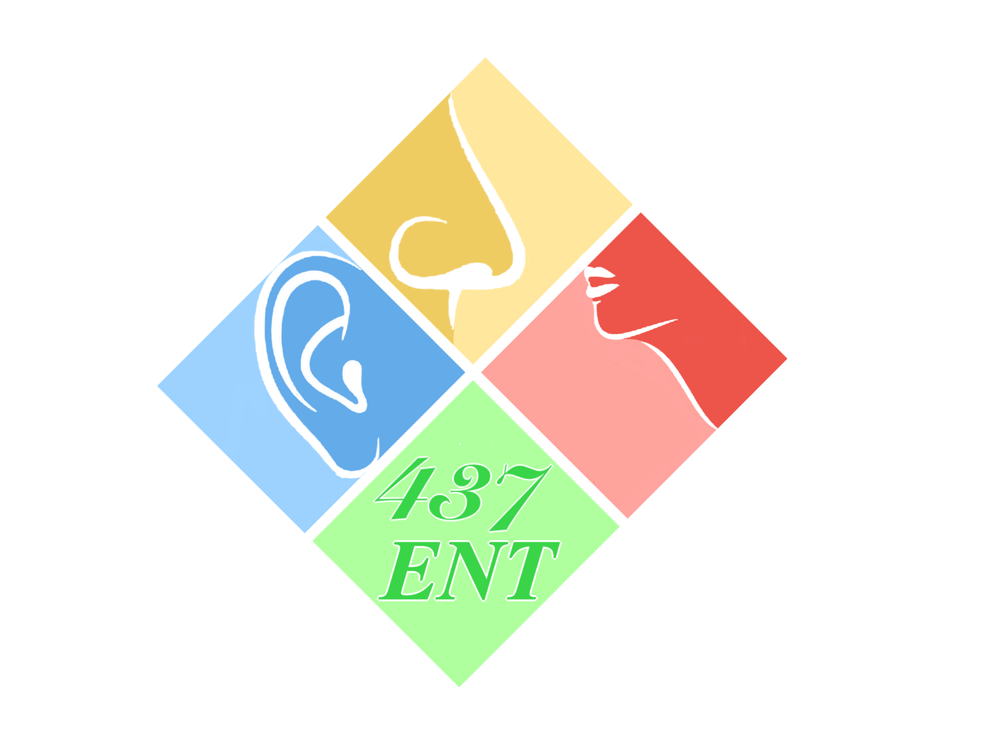
Ear I & Ear II
Objectives:
Ear I
Gross applied anatomy of the ear
Nerve supply of the external and middle ears and the principles of referred earache
Central connection of the vestibulo- cochlear nerve
Physiology of the external, middle and inner ears
Ear II
Recognize the congenital anomalies of the external ear
Diagnose and treat wax accumulation
Diagnose and treat the common external ear inflammatory conditions
Discuss the pathology, clinical features and management of AOM
Resources: Team 436, Slides
Done by: Saleh Mahjoub, Abdulrahman Almotairi
Edited by:
Revised by: Naif Almutairi
[ Color index: Important | Notes | Extra ]

Slide 2
Anatomy of the Ear
it has 3 parts:
External ear: From the outer part till the eardrum (tympanic membrane). It contains the Squamous part of tympanic membrane.
Middle ear: (tympanic cavity); From the eardrum till the stapes footplate. It contains the mucosal part of tympanic membrane.
Internal ear: Cochlea and vestibule (semicircular canals for angular acceleration and the saccule for linear acceleration).
balance. from the vestibule and the three semicircular canals.what is the difference between semi-circular canal and vestibules (contains utricle and saccule) ? semicircular canal is when you are in the elevator ‘’utricle’’ and you know you are going up and down , also in the car you know it’s moving forward and backward ‘’ saccule’’ .)
External ear:
Formed of Auricles (pinna) and External auditory meatus (auditory canal) and both are lined by skin (Auricle and meatus).
Auricle: is fibrous cartilage “thin” (except lobule area-no cartilage) lined by skin
● what is its significance?
- In case of Perichondritis (lobule is intact) but in case of any skin problem like
Erysipelas, all of auricle is affected. - Auricle is attached to temporomandibular
joint (so, movement of this joint will aggravate the pain in case of inflammation of
pinna) perichondrium is important. once we separate any perichondrium from a
cartilage the cartilage will die (necrosis) so if we have hematoma of the ear
(trauma, piercing, etc) and we did not treat it immediately we will end up with
necrosis, the septum will separate from the cartilage (the main blood supply to
the cartilage) and necrosis of the cartilage will happen.
(Perichondritis: redness, discharge)
(Erysipelas: skin infection with staph and there is redness)
The external auditory meatus (External Auditory Canal (EAC): (2.5 cm long) is an S shape canal
- it is not straight , if it was water will come in the ear while we are in shower one way to test
balance by applying warm air and cold air to the ear if the patient develops dizziness that means that the vestibular function is normal and the vestibular nerve is normal
- some patient will experience dizziness due to changes in temp, vago-vagal attack & cough because some nerves are there like the vagus and glossopharyngeal
- if you didn't pull upward & backward and make it straight you will hit the canal exactly in the (isthmus) which is the narrowest part, where the area of cartilaginous part meets the bony part
- In pediatric it might be straight but in adult it’s curved (it’s also could be straight if canaloplasty was done)
- (to protect the eardrum and middle ear. Normally we must hump one anterior and one posterior. So, at examination you should pull the auricle posteriorly and superiorly to straighten the canal “Push the pinna upward, backward and lateral”. In infant downward and backward.

Slide 3
External Auditory Canal (EAC is 2.5 cm long) consists of:
Lateral third (outer ⅓) of canal length:
Cartilagenous
Contains small amount of subcutaneous tissue
Appendages formed by elastic cartilage and contains ceruminous glands
(secrete wax), hair follicles, sebaceous and apocrine glands all together called (apopilosebaceous unit).
Medial two thirds (inner ⅔) is osseous:
Bony
The narrowest portion is at the bony-cartilaginous junction. No subcutaneous tissue or appendages developed after birth. No hair or wax here! Unless the patient pushes it inside and if so, it won’t go out, he must come for wash.
The skin is thin(0.2mm) skin over bone and easy to be injured during examination. Natural constriction. Another area of constriction is at the tympanic membrane.
The outer cartilaginous canal:
* Best places to take cartilage as grafting from, without affecting the shape, are: TARGUS (especially in rhinoplasty because it’s straight) Concha and Scaphia (for tympanoplasty).
* can I take from other places ? yes , for revision surgery rhinoplasty and there is no remaining septal cartilage to use, will take from the ear.
* there are other option that the ear like the costal rip. But ear is better, here morbidity is high
IMPORTANT
This is from the lecture only to refresh your memory: Facial nerves gives five branches temporal and cervical ,buccal , zygomatic, (extracranial branches) it comes along the parotid between the superficial and deep lobe from sternomastoid foramen. feel the mastoid . tip on your face there is a groove behind it there were the facial nerves leaves, so a lot of time when we want to do postauricular incision, we will not exceed the tip, if we did we will cause injury to the facial nerve. especially in pediatric (less than 1-2 , who can’t move their head yet) the mastoid tip is not long enough, so I must leave 1cm before the tip
External Ear Function:
- Protection of the middle ear: - Cerumen (wax), - Curvature.
- Auditory functions: – Sound Conduction. – Increase sound pressure by the resonance function

Slide 4
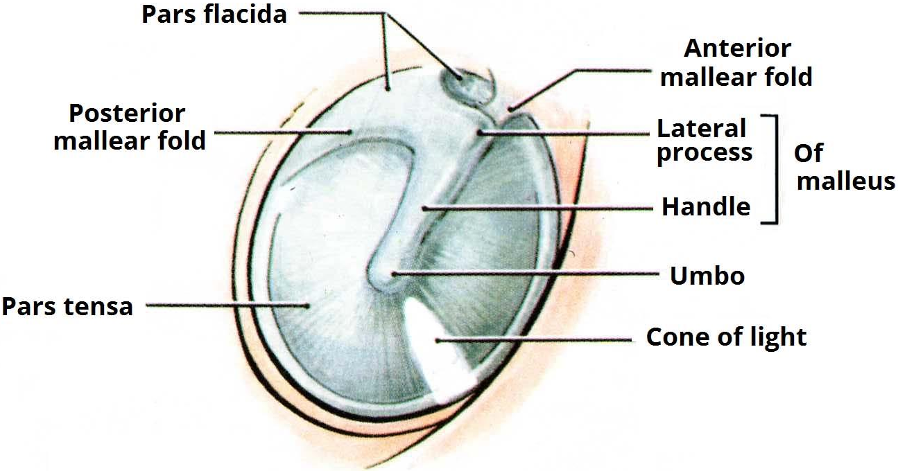
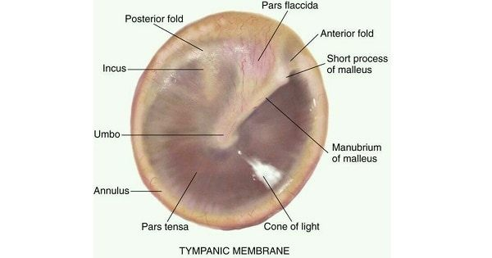
Tympanic membrane (TM):
It separates the external ear from middle ear
The Tympanic Membrane is divided into 2 parts:
Pars Tensa. 80%
Pars Flaccida. 20% (thin and weak. it goes with negative pressure inside &
if you do Valsalva it will go outside)
It’s a Fibroelastic Membrane has 3 layers :
Epithelial “Epidermal” layer: outer layer stratified squamous epithelium (skin), ectodermal origin.
Fibrous layer: the middle layer or lamina propria fibrous layer, mesodermal origin. (present only in pars tensa which makes pars flaccida more prone for perforation)
Mucosal layer: the inner layer of endodermal origin, comprising the middle ear mucosa.
➢TM supplied mainly by V3 (Mandibular) anterior, and X (Vagus) posterior on lateral (outer) aspect, IX (Glossopharyngeal) on medial (inner) aspect.
➢How can we determine this is right or left ear?
By the angle of cone of light and handle of malleus If right-> right ear ….
Left -> left ear.
- In case there was retraction of the tympanic membrane > narrowing of the
light cone, and if it was bulging (fusion) > widening of the light cone
Annulus is a fibrous band around the pars tensa that holds the TM.
if we do tympanoplasty, we do refreshment of the edge then I will take graft
and put it under it .why? for epithelialization. The graft will prevent the epithelization from going inside making it in one line. So if I did not elevate the annula and fix it again in its place it will be lateralized /blunt and wont give me the normal picture.
Why it’s important to be at the same place? because the sound when it stuck to the tympanic membrane and there is vibration it will not transmit to the ossicles. but if the tympanic membrane is thick we will have conductive hearing loss.
If it’s affected through marginal perforation that means the (stratified squamous) skin that is inside the external ear canal can go inside and induce a cholesteatoma
Cholesteatoma is not a tumor or high cholesterol, basically it’s a normal skin in abnormal place (mucosa.) It will eat the bone. Pars flaccida has no annulus so cholesteatoma can happen through it also.

Slide 5
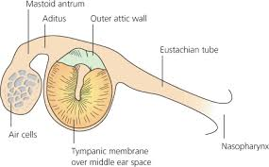
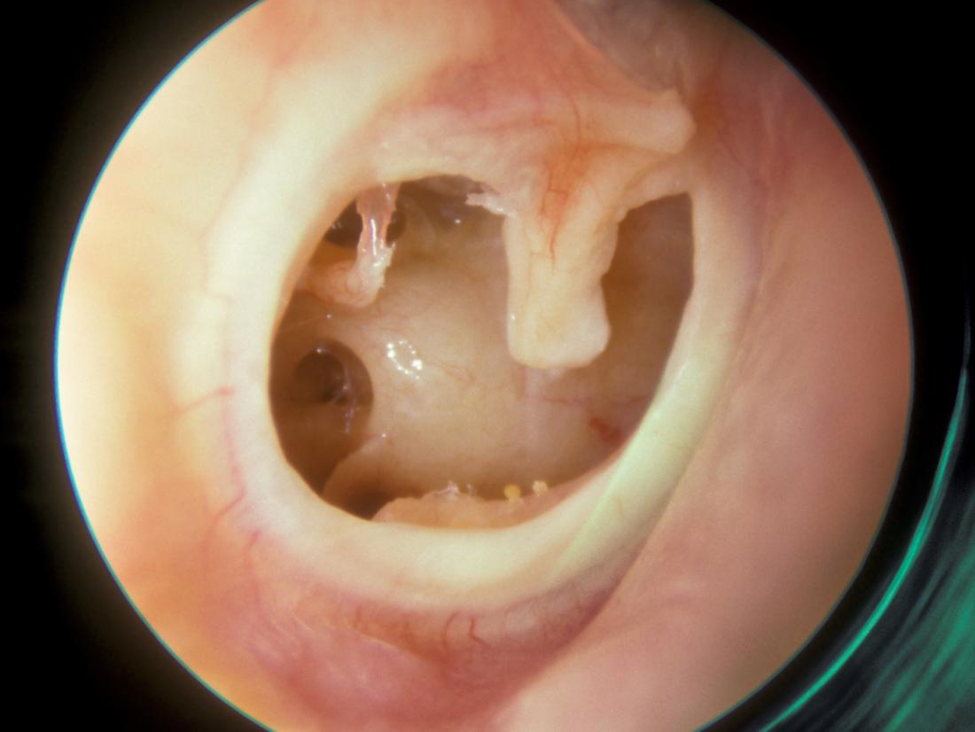
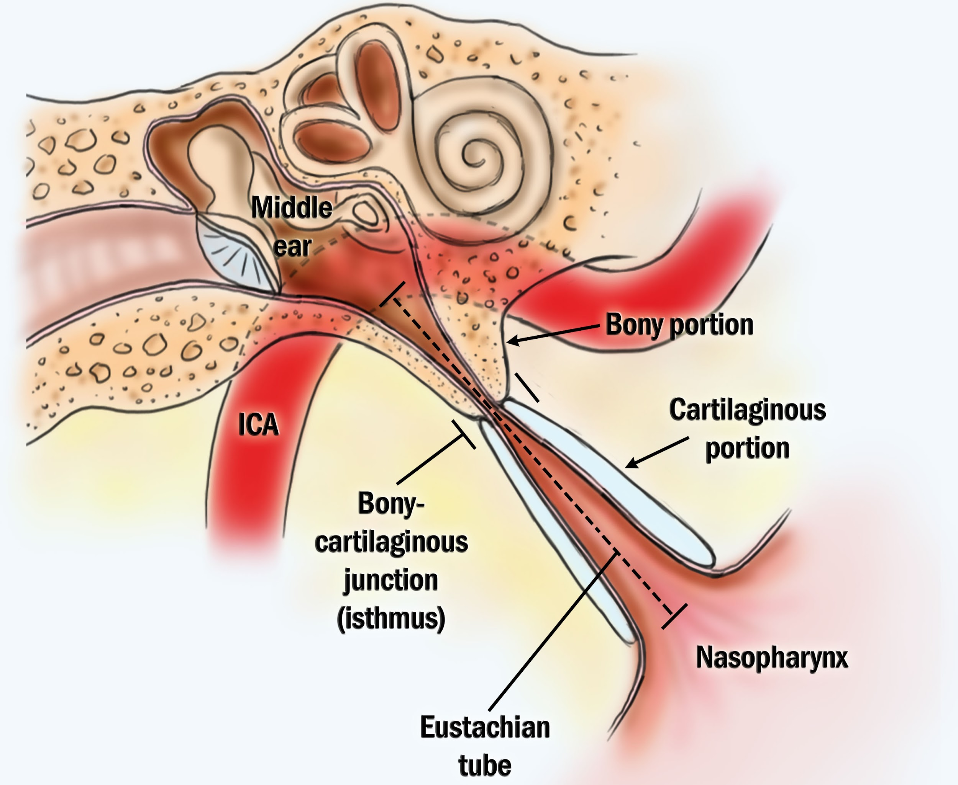
Middle ear:
Lining of the middle ear:
Mucous membrane: ciliated columnar anteriorly, and cuboidal or flat elsewhere.
Mucous membrane of the middle ear space consists of stratified cuboidal epithelium, which changes to pseudostratified ciliated epithelium around the mouth of the Eustachian tube.
Middle ear cleft formed of: important
Eustachian (Pharyngo-tympanic) Tube.
Tympanum (Middle Ear Cavity/proper).
Mastoid Antrum and Air Cells.
In OR you see opening from middle ear to mastoid is called Aditus (bridge).
But From mastoid to middle ear is called antrum (largest air cell in mastoid)
Middle Ear Function:
Conduction of sound
The middle ear plays an important role in the process of impedance matching between the air-filled middle ear and the fluid-filled inner ear to allow for efficient sound transmission (Impedance matching):
Area ratio between the ™ and the stapes footplate(20:1)
Ossicular Coupling: lever ratio
Transformer mechanism: - Hydraulic action, - Ossicular leverage 1.3x amplification due to size difference between malleus and incus Stapes alone increase sound by 2000 hz, any problem in stapes we will find the audiogram fall at 2000 hz
Protection to the inner ear. - Stapedial reflex, If the sound very loud it contracts to reduce the sound energy
Eustachian (Pharyngo-tympanic) Tube:
Connect the middle ear cavity with nasopharynx “nasal cavity” (upper aerodigestive tract).
Lies adjacent to the ICA (internal carotid artery).
Normally always closed. But in case of: Yawning, eating, Swallowing (When you swallow sometimes your ear make sound this is ET) → the ET open up by salpingopharyngeus muscle & Tensor tympani
when you are at the plane and have URTI, and the pilot landed very fast .so what can we do ? chew, steroid or atropine spary ( decongesta when you are at the plane and have URTI,and the pilot landed very fast .so what can we do ? chew, steroid or atropine spray ( decongestant nt)
Is the conduit through which air is exchanged between the middle ear space and upper aerodigestive tract.
open at torus tubarius .
Parts of Eustachian Tube:
Proximal 1/3 is bone.
distal 2/3 is fibrocartilaginous, That is collapsed at rest
Junction between 2 parts is isthmus, narrowest part of the tube.

Slide 6
Physiology of Eustachian tube:
Protection, Drainage, Ventilation “air entry” (most important function): The tube protect from anything comes from the nasopharynx to go to the middle ear
Opens actively by contraction of tensor veli palatine and passively by contraction of levator veli palatine (it releases the tension in tubal cartilage).
Closed by elastic recoil of elastin hinge + deforming force of Ostmann’s fat pad.
The tube permits aeration of the middle ear and if it is obstructed fluid may accumulate in the middle ear causing deafness.
The tube equalizes the air pressure during breathing with the external environment
علشان كذا لما تهبط الطیارة یكون الضغط عالي فنحاول نقلله عن طریق العملیات الي تفتح الانبوب هذا منها (Valsalva(
The tube is shorter, wider and more horizontal in the infant than in the adult.
Secretions or food may enter the tympanic cavity more easily when the baby is supine particularly during feeding.
The tube is normally closed and opens on swallowing because of movement of the muscles of the palate. This movement is impaired in cleft palate children who often develop accumulation of middle-ear fluid (otitis media with effusion).
❖ Tympanic cavity (Middle ear cavity):
● Contents of tympanic cavity: (roof, floor, anterior wall, posterior wall, lateral wall, medial wall)
○ Ossicles: the malleus, incus and stapes (The smallest bones in the body)
○ Intratympanic muscles: Tensor tympani , Stapedius 3 4
○ nerves: Chorda tympanim, Tympanic plexus.
● stapedius is stronger but they will help each other, if we don't have those two muscle well will all have noise trauma. once you have very strong voice / loudness or frequency higher that 60-70dp, those muscles will contract to prevent the extra-sound from going inside the ear and harm it في الأعراس لما تخلص نسمع صوت طنین هنا بدت تتأثر التینسور تحاول تمسك بس للأسف ارتخت في النهایة
● The neck of Stapes receives the insertion of stapedius muscle. Contraction of the stapedius muscle restrict the movement of the stapes (this is considered as a physiologic reflex that protects the inner ear from very loud sounds (Attenuation reflex). - Neck of Malleus receives the insertion of Tensor tympani muscle.
● Epitympanum: area above the tympanic membrane is the place where the most acquired cholesteatoma happens because the pars flaccida is here, so when retraction happens this is the first place to get affected called: Prussak's Space.
● Mesotympanum: area adjust to tympanic membrane, the one we see it once we open tympanic membrane.
● Hypotympanum: area below the tympanic membrane
● Nerve supply:
○ Sensory nerve supply of the middle ear mucosa:
■ Tympanic branch of the glossopharyngeal nerve.
■ Auriculotemporal branch of the trigeminal nerve.
○ Motor nerve supply of the middle ear muscles:
■ Stapedius muscle supplied by the stapedial branch of the facial nerve.
■ Tensor tympani muscle supplied by the mandibular division of the trigeminal nerve.

Slide 7
Clinical importance of walls of middle ear:
Fracture of temporal bone (roof of middle ear cavity) will be presented by either CSF otorrhea or rhinorrhea.
Lateral sinus thrombosis secondary to otitis media (posterior wall).
The middle cranial fossa of the brain is separated from the middle ear by the tegmen tympani.
1 st turn of the cochlea forms the promontory
Chordae tympani is a branch of CN7
The canal of the carotid a. doesn’t go into the middle ear but it’s adjacent to it.
How many nerves passes through? Facial, Jacobson (branch of 9th CN), chordae tympani. Facial pass on top of the stapes, Jacobson passing through promontory, chorda tympani in the middle ear and supply the inguinal nerve for anterior ⅔ of the tongue.
Facial nerve come from nucleus in pons go to internal auditory canal along with 8th CN , then passes into three canals (Labyrinth, tympanic “the most dehiscent [without bone coverage] part of the facial nerve” , mastoid) then it leaves the canal through stylomastoid foramen and turns into 5 branches (temporal, zygomatic, buccal, marginal mandibular, cervical).
Why this is important? During any ear surgery especially in the stapes, the adhesive part of the facial nerve could be collapsed preventing the surgery
❖ Mastoid antrum and air cells:
● Air-containing cells of the mastoid process are continuous with the air in the middle ear.
● Pneumatization is complete between the sixth and twelfth years of life.
● Normal tubal function is a prerequisite for biologically active, healthy middle ear mucosa, and thus for the normal process of pneumatization.
- مدخل من الماستوید الي بدخل فیه للمدل ایر الفتحة حقته اسمها antrum
- طیب أنا في المدل ایر وبدخل على الماستوید الفتحة الي بدخل فیها اسمها aditus. لما نفحص الاذن ونشوف flasidis para نعدیها هذي aditus
- why do we have air cells / sinuses ? to make the skull light ?how sound is transmitted? we have two windows in cochlea oval window & round window. hy are they important? the sound wave goes to the tympanic membrane , it moves the membrane and vibrate it (ossicles) , and changes from sound wave to mechanical then It reach pestim ( in the oval window) so it moves it in this way. inside the cochlea there is fluid that is divided into three rooms, upper room is “scale vestibule”, in the middle “scala media”, lower “scala tympani” ( it has the round window). so when moves the scala vestibuli the fluid goes into the cochlea swims and goes again to the scala tympani producing some movement in the round window.
لو ما كانت فیه هذه الازاحة (ازاحة الصوت) كان الفلود ما تحرك من جوا. یعني لو ماكا ن في مساحة شيء میكانیكي بحیث أنه یدخل ویطلع. عشان كذا عندنا ویندو release to مساحة الفلود الداخلیة كان ما تحرك الي في الوسط الي هو membrane basilar
- what is the basilar membrane? it is a tectorial membrane that has hair cells under it .when the tectorial membrane moves it will help the hair cells like a piano and sound will be produced. when it move I should see a reflection. This is how we know in surgeries if I fixed the ossicles well or not? we move the ossicles and see a reflection in the round window ( like the one we see in the tympanic membrane

Slide 8
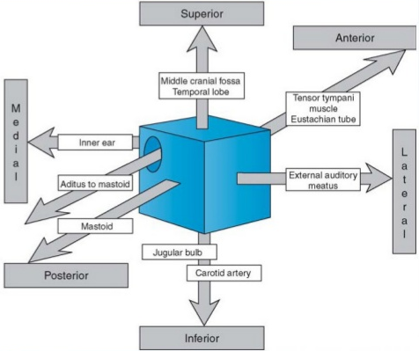
Anatomical relations of middle ear:
Floor: internal jugular vein and
common carotid
Lateral: tympanic membrane
Medial: promontory of the cochlea
❖ SUPPLY OF MIDDLE AND EXTERNAL EAR:
- corda tympani: is a branch of the facial nerve that gives special sensory for taste anterior ⅔ of the tongue it gives fibers with the lingual nerve and give taste.
- facial nerve : from brain stem ( intracranial part) then to the maditus “ internal auditory canal” and then to the temporal bone 3 parts , lastly it exit from stylomastoid and give 5 branches (extra-cranial) .
- #Those are common questions in the exam#:
- what are the 3 parts inside the temporal bone?
1-labyrinthine, in bells palsy usually edema is in the narrowest part witch is here
2-tympanic horizontal segment “ in the middle ear’’ .
3-mastoid vertical segment ‘’ in the mastoid bone ’’ .
- the most common dehiscence of facial nerve? tympanic segment 40% injury to the mastoid is
iatrogenic
❖ sensory supply of middle and external ear:
○ Great auricular nerve C2, C3 (lobule, lateral/inferior auricle)
○ Auricular or Arnold’s branch of vagus (concha, Post canal wall)
important if you put cotton inside the ear you will feel tingling in pharynx
this is vagus
○ Auriculotemporal nerve (V3): tragus. anterior helix, Ant canal wall
○ Lesser occipital C2 (medial surface of pinna)
○ TM supplied mainly by V3 (anterior) and X (posterior) on lateral aspect, IX on medial aspect IX cranial nerve: Tympanic or Jacobson’s.
○ Facial nerve concha, Post canal wall (if you have infection in facial nerve palsy you have to look in the ear you may see vesicles)
❖ Referred Earache : important 50% of ear pain is from outside the ear.
➢ Pain in the ear due to a disease in an area supplied by a nerve that also supply the ear.
○ Cervical II & III: Cervical spondylosis, neck injury (disc, muscle spasm) etc.
○ V (Trigeminal) cranial nerve: Dental infections, sinonasal diseases etc.
○ IX (Glossopharyngeal) cranial nerve (branch of CN 9 called jacobson in the promontory): Tonsillitis, pharyngitis, laryngitis , laryngeal cancer , esophageal foreign body, post-tonsillectomy, carcinoma etc.
○ X (vagus) cranial nerve: Tumors of hypopharynx, larynx & esophagus.One of the signs of recurrence tumors in larynx & pharynx is ear pain. Auriculotemporal nerve (V3): any patient that has dental issue or TMJ, tonsillitis ,URTI so when they present with ear pain I have to examine those, dental, pharynx,oropharynx, cervical

Slide 9
Inner ear:
● Consists of: Osseous Labyrinth and Internal auditory canal.
A) Labyrinth consists of:
○ Bony Labyrinth its parts:
● Bony Cochlea 35 mm long, 2.5 turns.
● Vestibule
● Bony semicircular canals.
Its contents:
- Perilymph fluid: extracellular-like fluid; found in scala tympani and
vestibuli. (K+= 4 mEq/L, Na+ = 139 mEq/L)
- Membranous labyrinth:
● Cochlear duct
● Saccule (inferior) and utricle (superior) > both form the endolymphatic duct extended to the dura laterally (its important in meniere's disease “increased perilymph” we used it for shunt placement).
● Membranous semicircular ducts.
Its contents:
- Endolymph: intracellular-like fluid; found in scala media; contributes to positive
DC resting potential of 80 mV in scala media; produced from perilymph by
marginal Membranous Labyrinth cells of stria vascularis; absorbed within the
endolymphatic sac. (K + = 144 mEq/L, Na+ = 13 mEq/L)
◆ Sensory epithelium: IMPORTANT IN EXAM
Cochlea: Organ of Corti : rests on basilar membrane and osseous spiral lamina; major components include:
Outer and inner hair cells.
Supporting cells: provide structural and metabolic support.
Tectorial membrane.
Reticular lamina.
Utricle & saccule: maculae.
Semicircular canals: cristae (angular acceleration). Fluid can move both way that’s why responsible for angular acceleration.
CENTRAL CONNECTIONS OF COCHLEAR NERVE | CENTRAL CONNECTIONS OF VESTIBULAR NERVE
The principal human auditory cortex is located deep within the sylvian fissure on the superior surface of the temporal lobe
The primary auditory cortex is often referred to as Brodmann area 41.

Slide 10
◆ Inner canal:
- Consist of cochlea has two window (round&oval ) , and semicircular canal
- Membranous part Why its important ?. here is Scala vestibule ,media and tympani
- Inside the membranous peart is fluid (indolium) inside it there is crystal “calcium tubercles “ inside each semi-circular canal . They give the sense of going up & down depending on gravity
- Like in BPV( benign positional vertigo) in people who had road traffic accident or prolonged surgery and during transportation the head has been shaken forcefully. Trauma to the head concussion of the inner ear
- فیها مادتنین وحدة سایلة وتحتها مادة جیلاینه. البارتكلز موجودة في المادة الجیلاتینیة حیث لما تلفین راسك تتحرك بشویش اذا طلعت من المادة الجیلاتینة وصارت تسبح في المادة السائلة .وش یصیر؟ مع اي حركة تحسین ان الدنیا تقلب وتدور مثلا لما تتروش وترفع راسها فوق تقول الدنیا تقلب على ورا أو ولما تنزل تربط الجزمة الدنیا تلف تقعد لها دقیقة كانها في ملاهي.
- so we do maneuvers to put them back in place ( epley maneuvers )
- المانوفرز منتو مطالبین تعرفون كیف تتسوى بس حلو تفهمون معناها, نثبت الراس على حسب السمي سیركلر كنال ونلف 45 درجة وننزلة تحت السریر نشوف اذا عنده سنتاقمس او لا العین والاذن مشتبكین مع بعض high very is reflex ocular-vestibulo فلما یصیر عندنا اي امبالس للكرستلز نشوف النستاقمس بعده اتهدا ونغیر البوزشن نرجعها مكانها لما نعید التست وماطلعت النستاقمس معناها انها تعدلت
- So its not medical treatment its re-positioning
- Scala media has ticlorial membrane and hair cells so with the fluid movement itw will move and produce sound
- Each part of the inner ear has sensory organ ‘’important’’
- In the utricle and saccule we have organ that moves and cause inflation and deflation with up & down movement its called Macula
- semicircular canal has bulla at the end that had crystal
- the lateral Semicircular canal is the most prominent one so it’s the first can be effected by diseases because the most close to external so any ear diseases that eat the bone or cholesteatoma it is the first to be effected.
- So what will happen ( for the vestibule ) once we have stimulation its goes to the brain stem the to the brain it gives two part one to the spine and one to the oracular muscle
- So we have nystagmus and imbalance this is for the vestibule
- So how can I know that its only vestibular diseases?
- We know balance is dependent on three thing : proprioception ( joint & muscle) & vision & vestibule Stand on pillow or spongy thing and close the eye .you are testing the vestibule alone you. If you did not find anything you can ask him to step. It is called “Vocada test”.One of the vestibular examination
Function of the inner ear:
Hearing Function: ○ Transduction of sound to action potentials Some cases they have the round window closed, once we open it they listen.
Vestibular Function :
Participate in maintaining body balance, the mechanisms of maintaining body balance: (see up for more info)
Brain stem: is the center of balance. It’s connected to:
Cerebellum to coordinate muscle tone and Cerebral cortex for the feeling of space.
Input: Proprioceptive (sensation), Visual and Vestibular
Output: gives information to: Postural muscles and Ocular muscle

Slide 11
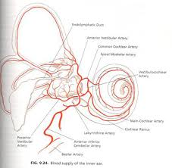
Utricle & saccule and cristae of the Semicircular canals:
How many factors our balance depends on?
1- cerebellum. 2- vision. 3- proprioception
So, you have to make sure when someone came to you with imbalance it’s not b/c of the cerebellum by testing it, then roll out the (peripheral) proprioception
Testing the vision > by closing the eye - Testing the proprioception > by asking him - to stand on sponge When you do so (closing the pt. Eyes and making him stand on sponge) you’re eliminating the vision and the proprioception effects and after it you can make sure you’re testing only the vestibule.
In case of dizziness related to ear problem; it’s either due to effect in the vestibular nerve (called -vestibular neuritis due to URI) or Benign positional vertigo ( inside the vestibule there are fluid and gelatinous material that has Ca particles within it ; with minor trauma or any minor head concussion these Ca particles will go out from the gelatinous material to the fluid > once the pt. Moves his head up > movement of these Ca particles rapidly “when it was in the gelatinous material its movement was slowly” > vertigo not imbalance > treated by repositioning exercise after checking the type of nystagmus “horizontal = lateral Semicircular canal , rotatory= superior (geogravic) and posterior (ageogravic) (Semicircular canals the pt. have
Cochlea:
The cochlea is divided into 3 rooms (scala tympani, scala (media, scala vestibuli)
Most important is scala media; where hearing takes place.
It contains hair cells and tectorial membrane.
The sounds wave vibrate the Tympanic membrane -> the ossicles move ( stapes act as a pistol in scala vestibuli) it pushes the fluid away , and at the apical part (helicotrema) the fluid back to scala media so the wave of fluid will push the hair cells in it and it will touch tectorial membrane and will produce electrical stimulus and pass it to through the spiral ganglion to the 8th nerve.
Inner ear sensory epithelium :
● cochlea : Organ of corti
● Utricle & Saccule : Maculae
● Semicircular Canals : Cristae
Vestibular System :
● Semi-circular Canals : Angular Acceleration
● Utricle & Saccule :
1- Macule of the utricle : plan horizontal
2- Macule of the saccule: plan vertical
3- Linear acceleration horizontal & Vertical (gravity)
Sound of High frequency affects the basal portion of Cochlea
Sounds of Low frequency affect the apical portion of Cochlea
➢ Blood supply of inner ear:
● Anterior inferior cerebellar artery →Labyrinthine artery→ common cochlear and anterior vestibular

Slide 12
Congenital Malformation
Anotia (Atresia):
It’s the total absence of the auricle most often with narrowing or absence of the external auditory meatus.
CT; to check if there is other malformations (internally).
Bone conduction is preserved Treatment: bone hearing aid (B.A.H.A )on mastoid.
No auricles + canal atresia.
We reconstruct the ear.
(Prosthetic ear (usually tumor patients Good sensory hearing > bone hearing aid.
Microtia:
It’s a condition in which the external portion of the ear (the auricle) is malformed. There is also narrowing or absence of the external auditory canal.
Any kind of remnant.
Accessory auricle:
It’s a type of ear anomaly in the tragus area.
Treatment: Plastic reconstruction, B.A.H.A (bone anchored hearing aid). It can present with no effect. usually in syndromes
Preauricular sinus:
It’s a common congenital malformation characterized by a nodule, dent or dimple located anywhere adjacent to the external ear.
Susceptible to infection.
Management: systemic antibiotics. If an abscess is present, it must be incised and drained (If got infected twice you must take it out by first testing its pathway through methylene blue injection or CT scan with contrast, but in the time of inflammation we do incision and drainage).
Most common embryological defect.
Run in families.
Removed only if infected by removing the whole tract guided methylene blue dye.
Protruding Ear (Bat ear):
Management: “cosmetic” Pinnaplasty or otoplasty. Do if after age of school. Note: There is no direct blood supply to the cartilage!
Antihelix pulls ear back while helix pushes it forward; Antihelix is absent.
By incisionless otoplasty (suture tie).

Slide 13
Development of the ear:-
● External ear: 1st pharyngeal cleft & arch
● Middle ear: 1st pharyngeal pouch & 1st and 2nd arches
● Inner ear: Ectoderm of hindbrain
Trauma to The Auricle:
Lacerations
Hematoma auris
Complication : cauliflower ear
Treatment: Excise fibrous tissue -
Apply pressure dressing ـ drain.
When we treat hematoma?
Immediate incision and drainage! So, don’t develop into cauliflower ear (necrosed cartilage).
PERICHONDRITIS OF THE PENNA:
Perichondritis is inflammation of the perichondrium, a layer of connective tissue, which surrounds cartilage. (with spared lobule area)
Usually follow trauma to the cartilage (hematoma auris, surgical “mastoid surgery”, frostbite, burn) or otitis externa & piercing (particularly with the modern trend for multiple perforations that go through the cartilage).
Commonly caused by Pseudomonas.
Fever, pain, redness and swelling (causes narrowing and further low hearing level).
Treatment: must be vigorous and immediately by parenteral antibiotics & Evacuation
(Any cartilaginous organ that forms a hematoma must be drained as early as possible)
If it is due to piercing the stud should be removed.
Complications of Perichondritis or Trauma:
Cauliflower ear (End stage of untreated haematoma). The ear can be exposed to trauma and lacerations leading to the formation of Hematoma, so if anything happens between the skin and cartilage →Hematoma (Number 1 killer of the cartilage, why?
Because the blood will not be able to reach the cartilage) →Ischemia →Necrosis →Ear deformity

Slide 14
Otitis Externa
An acute (Less than 3 months) or chronic (more than 3 months) infection of the whole or a part of the skin of the external ear canal. Any pathology affecting skin can also affect external ear.
Organisms enter the apopilosebaceous unit by break in skin
Commonly caused by fingernail or Q-tip to relieve itching
Periosteal lining of bony canal displaced by swelling
Subacute or chronic develops if AOE not treated adequately
History:
Itching
Pain: could be very severe because of underlying cartilage, evoked by movement of the jaw, because the ear auricle and external canal is attached to the TMJ (temporomandibular joint) pain can radiate to the throat!
Fullness
Tenderness and swelling, absent in otitis media.
Otorrhea: No discharge or very little and scanty, not mucoid. Large discharge in otitis media. (Not mucus discharge because the skin does not contain mucus-secreting cells. If the discharge doesn’t contain mucus, then it is from the External ear however if it contains mucus it is originating from the middle ear)
Deafness (Hearing loss): deafness caused by external ear needs to be completely obstructed, which is rare in otitis externa.
Changes in the lumen and skin of EAM (external auditory meatus)
Physical Exam:
Redness, swelling, sometimes you can’t see the TM because of the swelling, protrusion, discharge, preauricular or face or neck extension
Gently tug up and back: if true AOE, patient will not tolerate
Clean canal thoroughly and examine under Microscope
Pathophysiology:
Invasive
Reactive
- Bacterial: Pseudomonas aeruginosa (commonly in immunocompromised like diabatic, post radio or chemotherapy and it has a very bad smell if it presents with Cholesteatoma), Strep, Staphylococcus aureus (furuncle) most common, like in swimming ear. Proteus mirabilis, and various gram negative bacilli
- Fungal (Otomycosis):(newspaper appearance) Aspergillus − Niger (spores forming, hyphae), Candida albicans (whitish and cheesy, cotton like) dx by seeing it
- Viral: Herpes Zoster ... Others −
- Seborrheic: A disease of the sebaceous glands characterized by excessive secretion of sebum or an alteration in its quality, resulting in an oily coating, crusts, or scales on the skin. It’s usually painless
- Eczematous/Dermatitis: A non-contagious inflammation of the skin, characterized chiefly by redness, itching

Slide 15
Clinical types of Otitis Externa:
Localize O.E (furuncle)
small rounded swelling in the external canal
Diffuse infective O.E.: swimming ear
General narrowing of the canal. (on Ex we can’t see the external canal b\c of the edema) The canal will close, and you will not be able to pass anything through it
علشان كذا لما نبي ندخل لهم قطرات نستخدم شاش ندخله داخل الأذن ونصیر نبلله بالقطرات علشان توصل داخل وقت الانفیكشن ما نسوي أي تدخل جراحي لأنه یسبب ادهیجن وفایبروسیس
Otomycosis: fungal infection (More in those who take Abx for a long time)
Fungal vs. Bacterial Fungal: Less pain, more itching & NO fever.
Management: suction then antifungal cream
BULLOUS MYRINGITIS
Inflammatory condition involves the lateral surface of the TM and the medial portion of the canal wall
It typically occurs in association with upper respiratory infections and is more common in winter separation of one layer of the tympanic membrane “bullous” > viral (infection > pain)
Clinical manifestations
Severe otalgia
Serosanguinous otorrhea
Hearing loss
Treatment includes analgesics, topical antibiotic/steroid drops to prevent bacterial superinfection
Do not touch, if we open we will make it bacterial
Herpetic O.E:
herpes zoster oticus is a specific form of herpes zoster that presents with pre-eruptive (“pre-herpetic”) lesion reactivated from either the trigeminal or cervical ganglions
characterized by: PAINFUL vesicles
Management: Steroids + Acyclovir
Complications: Facial n. paralysi
Small vesicles + facial weakness = Ramsay Hunt syndrome or HSV
Eczematous and seborrheic: O.E. painless
If the eczema is only in the canal, keep on mind tympanic membrane perforation due to discharge

Slide 16
Management (to all clinical types):
History and Physical examination.
Frequent Cleaning:Meticulous debridement of debris, pus and cerumen
antibiotics: Anti-pseudomonal drops – Ciprodex
Swab for culture and sensitivity for ABx.
Keep the ear dry. Suction cleaning (especially the fungal infection = Suction, Suction, Suction) the antifungal won’t go inside so we have to take the deprea out.
Ear wick (best used after shower not in dry ear without pushing more than the length of the cotton > to avoid injury, infection and cotton dislodge ) This is an ear wick or sponge in the external ear canal for ear drops
Local Medication and analgesia to control pain. Not all E.O need oral or parenteral tx.
Systemic medications: as in diabetics.
Surgery may be required in chronic cases and failure of treatment because there is usually thickening in of the skin and closure of the canal.
Recommendations regarding prevention
Avoid instrumentation
Keep H2O out of the ear when possible
IN CASE OF:
Aspergillus Niger ➔ Give antifungal drops.
Herpetic O.E Tx: ➔ Acyclovir if < 3 days, Steroids to reduce inflammation.
Acute necrotizing (malignant is not a cancer) otitis externa /
Skull base Osteomyelitis (last approved name): Important Infection of the roof
of the EAC and skull base affected
An acute Pseudomonas infection of the skin of the external ear canal
(skull base), which spread to the adjacent bone. (Deep seated pain for
more than a month).
Life-threatening; osteomyelitis of temporal bone
AOE can spread via fissures of Santorini or tympanomastoid fissure
Diagnosis: Ct scan to rule out other pathology such as cholesteatoma PET scan to highlight the area
Diabetes, advanced age, severe otalgia > 1month , granulation tissue ,cranial nerve involvement , radiology
It has a triad:
ear discharge “Several weeks of purulent otorrhea with granulations”,
headache (esp at night),
Immunocompromised pt.,HIV or elderly
It occurs mostly in elderly diabetic patients. (Immunocompromised) Important!
Elderly with otorrhea and nocturnal headache and in examination granulation tissue and cranial palsy= necrotizing malignant otitis externa (skull base osteomyelitis)

Slide 17
Clinical/Radiographic Findings:
Lower Cranial nerve palsies (VIII, IX, X, XI, XII) (check the gag reflex), and 25% VII
No signs of acute inflammation & No swelling.
On Ex: Granulation tissue in EAC, sequestra and Foul-smelling discharge from the floor of the external Auditory canal.
It can infect the base of the skull, the cranium Causing meningitis, brain abscess.
Almost always caused by Pseudomonas; can be fungal in HIV
Radiology: always we do CT although it doesn’t tell us the definitive dx, that’s why we rely on nuclear scan Bone (Petrous) scan to rule out osteomyelitis. Bony erosion on contrast-enhanced CT
MRI useful for soft-tissue diagnosis, but not for F-U
Bone scan is sensitive, but not specific (Tc-99m most sensitive)
Granulation tissue at the junction of the bony and cartilaginous portions of the canal + -immunocompromised pt ➔ Dx as Malignant Otitis Externa!
Medical Treatment:
Should culture and biopsy.
Anti-pseudomonas antibiotic. At least 6 weeks
Blood-sugar control. (most important part of treatment)
Frequent debridement and anti-pseudomonal ear drops.
ID and Endocrinologist should be involved.
Surgical treatment:
reserved for clear failures of above medical treatment
Miscellaneous Conditions of the External Ear
Wax:
Mixture of ceruminous and sebaceous glands secretion
We always remove wax before examination
Could be liquidy soft, scaly, hard
Normally is expelled from the canal aided by movements of the jaw
When accumulated it may cause deafness, earache or tinnitus
Wax on tympanic membrane is very dangerous, it could be hiding retraction behind specially in parus flaccida or cholesteatoma
Treatment: is by removal using syringing very rare nowadays > anything you do it in ear will (cause vasovagal + there will be stimulation to the lateral semicircular canal bc of the water temperature that we are using), suction or instrumentation
In irrigation we have to make sure of the temperature (same as body temperature) to avoid dizziness crocodile forceps/ ear forceps Hock

Slide 18
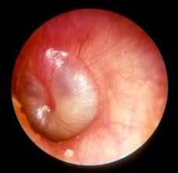
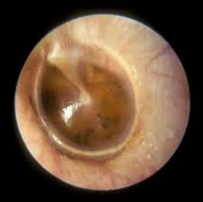
KERATOSIS OBTURANS:
Accumulation of desquamated epithelium (skin not wax) in the bony canal. (the difference b\w it and Cholesteatoma that in the later one we have normal ski in abnormal place).
It is excessive scaling of the skin causing very hard wax
Doesn’t cause erosion only expansion (intact canal)
This is how we differentiate with external ear cholesteatoma
It may be associated with Sinusitis, Bronchiectasis, Primary ciliary dyskinesia. (it doesn't cause boney erosion but it lead to compression “pressure like effect” and widening of the canal)
Usually cause deafness and pain.
Treatment is periodic removal
Otitis Media
Acute infection of the mucous membrane lining of the middle ear cleft.
The definition is specific to infection because in chronic Otitis media it can be due to infection of normal inflammation.
Estimated 85% of all children experience at least one episode of AOM (Acute Otitis Media).
Most common bacterial infection of childhood.
Predisposing factors:
Age: common in children as their Eustachian tube is more horizontal, wider and shorter in relation to their head.
Male sex
Bottle feeding: more likely to have milk regurgitation (because children tend to drink while lying) in middle ear
Allergic Rhinitis
Crowded living conditions (one infected will infect others)
Smoking within the home
Heredity
Climate
Associated conditions:
cleft palate why? tensor palatini muscle is absent in cleft palate and its job to open ET when you swallow, immunodeficiency, ciliary dyskinesia, Down syndrome, and cystic fibrosis .
Why in cleft palate? The muscles of the palate are affected and not well developed, so in cleft palate surgery ENT come to put tube to avoid otitis media with effusion for life

Slide 19
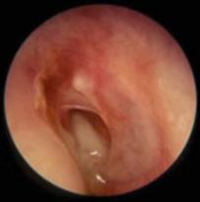
Otitis Media Count,
Route of infection:
Eustachian tube.
External auditory canal(rupture): rare.
Blood borne.
Bacteriology:
Streptococcus pneumonia (Most common)
Haemophilus influenzae
moraxella catarrhalis
Streptococcus pyogenes
Staphylococcus aureus
Pathophysiology:
The patient has an antecedent event (viral URI or allergy) → the event results in Congestion of the respiratory mucosa of the nose, nasopharynx, and Eustachian tube → Congestion of the mucosa in the Eustachian tube obstructs the narrowest portion of the tube, the isthmus → obstruction of the isthmus causes negative pressure followed by accumulation of secretions produced by the mucosa of the middle ear → these secretions Have no egress and accumulate in the middle ear space → viruses and bacteria that colonize the upper respiratory tract can reach the middle ear via aspiration, reflux, or insufflation → microbial growth in the middle ear secretions may result in suppuration.
Clinical picture
Tubal occlusion: produces early signs of acute otitis media.
Discomfort, autophony (feeling own sounds), retracted drum (opposite of bulging) caused by pressure difference.
There is mild deafness. Tinnitus in children, not adults.
First thing to happen in otitis media is redness/congestion > bulge (severe pain) > rupture if untreated > pus > abnormal/normal healing or perforation.
Suppurative inflammation of the middle ear: Fever, severe earache, (deafness, congestion and bulging drum) pus behind it.
Tympanic membrane rupture: Otorrhea, Temperature subside. & earache subside (pain relief), perforated drum and Mucopurulent (discharge )if not treated
Resolution: Either the rupture will persist, and it will discharge from time to time (chronic otitis media) Or close spontaneously (“retraction”) common
Tympanosclerosis “if not treated will retract if it was severe > adhesive otitis media (tympanic membrane reaching the promontory ”or the cochlea

Slide 20
The patient can present to you at any stage (mostly the congestion and bulging) and the treatment will be the same. However, the complications are different.
The patient will be in severe pain before the rupture of tympanic membrane due to the nerve stimulation and irritation by tension.
Complication of acute and chronic OM:
Extracranial:
Acute mastoiditis ,Chronic mastoiditis, Postauricular abscess, Bezold abscess, Temporal abscess, Petrous apicitis, Labyrinthine fistula, Facial nerve paralysis, Acute suppurative labyrinthitis.
Intracranial:
Meningitis, Brain abscess, Subdural empyema, Epidural abscess, Lateral sinus thrombosis, Otitic hydrocephalus, Encephalocele and cerebrospinal fluid leakage.
Treatment:
Symptomatic
Antimicrobials.
Amoxicillin ( 1st line) if allergic to penicillin & cephalosporins you give clarithromycin
Amoxycillin/clavulanic acid (B-lactamase bacteria) 2nd line.
Trimethoprim-Sulfamethoxazole.
Cefaclor, cefixime.
Erythromycin-sulfisoxazole
Decongestant. (opening in case of bulging with severe pain to relieve it and in congestion)
Myringotomy +/- tube.
Ear toilet and local antibiotics.
● Bulging + severe pain + adult > open small opening to relieve the pain
● If not > nasal steroidal spray so eustachian tube opens and remove the pus + oral ABx
● Recurrent Acute Otitis Media:
Three or more attacks over a 6-months period or (six attacks in a year).
- O.M. + diffusion > sterile fluid in the middle ear, or dysfunctioning Eustachian tube like in down syndrome or cleft palate.
● Treatment:
-Long-term low dose antimicrobials
-Ventilation tube insertion “it allows the air to enter the middle ear and drainage of fluid from the Eustachian tube” (Myringotomy with pressure equalization tube) Most common in acute otitis media after resolving there will be fluids.
Pediatrics last for 3-6 weeks if more it will affect speech, so we drain through eustachian tube (myringotomy) by putting a tube between the External Canal and middle ear
We put it in anterior inferior to avoid ossicles’ injury

Slide 21
Recurrent Acute Otitis Media:
Three or more attacks over a 6-months period or (six attacks in a year).
- O.M. + diffusion > sterile fluid in the middle ear, or dysfunctioning Eustachian tube like in down syndrome or cleft palate.
Treatment:
- Long-term low dose antimicrobials
- Ventilation tube insertion “it allows the air to enter the middle ear and drainage of fluid from the Eustachian tube” (Myringotomy with pressure equalization tube) Most common in acute otitis media after resolving there will be fluids. -Pediatrics last for 3-6 weeks if more it will affect speech, so we drain through eustachian tube (myringotomy) by putting a tube between the External Canal and middle ear We put it in anterior inferior to avoid ossicles’ injury

