Slide 1
Head & Neck I, II & III
Objectives:
objectives were not on slides, this is Team 436F objectives
Head & Neck I: - Neck masses (Intro, anatomy, diagnosis, differentials and examples). - Thyroid (anatomy, nodule, cancer, surgery & complications)
Head & Neck II: - Salivary gland (anatomy, physio, infection, autoimmune and tumors). - Tumors of oral cavity (Intro, pre-malignant lesions, leukoplakia, malignant lesions, SCCA)
Head & Neck III: - Tumors of pharynx (nasopharyngeal ca, oro & hypopharyngeal ca) - Tumors of larynx (Intro, laryngeal papillomatosis, ca larynx)
Resources: Dr’s slides - 436A- 436F
Done by:
Fahad Abdulaziz Aldhowaihy
Mohammed Alassiri
Edited by:
Revised by: Naif Almutairi
[ Color index: Important | Notes | Extra ]

Slide 2
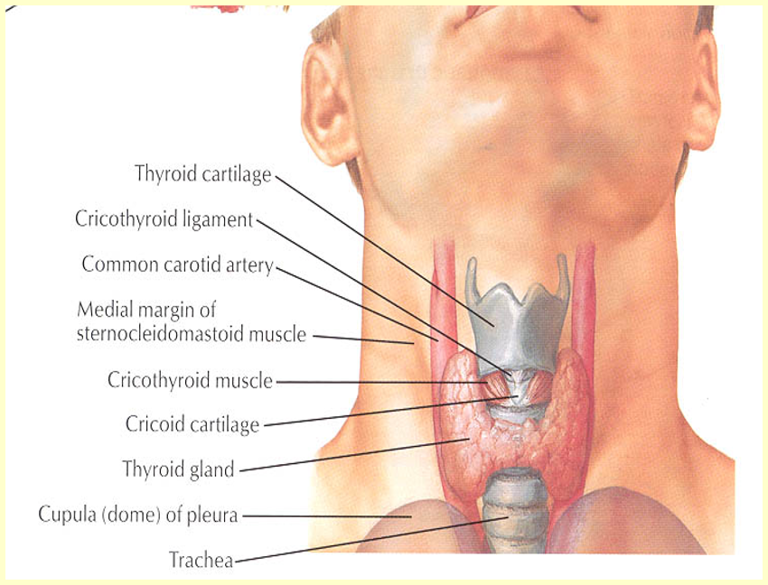
Introduction::
❖ Neck mass is a common complain that requires systematic clinical approach in order to get a final diagnosis and set an appropriate management plan.
❖ The most effective and accurate screening tool is actually obtaining a good medical history and performing physical examination.
Anatomical Considerations:
1. Prominent landmarks:
-Anatomical landmarks: Angel of mandible and Clavicle and mastoid tip. The ONLY obvious landmarks in every single patient including obese. Always look for bones!
So, make sure you locate them before starting your examination.
-In the midline of the neck, there is a cricoid. Anything above the cricoid is called upper midline (your DDx will be B/W the carotids.
-Anything below the cricoid to the Suprasternal notch, we call it lower Midline (DDX related to thyroid lobes).
2- Triangles of the neck:
- Lymphatic drainage
DDx of Anterior Triangle:
- Congenital:
Branchial cyst “Most common, Mostly level 2”, Thymic cyst, Hemangioma, Torticollis
- Acquired:
1-Benign: Lipoma, Neurofibroma, Carotid body tumor, Salivary G lesions, thyroid (malignant, primary)
2-Infection And inflammation
it contains the carotid vessels, thyroid gland and lymph nodes
1- Submental triangle: bounded by both anterior bellies of digastric and hyoid bone.
2- Submandibular triangle: bounded by anterior and posterior bellies of digastric and inferior border of mandible.
3-Carotid triangle: bounded by sternocleidomastoid, anterior belly of omohyoid, and posterior belly of digastric.

Slide 3
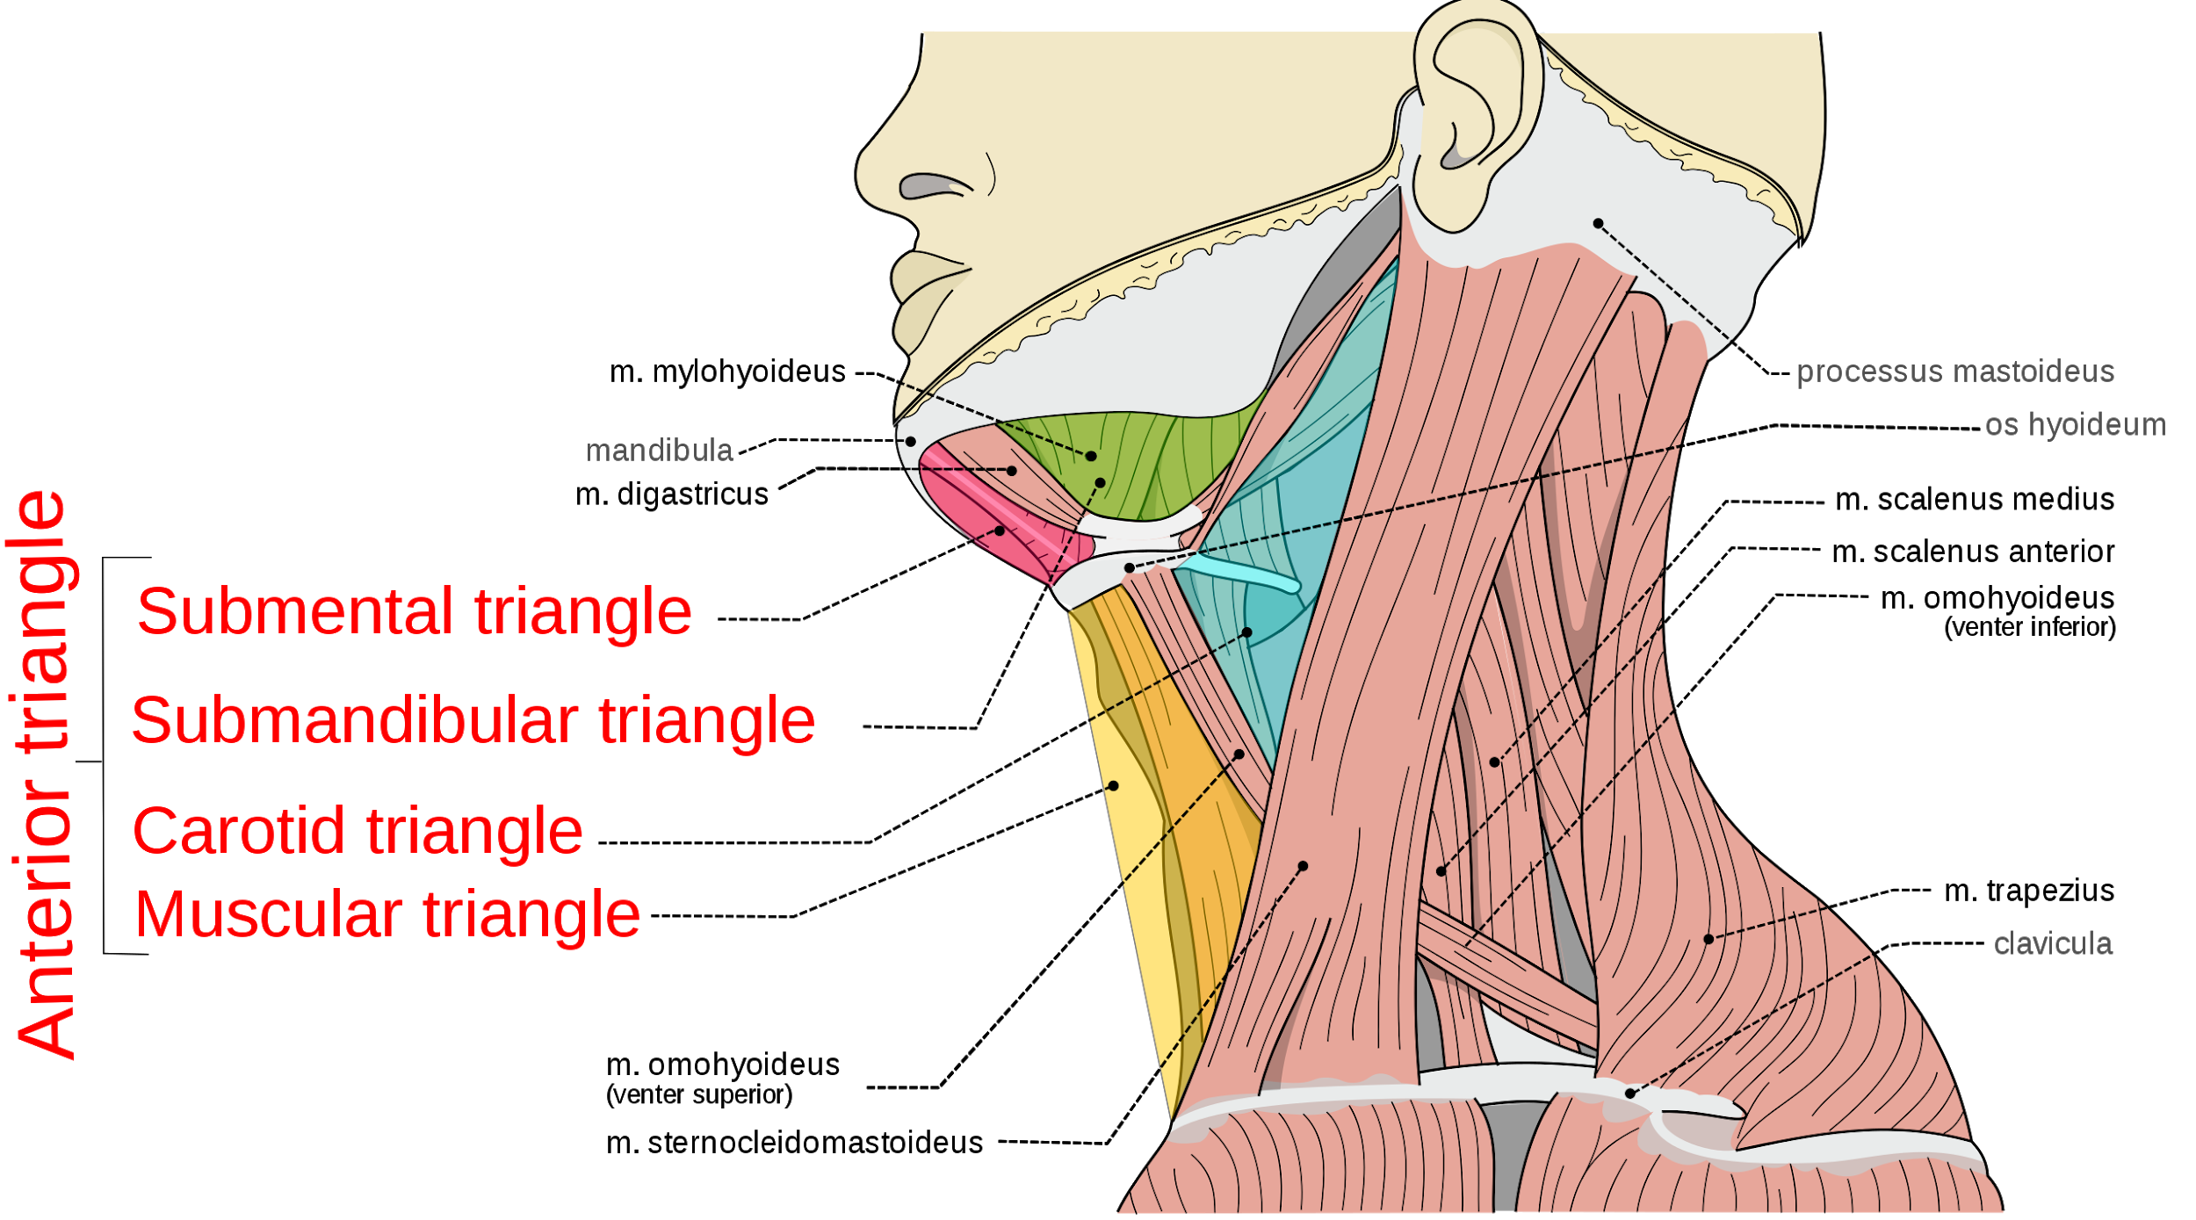
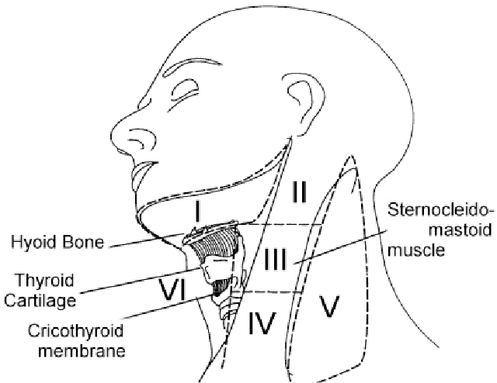
DDx in Posterior Triangle:
•Congenital :
Lymphangioma “Mostly level 5” (cystic hygroma)
•Acquired:
Lymphadenitis, Lymphoma, Metastatic CA.
3-Lymphatic levels
It contains lymphatic level 5. Divided into:
- Occipital triangle.
- Subclavian triangle
Level 1: Between the 2 bellies anterior and posterior of digastric muscle and hyoid bone (in submental and submandibular triangle). Anything in this level just considered it “High below the mandible” at the region of submandibular gland.
Level 2: anything anterior to sternocleidomastoid Deep cervical chain (from skull base to hyoid bone). Basically, is the “Jugular digastric” you will feel it immediately behind the angle of mandible, but anterior to the SCM high up.
Level 3: anything anterior to sternocleidomastoid Deep cervical chain (between hyoid bone to the omohyoid muscle). It’s at the middle of anterior triangle behind the angle of mandible.
Level 4: anything anterior to sternocleidomastoid Deep cervical chain (below omohyoid muscle). Lower at the neck just above the sternal notch.
Level 5: Posterior triangle (from SCM to the trapezius muscle). Level 5 was described previously as posterior triangle just behind the sternocleidomastoid but know level 5 is anterior neck between the two-strap muscle anteriorly, anterior to the trachea and larynx
3-Carotid bulb
Sometimes the carotid is prominent and appears as a pulsating mass it is just a normal vibration nothing to worry (carotid bulb) is an anatomical landmark always located at the level of hyoid bone, so if you look for carotid body tumor it must be around this area. It’s extremely rare tumor.

Slide 4
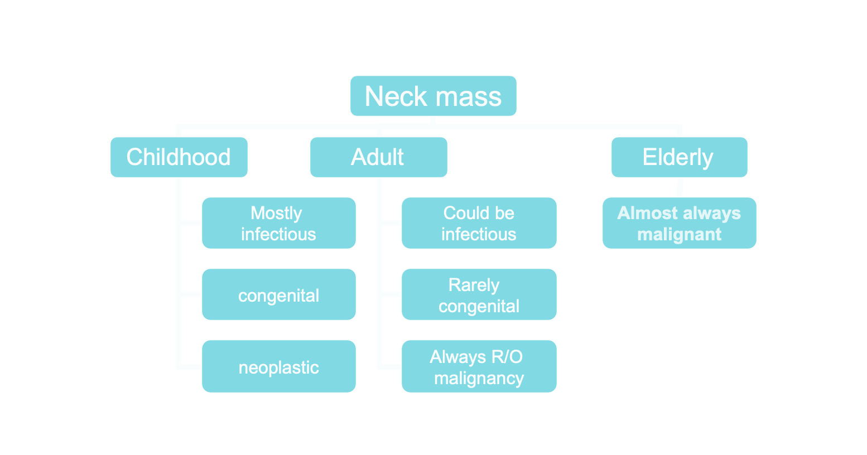
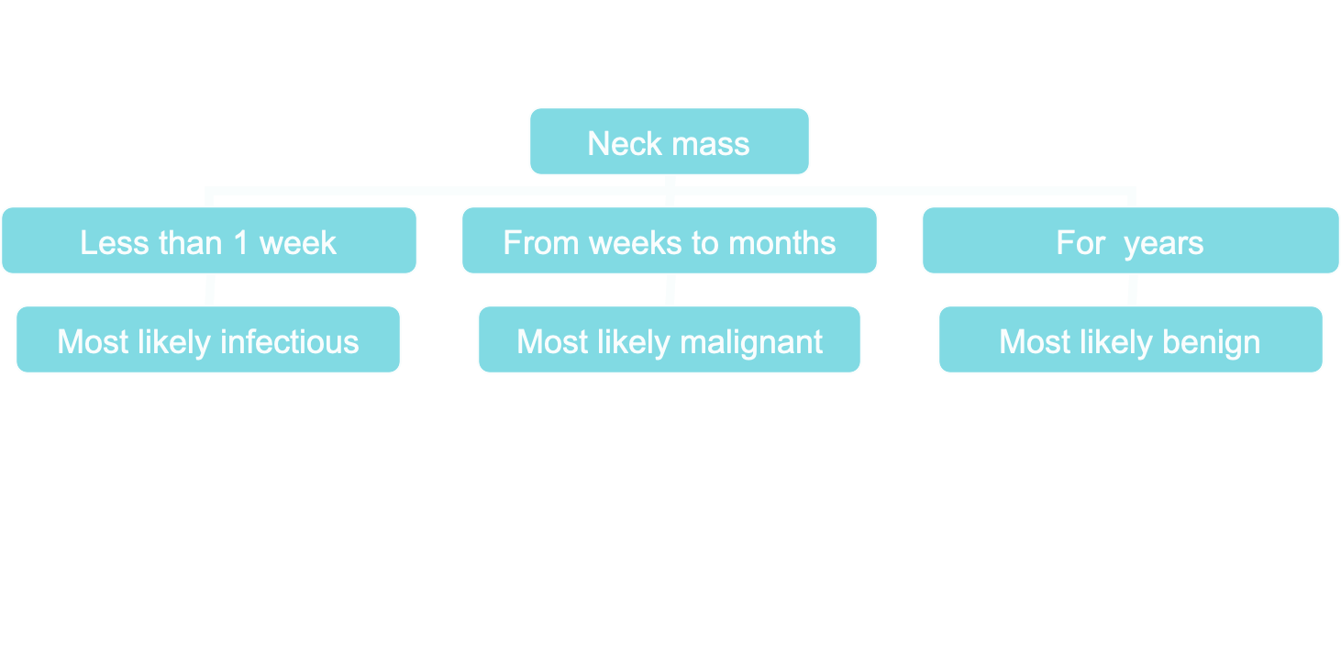
General Considerations:
1- Patient age
–Pediatrics (0 – 15 years): mostly benign
–Young adults (16 – 40 years): similar topediatric
–old adults (>40 years): High risk of malignancy
2- Location
-Congenital masses: consistent “specific” in location. FOR EXAMPLE: branchial cyst is in the upper left.
-Metastatic masses: key to primary lesion. Metastasis Location according to Various Primary Lesions The parotid area will drain the skin of temporal and the scalp, upper part of neck drain oropharynx and hypopharynx, level 1 drain the oral cavity, if you have a pt with supraclavicular lymph node or node of Virchow's it drains anything below the clavicle (prostate of ovaries).
-Submental lymph nodes (level I): examine the oral cavity, anterior nasal cavity, mouth floor, buccal area, and gums.
-Level II: oral cavity, nasal cavity, naso/oro/hypopharynx, larynx, and parotid gland.
-Level III: Naso/oro/hypopharynx, larynx, and oral cavity.
- Level IV: Hypopharynx, larynx, and thyroid.
- Posterior triangle (Level V): think of Naso/oropharynx, cutaneous structures of the posterior scalp and neck.
- Level VI: think of thyroid
3- Timeline
Diagnostic Steps:
1-History:
-Developmental time course. (Dr mentioned the most three important parts of History are : Age,Duration and location.)
-Associated symptoms (dysphagia, otalgia, voice). If a pt has a neck mass, otalgia, dysphagia and voice change what does that mean? Compression. If you have a malignancy on the nasopharynx, it will present with ear pain, epistaxis and neck mass. If you have a malignancy of the larynx, pt will have voice change, sometimes dysphagia and neck mass. So it correlates with the primary site or pathology.
-Alarming signs: (Neck mass - Unilateral ENT S/S - Constitutional symptoms ( B symptoms of lymphoma)
-Personal habits (tobacco, alcohol)
-Previous irradiation or surgery.
2- Physical Examination
-Complete head and neck exam (visualize & palpate). Include all neck area in addition to Head and Oral cavity ( with flexible or rigid scope)
-Emphasis on location, size, tenderness “if tender it means inflammatory mass”, solitary or multiple, mobility and consistency the harder the mass the more toward malignancy.

Slide 5
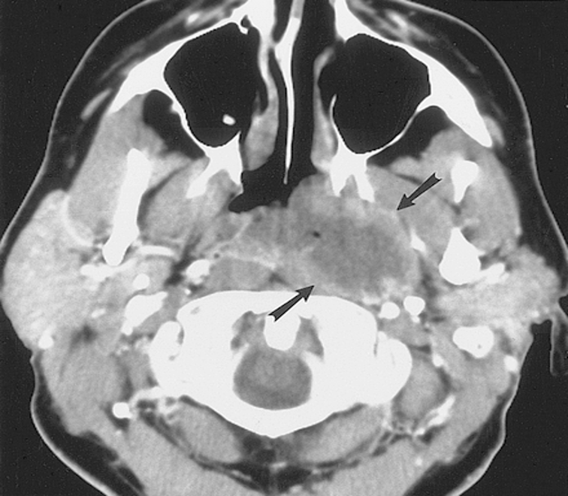
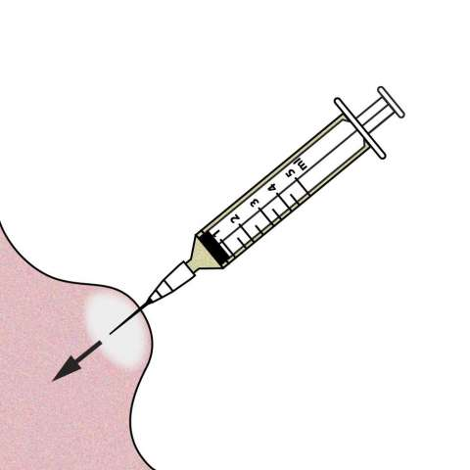
Empirical Antibiotics:
1- Inflammatory mass suspected
2- Two weeks trial of antibiotics
3- Follow-up for further investigation. If you gave the pt an antibiotic you need to bring him/her back, to make sure it’s not their 1st presentation of malignancy. If the patient is improving that proves you’re right and no need for further investigations, but if the pt wasn’t improving you need further investigations.
Diagnostic Tests:
1-Computed tomography (CT): (best to start with
all neck and head tumors except for thyroid)
-Distinguish cystic from solid
-Extent of lesion
-Vascularity (with contrast)
-Detection of unknown primary (metastatic)
-Pathologic node (lucent, >1.5cm, loss of shape)
-Avoid contrast in thyroid lesions
Take it like this: for thyroid we always start with US. MCQs: WHAT is the imaging of choice for any mass?? IF NOT IN THE THYROID, WE DO CT SCAN WITH CONTRAST
Pic shows a mass in the nasopharynx, how do we confirm it’s a nasopharyngeal carcinoma? TAKE a BIOPSY.
2-Fine needle aspiration biopsy (FNAB):
-Standard of diagnosis.”After CT” Either done with US or blindly.
- Indications:
Any neck mass that is not an obvious abscess “inflammatory”, going back to the scenario written above, if the patient came back to you with no improvement what would you do? FNAB!!!!
Persistence after a 2 week course of antibiotics
-Small gauge needle 22-24 gauge
Reduces bleeding
Seeding of tumor – not a concern
-No contraindications (Unless vascular like aneurysm, you do CT with contrast and make sure it’s not vascular otherwise hematoma will happen, but if you press it, it will be fine)
-Proper collection required take multiple samples
-Minimum of 4 separate passes
-Skilled cytopathologist essential
-On-site review best
-Takes about 2-5 days to show the results.

Slide 6
3- Magnetic resonance imaging (MRI)
-Similar information as CT But they usually do CT ( faster , cost effective , almost same results) Except in some cases like sinonasal tumors
-Better for upper neck and skull base
-Vascular delineation with infusion
4- Ultrasonography
-Used in thyroid, pregnant lady and children.
-Less important now with FNAB
-Describes the nature of a mass Solid versus cystic masses
Congenital cysts from solid nodes/tumors
-Noninvasive (pediatric)
5. Radionucleo ide scanning:
-Salivary and thyroid masses
-Location – glandular versus extra-glandular
-Functional information
-FNAB now preferred for for thyroid nodules
-Solitary nodules
-Multinodular goiter with new increasing nodule
-Hashimoto’s with new nodule
Nodal Mass Work Up in the Adult:
-If you have a neck mass and the CT scan confirms it’s multiple lymph node 3-4 cm, what’s the next step to confirm the diagnosis? Do FNAB to determine the etiology -> FNA showed SCC, what would you do after? You need to know the source so -> do proper examination to the oral cavity, nasopharynx and hypopharynx -> CT chest & abdomen (most of the times you find the primary In the head and neck area so either you do specific imaging for the head and neck area or you examine the pt under GA in the OR (Panendoscopy) to look for the source of the dis.
-Any solid asymmetric mass MUST be considered a metastatic neoplastic lesion until proven otherwise
-Asymptomatic cervical mass – 12% of cancer
- 80% of these are SCCa
-There are symptoms which tell you that you’re dealing with neoplasm like: Ipsilateral otalgia with normal otoscopy – direct attention to tonsil, tongue base, supraglottis and hypopharynx
-Unilateral serous otitis – direct examination of nasopharynx
1. Panendoscopy with Directed Biopsy:
Let’s say FNA showed SCC -> do CT -> then do panendoscopy which means: take pt to OR and do inspection under GA for the naso/oro/hypopharynx and esophagus -> if u see suspicious area take biopsy to look for the primary cause.
-FNAB positive with no primary on repeat exam. FNAB equivocal/negative in high risk patient
-All suspicious mucosal lesions
-Areas of concern on CT/MRI
-None observed – nasopharynx, tonsil (ipsilateral tonsillectomy for jugulodigastric nodes), base of tongue and piriforms
-Synchronous primaries (10 to 20%)
-Unknown primary
-Detected primary in 40%
-Without suggestive findings on CT or panendoscopy yield dropped to 20%
-Tonsillar fossa in 80% If you have a lymph node with FNA (+) FOR SCC -> you checked the tonsils and found it’s SCC what does that indicate? Tumor in the tonsil with metastatic lymph node.
2. Open excisional biopsy:
Only if complete workup negative. CT (-), FNA (-), panendo (-) -> Go for open biopsy + If PNAB shows Lymphoma.
Occurs in ~5% of patients
Be prepared for a complete neck dissection
Frozen section results (complete node excision):
- Inflammatory or granulomatous (ex: TB) – culture
- Lymphoma or adenocarcinoma – close wound.

Slide 7
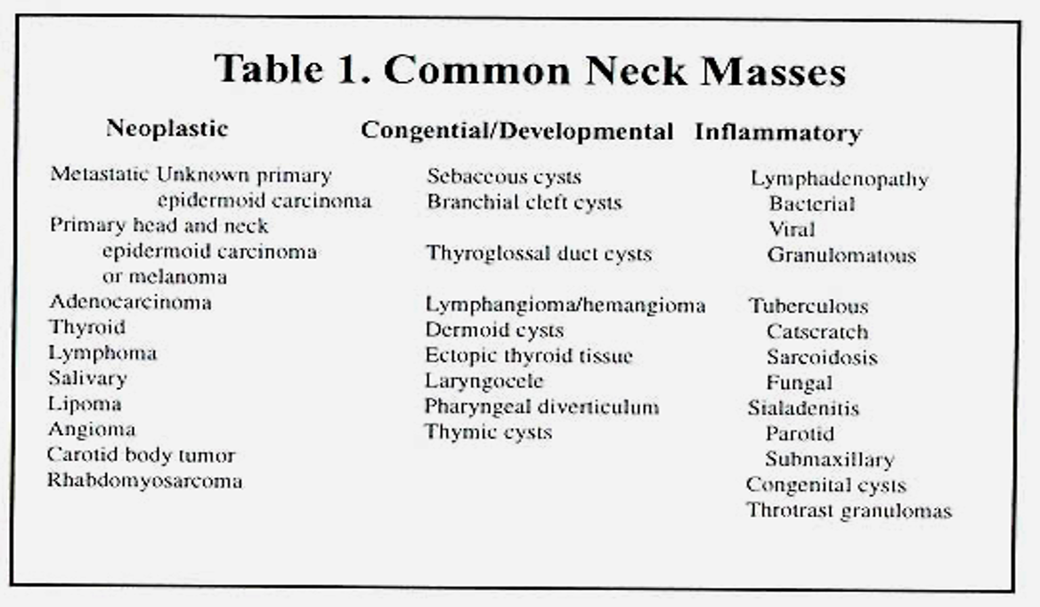
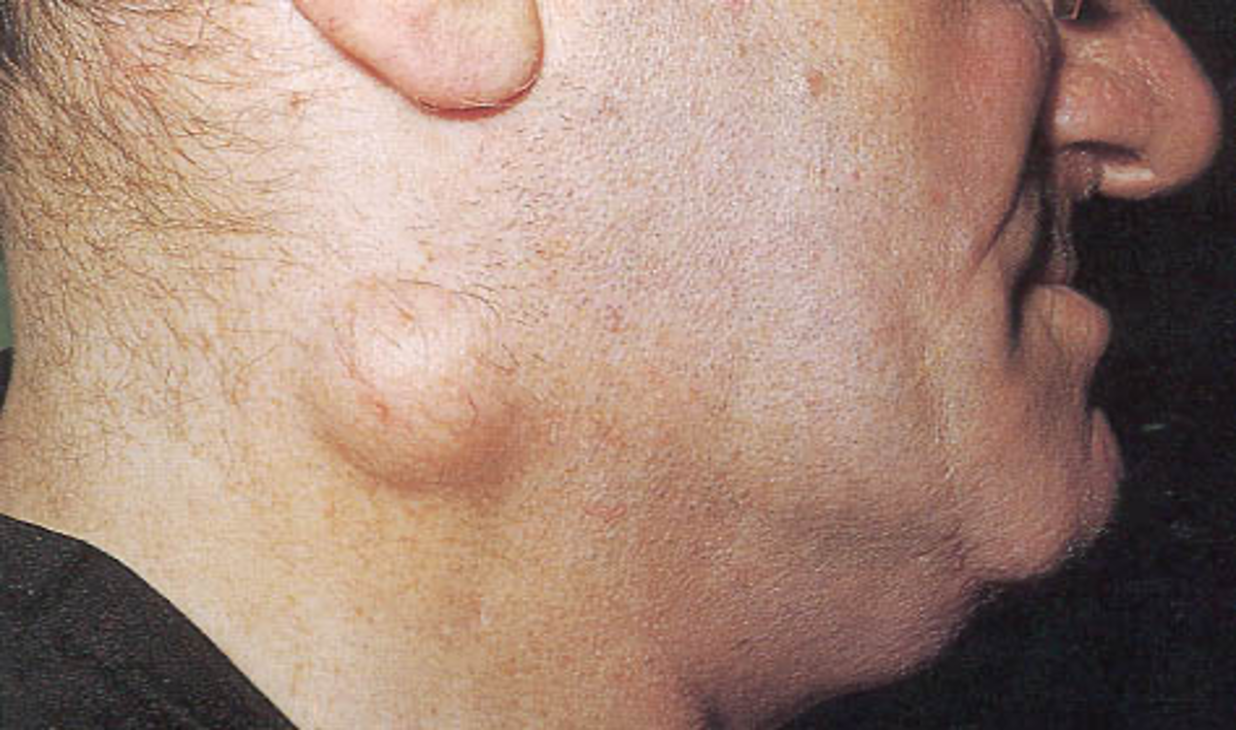
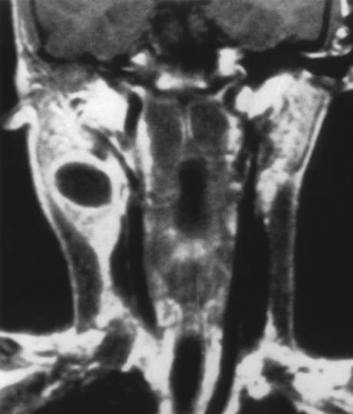
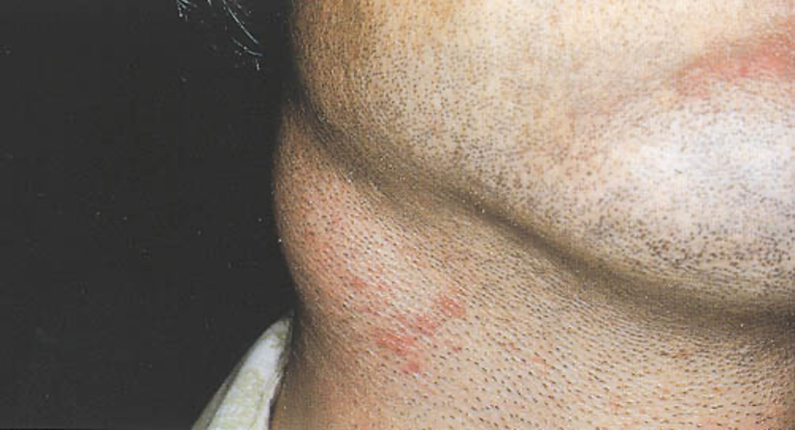
Differential Diagnosis:
Congenital and Developmental Mass
1. Epidermal and sebaceous cysts:
-Most common congenital/developmental mass
-Older age groups
-Clinical diagnosis:
Elevation and movement of overlying skin
-Skin dimple or drainage pore. Adjacent to the skin “once you touch the skin you find it there, usually soft non-tender unless inflamed.
-Rx: Excisional
-By history you can’t tell, so you need to do examination to limit your differentials by CT and then FNA
2. Branchial cleft cysts
-Branchial cleft anomalies
-Present in older children or young adults often following URI
-2nd cleft most common (95%) – tract medial to XII nerve between internal and external carotids(MCQ)
-1st cleft less common – close association with facial nerve possible
- 3rd and 4th clefts rarely reported
-Most common as smooth, fluctuant mass underlying
the SCM “Sternocleidomastoid”
-Skin erythema and tenderness if infected
-Treatment:
1- Initial control of infection
2-Surgical excision, including tract
3- May necessitate a total parotidectomy (1st cleft)
Pt with upper neck mass since birth, exacerbated by URTI, on examination you find a soft mass on level 2 upper lateral!!!, CT/MRI show cystic mass (this is typical for Branchial cleft cysts).

Slide 8
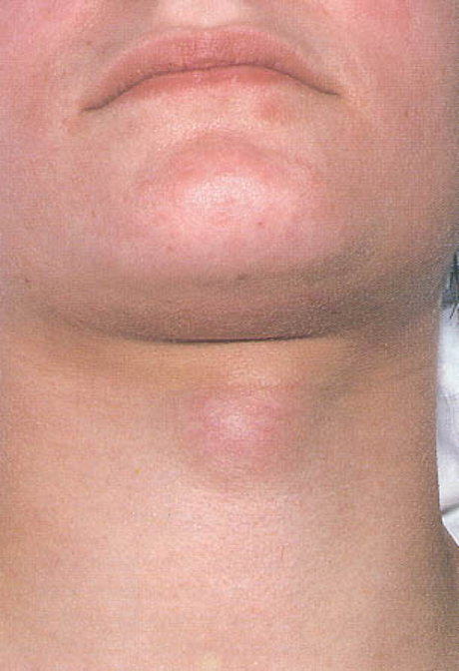
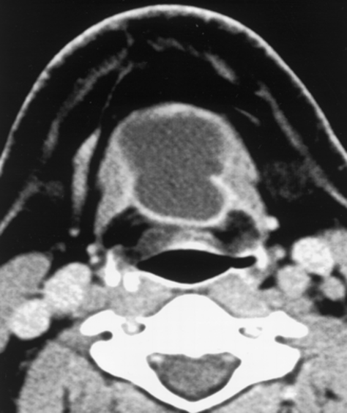
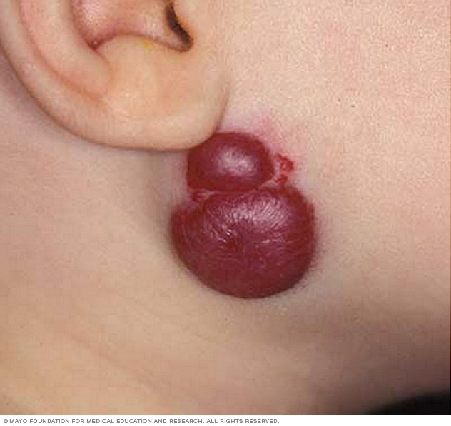
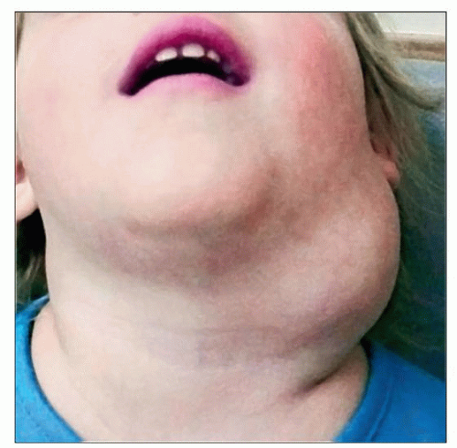
3. Thyroglossal duct cyst:
-Most common congenital neck mass (70%) any age after URTI
-50% present before age 20
-Medline (75%) or near midline (25%)
-Usually just inferior to hyoid bone (65%)
-Elevates on swallowing/protrusion of tongue
-Treatment is surgical removal (Sis trunk) after resolution of any infection
Pic shows: midline red (indicating inflammation) mass
Before you go for surgery, do US to have a good description of the mass. US will show cystic mass below the hyoid bone w/signs of inflammation -> CT w/contrast -> FNAB showed cyst -> surgery (sis trunk) remove the track with mid portion of hyoid bone.
If you only did excision, pt will come after 1 year with recurrence.
4. Vascular tumors
- Lymphangiomas and hemangiomas - Usually within 1st year of life
-CT/MRI may help define extent of disease
4A. Hemangiomas
-Often resolve spontaneously
-Surgical excision reserved for those with rapid growth involving vital structures or associated thrombocytopenia that fails medical therapy (steroids, interferon).
4B. Lymphangiomas
-Remain unchanged
-Surgical excision for easily accessible or lesions affecting vital functions; recurrence is common.
End of the first lecture

Slide 9
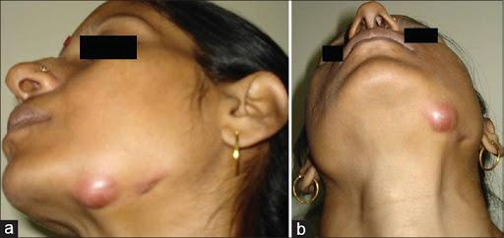
Extra from 436
Inflammatory Disorders:
1. Lymphadenitis:
Very common, especially within 1st decade
Tender node with signs of systemic infection
Directed antibiotic therapy with follow-up so we don’t go for imaging because history is obvious.
FNAB indications (pediatric)
- Actively infectious condition with no response
- Progressively enlarging
- Solitary and asymmetric nodal mass
- Supraclavicular mass (60% malignancy)
- Persistent nodal mass without active infection
- Equivocal or suspicious lymphoma FNAB in the pediatric nodal mass requires open excisional biopsy to rule out malignant or granulomatous disease
- Equivocal or suspicious FNAB in the pediatric nodal mass requires open excisional biopsy to rule out malignant or granulomatous disease
2. Granulomatous lymphadenitis:
Infection develops over weeks to months
Minimal systemic complaints or findings
Common etiologies
TB, atypical TB, cat-scratch fever, actinomycosis, sarcoidosis.
Firm, relatively fixed node with injection of skin. It mimics malignancy
Typical M. tuberculosis
- more common in adults
- Posterior triangle nodes
- Usually responds to anti-TB medications
- May require excisional biopsy for further workup
Atypical M. tuberculosis
- Pediatric age groups
- Anterior triangle nodes, won’t present with multiple lymph nodes in level 5, only present with submandibular mass.
- Brawny skin, induration and pain
- Usually responds to complete surgical excision or curettage
Cat-scratch fever (Bartonella)
- Pediatric group
- Preauricular and submandibular nodes
- Spontaneous resolution with or without antibiotics

Slide 10
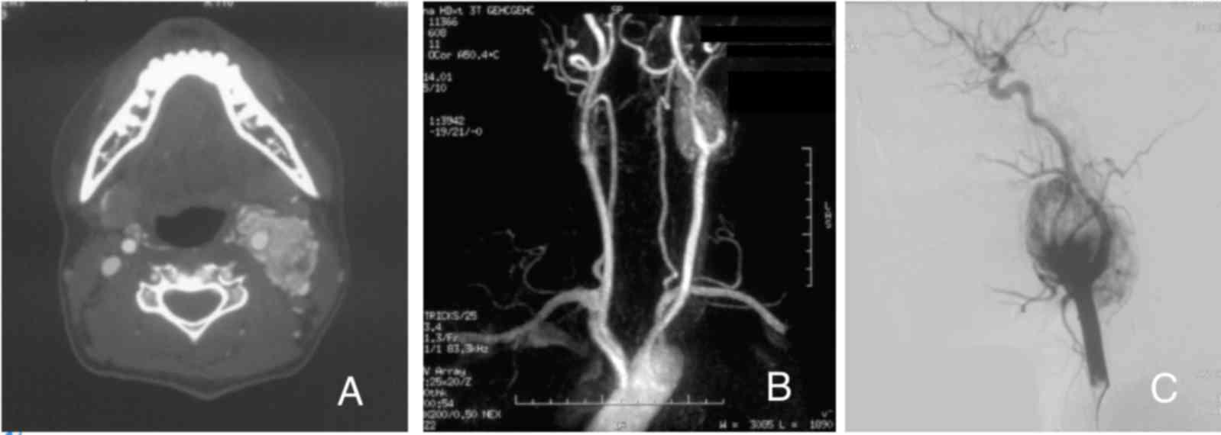
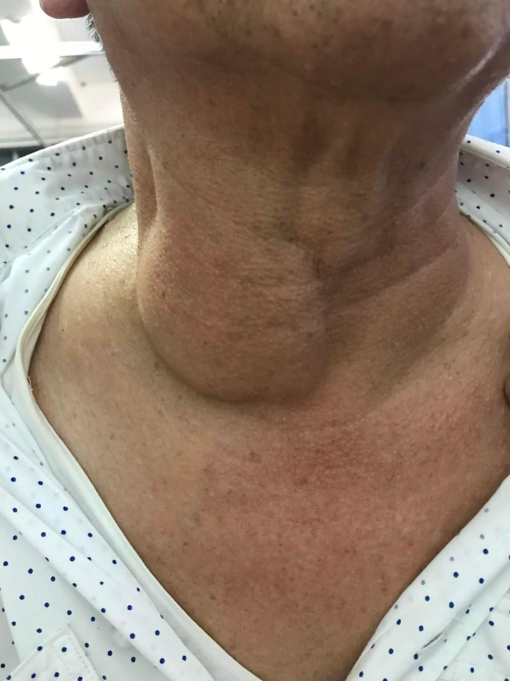
Extra from 435
❖Carotid body tumor:
● Rare Children.
● Pulsatile,compressiblemass.
● Mobile Medial Lateral And Superior Inferior.
● Clinical diagnosis confirmed by angiogram or CT.
● Treatment:
◆ Irradiation or close observation in the elderly.
◆ Surgical resection for small tumors in young patients:
➢ Hypotensive anesthesia (a type of anesthesia that reduces the mean arterial pressure (MAP) to 50 mmHg and thus reduces blood loss during the surgery).
➢ Preoperative measurement of catecholamines.
❖Lipoma:
➢ Soft, ill-defined mass, Usually >35 years of age.
➢ Asymptomatic.
➢ Clinical diagnosis
➢ Confirmed by excision.
❖ Neurogenic tumor:
➢ Arise from neural crest derivatives.
➢ Include schwannoma, neurofibroma, and malignant peripheral nerve sheath tumor. ➢ Increased incidence in NF syndromes.
➢ Schwannoma most common in head & neck.
❖ Schwannoma:
➢ Sporadic cases mostly.
➢ 25 to 45% in neck when extracranial.
➢ Most commonly between 20 and 50 years.
➢ Usually mid-neck in poststyloid compartment.
➢ Signs and symptoms (Depend on the site):
● Media Tonsillar Displacement.
● Hoarseness(vagus nerve).
● Horner’s syndrome (sympathetic chain).

Slide 11
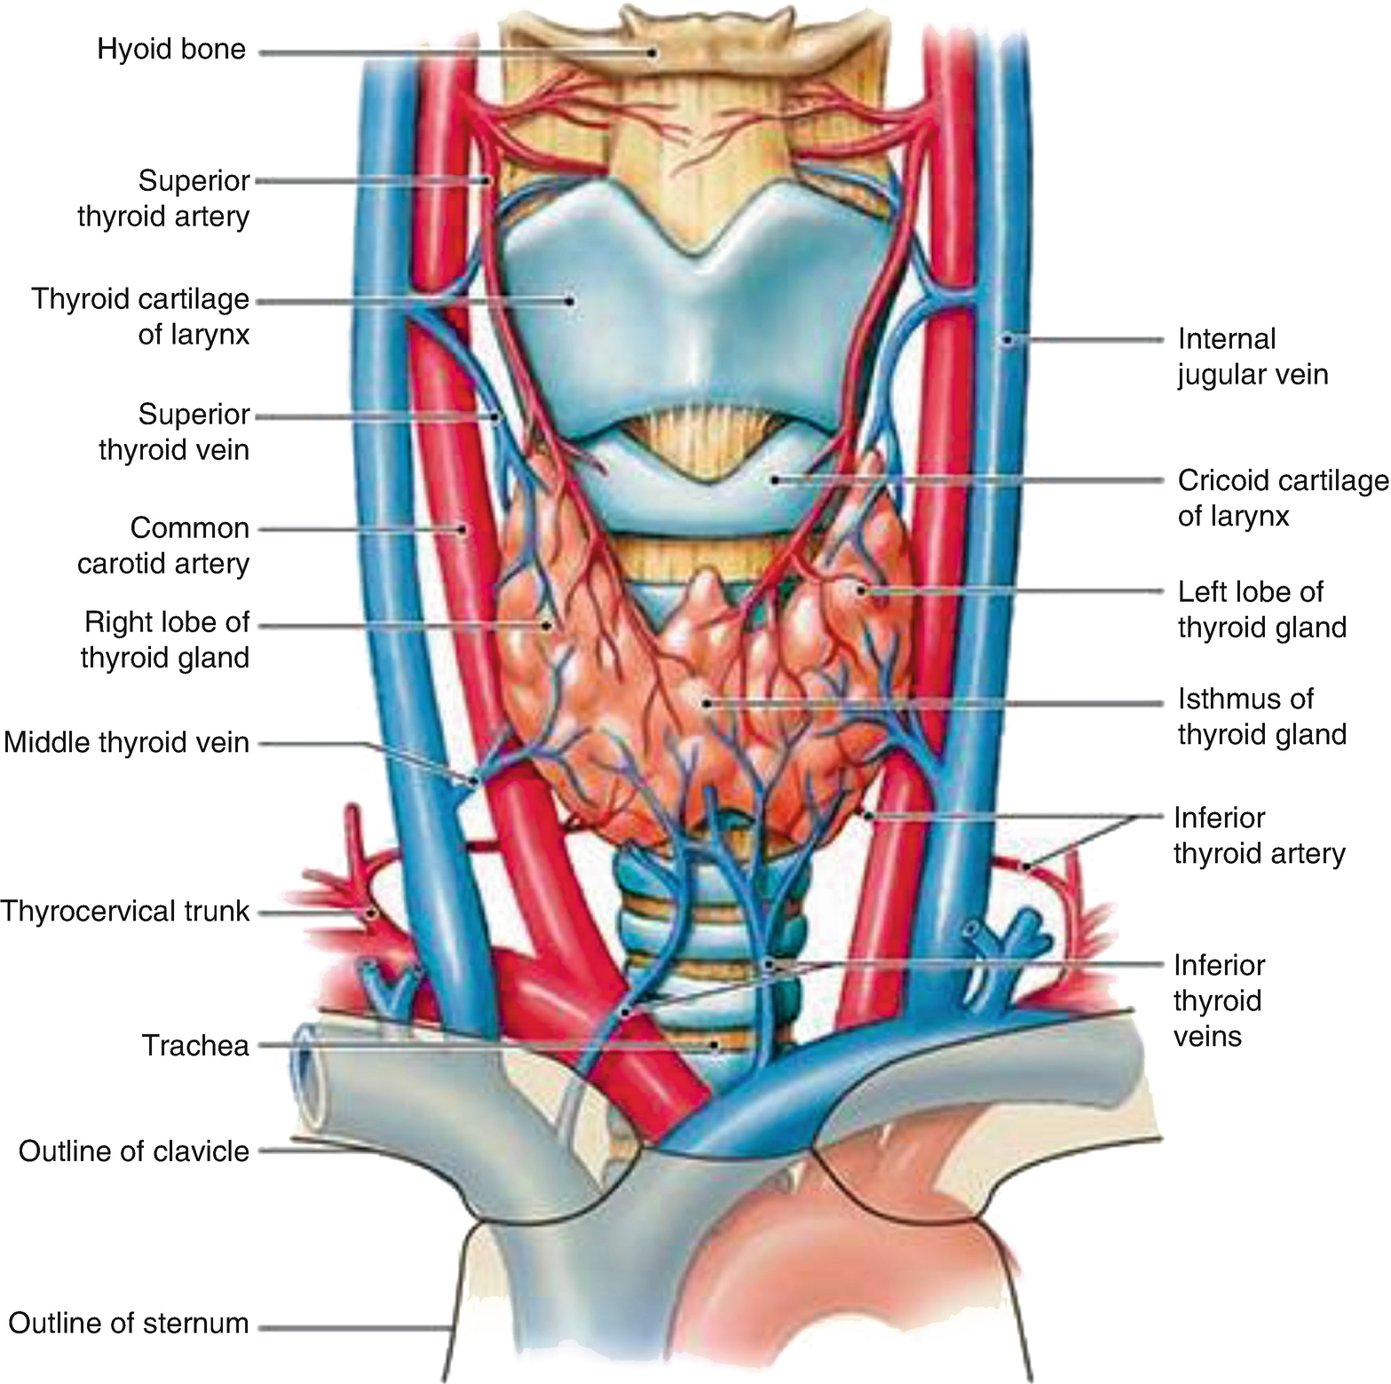
Head & Neck cancers
known primary
unknown primary
Mucosal
Non-Mucosal
-Oral
- Sinonasal
- Pharyngeal
-Laryngeal
-Endocrine
- Salivary
- Skin
Thyroid Gland:
Generally speaking:
- Shield shape, may be H or U shaped.
- 2 lateral lobes Connected by an isthmus
- Isthmus at level of 2nd to 4th tracheal cartilages (may be absent)
Lobes of thyroid:
• Each lobes measures approx 4cm high, 1.5cm wide, 2cm deep – Lobes have superior and inferior poles:
• Superior pole: may extend as far as the oblique line of the thyroid cartilage • Inferior pole: may extend inferiorly as far as the 5th or 6th tracheal rings
Arterial Blood Supply:
1- Superior thyroid artery (STA)
– 1st branch of ECA
– Followed by SLN until superior pole
– Anastomoses with contralateral STA
2- Inferior thyroid artery (ITA)
– From thyrocervical trunk (1st part of subclavian at 1st rib)
Venous Drainage:
• 3 pairs of veins
1-Superior thyroid vein
Parallels course of STA on ant surface thyroid Ascends to drain into internal jugular vein (IJV)
2– Middle thyroid vein
Direct lateral course from thyroid to IJV Shortest of 3 veins
3– Inferior thyroid vein
Ant surface thyroid (opposite of ITA)
Vertical downward course to brachiocephalic v.

Slide 12
Thyroid Nodule - Evaluation
Start with Hx ,P/E
Pre-operative Laryngoscopy:
-Assess RLN function / infiltration - Essential in revision cases (6.7% of patients with previous thyroid surgery had VC paralysis)
U/S:
– Often first modality, helps delineate architecture
– Accessible, inexpensive, safe
– Help locate nodule, assist with FNA
– Micro-calcifications and central blood flow
• Suggests CA
– Not useful for large masses
FNA:
– Gold standard
– Sensitivity→65% to 98%
– Specificity → 72% to 100%
Results:
– Benign → adenoma, goitre, thyroiditis “What are the indications for surgery in benign thyroid mass? 1-compressive symptoms.2- cosmetic. 3-hyperthyroidism uncontrolled by medications”
– Malignant → most common PTC
– Indeterminate → FTC and Hurthle most common
– Non-diagnostic → re-aspiration diagnostic in 50%
FNA Disadvantages
– Inability to distinguish benign microfollicular adenomas from differentiated FTC
– Inability to distinguish Hurthle cell lesion from adenoma or Hashimoto thyroiditis
Thyroid Function Tests
CT
– Useful for cervical lymphadenopathy
– Dye can interfere with function testing and radioactive treatment for up to 8 weeks
-There is a case when to use CT scan:
1-palpable lymph node
2-compression symptom 3- retrosternal mass.
MRI
– Used less commonly
Scintigraphy
– Hard to distinguish benign vs malignant nodule

Slide 13
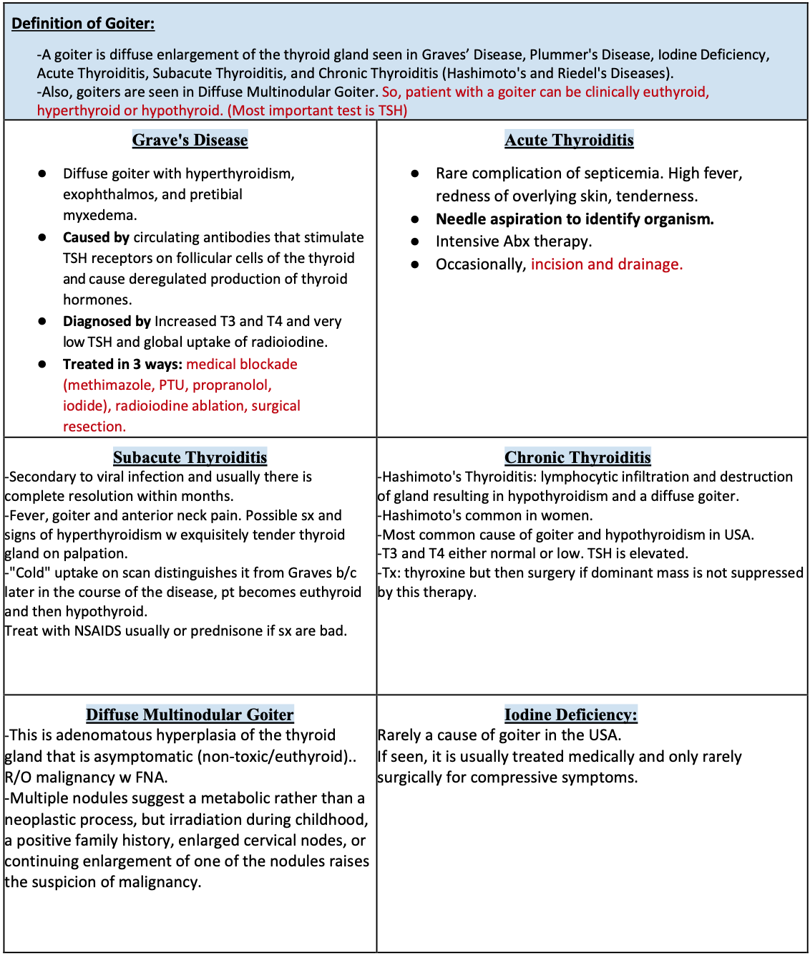
This page is extra! Thanks to 436

Slide 14
Thyroid Neoplasm:
General Info about Thyroid Cancers:
● Risk Factors suggesting Carcinoma: Hx of radiation therapy to neck, History of rapid development of nodule, vocal cord paralysis, and cervical adenopathy, hard fixed mass, elevated serum calcitonin.
● Risk Factors suggesting Malignancy: Hx of neck irradiation, young>old, cold nodule, solitary>multiple nodules.
● Signs and Sx: Mass/nodule, lymphadenopathy, most are euthyroid and usually asymptomatic masses in low midline ant. Neck.
● Workup: FNA and U/S, thyroid function test if there are symptoms or signs of hypo-or-hyperthyroidism.
● After thyroidectomy, you MUST follow Ca levels post-op (even give them supplemental Ca for a while to be on safe side): can be decreased 2ndary to parathyroid damage.
1. Well Differentiated (85%)
A–Papillary Thyroid Carcinoma (PTC):
the most common type
● Constitutes 80% of thyroid carcinomas.
● Spreads lymphatically and slowly.
● 10 yr. survival rate is 95%. Good 131 I uptake.
● Lymph node involvement in 30%
● Distant mets least common
o 1 - 25% during illness or 1 - 7% at Dx
● Predisposing Factors o Ionizing radiation o 5-10% of pts have +ve FamilyHx
● Clinical presentation o Young females,palpable mass in thyroid or cervical LN ( 1/3rd have lymphadenopathy) Treatment:
➔ Hemithyroidectomy (usually not enough).
➔ Or Total Thyroidectomy most appropriate.
● Post-Op need to give thyroid hormone replacement.
● Post-Op 131 I scan can diagnose and treat!
● Can be metastasized.
B–Follicular Thyroid Carcinoma (FTC)
● 13% of thyroid cancers.
● Hematogenous spread (commonly to bone).
● More aggressive, well differentiated compared to PTC.
● Good 131 I uptake.
● 10 yr. survival is 90%.
● Dx cannot be made with FNA!!!
● Tissue structure (capsule) needed for diagnosis.
● Malignancy if there is capsular or blood vessel invasion.
● Tx same as in papillary cancer.

Slide 15
C–Hurthle Cell Carcinoma (HCC):
Subtype of FTC (15% of FTC’s)
Like FTC, cannot exclude carcinoma vs adenoma based of FNA or frozen
Clinical Presentation – Thyroid nodule or mass – 35 % will have distant mets during illness – Higher rate of nodal mets than FTC Surgical options:
Total thyroidectomy (>1.5cm)
Thyroid lobectomy (<1.5cm)
+/- Neck dissection Adjuvant Therapy:
Post-op I-131
External beam RT
– Tumors that do not pick up I-131
– Advanced disease (mets, residual disease)
2. Poor differentiated malignant neoplasms:
- Medullary thyroid carcinoma (MTC):
● Sporadic (80%) o More Aggressive Type o Late presentation (age 40 – 60) o Early Mets To Regional Lymph Nodes(50%)
● Familial (20%) o MEN IIA, MEN IIB, Non-endocrinopathic o Mutation in RET-proto oncogene o Autosomal Dominant o Early presentation (birth – 20’s) ● Treatment
o Total thyroidectomy with bilateral SLND
o Prophylactic surgery for relatives with RET
mutation (preferably before age 7) o No adjuvant therapy advocated
o Radiotherapy and chemotherapy for
palliation (usually ineffective)
- Anaplastic thyroid carcinoma (ATC):
● Undifferentiated carcinoma arising in 75% of previously differentiated thyroid cancers.
● 1-2% of all thyroid cancers.
● FNA helps diagnose.
● Major DDx includes lymphoma (much better prognosis).
● Highly aggressive and fatal
● Median survival 3 - 6 months
● Distant mets common (lung)
● Grossly, large and bulky tumors
● Invade into surrounding tissue
● Rapid expansion
● Treat small tumors: Total Thyroidectomy
(possibly w external beam radiation).
● If there is airway obstruction, then do a debulking surgery and tracheostomy.
● Dismal prognosis. Most pt have stage IV (distant mets) at presentation.

Slide 16
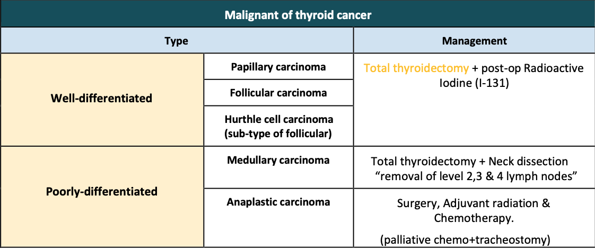
3. Other malignant tumors:
- Lymphoma:
• More common in children and young adults
• Up to 80% of children with Hodgkin’s have a neck mass
• Signs and symptoms
- Lateral neck mass only (discrete, rubbery, nontender), not impro w antibiotics
- Fever
- Hepatosplenomegaly
- Diffuse adenopathy
• Investigations:
• 1. CT head and neck with contrast “showed multiple lymph node, 3—4 cm, homogeneous, WHAT’S next? FNAB. DON’T FORGET THAT!!! MCQs
• 2. FNAB – first line diagnostic test .
• 3. If suggestive of lymphoma – open biopsy. ONLY DONE If: we don’t know the diagnosis or FNAB showed lymphoma.
• Full workup – CT scans of chest, abdomen, head and neck; bone marrow biopsy
- Metastatic tumors
● Be aware that the immediate removal of enlarged lymph node for diagnostic purposes is NOT GOOD for pt w metastatic cervical carcinoma. Disruption of lymphatic drainage and manipulation of the mets decrease chance for clean excision and cure.
● Enlarged nodes high in neck or in posterior triangle suggest nasopharyngeal lesion.
● Enlarged jugulodigastric nodes suggest tonsils, base of tongue or supraglottic larynx.
● If nodes are in supraclavicular area or lower 1/3 or neck then consider the whole digestive tract, lungs, breast, GU tract, and thyroid gland.
● Mets spread from chest or abdomen via thoracic duct (left side mets more common than right).
Complications of thyroidectomy: ➢ Recurrent laryngeal nerve injury:
○ Unilateral: hoarseness.
○ Bilateral: airway obstruction (stridor). ➢ Hematoma: it may cause airway obstruction. ➢ Hypothyroidism or/and hypoparathyroidism( (hypocalcemia)
In summary, treatment of malignant thyroid lesions is as follows : Important
Lymphoma > Chemotherapy

Slide 17
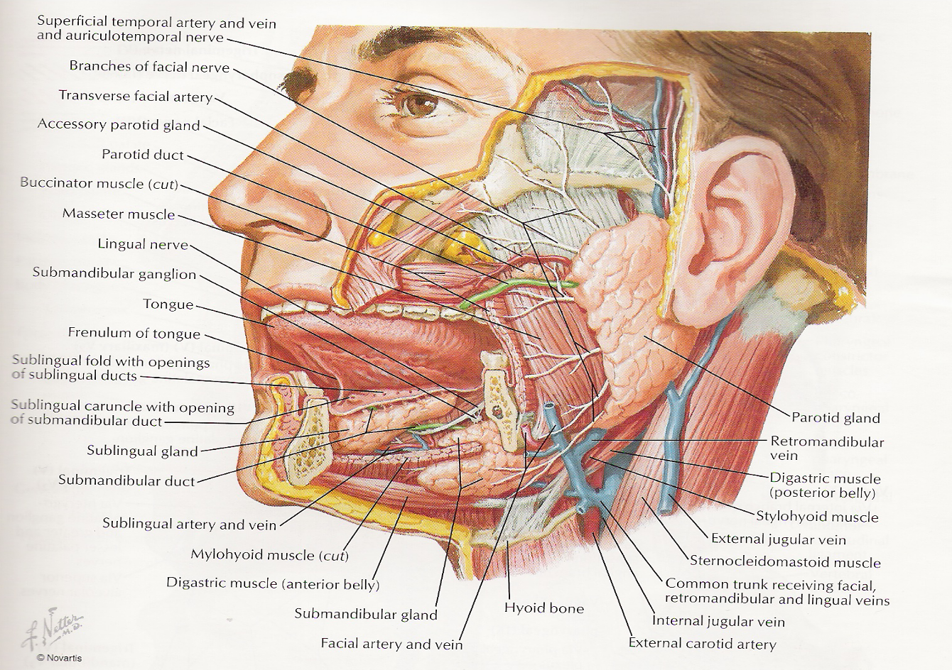
Salivary Glands:
•6 major salivary glands: 2 parotid, 2 submandibular, 2 sublingual.
•100’s of minor salivary glands lining the upper aerodigestive tract
•Main job…. Saliva!!!!
It is important to know each gland: location, nerve supply and relation, so you can remember the surgical comp. and related S/S
Parotids:
The most common gland get infected
Nerve injured during surgery ? Marginal mandibular nerve
• Serous cells only
• On side of the face, deep to skin, subcutaneous tissue, superficial to the masseter.
Stensen’s duct begins at anterior border of the gland 1.5cm below the zygoma.
• Traverses the masseter 5-6 cm, pierces the buccinator.
• Opens in mouth lateral to 2nd upper molar.
• Tail of parotid extends superficial to SCM.
Submandibular gland:
Nerve injured during surgery?
Marginal mandibular nerve( most common )
Lingual nerve
Hypoglossal
• Mucous and serous cells.
• Submandibular triangle: anterior and posterior bellies of digastric and inferior margin of the mandible.
• Medial and inferior to the mandible. Wharton’s duct
• Exits the gland from the medial surface travels b/w the hyoglossus and mylohyoid muscles enters the genioglossus muscle and opens into mouth just lateral to lingual frenulum.
• CN XII inferior to the duct and lingual nerve is superior to the duct.
Sublingual glands:
• Mucous secreting.
• Just below the floor of mouth mucosa.
• Bordered by genioglossus/hyoglossus medially, mandible laterally, and mylohyoid inferiorly.
• Wharton’s duct and lingual n. travel b/w SL
gland and genioglossus muscle.
• No facial capsule.
Ducts of Rivinus (~10) along the superior aspect of the gland open into the mouth along sublingual fold in the floor of mouth.
• Innervated by the PNS/SNS systems in the same way as the SM gland.

Slide 18
Minor salivary glands:
• Either mucous serious or both • 600-1000 /person
• Each gland has its own duct
• Found most commonly in buccal, labial, palatal, and lingual regions
Role of saliva:
Lubricates
Moistens, help with mastication
Cools hot food
Buffers chemicals
Cleans the mouth (lavage)
Protects mucosa
Prevent dental caries
Antibacterial (lysozyme, IgA, peroxidase)
Homeostasis
Salivary flow rates • ~1000-1500 ml/24 hrs, or 1 ml/min. • Unstimulated 69% of flow from SM gland, 26% parotid, 5% SL. • Stimulated parotid and SM. • Minor glands independent of stimulation usually account for 7-8% total flow.

Slide 19
Infections of the Salivary Glands:
Acute Suppurative Sialoadentitis:
“Surgical parotitis”, “Surgical mumps” > Other names
Retrograde migration of bacteria from the oral cavity
Parotid gland most frequently involved
– Inferior bacteriostatic properties
Symptoms of Acute infections:
•Rapid onset of pain, swelling, induration
•Fever, chills, malaise
•Increased WBC count
•Suppurative discharge from the gland
•S. aureus
Pathogenesis of Acute infections:
Stasis permits retrograde flow
Compromised host resistance
Poor oral hygiene (increase oral bacteria)
Chronic disease or prolonged recovery
DEHYDRATION
Anticholinergics or diuretics
Anorexia reduces salivation
25% bilateral
Treatment::
Antibiotics
Steroids
Analgesics
Local heat application
Increased fluid intake
Surgical treatment if no improvement within 48h
CT or US to rule out abscess
Sialogram C/I in acute phase
Viral Infections – Mumps:
• Most common nonsuppurative infection
• Children
• Parotid (occ. SMG)
• Bilateral, generalized swelling
• Paramyxovirus
– Highly contagious
– Airborne droplet spread
– Incubation 18 days
– Virus spread for 1 week following swelling
• Treatment – Hydration – Rest
– Modify diet to decrease gland stimulation
Acquired Immunodeficiency Syndrome:
• HIV
• Lymphoproliferative and cystic enlargement of the major salivary glands
• High suppressor T-cells and lymphocytosis
• Can be initial presentation
• Parotid (15- 30% bilateral) with lymphocytic interstitial pneumonitis
• HIV in saliva

Slide 20
Chronic Sialoadenitis:
Repeated episodes of pain and inflammation
Parenchymal degeneration and fibrous replacement of the gland
Initial severe acute infection
Duct obstruction
Depressed glandular secretion
Parotid
More infections = more damage to gland and duct
Pathophysiology and Treatment of chronic sialoadenitis:
Obstruction of salivary flow • No consistent Tx
Intraductal calculus • Tympanic neurectomy
Stricture • Duct ligation
Mucous plug • Gland excision
Ductal papilla lesion
Extrinsic compression
Sialolithiasis: Stone in salivary glands
Formation of hardened intraluminal deposits in the ductal system
Common with chronic sialoadenitis
Causes:
– Stagnation of saliva
– Focus for formation from duct injury
– Biologic factors (Calcium salts)
Location:
80% Wharthon’s duct “of submandibular gland”
19% Stenson’s
1% sublingual
Why Wharthon’s?
– Alkaline and viscous saliva
– Increased Ca and Phos
– Angulation of the duct at Mylohyoid
– Vertical orientation at the distal segment
Symptoms and Management:
Colicky postprandial pain “diagnostic”
Swelling
Plain films
Sialography
CT “to evaluate size and site of the stone”
If the stone is small we treat it medically and we observe
( drink a lot of water), if large we treat it surgically.
Like sialoadenitis
Avoid vigorous probing
Incise duct orifice
Stenting
Surgical excision

Slide 21
Salivary Gland Neoplasms:
•Diverse histopathology
–Determines Aggressiveness
•Relatively uncommon
–2% of head and neck neoplasms
•Distribution
–95% in adults
–Parotid: 80% overall; 80% benign
–Submandibular: 15% overall; 50% benign
–Sublingual/Minor: 5% overall; 40% benign
➢ Most common is carcinoma!
Benign tumors are a mobile and non-tender and Asymptomatic except for the mass.
While malignant tumors are Rapid growth, skin fixation, cranial nerve palsies, painful and fixed.
● Benign salivary gland management is surgery and post op radiotherapy. Why? because there is 9-10% probability of becoming malignant.
● Malignant tumors may involve lymph nodes (evidence of local metastasis) and/or facial paresis/paralysis. (fast growing tumor and pressure symptoms depends on the site).
Diagnostic tests:
➔ Open excisional biopsy (submandibulectomy or parotidectomy) preferred. ➔ CT/MRI – deep lobe tumors, intra vs. extra-parotid.
➔ FNAB:
▪ Shown to reduce surgery by 1/3 in some studies.
❏ Delineates intraglandular lymph node, localized sialadenitis or benign lymphoepithelial cysts.
❏ May facilitate surgical planning and patient counseling.
❏ Accuracy >90% (sensitivity: ~90%; specificity: ~80%).
● Treatment is generally via adequate surgical resection with neck dissection for node-positive
necks and radiation. Be prepared for total parotidectomy with possible facial nerve sacrifice.
Most Common Parotid Tumours:
Benign:
Pleomorphic adenoma
Warthin tumour
Malignant:
Mucoepidermoid carcinoma MEC
Adenoid Cystic Carcinoma

Slide 22
Parotid:
Role of the size: When the size of the tumor is big the probability of it being benign increase. Keep in mind any parotid mass should be removed because there is risk of malignancy, when to remove a benign tumor? For cosmetic– FNA is not accurate – risk of malignancy transformation
Malignancy :
CT , FNA
Surgery . Comp? Facial nerve
Radiotherapy
1-➔ Most common malignant tumor is mucoepidermoid carcinoma:
Most common salivary gland malignancy
5-9% of salivary neoplasms
Parotid 45-70% of cases
Palate 18%
3rd-8th decades, peak in 5th decade
F>M
Presentation:
Low-grade: slow growing, painless mass
High-grade: rapidly enlarging, +/- pain
Minor salivary glands: may be mistaken for benign or inflammatory process
2-➔Adenoid Cystic Carcinoma:
Overall, 2nd most common salivary gland malignancy
2nd most common of parotid
Most common in submandibular, sublingual and minor salivary glands
M=F (5th decade)
Presentation:
– Asymptomatic enlarging mass
– Pain, paresthesias, facial weakness/paralysis Histology: i) cribriform pattern ▪ Most common ▪ “swiss cheese” appearance ii) tubular pattern ▪ Layered cells forming duct-like structures ▪ Basophilic mucinous substance iii) solid pattern ▪ Solid nests of cells without cystic or tubular spaces.
3-Warthin's tumor “this tumor is imp and it's the most common benign tumor”
Papillary Cystadenoma Lymphomatosum
6-10% of parotid neoplasms
Older, males
10% bilateral; 20% multicentric
3% with associated neoplasms
Presentation: slow-growing, painless mass in parotid tail
RX:Surgery
Stinson duct (Parotid duct) it emerges from the gland and runs forward along the side of the masseter muscles open in the 2 upper molar Saliva of parotid is serous (its bacteriostatic factors is weak).so it is more prone to infection most common by staph. Aureus give AB. if I asked you which one of the following glands has great risk for infection?
Treatment:
– Influenced by site, stage, grade
– Low-grade tumors: complete resection by parotidectomy
– High-grade: parotidectomy, neck dissection (N0 neck) & Radiotherapy
Treatment
▪ Complete local excision
▪ Tendency for perineural invasion: facial nerve sacrifice
▪ Postoperative Neutron Beam XRT

Slide 23
Submandibular glands:
➔ Involved in 10% of salivary gland tumors. ➔ 60% are benign, 40% are malignant.
➔ Most common benign is pleomorphic adenoma:
Most common of all salivary gland neoplasms
70% of parotid tumors
50% of submandibular tumors
45% of minor salivary gland tumors
6% of sublingual tumors
4th-6th decades (F:M = 3-4:1)
Treatment: complete surgical excision
Parotidectomy with facial nerve preservation
Submandibular gland excision
Wide local excision of minor salivary gland
Avoid enucleation and tumor spill
20-45% recurrence
• Can metastasize and yet remain benign histologically
Most common malignancy in submandibular, sublingual and minor salivary glands is the Adenoid Cystic Carcinoma (Mucoepidermoid Carcinoma is 2nd).
• Submandibular gland related nerves: Hypoglossal nerve, Mandibular nerve and Lingual nerve FOR taste sensation. If I asked you in the exam which one of these nerves is most commonly injured? mandibular
The most important muscle related to submandibular gland is mylohyoid muscle.
It’s the most gland prone to stones
Sublingual gland:
➔ Rarely involved.
➔ 60-70 % is malignant.
➔ Most common benign is pleomorphic adenoma.
Minor salivary glands:
➔ 90% is malignant.
➔ Commonly involve the palatal region.
Parathyroid Masses:
General Points about Parathyroid Glands:
➢ After parathyroidectomy, watch out for recurrent nerve injury, neck hematoma and hypocalcemia.
➢ "Hungry Bone Syndrome" is severe hypocalcemia after surgery correction of hyperparathyroidism as bone aggressively absorbs Ca.
➢ Sx of this syndrome: perioral tingling, paresthesias, positive Chvostek's sign, carpopedal syndrome.
Primary Hyperparathyroidism: Adenoma
Primary hyperparathyroidism is usually due to an adenoma (85%) which is NOT usually palpable.
➢ Labs show elevated PTH and hypercalcemia. Check urine to R/O Familial Hypocalciuric Hypercalcemia.
Primary Hyperparathyroidism: Hyperplasia
➢ All 4 glands affected. Seen in MEN type I and IIa (must R/O MEN if pt has hyperplasia).
➢ Do a neck exploration and remove all of the parathyroid glands (leave 30 mg of parathyroid tissue behind placed in non- dominant forearm).

Slide 24
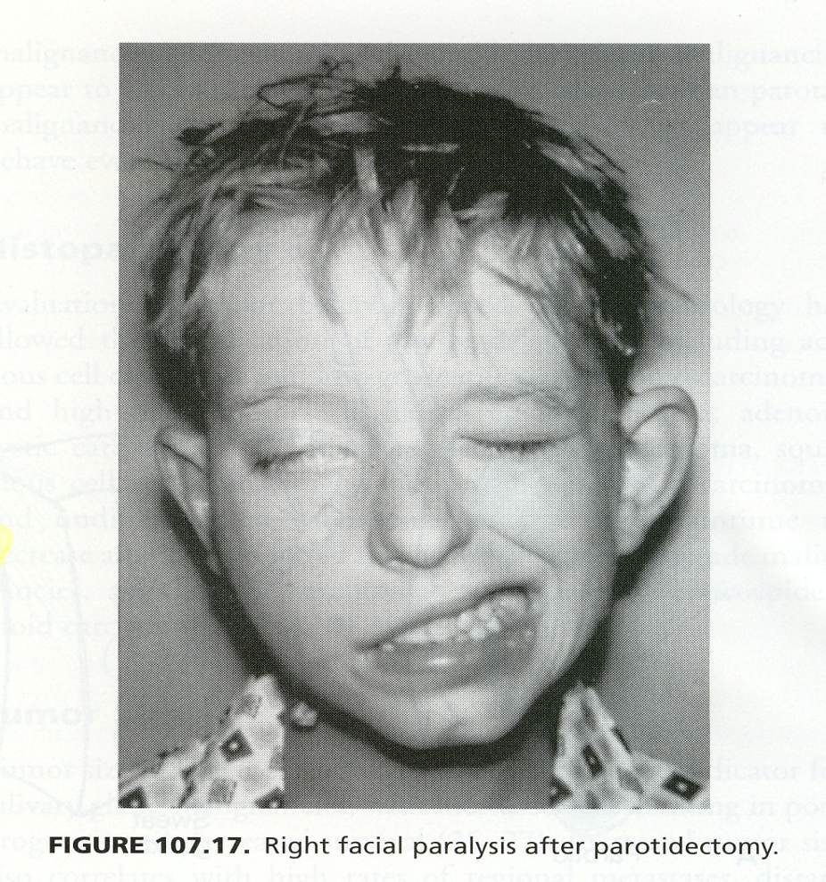
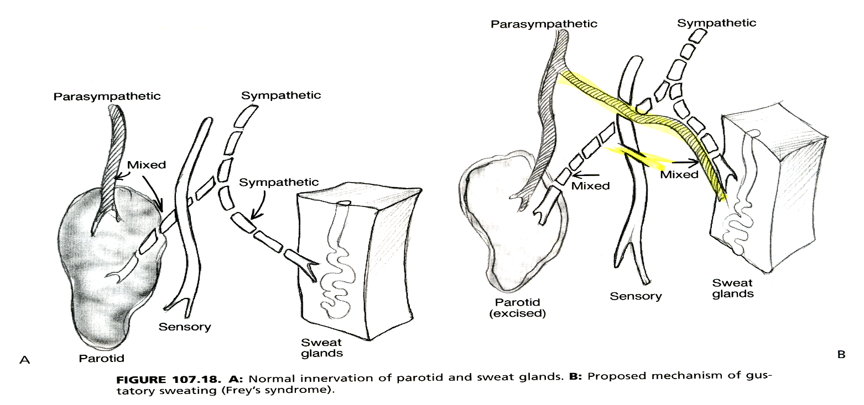
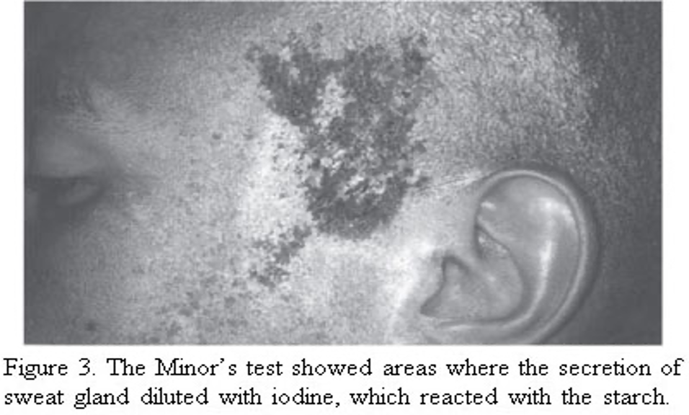
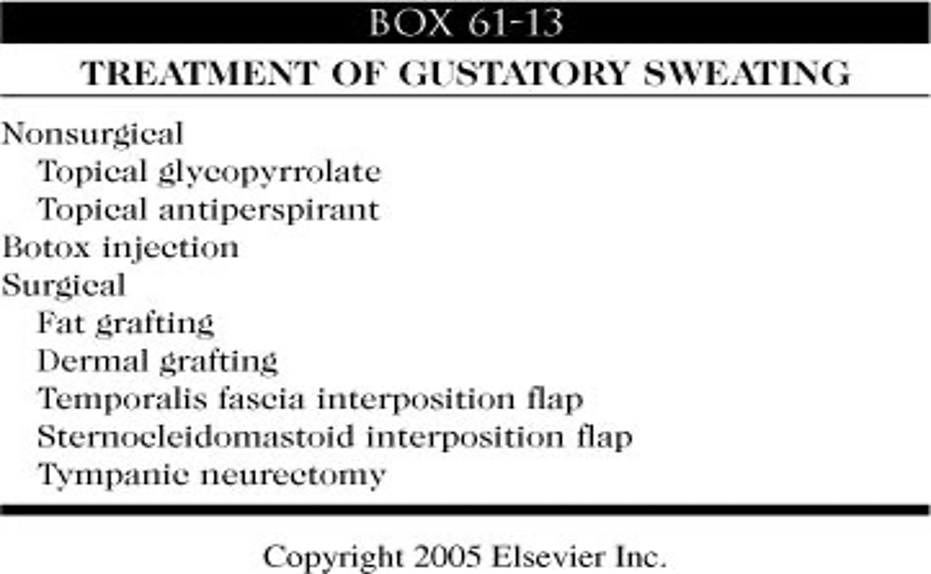
Facial nerve injury.
Frey’s syndrome (Gustatorysweating):
– Aberrant reinnervation of postganglionic parasympathetic nerves to the sweat glands of the face
– 10% of patients overtly symptomatic
– Diagnosis: Minor’s starch iodine test
Complications:
End of the second lecture!

Slide 25
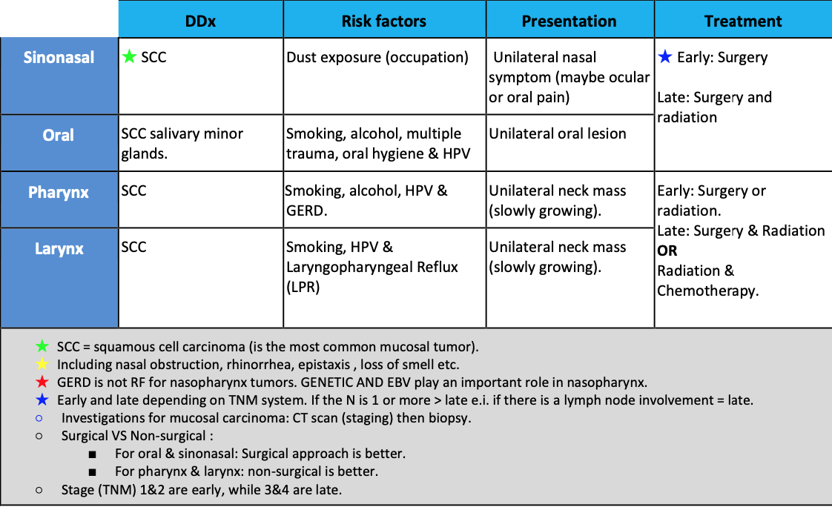
Head & Neck Mucosal Tumors
Important
check doctor cases last 2 slides
Neoplasms of the nose and paranasal sinus:
Very rare 3%. Delay in diagnosis due to similarity to benign conditions.
● Nasal cavity: 1⁄2 benign | 1⁄2 malignant. ● Paranasal Sinuses: Malignant.
● Multimodality treatment, Orbital Preservation and Minimally invasive surgical techniques.
Epidemiology: Predominately of older males | Exposure: Wood, nickel-refining processes, Industrial fumes, leather tanning. | Cigarette and Alcohol consumption (No significant association has been shown). Location: Maxillary sinus 70% | Ethmoid sinus 20% | Sphenoid 3% | Frontal1%.
Presentation:
- Oral symptoms: 25-35% | Pain, trismus, alveolar ridge fullness, erosion - Nasal findings: 50% | Obstruction, epistaxis, rhinorrhea.
- Ocular findings: 25% | Epiphora, diplopia, proptosis.
- Facial signs: Paresthesias, asymmetry.
1. Squamous cell carcinoma: Most common tumor (80%) | 90% have local invasion by presentation. ➢ Location: Maxillary sinus (70%) | Nasal cavity (20%).
➢ Lymphatic drainage: First echelon: retropharyngeal nodes.Second echelon: subdigastric nodes.
➢ Treatment: 88% present in advanced stages (T3/T4). Surgical resection with postoperative
radiation.
➢ Staging of Maxillary Sinus Tumors:
➔ T1: limited to antral mucosa without bony erosion.
➔ T2: erosion or destruction of the infrastructure, including the hard palate and/or middle meatus.
➔ T3: Tumor invades: skin of cheek, posterior wall of sinus, inferior or medial wall of orbit, anterior ethmoid sinus.
➔ T4: tumor invades orbital contents and/or cribriform plate, posterior ethmoids or sphenoid nasopharynx, soft palate, pterygopalatine or infratemporal fossa or base of skull.
2. Olfactory Neuroblastoma (Esthesioneuroblastoma): Originate from stem cells of neural crest origin that differentiate into olfactory sensory cells.
➢ Aggressive behavior. | Local failure: 50-75%. |Metastatic disease develops in 20-30%.
➢ Treatment: En bloc surgical resection with postoperative XRT.
➢ Kadish Classification: A: confined to nasal cavity. | B: involving the paranasal cavity. | C: extending beyond these limits.

Slide 26
Benign lesion of the nose and paranasal:
1. Papilloma:Three Types:
A: Fungiform: 50% nasal septum.
B: Cylindrical: 3% lateral wall/sinuses.
C: Inverted: 47% lateral wall.
❖ Inverted Papilloma: 4% of sinonasal tumors. | Site of Origin: lateral nasal wall.| Unilateral.|
Malignant degeneration in 2-13% (avg. 10%).
➢ Inverted Papilloma Resection: Initially via transnasal resection> 50-80% recurrence. | Medial Maxillectomy via lateral rhinotomy:(Gold standard)> 10-20%. Endoscopic medial maxillectomy: Key concepts: Identify the origin of the papilloma and Bony removal of this region. 37
2. Osteomas: Benign slow growing tumors of mature bone.
➢ Location: Frontal, ethmoid, maxillary sinuses.
➢ When obstructing mucosal flow can lead to mucocele formation.
➢ Treatment is local excision.
3. Fibrous dysplasia: Dysplastic transformation of normal bone with
collagen, fibroblasts, and osteoid material. (Fibrous tissue develops in place of normal bone. This can weaken the affected bone and cause it to deform or fracture).
■ Monostotic vs Polyostotic (single bone vs multiple bones).
■ Surgical excision for obstructing lesions
■ Malignant transformation to rhabdomyosarcoma has been seen with radiation.
Oral cavity cancer:
Epidemiology: 95% are squamous cell carcinoma. | 75% of cases occur on 10% of mucosal surface area.
➢ Risk factors: Smoking (depends on dosage and type). |Alcohol.|Snuff dipping /tobacco chewing.|HPV (subtype 16).|Reverse cigar smoking (India).|Betel-nut chewing (Asia).|Poor dentition / mechanical irritation (dentures). ➢ Incidence 4% cancers in males, 2% in females (increasing in females).
Evaluation and Diagnosis: Lesions generally easy to see | Simple biopsy under local anesthesia.
➢ Important goals: Stage full extent of disease | Rule out synchronous primary | Evaluate for possible metastatic disease.
➢ CT or MRI for T2 or greater. | Staging endoscopy.
AJCC TNM Staging: Primary Tumor (T):
○ Tx: unassessable.
○ T1: tumor 2 cm or less in greatest diameter. ○ T2: tumor 2-4 cm.
○ T3: tumor > 4 cm.
○ T4: tumor invades adjacent structures (Cortical bone, deep tongue musculature, maxillary sinus,
skin).
Differential Diagnosis: Minor salivary gland neoplasm (Adenoid cystic, mucoepidermoid, adeno-ca). Sarcomas (rhabdo, lipo, MFH, leiomyo) |Hodgkin and NH lymphoma|Malignant melanoma |Hairy leukoplakia,Kaposi sarcoma (HIV, immunocompromised).
Premalignant Lesions:
1. Leukoplakia: Hyperkeratosis, dysplasia. |Malignant transformation greater in non-smokers. ➔ Treatment: Surgical or laser excision | Topical bleomycin, retinoids.
2. Erythroplasia: Greater risk of malignancy!
Prognostic Factors: Poor prognostic tumor factors include:
➔ Tumor thickness (3mm FOM, 5mm tongue). | Stage. | Perineural invasion. | Lymphatic invasion. | Vascular invasion. | Neck/distant mets. | DNA ploidy. | Pathology.
Treatment and post-treatment follow-up: SURGERY!
★ Primary: Resection with adequate margins; frozen section as needed | Tracheostomy as needed |Feeding tube (optional) | Surgical orientation of specimen for pathologist.
★ Neck: Modified/radical dissection for unilateral metastatic disease and bilateral dissections for metastases in both necks | Suction drainage.
★ Perioperative care: Antibiotics | Hospitalization for 3–10 days | Tube feedings | Suction drainage for necks(s)—remove when output <25–30 mL/24-h period | Suture removal 5–10 days postoperatively.

Slide 27
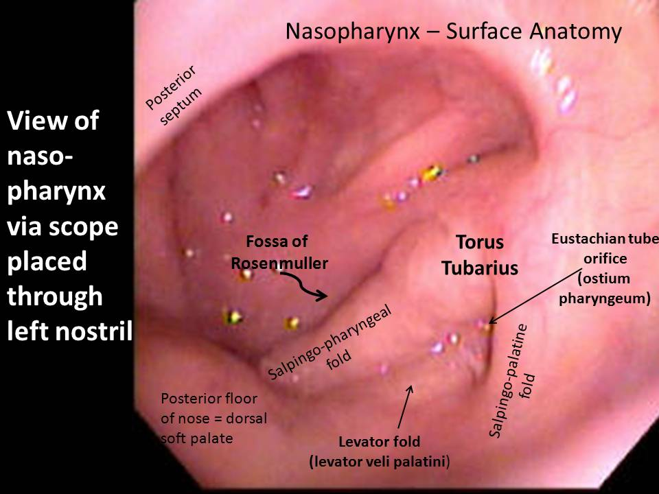
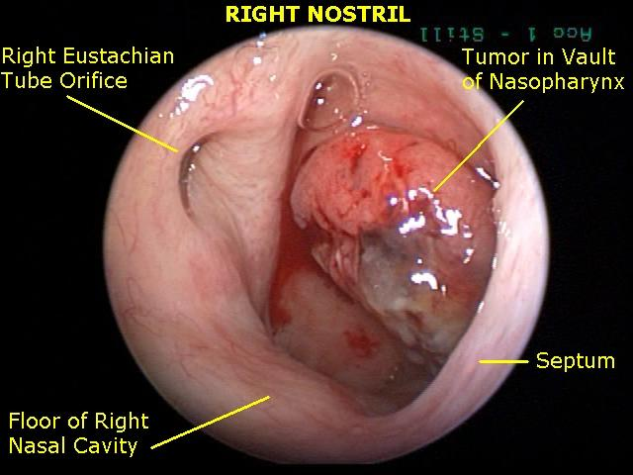
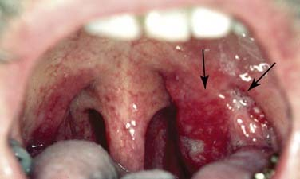
Pharyngeal & Laryngeal Tumors
A. Nasopharyngeal malignancy
General info:
Age: 6-7 decades
Most common mucosal head and neck neoplasm in Saudi arabia
Pathology:
- Epithelial lining: squamous cell carcinoma ( most common)
- Lymphoid tissue: lymphoma
Risk factor:
- Genetic
- Viral; EBV
- Diet
Clinical presentation:
Neck mass
Nasal blockage
Hearing loss, ear pain in one side
Epistaxis
Cranial nerve involvement: - Diplopia - Facial numbness
Radiology:
CT neck with contrast
MRI neck with contrast
CT chest, abdomen and pelvis:
- Extension of tumour
- Lymph node & distant metastasis
B. Oropharyngeal malignancy
General info
Squamous cell carcinoma is most common one
Smoking
Alcohol
Viral : HPV 2.
Lymphoma
- Most common in tonsil
Salivary gland tumor
Sarcoma
Clinical presentation (late):
Neck mass (most common)
Sore throat
Dysphagia
Weight loss
Decrease appetite
Oral bleeding
Otalgia
Trismus
Radiology
CT neck with contrast
MRI neck with contrast
CT chest, abdomen and pelvis
Diagnosis:
Fine needle aspiration cytology from neck mass
Nasopharyngeal biopsy
Early stage :
- Radiation therapy
• Advanced stage:
- Radiation and chemotherapy
Diagnosis:
-Panendoscopy if you can’t see it in the clinic
-Assessment of tumour extension
-examine hypopharynx , larynx , oesophagus and trachea
-Obtain biopsy from the mass
Management:
• Surgery
- Radiation
- Radio & chemotherapy

Slide 28
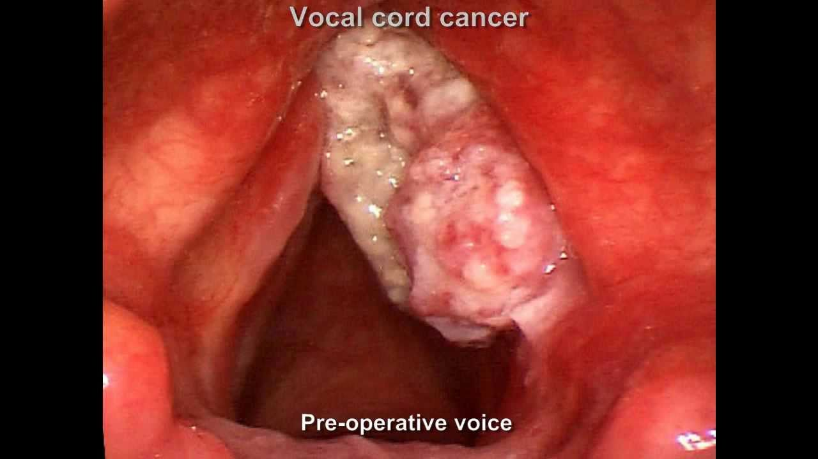
C. Hypopharyngeal & Laryngeal malignancy:
Clinical presentation:
hoarseness for 3-4 weeks (voice change) Most common
Neck mass
Globus sensation
Haemoptysis
Dysphagia
Weight loss
The don’t present with lymph node enlargement because they don’t have the drainage that much in the area.
Diagnosis
CT neck with contrast
MRI neck with contrast
CT chest, abdomen and pelvis ▪ Extension of tumour ▪ Lymph node & distant metastasis
Management
Early stage: ▪ Surgery or ▪ Radiation therapy
Advanced stage: ▪ Surgery and postoperative radiation ▪ Chemo radiotherapy
Neoplasms of the Ear and Lateral Skull Base:
Lesions of the Pinna, EAC, Middle Ear, Mastoid, Petrous Apex and Clivus, IAC, CPA, and Skull Base. Introduction:
●Generally classified by location, and occasionally by cell-type
●Causes of these neoplasms are largely unknown.
1- Neoplasms of the pinna and external auditory canal:
➢Cutaneous carcinoma: Squamous cell carcinoma and Basal cell carcinoma.
➢Malignant melanoma.
➢Glandular neoplasm: Ceruminous adenoma, Ceruminous adenocarcinoma, Pleomorphic adenoma and adenoid cystic carcinoma.
➢Osteoma and exostosis.
2- Lesions of the Petrous Apex and Clivus:
➢Adenomatous neoplasm:Benign middle ear adenoma and Endolymphatic sac tumor. ➢Chordoma.
➢Congenital neoplasm: Dermoid, Teratoma and Choristoma. ➢Cholesterol granuloma.
➢Langerhans cell histiocytosis.
3- Neoplasms of the internal auditory canal and cerebellopontine angle:
➢Schwannoma: Vestibular, Facial nerve, Trigeminal schwannoma and Jugular foramen. ➢Meningioma. ➢ Lipoma. ➢ Metastases.

Slide 29
4- Neoplasms of the Pinna and EAC:
➢Basal cell carcinoma (BCC): BCC (20% of ear / temporal bone neoplasms). Most on pinna. Sun exposure is initiator. Locally infiltrative, rolled border central crusting ulcer and May invade temporal bone if left untreated.
➢squamous cell carcinoma (SCC): Pinna and EAC are common. Sun, cold, radiation are all factors. Scaly irregular indurated maculopapular lesion often ulcerated with serosanguinous discharge. Can be confused with OE. Other symptoms VII, CHL, SNHL (with invasion of temporal bone). Met. To LN more common than BCC.
Treatment:
●Mohs micrographic surgery for most scc and bcc pinna lesions
●Temporal bone lesions require TB resection and RT. Don’t forget to Address LN in SCC.
➢ Osteomata and Exostoses: Benign bony growths in EAC.
●Osteoma is solitary, pedunculated, smooth, round lesions arising from tympanomastoid and squamous suture. ● Exostose is broad, more medial, multiple, often bilateral. Related to cold water exposure.
5. Lesions of the Middle Ear and Mastoid:
➢ Paragangliomas: Most common neoplasm of middle ear but still rare.
● Glomus tympanicum: Originate on promontory of cochlea (jacobson or Arnold’s nerve),
Fill ME space and ossicles involved, and May extend to hypotympanum and expose jugular or petrous carotid. Present with HL and pulsatile tinnitus and ME mass.
● Glomus jugulare: Arise in jugular fossa and Become large before symptomatic (multiple CN).
- Brown sign: +ve pressure leads to blanching.
- Aquino sign: ipsilateral CA compression decreases pulsation.
- Vernet syndrome (or JF syndrome): paresis of CN IX, X, XI.
- Villaret Syndrome = JF syndrome plus Horners.
Treatment: Rx is complete surgical excision.
- If secretory must address this (alpha or beta blockade).
- Transcanal, trans mastoid-lab, transcervical, infratemporal, intracranial. - Pre-op embolization is a necessary.
- If you think it invades the ICA, balloon occlusion studies must be done.
- RT or stereotactic radiosurgery can halt disease in up to 90%.
6. Lesions of the Petrous Apex and Clivus:
➢ Cholesterol granulomas: Most common lesion of the petrous apex. Negative pressure in lumen causes hemorrhage, Expansile lesion. Sx: Hearing loss, tinnitus, vertigo, facial twitching. - HRCT.
- MRI diagnostic: T1 and T2 hyperintense.
- Causes: poor drainage of ME, hemorrhage, obstruction of ventilation, FB reaction to cholesterol crystals from HB catabolism.
- Rx: surgical drainage.
7. Lesions of the IAC, CPA, and Skull Base:
➢ Schwannomas (no longer acoustic): Arise from sheaths of cranial nerves.
- HRCT: Inhomogeneous enhancement and Smooth mass effect.
- MRI (definitive diagnosis): T1- low intensity and Marked enhancement with gadolinium on T1.

Slide 30
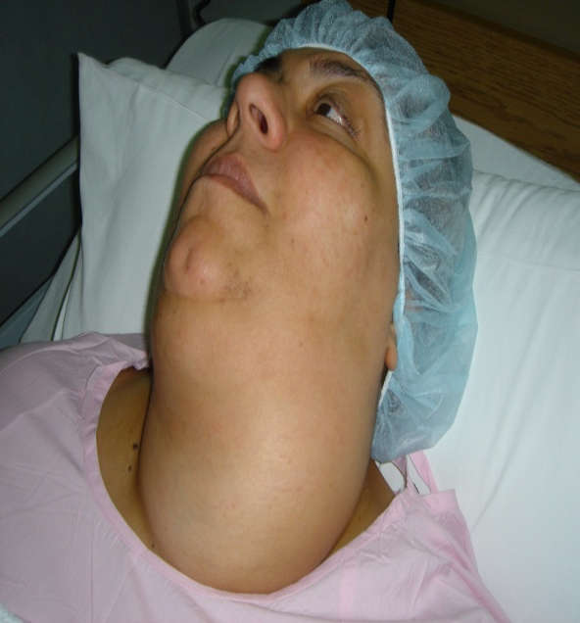
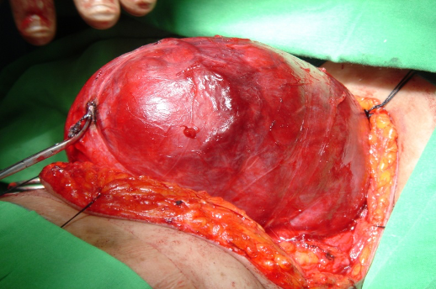
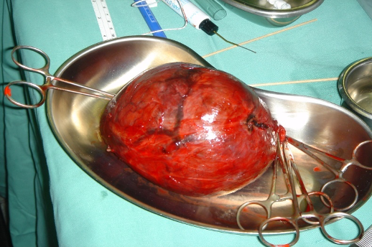
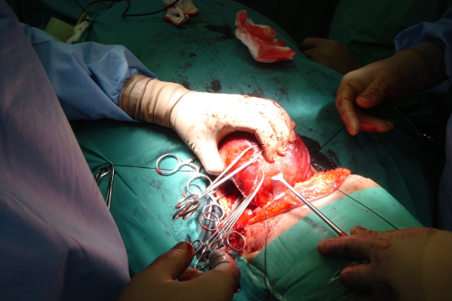
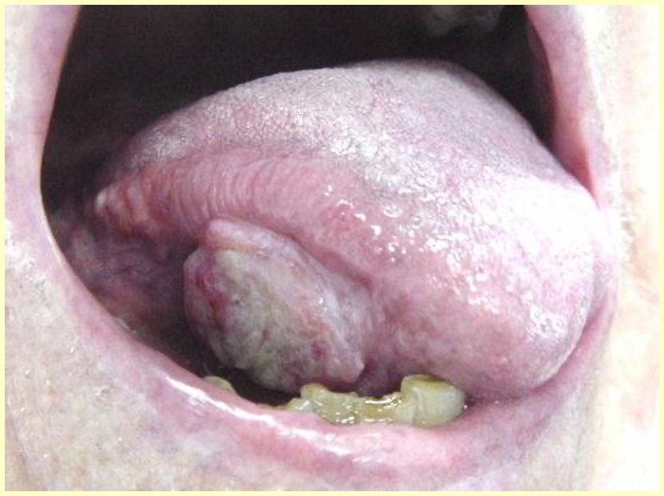
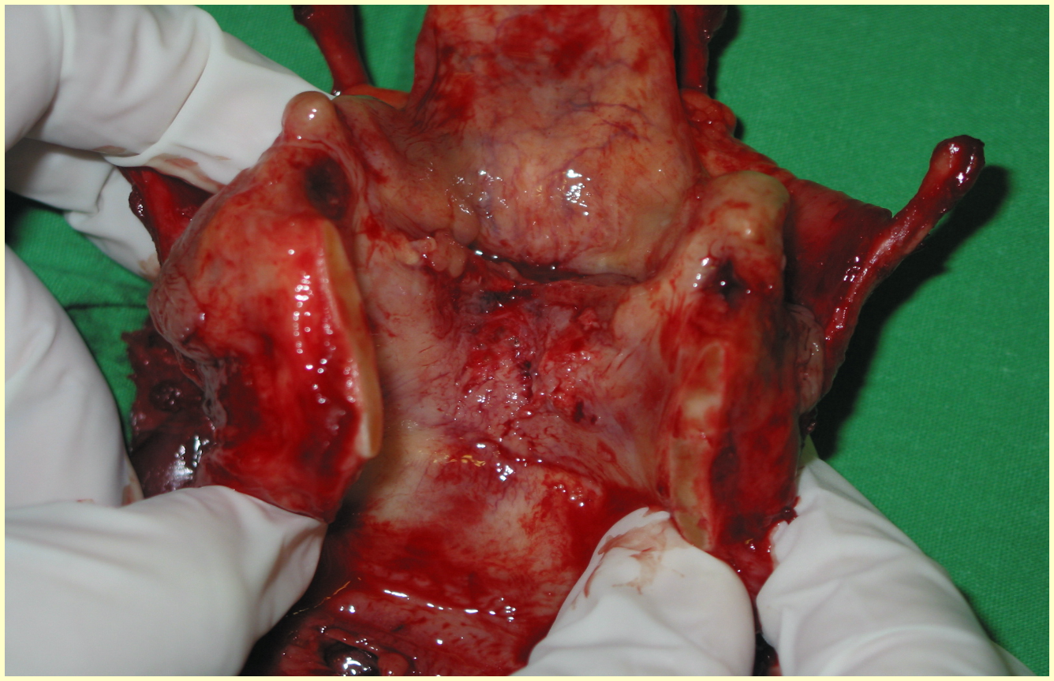
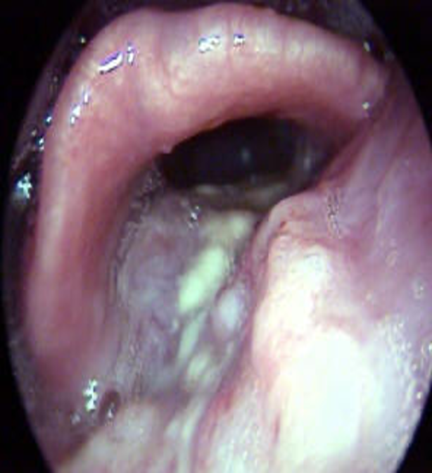
cases:
case1: Huge thyroid mass, US showed very big thyroid and FNA was negative
•What is abnormal? Mass
•What is your DDx?
•What is the most likely Dx?
•Work up : CT
•Management : Surgery for cosmetic purposes otherwise it should be observation
case2:
•What is abnormal?
•What is your DDx?
•What is the most likely Dx?
•Work up
•Management
case3:
•65 y old
•C/O : hoarseness X 10 Months
•Heavy smoker-2p/day X 40 years
•O/E :
–hoarse voice
–Mild stridor
–Neck mass 5X4 CM

Slide 31
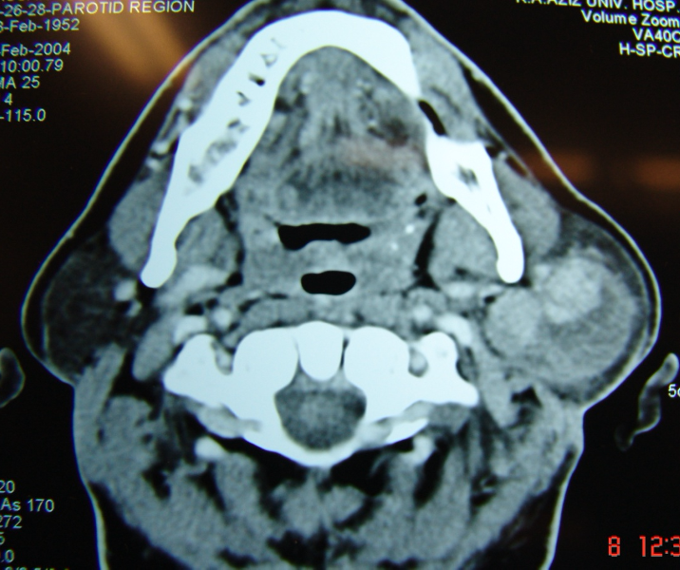
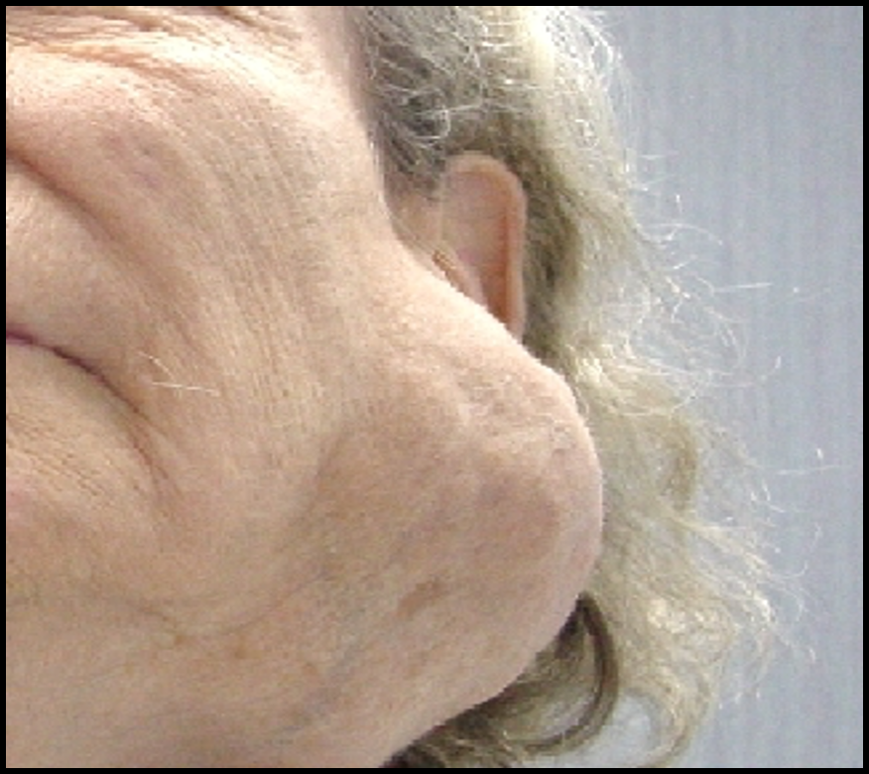
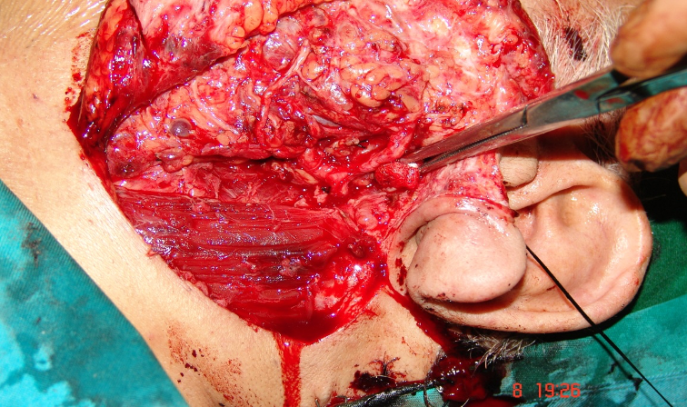
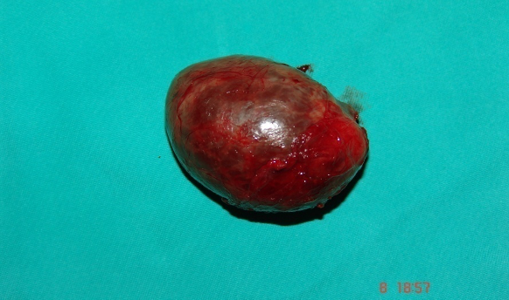
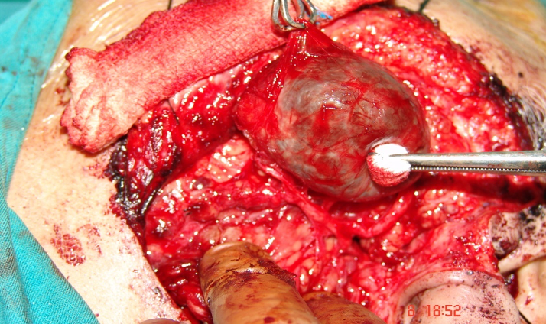
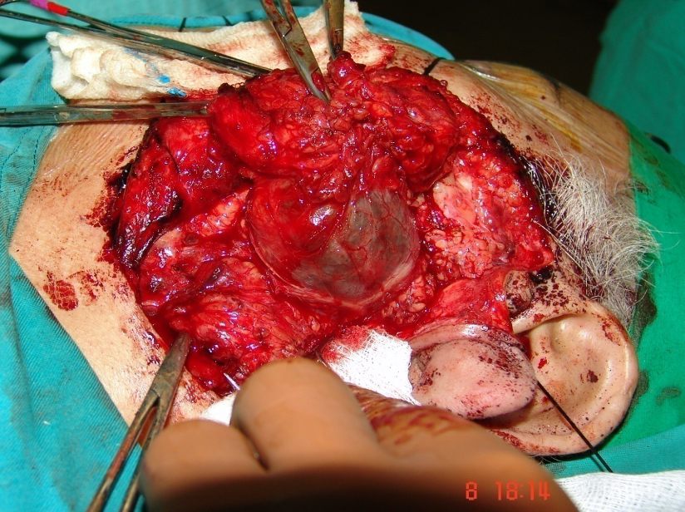
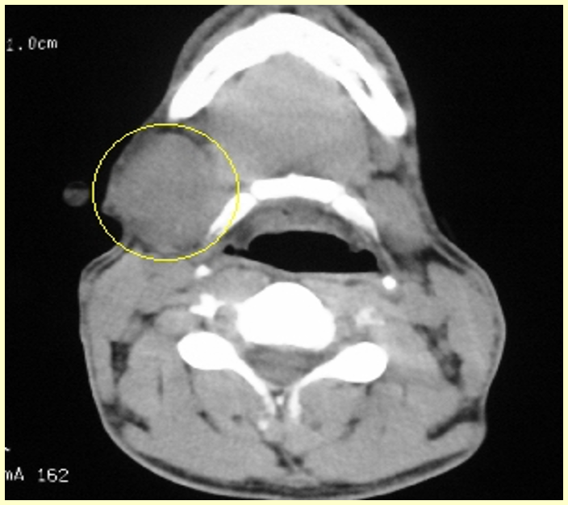
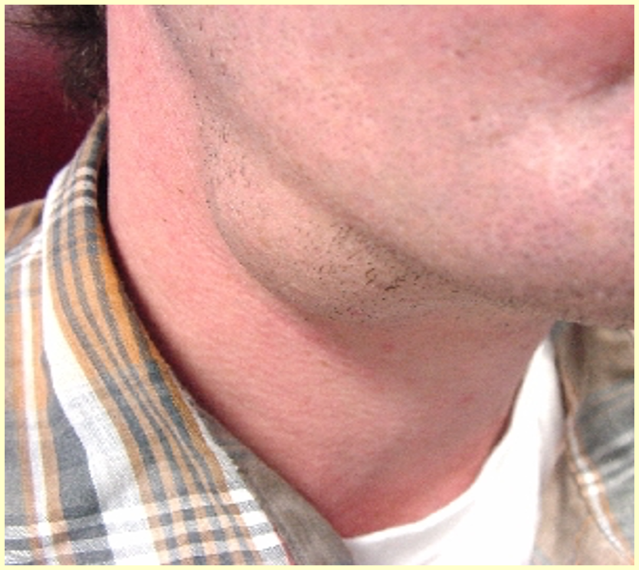
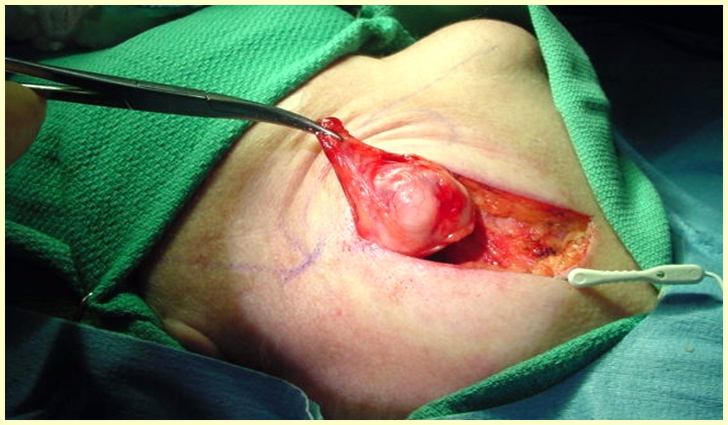
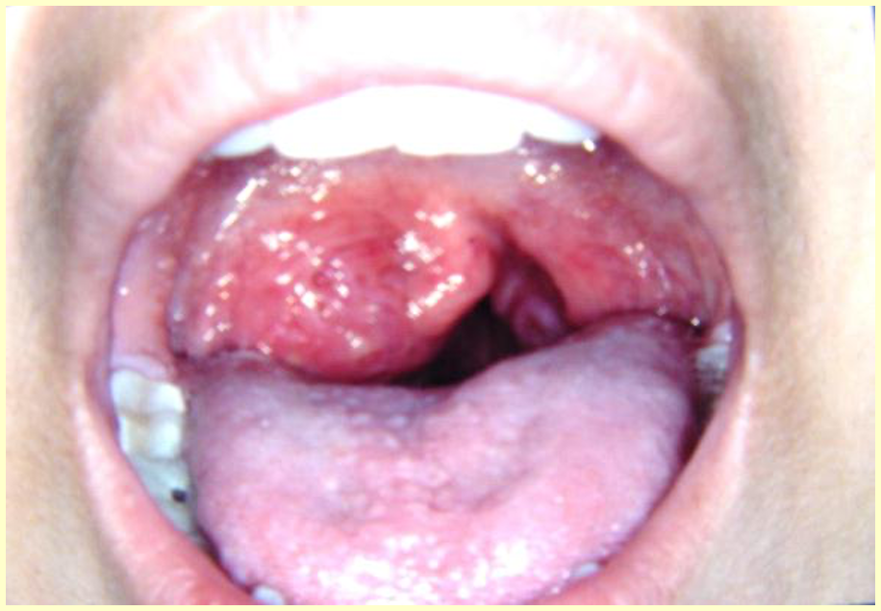
case4:
•What is abnormal?
•What is your DDx?
•What is the most likely Dx?
•Work up
•What are the areas you should examine?
•Management
•Can we leave it?
case5:
•What is abnormal?
•What is your DDx?
•What is the most likely Dx?
•Work up
•Management
case6:
•What is abnormal?
•What is your DDx?
•What is the most likely Dx?
•Work up
•Management

