Slide 1
Airway Obstruction I-II
Objectives:
Causes of airway obstruction (congenital and acquired)
- Signs and symptoms
- Investigations of airway obstruction
- Radiological illustration
- Medical and surgical treatment
- Operations (indication, procedure, and complication): tracheostomy, cricothyroidotomy, intubation, choanal atresia repair, etc..
Resources:Team 435, Team 436 (Group F), Slides, Dr. notes
Done by: abdulmalik alshrhan & mohammed thamer alzahrani
Edited by:
Revised by: Naif Almutairi
[ Color index: Important | Notes | Extra ]

Slide 2
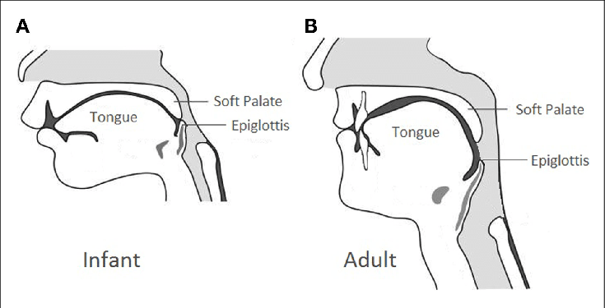
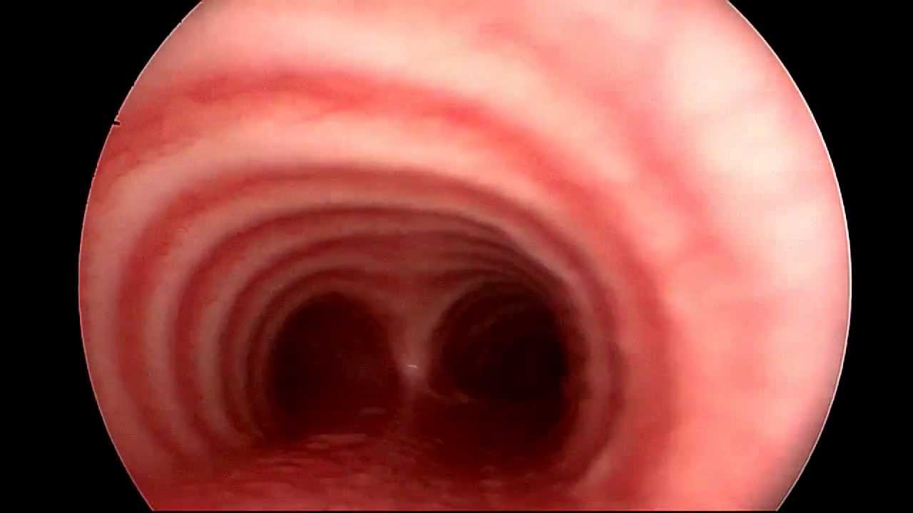
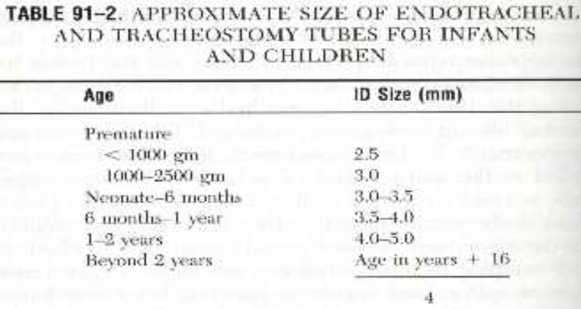
basic anatomy
Infant & Pediatric Larynx
-Position is higher at birth compared to adults. what is the benefit? to suck “eat” and breath at the same time) (C1-C4)
- Epiglottis lying at the nasopharynx behind the soft palate: makes the neonate an obligate nasal breather for 4-6 months .any nasal pathology at this age will cause airway obstruction.
- Cartilage & soft tissue are softer.
- Soft tissue: ➔ less adherent to the underlying cartilage “mild trauma leads to large edema” ➔ susceptible to collapse ➔ less resistant to develop submucosal edema
- Omega shaped Epiglottis “curved”
- Subglottis is the narrowest part of AW in children and non-expandable.
- In adult’s glottis is the narrowest.
trachea Consists of 16 to 20 incomplete cartilaginous rings (cartilage from the front and muscles behind). “complete in pediatric“ - The posterior wall is a membranous part .what is the value of it ? helps expanding in swallowing -Length is approximately 11 cm. in neonates it’s smaller around 4… -Diameter 19 mm male 16 mm female.
- The trachea bifurcates at the carina into right and left main bronchus. Pediatric trachea: Diameter: At Birth:6 mm, 6 months:7.2 mm, 1 year: 7.8 mm, 4 years: 11 mm.- You just need to understand that you need a smaller endotracheal tube in children undergoing GA according to their age(neonates: size 3 / 6 month: size 3 1⁄2 / 1 year: size 4) and there is a general equation that wil help i choosing the size : (age+16)/4

Slide 3
Airway obstruction
Signs & Symptoms of (Upper Airway Obstruction): Upper airway extends from the nares and lip to the subglottic area. 1. Stridor 2. Flaring of the nasal alae 3. Retraction of the neck, intercostal and abdominal muscles 4. Dyspnea 5. Tachypne 6. Restlessness (they are fighting to get air so you have to do something) 7. Cyanosis easily detected in children perioral or finger tips 8. Subcutaneous emphysema “Escaped air from the lumen of the airway” there is a break in the continouty of airway ,there will be crackling under skin
What is Stridor? We always ask about the difference between stridor and stertor ”اللي یجي مع nasal obstruction “ - Stridor is harsh high-pitched musical sound produced by turbulence of air flow through a partial obstruction of the airway (AW). - Audible sound produce during breathing due to air-flow change within the larynx. - It’s very important because it indicate pathological narrowing and possibly AWO (airway obstruction). - It indicates pathologic narrowing of airway, potential respiratory obstruction , even death. - The most common cause of stridor in pediatrics is Laryngomalacia
Types of stridor? (from 435)(we need to know if inspiratory or expiratory → tells you location of pathology - Inspiratory (extrathoracic) stridor: the obstruction is supraglottic, (glottis the area between the two vocal cords) e.g: Laryngomalacia the vocal cords and above (supraglottic). - Expiratory (intrathoracic) stridor: the obstruction is in the trachea (lower) (in the intrathoracictrachea) - Biphasic (fixed in middle of trachea) stridor: the obstruction is between the two areas: subglottic obstruction (below the vocal cord or upper trachea)the most dangerous If stridor is present since birth: ➔ congenital laryngomalacia 60% ➔ subglottic stenosis (can be congenital or acquired)➔ vocal cord paralysis(unilateral or bilateral) ➔ vascular rings(malformation can press on trachea) - If onset of stridor is gradual and progressing: ➔ subglottic hemangioma (most common infant tumor in 1st year)(treated medically by beta-blocker) appears between 1-3 months of age➔ papilloma of the larynx (rare)appears at 6 months of age

Slide 4
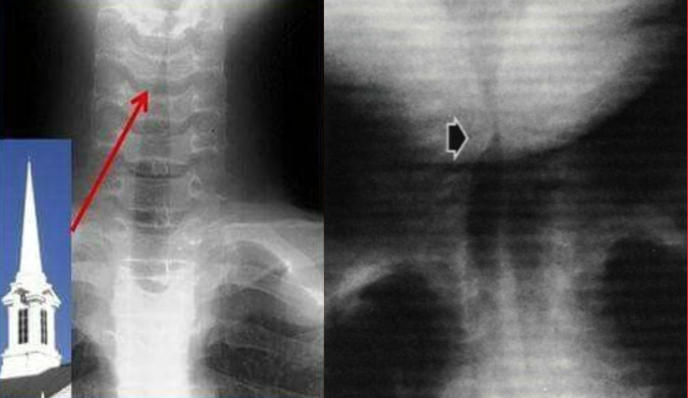
Assessment of child with upper airway obstruction
-Rapid airway assessment: to identify those who needs resuscitation depending on the presenting signs and symptoms of: complete upper airway obstruction, rapidly progressing partial airway obstruction, or respiratory failure.
if patient is unstable or in distress first thing to prioritize is securing airway
History:
- Age.
- Speed and onset of precipitating event. “immediately after birth or not”
- Associated symptoms (fever, drooling, hoarseness).
- Time of onset.
- Possible trauma
- Relation of airway problem to feeding and position → Feeding difficulty (this is very important for treatment decisions).
- Past medical history (birth trauma, intubation).
- Characteristic of cry “reflects the status of vocal cords”imp to ask about the nature of it (forceful, weak,..).
- History of previous intubation (this causes trauma to the airway).
- Questions about possible aspiration of foreign body“high index of suspicion” Physical examination (from 435):
- Vital signs, The patient’s position.(sniffing position in significant airway obstruction, Craniofacial anomalies, Cutaneous hemangiomas, Neck mass, Growth chart, Complete ENT examination,Flexible fiberoptic examination, Endoscopy is the tool of examination.
Physiological studies:
- ABG: late indicator of AWO, should not be used routinely to assess degree of obstruction (ABG usually is for chronic conditions) only used in emergency. - Flow volume loop to assess inhalation and exhalation , see if there is obstruction. -maging:radiological evaluation indicated for patient without respiratory distress:
-Plain views x-ray: -soft tissue neck (AP / lateral)
-chest Mobile pharyngeal tissue may bulge during expiration in normal infant
-High kilovoltage technique (croup series)
AP view assesses subglottic region:
look for steeple sign the left picture (narrow trachea) indicating acute laryngitis→
seen in ER a lot in winter and diagnosed by x ray.the right piture is for a patient with subglottic hemangioma it is unilateral .
-Fluoroscopy: dynamic air way change

Slide 5
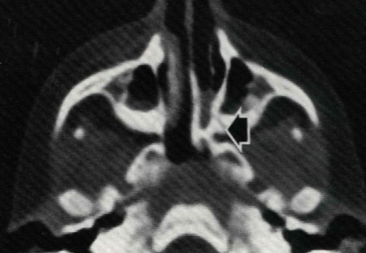
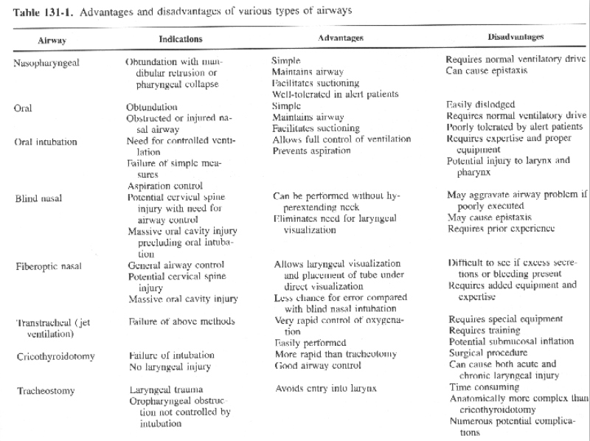
-Barium swallow: assess swallowing and r/o presence of vascular ring. -CT scan (Choanal atresia, retropharyngeal abscess, tumor), good in evaluating mediastinum.the axial CT is for a child with unilateral nasal obstruction and discharge and he has choanal atresia Nowadays we use it more than x ray. It gives more information and details. It is for Nasal oropharyngeal or airway sometimes -MRI Endoscopic evaluation: -Mirror examination (useless now): is not endoscopic, in older children and adult can provide information about hypopharynx and larynx. - Telescopic examination: ➔ Fibroeptic endoscope: excellent to assess the movement of vocal cord, done in clinic + pt awake ➔ Rigid bronchoscopy:done under GA, may enable removal of FB, assess the air way down to the main stem bronchi and we can take culture if the case requires full airway evaluation - Remember: it is important to do both rigid (while the pt is asleep) and fibroptic (while the pt is awake) to see the vocal cord movement. Therapeutic option : - Observation/medical support: ICU, airway team availability, oxygenation, steroid to reduce edema , antibiotic - Heimlich maneuver → when someone is choking. - N.P. (nasopharyngeal)airway. - Oral airway - Esophageal airway - Transoral intubation - Nasal intubation - Flexible fibroptic intubation - Transtracheal jet ventilation - Cricothyroidotomy - Tracheostomy Surgical Techniques 1. Trans-tracheal needle ventilation don’t do it anymore Where immediate ventilation is required. -Can support ventilation for several hours. - Technique: 12, 14 or 16 gauge cannula, high press ventilation system (50 p.s.I.) attached. Complications: - Failure to establish an AW - Misplaced catheter in soft tissue of the neck (esp. in children): pneumo-mediastinum, pneumothorax the trachea and airway is highly mobile slippery and soft in children and you find airway is slipping from you and you are passing the cannula around the trachea - Total obstruction of the airway prevents adequate ventilation
Choanal atresia

Slide 6
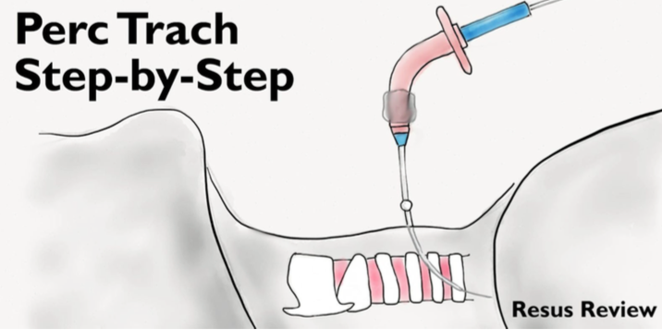
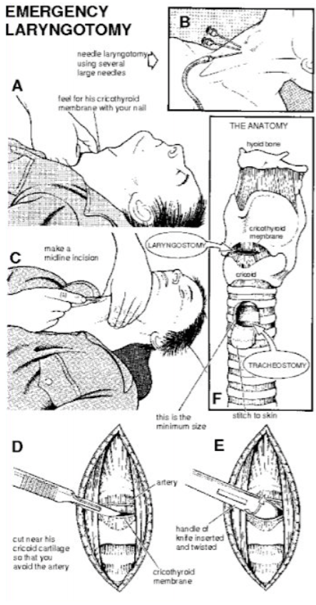
2. Percutaneous tracheostomy - Passing needle, guide wire, series of dilators, the tube. Complications: - Difficulty with dilatation - Failed intubation - Excessive bleeding - Pneumothorax - False passage of the tube - Accidental decannulation - Tracheoesophageal fistula 3. Cricothyroidotomy (imp) Definition: Cricothyrotomy (also called cricothyroidotomy) is a procedure that involves placing a tube through an incision in the cricothyroid membrane to establish an airway for oxygenation and ventilation. Indications: Generally for emergency upper airway obstruction when intubation is failed or contraindicated. Elective for head & neck or cardiovascular procedures where access to the tracheal rings is limited “you can’t do tracheostomy” stenosis / epiglottis Other indications (from 435): - Intubation is not possible (difficult intubation). - Need to avoid neck manipulation. - Severe maxillofacial trauma. - Edema of throat. - Severe oropharyngeal/tracheobronchial hemorrhage. - Foreign body in upper airway. - Lack of equipment for endotracheal intubation. - Technical failure of intubation. Procedure: - may utilize horizontal or vertical incision - use small trach. tube or endotracheal tube Complications: Emergency surgical cricothyrotomy has a much higher complication rate than elective cricothyrotomy. This is likely because emergency cricothyrotomy is performed on critically ill patients with difficult airways under emergency conditions.- injury of -anterior jugular vein (acceptable,in the area ), great vessels (not acceptable bacause it is located laterally - injury of recurrent laryngeal nerve - subglottic and laryngeal stenosis (especially in children) and it can collapse

Slide 7
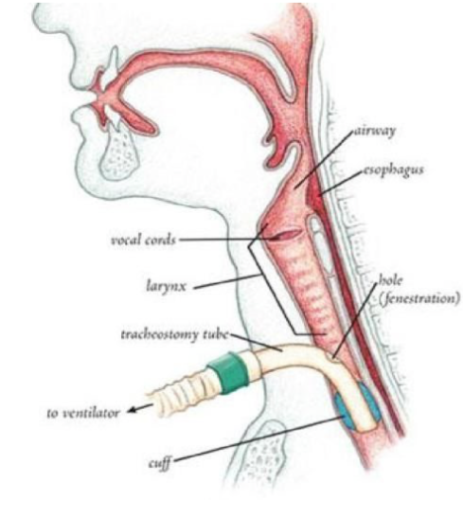
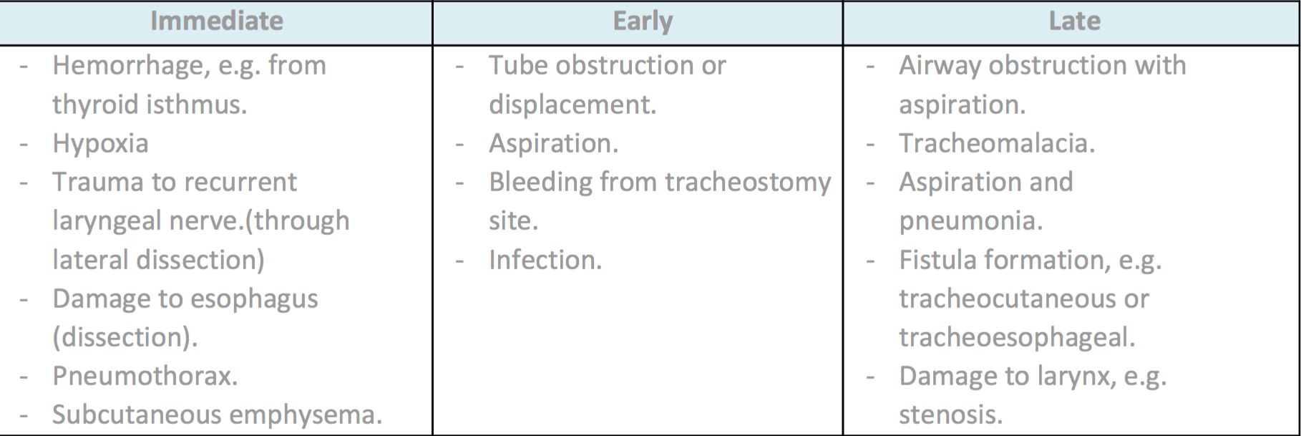
4. Tracheostomy very imp between 2 and 4 tracheal rings , not high because it will cause subglottic stenosis or low which will affect the artery . Fenestrated tube allow vocalization. Definition: - Tracheostomy is an operative procedure that creates a surgical airway in the cervical trachea. - For emergency or elective-airway obstruction acute or chronic-airway obstruction - In emergency tracheostomy vertical incision is preferred Bc there are no vessels in the midline. - Heamostasis after establishing airway obstruction - hyperextension then done between the (كبیرة ندبة تسوي لكنها اسهل و اسرع) - second and third tracheal ring or third and fourth) - When we do a tracheostomy we bypass all the upper airway. Indications (from 435): (Every exam includes the indications and complications 435dr notes) - Congenital anomalies like laryngeal hypoplasia. - Upper airway foreign body. - Supraglottic or glottis pathology like infection, neoplasm, bilateral vocal cord paralysis. - Neck trauma results in severe injury to the thyroid or cricoid cartilages. - Subcutaneous emphysema. - Facial fractures that may lead to upper airway obstruction. - Upper airway edema from trauma, burns, or anaphylaxis. Incisions:
- All these considerations are theoretical - No sound evidence to support one incision over the other -Complications (from 435):

Slide 8
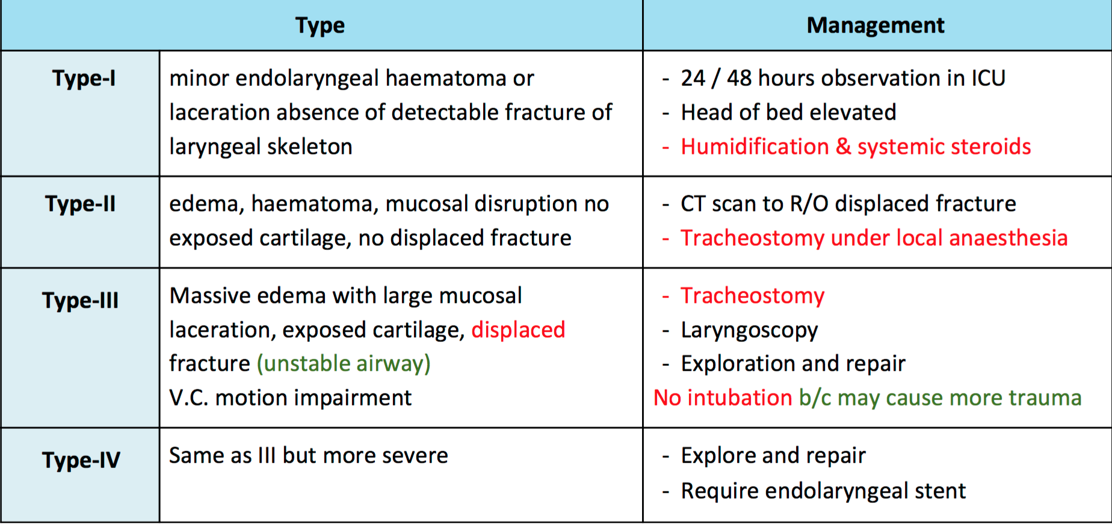
Airway Emergency :
A. Tumor: (most common adult laryngeal tumor is squamous cell carcinoma ) - Smoking is the main cause in oropharynx and laryngopharynx . Epstein–Barr virus (in nasopharyngeal) . - Commonly tumors of aerodigestive tract or thyroid. typically present with gradual airway obstruction - Initial management 0 2 humidification steroids and IV antibiotics.
Airway stabilization: - Organization between Surgeon and Anasthatist ,avoid blind attempt of intubation if available, fiberoptic intubation (experience) percutaneous jet ventilation to stabilize patient for patient with total obstruction - Elective awake tracheostomy under local anesthesia is the safest method to secure the airway , usually patients with tumors that prevents intubation - Precipitation of complete obstruction necessitates emergent cricothyroidotomy or tracheostomy
B. Trauma Presenting SX - Hoarseness (means at the level of vocal cord ) - Pain tenderness - Hemoptysis - Dysphagia - SC emphysema IMP (it is air in subcutaneous tissue) - Impaired respiration - Haematoma Classification of Laryngeal Trauma & Treatment: (CALLED SCAFER CLASSIFICATION)

Slide 9
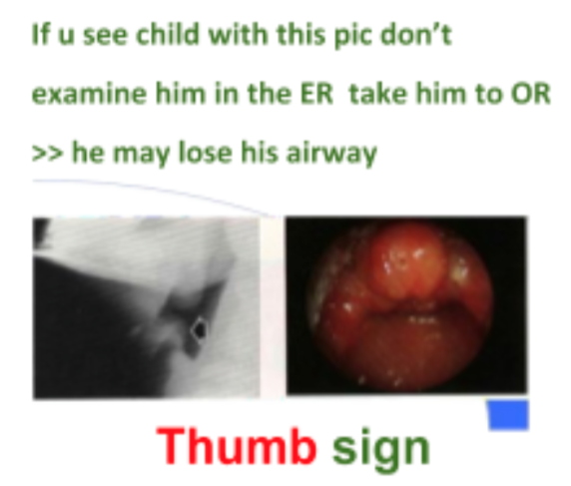
C. BURN PATIENT
- Airway management is controversial → some say intubate and some say don’t. - Considering the choice of airway
Oral or Nasal Endotracheal Tube - May exacerbate existing thermal injury - Inadvertent extubation is a potential disaster - When facial grafting is necessary tube and ties will limit the access - Tube obstruction occur more frequent (due to secretions and sluff) Tracheostomy - Reported to have higher mortality rate as a result of infectious complication (pulmonary sepsis, necrotizing tracheitis, mediastinitis steroid ) so we prefer not to do it. - Bleeding, pneumothorax, tracheal stenosis - Edema of the neck results in - difficult procedure - inadvertent removal of the tube - Cricothryroidotomy, may establish the airway more easily - Stabilization of airway is indicated for thermal injury of trachea, and extensive burns of the face ororopharynx. Where impending UAWO necessitates intubation - Intubation for assisted ventilation is required for inhalation injury with: changes in ABG, O2 sat, and increase CO . - Once decision of intubation is made: - ET should be attempted initially - If necessary, leave X 3-4 wks - Utilize this time for grafting neck burns - Shift to tracheostomy after that if necessary
D. SUPRAGLOTTITIS / EPIGLOTTITIS دائما تجي بالاختبارات - inflammation of the epiglottis, very common in the past and almost eradicated but coming back. Paediatric: by H. influenza . - sudden onset - rapidly progressive course and more acute than adults - high fever, respiratory distress - drooling, painful swallowing, sitting on edge of seat Adult: by staph aureus - Dysphagia, severe sore throat - Fever, stridor, voice change Management: - Children: secure airway → ET tube,tracheostomy after that give Abx and do culture - Adult: frequently observed in an ICU, may need intubation.

Slide 10
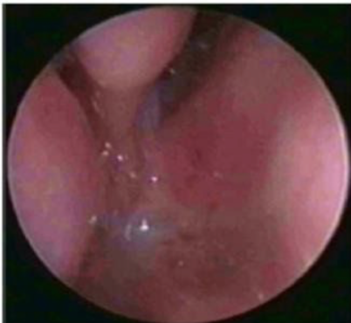
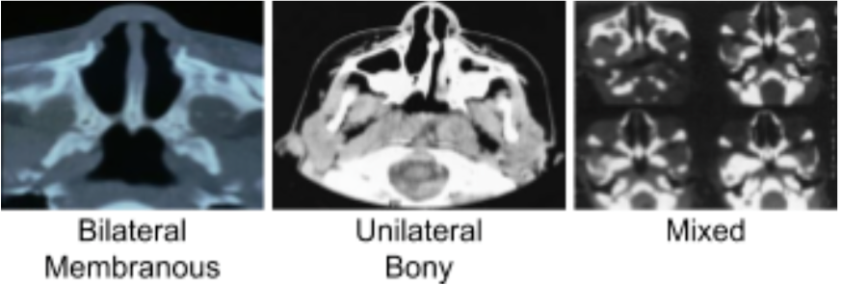
1. Choanal Atresia - Uncommon anomaly 1 / 5000 - 8000 - Lack of patency of posterior nasal aperture (complete closure) - Bilateral atresia →birth emergency! Presents soon after birth with severe respiratory distress “because neonates are obligate nasal breathers”The first thing to do is oral tube then do a CT scan and any other thing you would like to do <emergency>. - Unilateral atresia present late (may be undiagnosed until later in childhood w/ rhinorrhea) - Could be associated with other anomalies in 20-50% of cases: ➔ CHARGE 'Important MCQ' → C-coloboma (a hole in one of the structures of the eye, such as the iris, retina, choroid, or optic disc.)H-heart diseaseA-atresia R-retarded growthG-genital hypoplasia E-ear deformityThis is why we need to do a chromosomal analysis to look for everything. ➔ VATER “VACTERL” “Vertebral anomalies, Anal atresia, Cardiac defects, Tracheoesophageal fistula and/or Esophageal atresia, Renal & Radial anomalies and Limb defects “ ➔ Craniofacial anomalies Types:(Do CT to differentiate between the types) - Membranous - Bony - Mixed (commentest)accounts for 90%.
Examination: - Cyanosis improves with crying. - Infants: failure to pass # 6 - 8 catheter: - Pyriform aperture stenosis (1 CM) at nasal entry. - Choanal atresia (3.5 CM) if you can’t pass the catheter beyond 3.5 cm - Fiberoptic nasoscope. . Treatment (surgical repair): if bilateral :done within 10 days ,unilateral : postponed to one year - Emergency treatment is by insertion of oral tube. - Many surgical approaches: transpalatal, transnasal, transantral, trans-septal. - Surgical treatment is by either transnasal or transpalatal choanal atresia repair. - Endoscopic repair outcome is variable → success rates reported to range between 20-80%. It is the favorable method With the scope if it is membranous →cut it. if it is bony →drill it
congenital upper airway obstruction
Notes:
1 Note 431: The commonest cause for unilateral obstruction is foreign body (purulent, foul smelling discharge)

Slide 11
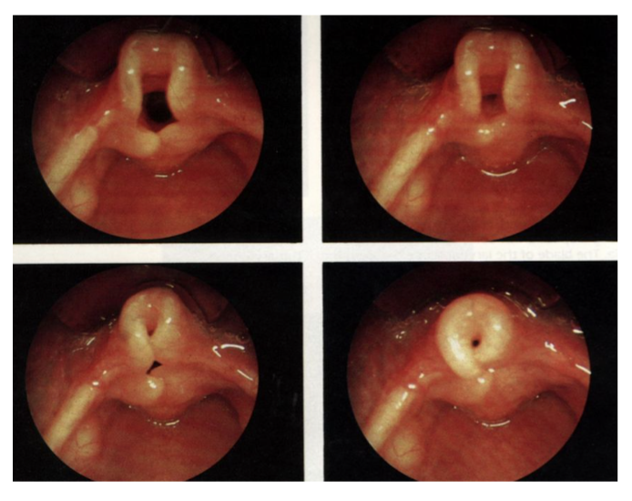
2. Laryngomalacia: - Accounts for 60% of laryngeal problems in newborn. - Due to flaccidity or incoordination of supra laryngeal cartilages which are pulled inside the lumen during inspiration leading to Upper Airway (UAW) obstruction. - Characterized by stridor in the first few week. The most common cause of inspiratory stridor in infancy (2nd is Bilateral vocal cord paralysis and 3rd subglottic stenosis) - In laryngomalacia, the epiglottis or the arytenoids that are soft and floppy. This floppy tissue gets pulled into the airway during inspiration, causing temporary partial blockage of the airway. This tissue is pushed back out when the infant exhales, opening the airway again. Cause is unknown: - Edema of the Aryepiglottic folds and loose suspension of the epiglottis. - Embryologically - rapid growth of the third branchial arch causes the epiglottis to curl open itself forming an omega shape. - Neurologic immaturity of Brainstem & vagus - infolding of the aryteroids in the AW
Diagnosis: - Symptoms: snoring is low pitch sound caused by tissue vibration of the nasopharynx pharynx and soft palate due to obstruction above the larynx. stridor inspiratory phase worse with crying, feeding and respiratory tract infection, improved in prone position. - Can only be confirmed by direct observation of movement of supraglottis during respiration. - Fibroeptic evaluation (imp)is the most appropriate method of visualization - Radiologic evaluation (not done anymore)by (high voltage X-ray PA lateral) may help in excluding the presence of associated AW problem: e.g. - SGS. - Innominate artery compression.
Complication: - Feeding difficulty and failure to thrive sensitive indicator for obstruction Endoscopic finding: - Tall, omega shaped epiglottis arytenoid mucosa (epiglottis is collapsing) - Inward forward movement of (sucked) - Short aryepiglottic fold

Slide 12
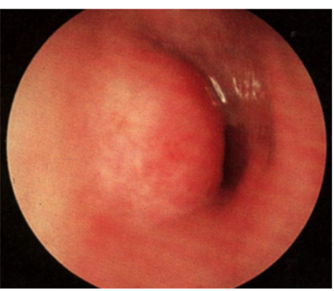
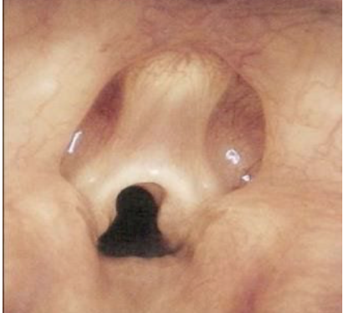
Treatment: - Reassurance as 85% will recover spontaneously - Infant can outgrow this problem: they could reach 18 month- 2 years and their problem would resolve - Tracheostomy for severe cases. Not good in pediatrics , high mortality rate up to 5% - Epiglottoplasty for severe cases → supraglottoplasty 'the best (cut of the aryepiglottic fold and trimming of arytenoid mucosa) - This only done if we did the supraglottoplasty and the child is cyanotic, so we perform the tracheostomy and leave it temporarily until the child gets better.
3. Subglottic Haemangioma Congenital vascular lesion Not present at birth but grow rapidly over the first few months of life. Hemangioma is the most common tumor in the pediatric can be anywhere in the body Symptoms: -Biphasic stridor. You want to insert a scope, and it is inserted while the child is awake because you want to observe the dynamic movement which will help you with the diagnosis. so you will see the vocal cords moving ok but there is a mass that is reddish or purplish in color. - Tend to involute slowly after one year. - 50% of the patients have cutaneous haemangioma in the head and neck - Present at age of 3 months with progressive dysphonia Treatment: Systemic steroid, intralesional steroid, Propranolol, laser ablation tracheostomy. The first line of treatment is Propranolol (beta blocker) but it needs to be administered under the guidance of a pediatric cardiologist. 4. Laryngeal web -Hoarseness and difficulty breathing - Small web just has dysphonia. - Weak cry - Stridor(more common with posterior webs) Treatment: - Laser excisions - Tracheostomy (any airway obstruction first thing to do is secure the airway). -laryngofissure for high grade with subglottic stenosis 5. Subglottic Stenosis - It is a narrowing of the subglottis; in newborn SG diameter of less than 3.5 mm. Two types: - Congenital - Acquired - the commonest - We rarely see Congenital Subglottic Stenosis, it is mostly acquired due to prolonged intubation2 (EXAM).
Notes:
2 432 Explanation: Usually, injury is caused by endotracheal intubation or high tracheostomy tube placement. If irritation persists, the original

Slide 13
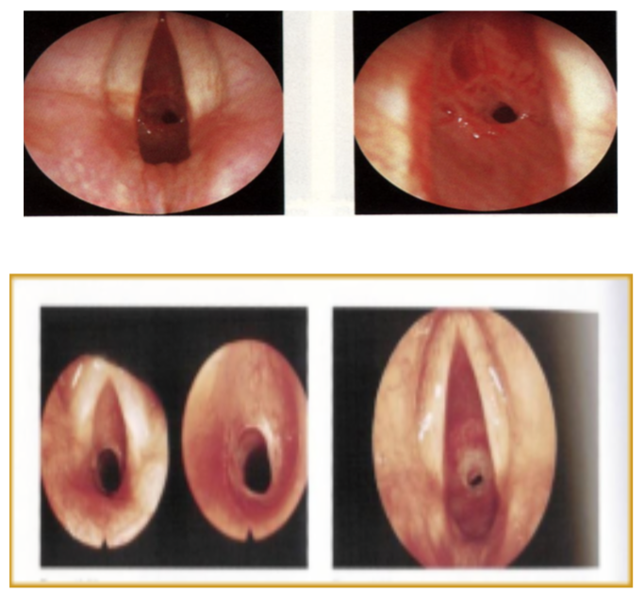
Risk Factors of Acquired (from 435) - Prolong / incorrect intubation duration and size of tube are important. - Size of the tube - Care of intubated patient. - High pressure cuffs tube. - Difficult intubations. - Multiple intubation. - GERD. - Tracheobronchial infection. Presentation: - Mild cases may present as recurrent croup secondary to URTI. - Generally present with symptoms and signs of URT obstruction. - Symptoms: dyspnea (may be on exertion or rest depending on the degree of stenosis), stridor, hoarseness, brassy cough, recurrent pneumonitis, cyanosis. Evaluation: - Plain film of the neck (high HKV)- not done anymore. - MRI - for difficult cases. - Confirm the diagnosis by rigid endoscopy under GA (check a picture of the rigid bronchoscope they love to bring it in the exam).
Management: - Endotracheal intubation - emergency situations - Tracheotomy the best to secure airway because it is under stenosis level - Cricothyroidotomy - Endoscopic techniques: dilation / laser - Open surgical technique: - Cricoid split - Laryngotracheoplasty + rib graft + stent - Resection and primary anastomosis
1- Foreign Body Aspiration Death from foreign body aspiration in USA is about 3000 per year for all ages. We see it mainly in the extreme ages: very young (children) and very old (geriatric). Complete airway obstruction may be recognized in the conscious child as sudden respiratory distress - inability to speak or cough. Types of foreign body3: vegetable matter (most common in children’s airway), metal, plastic.
Clinical presentation: 1- Usually coughing, choking, gagging, and wheezing the immediate stage . 2 - No symptoms or signs, mimic different acute or chronic disease of lungs e.g. croups, bronchial asthma. The intermediate stage 3- Stage of complications: pneumonia, obstructive emphysema and bronchiectasis.
Acquired upper airway obstruction
Notes:
edema and inflammation progress to ulceration and granulation tissue formation.When the source of irritation is removed, healing occurs with fibroblast proliferation, scar formation, and contracture, leading to stenosis or complete occlusion of the airway.
3 The most common objects aspirated by young children are food products (peanuts, seeds,Corn , فصفص). Most imp thing is vegetable matter because if it stay there, it will cause infections.

Slide 14
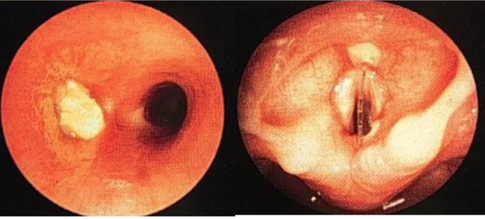
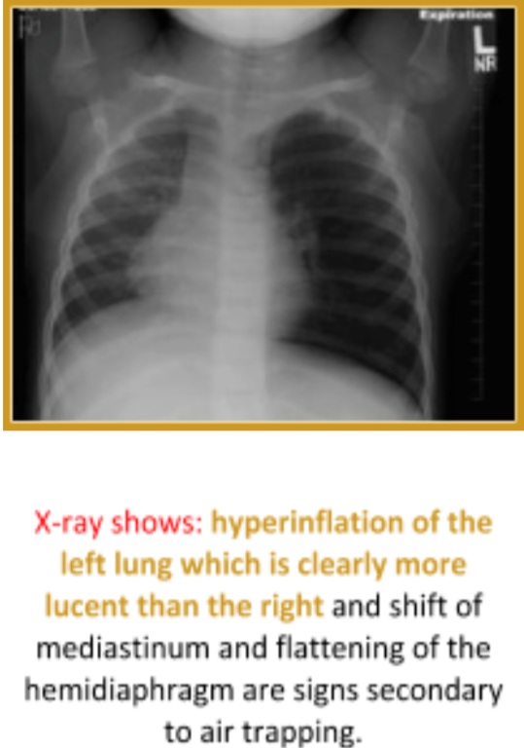
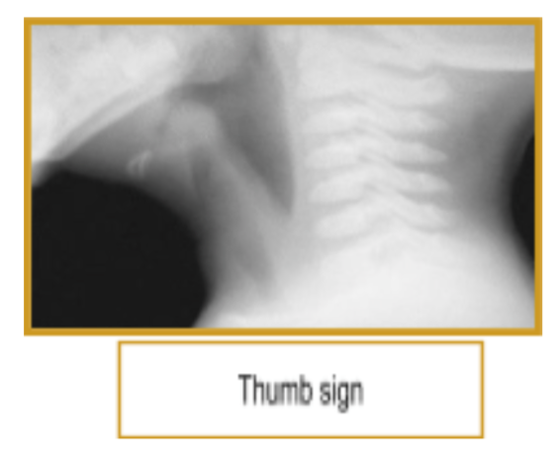
Location of FB in the AW:
- Commonly the final destination is one of the main bronchi→right bronchus affected more commonly than left bronchus (the right is shorter, wider and more vertical) - Larynx in case of sharp objects Trachea is there is narrowing in it. - Diagnosis:
- Radiologic: extended soft tissue neck, PA, lateral chest (most efficacious)
,in the picture posted on the right side ,the FB is in the left lung and one way to know where is the FB is to do inspiratory and expiratory x-rays to know the location
- It can demonstrate: foreign body, emphysema of lung, atelectasis of the lung. - Medical history is the key for diagnosing. - The most feared Complication is atelectasis and in order to avoid it, PERFORM A BRONCHOSCOPY FROM THE START! - Fluoroscopy and CT scanning may be used as well. If the index of suspicion is high, we can proceed to bronchoscopy. (Bronchoscopy is the gold standard, because x-ray is normal most of the time because the majority of foreign bodies are plastic toys that can’t be shown on x-ray).
Management: Endoscopic removal is both diagnostic and therapeutic(airway foreign bodies are removed most safely under general anesthesia using the ventilating rigid bronchoscope). (Optical) Telescopic forceps can be used for foreign bodies removal and biopsy.
2. Epiglottitis(from 435) Definition:It is an acute inflammation in the supraglottic region of the oropharynx (less acute in adults) with inflammation of the epiglottis, vallecula, arytenoids, and aryepiglottic folds. It is a life threatening rapidly progressive condition. Causes:Haemophilus influenzae Type B. Age: 2-7 years. Signs and Symptoms: - High fever. - Drooling. - Stridor. - Sore thorat. - Odynophagia/dysphagia. - Muffled voice. - “Hot potato voice”, as If the patient is struggling with a mouthful of hot food. - Adults may have preceding upper respiratory tract infection (URTI) symptoms

Slide 15
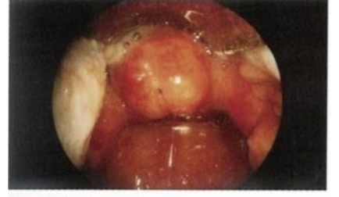
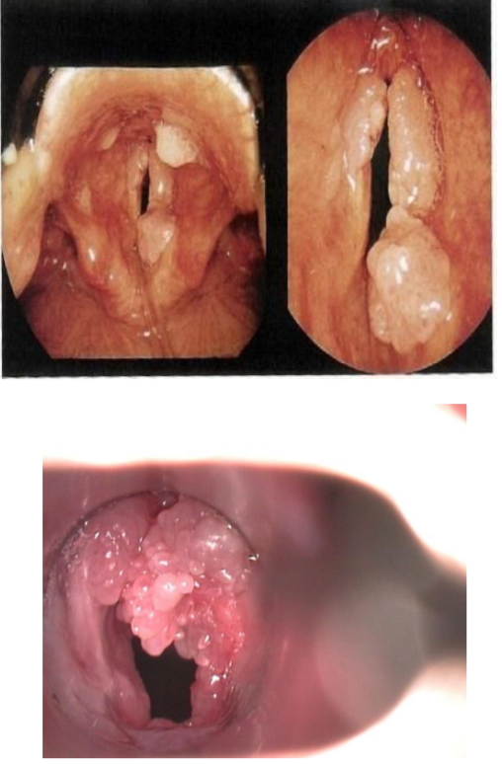
No examination should be done in the ER. (take to the OR and examine). - Investigation: - Airway management. “secure the airway!”. - Direct visualization of the epiglottis using nasopharyngoscopy/laryngoscopy after stabilizing the patient. “the preferred method of diagnosis”. - Lateral neck soft-tissue x-ray.“useful screening tool”.→Theclassiclateral neck radiographic findings are a swollen epiglottis (i.e., thumb sign), thickened aryepiglottic folds, and obliteration of the vallecula (vallecula sign).
- Management: - Artificial airway “endotracheal intubation, tracheostomy, or cricothyrotomy”. - Empiric IV antimicrobial therapy. We don’t see it now because vaccination reduced the incidence of epiglottitis.
3. Respiratory Papillomatosis Definition:It is a disease caused by human papillomavirus (HPV) types 6-11. The commonest 16 and 18, associated with malignancies. Two-thirds before the age of 15 years. Has two types juvenile and senile.
Risk factors:of juvenile-onset respiratory papillomatosis are firstborn child, vaginal delivery, and the mother being younger than 20 years + the presence of genital warts “condyloma acuminata”.
Symptoms:Symptoms of upper airway obstruction predominate because the larynx is usually affected in both types. - Hoarseness. - Voice changes (dysphonia). initially they come with only dysphonia when obstruction happens the other symptoms starts to appear. - Choking episodes. - Foreign body sensation in the throat. - Cough. - Dyspnea. - Inspiratory wheeze. - Stridor. Investigation:Laryngoscopy or bronchoscopy. Management: - Laser excision or microdebrider - Adjuvant therapy: Cidofovir, Acyclovir, Interferon

Slide 16
4. Thermal injury (from 435)
- It is caused by aspiration of hot liquid or caustic fluid.Alkali is more dangerous of acids. Because of the risk of rapidly developing airway edema, the patient’s airway and mental status should be immediately assessed and continually monitored. - The treatment starts with securing the airway “intubation”, tracheostomy and IV antibiotics. 5 Peritonsillar abscess (from 435)- Common deep infection in late childhood Symptoms: low grade fever severe sore throat, muffled voice, drooling, trismus Diagnosis: - Clinical diagnosis. - CT scan. Treatment: - Aspiration - Excision and drainage- Later tonsillectomy- IV ABX

Slide 17
Case: child had tonsillitis and treated with antibiotic for 3 days then stopped, after 2 days he started getting worse drooling of saliva, can’t open the mouth (trismus) and hot potato voice?Peritonsillar abscess (quinsy) (one of the indications of tonsillectomy)
GOLDEN NOTES MCQs
1- A child was playing with his toys when he suddenly started choking and coughing and cyanosed. His airway is patent. His parents took him to the hospital. What is the best management?
A- Bronchoscope. B- Cricthyroidotomy. C- Tracheostomy. D- Observe
Answer: C
2- 27-years old male had rod traffic accident with history of intubation at that time in the ICU for two months. Multiple trails of extubation were done but they failed. A tracheostomy was done for him. What is the most likely underlying cause for failure of intubation?
A- Laryngeomlacia. B- Subglottic stenosis. C- Tracheomalacia. D- Vocal cord paralysis.
Answer: B
3- A New born child had cyanosis and difficulty breathing immediately after delivery. The cyanosis improves with crying. Which of the following is the most likely diagnosis?
A.Enlarged Adenoid B.Laryngomalecia C.Laryngeal web D.Bilateral coanal atresia
Answer: D
4- A 3 months old baby brought to the emergency department by his parents because of noisy breath (stridor) which is not effected by position. No cyanosis, no history of previous intubation and the voice is normal. Systemic review revealed cerebral palsy. What's most likely diagnosis?
A- Laryngeal web B- laryngomalacia C- subglottic stenosis D- Bilateral vocal cords paralysis.
Answer: A (not sure)
5-A young patient presented with sore throat for which he took antibiotics and it did not work. Examination showed temperature of 38.9c and swollen tonsillar lymph nodes. CBC showed lymphocytosis. What is the diagnosis?
A- Infectious mononucleosis B- Acute diphtheria C- Vincent’s angina D- Quinsy abscessAnswer: A
6-A 28 y.o female complaining of right neck mass. Clinically euthyroid, on examination 4 cm right solid nodule, 3 cm left nodule. FNA shows follicular carcinoma, What is the recommended treatment?
A- thyroid replacement therapy B- thyroidectomy C- repeated aspiration
Answer: B
SAQs
Case: picture of baby with skin rash "hemangioma" and history of stridor? Q1: what is the diagnosis? Q2: how would you investigate it?
Picture of tracheostomy tube: Q1: identify it? Q2: indications?
Foreign body (dysphagia, odynophagia) Q1: site in the pic? Q2: management?
Bilateral choanal atresia
Q1: diagnosis? Q2: management?

