Slide 1
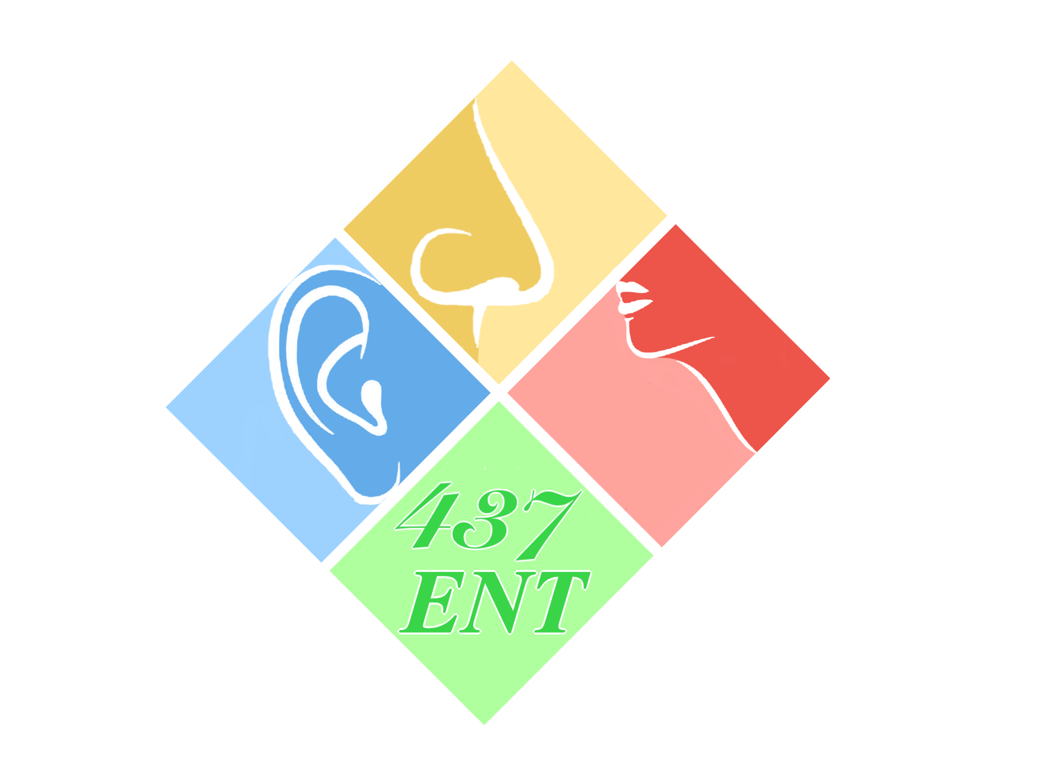
Nose I-II
Objectives:
our objectives are unavailable and these from 436
Anatomy of the external nose, nose, nasal cavity and paranasal sinuses.
Physiology of the nose and paranasal sinuses.
Blood and nerve supply of the external nose, nose, nasal cavity and paranasal sinuses.
Functions of the nose and paranasal sinuses.
Congenital anomalies.
Choanal atresia.
Acute & chronic rhinitis.
Allergic & non-allergic rhinitis.
Vestibular & furunculosis .
Nasal polyps (allergic & antrochoanal) etc.
Radiology illustration (e.g. CT scan)
Resources: Doctor slides,team 436
Done by: Tareq Ahmed Alomaim, Abdulhakim Bin Onaiq
Edited by:
Revised by: Abdulhakim Bin Onaiq
[ Color index: Important | Notes | Extra ]

Slide 2
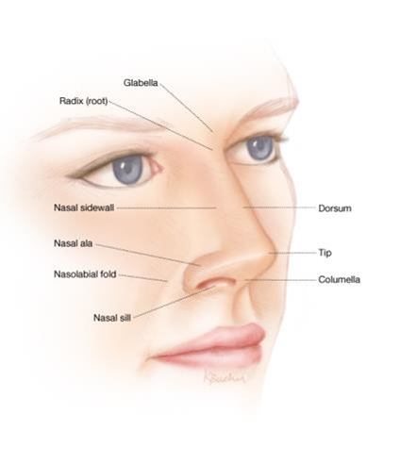
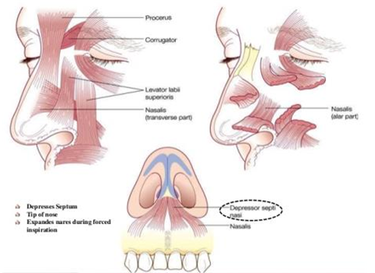
Anatomy
External Nose
- Pyramidal in shape -Root is up and base is down
Surface Anatomy: Subunits
Dorsum -Tip -Columella -Side walls -Ale -Sil
Skin
- The skin over the nasal bones and the upper lateral cartilage: is thin and freely mobile.
- The skin over the alar cartilages: is thick and adherent and contains many sebaceous glands.
Musculature:
Covers the osteo-cartilaginous framework. Movement of the tip, ala and the overlying skin, Includes:
-Procerus (common place for botox injection)
-Nasalis (transverse and alar parts)
-Levator labii superioris alaque nasi
-Dilator nares (anterior and posterior)
-Depressor septi
Consists of:
Skin
Musculature
Osteo-cartilagenous Framework

Slide 3
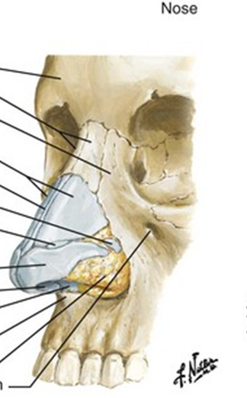
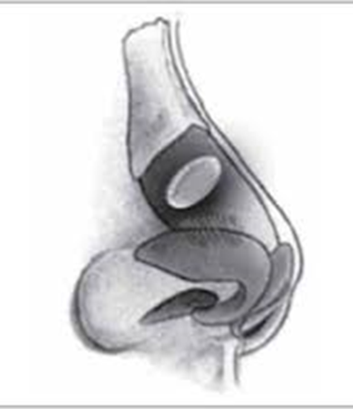
Osteo-cartilaginous framework:
- Bony and cartilaginous parts.
- Upper one third is bony and lower two thirds are cartilaginous.
Bony part:
- Consists of two nasal bones that meets in the midline and rest between the frontal bone superiorly and the frontal process of the maxillary bone infero-laterally.
Cartilaginous part:
- Upper lateral cartilages - Lower lateral cartilages (alar cartilages)
- Lesser alar cartilages -Septal cartilage
Upper lateral cartilage: | Between the nasal bones and the alar cartilages Fuses in the midline with the septal cartilage Part of the internal nasal valve
Alar cartilages ‘Lower lateral cartilage’: | U-shaped. Medial crus forms the columella and lateral crus forms the ala. Lateral crus overlaps the upper lateral cartilage on each side.
Lesser alar cartilages: AKA sesamoid cartilages | Two or more small cartilages Above and lateral to the alar cartilages Interconnected by the adjacent perichondrium and periostium.

Slide 4
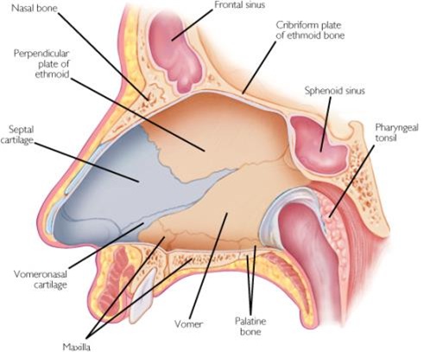
Internal Nose
Septum:
Support the nasal dorsum and the tip of the nose.
Separates the two nasal cavities
Septum Consists of:
-Perpendicular plate of ethmoid bone
-Vomer
-Large quadrilateral cartilage
-Minor contribution of crests of nasal bones, nasal spine of the frontal bone, anterior nasal spine of maxilla, rostrum of the sphenoid bone, crests of the palatine and maxillary bones.
Divided into: two nasal cavities by the nasal septum
Communicates with the exterior through the nostrils (naris) and with the nasopharynx through the choana (posterior nasal aperture).
Each cavity consists of a skin-lines portion called the vestibule and a mucosa-lined portion, the nasal cavity proper.
Vestibule of the nose:
Forms the anterior and
inferior part of the nasal cavity.
Lined by skin
.

Slide 5
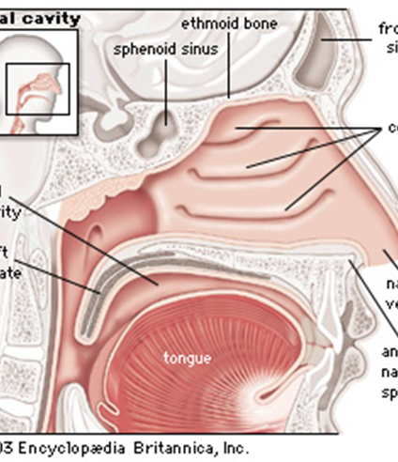
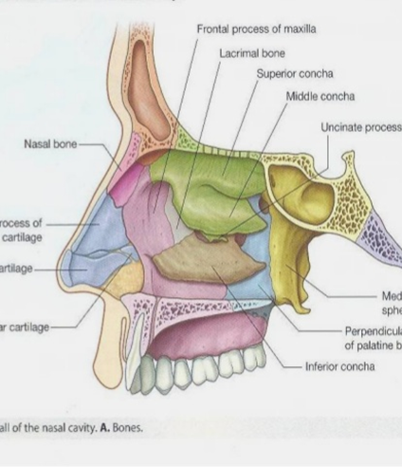
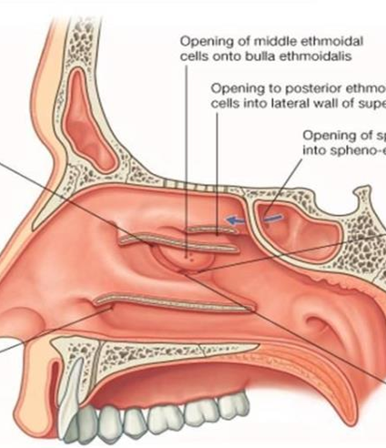
Contains sebaceous glands, hair follicles, and hair called vibrissae
Nasal cavity proper:Each side has:
-Medial wall -Lateral wall
-Roof and -floor
Lateral wall
Marked by the bony projections called turbinates or chonchae.
Inferior, middle, superior and sometimes supreme turbinates.
Below each turbinates is the corresponding meatus.
Inferior meatus: The largest
Runs along the whole length of the nasal cavity.
Nasolacrimal duct opens in its anterior part.
Middle meatus:
Runs in the posterior half of the nasal cavity
Anterior ethmoid cells, maxillary and
frontal sinus drain eventually in the middle meatus

Slide 6
Superior meatus: the smallest
Runs in the posterior one third of the nasal cavity.
Posterior ethmoid cells drain in the superior meatus
drain the posterior ethmoid sinus.
Spheno-ethmoid recess:
Lies behind the superior turbinate.
Receives the sphenoid sinus ostium.
Medial wall:
Formed by the nasal septum.
Roof:
Formed by the nasal bones, frontal bones, ethmoid (cribriform plate) and sphenoid bones
Floor:
Formed by the palatine process of the maxilla (anterior ¾) and the palatine bones (posterior ¼).
Lining:
Vestibule:¡Skin, hair follicles and sebaceous glands
Olfactory region: ¡upper 1/3 of the nasal cavity contains mucous membranes rich in the neuro-epithemium
Respiratory region:
-Mucous membranes which are highly vascular and contain erectile tissue.
-Lined by pseudostratified ciliated columnar epithelium rich in goblet cells. Sub-mucosa is rich in serous and mucous secreting glands.

Slide 7
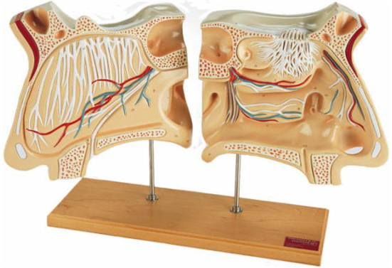
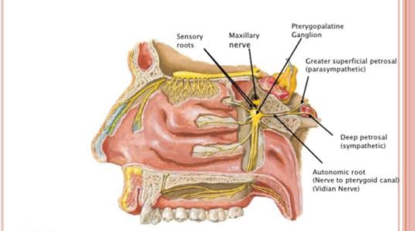
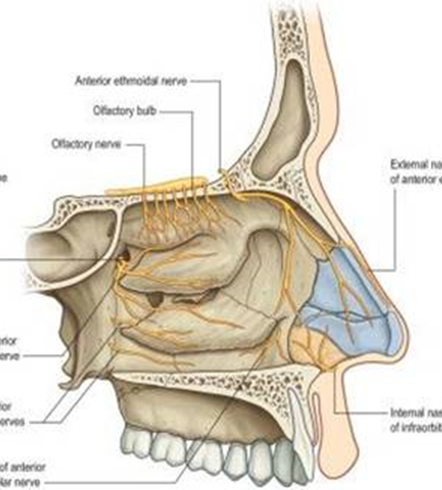
Nerve supply:
Olfactory nerves
Common sensation
Autonomic supply
Olfactory nerves:
Arranges in 12-20 nerves and passes through the cribriform plate and end in the olfactory bulb.
2.Common sensation:
Anterior ethmoidal nerves: anterior and superior part of the nasal cavity.
Branches of the sphenoidal ganglion: posterior 2/3 pf the nasal cavity.
Branches of infraorbital nerve: supply the nasal vestibule.
3.Autonomic supply:
Parasympathetic: come from the greater superficial petrosal nerve and travel through the vidian nerve, causes vasodilatation and increases nasal secretions.
Sympathetic: from the sympathetic chain, through superior cervical ganglion, travels in deep petrosal nerve through the vidian nerve.

Slide 8
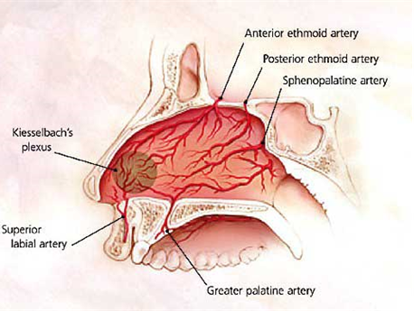
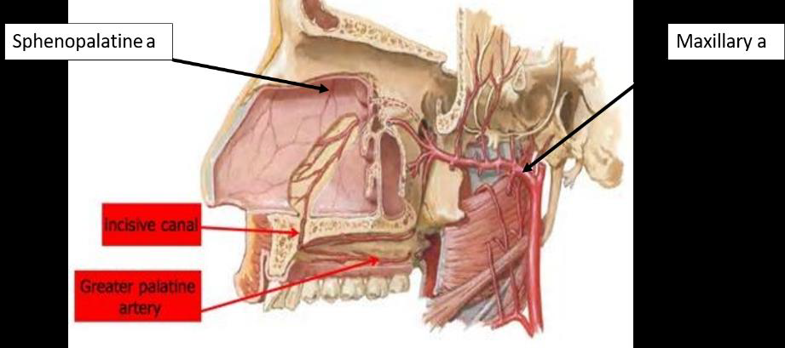
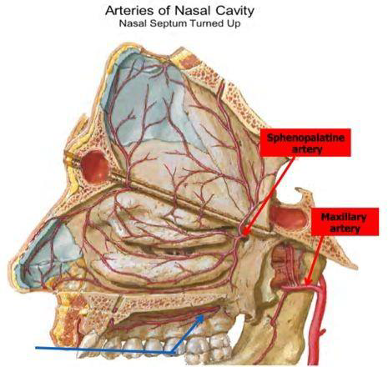
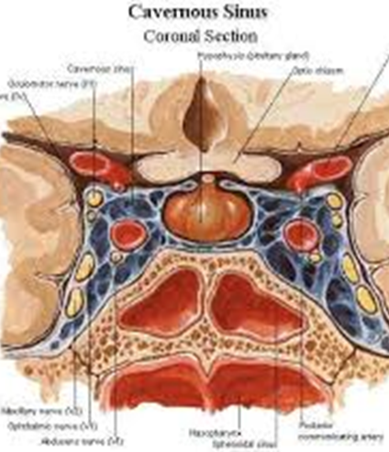
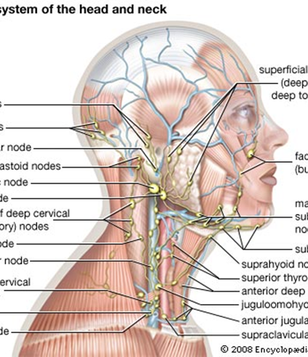
Blood supply:
From branches internal and
external carotid arteries.
Little’s area:
Anterior ethmoid artery
Septal branch of superior labial artery.
Sphenopalatine artery
Grearter palatine artery
Lymphatic drainage:
Drains in the submandibular, upper jugular and retropharyngeal
lymph nodes .

Slide 9
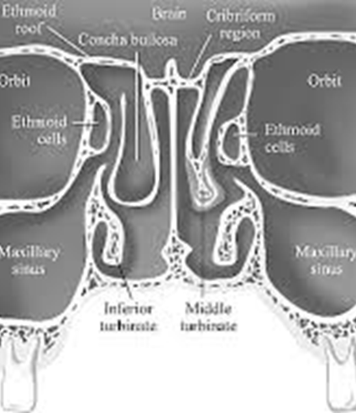
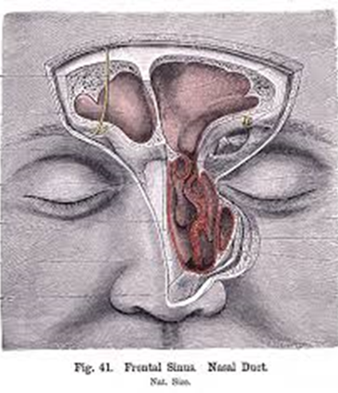
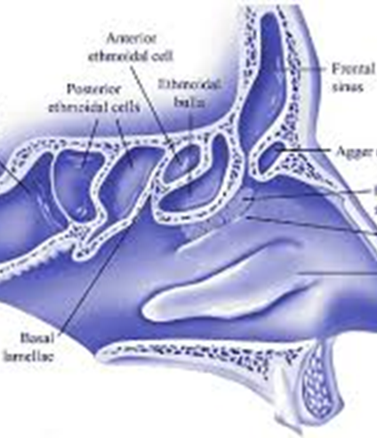
Sinuses
Maxillary sinus: | Largest sinus, presents at birth. Occupy the body of the maxillary bone. Anterior border is related to the cheek. Posteriorly related to the infratemporal and pterygopalatine fossae Medial wall is related to the nasal cavity. Floor is related to the palate. Roof is related to the orbital floor.
Frontal sinus: | Between the anterior and posterior tables of the frontal bone in the supra orbital region. Varies in size and shape, often loculated and asymmetrical.
Ethmoid sinuses: | Thin walled cavities, 3-18 cells. Present at birth. Anterior and posterior groups. Anterior: ultimately draining into the middle meatus. Posterior: open into the superior meatus. Bordered by the medial wall of the orbit, the skull base and the middle and superior turbinates.
Sphenoid sinus: | Occupies the body of the sphenoid sinus. Rarely symmetrical. Closely related to the optic nerve, internal carotid artery, Cavernous sinus, V2 and vidian nerve.

Slide 10
Physiology
Respiration: | New-borns are obligate nasal breathers until age of three months. Choanal atresia
Air conditioning: | Filtration and purification: Through vibrissae and mucous secretions. Temperature: Controlled through the large area of the highly vascular mucosa which is full of venous sinusoids. Humidification: Controlled through the thickness of the nasal secretions
Protection: | Through the mucociliary mechanisms and the mucous blanket. Enzymes and immunoglobulins: lyzozymes, IgA, IgE Sneezing: Foreign and irritant materials initiate the sneezing reflex.
Vocal resonance: | For phonating the constants M/N/NG
Nasal Reflex | Sneezing reflex Gustatory reflex: salivation when smelling food Noso-pulmonary reflex: increased pulmonary resistance associated with nasal obstruction

Slide 11
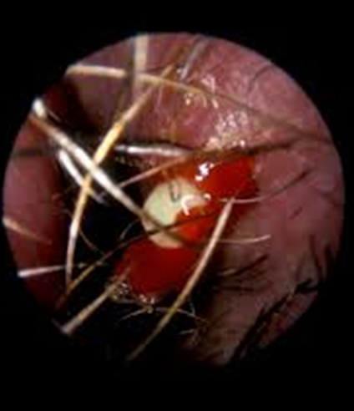
Acute rhinitis
Common Cold:
Mostly viral (adeno, picorna virus, rhinovirus)
Burning sensation in the nose, nasal congestion, obstruction, secretions and hyposmia or even anosmia.
Can be secondarily infected by bacteria (Strep pneum, Staph a., H.Inf, Kleb. Pneum, M.Catarrhalis)
Rx: Bed rest, rehydration, analgesia and econgestants.
Can progress into acute bacterial rhinosinusitis
Influenza rhinitis:
Influenza A, B, C viruses
Similar symptoms of common cold but with more constitutional symptoms.
Same management
Role of influenza vaccine.
Furuncle
Acute infection of hair follicle by Staph a.
Trauma from nose picking or plucking virissae is the usual predisposing factor.
Small but very painful.
Rx: include analgesia, warm compressors, topical +/-systemic antibiotics, +/-I&D
Risk of cavernous sinus thrombosis after squeezing the furuncle due to retrograde venous spread.

Slide 12
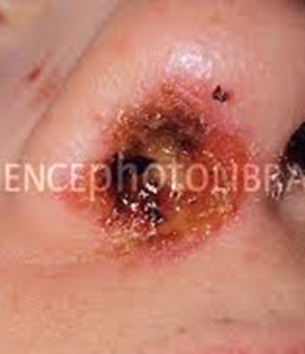
Vestibulitis
Diffuse dermatitis of the nasal vestibule, usually by Staph a.
Red, swollen, eroded and tender skin with crustations and scales.
Rx: Local cleaning, local antibiotic-steroid ointments
Furuncle | Vestibulitis
- حبة بالأنف صغیرة و تنرفز مرة - Very localized (around hair follicles) and very painful - Treatment: - Don’t squeeze, Don’t manipulate - Avoid nose picking (causes cross contamination) - Apply antibiotic like Fucidin, why? *imp this area is from the dangerous zone, so complications might happen like cavernous sinus thrombosis and blindness | - Broader than furuncle - Like cellulitis but in the nose - Management is the same as furuncle + maybe you’ll need oral antibiotics or IV antibiotics and admission (depends on the case)

Slide 13
Allergic rhinitis
Paroxysmal sneezing, nasal obstruction, watery rhinorrhea, itchiness of the nose, eyes, palate and/or throat.
Could be seasonal or perennial.
Signs: transverse nasal crease, pale and bluish mucosa, swollen turbinates and allergic shiners (dark circles around the eye).
Rx: Avoidance of the allergen (if known), Medications (Intranasal corticosteroids, antihistamines “local and systemic”, Anti-cholinergics, Na cromoglygate), turbinate reduction and immunotherapy
Non-Allergic Rhinitis
Similar symptoms of allergic rhinitis, but in the absence of identifiable allergies with less itchiness and sneezing.
Subtypes: Idiopathic Rhinitis, Occupational Rhinitis, Drug-induced Rhinitis, Hormone-Induced Rhinitis, Autonomic Rhinitis (Vasomotor), Atrophic Rhinitis, Systemic diseases causing rhinitis.
Rx: Addressing the cause of possible.
INCS, antihistamines, oral decongestants, topical anticholinergic, mast cell stabilizers and turbinate reduction are options that can be considered in each case.

