Slide 1
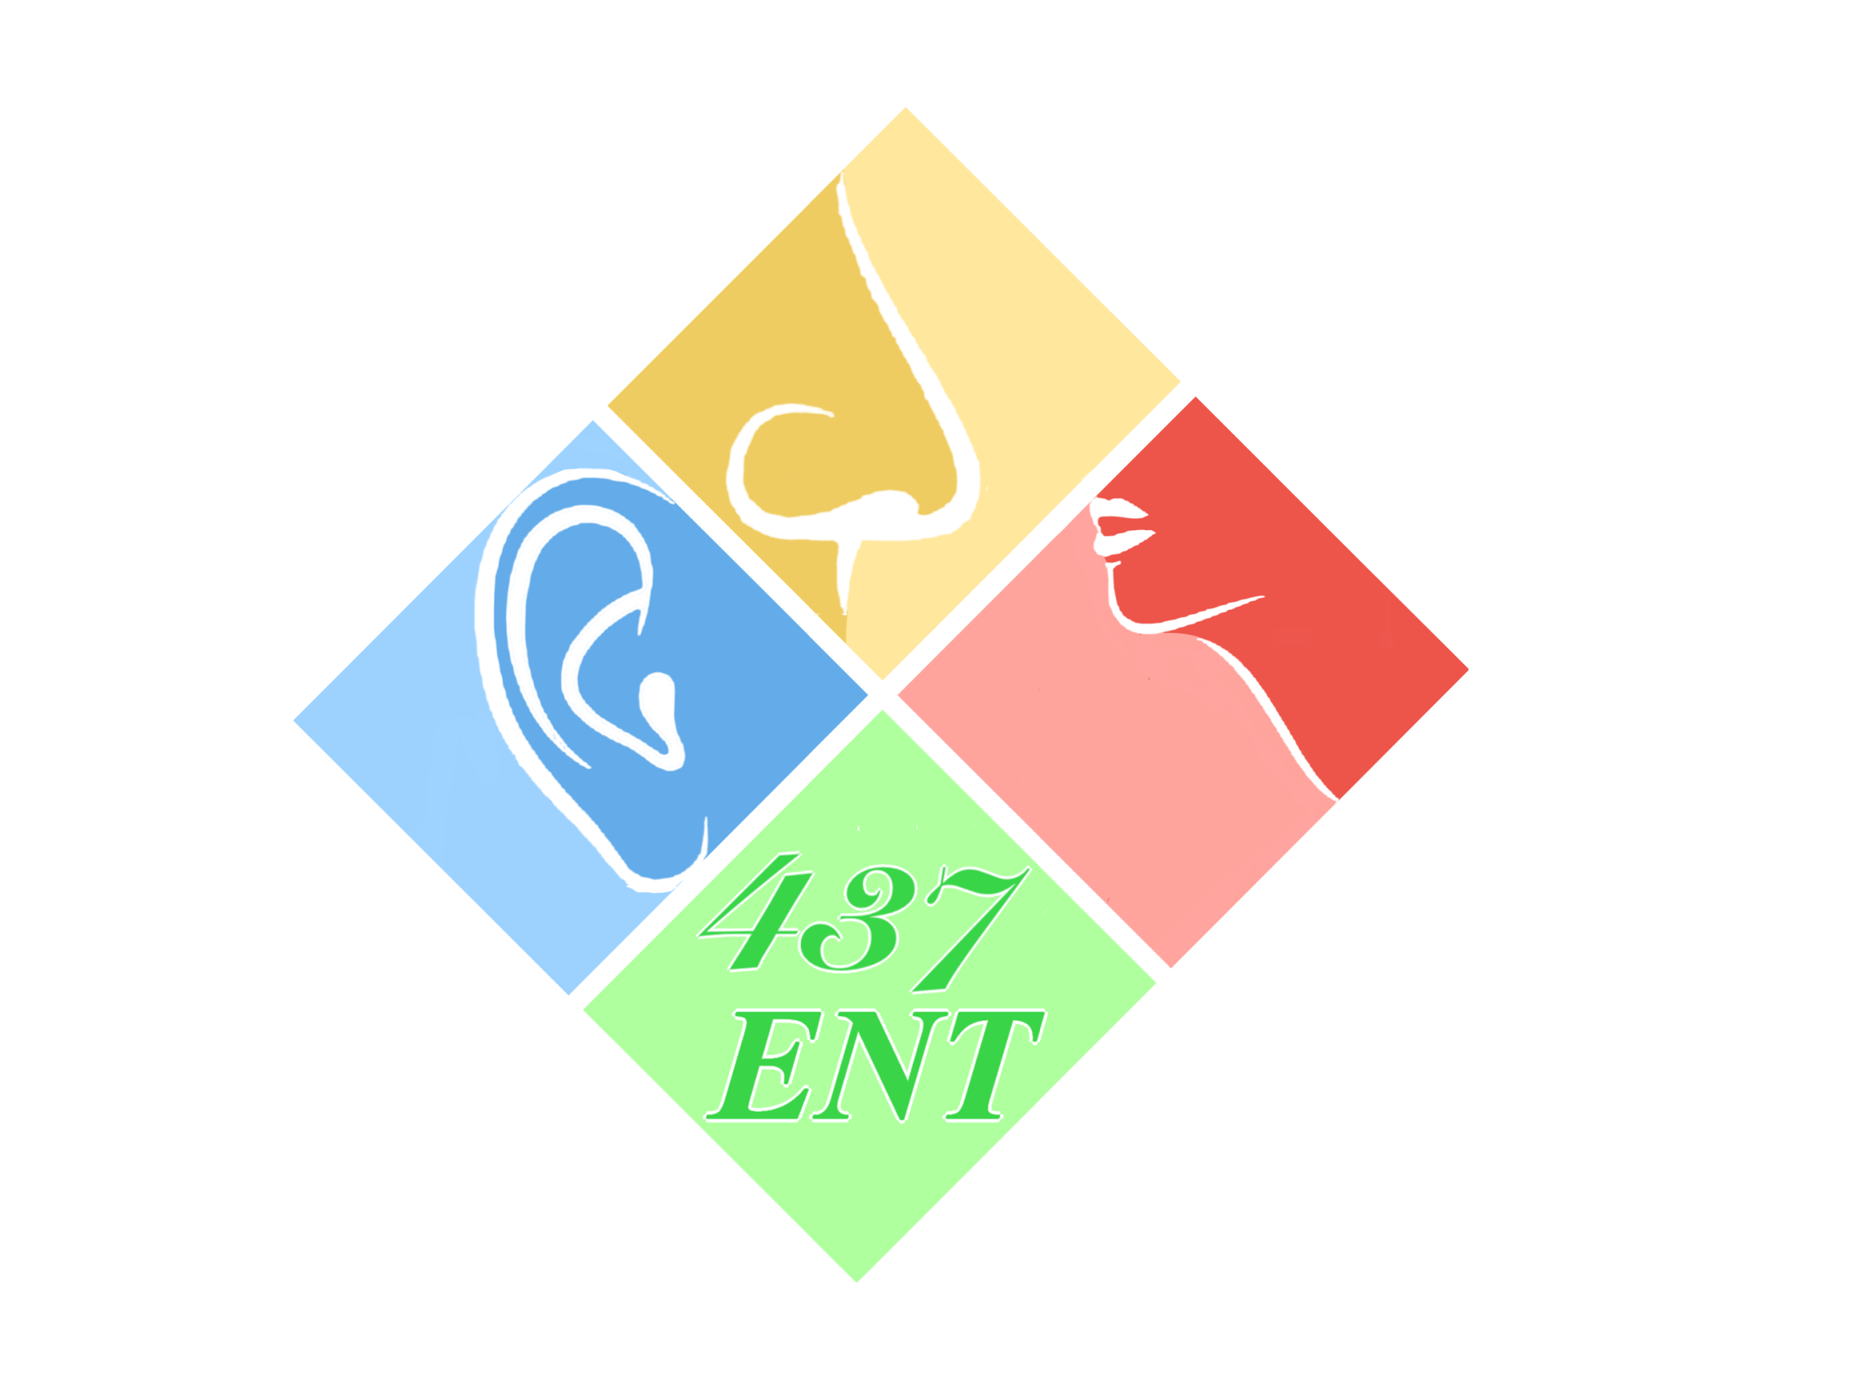
Larynx I-II
Objectives:
To know the basic larynx anatomy and physiology.
To recognize assessment and management of common laryngeal diseases, include ability
to obtain patients’ history, perform comprehensive physical and mental status assessment, interprets findings.
- To know how to handle common laryngeal emergencies. –
To be aware of common laryngeal operations...
Resources:
Done by:Abdulmajeed Alotaibi , Ali shehadah
Edited by:
Revised by: Naif Almutairi
[ Color index: Important | | Notes Extra ]

Slide 2
Larynx I
The larynx or voice-box is part of the upper respiratory tract.
● It is lined with ciliated columnar epithelium except over the vocal folds or ‘cords’ which are covered with squamous epithelium. so when you take a sample from the larynx and you see that it’s lined with squamous epithelium then you have to rule out cancer (metaplasia), and vica versa.
● It is made of a series of cartilages, the main ones being the epiglottis, the cricoid cartilage (a complete ring just above the trachea) and the thyroid cartilage, which you can palpate as the ‘Adam’s Apple’ externally in the neck. between the thyroid cartilage and the cricoid cartilage is the cricothyroid membrane.
● Various membranes, muscles and ligaments complete the structure of the larynx
● The Larynx extends from the epiglottis to the cricoid cartilage.
● The epiglottis is on top behind the Arytenoid cartilages and the hyoid bone (436) .
Definitions
Dysphonia: is a descriptive medical term meaning disorder of voice.
Hoarseness : is a subjective term, and usually refers to a weak or altered voice.
Voice changes are: breathy, harsh, tremulous, weak, reduced to a whisper, or vocal fatigue (voice deteriorates with use). 436 . Breathy voice occurs due incomplete closure of the vocal cords causing air to escape
Skeletomembranous framework of larynx
Thyroid cartilage
Cricoid cartilage
paired arytenoids cartilage
Epiglottis
Hyoid bone

Slide 3
Thyroid cartilage
Shield like - Thyroid cartilage is opened posteriorly. In men it is noted as Adam’s apple. it’s more prominent in men .It is attached to the cricoid.
Cricoid cartilage
Signet ring shaped.
the only complete skeletal ring for the air way. it facilitates the opening and shunting of the airway
Both thyroid and cricoid cartilage are hyaline (calcification).
Cricothyroid joint is a Synovial joint (hinge motion)1 .
Cricoid Cartilage is the narrowest area where the airway obstruction usually happens because it is a complete ring.
Thyroid and cricoid might be seen as bones (calcified) in an X--Ray of a 40-- year old patient
Arytenoid Cartilage: a pair of cartilages directly above the cricoid cartilage
Pyramidal shaped ➢ it has an anterior (vocal) process and posterior (muscular) process.
Apex, vocal processes attached to the vocal cords & muscular processes attached to the muscles that moves the vocal cords. It facilitates the opening and closure of the vocal cords
Cricoarytenoid joint: Synovial (Rocking motion). the only muscle that causes abduction to the vocal cords is posterior Cricoarytenoid muscle.
Corniculate and Cuneiform Cartilage
above the arytenoid cartilage is another small cartilage called corniculate cartilage. it helps to prolong arytenoid cartilage posteriorly and medially. It has no significant function

Slide 4
❖ Epiglottic Cartilage: It is elastic so unlike other cartilages it does not get calcified with age.
Leaf like structure.
Elastic cartilage.
Its ligaments and fold:
Thyroepiglottic ligament (to thyroid). anteriorly.it provides the stability to the epiglottis
Hyoepiglottic ligament (to hyoid bone).
Glossoepiglottic fold ➜ valleculae (Valleculae is the base of the tongue where the tongue is attached to the epiglottis).the one we see it during intubation.
The epiglottis on top is attached to the thyroid cartilage midline, inner margin of thyroid, it’s an elastic cartilage while swallowing it covers the airway and directs the food to cricopharaynegus. Its main function is to prevent food from passing down the trachea
Thyroid, cricoid and epiglottis are all single cartilages unlike the others are paired.
It is attached to the thyroid cartilage as well as to the tongue, thyroepiglottic ligament, hyoepiglottic ligament and glossiepiglottic.
❖ Laryngeal Membranes:
The cartilages are covered by membranes that form folds and ligaments.
Quadrangular membrane: Upper and lower border ➜ thickened
Aryepiglottic fold (it goes up covering the epiglottis)
Vestibular fold (or ventricular fold inferiorly also called false vocal cord) ventricle is the area between the true and the false vocal cords
Triangular membrane (conus elasticus): Medial and lateral border is free ➜ thickened ➜ vocal ligament Covers the trachea going up and ends at the level of vocal ligaments or fold. Between the upper membrane (quadrangular m) and the lower membrane (triangular m) there is a very weak area (in the larynx) which is not covered by any membrane we call it the ventricle or vestibule or saccule.

Slide 5
❖ Laryngeal Mucosa:
All mucosa from trachea to aryepiglottic fold. (ciliated columnar epithelium) with goblet cells. Common tumor is Adenocarcinoma 436
Except vocal cord and aryepiglottic fold. (squamous epithelium.) Commonest tumor in larynx is Squamous Cell Epithelium. Most common tumor of vocal cords is squamous cell carcinoma 436
Due to movement in vocal cords a more robust epithelium is needed
Laryngeal Musculature:
Extrinsic: they only move the larynx up and down during swallowing
Extrinsic depressors: (C1-C3) (Sternohyoid, sternothyroid, thyrohyoid, omhyoid.)
Extrensic elevators: above the hyoid bone (Genohyoid (C1), diagastric (CNV--CNVII) mylohyoid (v) stylohyoid (VII) Used in swallowing.
Intrinsic: responsible for vocal cord movement
Abductors: (breathing: open the airway)
posterior cricoarytenoid (PCA). when the two muscles move laterally the vocal cords open.
Adductors: (talking: phonation)
thyroarytenoid (TA4 ), lateral cricoarytenoid (LCA), cricothyroid, interarytenoid .
Vocal cords have 2 movements:
Adductors (4 muscles) are used for speaking, Abductor (1 muscle) used for breathing and located Posteriorly. (Important for MCQs) ○ Cricoidthyroid is an adductor muscle. But mainly it is responsible for the Vocal Cord tension of the vocal cords and supplied by the Superior Laryngeal Nerve (SLN). (Important for MCQs)

Slide 6
Vocal cord layers:
Squamous epithelium. No lymphoid tissue
Lamina propria: it helps to provide elasticity and protection to the vocal cords, the squamous epithelium glides on it to produce sound. ○ superficial layer Reinke’s space. Reinke’s edema is the collection of fluid within the Reinke’s space that causes heavy voice in smoker. ○ Intermediate layer. ○ Deep layer
Intermedate + deep layers = vocal ligament (the two layers are attached to each other
Vocalis (thyroarytenoid muscle)
Blood Supply:
Superior and inferior laryngeal artery and veins.
Lymphatic Drainage:
Above vocal cord ► upper deep cervical lymph node.
Below vocal cord ► lower deep cervical lymph node.
Vocal Cords have no lymphatic drainage, so when the patient has vocal cord carcinoma, he won’t have metastasis unless it goes supraglottic or subglottic he can start to have metastasis from there.
Nerve supply:
Vagus gives 2 branches: from the right side
Superior laryngeal nerve (SLN)
Internal branch (sensory) + superior laryngeal artery.
External branch (motor) cricothyroid muscle only. the one that gets contracted while shouting.
Recurrent laryngeal nerve (RLN)
RT side: crosses the subclavian artery
LT side: arises on the arch of the aorta deep to ligamentum arteriosum 436 (left is longer) more prone to trauma due to longer trajectory It is divided behind the cricothyroid joint.
Motor ► all the intrinsic muscles except the cricothyroid.
Sensory.
Superior laryngeal gives motor supply to cricothyroid muscle only and sensory supply to structures above the vocal cords
Recurrent laryngeal gives motor to the rest of the muscles and sensory to below the vocal cord
Both arise from the vagus nerve

Slide 7
How to manage vocal cord paralysis? Wait for 6 months it might resolve by its own. If it didn’t or the patient count on his voice for living, you interfere earlier. by injecting materials absorbable within six months to close the vocal cord temporary.
SLN: sensation above the vocal cords, choking means (they are working well, good sensation).
RLN: sensation of vocal cords and below. Left course is longer than the right course. However, vocal cord paralysis might be caused by: thyroidectomy - most common), brain tumor, vocal cord tumor, esophageal, mediastinal. Tumors compressing the nerve, iatrogenic causes: in cardiac thoracic surgery or idiopathic: waking up in the morning sounding weird).
Most common is to have left vocal cord paralysis due to the long course of the left recurrent laryngeal nerve.
Pediatric Airway Anatomy:
The neonates are obligate nasal breathers until 2 months. They can’t breathe from their mouth first when they are born. they have high larynx and epiglottis so the soft palate will cover the central side (mouth airway) witch will guide the milk to move to the lateral sides. that’s why they can eat and breath at the same time.
The epiglottis at birth is omega Ώ shaped. Its very high and descends with age
The infants have high larynx C1-C4.
Physiology
Protection: of the lower airway passage
Closure of the laryngeal inlet.
Closure of the glottis.
Cessation of respiration.
Cough reflex (forced expiration is made against a closed larynx).
Closure of the airways during swallowing the bolus.
Patient with CVA or neurological problem have loss of sensation so all the time they aspirate or choke.
Phonation:
Voice is produced by vibration of the vocal cord. Resonance is caused by mouth, nose and sinuses
Source of energy is the airflow (good lung ➜ good voice).
Normal vocal fold vibration occurs vertically from inferior to superior.
The mouth ,pharynx ,nose ,chest (are resonating chambers). We talk during expiration (we take deep breath feel pressure in subglottic area this pressure help in pushing the air between the vocal cords and start vibrating them). If I have bronchial asthma it means that the amount of air is little, I won’t be able to talk for long time because the pressure was so little.COPD, Smoker ➜ low air amount ➜ low vocal vibration ➜ dysphonia.
Respiration.

Slide 8
Laryngeal Sphincters:
True vocal cord.
false vocal cord. Helps protect the airways, located above the true vocal cord
Aryepiglottic sphincter.
Aryepiglottic fold is between the epiglottis and arytenoid. If it is short, then the epiglottis will always be covering the airway (air obstruction)
Epiglottis
Larynx
Vocal cords
Esophagus
Evaluation of dysphonic patients
History of Dysphonia (hoarseness):
Onset. duration. severity.
URTI. fever. cough.
voice abuse (job). tobacco or alcohol.
dysphagia. aspiration.
breathing difficulty (stridor).
weight loss. think about cancer
GERD. Commonest cause nowadays
trauma.
previous surgery. neck mass.
Laryngopharyngeal reflux (throat clearance).
(Occupation and medication are important).
Examination
Laryngeal examination and voice assessments:
Indirect laryngoscope (using mirror in old days) they used to do it before.
Direct laryngoscope done in the OR
Fibreoptic flexible scope (MCQ: indications are examination of nose, nasopharynx). small scope that goes inside the nose all the way to the larynx.
Stroboscopy for vocal cord vibration assessment. to check if there is any scars or cysts. done for patients with voice problems.
Acoustic analysis
Cranial nerves (tumors might be compressing the involved nerves) Neck examination
You always have to examine the patient nose, throat and vocal cords the difference between laryngoscopy and bronchoscopy is that bronchoscopy has an opening for breathing so you can ventilate at the same time.
you always have to examine the patient nose,throat,and vocal cords and always mention in the OSCE you need to examine the cranial nerve

Slide 9
Indirect
Laryngoscope the flexible scope is most used
Direct
Laryngoscope used in surgery
Right bronchoscope used for examination of trachea and bronchi and removal of foreign bodies
Laryngoscope
Rigid bronchoscopy

Slide 10
Larynx II
Introduction
Symptoms and signs of laryngeal disease:
● Lesions on or around the vocal cords cause hoarseness.
● Failure of the laryngeal inlet to close on swallowing causes aspiration; the patient will cough and splutter on swallowing – food ‘going down the wrong way’.
● The most dangerous laryngeal pathology is narrowing of the airway. This causes reduced air entry and turbulent flow so that the patient makes a high-pitched noise when breathing (stridor).
● Increasing difficulty causes a rise in respiratory rate (tachypnoea), and the patient will struggle to breathe and become distressed as he uses the accessory muscles of respiration to maintain airflow.
● In severe cases there may be cyanosis, cessation of air entry (apnoea) and death
Disease of Larynx
Congenital Abnormalities:
❖ Laryngomalacia :
● Most common cause of stridor( high pitched sound) in neonate and infants very common.
● Laryngeal finding:
Inward collapse of aryepiglottic fold (short) into laryngeal inlet during inspiration (inspirational stridor).
Epiglottis collapses into laryngeal inlet.
Omega shaped epiglottis with short aryepiglottic fold
● SSx: Intermittent inspiratory stridor that improve in prone position.
● Dx: HX and endoscopy “flexible endoscope through the nose” it can’t be diagnosed in the OR when the patient is sedated
● Rx: ○
Observation most of the time cause the condition will improve with time.
Supraglottoplasty (we will consider this surgery in case of severe laryngomalacia, when there is signs of growth retardation, signs of airway obstruction like: cyanosis, sleep apnea, and desaturation).
Tracheostomy old method
the percentage of children with laryngomalacia that will need surgical intervention is only 10%
Case scenario
10-months baby, his mother noticed noisy voice when breathing., on aryngoscope there was an omega shape epiglottis and short aryepiglottic.
What is the diagnosis? Laryngomalacia
What is the most appropriate management? *If no signs of growth retardation or airway obstruction, Reassurance * If there is, then do Supraglottoplasty .
Omega shaped epiglottis
Normally in inspiration: the epiglottis is open and vocal cords are abducted.

Slide 11
Subglottic stenosis stridor is noticed since birth
Incomplete recanalization, small cricoid ring
Can be acquired or congenital, acquired due to prolonged intubation and it’s more common than the congenital.
Types:
Membranous
Cartilaginous
Mixed
Failure of intubation again due to a history of prolonged intubation that result as subglottic stenosis. (SAQ)
Grades(Cotton-Myer grading system):
I <50%.
II 51--70%.
III 71--99%.
IV complete obstruction (no detectable lumen)
SSx:
Biphasic stridor “during inspiration and expiration “ because of a fixed stenosis unlike laryngomalacia which is dynamic.
Failure to thrive.
Dx:
Chest and neck X-ray, flexible endoscope
Rx: tracheostomy in severe cases. Or rural areas
Grade 1-2
Endoscope (CO2 or excision with dilation using a balloon).
-more commonly done nowadays.
-esophageal atresia is more common than laryngeal
atresia, both same concept of treatment.
Grade 3-4
Open procedure:
- LTR (Laryngotracheal reconstruction)
- Ant cricoid split
Grades 1 and 2 are treated by endoscopy and balloon dilation, While in grade 3 and 4 we first secure the airway by tracheostomy and we treat by LTR
Grade 2 stenosis, the redness underneath the opening is a wound
Grade 3 stenosis

Slide 12
The vocal cords are still attached to each other
Laryngeal web (vocal cord web)
● Incomplete canalization. (didn’t open completely)
● Types:
○ Supraglottic
○ Glottis
○ Subglottic
● SSx: 3 month baby came with abnormal noisy breath (stridor), no airway obstruction, no cyanosis, no history of previous intubation, other things are normal. The most likely diagnosis is Laryngeal Web
○ Weak cry at birth
○ Variable degrees of respiratory obstruction
○ On and off stridor
● Dx:
○ Flexible endoscope
● Rx:
○ No treatment (in small web)
○ Laser excision (in large web)
○ Open procedure + tracheostomy (if there is difficulty in breathing)
★ Patient with Anterior laryngeal web
○ dysphonia
★ Patient with Posterior laryngeal web
○ dysphonia and stridor
❖ Subglottic hemangioma
● The most common congenital pediatric tumor, and it is most common in subglottic space.
● 50% of subglottic hemangiomas associated with cutaneous involvement.
● Types:
○ Capillary (typically resolve)
○ Cavernous.
● SSx: biphasic stridor.
● Dx: endoscope.
● Rx:
○ Observation.
○ Corticosteroid ( old treatment).
○ Propranolol (to decrease neovascularization).very
effective.
○ CO2 Laser.
Here the cartilages and membranes are attached to each other
Unilateral
From 436, what are the commonest causes of stridor in pediatrics?
1- Laryngomalacia
2- Subglottic stenosis
3- Bilateral Vocal cord paralysis
Bilateral

Slide 13
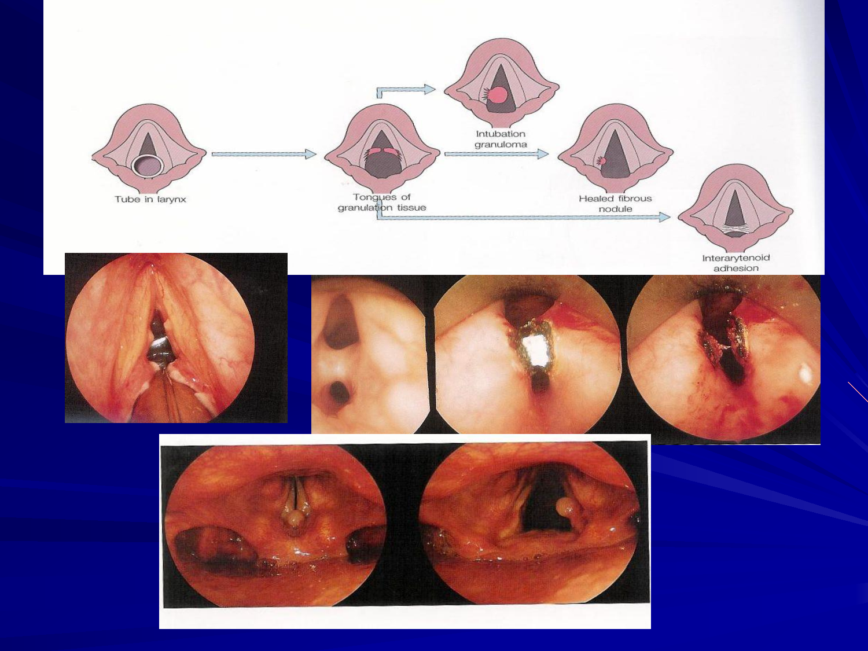
Traumatic Conditions of the Larynx :
● Direct injuries (blows). Common in RTA
● Penetration (open). knife
● Burns (inhalation, corrosive fluids).
● Inhalation foreign bodies. common in pediatric usually vegetables in pediatrics
➔ Intubations injuries:
● Prolonged intubation(more than 2 weeks in adults, more than 3 weeks in pediatrics). If intubation is needed for a longer time use tracheostomy
● Blind intubation.
● Too large tube.
● Inhalation “sloughing and carbonized tissue”
○ Give steroid, antibiotic and Anti-Reflux Drugs
Pathology:
● Abrasion (injury to the mucosa) ➜ granulomatous formation9 ➜ subglottic stenosis due to scaring.
● SSx: hoarseness, dyspnea
● Rx:
○ Voice rest.
○ Endoscopic removal.
○ Prevention.
Burn injury
Open wound
adhesion
nodule
The safest time to keep the Intubation tube is from 2-3 weeks maximum, after that time it has to be removed and instead put the pt on tracheostomy, because if longer than that it will cause granulation tissue, granuloma around it and scars and at the level of subglottic area it will cause narrowing and stenosis. E.g. When a comatose pt admitted after an RTA, they intubate him for long time. So, the most common cause of subglottic stenosis is iatrogenic (Prolonged intubation). Another scenario when the pt intubated with improper technique due to bad ventilators or improper size of tubes or bad tubes, etc.

Slide 14
Vocal Fold Lesions Secondary To Vocal Abuse and trauma
Vocal nodules (singer’s nodules). Seen in teachers, kids and singers
● At junction of ant ⅓ or mid ⅓. (Ant ⅓ and post ⅔)
● Rx : drink lots of water, rest your voice
○ voice therapy refer to speech therapy to learn who to not stress on voice.
○ surgical excision (microlaryngoscopy) if large but therapy is usually effective.
Vocal fold polyp:
● Middle and ant 1/3, free edge, unilateral (Usually anterior)
● Mucoid, hemorrhagic. (Vocal cord hemorrhagic polyp)
● can occur after trauma. like concert or long speech.
● they may present with dysphonia.
● Rx: surgical excision.
complication: dysphonia , pain while talking , aphonia’
Don’t miss it in the exam, they'll bring a case of acute voice injury and then they will describe a lesion on the vocal cord focus on the lesion b/c the treatment depends on it. If Tiny mass, voice therapy. If it,s large mass, then the treatment is surgical excision.
Vocal fold cyst:
● Congenital dermoid cyst
● Mucus retention cyst
Due to blockade of mucus drainage
● Rx: surgical excision dissection
❖ Reinke’s edema (al pacino’s voice). Caused by smoking and acid reflux
• Rx:
○ Voice rest stop smoking.
○ Anti-reflux therapy.
○ Surgical excision.
○ Accumulation of fluid in Reinke’s space
(Common in smokers).
spot dx in women who smoke (thick voice)
Thickened vocal cords

Slide 15
Laryngocele air filled cyst
● Air filled dilation of the appendix of the ventricle, communicates with laryngeal lumen.
● Congenital or acquired.
● Common site: ventricle.
● it could close the airway if happened congenital in children and may
even cause dysphagia or discomfort.
● Types:
○ External: through thyrohyoid membrane.
○ Internal.
○ Combined
● Rx: Marsupialization: partial removal of the mass.
Vocal cord paralysis
Vocal cord paralysis occurs when the nerve impulses to your voice box (larynx) are disrupted. This results in
paralysis of the vocal cord muscles.
Vocal cord paralysis can affect your ability to speak and even breathe. That's because your vocal cords, sometimes called vocal folds, do more than just produce sound. They also protect your airway by preventing food, drink and even your saliva from entering your windpipe (trachea) and causing you to choke.
it occurs to the left recurrent laryngeal nerve more due to its anatomical location(pass behind aortic arch).
Causes
Adult
Neoplastic
iatrogenic
Idiopathic
Trauma
Infection
Toxins
cervical surgery
Thoracic surgery
Skull base surgery (vagus nerve injury)
Other medical procedure: Thyroidectomy
Children
Arnold chiari malformation
Birth trauma “Forceps delivery”
SSx:
Dysphonia.
Choking in recurrent laryngeal nerve injury.
Stridor in pediatric patients or if there’s bilateral paralysis.
In unilateral we have one that’s moving and one not and that’s usually give us voice problems, but if bilateral usually respiratory problem.
Laryngocele

Slide 16
Vocal Cord Position
➔ Median, paramedian, cadaveric
● Rx: Self-limiting or permanent paralysis
★ For medialization: we perform it if we have a problem in the voice. the problem in abductors
○ Vocal cord injections Gelfoam, fat, Collagen and Teflon
○ Thyroplasty type 1 (Silicon Block “Permanent”)
★ For lateralization: if the problem is respiratory. the problem in adductors
○ Cordotomy
○ Tracheotomy
● Vocal cord paralysis can be unilateral or bilateral.
➔ Unilateral: One work and the other is paralyzed with gap in between affects voice (Breathy).
○ Treatment: medialization “inject the paralyzed cord to inflate it closure of the gap.
➔ Bilateral: Adduction of the cords can’t open and it will cause stridor, and dyspnea, voice is fine.
○ Treatment: lateralization.
Inflammation of the larynx
Acute Laryngitis الخناق
● Rhinovirus ● Parainfluenza
SSx:
● Dysphonia ● Fever ● Cough
Rx:
● Conservative ● steroids
Acute Epiglottitis
Used to be a threatening infection but know due to vaccinations it is seen less,
Haemophilus influenza B
vaccine (2-6 year).
What is the most common organism causes Acute Epiglottitis? H.influenza B
SSx
● Dysphonia ● No cough ● Normal voice ● Fever
● Drooling ● Dyspnea ● Sniffing position
Rx
● Do not Examine in the ER.
● Intubate in the OR.
● IV Antibiotics.
● Corticosteroids (For the Edema).
Thin, paralyzed and atrophic cord
Material is injected to push cord inward
X-ray (Thumbprint sign)
Epiglottis is inflamed and airway is obstructed

Slide 17
Croup (Laryngotracheobronchitis)
● Primarily involves the subglottic region. Edema in sub glottis
● Parainfluenza 1-3
● (1-5 years) Pediatric.
SSx:
● Biphasic stridor
● Fever
● Brassy cough
● No Dysphagia
● Hoarseness
Rx:
● Humidified O2.
● Racmic Epinephrine (IMP).
● Steroids. To resolve edema quickly
Dx: ● Xray (Steeple sign)
Diphtheric Laryngitis rare due to vaccination
➔ Causes: ● Corynebacterium diphtheriae.
➔ SSx:
● Cough, stridor (suggests the spread of the membrane to the larynx and trachea), dysphonia, fever.
● Greyish –white membrane.
➔ Treatment:
● Antitoxin injection.
● Systemic penicillin.
● Oxygen.
● Tracheostomy.
Fungal Laryngitis
● seen in diabetics and Immunocompromised patients.
● Candidiasis, aspergillosis
➔ SSx: ● Dysphonia, Cough, Odynophagia.
➔ Rx: Antifungal regimen
Recurrent Respiratory Papillomatosis
● 2/3 before age 15 (juvenile).
● Rarely malignant change.
● HPV 6-11 (common).
● HPV 16-18 (malignancy).
Risks:
○ Younger first time mother (condyloma acuminata)
○ Lesions: wart like (cluster of grapes). in genital area.
● Types:
○ Juvenile “affect children and it’s very aggressive”.
○ Senile.
● SSx: Hoarseness, stridor.
● Rx:
○ Laser excision, microdebrider.
○ Adjunctive therapy: Cidofovir, acyclovir interfero(new treatment :Avastin)
Papilloma

Slide 18
Malignant Neoplasm Of The Larynx
● 1-5 % of all malignancies. Of head and neck
● All are squamous cell carcinomas.
SSx:
Hoarseness,
aspiration,
dysphagia(functinal issue),
stridor,
weight lost.
Risks:
Smoking, alcohol, radiation exposure.
Classifcations
Supraglottic
30-40% of Laryngeal Ca.
25-75% Nodal metastasis
Glottic
50-75%. commonest
Limited regional metastasis
Subglottic
Rare.
20% regional metastasis
● Rx:
○ Radiotherapy.
○ Hemilaryngectolmy.
○ Total Laryngectomy + Neck dissection (lymphadenectomy.

Slide 19
Extra Notes
Vocal Cord Paralysis:
Unilateral: affected cord lies in the paramedian position, inadequate glottic closure during phonation >
weak, breathy voice.
Usually medializes with time whereby phonation and aspiration improve. Treatment options include voice therapy, injection laryngoplasty (Radiesse), medialization using silastic block.
Bilateral: cords rest in midline therefore voice remains good but respiratory function is compromised and may present as stridor.
If no respiratory issues, may monitor closely and wait for improvement. If respiratory issues, intubate and will likely require a tracheotomy.
Benign Laryngeal Papillomas (from Toronto notes):
Etiology
HPV types 6, 11
❏ possible hormonal influence, possibly acquired during delivery
Epidemiology Biphasic distribution:
❏ Birth to puberty (most common laryngeal tumour) and adulthood
Clinical Features
❏ hoarseness and airway obstruction
❏ can seed into tracheobronchial tree
❏ highly resistant to complete removal
❏ some juvenile papillomas resolve spontaneously at puberty
❏ may undergo malignant transformation
❏ laryngoscopy shows wart--like lesions in supraglottic larynx and trachea
Treatment
❏ microdebridement or CO2 laser
❏ adjuvants under investigation: interferon, cidofovir, acyclovir
❏ HPV vaccine may prevent/decrease the incidence but more research is needed
Laryngeal Carcinoma (from Toronto notes):
Etiology
SCC most common 3 sites:
1. Supraglottic (30 to 35%)
2. Glottic (60 to 65%)
3. Subglottic (1%)
Mean age: 45 to 75 M:F = 10:1 Risk factors:
❏ Smoking/EtOH
❏ HPV 16 infection strongly associated with the risk of laryngeal squamous cell cancers
Clinical Features:
❏ Dysphagia, odynophagia, globus Otalgia, hoarseness, Dyspnea/stridor Cough/hemoptysis
Cervical nodes: rare w/glottic CA
Diagnosis: Laryngoscopy CT/MRI
Treatment: 1ry radiation -2ry surgery -1ry surgery for bulky T4 disease

