Slide 1
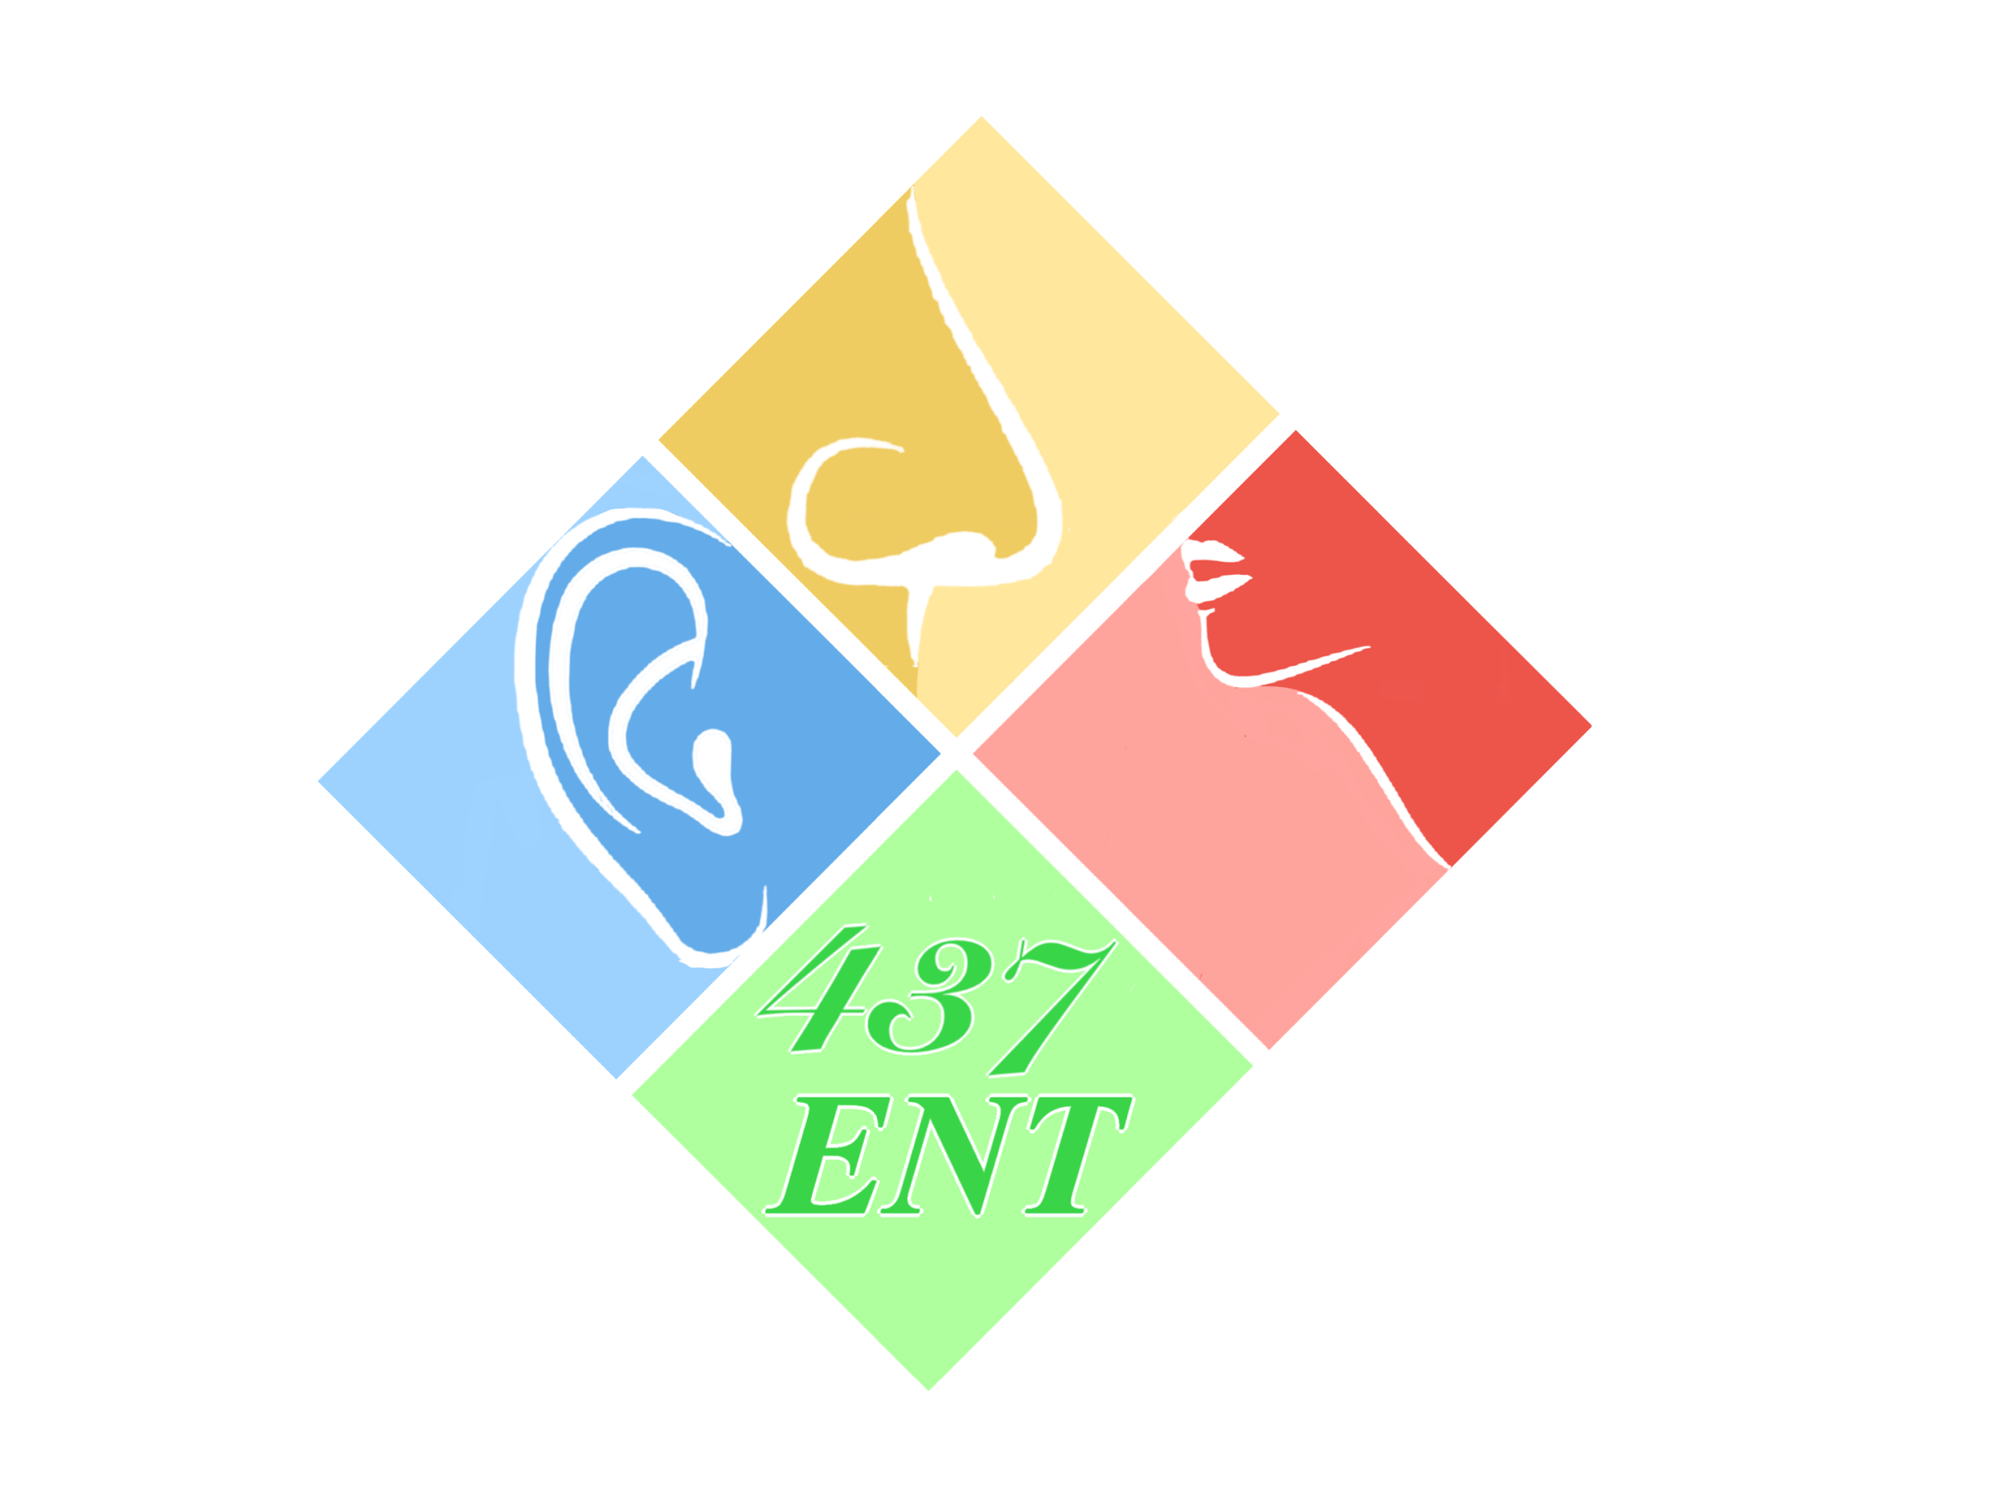
Communication and Swallowing Disorders I-II
Objectives:
Understand physiology of communication.
Recall different categories of communication and swallowing disorders.
differentiate different causes of communication and swallowing disorders.
assess and manage different communication and swallowing disorders.
Most important: VOICE, SWALLOWING AND HYPERNASALITY
Resources: Team 436 F, Doctor Slides.
Done by: Ali Alotaibi, Naif Almutairi
Edited by:
Revised by: Naif Almutairi
[ Color index: Important | Notes | Extra ]

Slide 2
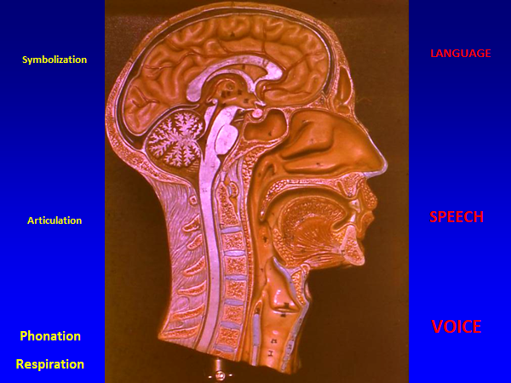
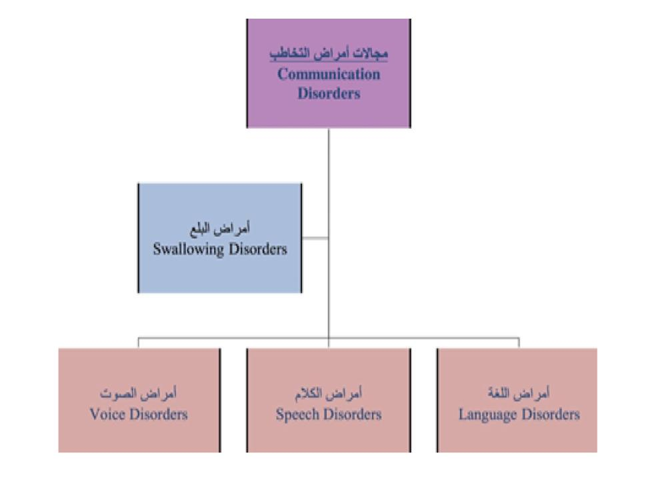
DEFINITIONS:
Communication difficulties have an impact on the following aspects:
Academic, Social, Psychological,Employment, Professional, Financial,
Family relations.
COMMUNICATION | ● Exchange of thoughts, ideas, emotions between two parties ● Types: A-Verbal B-Non verbal ● Parts of communication: 1-Voice 2-Speech 3-Language (try to mention them in this order)
VOICE | The result of vibration of the true vocal folds using the expired air.
SPEECH (ARTICULATORS) | • A neuro-muscular process whereby language is uttered. تلفظ • It includes the coordination of respiration, phonation, articulation,prosody and resonation. الحروف والاصوات الواضحة، بطلاقة جيدة وبدون خنة
LANGUAGE | A symbolic arbitrary system relating sounds to meaning.
SWALLOWING | The process of successful passage of food and drinks from the mouth through pharynx and esophagus into the stomach.
HOW COMMUNICATION HAPPENS? VERY IMPORTANT
In order to communicate 4 physiological process should happen in certain arrangement :
1- Inspiration → expiration → air passes through sound box (larynx) (expiratory phonatory airflow) → 2- vibration of vocal folds (not cords!) → 1&2 gives voice (primary laryngeal sound) → 3- Articulation by supralaryngeal. compartments (pharynx, epiglottis, tongue, soft palate, teeth, sinuses) (articulators or resonators/speech) (they produce a person's recognizable voice “Speech”)→ symbolization by the brain (language)
• Function of supralaryngeal compartments: change of primary laryngeal sound (voice) into secondary sound (speech).
• Disorders of communication can occur in each of the following:
○ Language
○ Speech
○ Voice

Slide 3
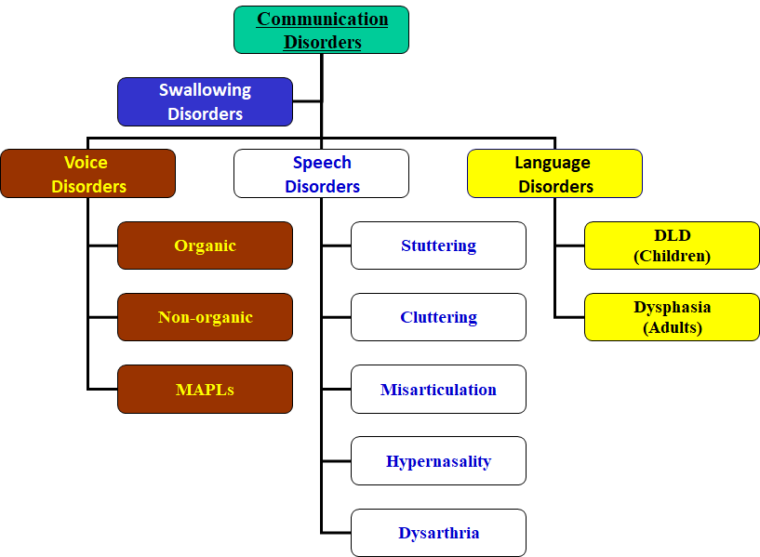
WHO IS MANAGING COMMUNICATION AND SWALLOWING DISORDERS?
1. PHONIATRICIANS (MD’S):
A. A medical specialty that deals with communication and swallowing disorders.
B. It stems mainly from ORL (ENT), especially when dealing with voice disorders.
2. SPEECH-LANGUAGE PATHOLOGIST.
Like in cleft palate
The ones that circled with red are the most IMPORTANT

Slide 4
A. LANGUAGE DISORDERS:
❖ 1- Delayed Language Development (DLD): Language disorders is the most common communication problem here in Saudi Arabia, and DLD the comments among children.
➔DEFINITION: Delay or failure to acquire language matched with age. Ex. 4 yrs. old child who knows 4 words only! i.e. an 8-month-old baby can’t talk, you won’t diagnose with DLD because at this age it’s normal.
Prerequisites of normal language development:
1. Normal brain function
2. Intact sensory channels (eg auditory)
3. Normal psyche
4. Stimulating environment
CENTRAL LANGUAGE CONTROL:
– The left hemisphere is the processor of language functions in almost all people regardless handedness. It is the dominant hemisphere.
– Language areas are distributed along the rolandic fissure.
– Anterior language area mainly in the temporal region concerned with expressive aspect.
– Posterior language area mainly in the parietal region concerned with receptive aspect
STRUCTURAL DOMAINS OF LANGUAGE:
- Semantics; meaning. - Phonology; articulation. -Syntax; grammar.
STAGES OF NORMAL LANGUAGE DEVELOPMENT:
– 2-4 MONTHS; Babbling.
– 6 MONTHS; Vocal play.
– 9 MO-1 YEAR; 1st word.
– 1-1/2 YEARS; 20 words.
– 2 YEARS; 200 words, 2 word sentence.
PRE-REQUISITES OF NORMAL LANGUAGE DEVELOPMENT:
– Intact brain functions (conceptual, motoric and cognitive abilities).
– Intact sensory channels; Auditory, Visual, Tactile, Kinesthetic.
– Intact psyche.
– Stimulating environment. (very important)
– 435 notes:
Babies should say their first word at their 1rst year (9 months – 1yr).
At their 3 year he should be able to say more than one sentence if not they may have DLD (delayed language development).
A parent with a baby who speaks no more than 2 word at age of 2 should seek advice.
– 3 YEARS; 2000 words, 3 word sentence.
– 4 YEARS; 4 word sentence.
– 5-7 YEARS; Full maturation of all language modalities.

Slide 5
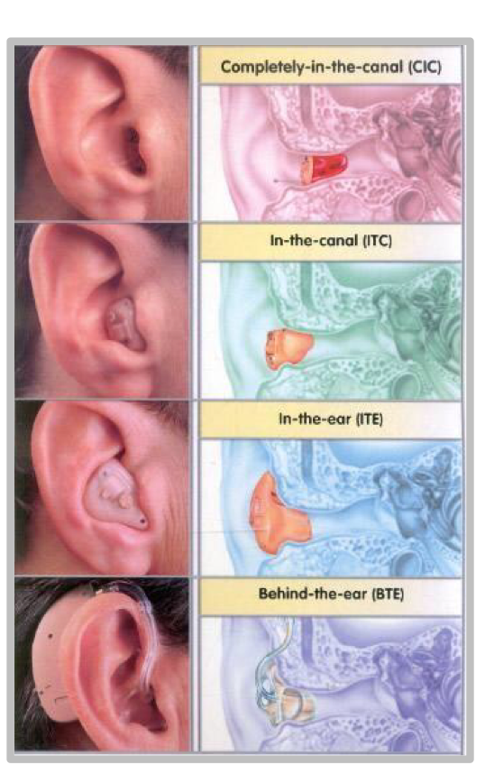
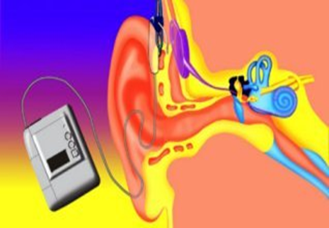
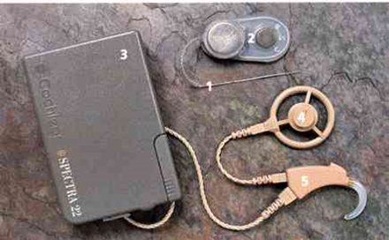
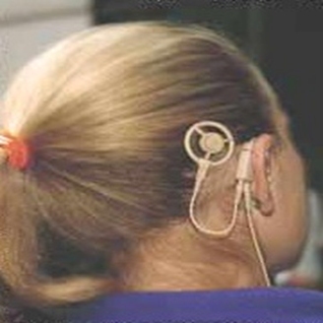
➔ ETIOLOGY (opposite of pre-requisites):
1. Brain damage.
– Diffuse brain damage (M.R.).
– Localized brain damage with motorly handicapped child (CP).
– Minimal brain damage (ADHD), medication then speech therapy.
– Cerebral palsy (CP), hypoxia or trauma during delivery.
2. Sensory deprivation.
– HEARING IMPAIRMENT: conductive, sensory-neural, mixed, central auditory processing disorder.
– VISUAL IMPAIRMENT.
3. Psychiatric illness: Autism, Autism Spectrum Disorder (ASD), childhood schizophrenia.
4. Environmental deprivation (Non-stimulating environment): Lonely child, first and last child.
5. Idiopathic -Specific Language Impairment- (best prognosis).
ASSESSMENT OF DLD:
1. History taking.
2. Physical Examination of articulators.
3. Investigations:
Psychometry (IQ).
Audiometry.
DLD sheet
Brain Imaging.
EEG.
Ophthalmological consultation.
management of DLD:
• Early detection. (the earlier the better the prognosis)
• Providing the suitable aid:
- hearing (HA or CI). - visual aid. – physiotherapy.
• family counseling.
• Direct language therapy (individual- group).
• Medications (autism and ADHD).
SAQ stop: VERY IMPORTANT
What is this device called? COCHLEAR IMPLANT
what are the indications for CI? BILATERAL SEVERE TO PROFOUND SENSORINEURAL HEARING LOSS.
2- Implant part

Slide 6
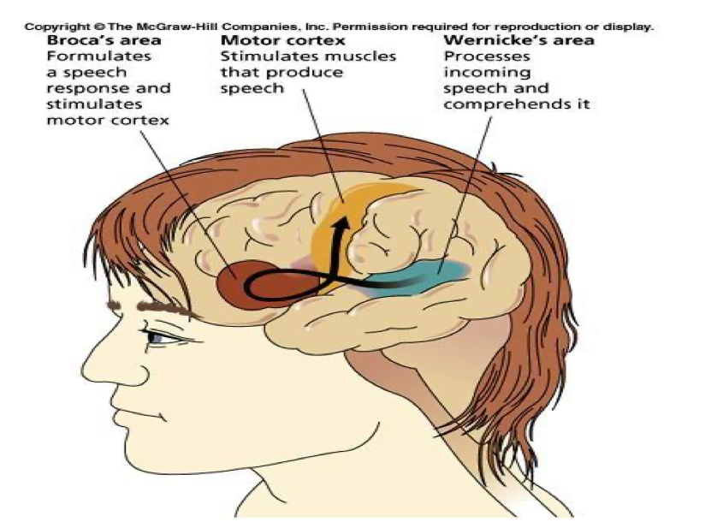
❖2- DYSPHASIA:
DEFINITION: Language deterioration after its full development due to brain insult: infarction, hemorrhage, atrophy, etc.
Full development of speech:
a. Females: 7.5 years (more stutter) b. Males: 8 years.
ETIOLOGY:
1-CVA. 2-Neoplastic. 3- Traumatic. 4-Inflammatory. 5- Degenerative. 6- Metabolic. 7-POISONING. 8- RTA
TYPES OF DYSPHASIA:
1. Expressive:(e.g. Broca’s aphasia) Understands but cannot speak, very traumatic psychologically. (better prognosis).
2. Receptive: Can speak but he doesn’t understand.
3. Mixed predominantly expressive.
4. Mixed Predominantly Receptive.
5. Global. (most severe)
Mixed types are more common.
❖ Examples:
1.Expressive: Dr: Where’s your son? Pt: Points to his son Dr: Ok, What’s his name? Pt: ....... (unable to answer to a direct Q).
2.Receptive: Dr: How R U today? Pt: oh, yes, I slept well yesterday…
ASSESSMENT OF DYSPHASIA:
1. HISTORY TAKING
2. PHYSICAL EXAMINATION: NEUROLOGICAL EXAM. ( Sensory and Motor )
3. INVESTIGATIONS:
– CT / MRI brain.
– Dysphasia test.
– Psychometry (IQ).
– Audiometry.
MANAGEMENT:
• Treat the cause. If tumor, if HTN causing Hemorrhage. etc.
• Physical rehabilitation (Physiotherapy).
• Family counseling. They have big role! If isolated, the problem will deteriorate.
• Language therapy.
• Alternative and augmentative communication: cards, sign boards. In mixed or severe Aphasia.

Slide 7
B- SPEECH DISORDERS:
1- DYSLALIA (MISARTICULATION): لدغة
DEFINITION: Faulty articulation of one or more of speech sounds not appropriate for age. And it is consistent.
TYPES: the first two are the most important
A. SIGMATISM (/S/ DEFECT): سبورة
– Interdental stigmatism ثبورة
– Lateral astigmatism شبورة
– Pharyngeal sigmatism خبورة
B. ROTACISM (/R/ DEFECT)5 مركب : ملكب = موكب = مكب = مغكب
C. BACK-TO-FRONT DYSLALIA:كورة
– /k/ → /t/ تورة/ - g/ → /d/
D. VOICED-TO-NONVOICED DYSLALIA:/g/→ /k/ /d/→ /t/ /z/→/s/
– IMITATIONAL DYSLALIA: parents have dyslalia → child never learned the correct sound
ASSESSMENT OF DYSLALIA:
A. HISTORY TAKING
B. PHYSICAL EXAMINATION “TONGUE” Check the Articulators
C. INVESTIGATIONS:
•Audio recording.
•Articulation test.
MANAGEMENT:
A. TREATMENT OF THE CAUSE:
– Tongue tie (prevents elevation of the tongue, can’t say La). RX: by cutting the frenulum.
– Dental anomalies (open bite).
– Hearing.
– Dyslalia sheet.
B. SPEECH THERAPY with assistance and counseling. Most cases treated this way and it very helpful .جلسات علاجية
2- STUTTERING: تأتأة أو تلعثم
➔ DEFINITION: The intra phonemic disruptions resulting in sound and syllable repetitions أأأأحمد , sound prolongations آآآآحمد(first sound or whole word is prolonged), and blocks. Worst prognosis (MCQ!)
➔ TYPES:
Prolongation
Repetitions
Blocking
*Most important problem facing children with stuttering is the avoidance:
يبدأ الطفل يتجنب المشاركة والتحدث ويصير كل أحد يتجنبه وهذا من أكثر الأشياء اللي يزيد المشكلة سوء.
• Psychometry (IQ). •Audiometry.
Time of onset is 1-13 years usually

Slide 8
NORMAL DISFLUINCY: هنا اسمها عدم طلاقة طبيعية يعني ممكن تعدي بدون مشاكل ولكن الطفل عرضة للتلعثم
A- Less than 6 years B- Only repetitions. C- No associated muscular activity. D- Not aware.
➔ INCIDENCE OF STUTTERING: 1%.
➔ ONSET: - Earliest = 18 months. -Latest = 13 years.
➔ EPIDEMIOLOGY:
More in families with history of stuttering.
Can occur in mentally retarded.
Very rare in the hearing impaired.
Gender ratio: 4: 1 (male: female) worse in females. (more shy)
➔THEORIES OF STUTTERING: The exact cause is unknown. Although the cause it's not psychological, but this problem has a psychological impact.
Organic/Genetic theory
Neurosis theory.
Learning theory.
➔ASSESSMENT OF STUTTERING:
1. HISTORY TAKING.
2. PHYSICAL EXAMINATION
3. INVESTIGATIONS:
Audio & video recording.
Stuttering severity index (SSI).
Psychometry (IQ)
Articulation test.
Auditory Perceptual Analysis (APA).
➔AUDITORY PERCEPTUAL ANALYSIS (APA)
1. CORE BEHAVIORS:
– Intraphonemic disruption.
– Repetitions.
– Prolongations.
– Blocks.
2. SECONDARY REACTIONS
– Muscular activity and struggle (tremors)
– Interjection
– Word substitutions and circumlocution
3. CONCOMITANT REACTIONS:
– Fear.
– Eye contact (poor)
– Skin pallor/flushing
– Breathing (antagonism, interruption, prolongation, cessation, ...)
➔MANAGEMENT OF STUTTERING: The only treatment till now is speech therapy جلسات علاجية
Family and patient counseling.
Speech therapy: يكون فيها تعويد الطفل على إبطاء سرعة الكلام + التحكم في النفس
A- Indirect therapy: if not aware. on the family side (slowing their talk).
B- Direct therapy: if aware
3- CLUTTERING: Is a fluency disorder characterized by a rapid and/or irregular speaking rate, excessive disfluencies. Rx: first by making the person aware of this problem.

Slide 9
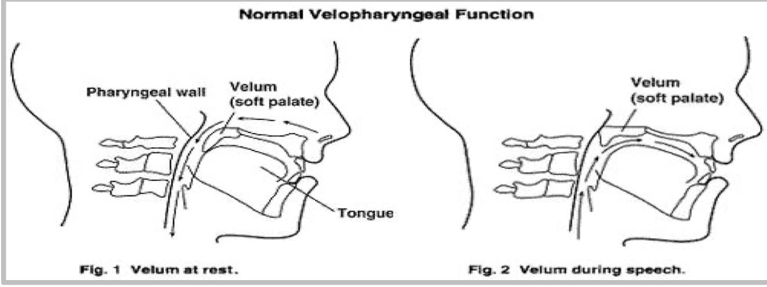
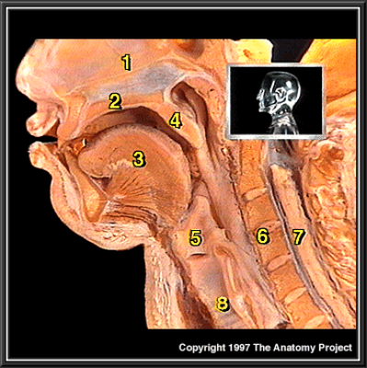
4- HYPERNASALITY: IMP
➔DEFINITION:
Faulty contamination of the speech signal by the addition of nasal noise. It results from velopharyngeal dysfunction (VPD) or insufficiency (VPI).
– Is a disorder that causes abnormal resonance in a human's voice due to increased airflow through the nose during speech.
– Nasal tone (soft palate is open) is used in the letter M (M nasal = B oral) and N
– Hyponasality→ soft palate closed (closed nasality) e.g. common cold, polyp, deviated septum adenoid, chronic sinusitis. (M becomes B) )مع الزكمة .
– Hypernasality→ soft palate open (open nasality) → velopharyngeal dysfunction (VPD).
جميع الحروف تخرج من الفم عدا (م , ن) تخرج من الأنف
In Hypernasality some letters come also from the nose
Important for SAQ
1- Nasal Cavity
2- Hard Palate
3- Tongue
4- Soft Palate : هو المتحكم بخروج الأصوات مع الأنف
فمثلا في حالات ال ”Cleft Palate”
هنا ما راح يقفل ويتحكم بخروج الأصوات لأن فيه مشكلة بالتالي بعض الأصوات راح تطلع مع الأنف على غير العادة
5- Larynx
6- Spinal column “Cervical part”
7- Spinal cord “Cervical part”
8- Trachea
ETIOLOGY:
Organic | Non-organic
1- Structural a.Congenital: Overt cleft palate. Submucous cleft palate. Non-cleft causes: 1-Congenital short palate. 2-Congenital deep pharynx. b. Acquired: – Palatal trauma – Tumors of the palate and pharynx – Adenotonsillectomy 2-4 weeks => temporary (pain=> decrease movement=> more inx are needed if it exceeds 4 weeks> surgical error 2- Neurogenic: (VP Incompetence) Palatal U motor neuron lesion. Palatal L motor neuron lesion. | • Faulty speech habits. • Mental retardation. • Neurosis or hysteria. • Hearing impairment. • post-tonsillectomy pain. (transient)

Slide 10
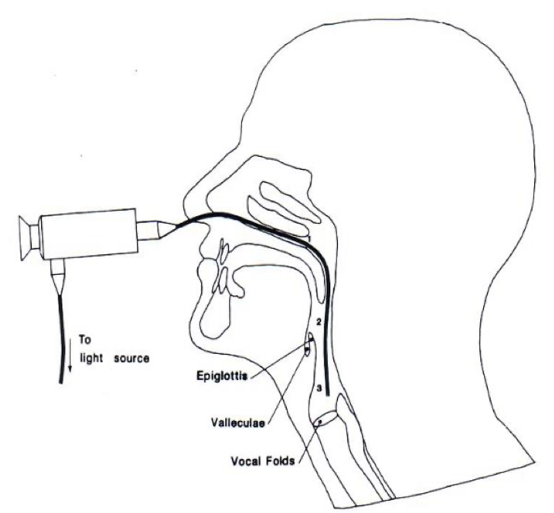
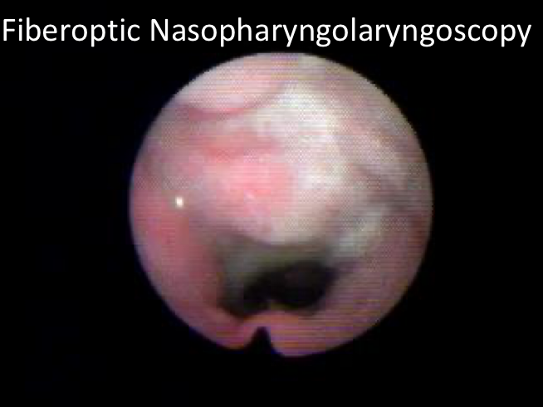
➔ EFFECTS OF VPI:
Feeding problems: nasal regurgitation.
Ear Infections (tensor Palati : CN V).
Psychosocial problems.
Communicative problems:
• Speech: hypernasality.
• Language: DLD.
• Voice: hyper or hypofunction.
➔ ASSESSMENT OF HYPERNASALITY (VPD):
I. History taking. Trauma, cleft abnormality…
II. Physical examination:
– General.
– ENT examination: palate (inspection, palpation).
– Simple test:
▪ Gutzman’s (a/i) test. ▪ Czermak’s (cold mirror) test.
III. Investigation:
– Audio recording.
– Fiberoptic Nasopharyngolaryngoscopy.
– Psychometry (IQ).
– Audiometry.
– Articulation test.
– Nasometry : Hypo or Hypernasality
– Hypernasality sheet.
➔ MANAGEMENT:
Teamwork - Feeding - Hearing - Maxillofacial - Palatal and lip surgeries - Obturators.
Communication (Phoniatric intervention):
▪ Language: Language therapy.
▪ Speech: Speech therapy
▪ Voice: Voice therapy.
Family counseling.
➔ TREATMENT DECISION: – Velopharyngeal insufficiency: surgery (speech therapy post-op). – Velopharyngeal incompetence: surgery (speech therapy post-op) / prosthetic devices / speech therapy. – Velopharyngeal mislearning: speech therapy.
➔ SURGERY: – Pharyngeal flap / sphincter- palatoplasty / post-pharyngeal wall augmentation.
Flexible Endoscopy
1- Examine soft palate (Speech and Hypernasality)
2- Examine Swallowing
3- Examine Vocal folds (Voice)

Slide 11
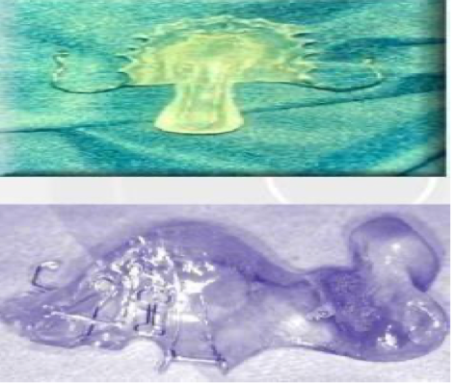
➔ PROSTHETIC DEVICE: (for elderly)
– Palatal lift: to raise the velum when there is poor velar
– movement (i.e. dysarthria).
– Palatal obturator: to occlude an open clef or fistula.
– Speech bulb: to occlude nasopharynx.
SUBMUCOUS CLEFT:
Difficult to diagnose >triad:
■Bluish central line in soft palate.
■Bifid uvula.
■Contraindicated to adenoidectomy >Hypernasality.
■Post nasal notch (instead of spine).
5- DYSARTHRIA: Here Language Center is intact, not like dysphasia
➔ DEFINITION:
Any combination of disorders of respiration, phonation, articulation, resonance, and prosody (intonations), that may result from a neuromuscular disorder. Brain and language are normal
The problem is in brainstem or nerves that supply muscles that produce speech sound.
It affect the Supralaryngial copartments
➔ TYPES OF DYSARTHRIA: only know the types
Type | 1- FLACCID | 2- SPASTIC | 3- ATAXIA | 4- DYSKINETIC | 5- MIXED
Lesion | Lower motor neuron level | Upper motor neuron level | Cerebellum level | Basal ganglia level | may the most common
Communication | Breathy phonation hypernasality. | Strained strangled. phonation. labored breathing | Increased equal stresses. Irregular articulatory. breakdown. | A. Hypokinetic type (Parkinsonism): breathy phonation rapid rate. B. Hyperkinetic type: i. Quick hyperkinetic (Chorea): variable rate and loudness. ii. Slow hyperkinetic (Athetosis): slow rate | - Examples: 1.Motor neuron disease. 2.Flaccid+Spastic Multiple. sclerosis: Ataxic. Spastic. 3. Wilson’s disease: Ataxic + Spastic + Hypokineti

Slide 12
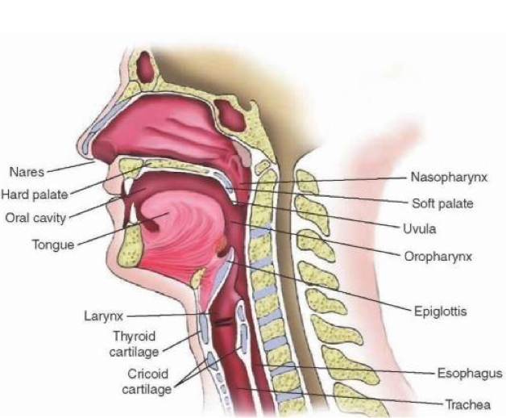
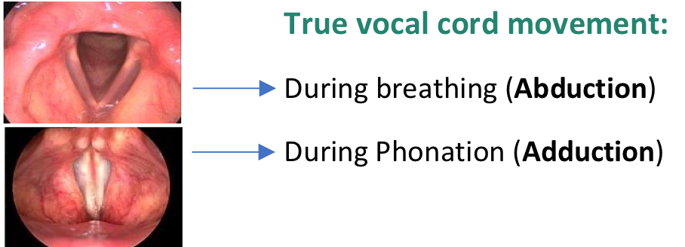
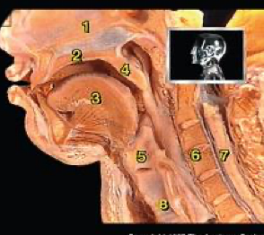
➔ ASSESSMENT OF DYSARTHRIA:
HISTORY TAKING.
PHYSICAL EXAMINATION: mouth, palate, neurological exam.
INVESTIGATIONS:
• Audio recording.
• MDVP.
• CT/MRI brain.
• Dysphasia test. Dysarthria can come with dysphasia (Mixed)
• Psychometry (IQ).
➔ MANAGEMENT OF DYSARTHRIA:
❖ INDIVIDUALIZED: No Language therapy b/c it’s intact unless it’s mixed
1. Management of the cause.
2. Patient counseling and speech therapy.
3. Communicative therapy: Depending on the area affected
• Articulation. • Phonation. • Resonance. • Respiration. • Prosody.
4-ALTERNATIVE AND AUGMENTATIVE COMMUNICATION.
10% of communications disorders.
Prerequisites of “normal” voice production:
Normal range of movement of vocal folds.
Normal mobility of mucosa on deep layers.
Optimal coaptation of vocal folds’ edges.
Optimal motor force.
Optimal pulmonary support.
Optimal timing between vocal fold closure and pulmonary exhalation.
Optimal tuning of vocal fold musculature (int. & ext.).
➔ Functions of the larynx:
– Airway.
– Protection.
– Phonation.
– Increasing intrathoracic pressure.
➔ USUALLY THE PRESENTING SYMPTOMS IN VOICE DISORDERS
ARE:
- Dysphonia:
A– Difficulty in phonation
B– Change patient’s voice from his/her habitual
C– Hoarseness: roughness & harshness of voice. Objective
term. Dysphonia is broader (includes high pitched)
MCQ : Difference between Dysphonia (Change of habitual sound) and Dysodia (Change of Singing Sound)
-Aphonia: Loss of the patient’s voice (functional or organic).
-Phonasthenia: voice fatigue.
Phonasthenia: a subjective complaint of dryness, tightness, globus feeling and voice fatigue, while the
patient’s voice and larynx is normal.
- Dysodia: Change of the singing voice while the speaking voice is normal.
• Audiometry.
• Nasometry.
• Fiberoptic nasopharyngolaryngoscopy.
• Aerodynamics (Aerophone II).
C. VOICE DISORDERS:

Slide 13
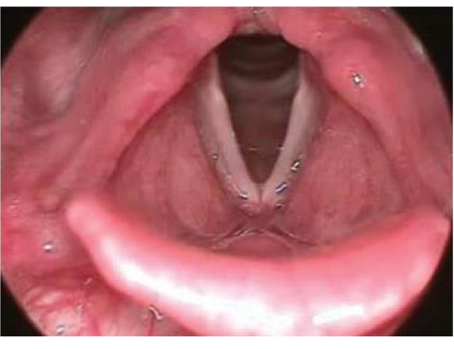
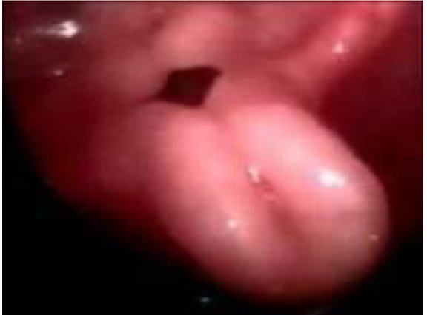
SAQ
➔ ANATOMICAL LANDMARKS OF THE LARYNX:
IMP understand the picture so you can locate the lesion.
– Anteriorly: Anterior commissure and epiglottis
– Posteriorly: Arytenoid cartilage and hypopharynx
Pictures: As seen in the second picture the false vocal cords are on top of the true
vocal folds and not next to them as it might appear in the first picture.
FF=False folds V=Ventricle TF=True folds.
How to know Right from Left? By the Anterior commissure (no posterior commissure),
so in the first picture the patient is facing us.
➔ CROSS SECTION OF THE VOCAL CORDS WHICH CONTAINS:
Mucosa:
1. Squamous epithelium
2. Lamina propria which contains:
– Superficial layer.
– The intermediate and deep layers (vocal ligament).
➔ Etiology of dysphonia:
Organic: there is clear seen pathology.
Non-organic (normal Phx): no clear seen pathology, but there is complaint.
Benign vocal cord lesion. Both, Start as non-organic then become organic due
to damage
Accompaniment of Neuro-psychiatric Ailments.
1- ORGANIC VOICE DISORDERS:
Congenital (Laryngeal web, Subglottic stenosis, Laryngomalacia)
Inflammatory
Traumatic
Neurological
Neoplastic
Hormonal
Status postlaryngectomy.
FF : False vocal folds
V :Ventricule
TF : True vocal folds
1- Normal
2- laryngomalacia (congenital)

Slide 14
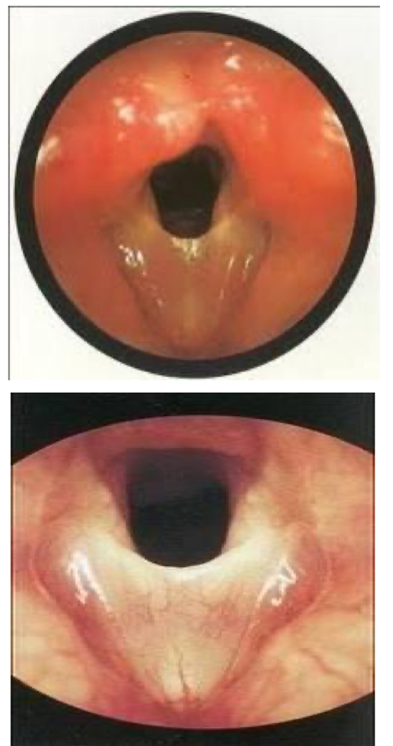
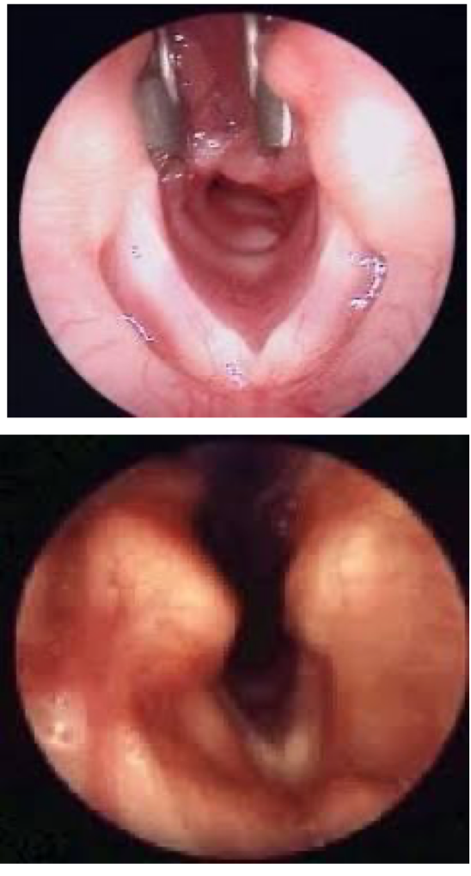
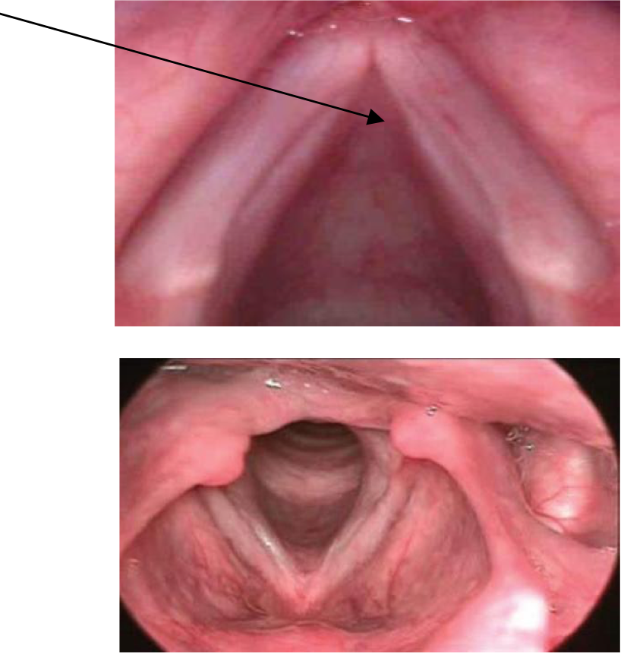
3- Congenital vocal folds web.
4- Laryngeal cleft.
5- Sulcus vocalis (bilateral groove) Congenital lesion (On the free edge of the true vocal fold) treated by: vocal folds injection(filler) Typical bilateral sulcus vocalis grove on the vocal fold edge Can be bilateral or unilateral, including the whole length or small portion of the vocal folds
L
R

Slide 15
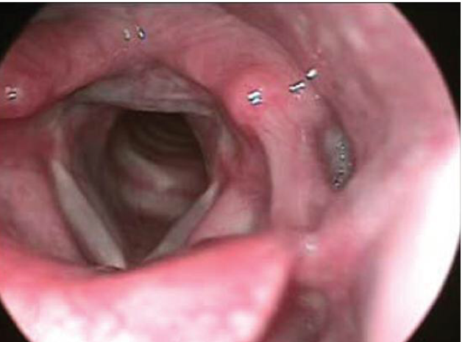
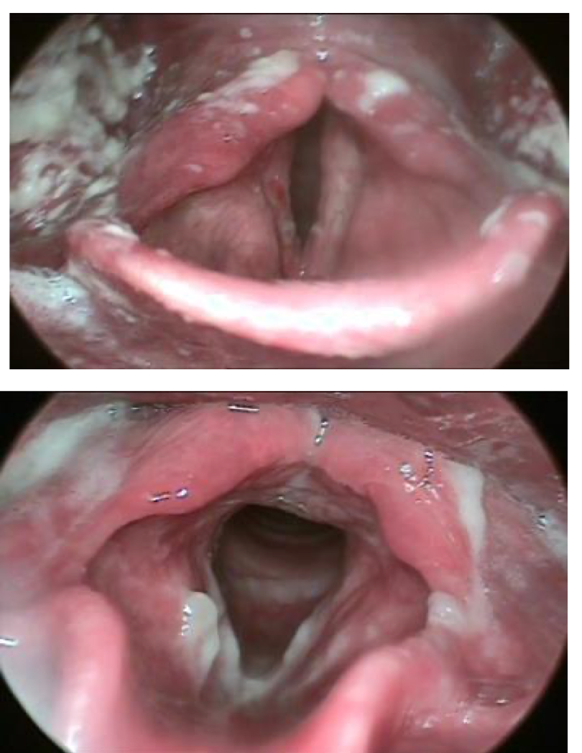
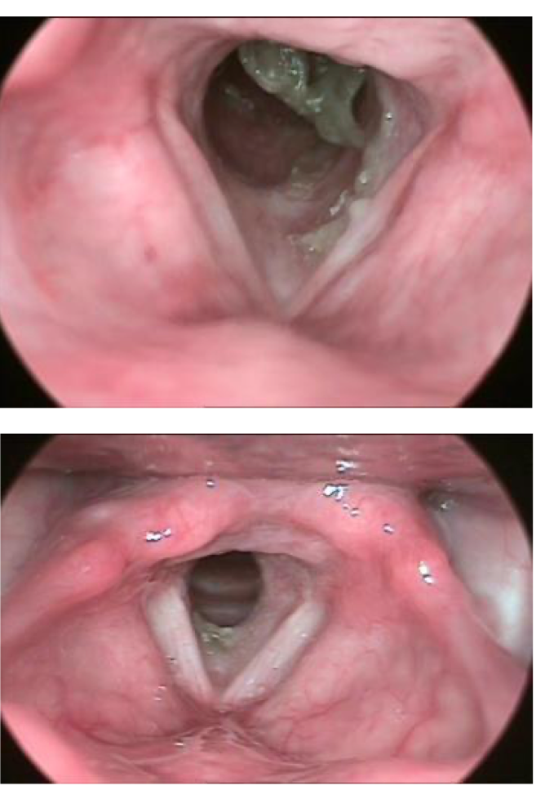
6- Laryngopharyngeal Reflux
7- Fungal infection
8-LARYNGOSCLEROMA

Slide 16
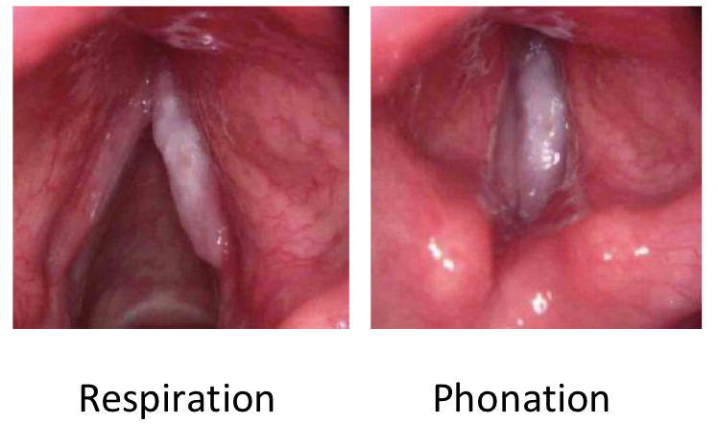
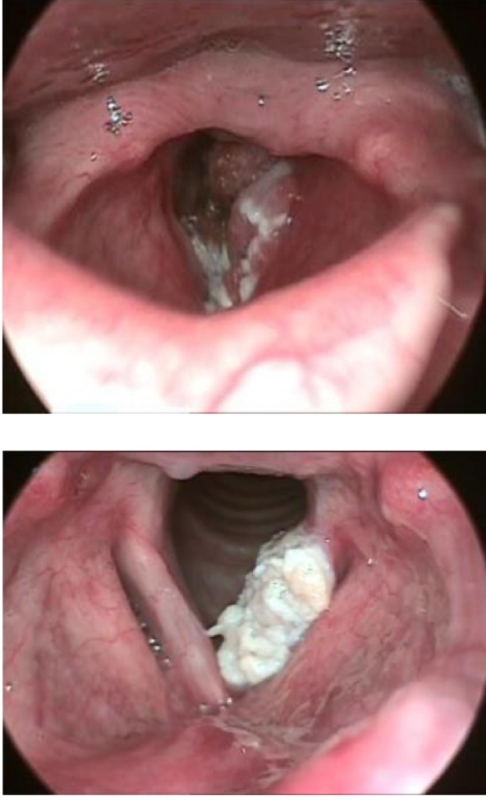
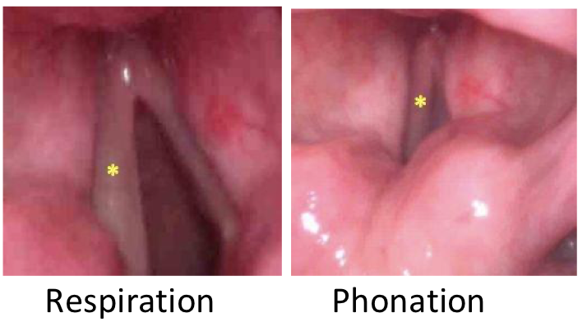
9- LARYNGEAL CARCINOMA: Whitish lesion occupying the full length of the right true vocal fold. Squamous cell carcinoma is the most common. Risk factors: Tobacco use, Excessive ethanol use, Infection with human papillomavirus, Increasing age.
10- Cancer
11- Left vocal cord paralysis Left vs right? left true vocal cord immobility (don't describe it as paralysis, because the diagnosis could be something else). 1-Determine anatomical landmarks (anterior and posterior) to know which side is left and which is right 2-During respiration vocal cords should be abducted if one of them is not abducted → paralysis. During phonation vocal cords should be adducted if one is not → paralysis. You cannot determine which cord is paralyzed if you don’t know if the picture is during inspiration or phonation. How it presents? Dysphonia- aspiration (if unilateral) Airway obstruction - swallowing abnormality (if bilateral)
L
R

Slide 17
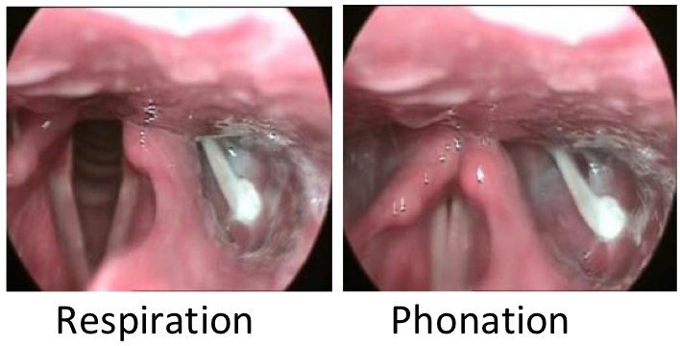
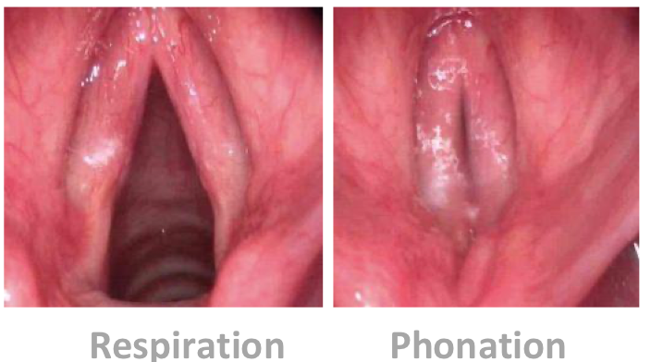
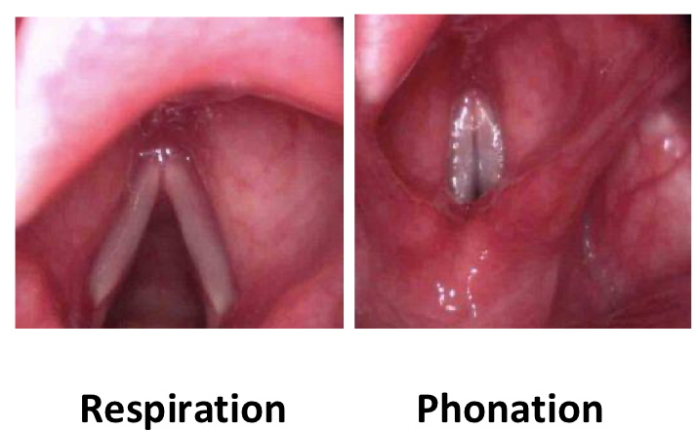
12- Trauma
2- NON-ORGANIC VOICE DISORDERS: (normal anatomy, medical treatment)
1. HABITUAL:
a. Hyperfunctional childhood dysphonia.
b. Incomplete mutation. Occurs in males during puberty. Change of voice from high frequency to low frequency voice. In males, 13-17 years.
c. Phonasthenia (Voice fatigue). مشجع أو شخص يتكلم كثير They have dryness, Tenderness, Frequent throat cleaning
It’s the only voice disorder that we can’t see any abnormality or hair any abnormality, Voice is normal but they feel pain with repetitive use (they used to speak for long periods put now they can’t)
d. Hyperfunctional dysphonia. With excessive use
e. Hypofunctional dysphonia. Laryngitis > pain with speech > they start speaking with low and soft voice b/c it’s painful > patient remain in this state of hypofunction even after the disease resolved b/c the brain got used to it.
E.g. acute pharyngitis. Patient won’t talk because of pain. If they stopped talking for more than 3 weeks, it will be difficult to get back normal voice.
f. Ventricular dysphonia. With very high voice and straining, they even start using the false vocal folds “which is not normal”
i. Misuse of voice will cause the ventricles to hypertrophy until they touch each other and dysphonia will occur (patient will sound like WWE fighter).
ii. Normal function of ventricle: -Helps shape the cords -holds glands which decrease friction between false and true vocal cords -fine tuning.
2. PSYCHOGENIC:
Psychogenic dysphonia
Psychogenic aphonia
➔ NOTES:
Misuse vs abuse of voice
■Misuse: incorrect use of voice e.g. shouting ■Abuse: overuse of voice
Voice frequencies: ■Children: 200-250 ■Males: 100-125 ■Females: 200
Male vs Female vocal cords
■Male: 20-24 mm
■Female: 18-19 mm
1- Hyperfunctional dysphonia In professional voice users normal anatomy > non-organic This is a male
2- Phonasthenia: most common E.g. teacher can’t talk after 5th period (fatigue) إجهاد صوتي خطيب المسجد يشتكي من هذا النوع. ● Won’t hear or see anything on examination. IMP if left untreated it can develop hyperfunctional dysphonia and if also left untreated it can lead to vocal folds nodules or polyps (benign vocal fold lesions)

Slide 18
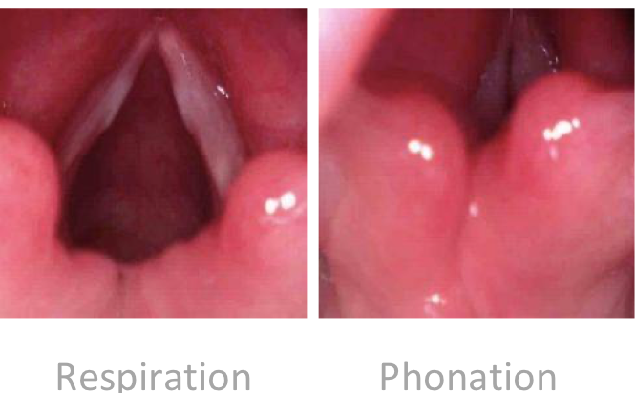
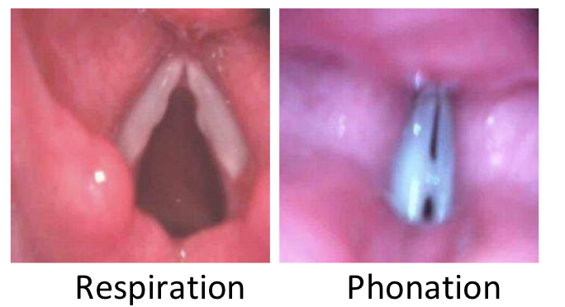
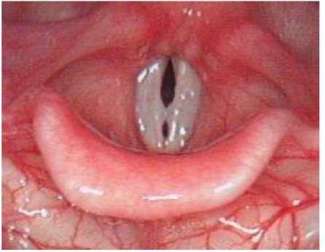
➔ 3- BENIGN VOCAL CORD LESIONS: (Minimal associated pathological lesions (MAPLs))
1- Vocal folds nodules. 2- Vocal folds polyps. 3- Vocal folds cysts. 4- Reinke’s edema.
5- Contact granuloma.
All are very Important with their management
1- vocal fold nodule ( bilateral true vocal fold nodule) (In females)
Juvenile type Kissing nodules More broad base | Adult type Describe: Bilateral nearly symmetrical vocal cords lesions at junction of anterior 1/3 and posterior 2/3. Presenting complaint: dysphonia or hoarseness Causes: phono-trauma, voice misuse and abuse, shouting. Treatment: voice therapy and vocal hygiene advices. More common in female adult and male children, very rare in adult male
Glottal gad, due to facing of both nodules.

Slide 19
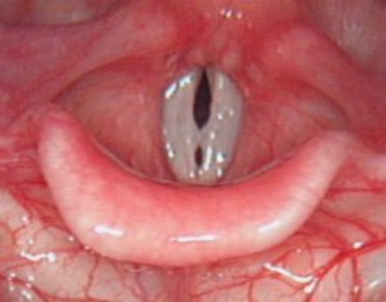
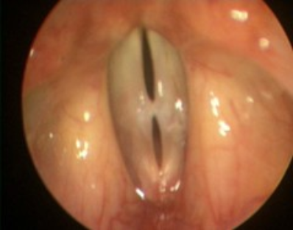
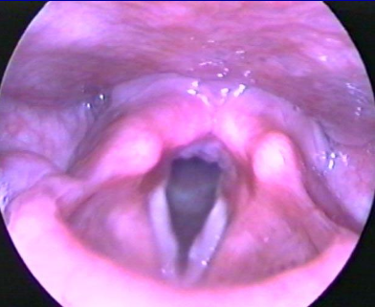
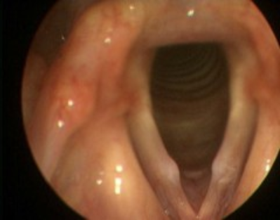
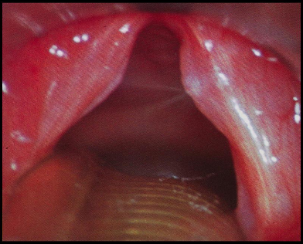
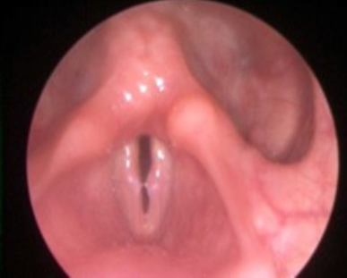
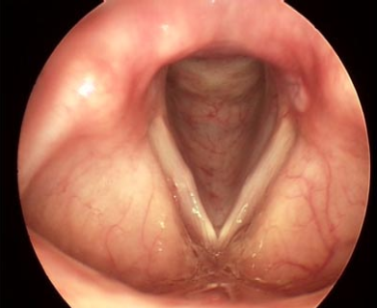
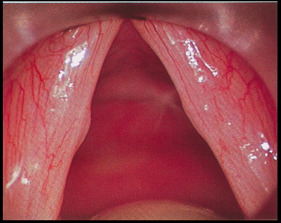
➔ 3- BENIGN VOCAL CORD LESIONS: (Minimal associated pathological lesions (MAPLs))
1- vocal fold nodule ( bilateral true vocal fold nodule)
SAQ : What is the diagnosis? Answer : Bilateral true vocal folds nodules
Here it’s very superficial
Here it’s Asymmetrical

Slide 20
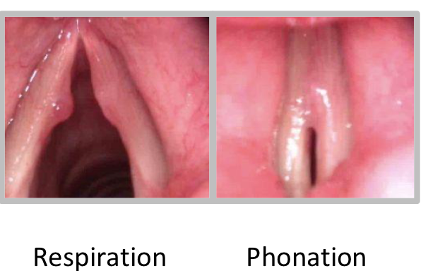
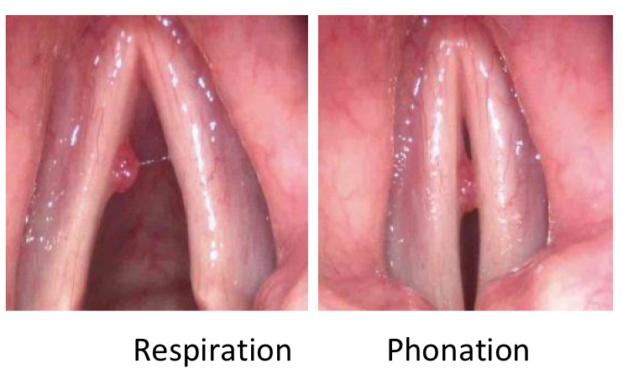
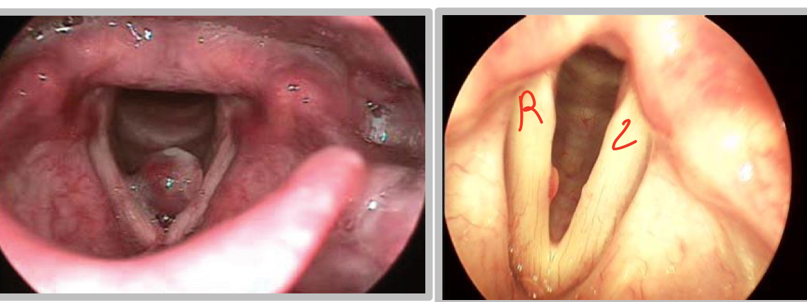
2- vocal fold polyp (different shapes) More common in males From epithelial layer ( mucosa ) → well defined
Left vocal fold polyp with a reaction (reaction occurs on the opposite side due to Friction during phonation) | Left true vocal fold polyp Describe: unilateral vocal fold mass or lesion at the left side in the middle third protruding medially. Presenting complaint: dysphonia or hoarseness. Causes: phono-trauma, voice abuse and sudden shouting. Treatment: Mainly surgical excision and voice therapy.
right vocal fold polyp

Slide 21
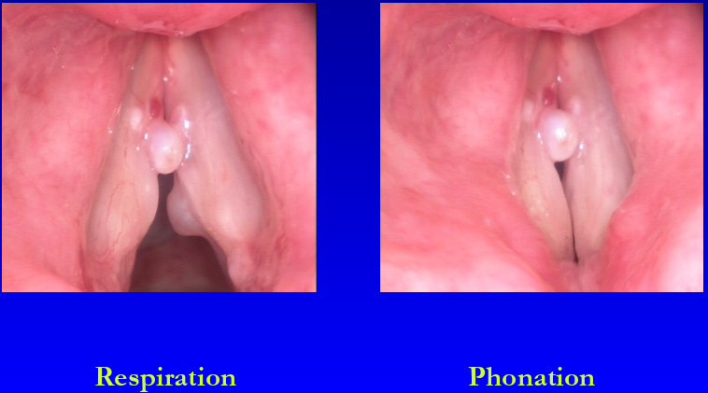
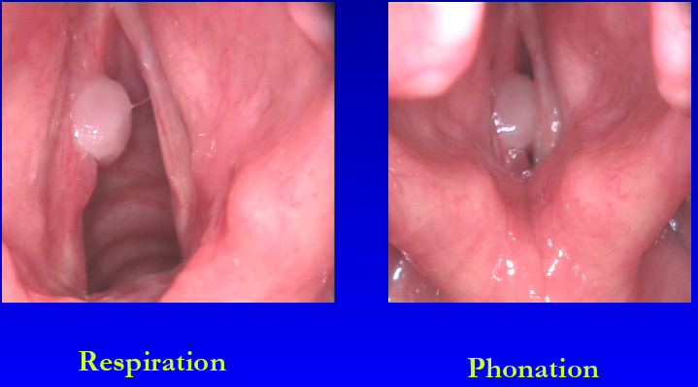
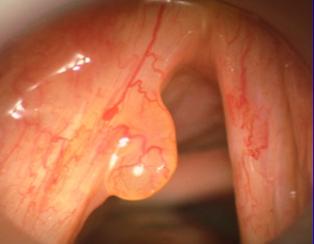
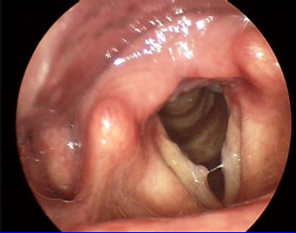
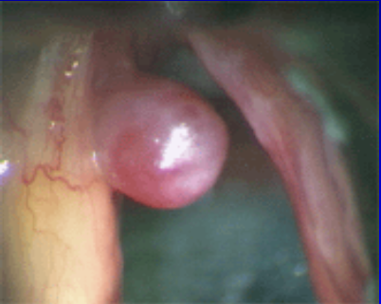
2- vocal fold polyp
SAQ : What is the diagnosis? Answer : Left true vocal fold polyp | Multiple polyps, bilateral and Asymmetrical Right true vocal fold polyp Right true vocal fold polyp We know it’s right from the anterior commissure

Slide 22
3- Vocal fold cyst Arises from deeper layers causing elevation of the covering mucosa → ill defined
Left True Vocal folds cyst
4- Reinke’s edema – Usually bilateral. In superficial lamina propria
Bilateral Reinke’s edema | Bilateral Reinke’s edema
5- Contact granuloma. No change in voice. From the cartilaginous part of the vocal fold “in vocal process not vocal folds”
Complain of dryness, pain, phlegm Goes by voice therapy | Right-sided Contact Granuloma
Causes: phono-trauma, congenital, duct closure voice abuse.
Treatment: primary management Surgery.
We can differentiate between the polyp and the cyst by the outer mucosa, in the polyp is changing, reddish and hemorrhagic.
Right-sided Reinke's edema
Causes: smoking, laryngopharyngeal reflex, voice abuse.
Treatment: stop smoking and surgical removal. Common amongst middle aged female smokers but also in male.
Right-sided Contact Granuloma
Unilateral swelling in the Cartilaginous part. IMP
Two types: 1- intubation granuloma 2- contact granuloma (due to reflex).

Slide 23
3- Vocal fold cyst
Right True Vocal folds cyst Right True Vocal folds cyst | Left True Vocal folds cyst Intrafolder cyst

Slide 24
➔ Causes: Laryngopharyngeal reflex, After intubation. ➔ Presenting complaint: pain or discomfort but rarely dysphonia unless very large. ➔ Treatment: Treat the cause (the reflex), voice therapy, surgery only if failed medical treatment or increasing in size. ➔ Why not polyp? It’s in the posterior part (Usual place for a granuloma). ➔ It is very similar to polyps but differ in location, here it involves the posterior cartilaginous part which does not vibrate, therefore no dysphonia. ➔ Intubation granuloma is a different type and it’s removed by surgery
➔ ASSESSMENT OF DYSPHONIA:
History taking.
Physical examination: APA, neck
Investigations:
• Audio recording.
• Digital laryngostroboscopy.
• Digital laryngo kymography.
• Acoustic analysis (MDVP).
• Aerodynamic analysis (Aerophone II).
• GERD (LPR) work-up.
• CT neck.
• Voice sheet
• CSL=Acoustic analysis of voice, intensity and frequency (Quantities).
➔ MANAGEMENT OF VOICE DISORDERS:
• Pharmacological agents. Ex.GERD ● Surgical procedures (Phonosurgery).
• Technical aid devices. • Voice therapy
Treatment of Benign vocal folds lesions in summary : Important
1-polyps. 2- Cysts. 3-Reinke’s edema > Surgical removal followed by voice therapy
4-Nodules. > Voice therapy
5- Contact granuloma. > Voice therapy and anti-reflux management
★ Stroboscope:
✓ is a special method used to visualize vocal fold vibration.
✓ It uses a synchronized, flashing light passed through a flexible or rigid telescope.
✓ The flashes of light from the stroboscope are
synchronized to the vocal fold vibration at a
slightly slower speed, allowing the examiner to
observe vocal fold vibration during sound production
in what appears to be slow motion
✓ females reach 300 cycle/ sec up to 1000
✓ Males reach 120-130 cycle/ sec up to 200
CSL(MDVP)
CSL : Computerized Speech Lab
MDVP : Multidimintional voice program
Videolaryngostroboscopy

Slide 25
SWALLOWING DISORDERS:
CVA:Cerebrovascular Accident
In ENT, they are concerned about the oropharyngeal causes.
➔ DEFINITIONS:
SWALLOWING: is the successful (timely and efficiently) passage of food and drinks from the mouth to the stomach. Happens 2,000-3,000 times/day
DYSPHAGIA: difficulty in moving food from the mouth to the stomach (pain, discomfort and/or difficulty in initiation or completing the act of swallowing)
ODYNOPHAGIA: painful swallowing due to a disorder of the esophagus.
➔ PHASES OF SWALLOWING:
1– Oral ( voluntary) 2– Pharyngeal 3– Esophageal
➔ CONSEQUENCES OF DYSPHAGIA:
Dehydration.
Weight loss.
Aspiration pneumonia. (MOST dangerous)
Airway obstruction.
Loss of joy of eating.

Slide 26
➢ Assessment of dysphagia:
A. History taking
B. Physical examination:
General examination.
Language and speech assessment.
Vocal tract examination.
Neck examination.
Trail feeding.
Dysphagia sheet.
C. Investigations:
● FEES “Fiberoptic endoscopic evaluation of swallowing”
● VFES (MBS) “Video fluoroscopic evaluation of swallowing”(Modified barium swallow) It shows the path way from lips to upper esophageal sphincter ( oral and pharyngeal steps)
●GERD (LPR) workup
● FEES protocol of evaluation (Langmore, 2003):
A. Anatomic and physiologic assessment.
B. Assessment of food and liquid swallowing.
C. Assessment of therapeutic interventions.
Residue in left piriform fossa
Residue in piriform fossa, laryngeal vestibule
Penetration on anterior commissure

Slide 27
Residue = in the pharynx, Penetration= at the true vocal folds, Aspiration= below vocal folds.
Normally when drinks or food enters the airway there is cough reflex, but if for e.g. an old age patient with CVA or stroke and the fluids enter the airway and no cough reflex, this is called Silent Aspiration which is very dangerous.
If aspiration occurs, penetration must have occurred first (except in tracheoesophageal fistula where aspiration occurs without penetration).
Aspiration of liquid is more common but less severe than aspiration of solids.
Management of dysphagia:
● Oral vs non oral feeding
○ Non oral feeding when
■ Aspiration >10% ■ Oral + pharyngeal transit time >10 s
● Direct vs Indirect therapy
○ Direct: food or liquid given to the patient
○ Indirect: no food or liquid given (only saliva)
● Compensatory vs Therapy technique
○ Compensatory: elimination of symptoms but no change in swallowing physiology, such as
postural techniques
○ Therapy techniques: change of swallowing physiology such as swallowing maneuvers.
1. Swallowing therapy:
a. Diet modification. (if the problem is with solids only or fluids only)
b. Postural techniques.
c. Swallowing maneuvers.
d. Sensory enhancement techniques.
e. Motor exercises.
f. Bolus control cup
2. Surgical treatment, e.g. medialization laryngoplasty. Like in vocal fold paralysis, cricopharyngeal muscle spasm
3. Medical (Drug) treatment, e.g. anti-parkinsonism drugs.
4. Intraoral prosthesis.
5. Alternative routes of feeding, e.g. NG tube feeding. Temporary (not more than 6 weeks) >6 weeks → gastrostomy.

