Slide 1
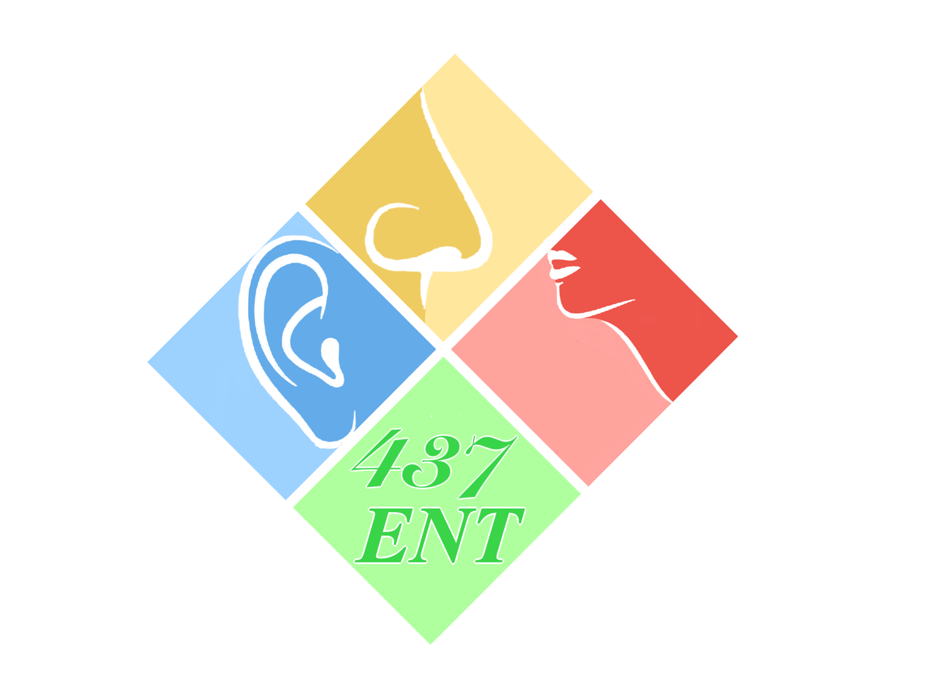
Ear III-IV
Objectives:
Chronic otitis media and middle ear operation
Classification of chronic otitis media
Otitis Media Effusion
Adhesive Otitis Media
Chronic suppurative otitis media - types and management
Ear operation in brief (myringotomy, tube, tympanoplasty and mastoidectomy)
Complication of acute & chronic OM
Classification (extra cranial,cranial(temporal) & intra cranial) (in detail acute mastoidectomy & management)
Resources: Doctor slides and team 436
Done by: Omar Alfawzan, Naif Almutairi
Edited by:
Revised by: Naif Almutairi
[ Color index: Important | Notes | Extra ]

Slide 2
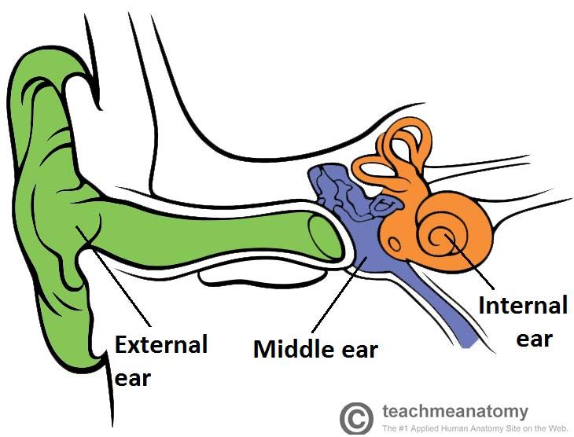
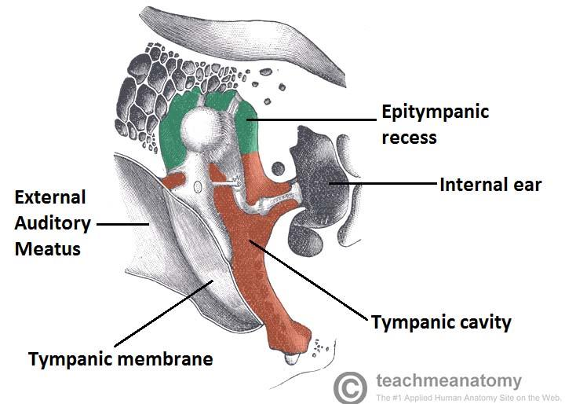
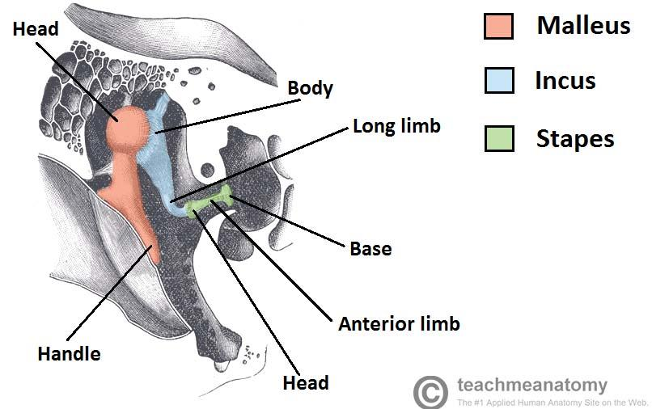
Overview of the lecture (extra)
As we know if the infection occur in the external part of the ear we call it otitis externa, if it’s in the middle part we call it otitis media and if it’s in the inner part we call it otitis interna or labyrinthitis. In the first part of this lectures we will talk about the types of chronic otitis media and in the second pert we will talk about the complications of otitis’s media. So since we will talk about chronic otitis media, let’s review the anatomy of the middle ear:
The middle ear lies within the temporal bone, and extends from the tympanic membrane to the lateral wall of the inner ear. The main function of the middle ear is to transmit vibrations from the tympanic membrane to the inner ear via the auditory ossicles. it contains:
o Tympanic cavity, Tympanum (Middle Ear Cavity): located medially to the tympanic membrane. It contains three small bones known as the auditory ossicles: the malleus, incus and stapes. They transmit sound vibrations through the middle ear.
o Epitympanic recess: a space superior to the tympanic cavity, which lies next to the mastoid air cells. The malleus and incus partially extend upwards into the epitympanic recess.
o Muscles: There are two muscles which serve a protective function in the middle ear the tensor tympani and stapedius. They contract in response to loud noise, inhibiting the vibrations of the malleus, incus and stapes, and reducing the transmission of sound to the inner ear. This action is known as the acoustic reflex. The tensor tympani originates from the auditory tube and attaches to the handle of malleus, pulling it medially when contracting. It is innervated by the tensor tympani nerve, a branch of the mandibular nerve of the trigeminal nerve. The stapedius muscle is the tiniest muscle in the body, attaches to the stapes, and is innervated by the stapedial nerve from the facial nerve.
o Nerves: Facial nerve
o Eustachian (Pharyngo-tympanic) Tube: The auditory tube, is a cartilaginous and bony tube that connects the middle ear to the nasopharynx. It acts to equalise the pressure of the middle ear to that of the external auditory meatus.

Slide 3
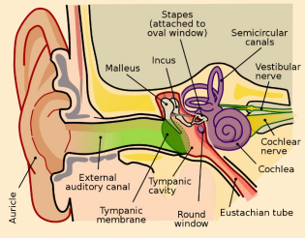
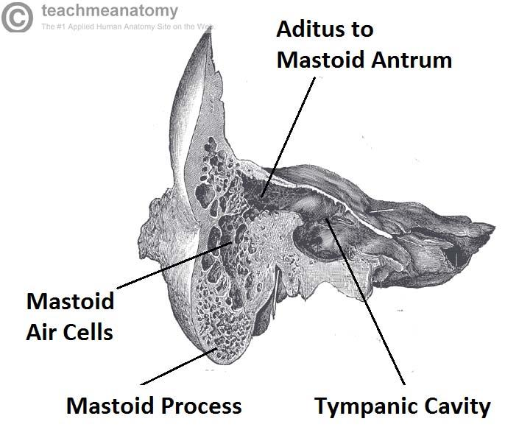
Overview of the lecture (extra)
Mastoid Air Cells: The mastoid air cells are located posterior to epitympanic recess. They are a collection of air-filled spaces in the mastoid process of the temporal bone. The air cells are contained within a cavity called the mastoid antrum. The mastoid antrum communicates with the middle ear via the aditus to mastoid antrum. The mastoid air cells act as a ‘buffer system‘ of air – releasing air into the tympanic cavity when the pressure is too low.
Acute Vs Chronic Otitis Media
 | Acute otitis media | Sub-acute otitis media | Chronic otitis media
Duration | Less than 3 weeks | From 3 weeks-3 months | More than 3 months
why it’s important to know is it acute or chronic? Because the treatment and complications are different.

Slide 4
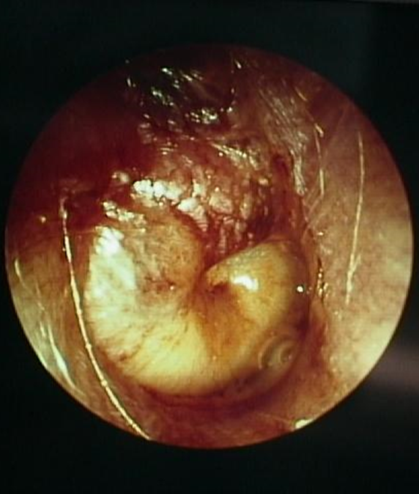
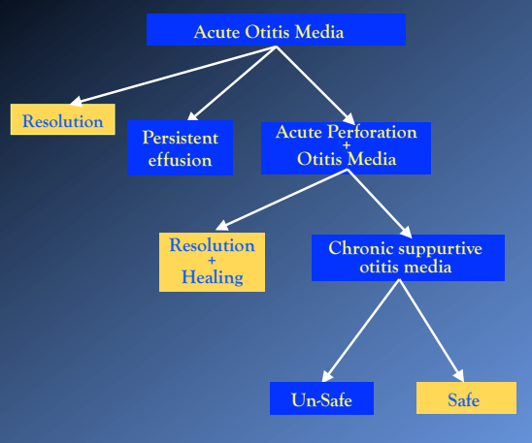
Middle ear anatomy
Eustachian (Pharyngo-tympanic) Tube
Tympanum (Middle Ear Cavity):
Ossicles: malleus, incus, and stapes.
Muscles: Stapedius muscle and Tensor tympani
Nerves: Facial nerve
Mastoid Antrum and Air Cells
Stages of Acute Otitis Media (OM)
Tubal occlusion
Presuppuration
Suppuration
Resolution/complications
Classifications of chronic OM
Chronic non-suppurative otitis media
Otitis media with effusion (OME).
Adhesive otitis media
Chronic suppurative otitis media (CSOM)
Tubo-tympanic (safe type)
Attico-antral (unsafe type)

Slide 5
Chronic otitis media (COM):
o Inflammation of the middle ear. May also involve inflammation of mastoid.
o Chronic Otitis Media is an infection involving a part of the middle ear cleft or all its components that is persistent for more than 3 months.
o To have a discharge coming through the external canal the membrane has to be perforated.
Classification: the chronic otitis media were divided according to (discharge) if there no discharge or pus صديد it’s chronic non suppurative otitis media and if there is any discharge or pusصديد , so it’s chronic suppurative otitis media.
A. Chronic Non suppurative otitis media:
1- Otitis media with effusion (OME) also called secretory otitis media. It’s mean there is fluid in the middle ear, which is related to the Eustachian tube. If not treated properly or not cured by itself, it could lead to adhesion in the tympanic membrane in middle ear (adhesive otitis media).
2- Adhesive otitis media. When there is a prolonged problem with the Eustachian tube, there will be retraction of the tympanic membrane, it will be sucked in (adhesive). you can see all the structures of the middle ear.
B. Chronic suppurative otitis media (CSOM): discharge, the reason maybe an acute infection not treated well or adequately or because of immunosuppressant patient. So the pus will accumulated and cease perforation of the tympanic membrane
1- TuboTympanic (As long as the annulus is intact, we consider it TT), which is also known as the Safe type, has no risks of serious complications. the perforation is toward the Eustachian tube or in the middle of tympanic membrane. Name: Tubo = Eustachian tube \Tympanic= problem in the middle ear.
2- AtticoAntral, which is also known as the Unsafe type, has a high risk of developing complications. Name: related to. Unsafe because it is associated with complications if not treated.
The tympanic membrane is intact (not perforated) in Chronic non- suppurative otitis media, while in chronic suppurative otitis media it is not intact (perforated).

Slide 6
Chronic non-suppurative OM:
Otitis media with effusion (OME) has other names: Middle Ear Effusion (MEE), glue ear, secretory otitis media (SOM)
Dysfunction of the Eustachian tube
Medical management:
Decongestants
Nasal sprays
OTOVENT
Surgical management:
Myringotomy +/- tube, balloon dilation of the Eustachian tube.
Chronic suppurative OM:
Safe vs Unsafe (Cholesteatoma)
Management is surgery:
Tympanoplasty
Mastoidectomy
Tymanomastidoectomy
Investigations in chronic OM
Audiology: Pure tone average (PTA). tympanogram, acoustic reflex.
Radiology: CT, MRI. We care more about CT than MRI in case of chronic OM (COM). When do we care more about MRI for COM? If you are dealing with or expecting complications.

Slide 7
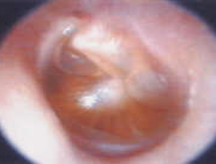
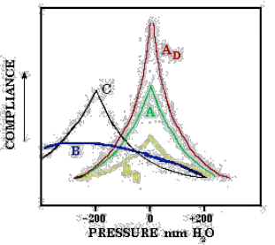
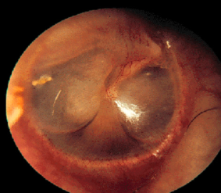
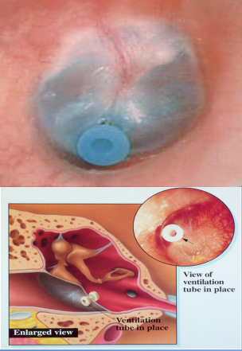
Chronic Middle ear effusion (MEE)
Previously thought to be sterile.
30-50% grow in culture.
Diagnosis:
Otoscopy
Microscopy
Audiogram:
Conductive hearing loss (CHL)
Sensorineural hearing loss (SNHL)
Tympanogram (type B)
Estimated of residual effusion:
70% at 2 weeks
40% at 4 weeks
20% at 8 weeks
10% at 12 weeks
So most of the fluid in these patients it will resolve spontaneously, IF the Eustachian tube starts working properly to drain the fluid into the nasopharynx
Treatment:
Surgery: Tympanostomy tube insertion:
Bypass Eustachian tube to ventilate middle ear
Indications:
Chronic OME > months with hearing loss
Speech delay
SNHL
Retraction pocket of tympanic membrane (TM)
Treatment is nasal wash and nasal steroid to treat the Eustachian tube, we don’t give ear drops b/c the tympanic membrane is normal, after 3 months if medical treatment didn’t work we do surgery which is myringotomy and ventilation tube insertion
if you have for example a child with speech delay or adult with SNHL we don’t wait we put the tube directly, same if the tympanic membrane starts to medialize.

Slide 8
A. Chronic non-suppurative OM:
1-Otitis media with effusion
Also called Glue ear or secretory otitis media (SOM)
Definition: persistence of serous or mucoid fluid in the middle ear space without evidence of infection.
Effusion means fluids in the middle ear cavity, you can see in the picture there are air bubbles and the tympanic membrane is red and bulging, this is an image of OM with effusion
o Often present after acute otitis media is treated appropriately with antibiotics
o Most will clear within 3 months
Etiology:
- Bacterial: Strep.pneumoniae, Moraxella cat, Haemophilus influ. cause of the acute infection which lead to choronic effusion. If after a while we did a fluid analysis, we will not find the bacteria because it is an early finding.
- Viral: RSV, Rhinovirus , Parainfluenza virus, Influenza virus
Sign and Symptom’s:
- Non mobile TM
- Air fluid level
- Aural fullness after URTI.
- Hearing loss (not complete)

Slide 9
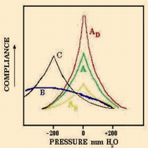
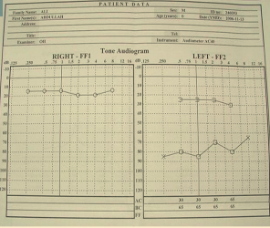
A. Chronic non-suppurative OM:
1-Otitis media with effusion
Diagnosis: - History. As we sied before there will be a history of previous infections with hearing loss
- Clinical Examination effusion
- Tuning fork tests (Weber and Rinne test)
- Audiological assessment to confirm the diagnosis
Audiological Assessment:
1. Tympanometry.
It’s a prob in the ear: We apply pressure and the machine will calculate the pressure with TM movement.
A: Normal. zero pressure, good movement.
AS: sclerotic (restricted). E.g: otosclerosis, tympanosclerosis.
AD: discontinuity. ossicles are disconnected.
B: flat, no movement: wax, effusion, perforation.
To differentiate between them: it will be compared to external canal volume:
- if it is less, then it is something outside.
- If it is the same, then it is effusion
- If it is more, then it is perforation
C: Eustachian tube dysfunction. There is a movement, but negative pressure.
2. Pure tone audiogram :
It's based on average population. Up to 25 is normal. 25 to 45 this is mild hearing loss. 45 to 60 this is moderate hearing loss.

Slide 10
A. Chronic non-suppurative OM:
1-Otitis media with effusion
Management:
o Medical - Observation: many European countries wait 6-9 months prior to placement of ear tubes.
- Antibiotics if there is an infection. Meta-analysis shows beneficial short-term resolution of OME.
- Audiogram at 3 months with persistent effusion to determine impact on hearing
- Decongestants, Nasal corticosteroid sprays, OTOVENT
Medical is the first step before surgical, nasal sprays, nasal drops, or for long term there are steroid sprays (not giving to children less than 2 years, and no longer than 3 months of use), OTOVENT: is a balloon that the patient inflate with one of the nostrils to open the blocked Eustachian tube
Surgery: Tympanostomy tube insertion:
Bypass Eustachian tube to ventilate middle ear
Indications:
Chronic OME > months with hearing loss
Speech delay
SNHL
Retraction pocket of tympanic membrane (TM)

Slide 11
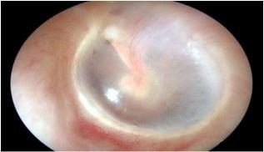
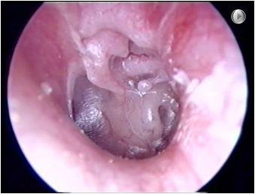
2-Adhesive OM:
The result of long-standing Eustachian tube dysfunction
The drum loses structural integrity and becomes flaccid
Contact between the drum and the incus or stapes can cause bone erosion at the IS joint
facial nerve
Stapus
Those patients need follow up b/c they can develop the unsafe type which is the cholesteatoma
Round window
complete medialsed manubrium : means completely touching the promonty or the middle ear
We should have bone in front of the facial nerve but here we have erosion of the ossicles
Clinical features:
- History of CSOM or OME
- Deafness is usually the inly symptom.
- TM shows various structural changes. There is retracted TM
Treatment:
- Observation
- Hearing aid
- Surgical treatment. Should we do a surgery or not? In this case we evaluate the hearing, if the hearing deteriorates, we operate. If hearing is normal, we will observe. Because if we try to elevate the tympanic membrane, we might miss some skin cells inside the middle ear, that will develop into cholesteatoma. cholesteatoma will affect ossicles (conductive hearing loss), facial nerve (weakness), lateral semicircular canal (dizziness), cochlea (sensorineural hearing loss), and skull base (brain herniation). It’s very rare to remove the retracted TM and put a new one.
Adhesive OM is other way of negative pressure in the middle ear cavity, in this case the negative pressure is without fluids, so it will create a tension pulling the tympanic membrane medially towards the ossicles and promontory (first turn of cochlea) and get adherent to them.

Slide 12
B. Chronic Suppurative Otitis Media
3D
Duration >3 months despite treatment
Discharge: purulent otorrhea (if the patient came with ear discharge think of OM)
Deafness due to perforation
Etiology:
Pseudomonas aeruginosa
Staphylococcus aureus
Proteus species
Chronic suppurative otitis media is a long-standing infection of a part or whole of the middle ear cleft characterized by ear discharge (Otorrhea) and permanent perforation of tympanic membrane. Previously there were many cases due to the lack of development in treatment methods. The reason is acute infection not treated well or adequately or because of immunosuppressant patient. So the pus will accumulated and cease perforation of the tympanic membrane.
Classified into :
1-Tubotympanic type (safe)
2-Attico-antral (unsafe)
Signs and symptoms
o Otorrhea: it’s important in the history to ask about the amount, color, odor and viscosity
- TT type: Intermittent non offensive(odorless) non bloody, Profuse ear discharge.
- AA type: Chronic(persist), Scanty, offensive (malodorouse) and bloody ear discharge.
o Deafness because the TM was perforated
o Tinnitus
o Sign of healing (granulation tissue and polyps, fibrosis and tympanoscelerosis)
o Cholesteatoma: in AA type
Orthoscopic examination:
o Discharge:
- TT type: present if active, but may be absent.
- AA type: usually present. Any wax superiorly, remove it. Because most of the time there is something under it. E.g. cholesteatoma
o Perforation:
- TT type: always central regardless of size. Annulus is intact
- AA type: marginal or attic perforation, In the area with no annulus. It may present inferiorly, but the annulus has been eroded because annulus acts as a barrier. with cholesteatoma
o There will be polyps, granulation tissue and tympanoscelerosis

Slide 13
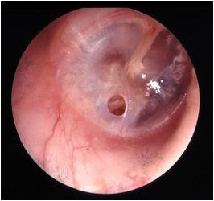
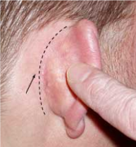
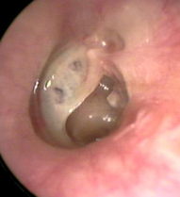
1-Tubotympanic type (safe)
Simple perforation.
Intermittent non offensive (odorless) non bloody ear discharge.
On examination (central perforation, peripheral/ nonmarginal)
Treatment:
Example is a patient with simple perforation takes shower and fluid gets inside the middle ear causing infection
Ototopical antibiotics. (ofloxacin)
Surgical repair of the TM perforation (Tympanoplasty)
Treatment is cleaning the ear and antibiotic, if the ear is dry you can repair the tympanic membrane perforation by surgery
Either incision behind the auricle or we go directly to the ear canal by doing incision of the external auditory canal and rise the skin then put a graft then put gel form then close, if you can see the perforation through the external auditory canal it’s better to do it through the ear canal, if we can’t see it go through postauricular incision.

Slide 14
1-Tubotympanic type (safe)
Treatment: (Extra)
o TT type: We start with conservative until the ear is dry then we do surgery.
1- Conservative:
- Treat any predisposing factor
- Keep the ear dry
- Ear toilet
- Antibiotic : Antibiotic only otic drops: Floxin (ofloxacin), Ciprofloxacin, Neomycin, Polymyxin B, Gentamicin, Tobramycin
Antibiotic with steroid otic drops:
o Ciprodex (ciprofloxin and dexamethasone)
o Cipro HC (ciprofloxin and hydrocortisone)
- Removal of polyps and granulation tissue
2- Surgery: repair of the TM perforation by:
Tympanoplasty: An operation performed to eradicate disease in the middle ear cavity. The aim of it’s are: 1. To close the perforation 2. To prevent reinfection 3. To improve hearing
Myringoplasty: an operation performed to repair the tympanic membrane only. Tympanoossiculoplasty: an operation performed to eradicate disease in the middle
ear cavity and to reconstruct the hearing mechanism.

Slide 15
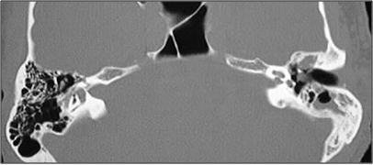
2-Attico-antral (unsafe-Cholesteatoma):
Cholesteatomas: are epidermal inclusion cysts of the middle ear and/or mastoid with a squamous epithelial lining
Skin growing in the wrong place: Middle ear cleft or Petrous apex
Chronic(persist), Scanty, offensive and bloody ear discharge
On examination marginal perforation.
Cholesteatomas are basically normal skin inside the middle ear, if it gets inside the middle ear is starts working as a tumor and start eating the bones leading to bony erosion and can cause facial paralysis. It releases enzymes each time it gets infected thus leading to destruction of the middle ear content
Diagnosis:
If you see cholesteatoma it’s actually bigger than what you see because it’s usually deep in the middle ear
History: Hearing loss, otorrhea, vertigo, tinnitus
Examination: Otoscopy, microscopy. tuning fork test
Investigation: Audiological assessment. radiological assessment
most important radiological assessment is CT-Scan “will not tell you if there is a cholesteatoma but will tell you if there is an opacity in this area”, the only modality that can give you a diagnostic images of cholesteatoma is MRI with diffusion.
Treatment:
Erosion of the ossicles leading to conductive hearing loss in the left ear
Surgery:
Canal wall up (CWU):
complete mastoidectomy
Canal wall down (CWD):
Radical Mastoidectomy or modified radical mastoidectomy
AA type: removal of cholesteatoma by mastoid operation. In TT type we start with conservative until the ear is dry then we do surgery. While in AA we do surgery

Slide 16
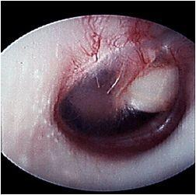
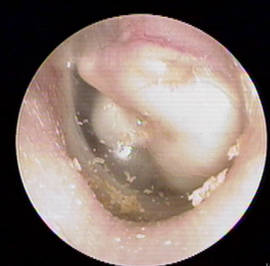
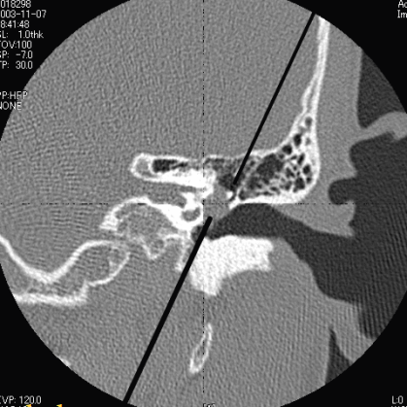
2-Cholesteatoma Classification:
Congenital:
Normal TM
Normal pars flaccida and pars tensa
No history of otorrhea or perforations
No prior otologic procedures
Usually located in the anterior superior part of the middle ear
Ossicular lesion
Large congenital cholesteatoma
Cholesteatoma
you see it like this, white in color like a ball inside the middle ear, usually incidental finding

Slide 17
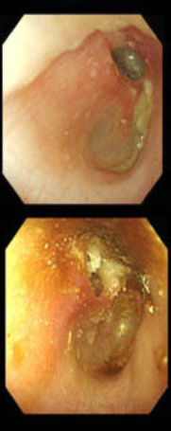
Acquired:
Primary acquired cholesteatoma:
Pocket invagination
OME
Secondary acquired cholesteatoma:
Implantation theory
Metaplasia theory
Epithelial invasion theory
Primary : usually starts form the pars flaccida type, so when you start having a negative pressure in the middle ear like when you are going on an airplane and the ear starts to be blocked or if you have highly negative pressure in the ear. Pars flaccida start to be suctioned inside, so the membrane go inside to make a ball or cyst in the middle ear with small neck and then the skin will go inside the middle ear.
Secondary :
1- Implantation like blast injury or surgery or foreign body
2- Metaplasia due to recurrent infection leading to transformation of middle ear mucosa into keratinized stratified squamous epithelium
3- Invagination which is migration of the squamous epithelium though proferated tympanic membrane to the middle ear

Slide 18
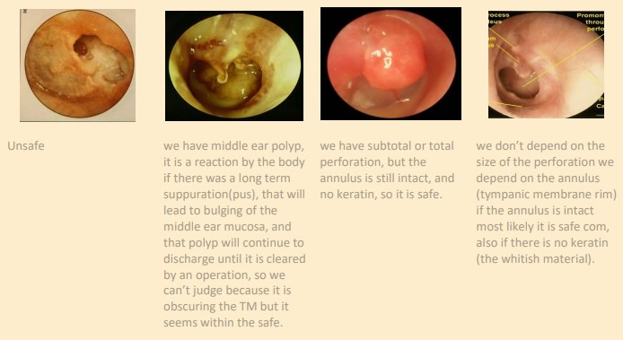
2-Cholesteatoma Treatment : (Extra)
Cholesteatoma Surgery : mastoidectomy
Classified as: you need to know modified radical & radical only
1. Simple (cortical, complete) mastoidectomy
2. Modified radical mastoidectomy: spares the ossicles, so we only clean the epitympanum.
3. Radical mastoidectomy: remove malleus, incus, mastoid. So we make the middle ear and the attic one cavity.
if you have discharge and perforation, the treatment is surgery.
In summary: the chrinic otitis media is devided into suppurative and non suppurative. The non suppurative devived into efusion and adhesive. And the suppurative devided into TT and AA. in TT type the discharge is usually copious, intermittent and oderless. The perforation is central and the treatment is conservitive if there is active infectio until it’s dry. Then followed by tympanoplasty to prevent reinfectio and improve hearing. While in AA type the discharge is usually scanty, persisten and with bad odor. The perforatiom is attac or marginal with cholesteatoma and the treatment is by mastiodectomy to proive safety and dry ear.

Slide 19
Complications of acute and chronic OM:
Predisposing factors:
Anything that decrease the immunity
Diabetes - Leukemia - Malnutrition
Immunodeficiency - Congenital dehiscence
Medications that suppress the immunity eg. steroids
Temporal bone fractures - Chronic infection
Temporal bone fracture is like an opening for the organisms to go though
Extracranial (Intra-temporal):
Intracranial:
Labyrinthine fistula
Facial nerve paralysis
Mastoiditis (acute and chronic)
Acute suppurative labyrinthitis
Ossicular fixation or erosions
Postauricular abscess
Brain abscess
Temporal abscess
Petrous apicitis
Meningitis
Brain abscess
Subdural empyema (abscess)
Epidural (extradural) abscess
Lateral sinus thrombosis
Otitic hydrocephalus
Encephalocele and cerebrospinal fluid leakage

Slide 20
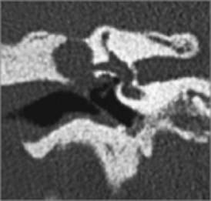
Labyrinthine fistula:
Definition and etiology:
communication between middle and inner ear
It is caused by erosion of bone by cholesteatoma.
This is the lateral semicircular canal and as you can see it’s open so this patient will have instability, vertigo, and positive fistula test
Cholesteatoma eating the petrous bone leading to destruction of the inner ear
Clinical picture:
Hearing loss - Positive fistula test
Attack of instability (vertigo) mostly during straining ,sneezing and lifting heavy object.
Diagnosis and treatment:
Diagnosis by CT scan of temporal bone
Treatment by surgery: Mastoidectomy + Tympanoplasty
After surgery patient may have complete SNHL in 30%-40% of cases
Extra: the idea that you will create more pressure in the EAC and that will reflect on the middle ear and TM, normal people won’t be affected, in abnormal Pts with + fistula test the pressure will extend to the inner ear
causing vertigo, tinnitus in the same time when you’re doing the test, fistula isn’t commonly seen, it is seen clearly in CT

Slide 21
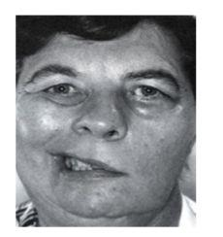
Facial Nerve Paralysis:
Definition and etiology:
Result of the inflammation within the fallopian canal to acute or chronic Otitis media
Tympanic segment is the most common site to be involved.
Diagnosis and treatment:
Left side facial nerve paralysis
Diagnosis: clinically and CT scan of mastoid
Treatment:
Antibiotics and steroids
Acute otitis media and acute mastoiditis: (cortical mastoidectomy +ventilation tube).
Chronic otitis media with cholestetoma: (mastoidecomy ± facial nerve decompression)
Facial nerve will be injured peripherally in OM, so the affected nerve side of the face will be completely paralyzed.
Upper vs lower motor neuron lesion:
Lower: upper and lower parts of the face are affected
Upper: lower part of the face is affected (upper part has bilateral supply from both hemispheres).

Slide 22
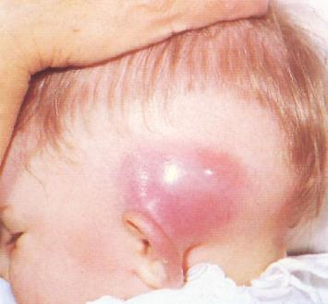
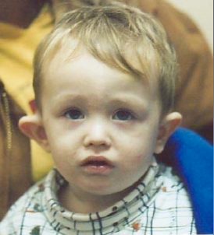
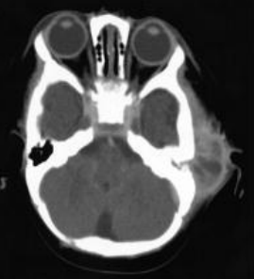
Mastoiditis:
Acute infection of the middle ear going to the mastoid causing subcutaneous abscess
Definition:
It is the inflammation of mucosal lining of antrum and mastoid air cells system.
Symptoms and signs:
Abscess
Symptoms:
Earache
High fever
Ear discharge
Signs:
Mastoid tenderness
Swelling over mastoid
Hearing loss
Auricular protrusion
Important pic you may have it in the exam
Investigations:
- CT scan of temporal bone
- Ear swab for culture and sensitivity
Q: 5 years old child presented with high fever, protruding right ear, with tenderness, he is crying and disturbed. A : this is an acute mastoiditis NOT a bat ear
Treatment:
Medical treatment (no abscess): Hospitalize, IV antibiotics, Analgesics.
Surgical treatment (there is an abscess) : Myringotomy, Cortical mastoidectomy.
Treatment : admit the child and start IV antibiotics, if we can go surgery directly we don’t start antibiotics we drain first then we take a sample for culture and then we start antibiotics, then you have to do mastoidectomy and put an air tube

Slide 23
Mastoiditis: (Exrta)
Mastoiditis is inflammation of the mastoid air cells in the temporal bone. At birth, the mastoid consists of a single air cell, the antrum, which is connected to the middle ear by a narrow channel, the aditus ad antrum. As the child grows, the mastoid bone becomes pneumatized, resulting in a series of interconnected air cells that are lined by modified respiratory epithelium. When AOM develops as a result of eustachian tube dysfunction, there is an acute inflammatory response of the mucosa lining the middle ear and, in many cases, the mastoid. Most episodes of AOM respond to antibiotic therapy. Eustachian tube dysfunction resolves, and the mucosa of the middle ear and mastoid recovers. In rare cases of newly diagnosed AOM or in cases of inadequate or inappropriate treatment, inflammation of the middle ear and mastoid persists.

Slide 24
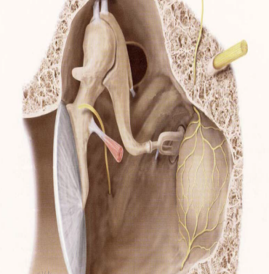
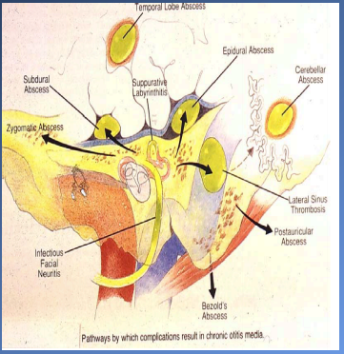
Intracranial complications:
What are the natural barriers between brain and temporal bone? Bone and meninges
The natural barrier between the brain and the temporal bone is 1- tagma (bone) 2- meninges (dura) it prevent the infection in the middle ear from going to brain
Meningitis:
Most common
Definition:
Inflammation of meninges surrounding the brain and spinal cord
Clinical picture:
Diagnosis and treatment:
General symptoms and signs:
High fever
Irritability the child will refuse eating and will be crying all the time
Photophobia
Delirium
Signs of meningeal irritation (low sensitivity but high specificity):
Kernig's sign
Brudzinski's sign
Diagnosis: by lumbar puncture.
But first do CT scan to prevent herniation of cerebellum.
Treatment of the complication itself and control of ear infection:
Specific antibiotics
Antipyretics and supportive measures
Mastoidectomy to control the infection

Slide 25
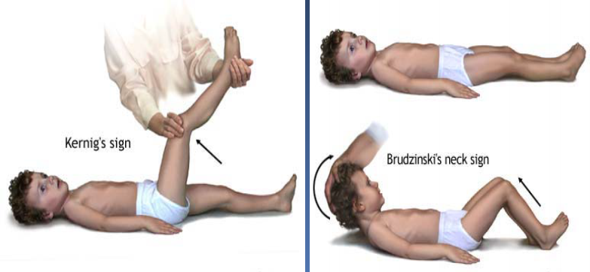
Meningitis:
Kering’s sign : when you flex the knee the child will have pain and cry
Brudzinski’s sign : flex the neck and knees and hips will flex automatically
It’s because stretching the inflamed meninges inside the spinal cord

Slide 26
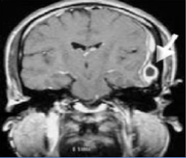
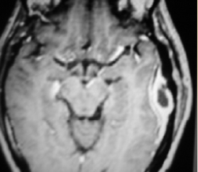
Epidural (Extradural) abscess:
Definition:
collections of pus external to the dura, usually in the Middle or posterior cranial fossa.
Clinical picture:
Diagnosis and treatment:
Persistent headache on the side of otitis media.
Pulsating discharge.
Fever
Asymptomatic (discovered during surgery)
Diagnosis:
CT scans reveal the abscess as well as the middle ear pathology.
Treatment:
Antibiotics (IV for prevention)
Mastoidectomy and drainage of the abscess

Slide 27
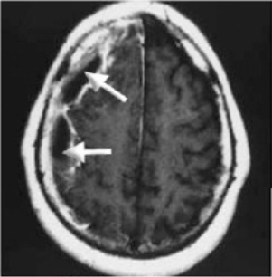
Subdural abscess:
Definition:
Collection of pus between the dura and the arachnoid. It’s a rare pathology
Clinical picture:
Investigations and treatment:
Headache without signs of meningeal irritation
Convulsions
Focal neurological deficit (paralysis, loss of sensation, visual field defects)
Investigations:
CT scan
MRI.
Treatment:
Systemic antibiotics (initially)
Drainage (neurosurgeons)
Mastoidectomy

Slide 28
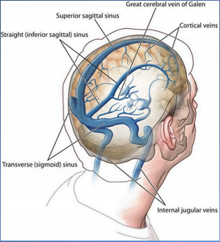
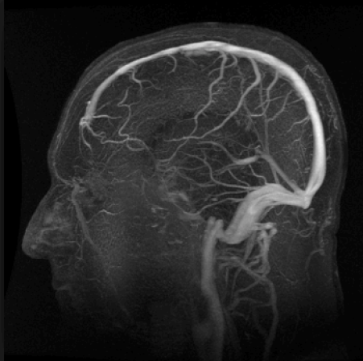
Venous sinus thrombosis:
The sigmoid sinus is located at the posterior border of the mastoid, so if we have acute mastoiditis and pus just near to wall of the venous sinus it will cause thrombophlebitis that will generate infection and will generate clots
Definition and etiology:
Thrombophlebitis of the venous sinus (usually the lateral sinus)
It usually develops secondary to direct extension.
Clinical picture:
Headache
Vomit
Papilledema (increase intracranial pressure)
Signs of blood invasion:
(spiking) fever with rigors and chills
Persistent fever (septicemia).
Diagnosis:
CT scan with contrast
MRI
MRA (MR angiography)
MRV (MR venography)
Blood cultures is positive during the febrile phase
Treatment:
Medical:
Antibiotics and supportive
Anticoagulation
Surgical:
Mastoidectomy with exposure of the affected sinus and the intra-sinus abscess is drained.
MRV

Slide 29
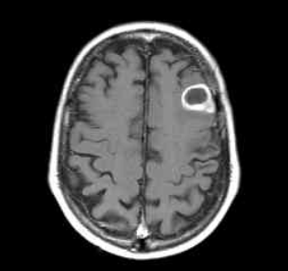
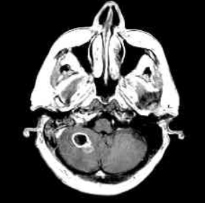
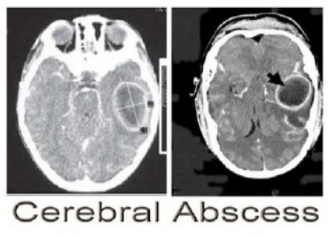
Brain abscess:
Definition and incidence:
Localized suppuration in the brain substance. It is the most lethal complication of Suppurative Otitis Media.
50% is Otogenic brain abscess. “so the main source is coming from the ear”
Pathology site:
Diagnosis:
Temporal lobe or Less frequently, in the cerebellum
- CT scan with contrast
- MRI
Treatment: admit the patient
Medical:
Systemic antibiotics
Measure to decrease intracranial pressure (LP is contraindicated)
Surgical:
Neurosurgical drainage of the abscess
Mastoidectomy operation after subsidence of the acute stage
Temporal lobe
Cerebellum
Abscess in the left temporal lobe

