Slide 1


5-Audiology
1
Objectives:
Identify type, degree and configuration of hearing loss.
Identify possible site of lesion for each type of hearing loss.
Determine middle ear function from Tympanometry measurement.
Understand origin, indications and clinical applications of OAE, ABR and speech audiometry.
Briefly recognize vestibular assessment test battery and its clinical significance.
Resources: Slides +Doctor’s notes +436 team.
Done by: mohammed hassan hakeem, Abdulhakim Bin Onayq
Edited by:
Revised by: Naif Almutairi
[Color index: Important | Notes | Extra] Editing File

Slide 2
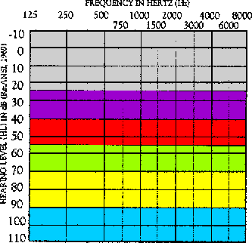
2
DR said these are the most Important for exam:
-Pure tone audiometry (type, degree of hearing loss)
- Middle ear assessment (tympanogram)
3- Auto acoustic emissions
4- Auditory brainstem response (hearing threshold in newborn)
5- Introduction vestibular assessment.
Pure tone audiometry (IMPORTANT)
The Most common test.
Indication: The usual primary purpose of pure-tone tests is to determine the type, Degree, and configuration of hearing loss.
Ranges of Hearing Loss:
  -10 – 25 dB HL = Normal range
  26 – 40 dB HL = Mild hearing loss
  41 – 55 dB HL = Moderate
  56 – 70 dB HL = Moderately Severe
  71 – 90 dB HL= Severe
  Greater than 90 dB HL = Profound
Y axis: sound intensity dB
Amplitude/ intensity:
  The quantity or magnitude of sound
  Decibel (dB): Unit of amplitude used most frequently in clinical audiology. (Unit of intensity).
X axis: Frequency in Hz
Humans can hear frequencies ranging from (20-20000HZ).
Below 20 Hz, we feel a vibration rather than hear a sound.
Most of the common sounds that humans hear are from(500-8000Hz)
Most people have very diminished sensitivity for frequencies > 8000---10, 000 Hz.
High frequency tones stimulate basal turn of the cochlea, and low frequency tones stimulate apical turn of the cochlea.
Generally, we lose high frequencies first.
  0 is not absence of sound. It is the average of hearing thresholds of a group of normal hearing adults that is used as reference (baseline for us to see where the person we are testing falls in comparison to the normal population). There is sound at 0 and even -10. So, a person that can hear at zero is the same as the normal population and a person that hears at -10 hears better than the normal population.
We deliver the sound through headphones (air conduction) and through a vibrator (bone conduction) either
on the mastoid or the frontal bone. We do that to determine the type of hearing loss. Bone conduction is always equal to or more than air conduction. This means that if air conduction is normal, bone conduction is also normal.

Slide 3
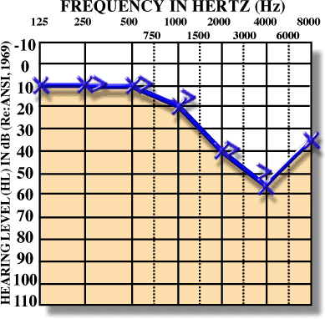
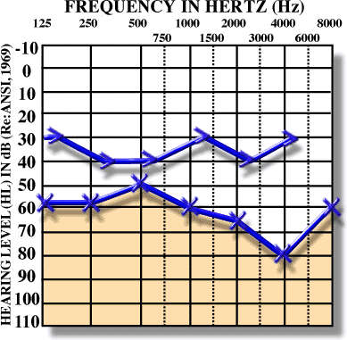
Normal Hearing |  | Comment: We can see in the audiometry above that both air and bone conduction is within the normal rage ( -10-25), so this audiometry indicates normal hearing (in the left ear). Usually when Air conduction is normal we do not test bone conduction.
Conductive Hearing Loss |  | Comments: we can see from the audiometry above the bone conduction is within normal range, but the air conduction is reduced by 30 dB. This audiometry indicates conductive hearing loss (in the left ear). Limitation: Bone conduction has limitation in the intensity (70db), so we will not be able to determine the hearing threshold if it exceeds 70 dB using bone conduction. Causes: Anything that limit the movement of the tympanic membrane cause conductive hearing loss. The pathology is either in the middle ear or outer ear E.g: outer ear: (Wax impaction, complete obstruction) middle ear ( otitis media with effusion , perforation , ossicular changes, eustachian problems) the degree of hearing loss is: moderately to moderately severe
Sensorineural Hearing Loss |  | Comments: we can see that both air and bone conduction is reduced blow the normal range starting from starting from 1500 Hz. This audiometry indicates sensorineural hearing loss (in the left ear). In such situations, describe the configuration. E.g.: Here, we have normal hearing in low frequencies, then we have a sharp drop at high frequencies with a notch and sensorineural hearing loss. Organ of Corti (basilar membrane, outer and inner hair cells; without basilar membrane we have deafness. Notched shape in the audiogram indicates noise associated hearing loss (working factories, airport workers). Causes: Inner ear (noise, labyrinthitis, fracture cochlea, Meniere's disease) nerve: tumor (acoustic neuroma) pathway up to the brain: (tumor in the pathway, trauma) Otosclerosis starts conductive, then mixed, finally pure sensory neural) the pathology is either inner ear, nerve or CNS
Mixed Hearing Loss |  | In mixed hearing loss, the degree is determined by the air conduction, (because it is always worse). The degree is: moderately sever to sever Comment: We can see that both air and bone conduction are below the normal range. In addition, the difference between air and bone conduction is greater than 10 Db. This audiometry indicates mixed hearing loss. (in the left ear)
3
Clinical Masking:

Slide 4
4
Non-tested ear can influence thresholds of test ear.
Masking is exclusion of one ear while doing the test; we do it when there is a possibility of crossing over. Crossing over gives false results in the test.
Procedures for conventional pure-tone audiometry:
After history taking and otoscopy we must choose how to test the hearing thresholds.
Before we do pure tone audiometry (PTA), we usually perform middle ear immittance testing.
PTA will be almost done to all patients visiting us in the clinic because it is the basic test and give us a lot of information about the problem.
With PTA we can determine whether the patient has peripheral hearing loss (that is at the level of outer, middle, inner ear or the auditory nerve).
PTA is administered both by air (air conduction PTA) or by bone (bone conduction PTA).
Air conduction tests are administered by loudspeakers or ear phones.
After establishing threshold at 1 KHz, we move to the frequencies (2000, 4000, and 8000Hz).
If the difference between any two adjacent frequencies is 20 dB or more, we must measure the threshold at the inter octave frequencies. We check the hearing threshold at the midoctive frequencies (750,1500,3000,6000). For example: if the hearing threshold at 500 Hz is 20 dB and at 1000 Hz is 50 dB, we need to check the hearing threshold at 750.
After we are done from the high frequencies, we return back and check the 1 KHz again to check for test-retest reliability.
Then we test (500, 250 and 125 Hz).
If we test in the sound field, we must use warble tones instead of pure tones to avoid the production of standing waves.
When using ear phones make sure that there is no excessive wax in external auditory canal and that the earphone is snugly inserted in the canal.
All equipment (audiometer, earphones, and testing room should be calibrated according the standards.
PTA-BONE CONDUCTION:
The most commonly used procedure for bone-conduction testing is mastoid placement because it is more convenient.
Frontal bone can be used as the place for the bone vibrator.
We should do bone conduction if the air conduction thresholds are above the normal range otherwise we do not need to do bone conduction testing.
Some exceptions?
We first do unmasked thresholds and then we should apply masking to the contralateral ear in order to get precise threshold measurement in this ear.

Slide 5
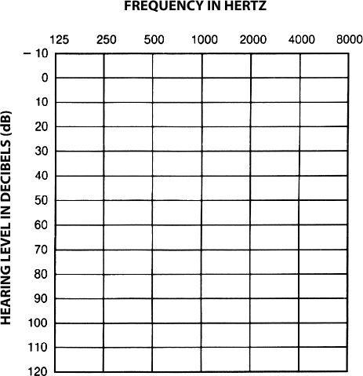
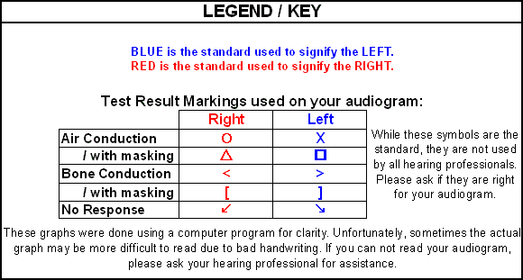
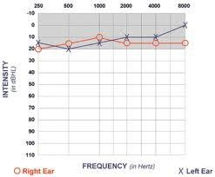
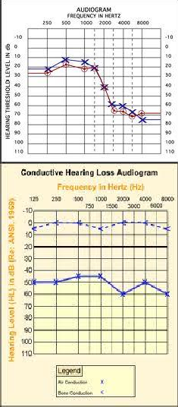
5
AUDIOGRAM:
Before we look at the audiometry, we first need to understand the symbols: In audiology noise is used as the masker. Covering the ears just wouldn't work. Instead, noise is introduced to one ear while the other ear is tested with a tone (or speech signal). To indicate that the hearing thresholds were obtained using masking, masked threshold symbols are used on the audiogram.

Slide 6
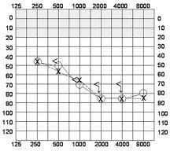
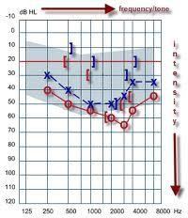
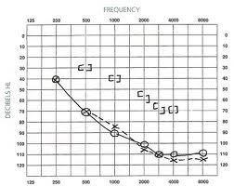
6
 | The sign means that there was no response to the maximum output of the bone conduction vibrator. It doesn’t mean that there is a hearing issue it just means that you can't determine the hearing loss in high frequencies based on the audiogram alone.
 | Comment: there is a reduction in air conduction in both RT and LT ear. So we can see it is conductive hearing loss in both ears. Why not sensorineural? Because in order to confirm that it is sensorineural, you have to check the bone conduction. Remember: Bone conduction has limitation in the intensity of (70db). Perform other tests like tympanogram.
Summary:
Air conduction (abnormal) + Bone conduction (normal) = Conductive hearing loss
Air conduction (abnormal) + Bone conduction (abnormal) + NO GAP = Sensorineural hearing loss
Air conduction (abnormal) + Bone conduction (abnormal) + GAP = Mixed hearing loss
What is the definition of the gap? >10 db between air and bone conductions
You MUST know:
  What is the type of hearing loss?
  What is the degree of hearing loss?
Information we get from audiogram:
Degree of hearing loss.
Type of hearing loss.
Configuration of hearing loss.

Slide 7
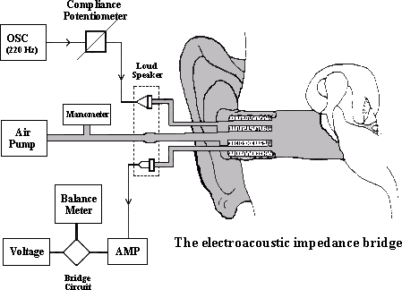
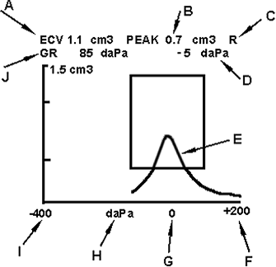
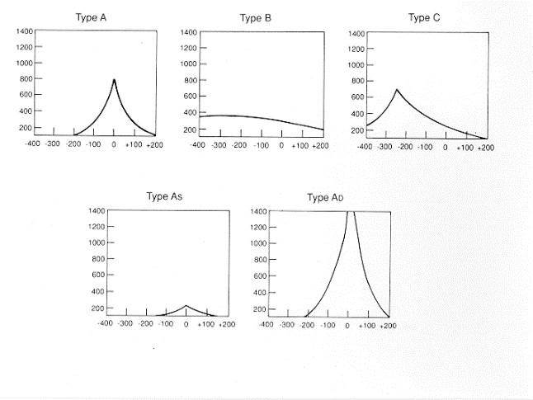
7
Tympanometry
Tympanogram: uses pressure and sound to check how much was absorbed and reflected.
Middle ear analysis is important given that it is the most commonly affected organ in the ear.
X axis middle ear pressure, Y axis admittance the middle ear is most effective if the pressure is equal to the atmospheric pressure. (ATM=0 in the tympanogram)
Physiology:
o When sound travels between air and fluid there will be a mismatch and most of the energy will be
reflected. The middle ear amplifies and transduces the sound energy to mechanical energy that can easily penetrate the fluid.
it gives you the status of outer and middle ear
TYMPANOMETRIC FEATURES:
Tympanometric shapes.
Static acoustic admittance.
Tympanometric width (gradient).
Tympanometric peak pressure.
Equivalent ear canal volume.
Sensitivity and specificity:
Sensitivity has been found to be around 82% for MEE.
Normal type A has 100% specificity.
Overall sensitivity of around 80% and specificity of around 90%.
That is good but means we need to interpret results with caution.
Types of tympanogram:
Questions you need to ask when assessing the tympanogram:
  Is there a Peak?
  And at What pressure?

Slide 8
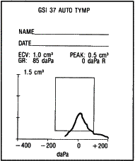
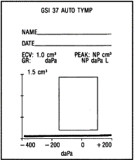
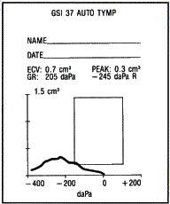
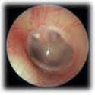
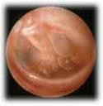
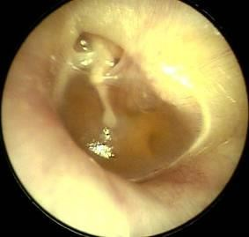

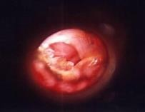
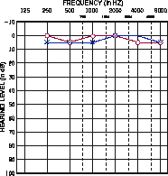
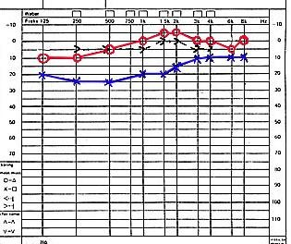
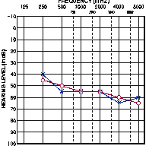
8
Type A (normal) | Type B | Type C
Q1) Is there a peak? Yes The peak means maximum sound penetration through the tympanic membrane. This happens when the pressure inside and outside the tympanic membrane are equal. Ranges: Adults: -100 to +50 Children: -150 to +50 Q2) At what pressure? 0. Zero here does not mean no pressure. It means that the pressure inside and outside the membrane are equal. Dr: to make it easy if the peak is in the square or rectangle, then it is normal. ECV: ear canal volume Corresponding audiogram: Normal hearing Moderate Hearing Loss | Type BLow It comes with OME (Otitis Media with Effusion) Type BHi It comes with perforation Q1) Is there a peak? No Q2) With type B you have to ask about the ear canal volume Why do measure the volume of the ear canal? To detect different pathologies like perforation or wax impaction Causes low ECV = Wax Impaction/ Foreign body Normal ECV = Pathology in middle ear (tympanic membrane is not moving) E.g. Otitis media with effusion High ECV = perforation with or without middle ear effusion. | It comes with Eustachian tube dysfunction Q1) is there a peak? Yes Q2) At what pressure? -250 (the reference is atmospheric pressure) - 250 pressure (severe negative pressure). There is problem in the Eustachian tube. Why negative pressure not positive? We have normal flora in the middle ear that consumes oxygen. As a result, the oxygen will be consumed and there is no ventilation. Cause: problem in the Eustachian tube. Corresponding audiogram: Conductive hearing loss (air)

Slide 9
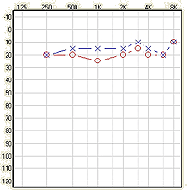
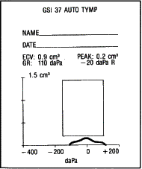
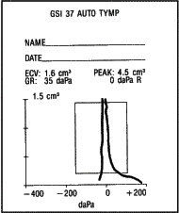
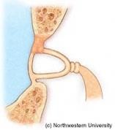
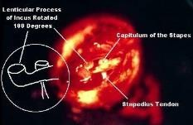
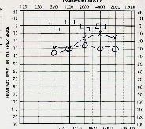
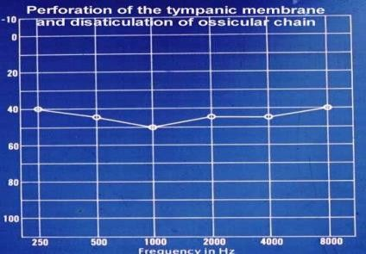
9
Type A could be either normal or sensorineural hearing loss Type A is a normal tympanogram, which means normal movement of the tympanic membrane not, it doesn't mean normal hearing. | Corresponding audiogram: Slight conductive hearing loss in audiogram
Type As (s= stiffness) | Type AD (D=dislocation)
It comes with Otosclerosis Q1) Is there a peak? yes Q2) at what pressure? 0 Q3) Is it a normal tympanogram? It is a subtype of a normal tympanogram where the peak is short Cause: Otosclerosis of stapes bone. The other structures are still moving (Incus, mallues), but the stapes is not so the intensity is low. It does not always mean otosclerosis. It can appear in cases of decreased elasticity (elderly) Corresponding audiogram: Conductive hearing loss: (air conduction) | It comes with disarticulation Q1) Is there a peak? yes Q2) at what pressure? 0 Q3) Is it a normal tympanogram? It is a subtype of a normal tympanogram where the peak is high Cause: ossicular dislocation (the system is moving too freely) Corresponding audiogram: Conductive hearing loss:(Air conduction)
Static Compliance (Peak Compliance):

Slide 10
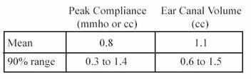
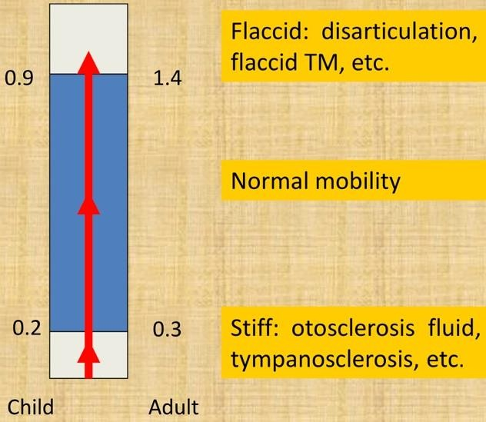
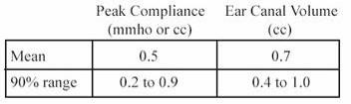
10
Acceptable Range by Age:
Adult
Child
Tympanometry in infants:
Studies has found frequent occurrence of double peaked tymps.
Usually we use higher probe frequency when testing infants like 1000 Hz.
Otoacoustic Emissions (OAE)
Physiology:
Round widow has membrane (round window membrane) . helps in decompressing the inner era or remove some pressure, otherwise the fluid will not be able to move.
A complete wave cycle is one complete period of compression and rarefaction of a sound wave.
the sound enters the inner ear, fluid vibrate movement of the outer hair cells. the movement of the hair cells create a wave moving forward (compression) and backward (refraction) to the stabes. then the tympanic will move creation sound. This sound is detected in OAE
Origin of OAE:
Initially reported by Kemp in 1978.
OAE are considered a by-product of sensory OHCs transduction and represent cochlear amplifier that thought to be as a result of the contraction of OHCs in synchrony with BM displacement.
The contraction of the OHCs (movement) is then propagated outward toward the middle ear and moves the TM.
This in turn creates acoustic energy that is picked by the OAE probe.
They provide the majority of otoacoutic emission. They are also the most sensitive structure, therefore if they are normal, the inner ear is assumed to be normal. (retrochochlear lesions though will not be picked up in OAE readings. This test will only give information up to the level of the chochlea.)

Slide 11
Recording OAE’s:
11
OAE can be recorded in both adults and infants.
Tests the healthiness of the inner ear mainly the healthiness of the sensory cells in the inner ear (Outer hair cells)
We cannot use this tool to measure threshold of hearing.
OAEs are measured by presenting a series of very brief acoustic stimuli, clicks, to the ear through a probe that is inserted in the outer third of the ear canal. The probe contains a loudspeaker that generates clicks and a microphone that measures the resulting OAE’s that are produced in the cochlea and are then reflected back through the middle ear into the outer ear canal.
The resulting sound that is picked up by the microphone is digitized and processed by specially designed hardware and software. The very low-level OAEs are separated by the software from both the background noise and from the contamination of the evoking clicks.
So in order to record OAE in EAC (external auditory canal) we need to have normal middle ear function.
Conductive pathologies can prevent the recording of OAE but this does not mean that OAE is not present.
Acquisition:
  Not affected by sleep but needs test subject to be still and compliant.
  Very quick.
Types of OAE’s:
Types
Spontaneous OAE’s (SPOAE’s)
Distortion Product
OAE’s (DPOAE’s)
Transient Evoked
OAE’s (TEOAE’s)
1. Spontaneous OAE: (not usually used)
Occurs in the absence of any intentional stimulation of the ear. You have the emission without stimulation.
Prevalence is in about 40-60% of normal hearing people.
When you record SOAE’s, you average the number of samples of sounds in the ear and perform a spectral analysis.
The presence of SOAE’s is usually considered to be a sign of cochlear health, but the absence of SOAE’s is not necessarily a sign of abnormality.
Evoked OAE:
  Distortion Product OAE
Result from the interaction of two simultaneously presented pure tones.
Stimuli consist of 2 pure tones at 2 frequencies (ie, f1, f2 [f2>f1]) and 2 intensity levels (ie, L1, L2). The relationship between L1-L2 and f1-f2 dictates the frequency response.
DPOAEs allow for a greater frequency specificity and can be used to record at higher frequencies than TOAE. Therefore, DPOAE may be useful for early detection of cochlear damage as they are for ototoxicity and noise-induced damage.
b. Transient Evoked OAE (usually used)
TEOAE are frequency responses that follow a brief acoustic stimulus, such as a click or tone burst.
The evoked response from this type of stimulus covers the frequency range up to around 4 kHz.

Slide 12
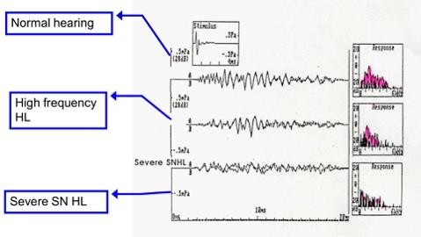
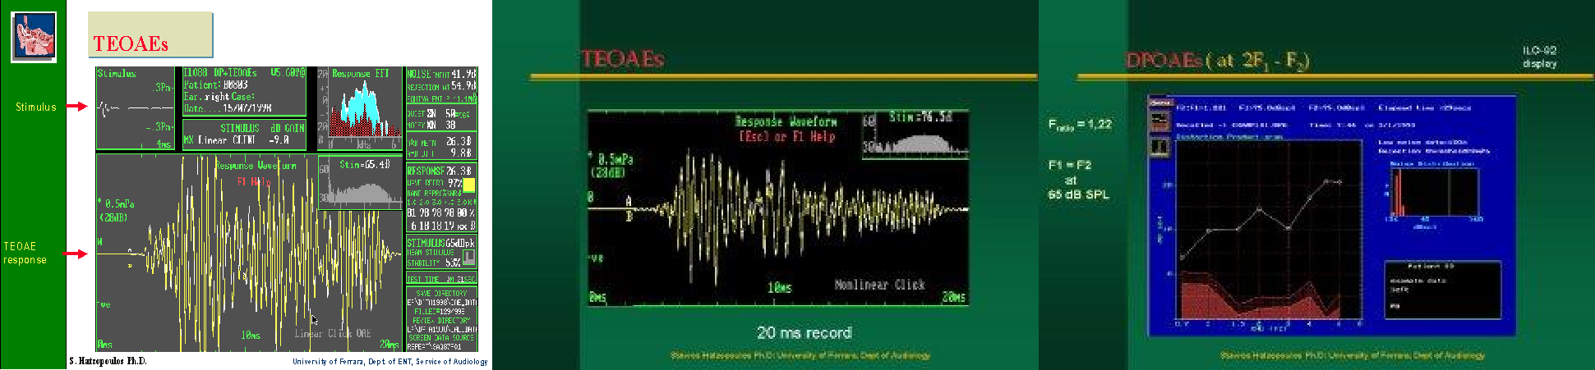
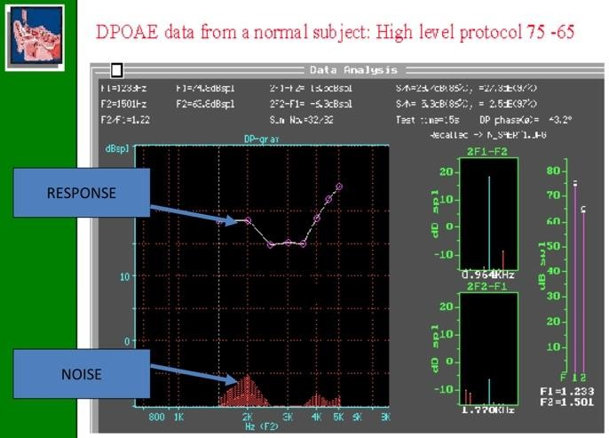
12
In normal adult ears, the click-elicited TEOAE typically falls off for frequencies more than 2 kHz, and is rarely present over 4 kHz, because of both technical limitations in the ear- speaker at higher frequencies and the physical features of adult ear canals so that is why DPOAE would be more efficacious (Not frequency specific).
For newborns and older infants, the TEOAE is much more robust by about 10 dB and typically can be measured out to about 6 kHz indicating that smaller ear canals influence the acoustic characteristics of standard click stimuli much differently than do adult ears.
TEOAE do not occur in people with a hearing loss greater than 30dB.
Accordingly, TEOAE and DPOAE can be used to screen for hearing loss in infants.
Comment: the first reading is normal, second is high frequency hearing loss, third is severe sensorineural hearing loss
TEOAE & DPOAE:
Clinical Application of OAE:
1. Can be used in newborn hearing screening. The results will indicate either fail or pass. Fail means that hearing thresholds are worse than 30 dB HL. Pass results means hearing thresholds are 30 dB HL or better (So, we can not use this tool to measure threshold of hearing).
TEOAE can be recorded in all non-pathologic ears that do not display hearing loss of greater than 30 dB.
OAE can be recorded in both adults and infants.
Accordingly TEOAE and DPOAE can be used to screen for hearing loss in infants.
DPOAE provide more frequency specific evaluation that TEOAE.
In differential diagnosis of hearing loss (site of lesion). This can help in differentiating sensory from neural.
Monitoring of the effect of ototoxicity or noise exposure.
Although still under research: DPOAE can be used to screen for the carriers of the recessive hearing loss genes: many studies found that DPOAE is larger (especially at high frequencies)

Slide 13
13
in carriers than in non-carriers when using f2/f1 of 1.3 and low stimulus levels of 50-60 Db.
Clinical limitations:
Problems because of middle ear disease
Not sensitive for neonates within 24 hours of birth
Results affected by test conditions (Noise)
Not a test of hearing- limited application
Sometimes the screening will not detect pathologies in the higher centers (auditory cortex).
Criteria for Normal OAE:
  Signal to noise difference >3dB.
  In at least 3 bands.
Auditory Brainstem response
This tests what is beyond the cochlea. So we are testing the nerve up to the brainstem (neural assessment). To pick up the electrical impulses (action potentials) that originated from the ear which are very small (microvolts), we have to cancel out the EEG.
You need a compound action potential to stimulate the brain (several thousand).
The most important clinical application of ABR is to estimate hearing threshold. In who? In neonates, mentally retarded individuals or comatose patients. Why? Because they cannot respond and tell you when they hear the sound.
The normal ABR waveform:
Is characterized by 5-7 peaks.
Occurs in a latency epoch of 1.4 – 8.0 ms.
Responses are usually displayed with positive peaks reflecting neural activity toward the vertex.
These peaks are labeled with the roman numerals I through XII.
A normal reading requires a minimum of 3 waves which are I, III and V.

Slide 14
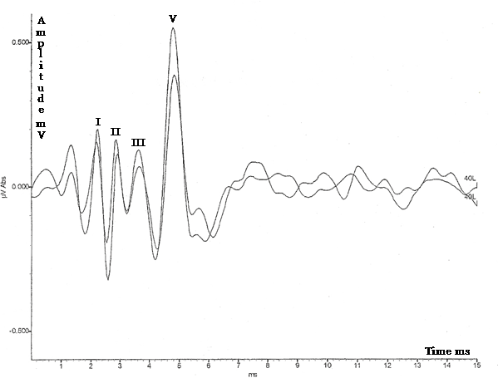
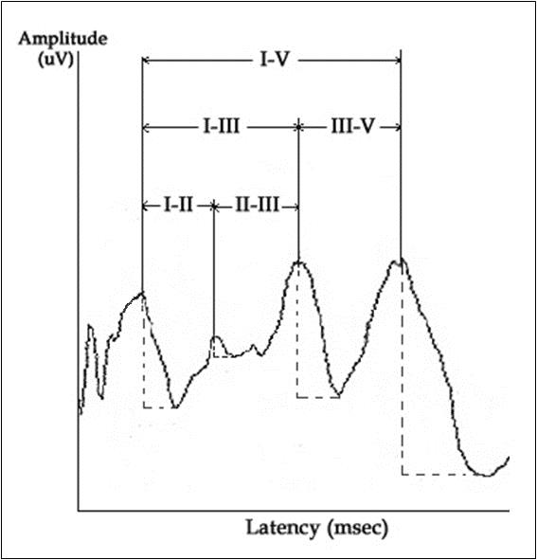
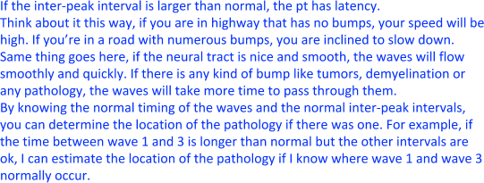
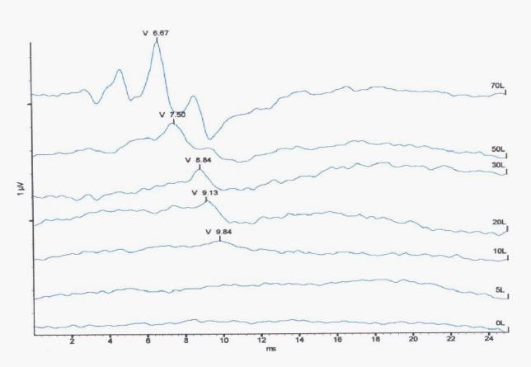
14
The most prominent waves are I, III, and V.
This graph is only in one level, you can't determine the threshold.
What is the hearing threshold?
The least intensity at which the peak appears. Wave 5 is the last one to disappear, hence it is an accurate estimate of hearing threshold. It disappears below 10 dBnHL.
So what is the hearing threshold here? 10 dBnHL.
What you must know?
Which wave?
What is the hearing threshold?
It tests the whole pathway
It most suitable for hard to test subjects (infants.)
How is an ABR recorded?
Electrodes are placed on the scalp and coupled via leads to an amplifier and signal average. EEG activity from the scalp is recorded while the ear(s) are stimulated via earphones with brief clicks or tones.
A series of waveforms unique to the auditory neural structures is viewed after time locking the EEG recording to each auditory stimulus and averaging several thousand recordings.

Slide 15
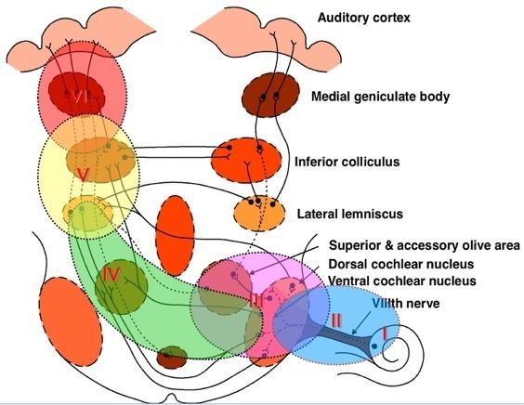
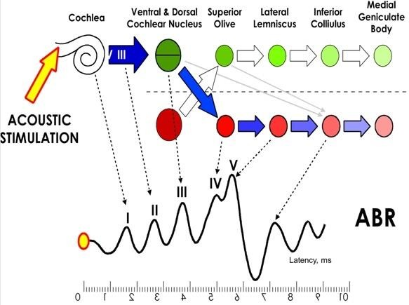
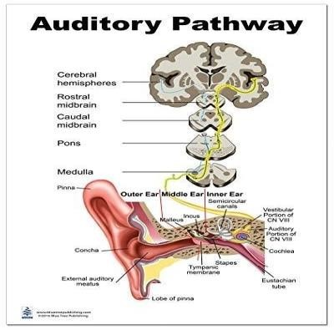
15
Generators of the ABR:
Characteristics of normal ABR:
  Information to determine normal ABR waveform depends on: Waves absolute latency.
Waves interpeak intervals. Latency-intensity function.
Wave V/I amplitude ratio.
Interaural wave V latency difference.
  Research established normal ranges of the above parameters.
  Normal ranges for the above parameters are not universal.
  There are some variation among different research findings.
  Many factors affects normal values including age, sex, temp and other factors.
  It is always better for each practice to establish its own norms.
  Absolute latency of ABR waves in adults: Wave I: at around 1.6 ms +/- 0.2 ms. Wave III: at around 3.7 ms +/- 0.2 ms. Wave V: at around 5.6 ms +/- 0.2 ms.
  Interwave latency intervals: I-III: 2.0 ms+/- 0.4 ms. III-V: 1.8 ms +/- 0.4 ms. I-V: 3.8 ms +/- 0.4 ms.
  Wave V latency-intensity function: increases by around 0.3 ms per 10 dB decrease of the stimulus level.
  V/I amplitude ratio: greater than 1.0.

Slide 16
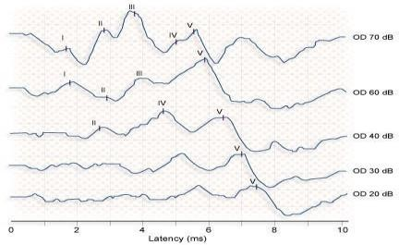
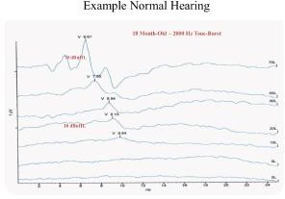
16
Wave V latency difference: less than 0.4 ms.
Latency helps determine the site of electrical activity in the auditory pathway.
Clinical applications of ABR:
There are two main applications for ABR in the clinical settings:
1- Neurodiagnosis: to assess the auditory pathway. This feature is specially used in adult populations.
Waves absolute latency.
Interpeak intervals.
Interaural wave V latency difference.
Absence of waves.
Who should be tested? Patients with: Dizziness, Unilateral tinnitus, asymmetrical hearing loss, sudden onset of hearing loss and progressive hearing loss.
2- Hearing thresholds estimation: mainly used in infants and children population. non- cooperative patients, and mental retardation.
Wave V threshold.
Wave V latency-intensity function.
Can be obtained by progressively decreasing intensity of the stimulus (click or toneburst) and observing wave V.
The last intensity that wave V appears at is considered its threshold.
ABR threshold is within 10-20 dB from the subjective threshold.
the last to disappear is wave 5 as we decrease the intensity.
Wave 5 is used to estimate hearing threshold
See wave 5, when the peak disappears this the hearing threshold. The peak disappeared at 20 dB, therefore the hearing threshold is at 20dB.

Slide 17
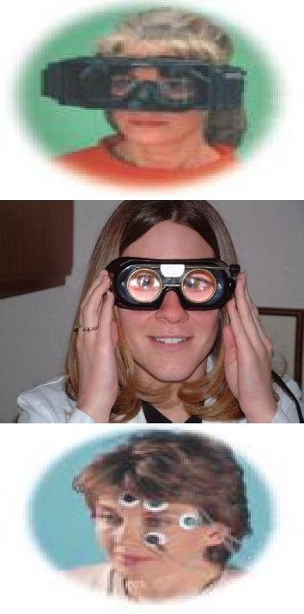
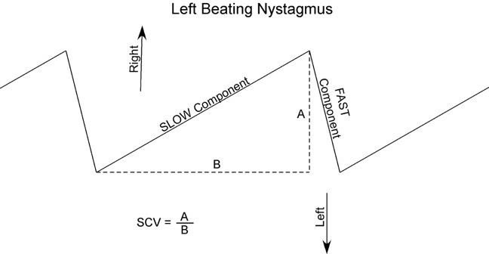
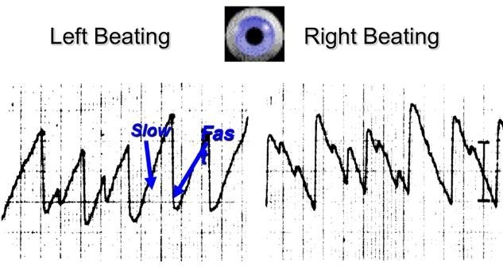
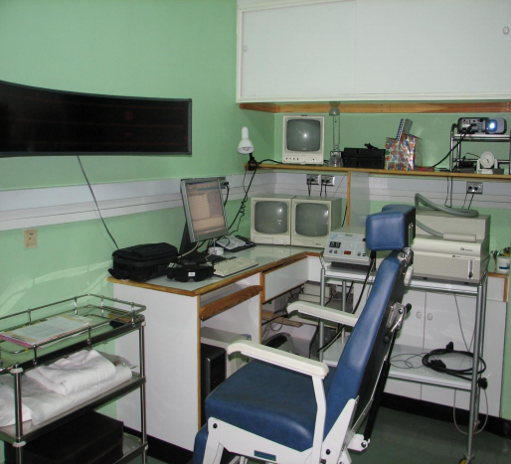
17
Eye movement recording
In performing ENG/VNG, the patient eye movements are measured relative to head position, which can be achieved in a number of ways.
Measuring electric potentials, measuring magnetic potentials, using video cameras or using infrared technology and direct observation.
Balance:
1- vestibular (most important) 2- vision
3- proprioception.
If you focus on one object and move your head, the object should still
be clear and not hazy. This will happen if all the three systems are intact.
Information from all these systems need to match for us t have clear
images. If there is a pathology in the vestibular system (peripheral or central), we make the diagnosis from the eye movement.
misinformation in these modalities lead to vertigo, dizziness, and nystagmus.
Nystagmus:
Is an involuntary conjugated rapid repetitive eye movement.
Side to side (horizontal), Up and down (vertical), In a circle (torsional) It could right or left beating depending on the fast component.
Light suppress nystagmus so we need to examine in a dim light room.
Videonystagmography (VNG) test battery
Calibration
Gaze
Saccade
Pursuit
Optokinetic
Positional
Hallpike
Caloric

Slide 18
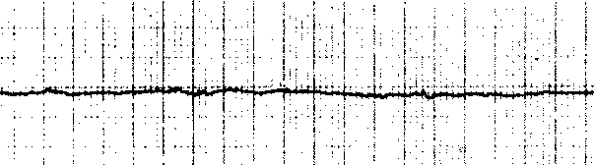






Gaze test | Gaze test in peripheral lesion
The function of the gaze system is to maintain visual fixation of an object on the fovea of the eye. To identify the presence of spontaneous eye movement. Normal gaze, patient able to maintain position with eyes opened and closed. | Horizontal. Directional fixed. Suppressed with visual fixation.
Gaze test in central lesion | Saccade (re-fixation ) Test
Horizontal, vertical or rotatory. Directional changing. Enhanced with visual fixation. | The function of saccadic eye movement system is to redirect the eye from one target to another in the shortest possible time. Inaccurate eye movement, where the eye either undershot or overshot the target is abnormal and seen frequently in patients with cerebellar dysfunction. Results: Normal saccadic eye movement test should produce rapid and accurate eye movement. Inaccurate eye movement, where the eyes overshot or undershot the target.
Ocular Pursuit Test | Optokinetic Test
The function of ocular pursuit system is to stabilize a slowly moving object on the fovea of the eye by matching the angular velocity of the eye with that of the moving object. (Simply: Can the patient follow the moving object smoothly or not). Results: When the pursuit system is impaired, small corrective saccadic movements replace the smooth pursuit movement, so the eye can catch up the | Optokinetic system maintains visual fixation when the head is in motion. Target is rapidly passed in front of the subject in one direction, then the other. Eye movements are recorded and compared in each direction. Asymmetry suggestive of central lesion
18

Slide 19




19
moving target. It may be the most sensitive subtest in ENG battery for detection of brainstem and cerebellar disorders. Normal Pursuit Abnormal Pursuit | Remember: Abnormalities in Pursuit, Optokinetic or Saccade, we have a central vestibular pathology.
Dynamic Positional Test ( Hallpike ) | Caloric Tests
The patient complains a motion related vertigo at certain position It is maneuver that places the patient head in the position that creates the response. Criteria: Latency period, subjective vertigo, Transient nystagmus, fatigable, lesion in the undermost ear. Dix Hallpike maneuver: Used to provoke nystagmus and vertigo commonly associated with BPPV. Recent research shows that there is an association between BPPV and vit D deficiency. This is because the crystals in the inner ear are made up of calcium carbonate. Head turned 45 degrees to maximally stimulate posterior semicircular canal. Head supported and rapidly placed into head hanging position. Frenzel glasses eliminate visual fixation suppression of response or can be tested Using VNG. | Caloric test is a part of ENG/VNG. It reflects an attempt to discover the degree to which the vestibular system is responsive and also how symmetric the responses are, between left and right. It is a test of the lateral semicircular canals. We are stimulating the horizontal semicircular canal. Most caloric tests are nowadays done using computerized systems, the computer analyzes the caloric data, computing peak slow-phase velocity. You can test each side independently (ONLY test) If the nystagmus is low or absent, there is hypofunction of the vestibular system. Disadvantage of this test: It is a very low frequency test. It does not give you the whole picture of the vestibular system (problems in the high frequency will not be picked up) How is the vestibular system stimulated? The difference between the temperature of the body and the stimulus will lead to the transfer of heat to the endolymph and perilymph. Caloric test procedure: Irrigations of EEC performed with cold and warm water or air. Water - cool = 30 C; warm = 44 C Air - cool = 24 C; warm = 50 C Response pattern follows the form of COWS

Slide 20


20
Nystagmus induced results are calculated to obtain Unilateral Weakness and Directional preponderance.

Slide 21
21
Lecture Notes:
Pure tone audiometry
Pure tone audiometry provides a measurement of hearing levels by AC (air conduction) and BC (bone conduction) and depends on the co-operation of the subject. The test should be carried out in a soundproofed room. The audiometer is an instrument that generates pure tone signals ranging from 125 to 12 000 Hz (12 kHz) at variable intensities. The signal is presented to the patient through earphones (for AC) or a small vibrator applied to the mastoid process (for BC). Signals of increasing intensity at each frequency are presented to the patient, who indicates when the test tone can be heard. The threshold of hearing at each frequency is charted in the form of an audiogram, with hearing loss expressed in decibels (dB). Decibels are logarithmic units of relative intensity of sound energy. When testing hearing by BC, it is essential to mask the opposite ear with narrow-band noise to avoid cross-transmission of the signal to that ear.
Impedance audiometry (tympanometry)
Impedance audiometry measures not hearing but the compliance or mobility of the middle ear structures. A pure tone signal of known intensity is fed into the external auditory canal via an ear probe and a microphone in the probe measures reflected sound levels. Thus, the sound admitted to the ear can be measured. Most sound is absorbed when the compliance is maximal, and by altering the pressure in the external canal a measure can be made of the compliance at different pressures. Impedance testing is widely used as a screening method for otitis media with effusion (OME) in children. If there is uid in the middle ear, the compliance curve is flattened.
Otoacoustic emissions
When the ear is subjected to a sound wave it is stimulated to produce itself an emission of sound generated within the cochlea. This can be detected and recorded and has been used as a screening test of hearing in newborn babies. It is now in routine clinical use.
Types of Hearing Loss (from Toronto Notes)
  Conductive Hearing Loss (CHL)
the conduction of sound to the cochlea is impaired
can be caused by external and middle ear disease
2. Sensorineural Hearing Loss (SNHL)
Due to a defect in the conversion of sound into neural signals or in the transmission of those signals to the cortex
can be caused by disease of the cochlea, acoustic nerve (CN VIII), brainstem, or cortex
3. Mixed Hearing Loss
both a conductive hearing loss and a sensorineural hearing loss.

Slide 22


Questions
22
Q1: patient comes with hearing loss. Tympanometry was done, what’s the diagnosis?
A- Acute otitis media with effusion B- Otosclerosis
C- Eustachian tube dysfunction D- Ossicular chain disruption
Ans: A
Q2: A child brought by his mother complaining of his lack of response to low noises. On examination tympanogram showed type B with normal canal volume. Which of the following is the interpretation of the tympanogram?
A- Normal tympanic membrane and no middle ear effusion. B- Normal tympanic membrane with effusion.
C- Perforated tympanic membrane with effusion.
D- Perforated tympanic membrane without effusion.
Ans: B
low ECV = Wax Impaction
normal ECV = Pathology in middle ear
(tympanic membrane is not moving) E.g: Otitis media with effusion High ECV = perforation with or without middle ear effusion.
Q3: tympanogram what is the type? B
what is the diagnosis effusion or perforation
if volume is 0.5 ml = OME
if volume is 5 ml = perforation or PE tube.

