Slide 1
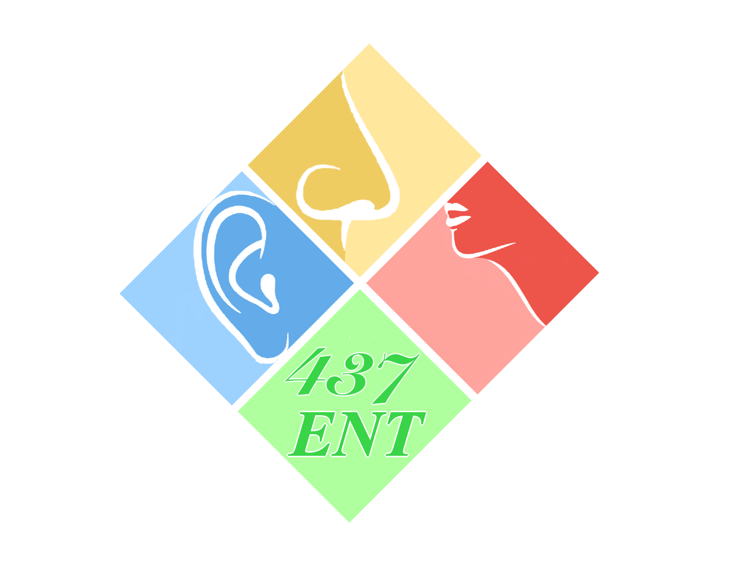
Hearing loss
1
Objectives:
Definition of the HL (hearing loss).
Prevalence of deafness.
Etiology of:
Conductive deafness.
Sensorineural deafness.
Who’s at risk to develop HL.
Impact of HL.
Classification of hearing loss.
Examination of the patient with HL.
Investigation of patient with HL.
Management of HL.
Resources: Slides+Lecture notes of ENT+team 436 group A
Done by: mohammed hassan hakeem, Abdulhakim Bin Onayq
Edited by:
Revised by: Naif Almutairi
[Color index: Important | Notes | Extra] Editing File

Slide 2
2
Introduction :
Deafness is the Impairment of sound perception more than 20 (15) decibel¹ on pure tone audiogram. The normal is hearing at 20 if you need more than 20 its abnormal.
Hearing impairment is partial or complete inability to hear from one side or both sides of the ear.
50% of deafness and hearing loss is avoidable through prevention, early diagnosis, and proper management.
How common is hearing loss?
Overall about 1 in 10.
1 in 3 adults 65 - 75.
1 in 2 older than 75.
1-2% school age children.
4% children under 5.
it’s in the Saudi guideline to do newborn screening because it’s the commonest congenital anomaly.
Signs of Hearing Loss:
Talking louder than necessary. تلاحظها في كبارالسن
Turning up volume on the TV or radio.
Complaints that other people “mumble”.
Confusion of similar sounding words ﺔﻠﺨﻧ/ ﺔﻠﺤﻧ.
inappropriate responses in conversation.
Ringing or buzzing in the ears.
Lip Reading.
Watching a speaker’s face intently.
Difficulty “hearing” someone behind.
Having difficulty speaking on the telephone.
The impact of hearing impairment:
Affects Speech if the input is flawed then the output will be flawed too/ if you listen to
something in a wrong way then you’ll repeat it wrong too.
Language
Education
Social They’ll feel left out/isolated and depressed. They’ll have thoughts like “what if others are talking about me”
New studies that show hearing loss is associated with dementia, and the incidences decreased if hearing aids have been used.
limit activities, Isolation, Depression, Anxiety, Insecurity, strain relationships, Increase psychosocial difficulties
¹ decibel is a unit for expressing the relative intensity of sound on a logarithmic scale.
.

Slide 3
3
High Risk Criteria For Hearing Loss in Infants:
Family history of hereditary childhood sensorineural hearing loss.
Hyperbilirubinemia
Ototoxic medications. Such as Aminoglycosides or chemotherapy like Methotrexate
Bacterial meningitis.
Birth weight less than 1500 grams
In utero infections (toxoplasmosis, syphilis, rubella, cytomegalovirus and herpes).
Craniofacial anomalies (including pinna and ear canal).
Birth asphyxia.
Mechanical ventilation lasting 5 days or longer.
Stigmata or other findings associated with a syndrome known to include a sensorineural and/or conductive hearing loss. RF for adults such as Trauma or noise exposure in airplanes (not wearing ear plugs)
When the external and the middle ear are affected= conductive hearing loss. Inner ear (cochlea) and the nerve= sensory hearing loss.
Cochlea’s job is tuning of the sound.

Slide 4
4
Conductive hearing loss (CHL):
Conduction of sound to the cochlea is impaired.
Can be caused by external and middle ear disease
The lesion may lie in the external ear and tympanic membrane, middle ear or ossicles up to stapediovestibular joint. (433)
External canal pathology:
Congenital
Atresia (No ear canal) & Microtia: Deformity of the ear auricle
Inflammatory:
Otitis media: Acute suppurative (ASOM) – Otitis media with effusion (OME) - Chronic otitis media (CSOM).
Acute otitis externa: It’s a common condition involving inflammation of the ear canal. The acute form is caused primarily by bacterial infection, with Pseudomonas aeruginosa and Staphylococcus aureus the most common pathogens. Very painful.
Obstruction:
Wax: the commonest cause of conductive hearing loss (CHL).
Foreign body (Any form of obstruction can cause CHL like insekt or Q-tips).
Tumors: Benign or malignant.
Osteoma: Benign bone tumor, single, unilateral, broad-base.
Exostosis: Benign bone overgrowth, multiple, bilateral, pedunculated, in cold regions (Austria and Scandinavia).
Trauma: Skull base fracture blood goes to the external auditory canal> tympanic membrane perforation> blood in the middle ear gives Raccoon eyes sign³ and battle’s sign.
Atresia
³ periorbital ecchymosis

Slide 5
5
wax
Acute otitis externa
Foreign body
Tympanic membrane pathology:
-Absent TM caused by perforation: Fresh blood indicates a recent injury (acute injury).
-Too thick TM caused by tympanosclerosis.
Tympanosclerosis: Calcification of an old inflamed tissue. (usually it’s asymptomatic -most of the time-, but when it’s symptomatic it causes CHL) (ask about previous infection in the ear while taking the history because it comes from recurrent infections) ,It’s a condition characterized by the presence of masses of hard, dense connective tissue around the auditory ossicles in the middle ear, also known as myringosclerosis.
Multiple surgeries or infections (myringitis) causes TM scarring and thickening.
3-Too thin TM caused by Secretory otitis media (SOM), Retraction.
Drum Retraction (Adhesive OM):
It's also called Atresia, Atelectasis ear.
The tympanic membrane gets sucked in because of eustachian tube dysfunction and negative pressure, which will suck the ear-drum inside. We treat it by ventilation tube, which prevents the ear from getting sucked inside by preventing the negative pressure. So
perforation and retraction both of them are causes to conductive hearing loss.
Treatment of adhesive OM is attachment of tube.

Slide 6
6
Ossicular chains:
Absent & erosion.
Fixation: congenital or acquired otosclerosis.
Disrupted trauma or dislocation.
Otosclerosis:
Congenital inherited autosomal recessive disease causes fixation of the footplate (stapes) by new bone formation.
A disease of the bony otic capsule characterized by abnormal replacement of mature bone of the otic capsule by woven bone of greater thickness.
10% otosclerosis lesions (10% symptomatic).
Middle-age.
Females: Male, 2: 1.
Occur in Caucasian and Europeans mostly.
Worse during pregnancy and improve after delivery (due to hormonal changes).
Treatment: Stapedectomy is a surgical procedure in which the innermost bone (stapes) of the middle ear is replaced with a small plastic tube of stainless-steel wire to improve the movement of sound to the inner ear.
Eustachian Tube dysfunction:
Retraction.
Effusion.
Otitis media: Acute suppurative (ASOM) Otitis media with effusion (OME) Chronic otitis media (CSOM).
Congenital cholesteatoma.
Squamous cell carcinoma
Paraganglioma
schwannoma
Sensorineural hearing loss (SNHL):
SNHL is a defect in the conversion of sound into neural signals or in the transmission of those signals to the cortex
It can be caused by disease of the inner ear (cochlea), acoustic nerve (CNVIII), brainstem, or cortex.
IT has Two types:
Sensory (the pathology is within hair cells in cochlea).
Neural (the pathology is within the auditory nerve and its connection
Etiologies:
• Congenital • Trauma • Infection • Noise • Ototoxic • Presbycusis
• Acoustic neuroma it may be congenital or acquired

Slide 7
7
Congenital:
- Inherited
Syndromic (less common)
Mondini malformation
Non-syndromic (more common).
Congenital infection (TORCH)
can lead to delay speech and language development.
acquired:
Trauma:
Temporal bone fracture: affect hearing, balance and facial nerve.
Longitudinal fracture:
Bleeding from ear.
Conductive hearing loss.
Uncommon facial nerve paralysis.
CSF.
Transverse fracture:
SNHL.
Facial nerve paralysis common.
CSF.
Mixed.
Noise exposure induced SNHL:
Boilermaker's deafness.
One of the most common occupationally induced disabilities.
Tinnitus : commonly accompanied NISNHL, warning sign
Follows chronic exposure to less intense sounds than seen in acoustic trauma and is mainly a hazard of noisy occupations. Here its cumulative like blow drying it is NOT REVERSIBLE (That's why they have devices that measure the noise in factories and airports) Load speakers in weddings have the same effects)

Slide 8
8
Tinnitus (only sign). earliest sign
Commonly accompanied NISNHL.
Warning sign (one gunshot could cause SNHL, and in KSA fireworks) Hunting or explosions are one time highly intense shots causing hearing loss straight away.. Causes damage to hair cells, starting in the basal turn of cochlea. Outer hair cells are affected before the inner hair cells.
Ototoxic:
Antibiotics (aminoglycosides). like Gentamicin.
Diuretics. (Furosemide)They are known to cause oedema and cystic changes in the stria vascularis of the cochlear duct.
Antineoplastics.
Anti Inflammatories.
Antimalarial agents. (chloroquine, quinine)
Ototopic agents.
Others.
Higher risk:
Renal failure (Elevated peak and trough levels)
Liver failure
Immunocompromise
Collagen-vascular disorders
Advanced age (> 65 years)
Prior ototoxicity
Concurrent use of known ototoxic agents
Preexisting HL or Vestibular
Bacteremia (fever )
Treatment course longer than 14 days
+ ve FHx of AG ototoxicity
Patients particularly at risk are those: Concomitantly receiving other ototoxic drugs, who have already received aminoglycoside antibiotics, who are receiving high doses of ototoxic drugs with high serum level of drug, who have genetic susceptibility to aminoglycosides. (433team).
Acoustic neuroma (Vestibular Schwannoma):
Vestibular Schwannoma is a benign nerve tumor in the internal auditory meatus or cerebello-pontine (CP) angle at the base of the skull. It is usually unilateral, except in the very rare familial neurofibromatosis type 2 (NF2), when it may be bilateral. In its early stages, it causes progressive hearing loss and imbalance. As it enlarges, it may encroach on the trigeminal nerve in the CP angle, causing loss of corneal sensation. In its advanced stage, there is raised
intracranial pressure and brain stem displacement. Early diagnosis reduces the morbidity and mortality. Unilateral sensorineural deafness should always be investigated to exclude a neuroma. Audiometry will confirm the hearing loss. MR scanning will identify even small tumors.

Slide 9
9
Presbycusis:
Aging process of human beings, it’s associated with grey hair, cataract and SNHL. most common type.
Presbycusis = Deafness + Tinnitus + Recruitment (Out of proportion of
loudness. (Meaning the patient can’t hear, but when he hear, he hear
everything louder than it’s normal range) The cochlea normally acts as afilter; it decreases loud voices and amplifies the low sounds, here the cochlea is not functioning well.)
Overview of Hearing Loss:
#1 handicapping disorder
60% of Americans > 65 HL
90% of > 75 Y have HL
HL + degenerative processes of aging
Half vestibular symptoms
Problems With Diagnosis includes: Shame or embarrassment, HA social stigma, Embarrassment prevents 15 million elderly people from getting help.
Inflammatory: (labyrinthitis, meningitis): in meningitis it goes to cochlear through natural connection of the brain and ear causing ossification and the new bone being made causes death of OHC, some say the connection is through a blood supply, also it may affect Wernicke’s and the temporal lobe causing neural hearing loss.
Autoimmune (Cogan syndrome) with SLE or PRH

Slide 10
10
Examination:
−
General look (syndromic)
Complete head and neck exam.
Otoscopic / microscopic ear exam for both ears.
Tuning fork test.
Clinical testing of hearing:
Tuning forks: Tuning fork tests rely on the basic concept of classification of hearing loss. Deafness may be classified under one of these headings:
Conductive deafness.
Sensorineural deafness.
Mixed conductive and sensorineural deafness.
There are 2 tests:
Weber test: is a quick screening test for hearing. You need to know how to interpret the result
It can detect:
Unilateral conductive hearing loss (middle ear hearing loss) deviated to affected ear.
Unilateral sensorineural hearing loss (inner ear hearing loss) deviated to better ear.
The test is useful in determining the type of deafness and in deciding which ear has the better-functioning cochlea. The base of a vibrating tuning fork is held on the middle of the skull and the patient is asked whether the sound is heard centrally or is referred to one or another ear.
Interpretation:
In conductive deafness the sound is heard in the deafer ear.
In sensorineural deafness the sound is heard in the better-hearing ear.

Slide 11
11
Rinne test:
It compares perception of sounds transmitted by air conduction to those transmitted by bone conduction through mastoid. evaluates hearing loss in one ear.
This test compares hearing in one ear by air conduction (AC), and bone conduction (BC). It is usually performed as follows:
a tuning fork of 512Hz (cycles per second) is struck and held close to the
patient’s ear (AC); the base is then placed firmly on the mastoid process behind the ear (BC) and the patient is asked to state whether it is heard better by BC or AC (Fig. 3.3-check it above).
Interpretation of Rinne’s test:
If AC > BC (called Rinne positive) the middle and outer ears are functioning normally.
If BC > AC (called Rinne negative) there is defective function of the outer or middle ear (conductive deafness).
Try this on yourself. Then gently occlude your outer ear by pressing the tragus, giving yourself a mild temporary conductive deafness. Now repeat the test and you should find that Rinne becomes negative, demonstrating the conductive loss.
Rinne’s test tells you little or nothing about the cochlea. It is a test of middle-ear function.
Impedance: Acoustic reflex.
Tympanogram:
Is graphic representation of the relationship between the air pressure in the ear canal and the movement of the tympanic membrane.
Type A: normal.
Type B: fluid or perforated tympanic membrane.
Type C: negative pressure in the middle ear.

Slide 12
12
Type Ad: ossicular disruption with normal TM.
Type As: ossicular fixation
Audiogram:
Pure tone audiogram:
Pure tone audiometry provides a measurement of hearing levels by AC and BC and depends on the co-operation of the subject.
The test should be carried out in a soundproofed room¹. The signal is presented to the patient through earphones (for AC) or a small vibrator
applied to the mastoid process (for BC). Signals of increasing intensity at each frequency are presented to the patient, who indicates when the
test tone can be heard.
The threshold of hearing at each frequency is charted in the form of an audiogram (Figs 3.6–3.8), with hearing loss expressed in decibels (dB)².
When testing hearing by BC.it is essential to mask the opposite ear with narrow-band noise to avoid cross-transmission of the signal to that ear.
Tests the intensity of sound and its frequency, the patient decides the
threshold by saying if he can or can’t hear it.
Normal hearing
Conductive hearing loss
Mixed hearing loss
sensorineural hearing
¹ The audiometer is an instrument that generates pure tone signals ranging from 125 to 12 000 Hz (12 kHz) at variable intensities.
² Decibels are logarithmic units of relative intensity of sound energy.

Slide 13
13
Speech audiogram:
Speech audiometry measures the ability of each ear to discriminate the spoken word at different intensities.
A recorded word list is supplied to the patient through the audiometer at increasing loudness levels, and the score is plotted on a graph.
In some disorders, the intelligibility of speech may fail above a certain intensity level.
Above a critical threshold, sounds are suddenly perceived as having
become excessively loud – loudness recruitment. This suggests a cochlear disorder and is common in elderly patients with presbycusis.
Degree of hearing impairment:

Slide 14
14
Management of hearing impairment:
Two Types :
Medical
Hearing Aid: they magnify the sound so it reaches the cochlear amplified. Hearing aids are better in sensory rather than neural loss.
History: 1550 by Girolamo Cardano when he saw that sound could be transmitted through the teeth.
Treat the underlying cause
Surgery:
Myringoplasty & ventilation tube: in case of otitis media with effusion most common procedure performed (done in a eustachian tube infection) ventilation tube indication: 1-Persistent effusion 2-Eustachian tube dysfunction 3-Recurrent acute otitis media
Myringoplasty & tympanoplasty: in case of CSOM.
Ossiculoplasty:
in case of ossicular discontinuity.
Either partial or complete (in case all 3 ossicles are involved) ossiculoplasty.
Bone Anchored Hearing Aids (B.A.H.A):
Titanium implants, used in CHL (they use titanium because it doesn’t react with the body)
BAHA stimulates the cochlea by

Slide 15
15
transmitting the sound waves through the bones in our skull, or bone conduction, thereby bypassing the outer and the middle ear.
Atresia of external ear canal. and microtia
Chronic drainage ear not responding to surgery
Done for all types of HL (mainly conductive) it skips the middle and internal ear and goes straight to the cochlear and stimulates the bone directly.
We can also reach the brainstem and due to the presence of the cardiac center you can stimulate one and the patient may die but they still want the procedure to be done so it says a lot about the importance of hearing.
Cochlear implant:
“audiogram shows bilateral profound sensorineural hearing loss can be an indication”
Putting tiny electrode in the cochlea.
Prelingual children and postlingual adult
It by pass the external, middle and inner ear to stimulate the auditory nerve directly.
In congenital HL the cochlear implant is ineffective after 5 years (The child will be prelingual and the child would’ve already learned sign language so it will be difficult to adapt) , due to the disappearance of auditory segment from the brain (it gets used up by other centers of other senses that's why their other senses become better like vision for example) . But in people who used to hear and then lost their hearing there is no time limit for the usage of cochlear implant, but we prefer to implant within 10 years.
It’s a device consisting of a microphone, signal processor, external transmitter, and implanted receiver; the receiver is surgically implanted under the skin near the mastoid process above and behind the ear.
So, in the exam if they gave you a cochlear implant picture you should know it, it looks like a regular hearing aid but with a magnet from outside.
Classical indication of cochlear implant:
Bilateral sensory-neural hearing loss not benefiting from hearing aids and less than 5years of age
if congenital hearing loss.
It is standard practice everywhere to implant for children under 5 because of the improvement in the quality of life.
We have to make sure that the patient has a cochlea and a nerve

Slide 16
16
prior to implant.
Auditory brainstem implant (A.B.I):
Implant in the brains
When there’s no cochlea or nerve we bypass them directly to brainstem. After the procedure is done there wont be a noise protective mechanism so we send the patients to the ICU to monitor them from any cardiorespiratory complication.
Lip Reading
Sign Language
Myringplasty and tympanoplasty
Ossicloplasty
In case of ossicular dicontinutity
Either partial or complete in case all 3 ossicles are involved ossiculoplasty

Slide 17
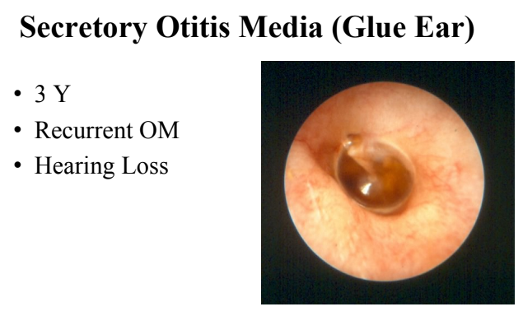
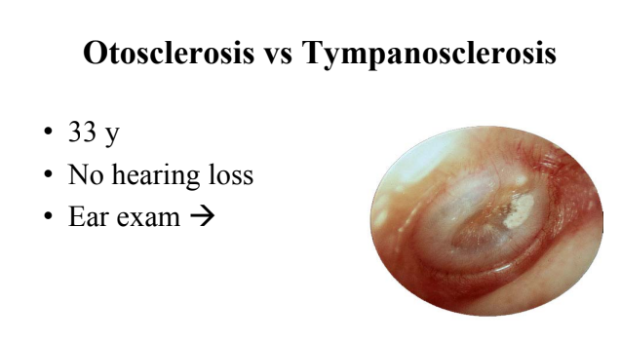
16
Cases

