Slide 1
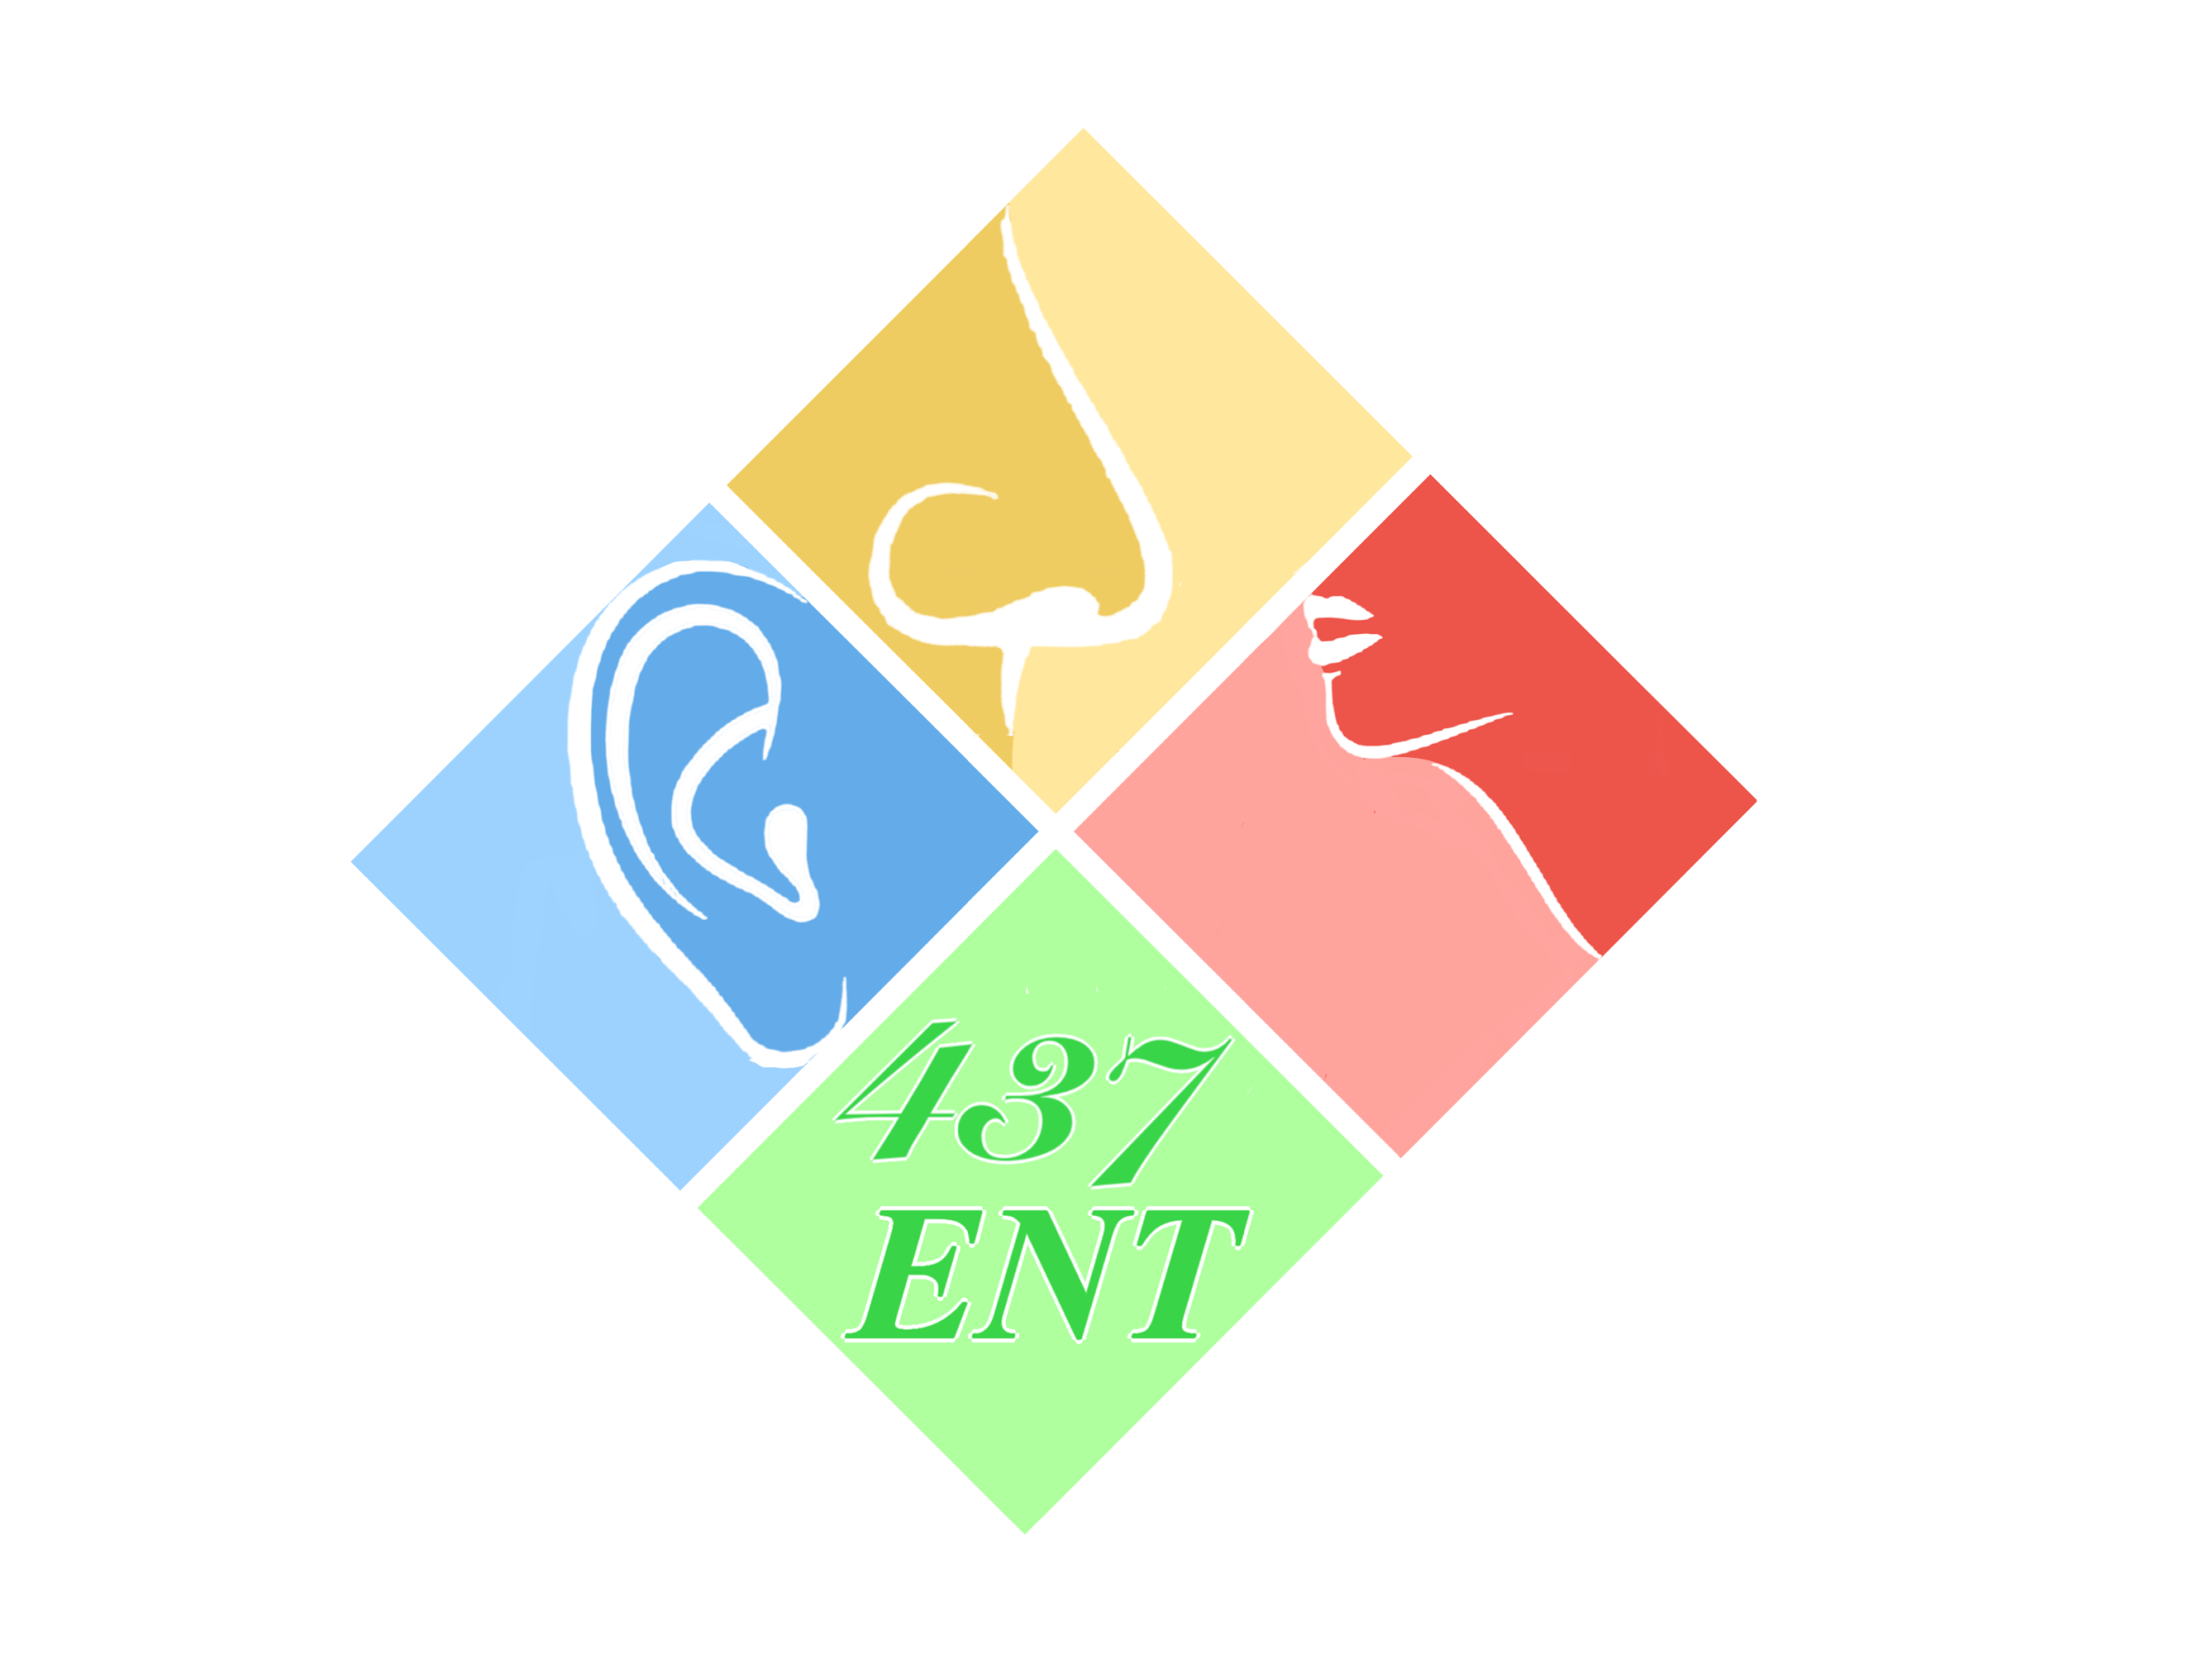
Vertigo
Objectives:
From Team 436F
Nothing was mentioned in our slides
To know anatomy of balance organs.
Physiology of balance.
Relevant history in dizzy patients.
Classification of vertigo.
Common peripheral causes of vertigo, clinical features, investigation and management.
Common central causes of vertigo, clinical features, investigation and management Vertigo Central Peripheral Meniere's disease BPPV Vestibular neuritis CVA Acoustic Neuroma Multiple Sclerosis Migraine.
Resources: Team 436F, Doctor’s slides
Done by: Thamer AL-zahrani, Khaled Aloqeely
Edited by:
Revised by: Naif Almutairi
[ Color index: Important | Notes | Extra ]

Slide 2
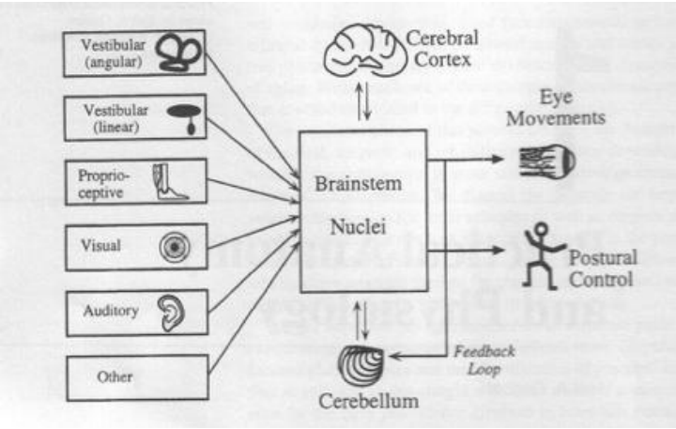
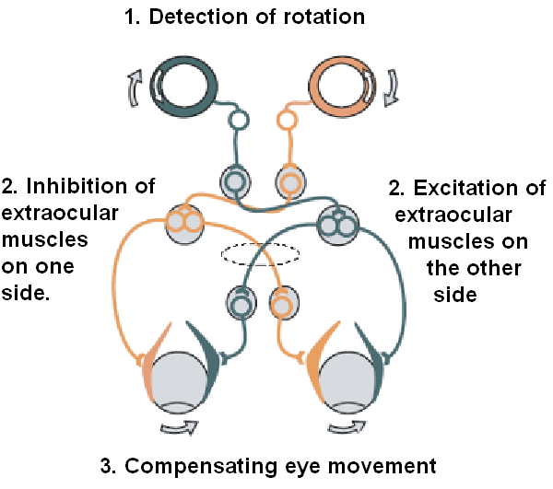
Introduction
What are the balance organs?
more than just vestibule
1. Inner ear (3 semicircular canals and otolith organ).
2. Cerebellum.
3. Vision (VOR-Vestibulo Ocular reflex)*:
*To stabilize images on the retina
during head movement, by moving the eye
in direction opposite to the direction of the
head, thus keeping image on the center of
the visual field.
The anatomical component of VOR are:
a. Semicircular canals.
b. Vestibular and oculomotor nuclei in the brainstem.
c. Extra-ocular muscles.
4. Proprioception (Muscles & Joints).To know the position of your joints
5. Cerebral cortex

Slide 3
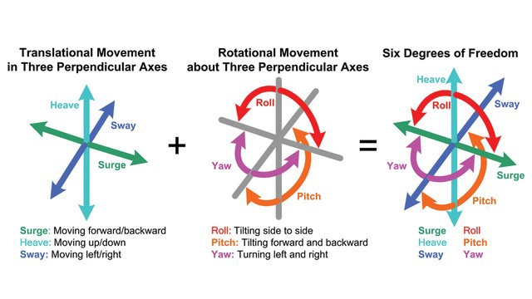
Types of Spatial Movement:
Rotational – 3 degrees of freedom (semicircular canals)
Translational – 3 degrees of freedom (otolith organs)
Head acceleration and gravity (stimulus) → biological signals → brain develops subjective awareness of head position (orientation) → produce motor reflexes (contracts and relaxes certain muscles) → maintains posture and ocular stability e.g; If someone were to ask you to concentrate on something and shakes your head, you will keep the object of interest in sight (keeping your eye mobility) and the clarity of vision despite the shaking.
An illusion of movement of self or environment.
Exact description is important: o True spinning?
o Lightheadedness?
o Unsteadiness?
o Fainting, passing out?
Function of vestibular system:
What is Dizziness?
*dizziness is a broad term, every patient with vertigo have dizziness, you can have dizziness without vertigo

Slide 4
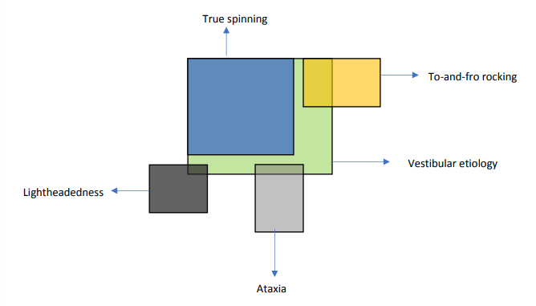
❖ Hint #1: Significance of True spinning.
true spinning ”vertigo” (vs dizziness)
• Almost all true spinning is vestibular.
• All vestibular is not true spinning.(vestibular involvement causes vertigo mainly, but it can cause dizziness rarely)
❖ Vestibular vertigo features:
● Spinning sensation
● Nausea and vomiting
● Worse with head movement
● Ataxia
● Nystagmus
❖ Hint #2: Central vs. Peripheral.
● Central:
○ Neurologic symptoms
■ New severe headache
■ LOC loss of consciousness
■ Numbness, weakness
○ Type of nystagmus
○ Risk factors (HTN, DM, if they’re on Anticoagulants like warfarin)
○ No improvement within 48 hours
● Peripheral:
○ Ex. Meniere’s
○ Ear symptoms
common clinical diseases: (know the main 3)
• Vestibular neuritis. Inflammation of vestibular nerve
• BPPV. Benign Paroxysmal Positional Vertigo
• Meniere's disease.
• Labyrinthine fistula.
• Superior semicircular canal dehiscence.
• Autoimmune inner disease.
• Vestibulopathy.
• Vestibular nerve tumor (vestibular schwannoma).
How to approach a patient with vertigo

Slide 5
❖ BPPV (benign paroxysmal positional vertigo)
*most common cause of peripheral vertigo in patients over 40*
pathophysiology: ear stones “otoliths”
*posterior semicircular canal is the most common canal affected
etiology:
not identifiable
closed head injury, surgery
infections
prolonged bed rest
menieres disease
recurrent vestibulopathy
migraine
Doctor: unknown cause
approach:
history:”pathognomonic”
vertigo:
-multiple times a day
-brief episodes (seconds) *never last for more than a minute*
-provoked by certain positions
(rolling in beds, looking up for shaving and head rotation)
unaccompanied by auditory complaints (Not associated with
any hearing impairment)
(vs? which has has hearing loss)
examination
(to confirm the diagnosis)
Dix hallpike maneuver *3min video*
6Ds (doctor: you don't have to remember it)
delay (seconds latency)
downward (geotropic)
duration (less than 1 min)
directional changes
dizziness
disappear
treatment:
epley maneuver *2min video*

Slide 6
❖ Meniere’s disease
-pathology:
decrease endolymphatic reabsorption
progressive hydrops
membranous ruptures
spillage of large amount of neurotoxic endolymphatic compartment
healing of the membranes
distortion and atrophy of sensory and neural structure
-Doctor: unknown
-histology: scala media is hyperinflated-> ruptures
-Causes: autoimmune, ischemia, mumps, syphilis, hypothyroidism, head trauma, previous infection, hormonal
Diagnosis:
-history:*pathognomonic*
-recurrent attack of vertigo lasting hours
-associated with tinnitus, hearing loss (vs BPPV)
-aural(ear) fullness (unlike vestibular neuritis)
-Triggers: High salt intake, caffeine, stress, nicotine and alcohol.
-diseases course
early
predominant vertio
deafness (partial)
normal hearing between (the attacks)
later
hearing loss stops fluctuating
progressively worse (50db)
-physical exam: unilateral hearing weakness
-PTA(pure tone audiometry): LF-SNHL (low frequency sensorineural hearing loss)
-you must rule out other possible diagnosis
○ There is a typical triad of symptoms of:
1- vertigo( (usually spinning sensation; lasts 20 minutes - 5hours) accompanied by nausea and vomiting with ataxia and nystagmus towards the unaffected ear 2- deafness (improves after the attack)(Low frequency fluctuating SNHL - Although deafness is fluctuant repeated attacks can cause significant sensorineural hearing loss)
3-tinnitus (usually low-tone roaring). 4- Aural fullness

Slide 7
-management:
education
treat the acute attacks (stay away from dangerous places, prevent falls)
medical (anticholinergic, antihistamine, phenothiazine,benzodiazepines)
prevent further attacks
improve hearing
vestibular rehabilitation
surgical (we may put ototoxic drugs to destroy the damaged ear)
F/U.. bilateral Meniere’s disease
❖ Vestibular neuritis:(may start following a viral infection)
abrupt onset
single, severe, prolonged vertigo
nystagmus
no hearing loss, or severe vertigo
no neurological signs/symptoms
treatment: symptomatic
❖ ototoxicity:
● usually aminoglycosides or chemotherapy
● complain of oscillo boscia
● It takes 3 weeks to recover from vestibular neuritis
❖ Investigations: (for any patient with dizziness)
audiology*
PTA (pure tone audiometry)
ENG (Electronystagmography)
posturography
rotation chair
radiology
CT/MRI (if we suspect a brain tumor)
blood tests (for other diseases)
CBC, thyroid, FTA-ABS
-99% of cases are diagnosed by history
*audiology tests are routinely done for any dizzy patients, and will be discussed in audiology.
➔ Acute attack: Bed rest, vestibular sedatives (dimenhydrinate, promethazine theoclate or prochlorperazine), vasodilators.
➔ Chronic phase: Vestibular sedatives, vasodilators, diuretics, elimination of allergen, hormones (in case of hypothyroidism)
(labyrinthitis: a similar syndrome, but with hearing symptoms)
Treatment: usually self-limiting
● The patient requires only symptomatic treatment:
○ Acute phase: bed rest, vestibular sedatives (Gravol®), and diazepam.
○ Convalescent phase: progressive ambulation especially in the elderly, vestibular exercise: (involve eye and head movements, sitting, standing, and walking).

Slide 8
Physiology
this slide and the following slides are from 436 team
● The body’s sense of equilibrium is maintained by input from a number of sources. These include the (eyes, proprioceptive organs especially in the muscles and joints of the neck, peripheral nerves, the labyrinth or ‘balance organ’ in the inner ear which includes the vestibule and semicircular canals and the cerebral cortex and cerebellum).
● Input from all these sources converge in the brain stem; dysfunction of any of these systems may lead to imbalance, a feeling of unsteadiness, ‘vertigo’ – a sensation of movement – and a tendency to fall.
● Vertigo may be accompanied by ‘nystagmus’ – a rapid beating of the eyes to one side as impulses from the brainstem to the ocular muscles attempt to correct the patient’s balance.
● Vestibular System: It is the apparatus of the inner ear that provides stable vision during head movements. It transforms the forces associated with head acceleration and gravity into biological signals that the brain can use to:
○ develop subjective awareness of head position in space (orientation).
○ Produce motor reflexes that will maintain posture and ocular stability keep the eye focused on the object of interest.
○ Semicircular Canals is for Angular Acceleration.
○ Utricle & Saccule:
■ Macule of the utricle: plan horizontal.
■ Macule of the saccule: plan vertical.
■ Linear acceleration horizontal & Vertical (gravity).

Slide 9
Definitions
Vertigo: It is an illusion of rotary moving.
Instability: impossibility to maintain one’s body
in desired position. could be caused by low BP and low blood sugar
Nystagmus: Is an involuntary conjugated rapid repetitive
eye movement.
Side to side (horizontal)
Up and down (vertical)
In a circle (torsional)
(MANAGEMENT IN 5 MINUTES) :
• Vestibular or Non vestibular?
• Central or Peripheral? (Stroke or Otitis media? Your approach and Rx would be different)
• Duration and auditory system hearing loss (Was it for sec, min, or days? Was it hearing loss or tinnitus or any other symptom?)
• Physical exam (10%).
• Treatment.
How to approach a patient with vertigo

Slide 10
Disorders of vestibular system cause vertigo and are divided into:
Peripheral Vestibular loss | Central Vestibular loss
involve vestibular end organs and their 1st order neurons (i.e. the vestibular nerve). The cause lies in the internal ear or the VIIIth nerve. They are responsible for 85% of all cases of vertigo. Examples (will be discussed in details): 1-Vestibular neuritis 2-BPPV (benign paroxysmal positional vertigo) 3-Meniere's disease | involve central nervous system after the entrance of vestibular nerve in the brainstem and involve vestibulo-ocular, vestibulospinal and other central nervous system pathways. Examples: 1- CVA 2- Acoustic neuroma: If there is any neurological symptoms never call an ENT consultant:)
-extra: acoustic neuroma has been associated with exposure to loud noise and music.

Slide 11
vertigo approach cont.
❖ Vertigo duration and Hearing loss
❖ History:(History is the most important key to diagnosis for a patient with dizziness)
● The diagnosis of the cause of vertigo or imbalance depends mostly on history, much on examination and little on investigation.
● Patients will use various terms to describe their imbalance including ‘dizziness’, ‘vertigo’, ‘funny turns’ and giddiness’.
● Pay particular attention to timing, i.e. are the symptoms:
○ Constant or episodic.
○ Short lived as in the few minutes of dizziness associated with benign positional vertigo.
○ Last for a few hours as in Menière’s disease.
○ Are there associated ear symptoms:
■ deafness, tinnitus, earache or discharge, and are there neurological features (loss of consciousness, weakness, numbness, dysarthria and diplopia, or seizures).
○ Note the past medical history and make a record of the patient’s medications (ototoxic drug intake: gentamicin and other aminoglycoside antibiotics).
important table
Vertigo | With Hearing Loss | Without Hearing Loss
Seconds-Minutes | ——— | BPPV usually less than a minute.
Minutes-Hours | Meniere’s Disease | RV, MAV(migraine associated vertigo)
Hours-Days | Labyrinthitis (SSHL with vertigo) | Vestibular Neuronitis Lasts for days

Slide 12
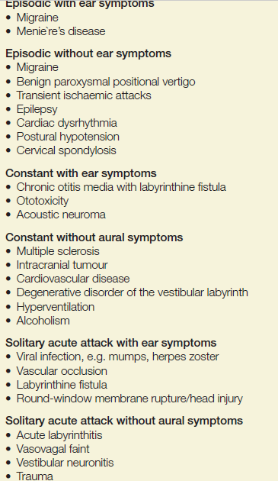
What are the questions to ask in history? EXTRA
○ Frequency: Recurrent, Non -Recurrent.
○ Duration: Seconds, Minutes, Hours to days.
○ Associated auditory symptoms: Tinnitus, Deafness, Fullness
○ Aggravating and relieving factors: Rolling over in bed, getting up from bed, looking up, Consume salty food.
○ Ear disease or ear surgery.
○ Trauma.
○ Migraine.
❖ Examination:
● BP (HTN), Pulse, Eye movement (nystagmus)
● Hearing test: Tone Audiogram, Speech Audiogram, examining the CN.8.
● Balance test: Romberg , finger to nose test, unterberger test .
● Vestibular examination: Caloric (ENG), swivel chair.
❖ Investigation:
● CT: Skull Fracture, tumor?
● MRI: Of brain, Tumor?
● Duplex sonography cervicals.
● VNG.
● Audiogram.
● Head impulse test.
● v-HIT.
(extra)

Slide 13
❖ Vertigo consequences:
● Mental stress (possibly psychotherapy)
● Impairment of the quality of life
● possibility of deafness (M. Menière)
● Increased danger of falling (fractures, especially older patients)
● Serious health and social consequences.
● drive prohibition (safety issue - occupations requiring driver's license)
● loss of occupations.
1- CVA: Elderly patient with chronic disease like (DM, HTN) with sudden attack of vertigo +neurological symptoms. Vertigo is abrupt in onset, lasts several minutes and is associated with nausea and vomiting. Other neurological symptoms like visual disturbances, drop attacks, diplopia, hemianopia, dysphagia and hemiparesis resulting from ischaemia to other areas of brain may also accompany vertigo.
2- Acoustic neuroma: Benign tumor. Arise from vestibular division of VIII. Pathogenesis:
○ Starts in the internal auditory canal and expands into cerebellopontine angle (CPA), compressing cerebellum and brainstem
○ When associated with type 2 neurofibromatosis (NF2): bilateral acoustic neuromas, café-au-lait skin lesions, and multiple intracranial lesions
Clinical presentation:
● Unilateral tinnitus
● Hearing loss
● Dizziness But true vertigo is rare as tumor growth slowly thus compensation occurs.
● Facial nerve palsy and trigeminal (V1) sensory deficit (corneal reflex) are late complication.
Wasn’t mentioned in the slides, if you have time you can read it
Central vestibular loss

Slide 14
DDx: Acoustic neuroma mimics Meniere’s disease in presentation and imaging is the only way to differentiate between them.
Diagnosis:
● History
● PTA (Unilateral SNHL)
● Radiology (CT, MRI)
● MRI with Gadolinium contrast is the gold standard.
Treatment: ● Expectant management if tumor is very small, or in elderly. Definitive management is surgical excision.
❖ Conclusion:
• Proper history is the most important key for diagnosis of a dizzy patient.
• A multi specialty (Cardiac, Optha, Psych) approach is sometimes appropriate for some complicated cases.
• Investigations should be tailored to the most likely diagnosis. Don’t do unnecessary tests when they’re not needed
case scenario #1
50-year-old patient, medically free
Sudden dizziness with head movement 3 days ago
Horizontal Nystagmus to the left
No problems without Head movement
accompanying symptoms (nausea, vomitus)
No hearing problems, no tinnitus)
Answer: benign paroxysmal positional vertigo

Slide 15
case scenario #2
32-year-old female patient with recurrent episodes of
vertigo
Relapsing accompanying hearing loss, tinnitus
Frequently nausea / vomiting
Fall inclination both sides
Persistent hearing loss in the interval (weeks)
Recurrent inflammation of both eyes
Answer: cogan syndrome
Questions:
1. Young female complaining of acute persistent vertical vertigo no hearing loss no tinnitus no fullness, but she reported a history of respiratory infection last week. what is the diagnosis?
A- BPPV
B- Vestibular neuritis
C- Meniere’s disease
2.A 60-year-old man, complaining of severe tinnitus, episode of vertigo, and hearing loss in his right ear. PTA showed SNHL in the right ear, while the left was normal. What are the suspected finding in tuning fork test in this patient?
A- Weber test is lateralized to the right, Rennes test is negative
B- Weber test is lateralized to the left, Rennes test is positive.
C- Weber test is central, Rinne test is negative.
D- Weber test is central, Rinne test is positive.

Slide 16
Questions:
3.A patient presented with history of hearing loss and vertigo. Pure tone audiometry showed SN hearing loss. ABR(auditory brainstem response) showed abnormal waves. What is the diagnosis?
A. Vestibulitis
B. Acoustic neuroma
C. Meniere disease
D. BPPV (Benign Paroxysmal Positional Vertigo)
4.28-year-old female presented with vertigo which last for minutes with hearing loss and tinnitus. What is most likely the diagnosis?
A- Benign paroxysmal positional vertigo
B- Vestibular neuritis
C- Meniere's disease
D- Acoustic neuroma
5. 26 years old female comes with 6 days history of severe vertigo associated with right sided hearing loss. She had a history of chronic suppurative otitis media for many years. On examination there is marginal moist perforation on the right ear drum. There is horizontal nystagmus. What is the most likely cause of vertigo?
A- Acute labyrinthitis
B- Benign paroxysmal positional vertigo.
C- Meniere’s disease
D- Vestibular neuritis
Ans:1-B,2-B,3-B,4-C,5-A.

