Slide 1
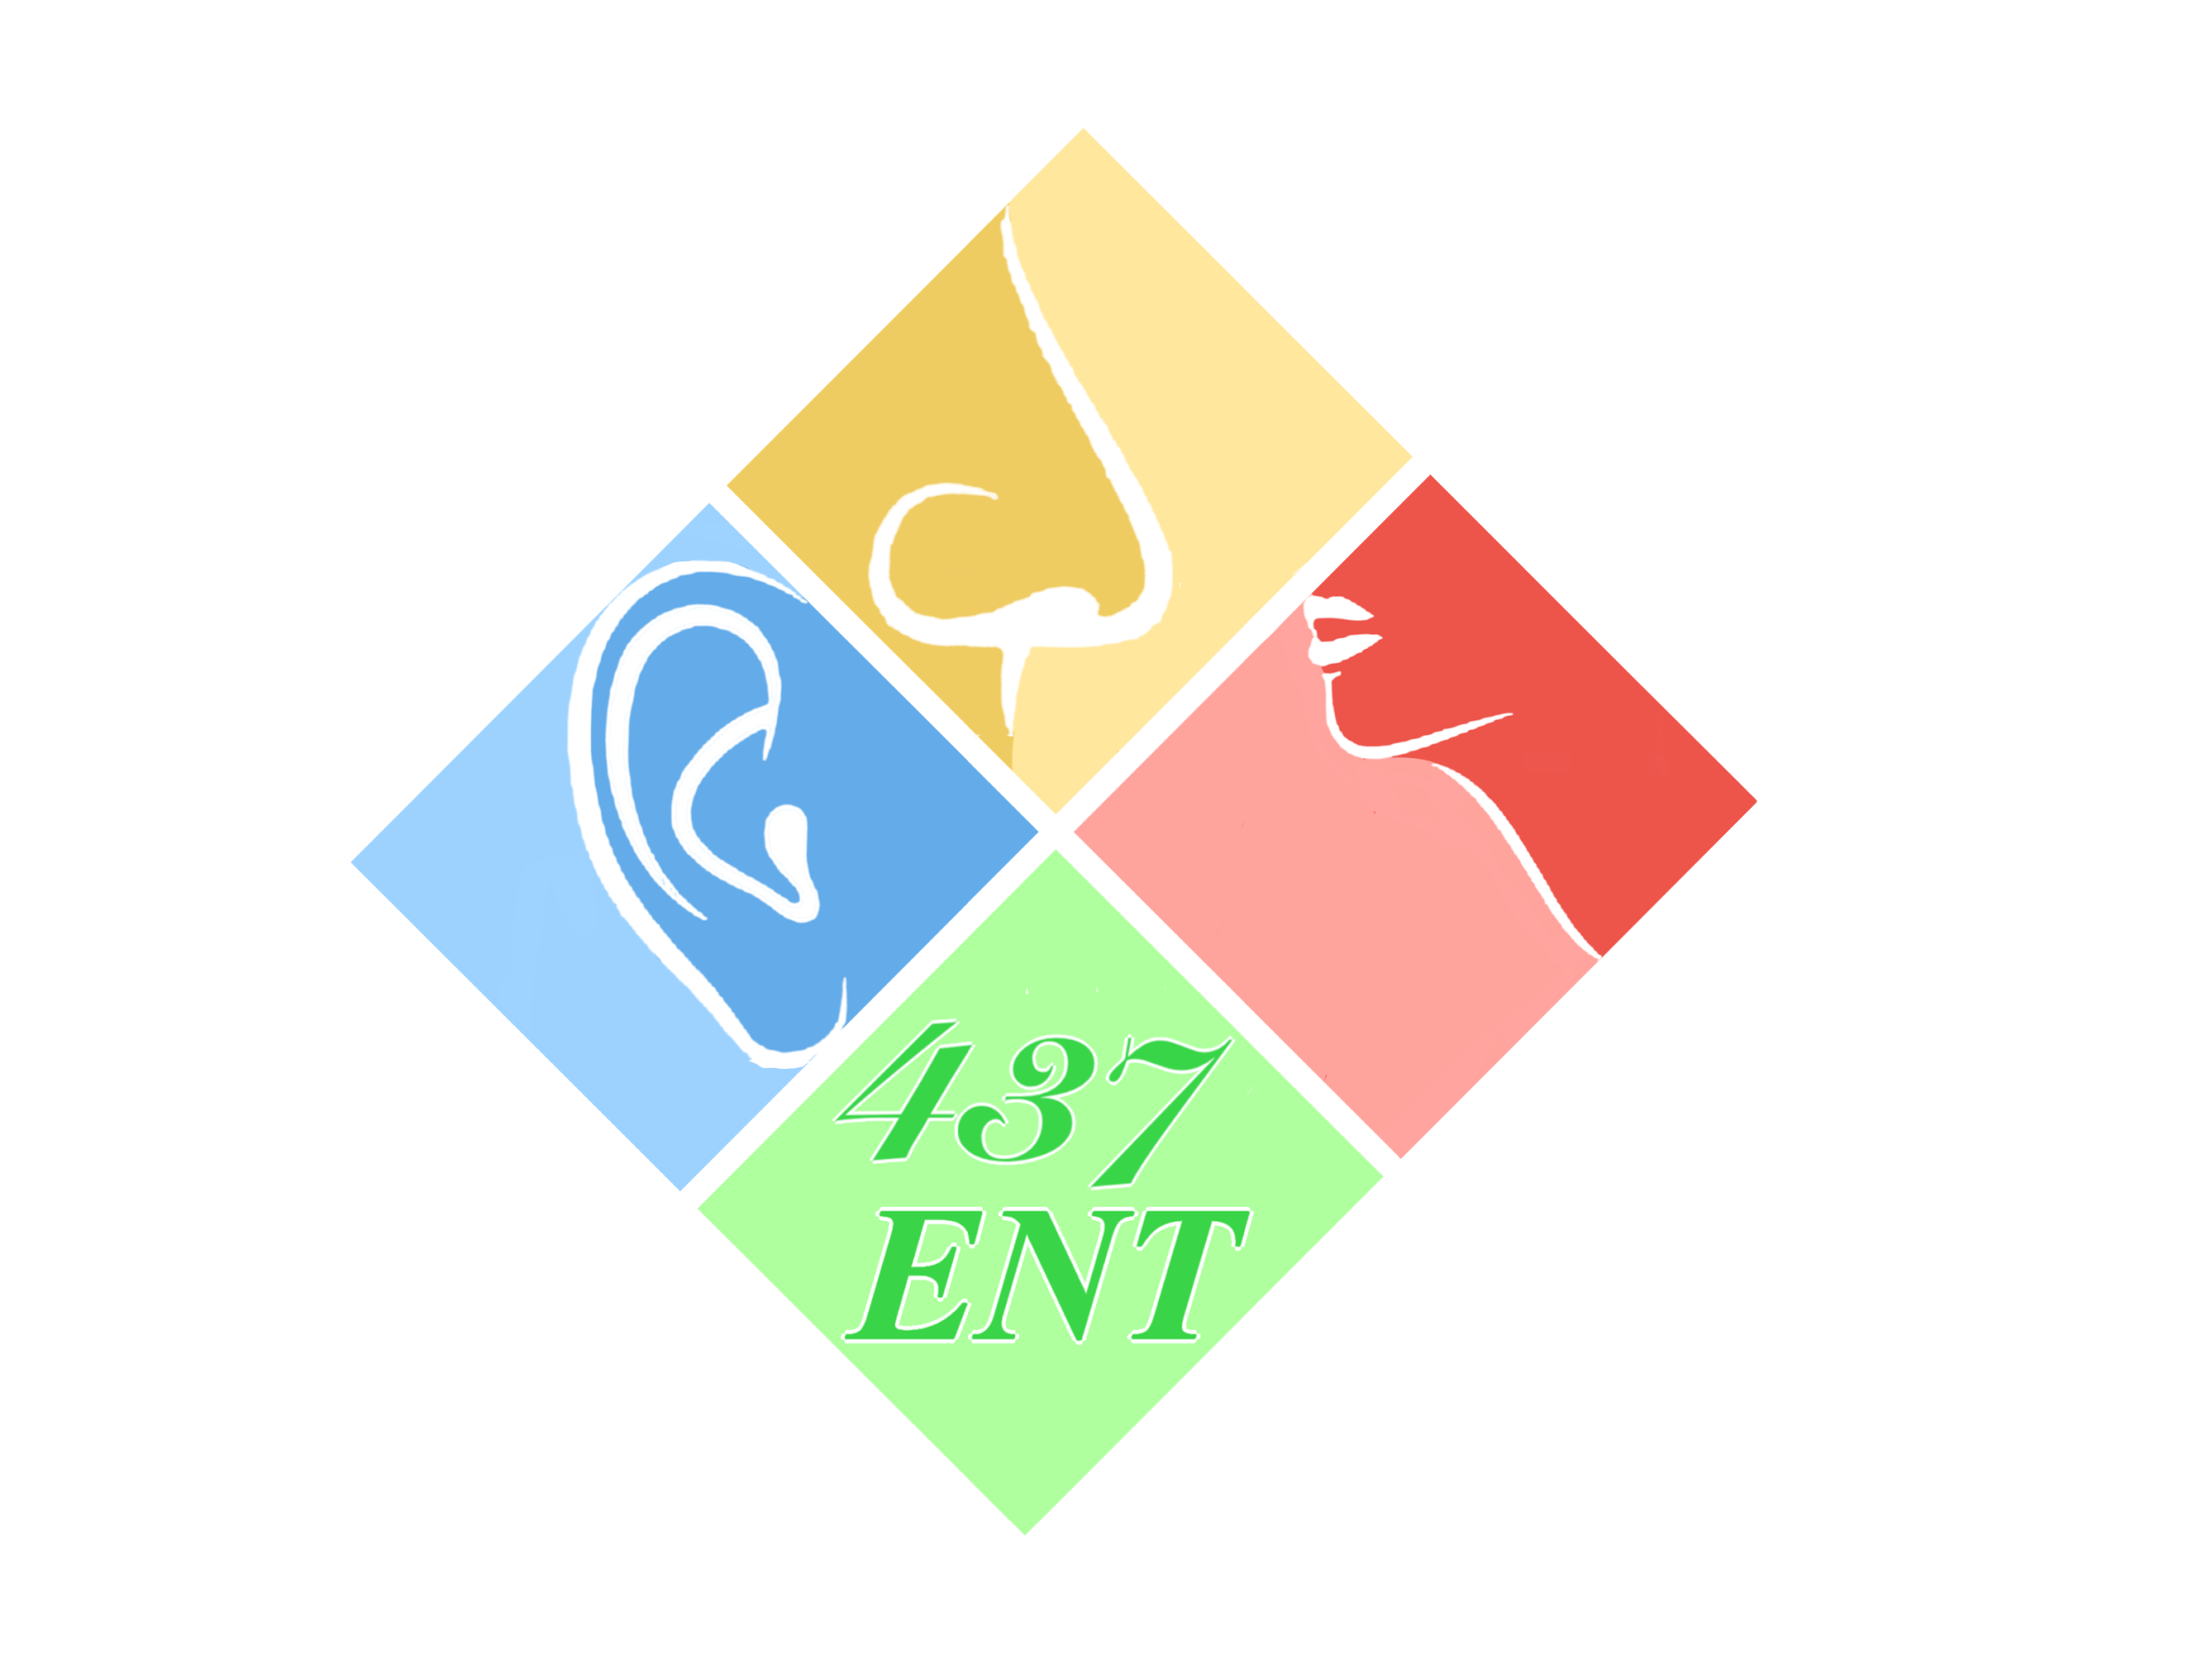
Facial Nerve
Objectives:
From Team 436F
Nothing was mentioned in our slides
Anatomy (course and branches).
Causes of facial palsy (including Bell's palsy, middle ear complication, traumatic and Ramsey Hunt syndrome).
من ناحية الإختبار: تم تسجيل الملاحظات المهمة آخر العرض واللي متأخر يقدر يذاكر من الملاحظات لان الدكتور حدد المهم ، والله يوفقكم
Resources: Team 436F, Doctor’s slides
Done by: Thamer AL-zahrani, Khaled Aloqeely
Edited by:
Revised by: Naif Almutairi
[ Color index: Important | Notes | Extra ]

Slide 2
Introduction
● The facial nerve (CN VII) provides motor fibers to the muscles of facial expression.
● It originates in the seventh nerve nucleus in the brain stem (pons), enters the middle ear and mastoid and exits the skull at the stylomastoid foramen just in front of the mastoid process.
● From here it enters the parotid gland where it divides into its branches(Figure below).
● Paralysis can be caused by pathology anywhere along the nerve course or in the cortical nerves which control the nucleus (supranuclear or upper motor neuron fibers) resulting in asymmetric movement of some or all the muscles of facial expression.
● Facial nerve palsy causes difficulty with smiling, frowning and expressing emotions, it is a devastating condition for the patient.
● The causes are numerous and are listed in (Table 15.1). ‘Supranuclear’ or upper motor neuron causes will often spare the forehead as these muscles receive fibers from both facial nerve nuclei.

Slide 3
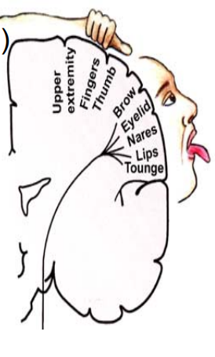
Facial Nerve Fibers
Consists of 10k (10,000) neurons, 7k (7,000) of which have myelinated motor fibers (facial expression). 70% motor and go to the muscles of expressions, 30% sensory (10: Taste, 10: General sensation, 10: secretomotor)
• Superiorly along the roof of the IAC (7UP)
• The course 7segments
o Motor fibers:
↪ To the stapedius and facial muscles.
↪ What does the stapedius do? A dampening action as it stabilizes the foot of stapes, so any damage to the stapedial nerve → hyperacusis and phonophobia
o Secretomotor fibers (parasympathetic):
↪ To the lacrimal gland and the submandibular and sublingual salivary glands.
↪ Also supplies palatine and nasal glands.
↪ Note that the parotid gland is supplied by CN IX
o Taste fibers:
↪ From the anterior two thirds of the tongue and palate.
o Sensory fibers:
↪ pain, temperature, and touch from the external auditory canal (external auditory meatus) very few. They carryout pain, temperature and touch sensation
o Motor part :
• Precentral gyrus (frontal lobe)
• Upper face corticobulbar cross
• Contralateral predominance
• Motor fiber bend around the abducens ( CN VIth) nucleus

Slide 4
Nuclei (PONS) 4Ss’ (The intracranial part)
• This part includes the nuclei of facial nerve and the cerebellopontine (CP) angle segments.
• Facial Nerve Nuclei (in the pons):
↪ Solitarius (Taste) receives taste fibers.
↪ Seventh (motor) Facial nucleus: main nucleus which gives motor fibers
↪ Superior Salivatory (Lacrimal) Nucleus gives parasympathetic fibers.
↪ Spinal Nucleus of The Trigeminal Nerve. General sensation
The Facial nucleus is divided into 2 parts:
A. The upper half that receives innervation from both cerebral cortices.
B. The lower half that receives innervation only from the contralateral cerebral cortex.
o Lower motor lesions affect all the ipsilateral facial muscles “Lower motor neuron lesion is form the nucleus downward”.
o Upper motor lesions spare the upper facial muscles and affect the contralateral lower face because the forehead is innervated bilaterally.
o LMN vs UMN lesions is a possible MCQ
● Facial nerve segments:
1.Pons.
2.Cerebello-pontine angle (CPA).
3.Internal Auditory Canal (IAC).
4.Labyrinthine.
5.Tympanic.
6.Mastoid
7.External
Fallopian canal (FC)

Slide 5
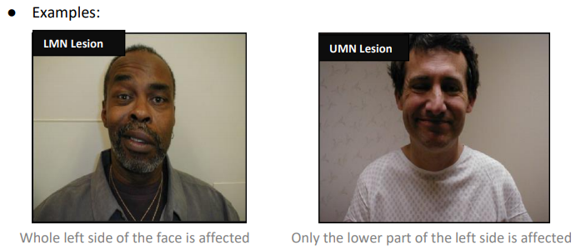
In LMNL the Idea is basically the involvement of frontalis (wrinkles of the forehead) and orbicularis oculi (give you the ability to close the eye), while in UMNL Frontalis and orbicularis occuli are spared.
● Embryology
• Second Branchial Arch
• 0.05 % unilateral facial palsy
• 80% birth trauma
• 90% spontaneous recovery
• Congenital Unilateral Lower Lip Paralysis (CULLP)
• Anatomy of adult (Mastoid more superficial )
o The facial nerve is developmentally derived from the hyoid arch, which is the second branchial arch
o It arises as 2 main divisions-motor and sensory
o The motor division of facial nerve is derived from the basal plate of the embryonic pons.
o The sensory division originates from the cranial neural crest
● Anatomy Facial Nerve Segments:
1. Intracranial (cisternal) segment
2. Meatal segment (internal auditory canal): 8mm, zero branches,
7UP: it is in the anterior superior portion of the IAC and behind it is the vestibulo (sup and inferior) and cochlear
3. Labyrinthine segment: 3-4mm, 3 branches (IAC geniculate ganglion).
Greater superficial petrosal nerve > lacrimal gland.
Shortest segment and narrowest > susceptible to compression (only segment that lacks arterial anastomosis) → vulnerable to injury → the geniculate ganglion before entering the middle ear gives the first branch (1st genu) →
Anatomical Divisions

Slide 6
greater superficial petrosal nerve → fibers for lacrimation and salivation ↪What is the first branch of CN VII? greater superficial petrosal nerve ↪If there is a lesion in the middle ear after the first branch there will be normal lacrimation and salivation this process is called “Topography”
4. Tympanic segment: 8-11mm, zero branches, 50% dehiscent, (2nd genu) (Geniculate ganglion to pyramidal eminence) if you remove the drum you can see the facial nerve passing → importance; any infection or cholesteatoma can easily put pressure on the facial nerve
5. Mastoid segment: 8-14mm, 3 branches, longest part of the intratemporal course, Pyramidal eminence to stylomastoid foramen If a lesion is effecting the stapedius nerve or the chorda tympani it maybe high mastoid or tympanic
Branchs to Stapedius muscle, Chorda tympani nerve > (submaxillary and sublingual) (Taste anterior 2/3 tongue) (pain, temperature, and touch EAC.), Auricular nerve.
6.Extratemporal (extracranial) segment: 15- 20mm, 9 branches, Stylomastoid foramen to the parotid and gets separated into superficial and deep and it ends in 5 major branches (T,Z,B,M,C)
• Pes anserinus (goose's foot ) separates parotid > deep and superficial lobes
• supply :
Postauricular muscles, Stylohyoid muscle, Posterior belly of the digastric muscle
• Highest risk during surgical T&M
● The CP angle segments:
↪Facial nerve is in relation with the last 4 cranial nerves.
↪The facial fibers cross the CP angle and pass through the internal auditory canal (meatal segment) with vestibulocochlear nerve (8th).
↪7 th CN occupies the anterior superior part of the internal auditory canal “7up” (possible MCQ)

Slide 7
1. The intratemporal part:
● From the internal auditory meatus or canal it crosses the temporal bone through fallopian canal and it is related directly to the inner, middle and external ear.
● It is divided into 3 segments:
1. Labyrinthine (IAC to geniculate ganglion) “in the inner ear”: Only segment that lacks arterial anastomosis, (embolic phenomena, vascular Compression) high risk of ischemia (possible MCQ).
2. Tympanic (from geniculate ganglion to pyramidal eminence) “in the middle ear”
( 50% of the Tympanic part is open in children, that’s why they might get Acute otitis media which can lead to facial nerve palsy) (imp for OSCE)
3.Mastoid or vertical (from pyramidal eminence to stylomastoid foramen) in the external ear it finally leaves the skull through stylomastoid foramen. ( Mastoid has a high risk to get injured during surgery ) Branches are:
• Stapedius muscle: if get injured patient won’t be able to tolerate high sound
• Chorda tympani nerve, which give:
1-Submaxillary,
2-sublingual and Taste anterior 2/3 tongue,
3- pain, temperature, and touch EAC.
• Auricular nerve
(very imp for MCQ):
- Labyrinthine segment is the shortest and narrowest part of the facial nerve segments, that's why most of the patients presenting with facial palsy due to compression of this segment.
- Whereas the mastoid segment is the longest → At risk of injury in trauma and mastoidectomy
2. The extratemporal (extracranial) part:
● From stylomastoid foramen to division into major branches.
● As soon as the nerve leaves the stylomastoid foramen, it goes within the parotid gland and separates it into superficial and deep lobes (check the figure), Parotid surgeries can cause facial nerve paralysis.
● Then, it branches within the anterior border of the parotid into five terminal branches:
(Always in Exam either MCQ or SAQ, know the nerve + the muscles + the functions):

Slide 8
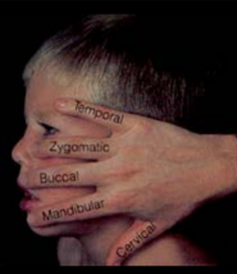
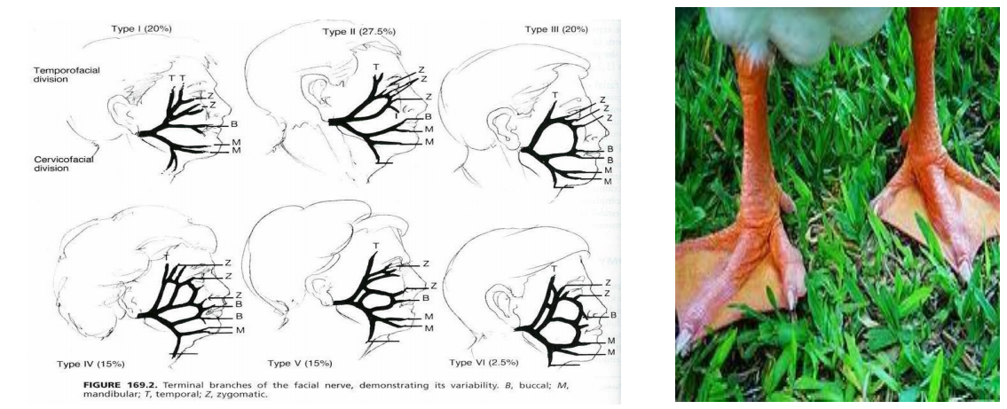
1. Temporal: most superior > supplies the frontalis muscle.
2. Zygomatic: supplies orbicularis oculi muscle.
3. Buccal: supplies buccinators muscle. (if get injured food will accumulate on cheek + weak chewing) remember that the muscles of mastication are supplied by CNV
4. Mandibular: supplies the muscles of the angle of the mouth.
5. Cervical “long but thin branch”: supplies platysma muscle.
● Least important branch is cervical.
● There are usually some variations in different branches; some branches may get divided into two and each branch divides into another two etc.
★ Most important 2 branches:
1. Zygomatic “to protect the eye” (imp)
2. Mandibular “its paralysis causes
cosmetically bad deformity” (imp)
● Commonest surgical procedure that
affects the mandibular
branch → Submandibular salivary gland
surgeries, leading to paralysis of the
angle of the mouth.
Pes anserinus (goose's foot):

Slide 9
The course of secretomotor and taste:
● The secreto-motor fibers leave the superior salivary nucleus with the facial nerve. Some fibers leave the facial nerve in the geniculate ganglion as great petrosal nerve and this supplies the lacrimal glands. (if greater petrosal nerve get injured patient will have Dryness) (imp of MCQ)
● The other fibers leave the facial nerve in the chorda tympani and supply the submandibular and sublingual salivary glands.
● Taste fibers follow the same course but in the other way. Taste fibers from anterior 2/3 of the tongue go through the chorda tympani to the facial nerve and finally to nucleus solitares.
● What happens if there is an injury of the chorda tympani? It easily gets injured because it passes in the inner ear
● Minor defect in the taste “because it affects the anterior 2/3 of only one side of the tongue” ↪ There will be no dryness “because the parotid is supplied by the glossopharyngeal nerve (9th)”
● Function of Facial nerve:
•Lacrimation •Expression
•Mastication •Salivation
•Speech •Hearing
● Dehiscence: a defect in the fallopian canal. (The Nerve is Exposed inside the middle ear).
● Fallopian canal is a bony canal through which the facial nerve passes inside the temporal bone.
● Mainly congenital, when there is a deficiency of the bone, thus the nerve will not be covered by a bone and liesimmediately in the middle ear. 50% of people are dehiscent.
● Becomes more subjected to trauma and infection leading to facial nerve paralysis. (when they have otitis media they get facial paralysis).
Variations Anomalies:

Slide 10
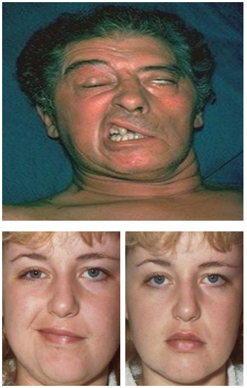
Facial nerve Palsy:
Degeneration.
● Metabolic source (cell body).
● Wallerian degeneration:
o Begins within 24 hours
o Degeneration distal axon & myelin sheath
o Distal to the site of an injury.
o Without local Inflammation.
● Macrophages degrade myelin and axons
Regeneration
● Axonal stumps swell and proliferating neuro-filaments
● Misdirected regrowth of nerve fibers
● Facial muscle contractures >> Synkinesia ● Salivation>>crocodile tears.
Clinical manifestations
● Paralysis of facial muscles:
o Asymmetry of the face.
o Inability to close the eye. Orbicularis oculi
o Accumulation of food in the cheeks.
Paralysis of buccinators.
● Lower motor neuron lesion of the left side: (upper picture)
o No wrinkles in the forehead when looking up due to failure of contractions of frontalis muscle
o Inability to close the eye completely “most accurate sign”
o Flattening of the nasolabial fold
o Angulation of the mouth when showing the teeth “the angle goes to the other side”
● Upper motor neuron lesion of left side: Looks normal at rest (lower 2)
o The orbicularis oculi and frontalis muscles will not be affected.
Facial Nerve Paralysis:

Slide 11
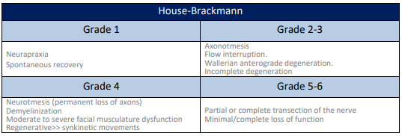
● Other manifestations of facial nerve paralysis:
o Phonophobia due to failure of strapedius atteniuation reflex, uncomfortable feeling in exposure to loud sounds.
o Acoustic reflex (stapedial reflex) is a useful tool to localize the lesion; if intact the problem is distal to it and vice versa.
o Dryness of the eye; Some people present with lacrimation and others present with dryness. Why?
- Lacrimation is due to paralysis of orbicularis oculi as this muscle help in draining the tears.
- Dryness is due to affection of greater petrosal nerve which arise from geniculate ganglion.
- So if the paralysis is above the level of geniculate ganglion > dryness
- If below it > no dryness.
o Loss of taste; very little just in the ant. ⅔ of one side. They feel a metallic taste.
House-Brackmann is the most useful classification in facial nerve palsy: (just know the name)

Slide 12
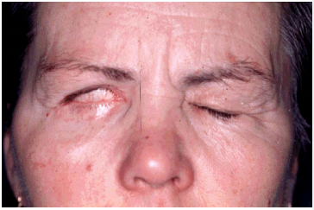
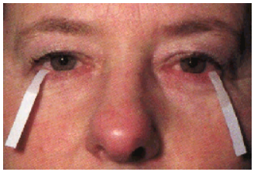
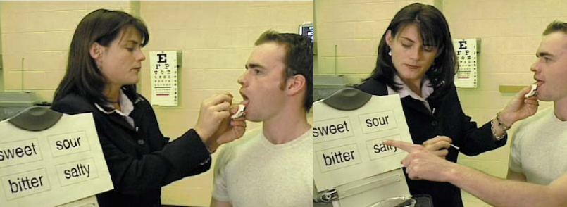
Evaluation
• Careful history
• Physical exam
• Audiometry
• CT/MRI/other
• Topographic
• Electrophysiology
History
Physical exam
• Timing
• Associated symptoms
• SNHL
• Vesicles
• Severe pain
• Trauma
• OM acute or chronic
• Past medical history
• Complete head and neck exam
• Wide smile
• Whistling
• Blowing
• LMNL
– Forehead wrinkling
– Eye closure
– Bell’s phenomenon
Topognostic Tests
• Schirmer’s Test
• Stapedial reflex
• Taste
• Salivary Flow
• Imaging

Slide 13
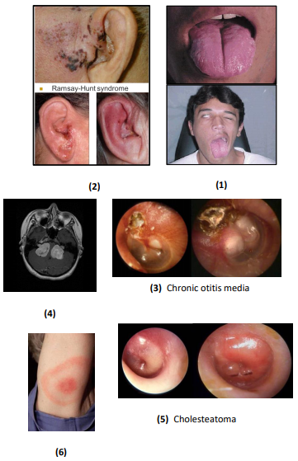
Clinical examination and history:
• Hearing loss or vertigo
• Timing
o Sudden onset, aggressive? Or slow?
o Evolution over 2-3 weeks
• Presence of ear disease (Pics 3+5)
o Chronic otitis media
o Cholesteatoma
• Vesicular eruption (pic 2)
o Ramsay-Hunt syndrome
• Ask the patient to:
o Look up to test frontalis.
o Close eyes to test orbicularis oculi.
o Blow the cheek to test buccinators.
o Show the teeth for angulation.
• Bilateral: (Pics 4+6)
o Guillain-Barre syndrome.
o Lyme disease.
o Intracranial neoplasm.
o Neurofibromatosis
• Recurrent: (Pic 1)
• Melkersson-Rosenthal syndrome :4 Fs
• Facial nerve palsy (Recurrent )
• Furrowed tongue
• Faciolabial edema
• FHx + ve
House-Brackmann Scale (just know the name)
Grade 1: Normal.
Grade 2: Slight weakness.
Grade 3: Patient Can Close the Eye.
Grade 4: Patient Can’t Close the Eye.
Grade 5 and 6: Masked Face, Asymmetric.
In History of Facial nerve palsy the most important question is WHEN DID IT START? Because if it starts from weeks and it’s gradual you have to think of Malignancy

Slide 14
Investigations:
Radiology: To localize lesion
● Computed tomography (intratemporal)
○ Trauma
○ Mastoiditis
○ Cholesteatoma
● Magnetic resonance imaging (MRI) (intracranial)
○ Nerve enhancement
○ Exclude neoplasm: vestibular schwannoma or neurofibromatosis Usually MRI enhancement in labyrinthine segment.
Topography (Topognostic tests): could be MCQs
● Indicated in some cases to determine the level of the lesion:
1. Schirmer's test; test lacrimation function → greater superficial petrosal.
Put two tapes in the eyes and check if they're equal on both sides, if one eye is tearing and the other isn’t; lesion proximal to this branch.
2. Stapedial reflex → stapedial branch with tympanometry
3. Taste sensation (Electrogustometry) → chorda tympani.
4. Salivary flow → chorda tympani.
Collect from both sides and compare the amount; If lacrimation is involved then the lesion is most likely proximal to the geniculate ganglion (before the greater superficial petrosal nerve branch)
Audiology:
● Evaluate for pathology of eighth cranial nerve
○ Bell’s palsy:
■ Symmetric audiological function (normal).
■ Absent ipsilateral acoustic (stapedial) reflex.
○ Retrocochlear pathology
■ Asymmetrical thresholds.
Evaluate for retro cochlear pathology (e.g. neoplasm) with either ABR or MRI. The facial nerve might be affected secondary to a lesion

Slide 15
Electrophysiology:
● It detects degeneration of the nerve fibers
● Useful only 48-72 hours following the onset of the paralysis. Provides prognostic information.
● If the nerve is stimulated distal to the injury in the first 2-3 days > there will be a response in all cases.
● After 3 days > there will be no response in case of degeneration. ● Electrophysiological tests: Provides prognostic information
Principle: stimulate the nerve and look for response:
o Nerve Excitability Test (NET)
o Electroneurography (ENoG)
o Electromyography (EMG) tests the strength of the muscle, important for prognosis
o Maximum stimulation test (MST)
ACUTE=Acute+Complete+Unilateral+Threedays+Evaluate
Interpretation of the tests:
- Not useful in the first 48-27 hours.
- After 48-72 hours (the time required for degeneration to take place):
- Normal results > no degeneration (neuropraxia)
- Abnormal result > degeneration.

Slide 16
Pathophysiology of Nerve Injury:
Neuropraxia (conductive block):
● In cases of mild trauma causing only functional block of the facial nerve, the fibers keep their integrity.
● In Regeneration: there will be restoration of full function if the cause is treated.
Neurotmesis (degeneration):
● Wallerian degeneration (distal to lesion)
● Axon disrupted, loss of tubules, support cells destroyed
● Anatomical block due to complete transection of the facial nerve. Wallerian degeneration of the distal part of the nerve, and this takes 2-3 days to occur.
● In Regeneration: no recovery unless the distal and proximal parts are approximated.
● The recovery here is delayed and usually incomplete “why?” The rate of growing is 1mm/day or 1 inch/month > it will be delayed (It takes the fibers approximately 2-3 months to reach the angle of the mouth if the injury is in the temporal bone). Not all the fibers of the proximal part will reach thedistal > it will be incomplete.
● After regeneration, sometimes misdirection of the fibers occurs: the fibers that go to the salivary gland deviate to sweat gland “the patient sweats when he eats” Or to lacrimal gland “patient tears when he eats (crocodile tears)”
Axonotmesis :
– Wallerian degeneration (distal to lesion)
– Endoneural sheaths intact
● Care of the eye the patient is unable to close his eye so the cornea will be exposed to trauma Protect it by:
1. Artificial tears if the patient has dryness.
2. Protect them from dust by wearing sunglasses
3. See ophthalmologist in case of any irritation
4. Cover the eye while sleeping
● Treatment of the cause if applicable.
● Treatment of the nerve varies according to the degree of the paralysis.
Principles of Management of facial nerve injury:

Slide 17
● Partial facial paralysis:
↪ Being partial means that some of the nerve fibers are in continuity. Recovery is expected by conservative treatment (e.g. removal of pressure, steroid etc.). No need for surgical intervention.
● Complete facial paralysis:
↪ Complete paralysis may be a result of neuropraxia or/and degeneration.
↪ If it is due to neuropraxia, recovery is expected by conservative treatment, If it is due to degeneration, surgical treatment is required.
↪ To differentiate between degeneration and neuropraxia electrophysiological tests are required.
The most significant complication is the social isolation these patients. Facial paralysis severely affect:
• Normal facial expressions
• Mastication
• Speech production
• Eye protection
According to the anatomy:
● Intracranial causes “brain tumors and neurosurgical trauma”.
● Cranial (intratemporal) causes “middle ear infection or trauma”.
● Extracranial causes “parotid tumors”.
According to the cause itself:
● Congenital: Birth trauma.
● Traumatic: Forceps delivery, Basal skull/temporal bone fractures, Facial injury, Penetrating to middle ear, Barotrauma, Lightning
Head and neck injuries & surgery parotid, mastoid and intracranial surgeries.
● Iatrogenic
● Idiopathic
● Infection : Malignant otitis externa, Otitis media, Mastoiditis, Ramsey Hunt (Herpes zoster), Encephalitis, Polio, Syphilis
● Toxic
● Neurologic
● Neoplastic
● Inflammatory: O.M, Necrotizing O.E., Herpes.
Complications of Facial Paralysis :
Causes of facial paralysis:

Slide 18
● Neoplastic: Meningioma, malignancy of the ear or parotid.
● Neurological: Guillain-Barre syndrome, multiple sclerosis.
● Idiopathic: Bell’s palsy “most common”, Melkersson Rosenthal, Gullian Barre, MS,Mysethenia gravis, Sarcoidosis(Heerfordt’s).
● Iatrogenic:
o Parotid surgery.
o Mastoid surgery.
o Local anesthesia.
o Acoustic neuroma.
1. Facial paralysis in Acute Otitis Media (AOM) (imp for MCQ):
• Mostly due to pressure on a dehiscent nerve by inflammatory products and fluid accumulation.
• Usually is partial and sudden in onset.
• Treatment: is by antibiotics and myringotomy; open the drum and drain the fluid.
• Mastoiditis can cause pressure on the nerve.
• 3 days history of fever, earache and facial palsy = AOM
2. Facial paralysis in Chronic Suppurative Otitis Media (CSOM):
• Usually is due to pressure by cholesteatoma or granulation tissue causing bony erosion.
• Insidious in onset -slow onset- long history of deafness and discharge.
• May be partial “if detected early” or complete.
• Treatment is by immediate surgical exploration and “proceed”
Mastoidectomy; remove the cholesteatoma and repair the nerve.
3. Herpes Zoster Oticus (Ramsay Hunt Syndrome):
o Herpes zoster affection of cranial nerves VII, VIII, and cervical nerves. vestibulocochlear dysfunction
o Symptoms: Facial palsy, severe pain, skin rash, SNHL (sensory neural hearing loss) and vertigo.
o Treatment is equivalent to Bell palsy
o Poor outcome
A- Inflammatory Causes of Facial Paralysis

Slide 19
o The patient is usually elderly, and severe pain precedes the facial palsy.
o The characteristic clinical feature is a vesicular eruption in the ear (sometimes on the tongue and palate).
o Treatment by: Acyclovir, steroid and symptomatic.
↪ Vertigo improves due to compensation from the other side “takes few weeks”.
↪ SNHL is usually irreversible.
↪ Facial nerve recovers in about 60%. Recovery of facial nerve function is much less likely than in Bell’s palsy.
(you will be asked about it in exam, patient has facial palsy and skin rash and Ear symptoms it’s Ramsay hunt syndrome)
4. Malignant Otitis Externa:
o Osteomyelitis of the temporal bone (osteomyelitis of the external auditory canal bone).
o Granulation tissueobscured TM
o It could affect multiple nerves other than 7th if it reaches the jugular foramen (9th 10th 11th)
o Very aggressive, which is why it was thought to be malignant 4Ds:
↪ Diabetes mellitus or anything considered
immunocompromising
↪ Discharge (purulent)
↪ Discomfort
↪ Dysfunction cranial nerve
1. Iatrogenic: Operations at the CP (cerebellopontine) angle, ear and the parotid glands. acoustic neuroma resection or mastoidectomy. local anesthesia.
B- Traumatic Facial Injury:

Slide 20
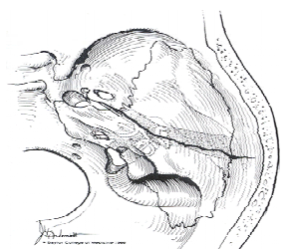
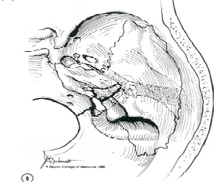
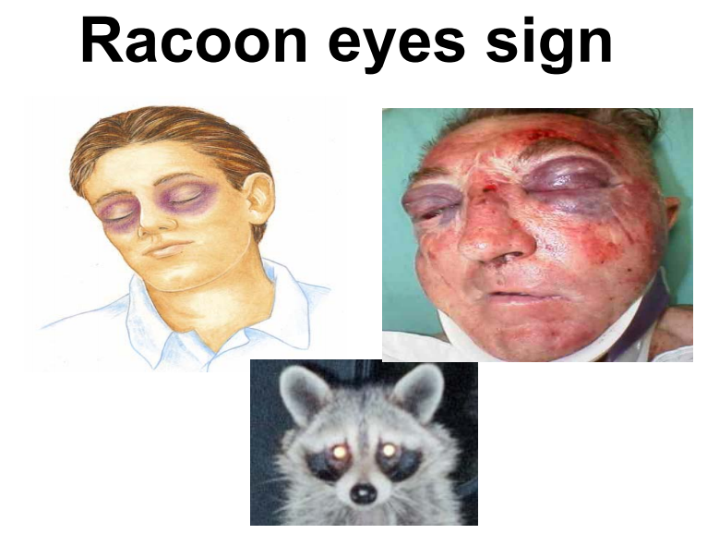
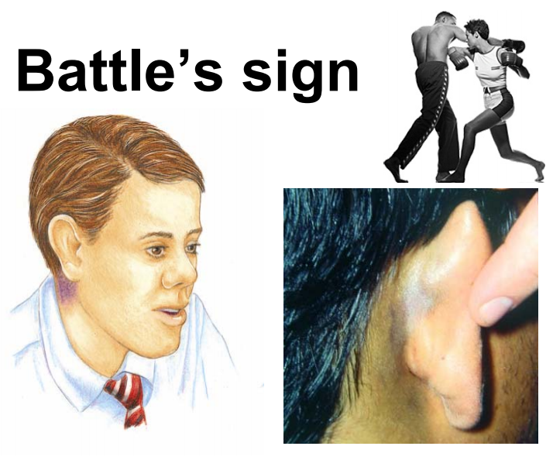
2. Birth trauma (congenital facial palsy):
o 80-90% are associated with birth trauma
o 10 -20 % are associated with developmental lesions
o Most of them are partial and need only conservative management
3. Temporal bone fracture (possible MCQ):
A- Longitudinal:
↪ 80% of Temporal Bone Fractures.
↪ 15-20% Facial Nerve involvement.
B- Transverse:
↪ 20% of Temporal Bone Fractures.
↪ 50% Facial Nerve Involvement
(more likely to cause paralysis)
Most common cause of facial nerve palsy in temporal bone trauma is transverse temporal bone fracture, It is important to differentiate between the two.
● Signs for temporal bone fracture:
o CSF or blood leak from ear.
o Raccoon eyes sign.
o Battle’s sign.
o Ossicles injury.
● Pathology: Edema or transection of the nerve.
● Management of traumatic facial nerve injury:
o If it is delayed in onset, it is usually incomplete and is due to edema → Conservative “steroids and relieve the pressure”
o If of immediate onset, it is usually complete and due to transection of the nerve
→ Surgical repair
→ If borderline; conservative.

Slide 21
● Surgical Repair:
1. Direct Anastomosis:
o If the proximal and distal parts are identified and no distance between them.
2. Nerve Graft:
o If there is a distance between them
o Most common nerve used is great auricular nerve; it can give up to 10 cm and has the same thickness of facial nerve. o Sural nerve.
o If the injury is in the temporal bone, sometimes we graft the nerve in the fallopian canal without stitching
o But if outside > we must stitch it.
3. Nerve Transfer (anastomosis):
o If the proximal part can’t be identified, get a nerve and connect it to the distal part.
o Most common nerve used is hypoglossal nerve3 IF the other one is healthy and functioning well, because bilateral hypoglossal nerve damage is catastrophic.
4. Muscle flap:
o If the distal and proximal parts can’t be identified.
o For cosmetics only “temporalis or masseter muscles are used”.
• Commonest cause of acute VII paralysis • Diagnosis of exclusion
• Unilateral facial paralysis • Sudden onset • Unknown cause • LMNL
• Limited duration • Minimal symptoms • Spontaneous recovery
• No sensory loss
• Bell’s palsy is a lower motor neuron facial palsy of unknown cause, but thought to be viral. (Will come in the exam)
• Bell’s palsy may be complete or incomplete; the more severe the palsy, the worse the prognosis. In practice, full recovery may be expected in over 90% of cases.
• The remainder may develop persistent paralysis and other complications including ectropion (weakness of the muscles of the lower eyelid causing persistent overflow of tears) or an aberrant sequence of movements of the face (synkinesis ).
C- Bell’s Palsy

Slide 22
● CT or MRI scanning may be needed if the symptoms persist or a specific cause (i.e. other than Bell’s palsy) issuspected.
● Electrodiagnosis is used in the assessment of the degree of involvement of the nerve and includes nerve conduction tests and electromyography. These tests are done in a specialist center and be invaluable in predicting prognosis.
● Most common diagnosis of acute facial paralysis, if slowly progressive it is NOT Bell’s palsy.
● Diagnosis is by exclusion.
● Pathology: Edema of the facial nerve sheath along its entire intratemporal course (Fallopian canal) → Swelling of the nerve → Compression and ischemia → Complete paralysis, if mild edema → neuropraxia, if severe → degeneration.
● Etiology: Vascular or viral measles, cold weather but the exact etiology is still unknown (not proven)
● Clinical features:
o Sudden onset unilateral LM FP. Occurs after exposure to cold weather could be vascular spasm. Pain behind the ear → few hours later facial paralysis.
o Partial or complete.
o No other manifestations apart from occasional mild pain behind the ear. No discharge, no parotid swelling, not following trauma.
o May recur in 10% (6 – 12%), previous history of paralysis in the same side 12%, other side 6%.
o Risk factors: family history and pregnancy.
● Diagnosis:
• Weakness of the entire half of the face
• In doubt → CT and MRI scans
• MRI may show contrast enhancement of the facial nerve
● Prognosis: if left untreated
o 80% complete recovery.
o 10% satisfactory recovery.
o 10% no recovery.
Partial usually recovers within 4-6 weeks while complete may take up to 6 months.
o Prevent corneal drying
– Natural tears
– Isotonic saline
– Strips of skin tape to close the eye
Surgery is not usually done because most of patients recover with conservative treatment

Slide 23
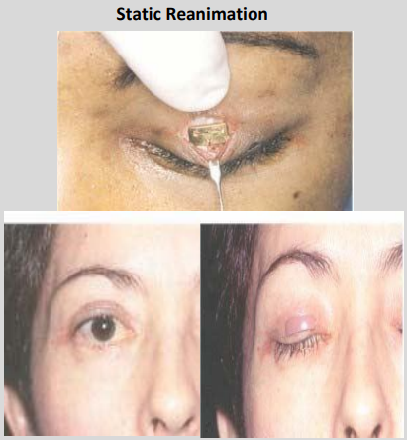
• Treatment:
o Reassurance.
o Eye protection.
o Physiotherapy.
o Medications (steroids; to decrease edema, antivirals, vasodilators) Antiviral and vasodilators only given in combination with steroids, not effective alone.
•Corticosteroids – 80 mg/day po – Within 24 to 48 h of onset for 1 wk – Decreased gradually over the 2nd wk
• Antivirals (Acyclovir ) – Less degrees of facial weakness
o Surgical decompression in selected cases:
↪ Patients with 90% degeneration.
↪ Within 14 days of onset.
•Synkinesis and hypertonia
•Advantages
o Ease of use
o Selective
•Disadvantages
o Temporary
o Repeated every 3 months.
Conclusion:
Facial paralysis sequelae (significant)
•Functional
•Cosmetic
•Psychological
The primary goals of facial reanimation
•Corneal protection
•Symmetry at rest
•Smile restoration
Botulinum Toxin

Slide 24
Neoplastic
• Malignant parotid lesion • Cholesteatoma • Acoustic neuroma
• CN VII tumor • Meningioma
SPORT > Neoplasm
• Slowly progressive
• Persistent >4 months
• Other C.N. Ex SNHL
• Recurrent
• Tumor History

Slide 25
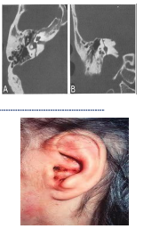
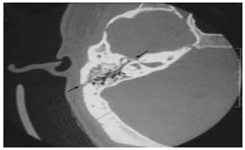
Questions from the doctor's 436 slides:
What is the most likely diagnosis?
Left lower motor neuron facial paralysis
(most likely bell’s palsy).
Mention 2 common causes?
● Bell’s palsy (most common)
● Temporal bone fracture
● Acute otitis media
36 years old man with RTA:
What is your diagnosis?
Transverse fracture of the temporal bone.
Mention 2 clinical findings?
● Facial nerve paralysis
● CSF leak
● Ossicles injury
34 years old with LMN facial paralysis:
What is your diagnosis?
Herpes Zoster Oticus (Ramsay Hunt syndrome).
What is your management?
● Acyclovir ● Steroids ● Physiotherapy
24 years old man involved in RTA: What is your diagnosis?
Longitudinal fracture of the temporal bone.
Mention 2 other clinical findings?
• Facial nerve paralysis
• CSF leak
• Ossicles injury

Slide 26
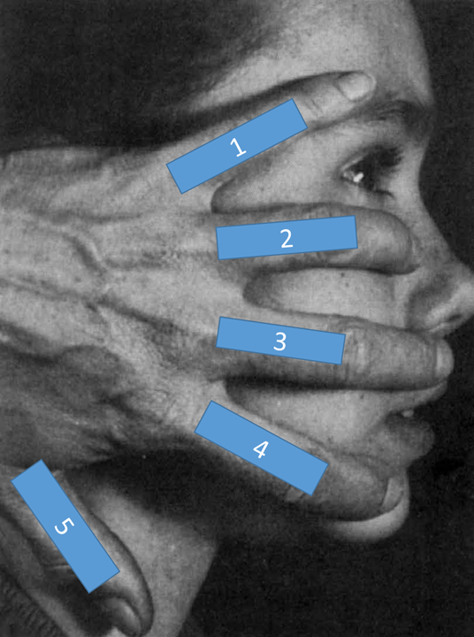
Doctor notes: (kindly read it)
1-what's the embryological origin of facial nerve?
second branchial arch
2-where is the position of the facial nerve during its course of the auditory canal?
the upper part (7UP)
facial nerve segments:
3-what's the narrowest segment of the facial nerve, that is easily compressed?
segment 4(labyrinthine)
4-which segment of the facial nerve is highly exposed and more prone to injury after otitis media?
segment 5(tympanic)
5-what's the largest segment of the facial nerve that is easily injured after a trauma?
segment 6(mastoid)
-in question 5, name one of its branches that supplies the lacrimal gland and what will happen if it gets injured?
superficial petrosal nerve, shedding of tears while eating (crocodile tears)
-in question 5, name one of its branches that gives taste sensation and what will happen if it gets injured?
chorda tympani, metallic taste
6-name the 5 major branches of facial nerve which are illustrated in this picture below? *might come as SAQ*
temporal
zygomatic
buccal
mandibular
cervical
Notes:
437 notes, (Done)

Slide 27
Doctor notes cont.
7-what is the name of the classification used to grade facial nerve palsy?
Brackmann classification
-Brackmann classification (in short):
1=almost normal
2=partial degeneration
3≤can close their eyes
4≥can't close their eyes
6=almost all muscle affected (masked face)
8-whats the management of facial nerve palsy?
eyes: artificial tears, might need a to put a special striprs to close
the eyes while sleeping
synkinesis: botox
9-whats the management of the patient had a complete nerve cut?
surgery (like surgical repair)
10-what's bell’s phenomenon?
upward and outward movement of the eye, when an attempt is
made to close the eyes
11-what's the prognosis of facial nerve palsy in general?
90% completely recover

Slide 28
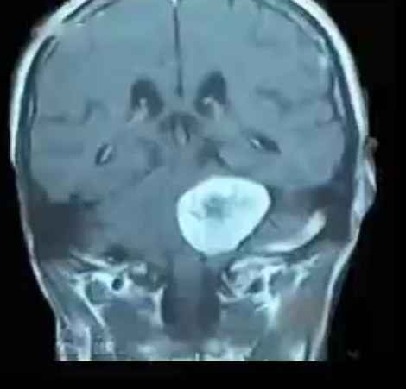
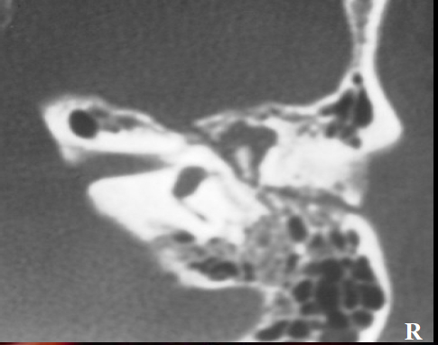
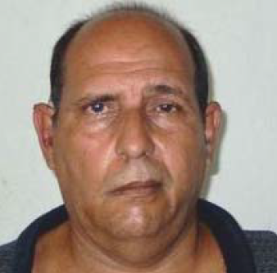
Doctor notes cont. (cases mentioned, might come as SAQ)
❖a patient presented with asymmetric face, metallic taste, drooling, hearing loss, an MRI was done which showed the following (pic.)
what's the most likely lesion seen on this MRI?
acoustic neuroma (schwannoma)
❖20 year old female brought to the ER after a car accident, her face was covered red because of the blood and it was clearly asymmetric, she lost one of the nasolabial fold, and she can't close her eyes at that side.
an urgent CT was done, which showed the following (pic.)
→ →
what's the most likely diagnosis that explains the patient presentation?
facial nerve palsy
after seeing the CT whats the most likely etiology?
temporal bone fracture (longitudinal)
❖patient presented to the clinic complaining of ear pain vomiting and spinning sensation, on face inspection the doctor noted an abnormality (pic.)
→ →
what's the abnormality seen on this picture?
asymmetric face (facial nerve palsy)
which cranial nerves are most likely to be affected?
(CN 7-8) facial-vestibulocochlear
which syndrome does this patient likely have?
ramsay hunt syndrome

