Slide 1

Preoperative Anaesthetic Assessment and Premedication
08/ 03/ 2020
Dr. Jumana. M. Baaj
Ass. professor , Anesthesia consultant
Dept. of Anesthesia
KKUH- KSU
Riyadh, Saudi Arabia

Slide 2
Objective
learn pre-anesthetic patient evaluation and risk stratification.
Obtain a full history and physical examination including allergies, current medications, past anesthetic history, family anesthetic history
Understand how patient co-morbidities can affect the anesthetic plan.
Understand potential anesthetic options for a given surgical procedure.
Able to plan an anesthetic for a basic surgical procedure.
Understand risk stratification of a patient undergoing anesthesia
The perioperative patient journey

Slide 3
Overview
The preoperative visit
Anaesthetic history
Examination
Special investigations
Medical referral
Risk assessment
Informing the patient and consent
Premedication

Slide 4
NCEPOD classification of intervention
(National Confidential Enquiry into Patient Outcome and Death
 | Description | Example
Immediate | Life/limb/organ saving • Resuscitation occurs simultaneously with surgery • Surgery within minutes | Rapid bleeding, e.g. trauma, aneurysm
Urgent | Life/limb/organ threatening • Surgery within hours | Perforated bowel or less urgent bleeding
Expedited | Early surgery (within a day or two) | Large bowel obstruction, closed long bone fracture
elective | Timing to suit patient and hospital | Joint replacement, unobstructed hernia repair, cataract

Slide 5
The preoperative visit
Main aim is to assess the patient's fitness for anaesthesia
The Best to be performed by an anaesthetist
Preferably the one who is going to administer the anaesthetic

Slide 6
The Goal of Preoperative visit.
To educate about anesthesia , perioperative care and pain management to reduce anxiety.
To obtain patient's medical history and physical examination .
To determine which lab test or further medical consultation are needed .
To choose care plan guided by patient's choice and risk factors

Slide 7
The preoperative visit
visit allows
  Best anaesthetic technique
  Any potential interactions between concurrent diseases
  Anaesthesia anticipated
  Provides an explanation
  Reassurance for the patient

Slide 8
The preoperative visit
Coexisting Illness
  Improve the patients condition prior to surgery
  Seeking advice from other specialists
  Optimise treatment
  Final decision .

Slide 9
Three situations where special arrangements are usually made
  1-Patients with complex medical or surgical problems
    patient is often admitted several days before surgery
    anaesthetist is actively involved in optimising their condition prior to anaesthesia and surgery
  2-Surgical emergencies
    only a few hours separates admission and operation in these patients urgent investigations or treatment
  3-Day-case patients
    These are patients who are planned
    Generally ‘fitter’ ASA1 or ASA 2
    Assessment in anesthesia clinic

Slide 10
PREVIOUS ANAESTHETICS AND OPERATIONS
Hospitals
Enquire about inherited or 'family' diseases
  sickle-cell disease
  porphyria
Difficulties with previous anaesthetics
  History of difficult intubation
  nausea
  vomiting
  dreams
  awareness
  postoperative jaundice
Present & past medical history
  all the aspects of the patient's medical history
  relating to the cardiovascular and respiratory systems and its severity

Slide 11
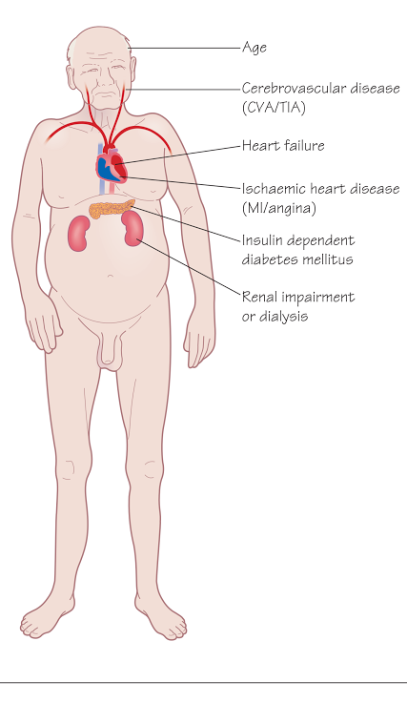
Patient factors associated with cardiac risk
Age
Heart failure
Ischaemic heart disease
(MI / angina)
Cerebrovascular disease
(CVA / TIA)
Insulin dependent diabetes mellitus
Renal impairment or dialysis

Slide 12
Cardiovascular system
Specific enquiries must be made about:
  Angina
    incidence
    precipitating factors
    duration
    use of anti-anginal medications, e.g. glyceryl trinitrate (GTN) oral or sublingual )
  Previous myocardial infarction and subsequent symptoms
  Symptoms indicating heart failure

Slide 13
Cardiovascular system
  Myocardial infarction are at a greater risk of perioperative reinfarction
  Elective surgery postponed until at least 6 months after the event
  Untreated or poorly controlled hypertension (diastolic consistently > 110 mmHg) may lead to exaggerated cardiovascular responses
  Both hypertension and hypotension can be precipitated which increase the risk of myocardial ischemia

Slide 14
Cardiovascular system
  Heart failure will be worsened by the depressant effects impairing the perfusion of vital organs
  valvular heart disease
  * ? prosthetic valves may be on anticoagulants --
  need to be stopped or changed prior to surgery
  * Antibiotic prophylaxis

Slide 15
Active Cardiac Conditions
Unstable coronary syndromes
  Unstable or severe angina
  Recent MI
Decompensated HF
Significant arrhythmias
Severe valvar disease

Slide 16
Minor Cardiac Predictors
Advanced age (>70)
Abnormal ECG
  LV hypertrophy
  LBBB
  ST-T abnormalities
  Rhythm other than sinus
Uncontrolled systemic hypertension

Slide 18
Surgical factors in assessment of risk of significant cardiac event
Low risk <1% | Minor orthopaedic and urology • Gynaecology • Breast • Dental
Intermediate 1–5% | Major orthopaedic and urology • Abdominal • Head and neck
High risk >5% | Aortic, major vascular • Peripheral vascular • Intraperitoneal/intrathoracic

Slide 19
THEN RS

Slide 20
Respiratory system
  Patients with pre-existing lung disease
  prone to postoperative chest infections if they are obese or undergoing upper abdominal or thoracic surgery
  In the patients with chronic obstructive lung disease they have sputum production (volume and color) , dyspnea. Should be treated preoperatively
  Bronchial Asthma, including precipitating factor and last attack , previous hospital admission
  upper respiratory tract infection ( anaesthesia and surgery should be postponed unless it is for a life-threatening condition )

Slide 21
Other conditions in the medical history
GI
  Indigestion
  GER reflux
  Hurt burn
    may indicate the possibility of a hiatus hernia
Rheumatoid disease
    chronically anaemic
    severely limited movement of their joints
    makes positioning for surgery and airway maintenance difficult.
    Tendency for dislocation of atalnto-occiptal joint

Slide 22
Other conditions in the medical history
  Diabetes
    Patients have an increased incidence of
      ischaemic heart disease
      renal dysfunction
      autonomic and peripheral neuropathy
    intra- and postoperative complications
  Neuromuscular disorders
    Care with muscle relaxants
    Coexisting heart disease
    restrictive pulmonary disease

Slide 23
Other conditions in the medical history
  Chronic renal failure
    Anaemia
    Electrolyte abnormalities
    Altered drug excretion
    Restricts the choice of anaesthetic agents
  Jaundice
    Infectious or obstructive liver disease
    Altered drug metabolism
    Altered Coagulation function
  Epilepsy
    well controlled or not , compliance to medication
    avoid anaesthetic agents potentially epileptogenic (e.g. enflurane)
    Predict convulsions which induced by withdrawal effects of anesthesia drugs

Slide 24
DRUG HISTORY AND ALLERGIES
Identify all medications
  Prescribed
  self-administered
  Allergies to drugs
    topical preparations (e.g. iodine)
    adhesive dressings
    foodstuffs
    Latex allergy

Slide 25
SOCIAL HISTORY
Smoking
  number of cigarettes
  amount of tobacco nicotine stimulates the sympathetic nervous system
    causing tachycardia
    hypertension
    coronary artery narrowing
Alcohol
  induction of liver enzymes
  tolerance
Addiction
  Difficulty with venous access
  Thrombosis of veins
  Withdrawal syndromes
Look for tattooing ????

Slide 26
Pregnancy
  increased risk of regurgitation and aspiration
  Elective surgery is best postponed until after delivery.

Slide 27
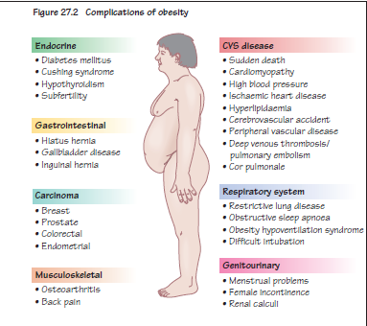
Obesity
Cardiovascular
Respiratory
Sleep apnea
Diabetics
Fatty liver
Technical problem
  Airway , aspiration
  Intravenous access
  Positioning

Slide 28
THE EXAMINATION

Slide 29
THE EXAMINATION
Cardiovascular system
  dysrhythmias
  atrial fibrillation
  heart failure
  heart murmur
  valvular heart disease
  blood pressure is best measured at the end of the examination
Respiratory system
  cyanosis
  pattern of ventilation
  respiratory rate
  Dyspnoea
  Wheeziness
  signs of collapse
  consolidation and effusion

Slide 30
THE EXAMINATION
Nervous system
  Chronic disease of the peripheral and central nervous systems
  evidence of motor or sensory impairment should be documented
Musculoskeletal
  restriction of movement and deformities
  reduced muscle mass
  peripheral neuropathies
  pulmonary involvement
  Particular attention to the patient's cervical spine and temporomandibular joints

Slide 31
THE EXAMINATION
The airway
  Try and predict difficult intubation
  Assessment is often made in three stages
  1. Observation of the patient's anatomy
    Look for limitation of mouth opening, receding mandible position, number and health of teeth, size of tongue.
    Examine the front of the neck for soft tissue swellings, deviated larynx or trachea.
    Check the mobility of the cervical spine in both flexion and extension.

Slide 32
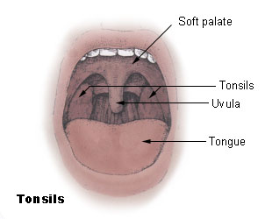
Airway Evaluation

Slide 33
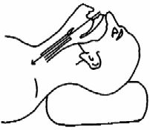
Airway Evaluation (cont.)
Take very seriously history of prior difficulty
Head and neck movement (extension)
  Alignment of oral, pharyngeal, laryngeal axes
  Cervical spine arthritis or trauma, burn, radiation, tumor, infection, scleroderma, short and thick neck

Slide 34
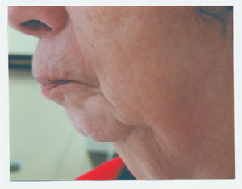

Airway Evaluation (cont..)
Jaw Movement
  Receding mandible
  Inability to sublux lower incisors beyond upper incisors
Protruding Maxillary Incisors (buck teeth)

Slide 35
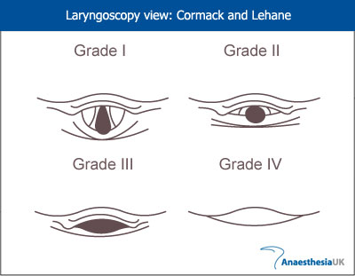
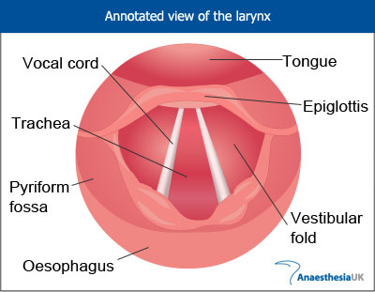
Airway Evaluation (cont…)
Laryngoscopy view: Cormack and Lehane
Grade I: complete glottis visible
Grade II: anterior glottis not seen
Grade III: epiglottis seen, but not glottis
Grade IV: epiglottis not seen

Slide 36
Airway assessment

Slide 37
Investigations

Slide 38
Special Investigations
Baseline investigations
If no concurrent disease, investigations can be limited as:
Age
<40
<40
41-60
41-60
>61
Sex
Male
Female
Male
Female
All
Investigations
Nil
Hb
ECG, Blood sugar, creatinine
Hb, ECG, Blood sugar, creatinine
Hb, ECG, Blood sugar, creatinine

Slide 39
ADDITIONAL INVESTIGATIONS
Urea and electrolytes
  in patients taking digoxin
  diuretics
  diabetes, renal disease
  vomiting
  diarrhea
Liver function tests
  hepatic disease
  high alcohol
  metastatic disease
  evidence of malnutrition

Slide 40
ADDITIONAL INVESTIGATIONS
Blood sugar
  Diabetes
  peripheral arterial disease
  taking long-term steroids
Electrocardiogram (ECG)
  hypertensive
  with symptoms or signs of heart disease
Chest X-ray
Pulmonary function tests
Coagulation screen
Sickle-cell screen

Slide 41
Referral

Slide 42
Medical referral
Optimization of coexisting medical (or surgical) problems may mean postponing surgery

Slide 43
Medical referral
CARDIOVASCULAR DISEASE
  Untreated or poorly controlled hypertension or heart failure.
  Symptomatic ischaemic heart disease, (unstable angina).
  Dysrhythmias: uncontrolled atrial fibrillation, paroxysmal supraventricular tachycardia, second and third degree heart block.
  congenital heart disease or symptomatic valvular heart disease

Slide 44
Medical referral
RESPIRATORY DISEASE
  Chronic obstructive airways disease, if dyspnoeic at rest.
  Bronchiectasis
  Asthmatics
    unstable
    taking oral steroids or
    have a FEV₁ % 60% predicted

Slide 45
Medical referral
ENDOCRINE DISORDERS
  Insulin and non-insulin dependent diabetics
  ketonuria
  random blood sugar > 12mmol/L
  Hypo- or hyperthyroidism
  Cushing's
  Addison's disease
  Hypopituitarism

Slide 46
Medical referral
RENAL DISEASE
  Chronic renal failure
  Patients undergoing chronic dialysis
HAEMATOLOGICAL DISORDERS
  Bleeding diatheses
    haemophilia
    thrombocytopenia
  Therapeutic anticoagulation
  Haemoglobinopathies
  Polycythaemia
  Haemolytic anaemias
  Leukaemias

Slide 47
FACTORES INCREASED RISK OF MORTALITY

Slide 48
INCREASED RISK OF MORTALITY
Inadequate preoperative preparation including resuscitation
Lack of and inappropriate monitoring during surgery
Poor postoperative care, including lack of intensive care beds
Inadequate supervision of trainees

Slide 49
Mortality related to anaesthesia
Approx 1:26,000 anaesthetics
One third of deaths are preventable
Causes in order of frequency
  inadequate patient preparation
  inadequate postoperative management
  wrong choice of anaesthetic technique
  inadequate crisis management

Slide 50
ANAESTHETIC ASSOCIATED DEATHS
Increasing age: >60 years
Sex: male > female
Worsening physical status
Increasing number of concurrent medical conditions, in particular:
  myocardial infarction
  diabetes mellitus

Slide 51
ANAESTHETIC ASSOCIATED DEATHS
renal disease
Increasing complexity of surgery:
  intracranial
  major vascular
  intrathoracic
Increasing length of surgery
Emergency operations

Slide 52
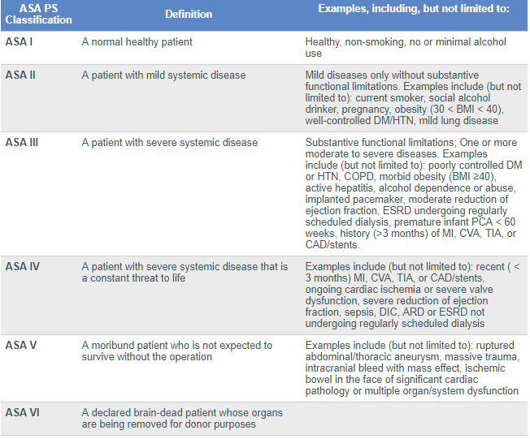

Slide 53
*The addition of “E” denotes Emergency surgery: (An emergency is defined as existing when delay in treatment of the patient would lead to a significant increase in the threat to life or body part)

Slide 54
Preoperative fasting
2 hours water with juice without pulb
4 hours breast feeding
6 hours formula
8 hours after heavy fatty meal

Slide 55
Informing the patient

Slide 56
Informing the patient
The choice of anaesthetic technique rests with the anaesthetist, but most patients appreciate some details of what to expect

Slide 57
The perioperative patient journey
Consent
Surgical safety checklist
Criteria for discharge from a day surgery unit

Slide 58
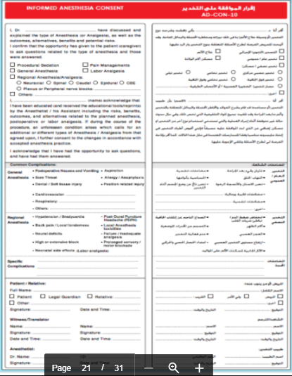

Slide 59
Consent
Anaesthetic consent is an important aspect of operative consent.
All patients should have received written information in advance as well as an explanation of side effects:
    Common side effects, e.g. postoperative nausea and vomiting
    Rare side effects, e.g. nerve damage after spinal or epidural
    Anaesthesia
    3. Risks specific to that patient – this can relate to a career (e.g. an opera
    singer and the risk of vocal cord injury) or the risk of perioperative
    myocardial infarction in a patient with a significant history of cardiac
    disease.
Consent must be obtained before any sedating , premedication is given.

Slide 60
Consent requires
Capacity necessitates:
  • Ability to understand and retain information about the treatment
  • Ability to weigh up the information
  • Ability to make a free choice
Enough relevant information

Slide 61
Informing the patient
patients will ask about their immediate recovery
Finally
  reassure patients about postoperative pain control
  informed of the technique
Consent for anaesthesia

Slide 62
Premedication

Slide 63
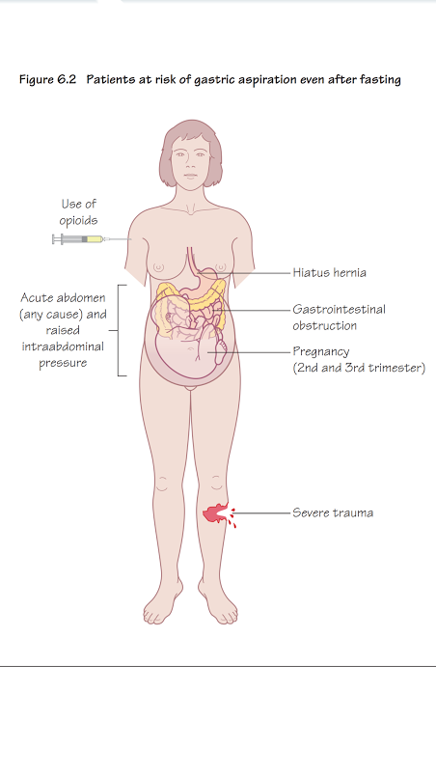
Patients at risk of gastric aspiration even after fasting
Gastrointestinal obstruction
Hiatus hernia
Pregnancy (2nd and 3rd trimester)
Severe trauma
Use of opioids
Acute abdomen (any cause)
Raised intraabdominal pressure

Slide 64
The 6 As of premedication
Anxiolysis – the best anxiolytic is the anesthetist who visits the patient and listens to the patient
Amnesia
Anti-emetic
Antacid
Anti-autonomic
Analgesic

Slide 65
Premedication
Anxiolysis
  benzodiazepines
  phenothiazines
Amnesia
  lorazepam
  anterograde amnesia

Slide 66
Premedication
Anti-emetic
  dopamine antagonists
  antihistamines
  anticholinergics
  phenothiazines
  5-hydroxytryptamine antagonists
  a₂- agonists: clonidine, Dex

Slide 67
Premedication
Antacid
    Patients who have received opiates
    present as emergencies
    If in pain
    delayed gastric emptying
    hiatus hernia
  Oral sodium citrate
  Ranitidine , Proton inhibitors
  Metoclopramide
  naso- or orogastric tube

Slide 68
Premedication
Anti-autonomic
  Parasympathetic reflexes
    Excessive vagal activity causing profound bradycardia
    halothane
    suxamethonium
    surgery
    traction on the extraocular muscles
    handling of the viscera
    during elevation of a fractured zygoma

Slide 69
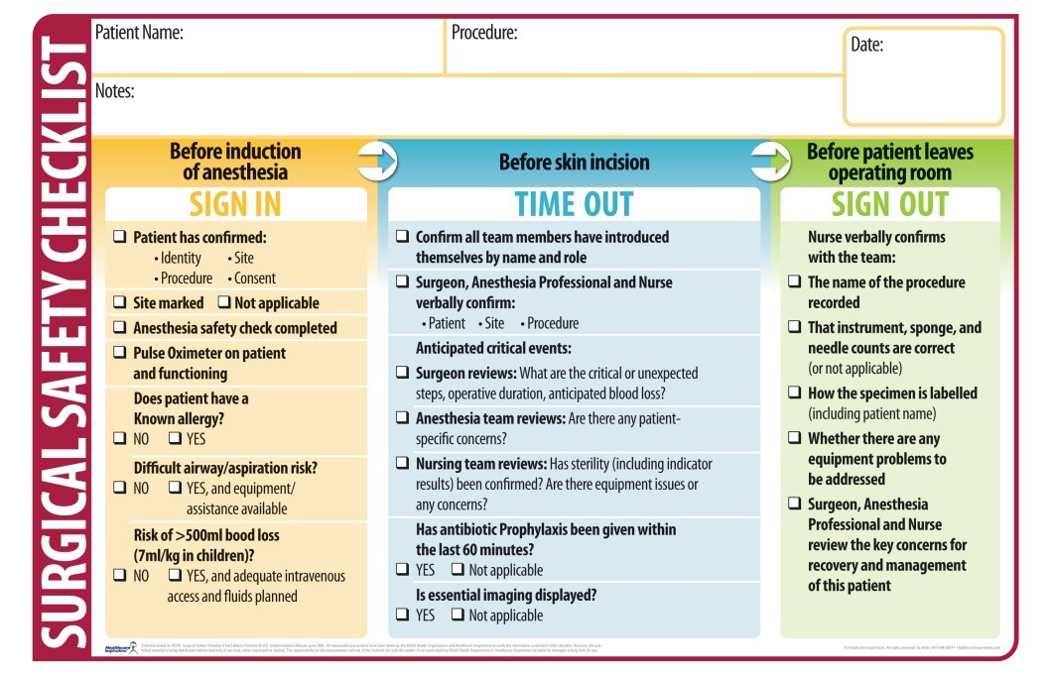

Slide 70
Postoperative stage
At the end of the operation, the patient is either extubated in the operating theatre (and an oropharyngeal airway inserted if needed) or transferred to the recovery room with an LMA still in situ.
All patients receive supplemental oxygen during transfer.
Many patients who do not have a general anesthetia/sedation bypass the recovery room and go straight from the operating theatre
Examples include local anesthetia cases (e.g. minor surface surgery, cataract removal, some
regional anesthetia cases).

Slide 71
Once in the recovery room,
Handover occurs between the anesthetist and a recovery nurse. Important information passed on includes:
  • patients name and age;
  • operation details;
  • blood loss;
  • anaesthetic technique with emphasis on:
    • analgesia given;
    • regional/nerve blocks;
    • antiemetics given;
    • antibiotics;
    • the use of local anaesthetic infiltration;
    • thromboprophylaxis.

Slide 72
THANK YOU

Slide 73
