Slide 1

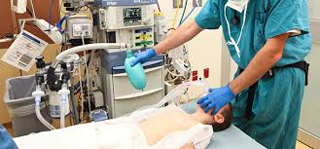
General Anesthesia Techniques
Lecturer name: Dr. Altaf Hussain

Slide 2
Lecture Objectives..
Students at the end of the lecture will be able to:
Define General Anesthesia
Learn about several equipment, adjuncts and agents used for induction of general anesthesia including intravenous agents, inhalation agents, neuromuscular blocking agents and reversal agents.
Understand basic advantages and disadvantages of these agents.
Anesthesia Work Station anesthesia machine structure
5. Complications commonly encountered during general anesthesia

Slide 3
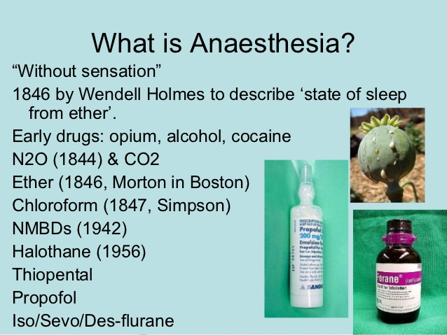

Slide 4
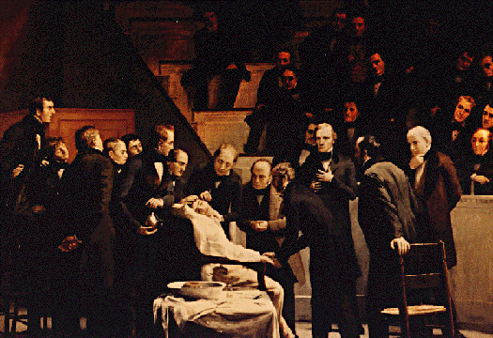
General anesthetics have been used since 1846 when Morton demonstrated the first anesthetic (using ether) on 16th of Oct 1846 in Boston, USA.
Local anesthetics arrived later, the first being scientifically described in1884.

Slide 5
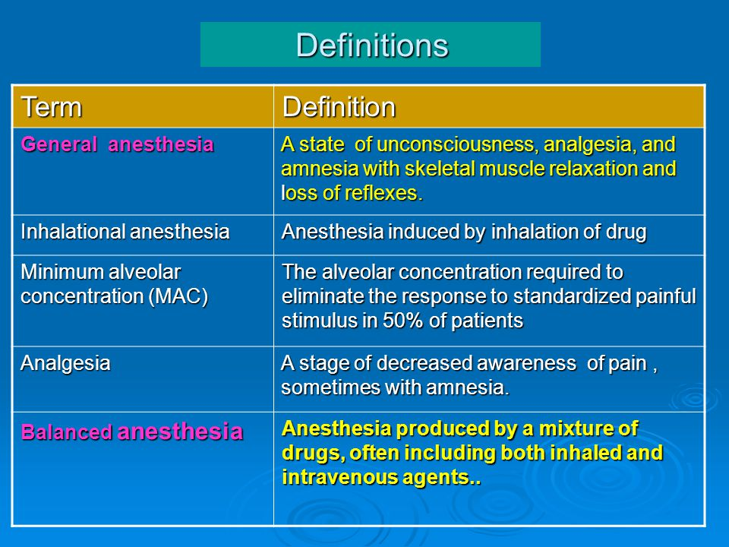

Slide 6
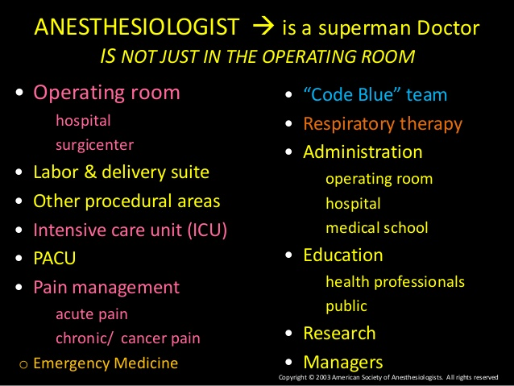

Slide 7
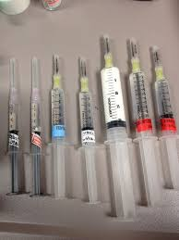
General Anesthesia Goals
Primary goal:
Oxygenation
Ventilation
Monitoring
Amnesia: patient should forget any unpleasant feeling.
Hypnosis: Unconscious state
Analgesia: No pain sensation
Autonomic Block: Reflexes blocked
Optimal conditions: all the above along with good muscle relaxation.
SAFETY AND PATIENT CARE IS THE PRIORITY

Slide 8
General Anesthesia
Assessment
Planning I: Monitors
Planning II: Drugs
Planning III: Fluids
Planning IV: Airway
Management
Process of Anesthesia
Premedication
Induction
Maintenance
Emergence
Postoperative care

Slide 9
Physical status classification
Class I: A normal healthy patient.
Class II: A patient with mild systemic disease (no functional limitation)
Class III: A patient with severe systemic disease (some functional limitation)
Class IV: A patient with severe systemic disease that is a constant threat to life (functionality incapacitated)
Class V: A moribund patient who is not expected to survive with or without the operation within 24 hours.
Class VI: A brain-dead patient whose organs are being removed for donor purposes
Class E: Emergent procedure

Slide 10
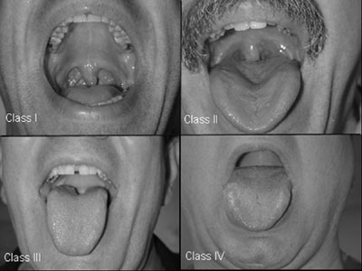
Airway examination
Mallampati classification
Class I:
uvula, faucial pillars, soft and hard palate visible
Class II:
faucial pillars, soft and hard palate visible
Class III:
soft and hard palate visible
Class IV:
hard palate visible

Slide 11
NPO status
NPO, Nil Per Os, means nothing by mouth
Solid food: 8 hrs before induction
Liquid: 4 hrs before induction
Clear water: 2 hrs before induction
Pediatrics: stop breast milk feeding 4 hrs before induction

Slide 12
Anesthetic plan
Stages of general anaesthesia (Arthur Ernest Guedel 1937)
Based on inhalation of diethyl Ether
Stage 1 stage of analgesia start (Joseph Frank Artusio 1954)
Plane 1 no amnesia, no analgesia
Plane 2 amnesia, partial analgesia
Plane 3 full amnesia and analgesia
Stage 2 stage of excitement unconsciousness
Stage 3 stage of surgical anaesthesia
Plane 1 regular respiration
Plane 2 eyeball movement
Plane 3 intercostal muscles
Plane 4 diaphragm
Stage 4 stage of medullary depression diaphragm paralysis

Slide 13
General Anesthesia
Monitor
Pre-oxygenation
Induction ( including RSI & cricoid pressure)
Mask ventilation
Muscle relaxants
Intubation & ETT position confirmation
Maintenance
Emergence
Post operative recovery

Slide 14
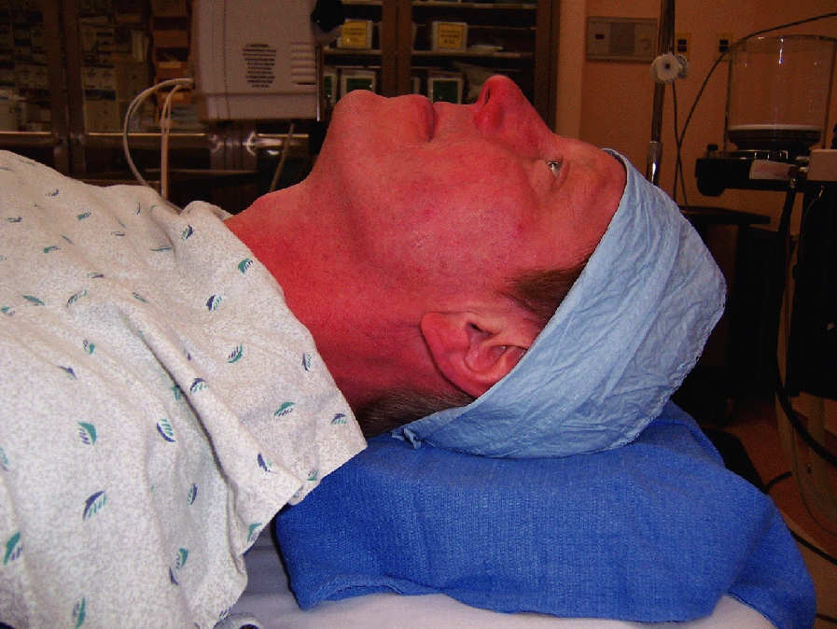
Sniffing position

Slide 15
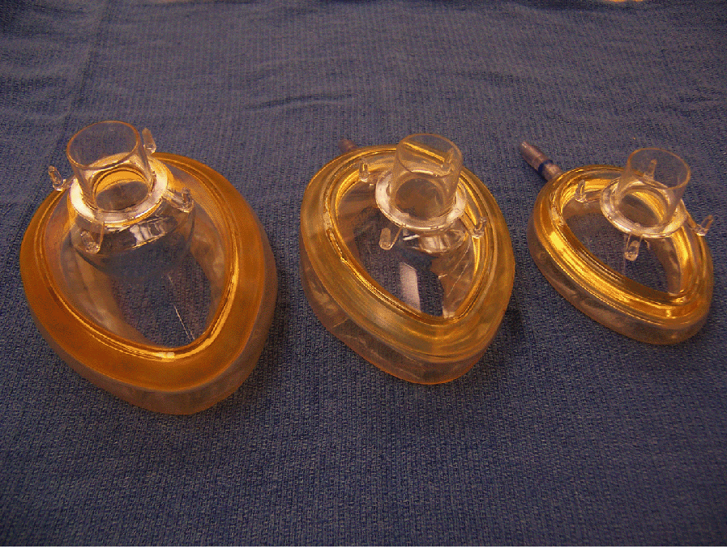
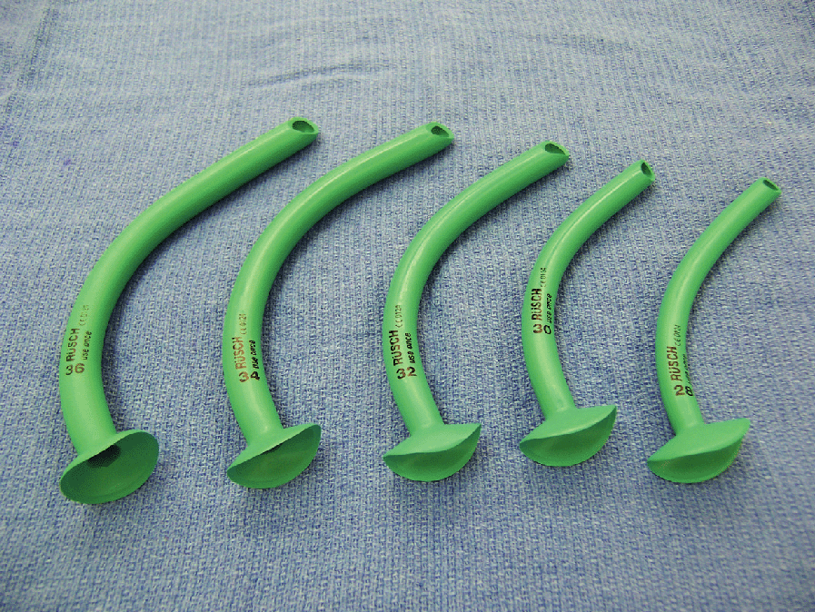
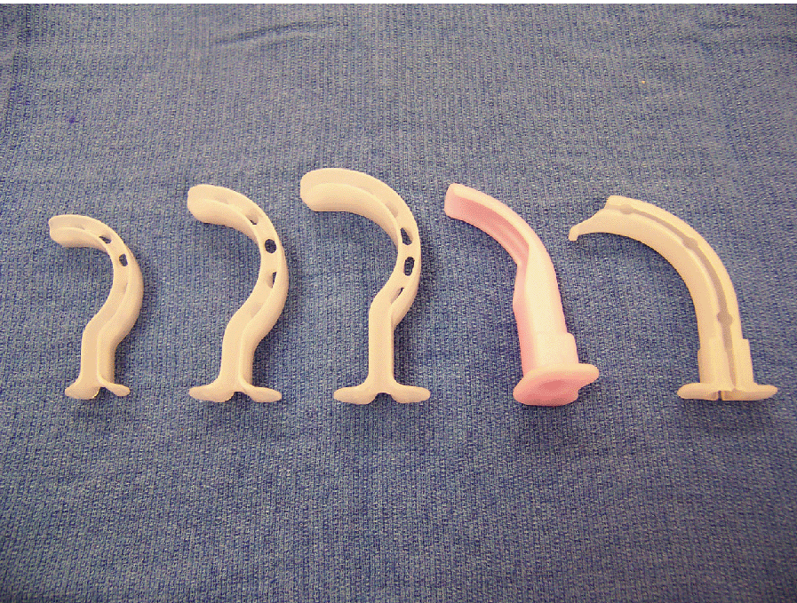
Mask and airway tools

Slide 16
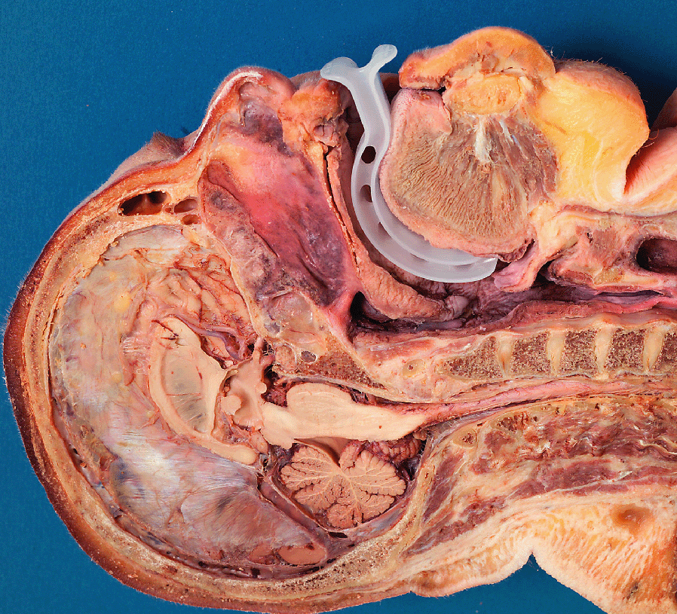
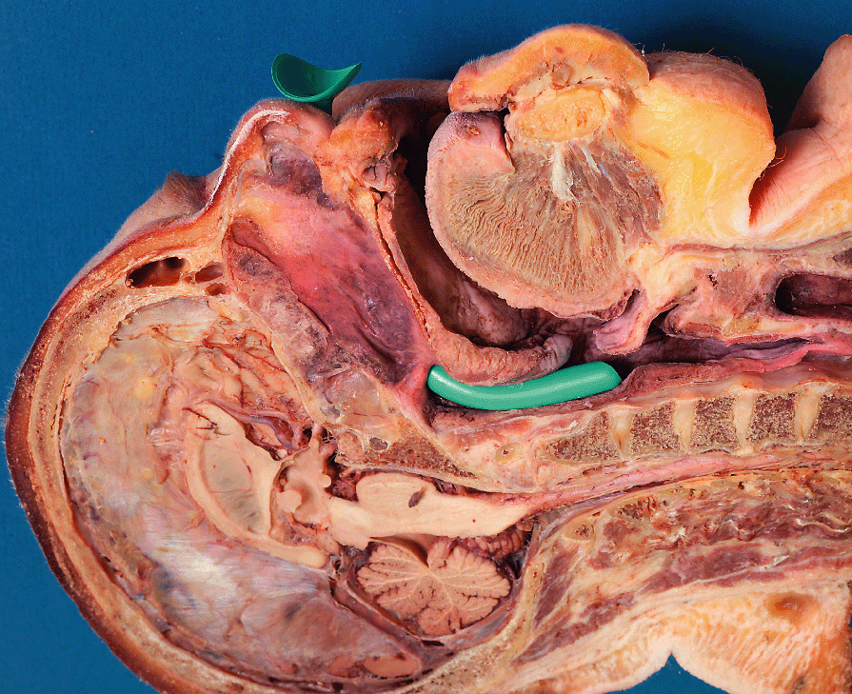
Oral and nasal airway

Slide 17
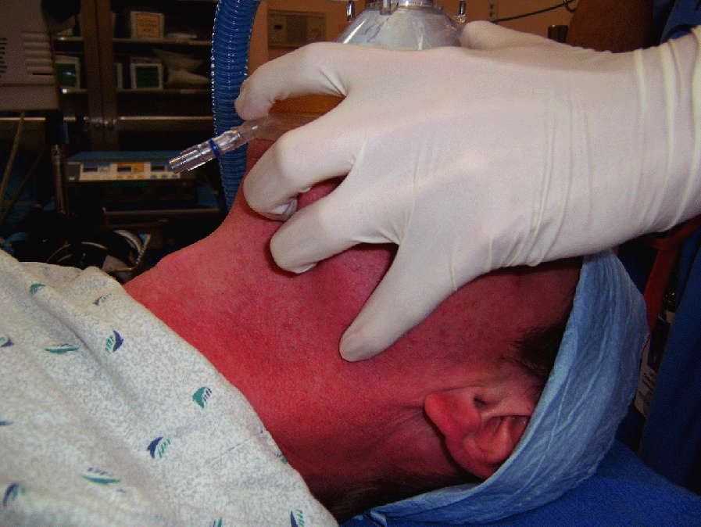
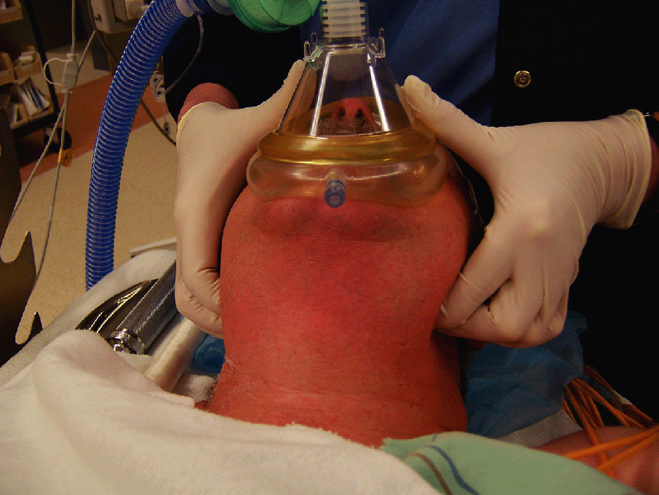
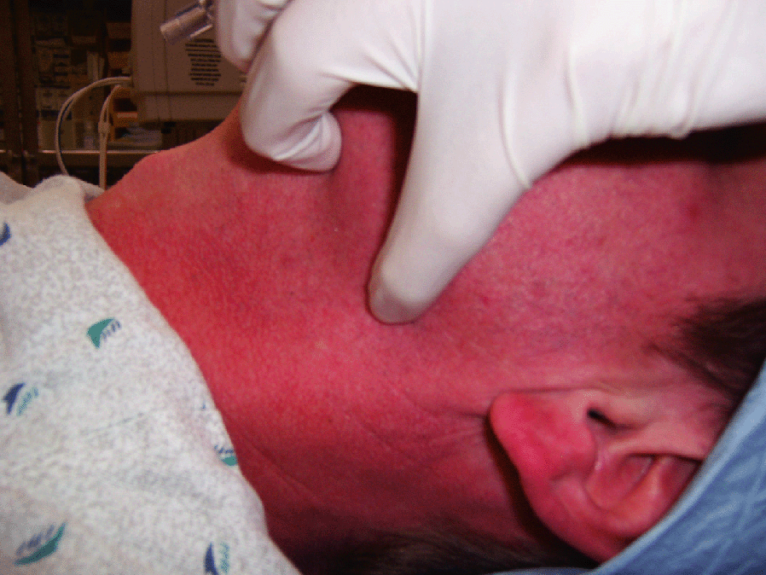
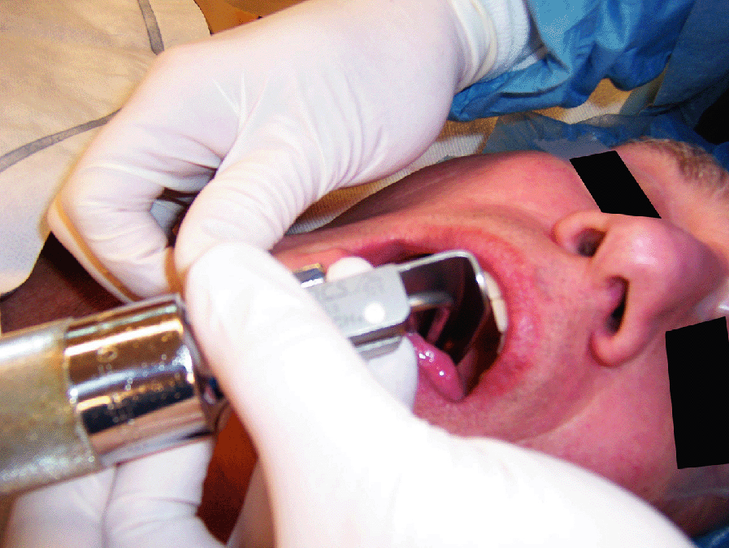
Mask ventilation and intubation

Slide 18
Difficult BMV- MOANS
MASK SEAL: mask seal requires normal anatomy, absence of facial hair, lack of interfering substances like vomitus or bleeding & ability of apply mask with pressure.
OBSTRUCTION/ OBESITY: Obstruction of upper airway, obesity (BMI greater than 26) is an independent marker. Redundant upper airway tissue, chest wall weight & resistance from abdominal contents impede airflow.
AGE: General loss of elasticity & increased incidence of restrictive /obstructive lung disease with increasing age.
NO THEETH: Edentulous creates difficulty.
STIFFNESS: Resistance to ventilation with COPD, Asthma, Pulmonary edema.

Slide 19
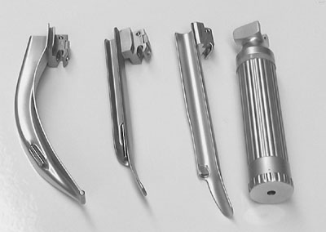
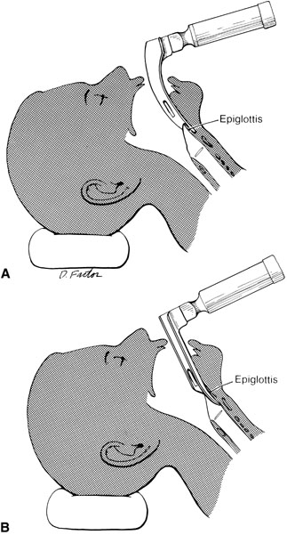
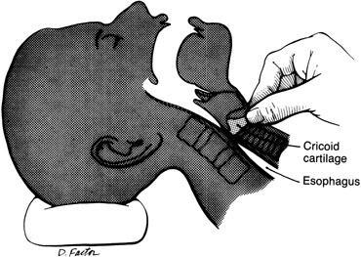
Intubation

Slide 20
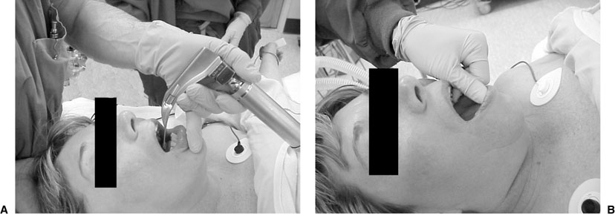
Intubation

Slide 21
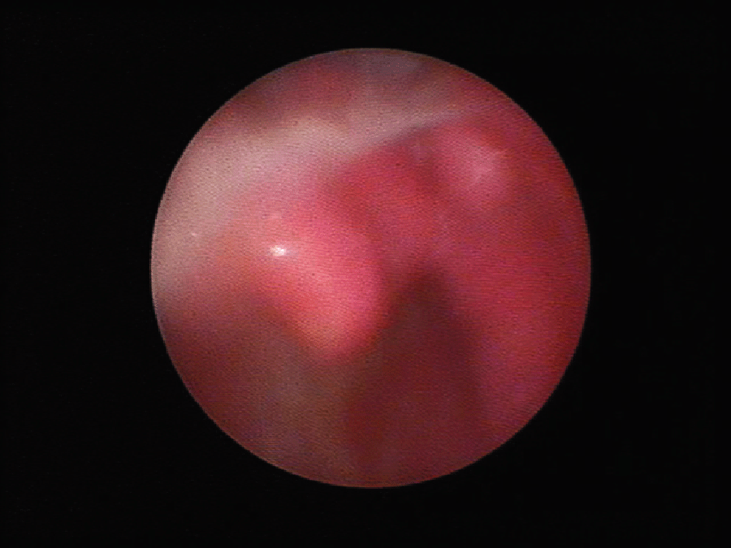
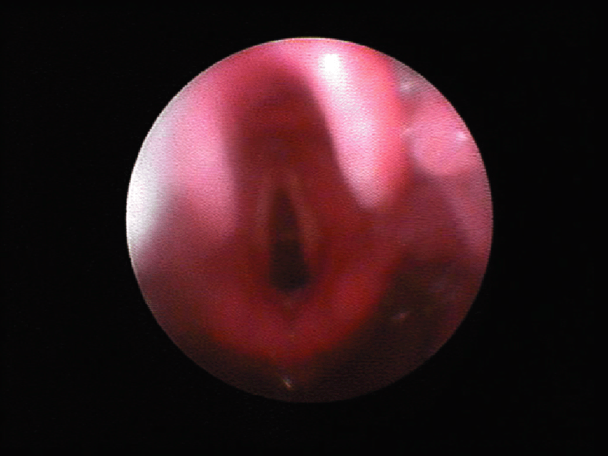
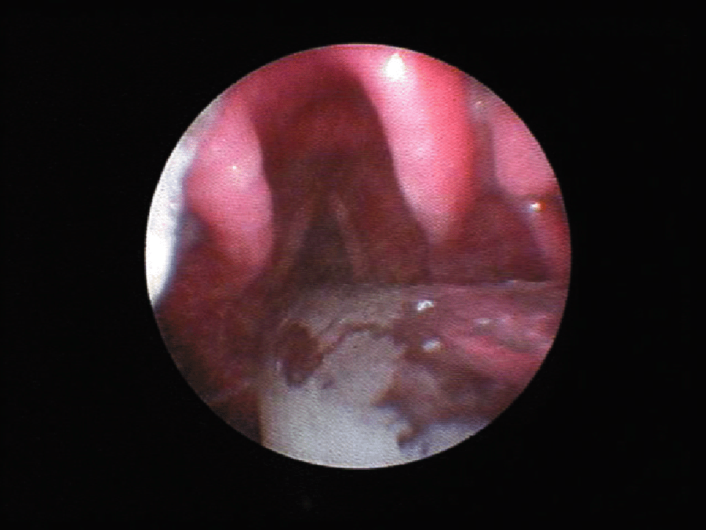
Laryngeal view

Slide 22
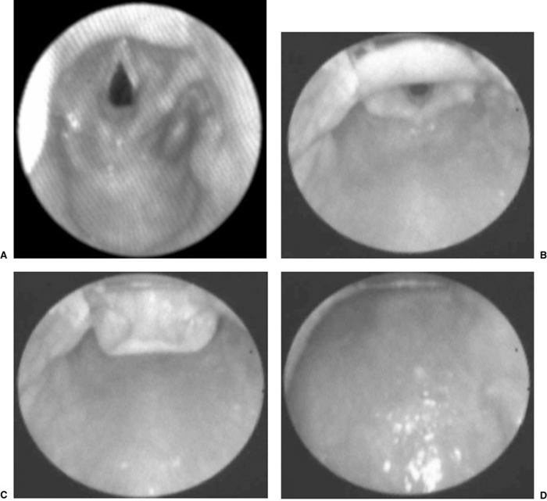
Laryngeal view scoring system

Slide 23
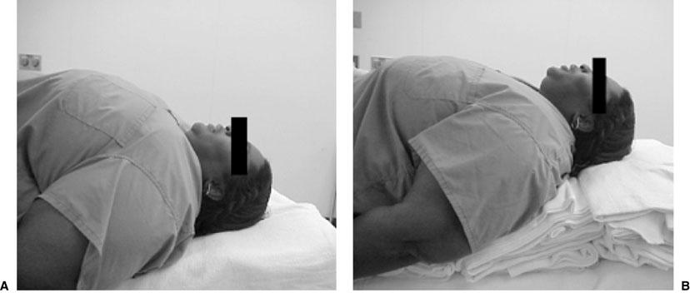
Difficult airway

Slide 24
The LEMON Approach
LOOK EXTERNALLY: Abnormal facies, unusual anatomy or facial Trauma.
EVALUATE (3-3-2 rule):3 fingers between the incisors, 3 fingers along the floor of the mandible b/w the mentum and the neck mandible junction & 2 fingers in the superior laryngeal notch. This predicts difficulty in visualizing the glottis.
MALLAMPATTI SCORE:III predicts difficulty and IV predicts extreme difficulty.
OBSTRUCTION/ OBESITY.
NECK MOBILITY.

Slide 25
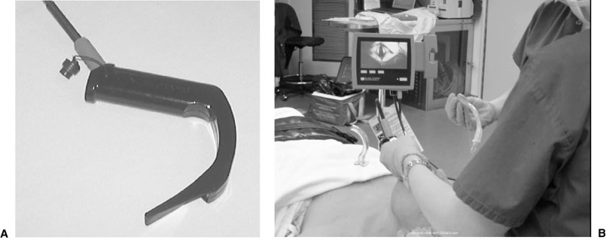
Glidescope

Slide 26
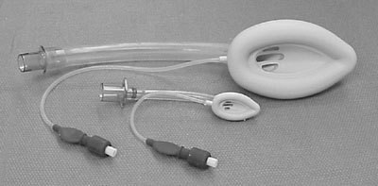
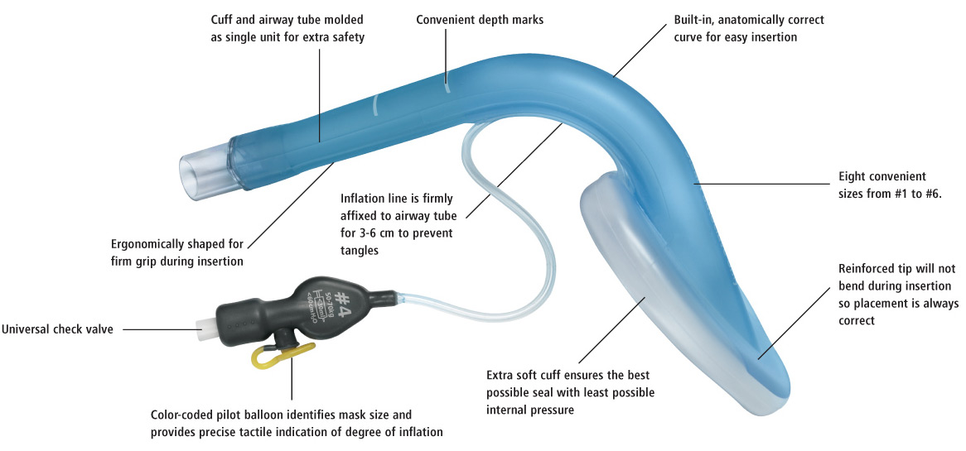
LMA

Slide 27
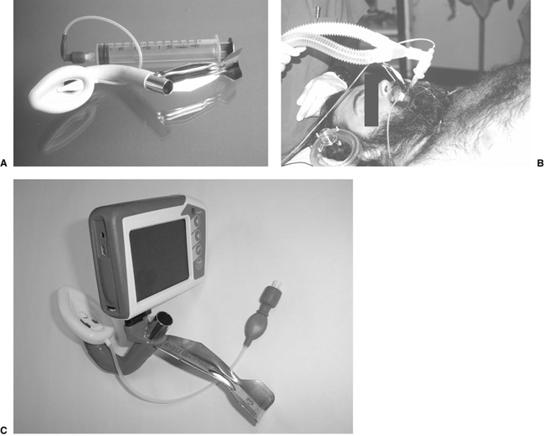
Fast track LMA

Slide 28
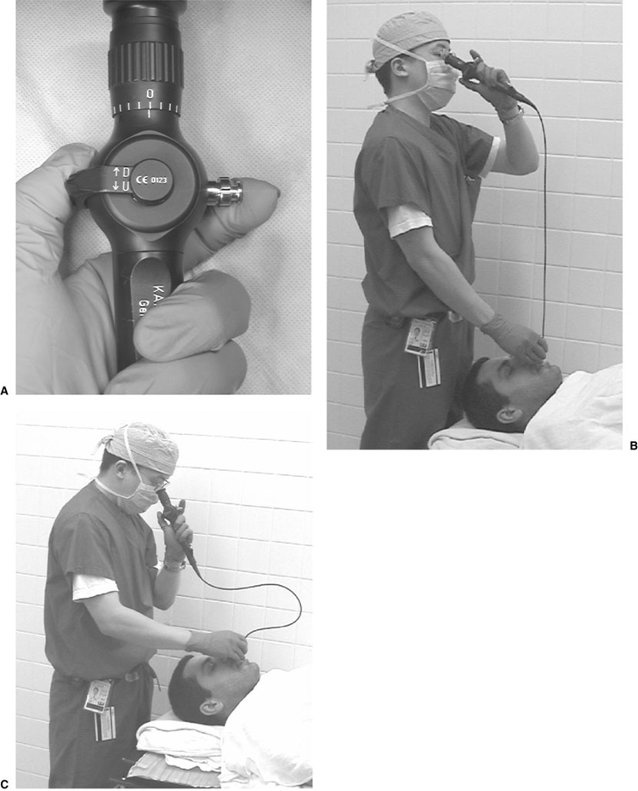
Fiberoptic intubation

Slide 29
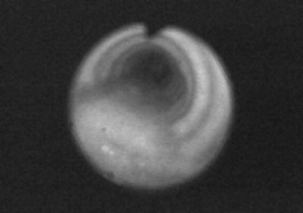
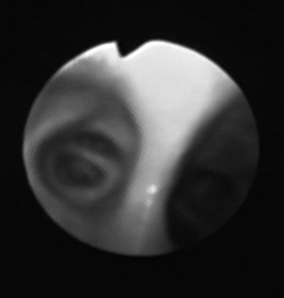
Trachea view Carina view

Slide 30
Anesthesia Machine
Anesthesia is delivered via a machine from the main gas supply to the patient.

Slide 31
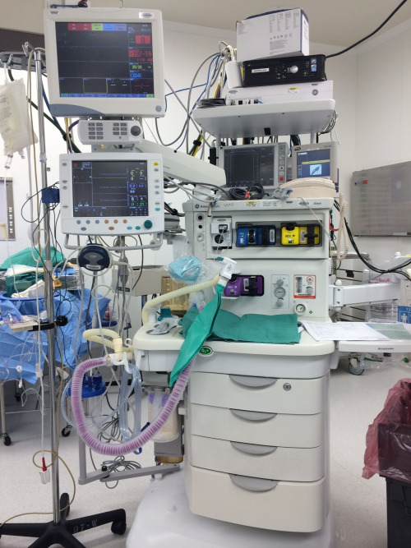
Anesthesia Machine
Anesthesia Workstation

Slide 32
Anesthesia Machine
FUNCTIONS OF ANAESTHESIA MACHINE
The machine performs four essential functions:
1.Provides O2,
2.Accurately mixes anaesthetic gases and vapours,
3.Enables patient ventilation and
4.Minimises anaesthesia related risks to patients and staff.

Slide 33
Anesthesia Machine
Gas supplies: From the central pipeline to the machine as well as cylinders.
Flow meters.
Vaporizers.
Fresh gas delivery: Breathing systems and ventilators.
Scavenging.
Monitoring.

Slide 34
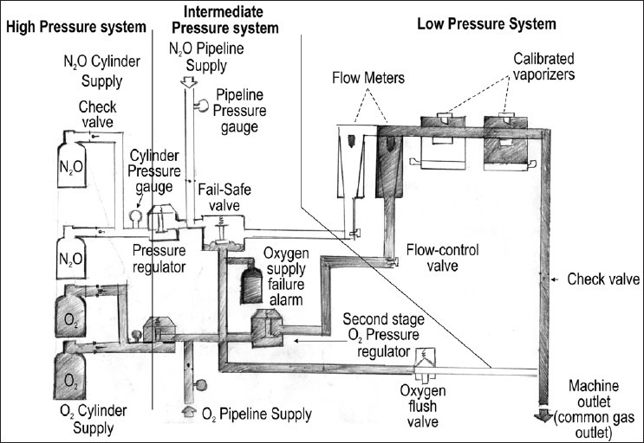
Diagram of Anesthesia Machine

Slide 35
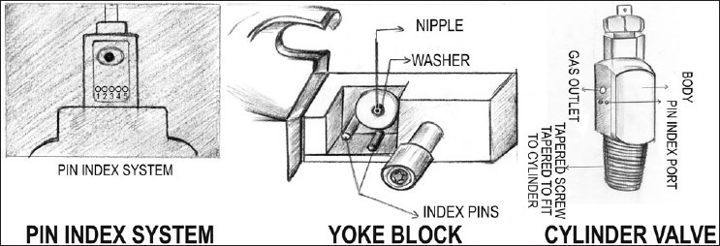
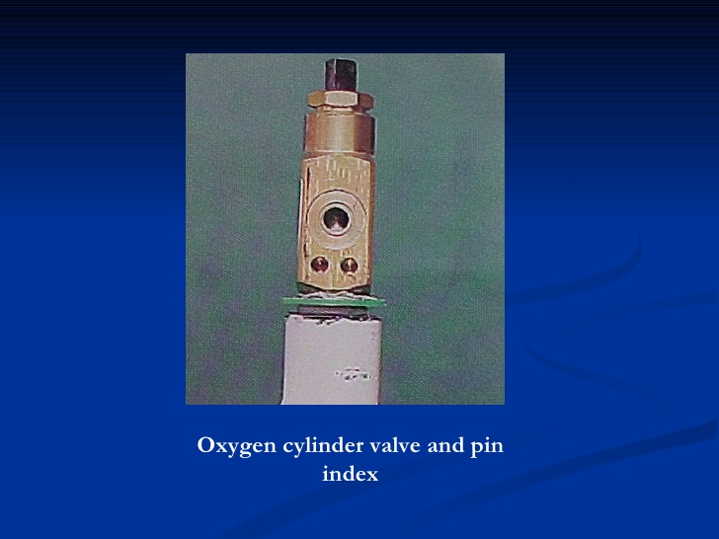
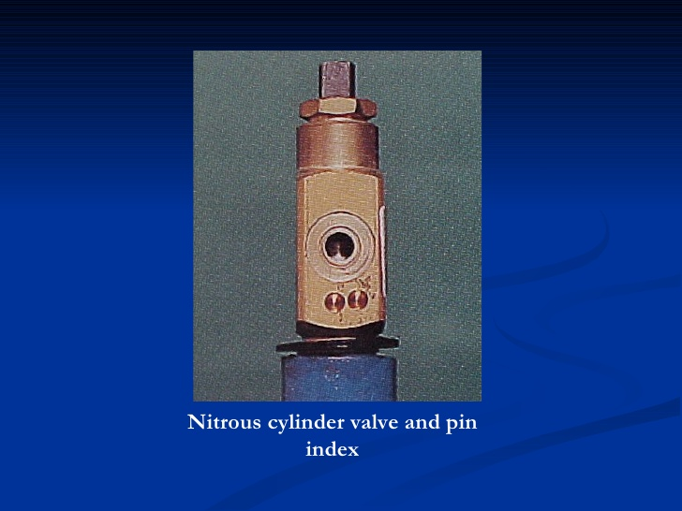
Safety Features
Pin Index safety system

Slide 36
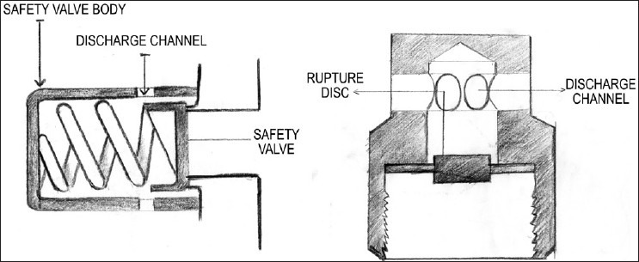
Safety Features
Pressure Regulators

Slide 37
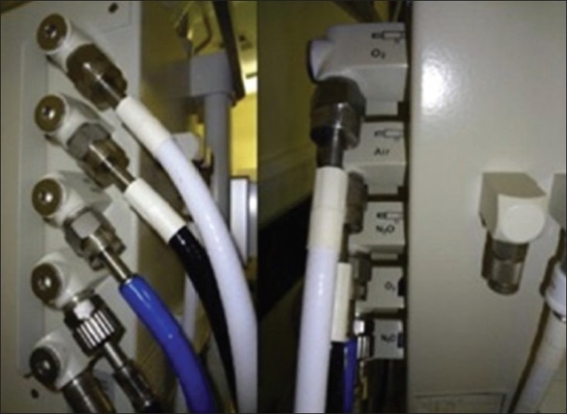
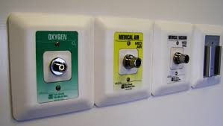
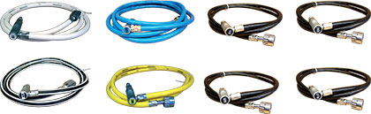
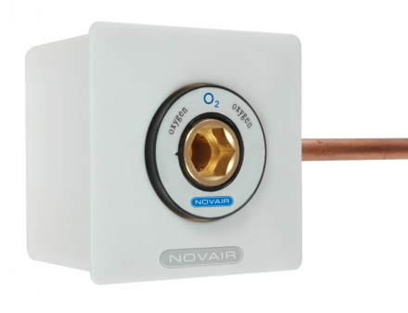
Safety Features
DISS safety connections
Non-interchangeable screw thread

Slide 38
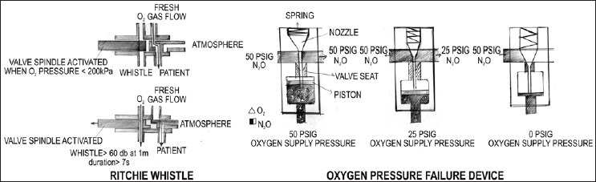
Safety Features
Oxygen Failures device

Slide 39
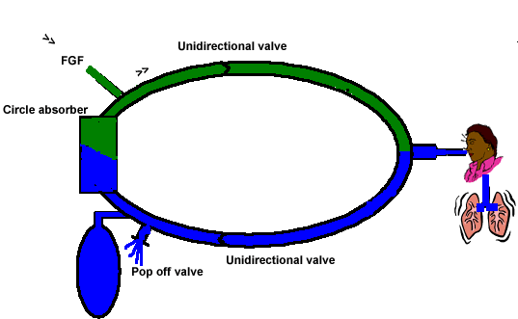
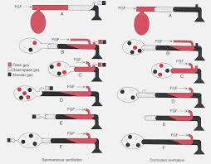
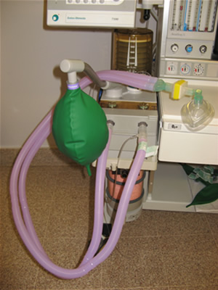
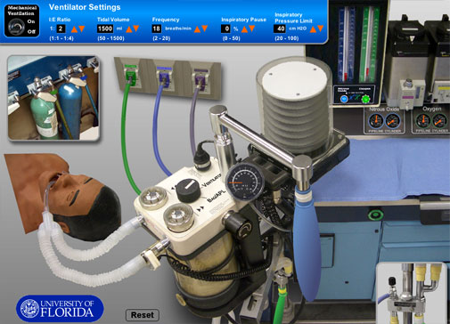
Breathing Circuits

Slide 40
Induction agents
Analgesics:
Opioids – Fentanyl,Sufentanyl, Remifentanil
Induction of unconscious:
Propofol,Thiopental and Etomidate, Benzodiazepines
Muscle relaxants:
Depolarizing
Non-depolarizing

Slide 41
Induction
IV induction
Inhalation induction

Slide 42
Intraoperative management
Maintenance
Inhalation agents: N2O, Sevo, Deso, Iso.
Total IV agents: Propofol
Opioids: Fentanyl, Morphine
Muscle relaxants
Balance anesthesia

Slide 43
Intraoperative management
Monitoring
Positioning during surgery –
Supine
Lateral
Prone
Sitting
Lithotomy
Fluid management
- Crystalloid vs colloid
- NPO fluid replacement:
1st 10kg weight-4ml/kg/hr,
2nd 10kg weight-2ml/kg/hr and 1ml/kg/hr thereafter
- Intraoperative fluid replacement:
minor procedures 1-3ml/kg/hr,
major procedures 4-6ml/kg/hr,
major abdominal procedures 7-10ml/kg/hr

Slide 44
Intraoperative Management and Recovery
Waking up is a crucial time where there is short period when the patient is aware of emergence without a full return to consciousness.
Turn off the agent (inhalation or IV agents)
Reverse the muscle relaxants
Return to spontaneous ventilation with adequate ventilation and oxygenation
Suction upper airway
Wait for patient to wake up and follow command
Hemodynamically stable

Slide 45
Postoperative management
Post-anesthesia care unit (PACU)
- Oxygen supplement
- Pain control
- Nausea and vomiting
- Hypertension and hypotension
- Agitation
Surgical intensive care unit (SICU)
- Mechanical ventilation
- Hemodynamic monitoring

Slide 46
General Anesthesia
Complications
Respiratory complications
- Aspiration – airway obstruction and pneumonia
- Bronchospasm
- Atelectasis
- Hypoventilation
Cardiovascular complications
- Hypertension and hypotension
- Arrhythmia
- Myocardial ischemia and infarction
- Cardiac arrest

Slide 47
General Anesthesia
Complication and Management
Neurological complications
- Slow recovery from anesthesia.
- Stroke
Malignant hyperthermia

Slide 48
HYPOTHERMIA
Definition 35 C
Classification
Mild 35-32 C
Moderate 32-28 C
Severe 28-20 C
Mechanism
Heat loss
Radiation
Convection
Evaporation
Conduction
Therapeutic vs Accidental Hypothermia
Adverse effects
Prevention
Treatment

Slide 49
Thank You

