Slide 1
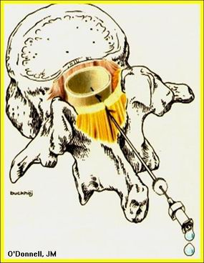
Neuraxial Blokade
Dr: Ahmed Thallaj
Associate Professor, college of medicine, KSU
Head of regional Anesthesia division
Director, KSU Regional Anesthesia Fellowship Program

Slide 2
Objectives
Relevant anatomy and surface landmark for Neuraxial block.
Differences between spinal and epidural.
Equipment and local anesthetics.
Indication and contraindication.
Side effects, complications and treatment.
LAST

Slide 3
Knowledge of anatomy for neuraxial blockade is essential!
7 cervical vertebrae
12 thoracic vertebrae
5 lumbar vertebrae
Sacrum
Coccyx

Slide 4
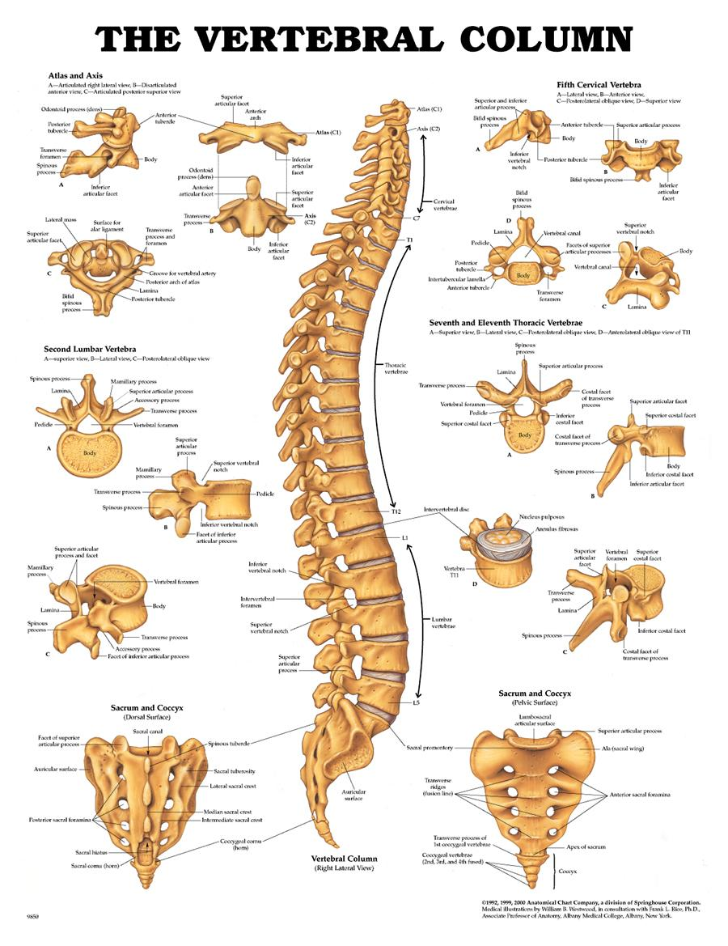
Cervical
Vertebrae
Thoracic
Vertebrae
Lumbar
Vertebrae

Slide 5
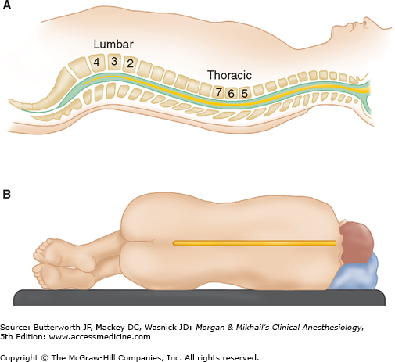

Slide 6
Individual Vertebral Anatomy
Each vertebra consists of a pedicle, transverse process, superior and inferior articular processes, and a spinous process.
Each vertebra is connected to the next by intervertebral disks.
There are 2 superior and inferior articular processes (synovial joints) on each vertebra that allows for articulation.
Pedicles contain a notch superiorly and inferiorly to allow the spinal nerve root to exit the vertebral column.

Slide 7
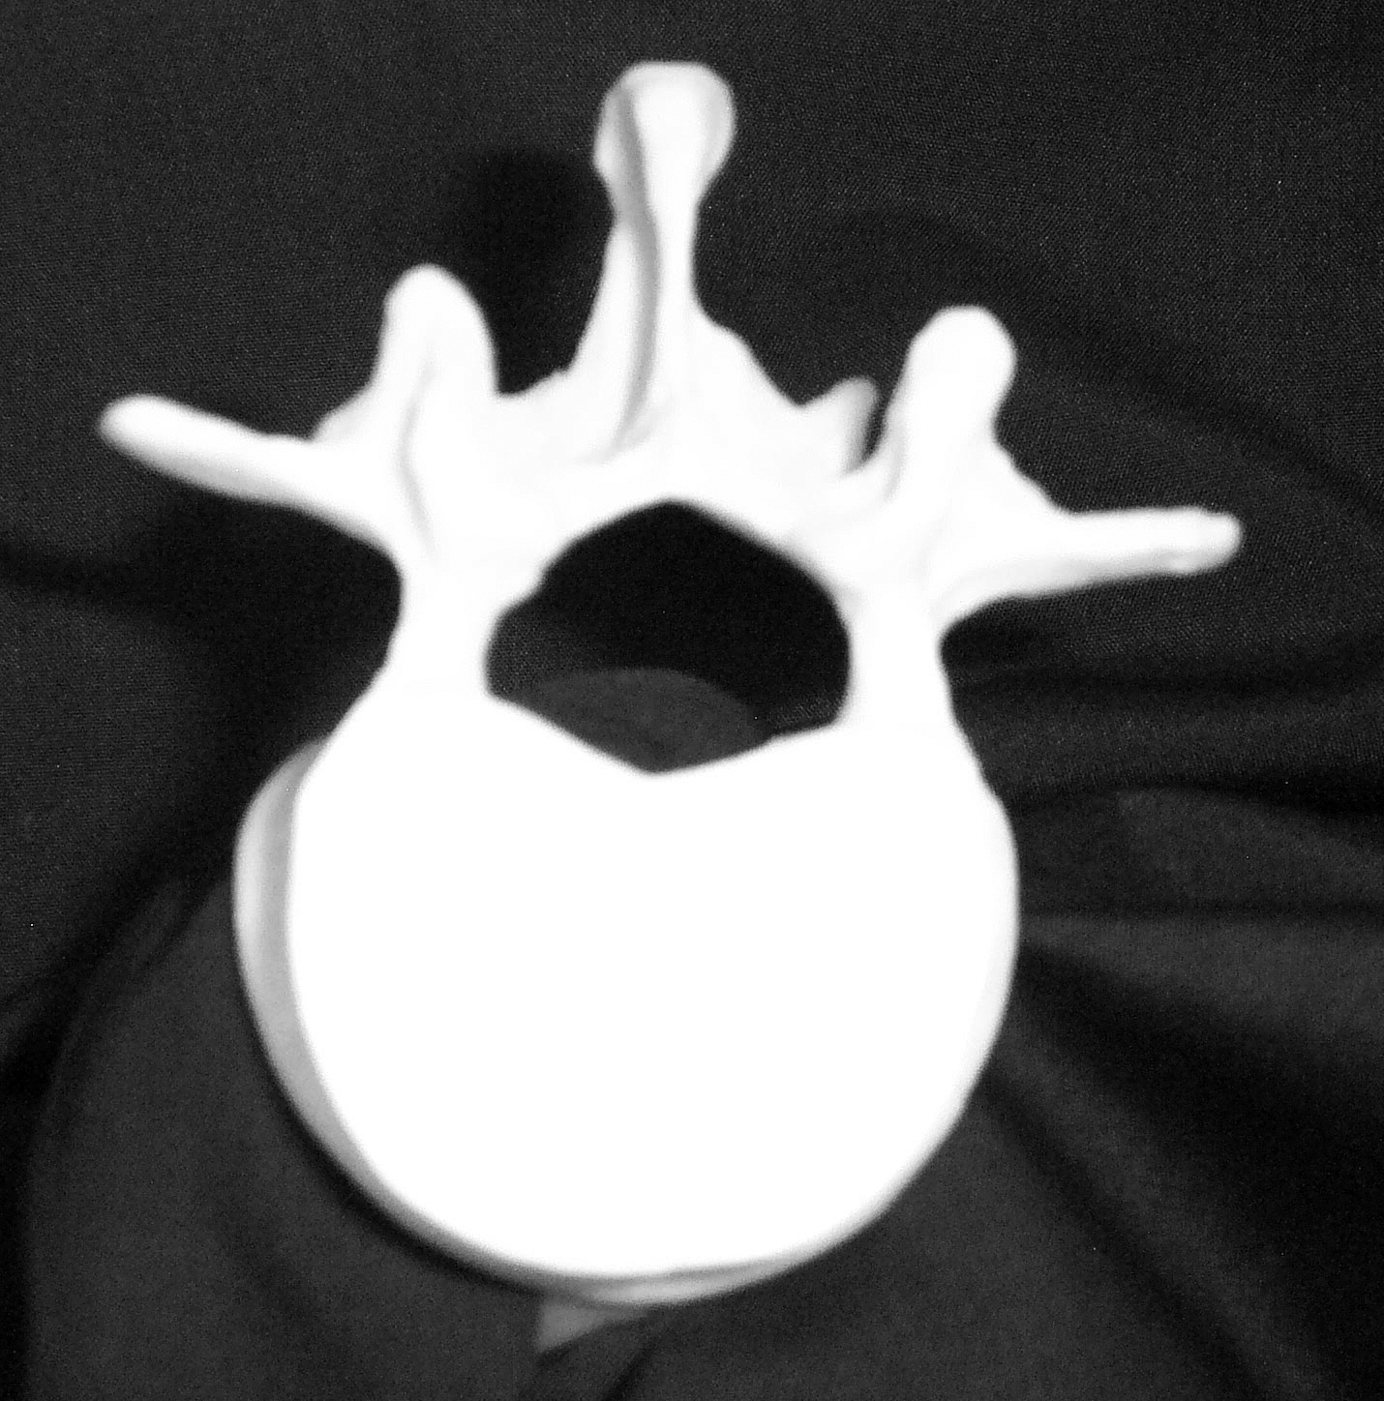
Vertebral Anatomy- Top View
Transverse Process
Spinous Process
Lamina
Spinal Canal
Vertebral Body

Slide 8
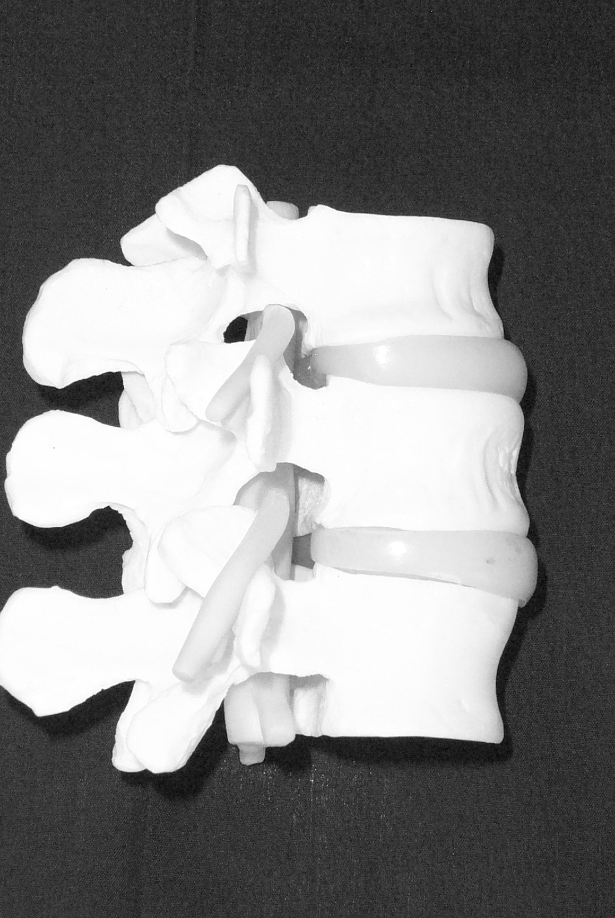
Intervertebral Disc
Intervertebral Foramina
Spinal Nerve
Root

Slide 9
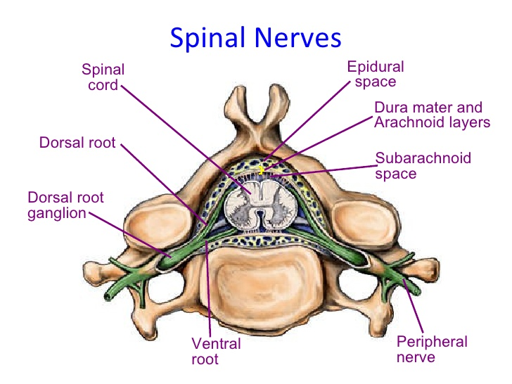

Slide 10
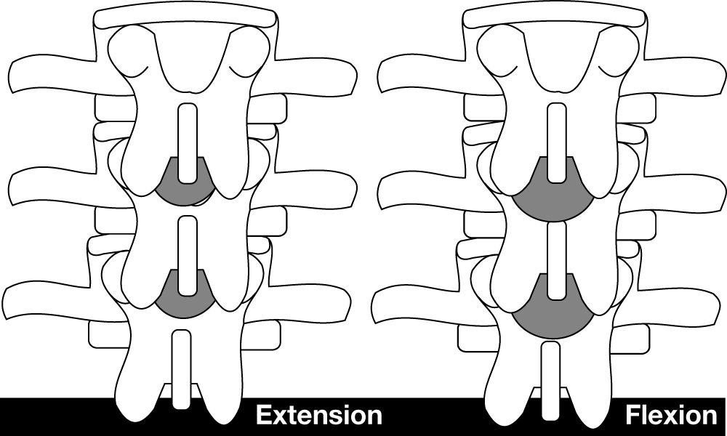
Lumbar Extension versus Flexion

Slide 11
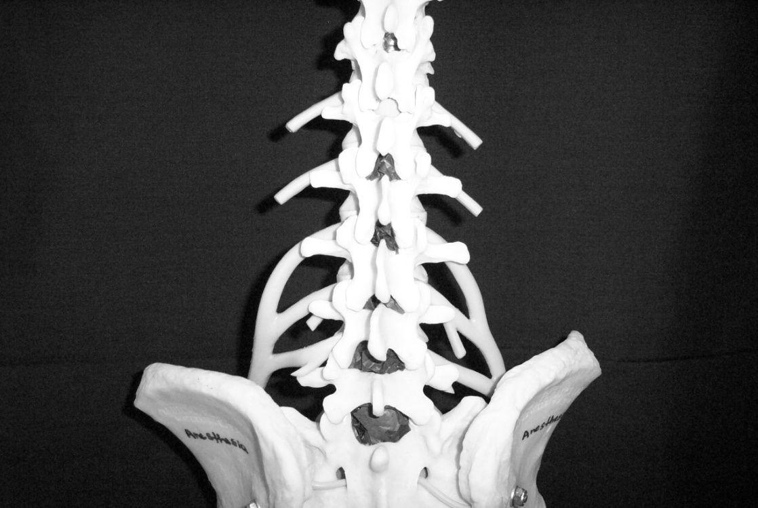
L 2
L 5
Interlaminar spaces are larger in the lower lumbar region. If an anesthesia provider finds it challenging at one level it is important to remember that moving down one space may provide a larger space.

Slide 14
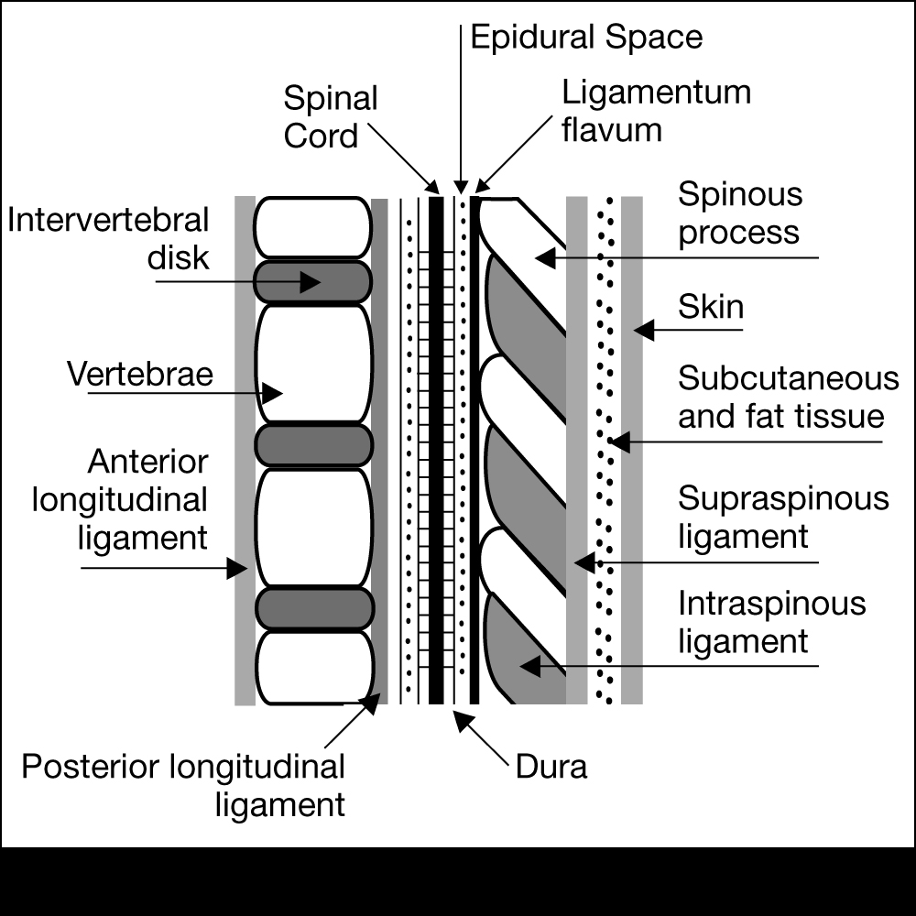
Ligaments that support the vertebral column
Ventral side:
Anterior and posterior longitudinal ligaments
Dorsal side:
Important since these are the structures your needle will pass through!

Slide 15
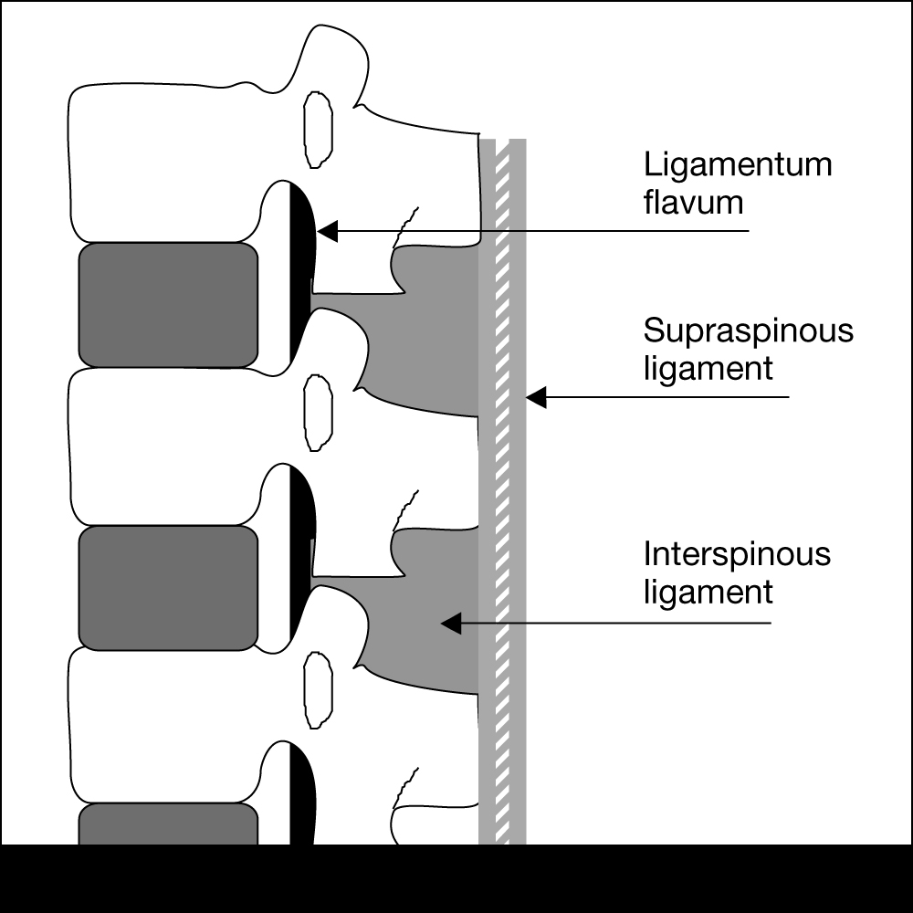
Ligaments are identified by tactile sensation (feel)
Dorsal ligaments transversed during neuraxial blockade. With experience the anesthesia provider will be able to identify anatomical structures by “feel”.

Slide 16
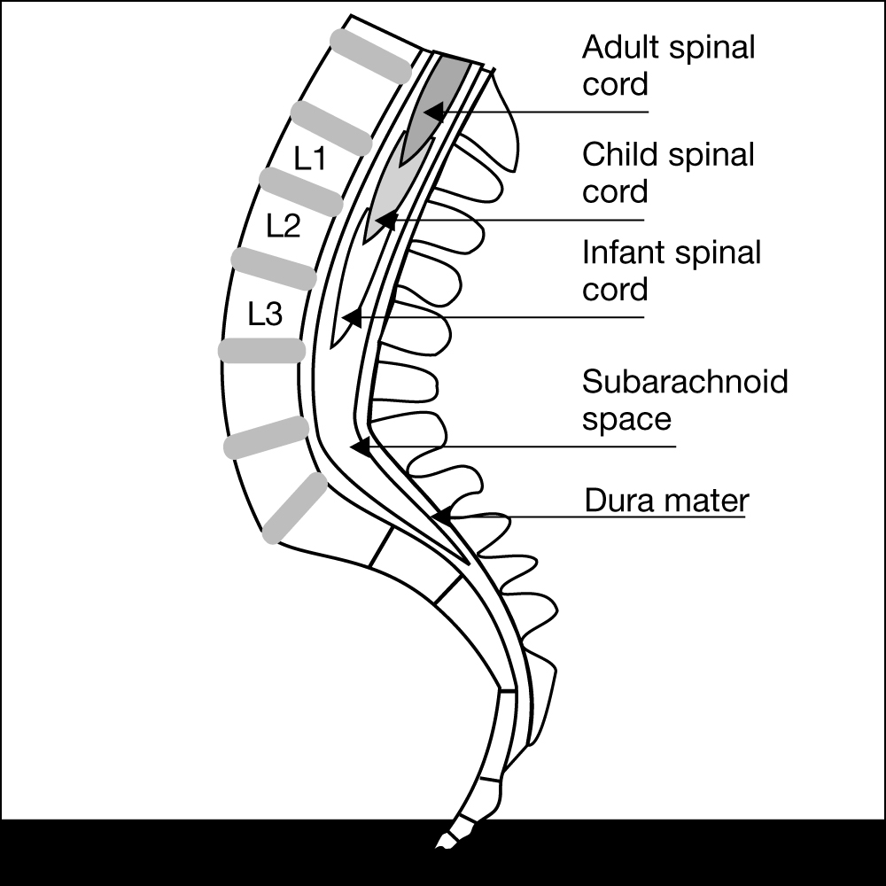
Termination of Spinal Cord
In adults usually ends at L1.
Infants L3
There are anatomical variations. For most adults it is generally safe to place a spinal needle below L2.

Slide 17
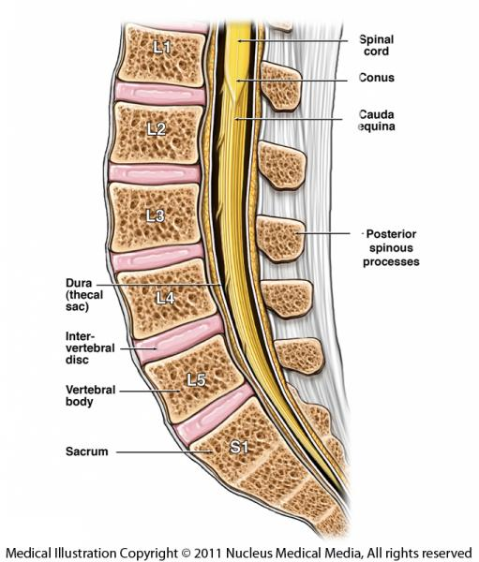

Slide 18
Surface Anatomy and Landmarks

Slide 19
Locating prominent cervical and thoracic vertebrae
C2 is the first palpable vertebrae
C7 is the most prominent cervical vertebrae
With the patients arms at the side the tip of the scapula generally corresponds with T7

Slide 20
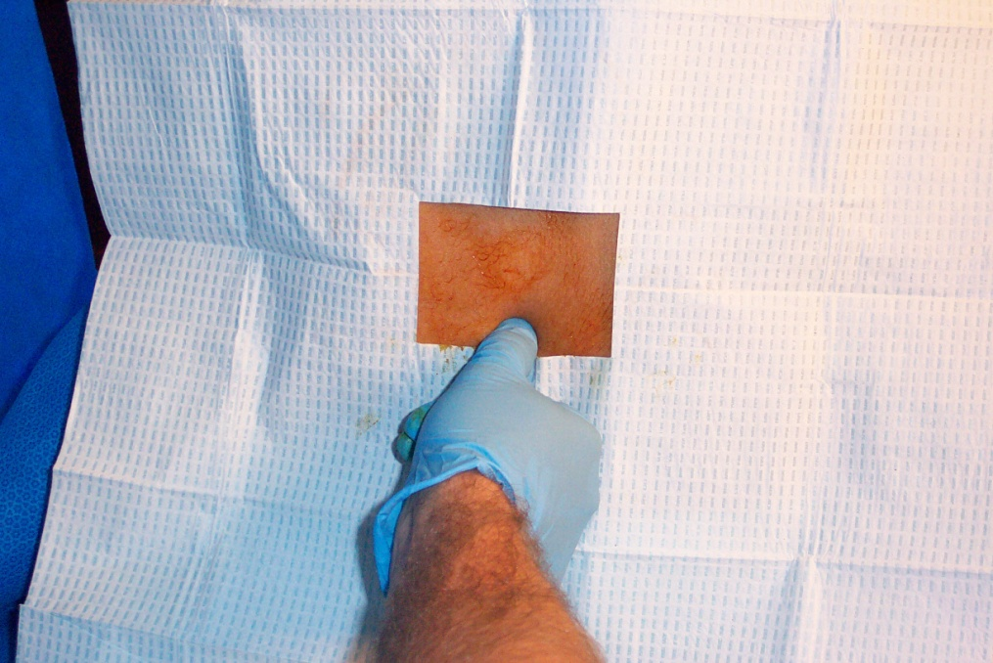
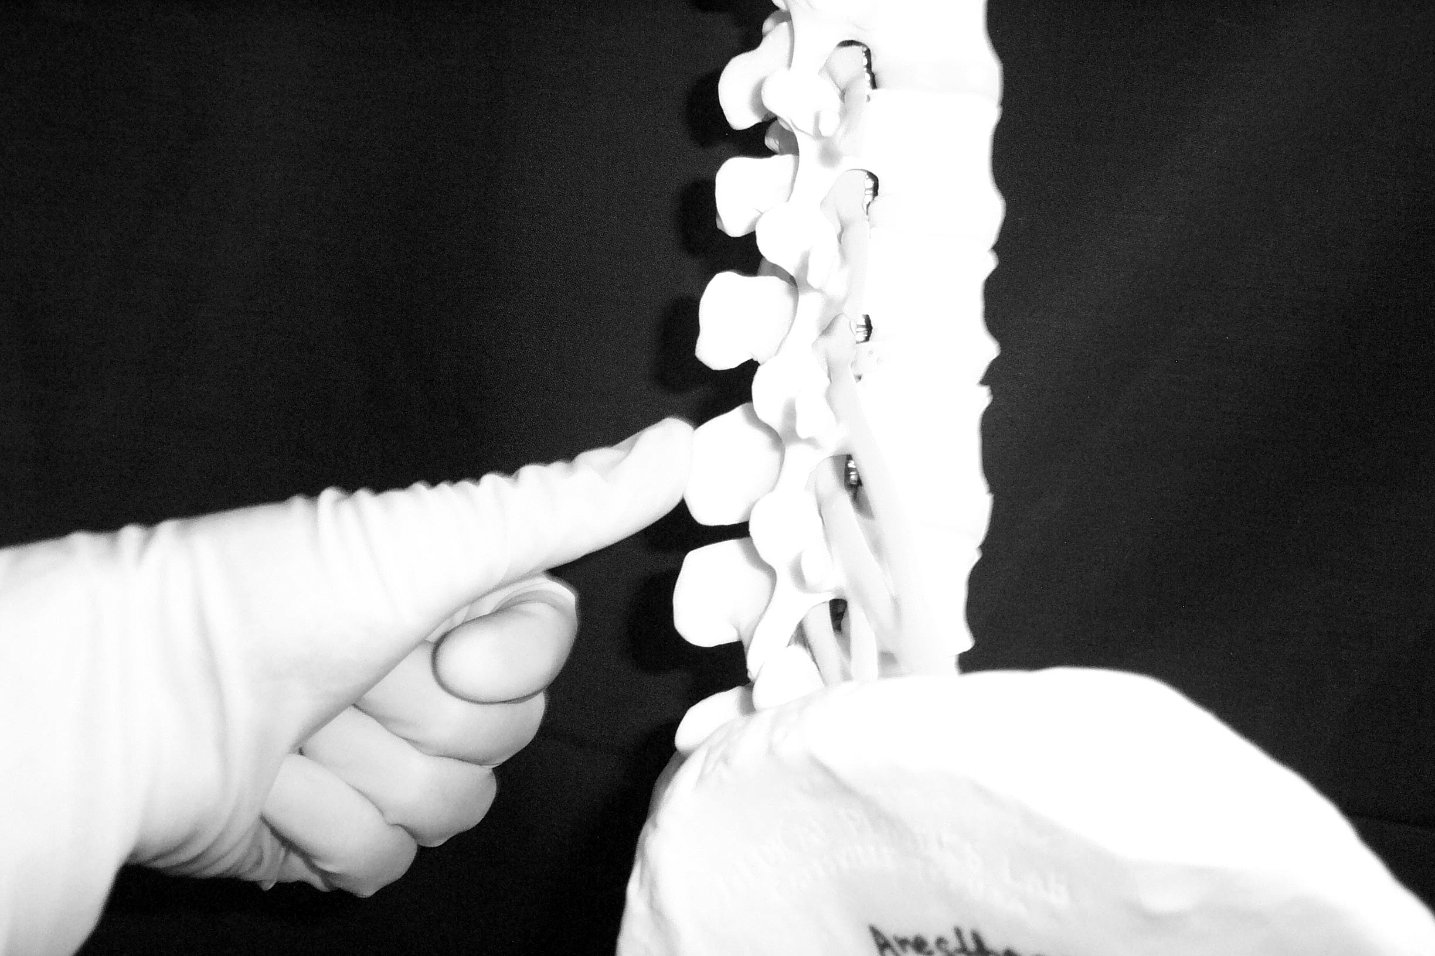
Palpation of Spinous Process

Slide 21
Spinous Processes
Generally are palpable to help identify the midline
If unable to palpate the spinous process one can look at the upper crease of the buttocks and line up the midline as long as there is no scoliosis or other deformities of the spine

Slide 22
What is Tuffier’s Line?
A line drawn between the highest points of both iliac crests will yield either the body of L4 or the L4-L5 interspace.

Slide 23
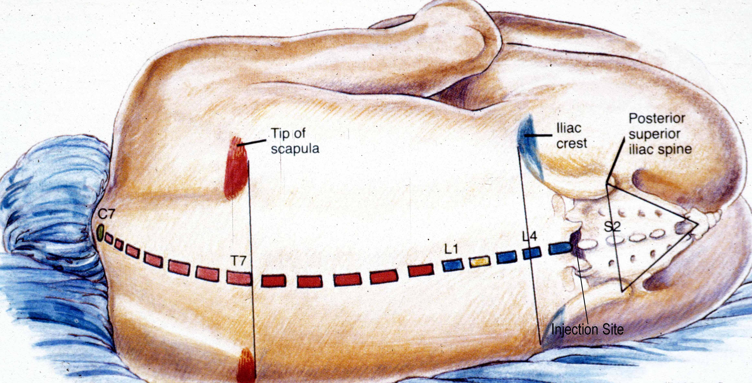

Slide 24
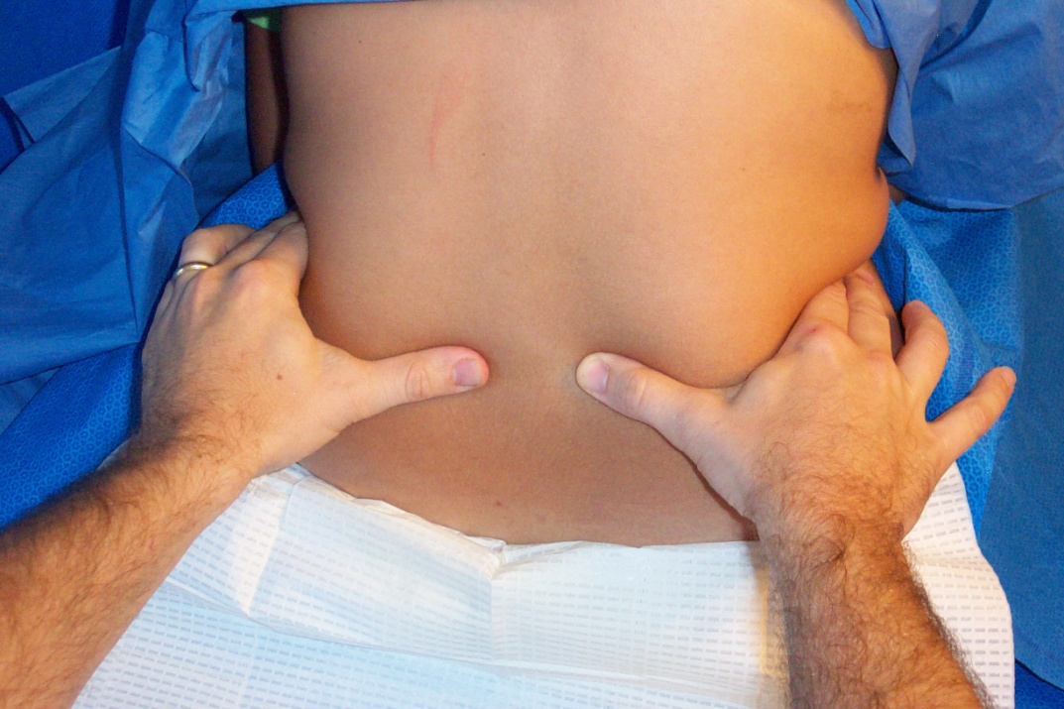
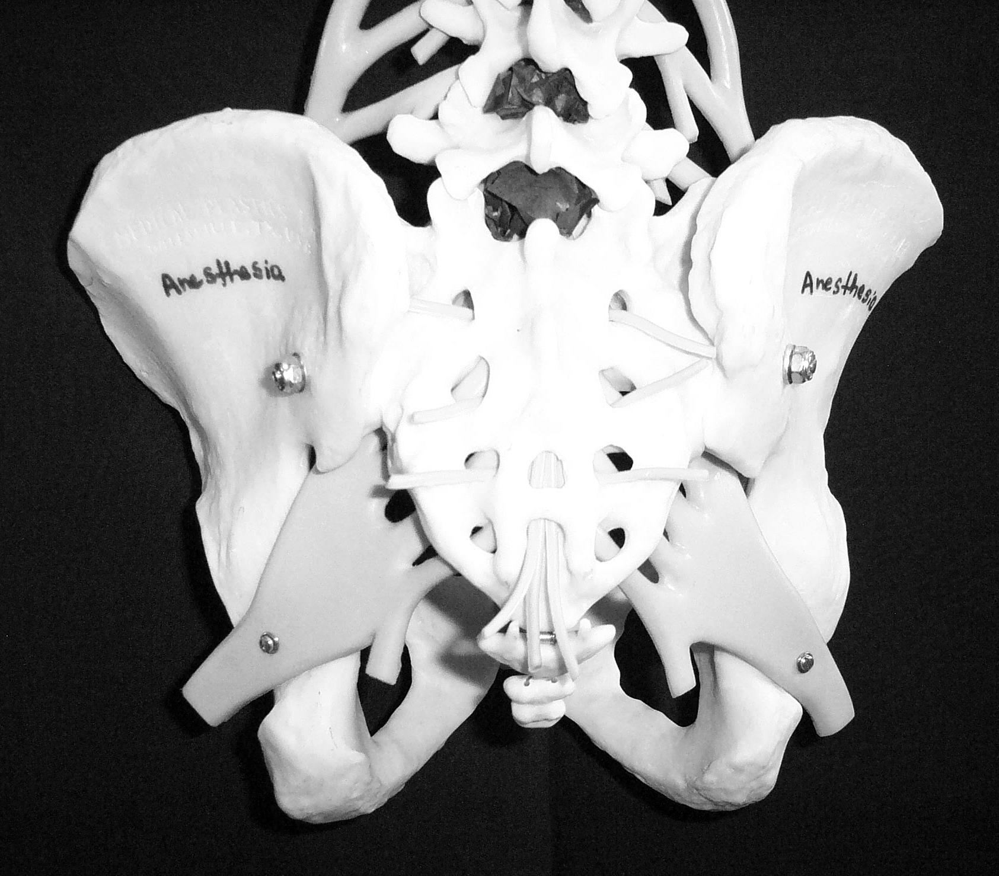

Slide 25
Anatomical Considerations of the Spinal Cord and Neuraxial Blockade.

Slide 26
The Subarachnoid Space is a continuous space that contains
CSF
Spinal cord & nerves

Slide 27
CSF
Clear fluid that fills the subarachnoid space
Total volume in adults is ~100-150 ml (2 ml/kg)
Volume found in the subarachnoid space is ~45 ml
Continually produced at a rate of 450 ml per 24 hour period replacing itself 3-4 times

Slide 28
CSF
Reabsorbed into the blood stream by arachnoid villi.
Specific gravity is between 1.003-1.007 (this will play a crucial role in the baracity of local anesthetic that one chooses)
CSF plays a role the patient to patient variability in relation to block height and sensory/motor regression (80% of the patient to patient variability)
Body wt is the only measurement that coincides with CSF volume (this becomes important in the obese and pregnant).

Slide 29
Membranes that surround the spinal cord
Pia mater- highly vascular, covers the spinal cord and brain, attaches to the periosteum of the coccyx ( Filum terminalis)
Arachnoid mater- non vascular and attached to the dura mater. Principal barrier to the migration of medications in and out of the CSF.
Dura mater (“tough mother”)- extension of the cranial dura mater, extends from the foramen magnum to S2.

Slide 30
Filum Terminale
An extension of the pia mater that attaches to the periosteum of the coccyx.

Slide 31
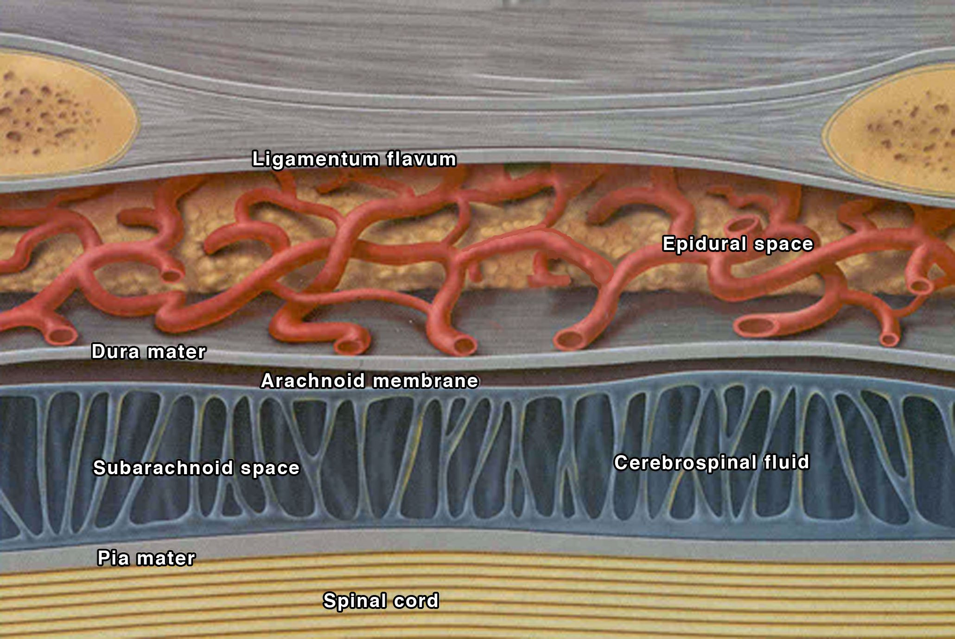

Slide 32
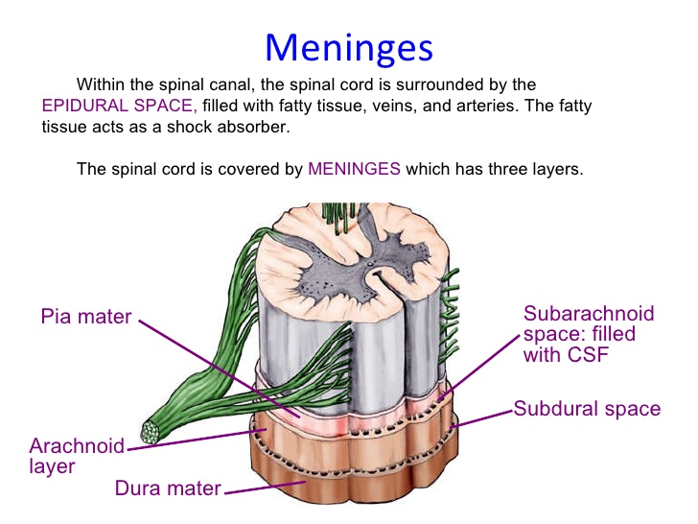

Slide 33
Epidural Space Anatomy

Slide 34
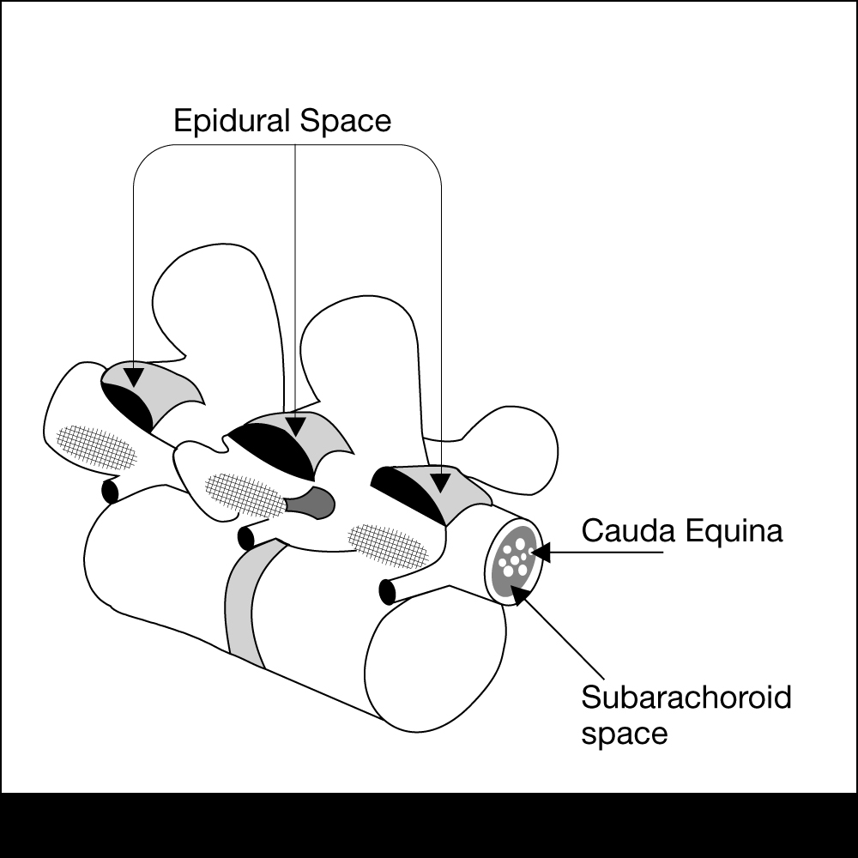
Epidural Space Anatomy
Extends from the formen magnum to the sacral hiatus

Slide 35
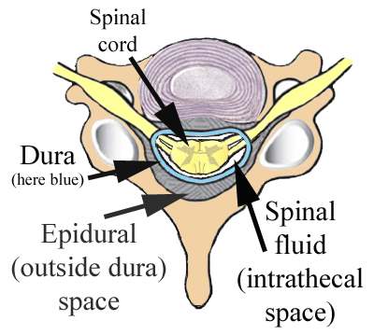
Epidural Space Anatomy
The epidural space surrounds the dura mater anteriorly, laterally, and most importantly to us posteriorly.

Slide 36
The Bounds of the Epidural Space are as follows:
Anterior- posterior longitudinal ligament
Lateral- pedicles and intervertebral ligaments
Posterior- ligamentum flavum

Slide 37
Ligamentum Flavum
Posterior to the epidural space
Extends from the foramen magnum to the sacral hiatus
Distance from skin to ligament varies from 3-8 cm in the lumbar area. It is 4 cm in 50% of the patients and 4-6 cm in 80% of the patients.
Thickness of the ligamentum flavum also varies. In the thoracic area it can range from 3-5 mm and in the lumbar it can range from 5-6 mm

Slide 38
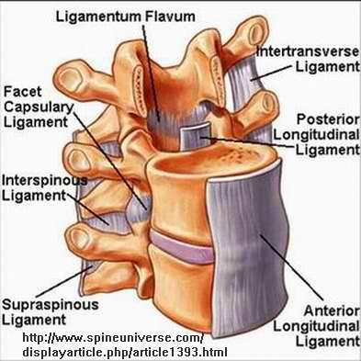

Slide 39
Contents of the Epidural Space
Fat
Areolar tissue
Lymphatics
Blood vessels including the Batson venous plexus

Slide 40
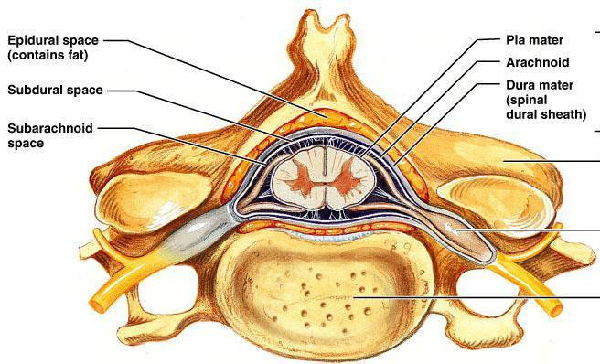

Slide 41
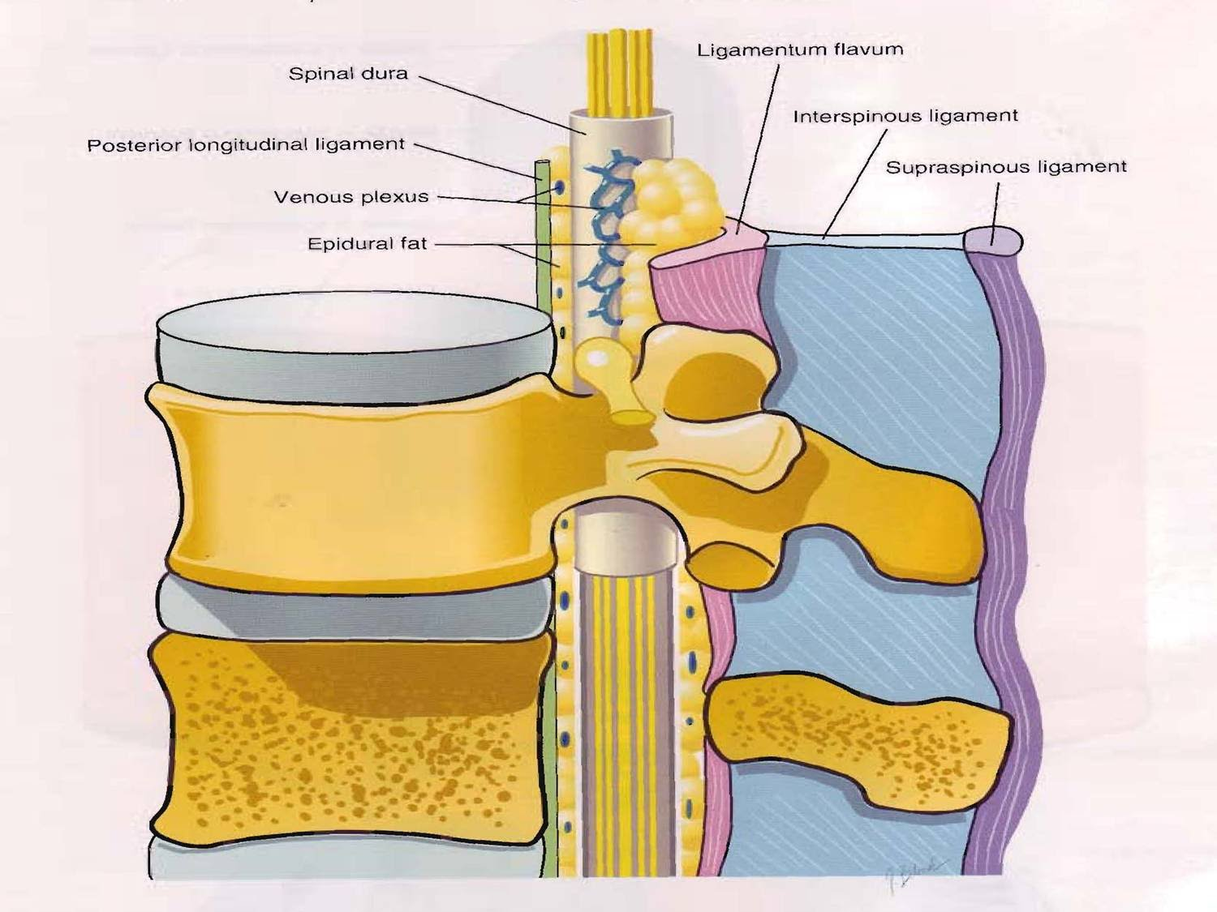

Slide 42
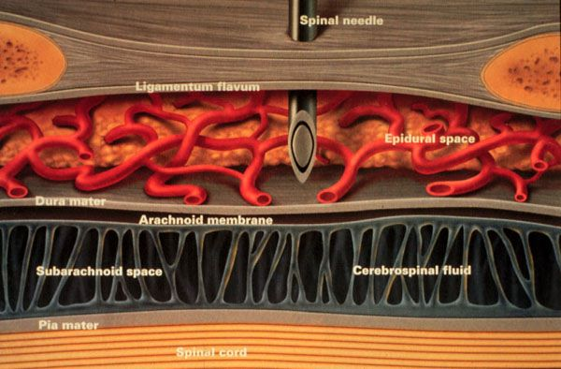

Slide 43
Definition
Spinal anesthesia :
Injection of small amounts ( 2-3 ml) of local anaesthetics into the CSF at the level below ( L2 ) ,where the spinal cord ends, anesthesia of the lower body part below the umbilicus is achieved.
Indication
Operations below the umbilicus: hernia repairs, gynaecological, urological operation, orthopedics,
Any operation on the perineum or genitalia.

Slide 44
Spinal Anesthesia
Contraindications
  Absolute:
    Refusal
    Infection
    Coagulopathy & anticoagulated patient
    Severe hypovolemia
    Increased intracranial pressure
    Severe aortic or mitral stenosis
  Relative:
    Use your best judgment

Slide 45
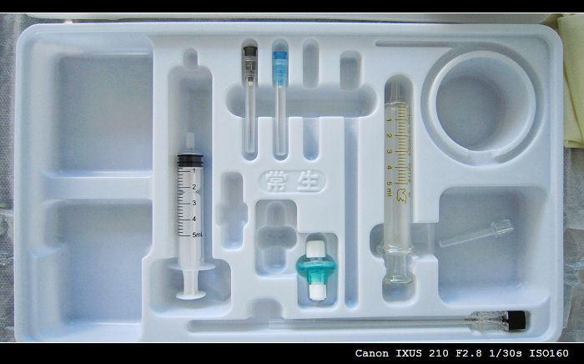
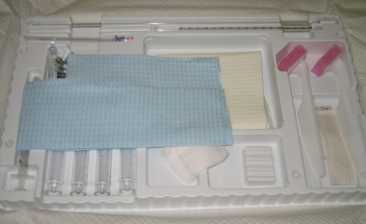
Sterility

Slide 46
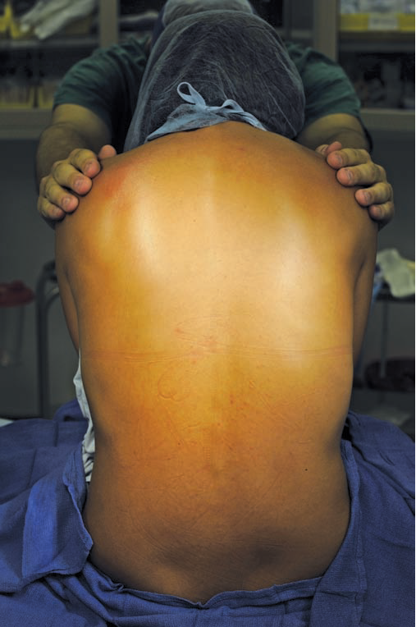
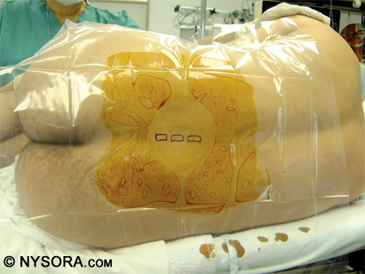
Sitting Vs. Lateral decobitus

Slide 47
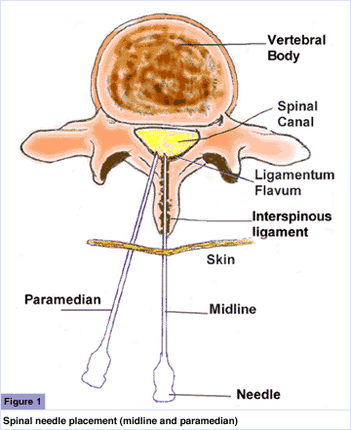
Spinal Technique
Midline Approach
  Skin
  Subcutaneous tissue
  Supraspinous ligament
  Interspinous ligament
  Ligamentum flavum
  Epidural space
  Dura mater
  Arachnoid mater
Paramedian or Lateral Approach
  Same as midline excluding supraspinous & interspinous ligaments

Slide 48
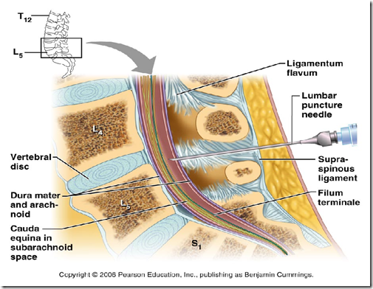

Slide 49
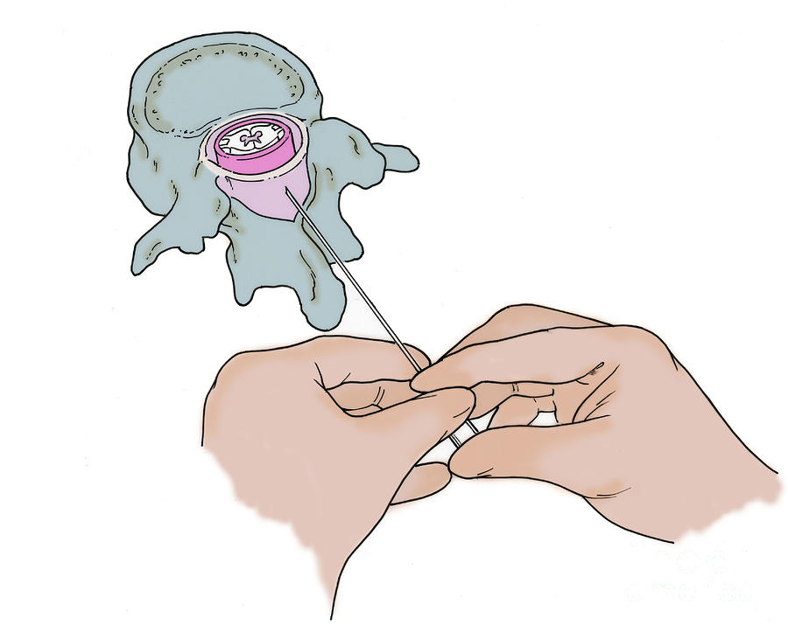

Slide 50
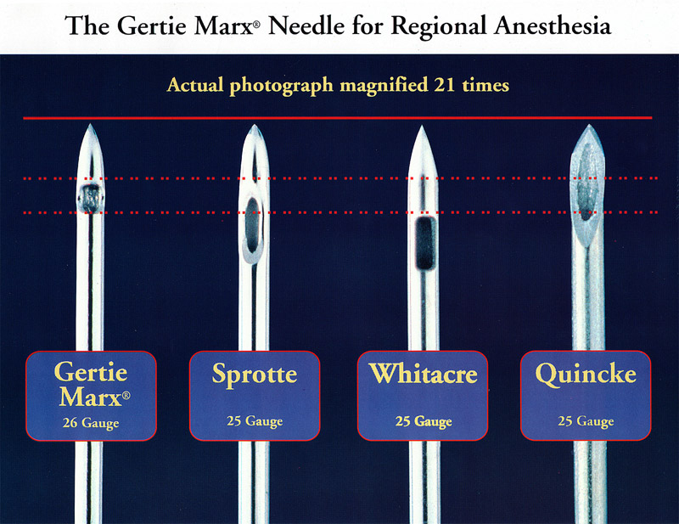
Spinal needles type

Slide 51
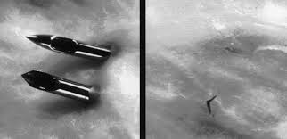
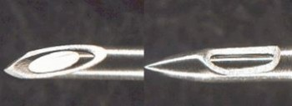

Slide 52
PDPH
Develop 12-48 hours after spinal anesthesia.
Headache improve when lying supine.

Slide 53
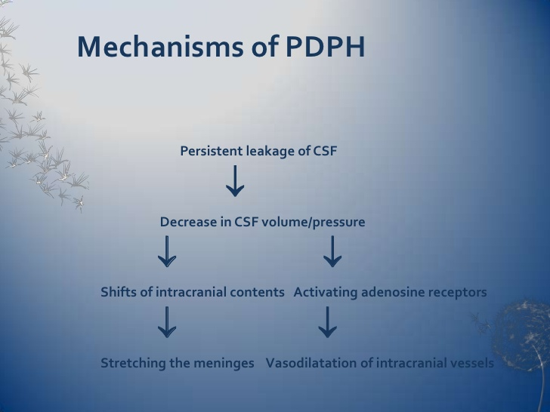

Slide 54
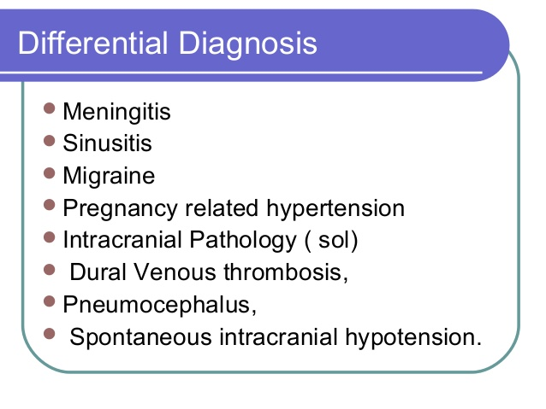

Slide 55
PDPH; Treatment
Conservative.
Epidural blood patch.

Slide 56
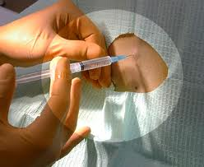
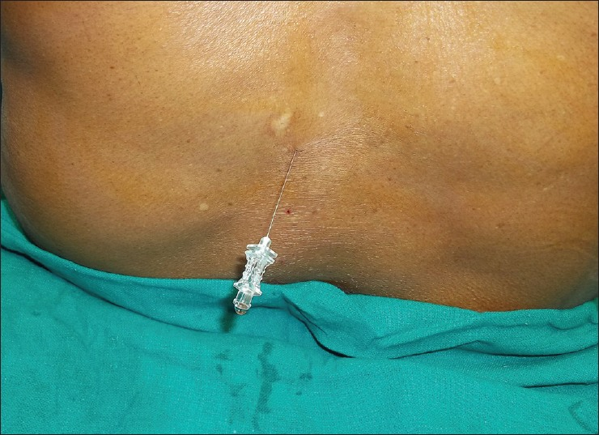
Spinal anesthesia; single shot technique

Slide 57
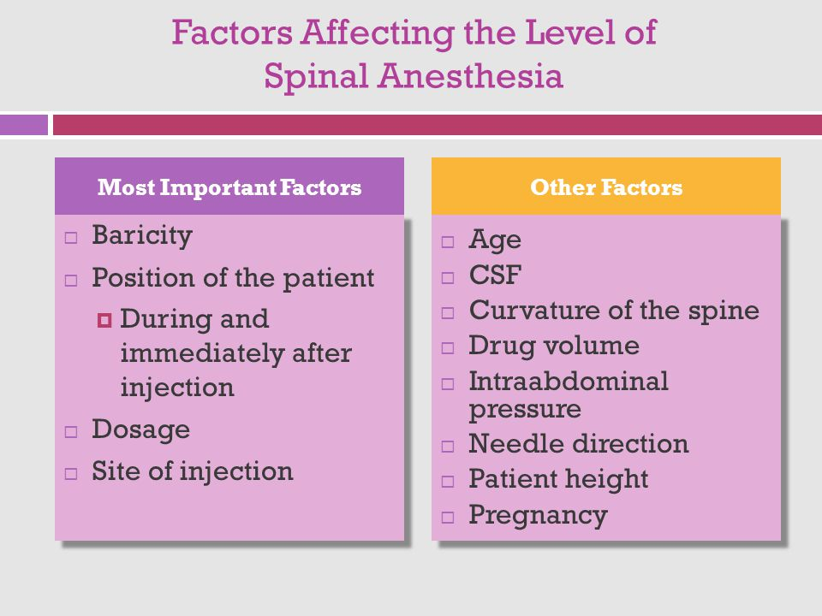

Slide 58
Baricity( a concern only in spinal anesthesia)
Hyperbaric
  Typically prepared by mixing local with dextrose
  Flow is to most dependent area due to gravity
  Very predictable spread
Hypobaric
  Prepared by mixing local with sterile water
  Flow is to highest part of CSF column
Isobaric
  Neutral flow that can be manipulated by positioning
  Increased dose has more effect on duration than dermatomal spread
Note: Be cognizant of high & low regions of spinal column

Slide 59
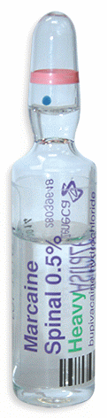
Hyperbaric bupivacaine is prepared by mixing it with dextrose
Sterile, clear
Preservative free
3 ml ampoules
See the expiry date
Be sure it is bupivacaine??

Slide 60
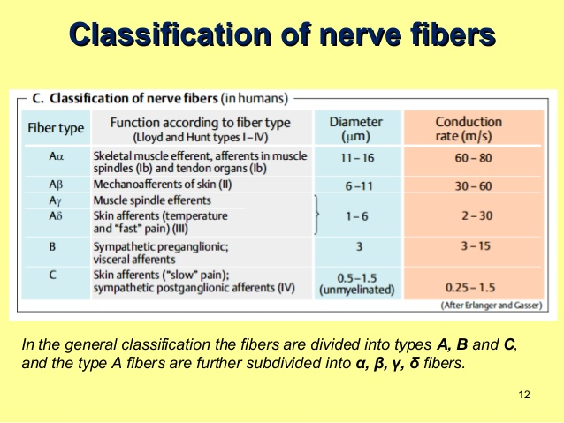
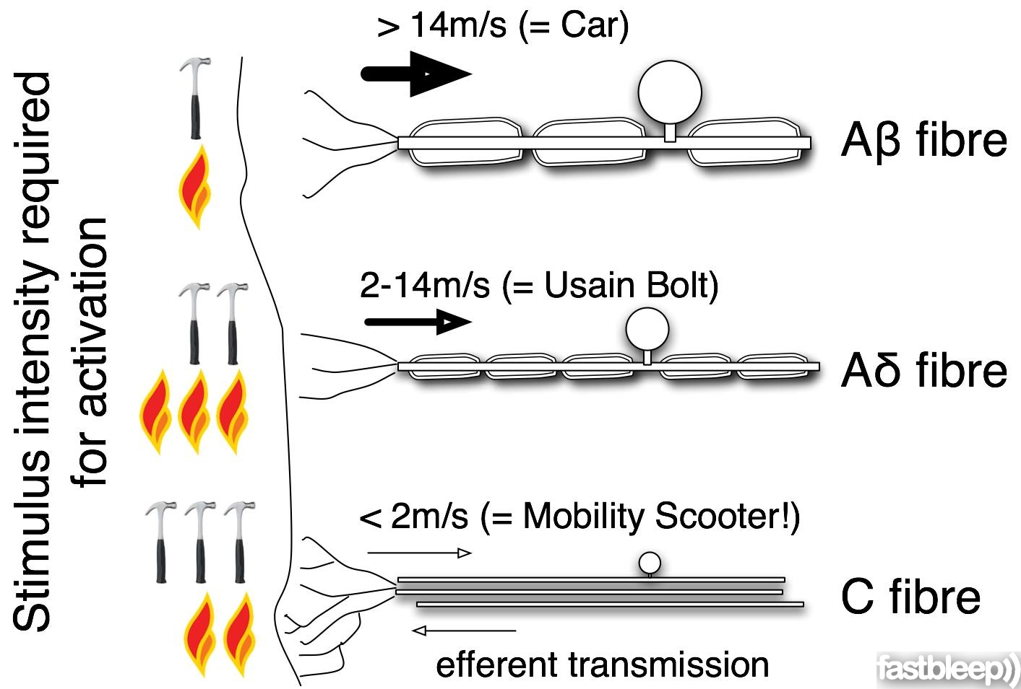

Slide 61
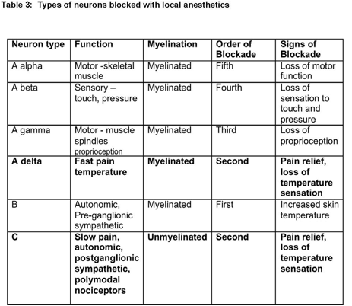

Slide 62
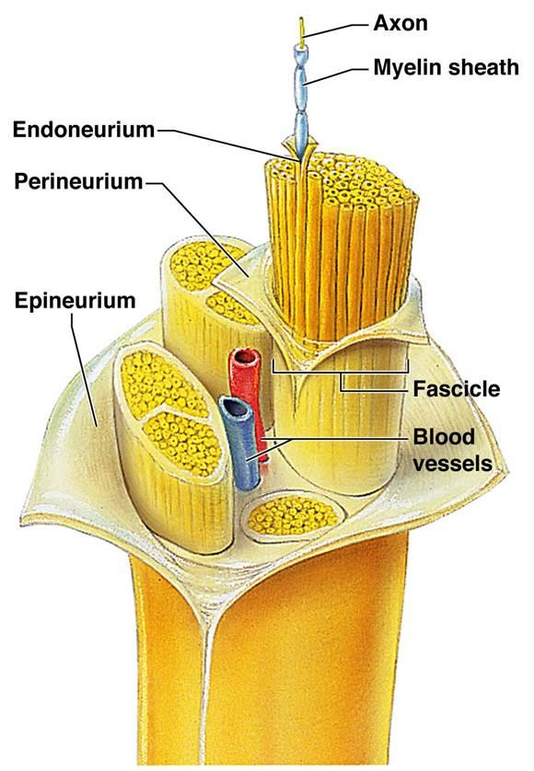

Slide 63
Sympathetic, Sensory & Motor Blockade
Spinal Injection
  Sympathetic block is 2 dermatomes higher than sensory block
  Motor block is 2 dermatomes lower than sensory block
  Detect the sensory level by cold sensation test,
  ( Ice cubes).
  Block order B> C=A delta> A beta>A alfa

Slide 64
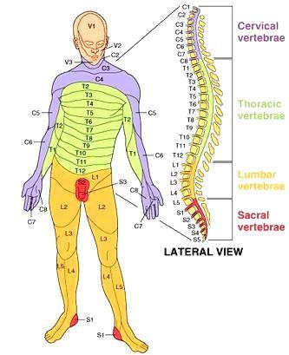
Dermatomes of the Body

Slide 65
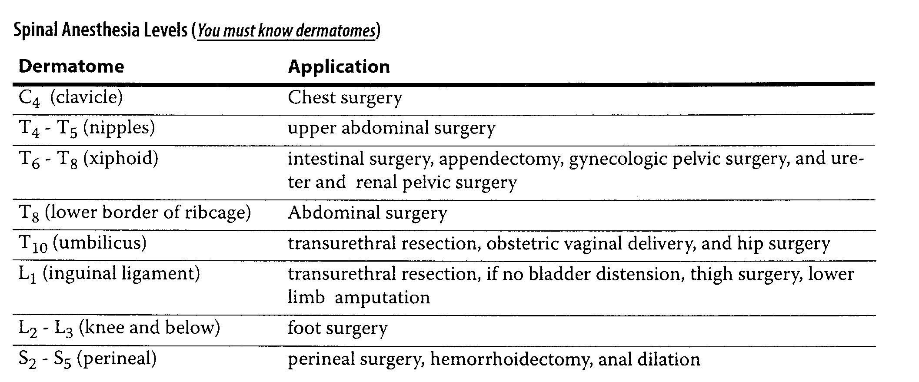
Spinal Anesthesia Levels

Slide 66
Spinal Anesthesia
Complications
  Failed block
  Back pain (most common)
  Spinal head ache
    More common in women ages 13-40
    Larger needle size increase severity
    Onset typically occurs first or second day post-op
    Treatment:
      Bed rest
      Fluids
      Caffeine
      Blood patch

Slide 67
Spinal Anesthesia
Complications
  Epidural hematoma
  Epidural abscess
  Meningitis
  Cauda equina
  Neurological deficit
  TNS
  Bradycardia--- Cardiac arrest

Slide 68
Hypotension
Treatment
  Best way to treat is physiologic not pharmacologic
  Primary Treatment
    Increase the cardiac preload
      Large IV fluid bolus within 30 minutes prior to spinal placement, minimum 1 liter of crystalloids
  Secondary Treatment
    Pharmacologic
      Ephedrine

Slide 69
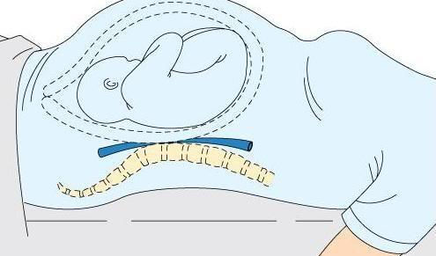
IVC syndrome ( pregnancy)

Slide 70
EPIDURAL ANESTHESIA
EPIDURAL ANESTHESIA

Slide 71
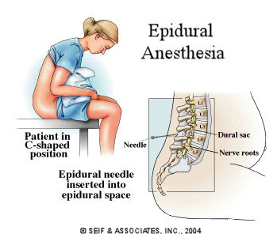
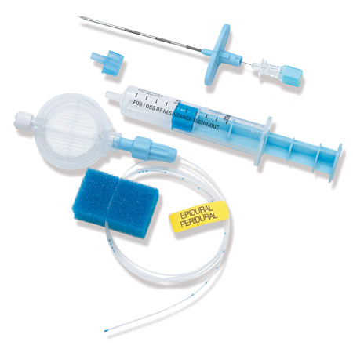
Epidural anesthesia; catheter technique

Slide 72

Isobaric bupivacaine (20 ml)

Slide 73

Slow onset (30 min), less dense block

Slide 74


Touhy needle

Slide 75

Loss of resistance technique

Slide 76

Catheter technique

Slide 77
Epidural Test dose
After checking the catheter
Careful aspiration, NO blood or CSF
3 ml Lidocaine 1.5% mixed with epinephrine 5 micg/ml
With careful monitoring, give the epidural injection15-20 ml bupivacaine in allequete.

Slide 78



Slide 79


Local anesthetics

Slide 80


Slide 81


Slide 82


Slide 83

Mechanism of Action
Un-ionized local anesthetic defuses into nerve axon & the ionized form binds the receptors of the Na channel in the inactivated state

Slide 84
Duration of Action
  The degree of protein binding is the most important factor
  Lipid solubility is the second leading determining factor
  Greater protein bound + increase lipid solubility = longer duration of action

Slide 85
Toxicity & Allergies
  Esters: Increase risk for allergic reaction due to para-aminobenzoic acid produced through ester-hydralysis
  Amides: Greater risk of plasma toxicity due to slower metabolism in liver

Slide 86
LAST
Exceeding the maximum save dose( Bupivacaine 2mg/kg), Lidocaine (5mg/kg)
Intravascular injection

Slide 87

LAST(CNS)

Slide 88
LAST (CVS)
Tachycardia & Hypertension
Hypotension
Wide QRS
VF
Cardiac arrest

Slide 89

LAST; Management

Slide 90
References
Brown, D.L. (2005). Spinal, epidural, and caudal anesthesia. In R.D. Miller Miller’s Anesthesia, 6th edition. Philadelphia: Elsevier Churchill Livingstone.
Burkard J, Lee Olson R., Vacchiano CA. (2005) Regional Anesthesia. In JJ Nagelhout & KL Zaglaniczny (eds) Nurse Anesthesia 3rd edition. Pages 977-1030.
Kleinman, W. & Mikhail, M. (2006). Spinal, epidural, & caudal blocks. In G.E. Morgan et al Clinical Anesthesiology, 4th edition. New York: Lange Medical Books.
Warren, D.T. & Liu, S.S. (2008). Neuraxial Anesthesia. In D.E. Longnecker et al (eds) Anesthesiology. New York: McGraw-Hill Medical.

