Slide 1
PERIOPERATIVE FLUID THERAPY
Dr. Abdullah Alharbi m.b.b.s, fanzca
Consultant and assistant professor of anaesthesia

Slide 2
Lecture Objectives
To understand body fluid composition.
To understand the basic physiologic principles to guide fluid therapy.
To know the available types of Intravenous fluid.
To know the advantages and disadvantages of each type.
To identify perioperative factors which affect the patient fluid requirements.
To know the different types of blood and blood products.

Slide 3
Water is the most abundant component of the human body~ 60%.

Slide 4
Total Body Water (TBW) Volume
The body of a 70 kg (male) contains nearly 42 L of water.
60% body weight in males
50% body weight in females
80% body weight in new born

Slide 5
Body Fluid Compartments
Total Body Water 60% (42 L)
Intracellular fluid 2/3 of TBW
Interstitial fluid
2/3 of ECF
Plasma
1/3 of ECF
~ 28 L
~ 10.5 L
~ 3.5L
Extracellular Fluid 1/3 TBW (14L)

Slide 6
Composition of body fluid compartments:
High K+ 159
High Mg++ 40
Low Na+ 10
Low Ca++ < 1
High Proteins ++ 45
High Na+ 145
Low K+ 4.3
Low Proteins 0.1
Low Mg 1.1
Ca 2.4
Cell wall :Phospholipid bilayer
Capillary endothelium
High Na+ 145
Low K+4.3
Low Mg 1.1
High Proteins 15
Ca 2.4

Slide 7
What controls body fluid content and composition?
Physical sensors:
Stretch receptors and baroreceptors: Volume, Venous return and cardiac output.
Chemical sensors:
Osmolarity through osmo-receptors.
Total body water is controlled primarily through controlling Na+ content i.e. osmolarity.

Slide 8
Neuro endocrine Regulation Process:
Reduced volume → low VR→ less stretch→ low ANP and BNP.
Low volume → increased Renin, ADH and Noradrenaline.
Renin- sympathetic release → reduced Na+ excretion in kideny, and to water preservation.
Renin → Angiotensin II and aldosterone release, both increase Na reabsorption.
High osmolarity→ thirst stimulation→ more water intake.

Slide 9
Fluid movement From IV to ECF : Starling Forces

Slide 10
Arteriole
Interstitial compartment
HP
COP
COP
HP
Venule
HP > COP
Net: Filtration
COP> HP
Net:Resorption
Lymph

Slide 11
Fluid movement between ISF and ICF
High K+ 159
High Mg++ 40
Low Na+ 10
Low Ca++ < 1
High Proteins ++ 45
High Na+ 145
Low K+ 4.3
Low Proteins 0.1
Low Mg 1.1
Ca 2.4
The membranes separating fluid compartments , allow free passage of water but not solutes. (semipermeable).
Controller: Osmolarity and Tonicity.
High Na+ 145
Low K+4.3
Low Mg 1.1
High Proteins 15
Ca 2.4

Slide 12
FLUID THERAPY

Slide 13
History of fluid therapy
Blackfan and Maxcy in 1918 gave 0.8% saline by intraperitoneal injection to nine infants with dehydration and all recovered.
In 1957, Holliday and Segar described the 4-2-1 rule for fluid maintenance therapy.

Slide 14
Why do we need to give fluids?
Perioperative fluid therapy ensures:
Adequate organ perfusion( O2 )
Prevent catabolism
Maintain electrolytes and pH balance.

Slide 15
Goals of fluid Therapy
Hypovolumia
Volume overload
Overt Hypoperfusion
Cellular Hypoperfusion
Adequate Perfusion

Slide 16
Clinical indications for fluid therapy:
Routine maintenance( water, electrolyte, carbohydrate)
Fluid resuscitation ; ( Hypovolemic, distributive shock)
Replacements(of high output loss)

Slide 17
Assessment of volume status
History and Examination:
Intake, Pulse, BP, CRT, Mucous membranes, skin turgor,JVP, Pulmonary/Peripheral oedema
Urine output
Input/output charts.
Fluid responsiveness:
Fluid challenge, Passive leg raising test.

Slide 18
Assessment of volume status
Laboratory:
CBC, Hb,Hct,Urea,Creatinine, electrolytes, Lactate,Acid base balance
Advanced monitoring:
Central Venous Pressure, Echocardiography AND Doppler.
Pulmonary Artery Catheter;Cardiac output AND PCWP.
Pulse Pressure Variation Index, Plethsmography variation index
Stroke volume variation index.

Slide 19
Basal requirement for adults
25-30 ml/kg/day H2O
1 mMol/kg K+, Na+, and Cl-
50 -100 g/day Glucose to limit starvation ketosis.

Slide 20
1- Maintenance Fluid Requirements
4-2-1 Rule
4 ml/kg/hr for the first 10 kg of body weight
2 ml/kg/hr for the second 10 kg body weight
1 ml/kg/hr subsequent kg body weight

Slide 21
Factors which guide fluid therapy
1- Maintenance (Basal) fluid requirement.
2- Fasting deficits.
3- Third space losses/ Insesnible loss
4- Blood loss
5- Special additional losses: , Urine, Vomiting, diarrhea, Stomas, NGT, burns.

Slide 22
2- NPO and other deficits
NPO deficit = Number of hours NPO x maintenance fluid requirement.
Measurable fluid losses, e.g. urine output, NG suctioning, vomiting, ostomy output, biliary fistula and tube.

Slide 23
3- Third Space Losses
Capillary leakage and extravasation of protein rich into interstitial spaces of soft tissues, organs and deep cavities.
Typically occurs during the first 72 hours.
Hypoalbuminemia , contribute to third spacing.
Volume depends on location and duration of surgical procedure, amount of tissue trauma, ambient temperature, room ventilation.

Slide 24
Estimation of Third Space Losses
Superficial surgical trauma: 1-2 ml/kg/hr
Minimal Surgical Trauma (Laparoscopy): 3-4 ml/kg/hr
Moderate Surgical Trauma: 5-6 ml/kg/hr
Severe surgical trauma: 8-10 ml/kg/hr.

Slide 25
4- Blood Loss
Hard to estimate accurately.
Amount of blood in suction tubes, drains, gauzes.
Change in Hb and Hct.
Hemodynamic change.

Slide 26
Example
62 y/o male, 70 kg, for laparoscopic hemicolectomy.
NPO from 2200 no IVF given preoperatively.
Surgery started at 0800 until 11 am.
What is the estimated intraoperative fluid requirement?

Slide 27
Example (cont.)
Maintenance: 110 x 3hrs = 330mls
Fluid deficit (NPO): 110 x 10 hrs = 1100 ml .
Third Space Losses: 3ml/kg/hr x 3 hrs = 630 mls
Total = 330 +1100+ 630 = 2060 mls

Slide 28
Available Fluid types

Slide 29
Crystalloids
0.9% NaCl
Balanced solutions
Lactated ringers, plasmalyte
D5% 0.9%NaCl
D5% 0.45%NaCl
D5% 0.225%NaCl
D5% W
Colloids
Albumin
Hetastarch
Gelfusins
Blood and Blood products
PRBC
Fresh Frozen Plasma
Platelet
Cryprecipitate

Slide 30
Water, and Dextrose
Isotonic Crystalloids
colloid
ICF compartment
ISF comp.
IVF comp.

Slide 31
Comparison of crytalloids
diagram

Slide 32
Term we need to understand:
Isotonic: Tonicity in clinical practice refers to Na+ concentration. Distribute evenly between IVF and ISF
Hypotonic: lower concentration of Na+ compared to the plasma: will cross cellular wall more and case cellular swelling.
Hypertonic: higher concentration of Na+ compared to the plasma. Will cause cellular shrinkage through increasing osmotic pressure in ECF.

Slide 33
Colloids
Fluids containing molecules sufficiently large enough to prevent transfer across capillary membranes.
Solutions stay in the space into which they are infused (remain intravascular).
Examples: hetastarch and albumin.

Slide 34
Advantages of Colloids:
Prolonged plasma volume support
Moderate volume needed
Minimal risk of tissue edema
Potentially enhanced microvascular flow

Slide 35
Disadvantages of Colloids:
Risk of volume overload
Adverse effect on hemostasis
Adverse effect on renal function
Anaphylactic reaction
Expensive

Slide 36
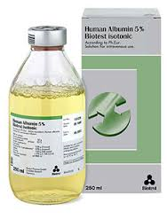
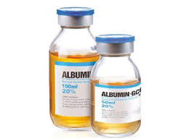
Albumin
Heat treated preparation of human serum. Comes in two preparations:
5% albumin( 50 g/l) 250 mls bottles, used for volume expansion, Half of infused volume will stay intravascular
20 % ( 200 mg/l) 50 ml bottle, used for treatment of hypoalbuminemia.

Slide 37
Transfusion Therapy

Slide 38
Transfusion Therapy
Indications for PRBC transfusion perioperatively:
Bleeding
Anaemia: Hb; threshold 7g/dl , 10 for patients with IHD.
? Haemoglobinopathies

Slide 39
Estimated total blood volume
Neonates - 90 ml/kg
Children - 80ml/kg
Adult males - 70ml/kg
Adult females - 60ml/kg

Slide 41
Blood Grouping
The most common systems are ABO and rhesus systems.

Slide 42
ABO system
A
A
B
A
B
AB
A
B
O
B
A
B
Anti
Anti
Anti
A
Anti

Slide 43
Blood transfusion tests:
Group and screen
Cross match

Slide 44
Group and Screen
Test for patient blood group and availability of antibodies.
Used when transfusion is blood is unlikely.

Slide 45
Cross Match
Donor’s erythrocytes (packed cells) incubated with recipients plasma
Agglutination Occurs if there is incompatibility.
Used when transfusion is likely or massive bleeding is potential.

Slide 46
Transfusion
Ideally, transfused PRBC should be crosshatched however:
Universal donor (O Neg) can be given in emergency when the blood group of the patient is not known.
If transfusion needed urgently for a patient with known blood gorup, then group specific PRBC should be given.
Crossmatch generally requires 35 to 45 min.

Slide 47
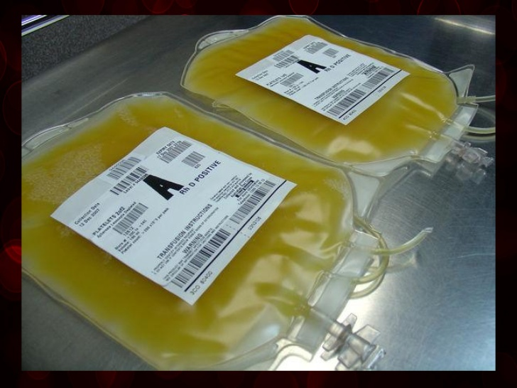
Platelet Concentrate
Thrombocytopenia,
Low platelet perioperatively, bleeding
During massive transfusion
1:1:1 ratio.

Slide 48
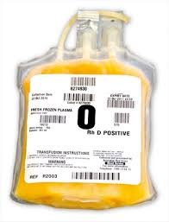
Plasma and FFP
Indications
Coagulation Factor deficiency, fibrinogen replacement, massive transfusion, emergency warfarin reversal.
Massive transfusion ratio 1:1:1

Slide 49
Crypreciptate
Derived from Plasma
Rich in fibrinogen, Von willebrand factor, factor VIII.
Used in cases of low fibrinogen levels and massive bleeding.

Slide 50
Transfusion Complications
Hemolytic Reactions (acute or delayed)
Febrile Reactions (FNHTR)
Allergic Reactions
TRALI
Coagulopathy with Massive transfusions
Infection

Slide 51
Transmission of Viral Diseases:
Transmission of Viral Diseases:
Hepatitis C; 1:30,000 per unit
Hepatitis B; 1:200,000 per unit
HIV; 1:450,000-1:600,000 per unit
22 day window for HIV infection and test detection
CMV may be the most common agent transmitted, but only effects immuno-compromised patients
Parasitic and bacterial transmission very low

Slide 52
What to do if an AHTR occurs?
STOP TRANSFUSION
ABC’s
Maintain IV access and run IVF (NS or LR)
Monitor and maintain BP/pulse
Give diuretic
Obtain blood and urine for transfusion reaction workup
Send remaining blood back to Blood Bank

Slide 53
Administering Blood Products
Consent necessary for elective transfusion
Unit is checked by 2 people for Unit #, patient ID, expiration date.
PRBC’s are mixed with saline solution (not LR)
Products are warmed mechanically and given slowly if condition permits
Close observation of patient for signs of complications
If complications suspected, infusion discontinued, blood bank notified, proper steps taken.

Slide 54
Blood preserving techniques

Slide 55
Autologous Blood donation
Pre-donation of patient’s own blood prior to elective surgery
1 unit donated every 4 days (up to 3 units)
Last unit donated at least 72 hrs prior to surgery
Reduces chance of hemolytic reactions and transmission of blood-bourne diseases
Not desirable for compromised patients.

Slide 56
Autotransfusion
Commonly known as “Cell-saver”
Allows collection of blood during surgery for re-administration
RBC’s centrifuged from plasma
Effective when > 1000ml are collected
Malignancy, Infections, are contraindications

Slide 57
Blood substitutes: oxygen carriers
Still under research.
Perfluorocarbons.
Stromal free hemoglobin.
Microencapsulated haemoglobin.

Slide 58
References and further readings:
Fundamentals of Anaesthesia, Tim Smith fourth ed. Cambridge.
Basic physiology for anaesthetists. David Chambers. Cambridge.
Rapid Review Physiology, T.Brown.Elsevier
Uptodate website.

