Slide 1
Safety in anesthesia
Dr. Jumana Baaj
Assist Professor , consultant anesthesia
19/03/2020

Slide 2
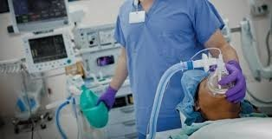
Anaesthesiology: A High risk Speciality
bbp0
Anaesthesiology is a high-risk speciality as compared with other
_{specialities in medicine}

Slide 3
Why?

Slide 4
Objective
Risk of anesthesia
Complication of anesthesia
How to implement anesthesia safety in OR
Error related to complication
factors threatening patient safety in the operation rooms
General safety strategies
Quality assurance
Crucial errors to know and avoid
Post operative pain
Hypothermia sequences

Slide 5
Risk of anesthesia
Anesthesia may contribute to death in about 1 per 10,000 to 1 per 200.000 anesthetics
Many other patients suffer serious and costly nonfatal injuries such as permanent neurologic damage (paraplegia and vegetative state)

Slide 6
Complication of anesthesia
Major Complications
  cardiac arrest
  Perioperative MI
  Aspiration
  Anaphylaxis
  Drug overdose
  Convulsion
  nerve pulses
  Organ injury
  Malignant hyperthermia
Minor complications
  Airway obstruction
  Postop nausea, vomiting
  Sore throat
  Hemodynamic instability
  Pneumonia
  Delirium
  Shivering

Slide 7
10 common causes of cardiac arrest under anesthesia
Drugs over dose & adverse events
Arrhythmia
Perioperative MI
Airway obstruction
High spinal
Lack of vigilance
Aspiration
Bleeding
Technical problem in anesthesia machine

Slide 8
Now we can see anesthesia event can cause severe results
we should find out factors threatening patient safety in the operation room and search for strategies to deal with them

Slide 9

What
makes
anaesthesia
safe
?

Slide 10
How to implement anesthesia safety in OR
Standardization drug dosage , dosing units , concentration , drugs preparation methods workplace design
Technology :drug identification and delivery system by utilization automated information system
Pharmacy : dedicate pharmacy resource to the OR
Culture: recognize and report the errors, learn from adverse events
www.apsf.org

Slide 11
Error related to complication
Technical accident
Equipment failure
Commincation error
Limitation of therapeutic standard
Limitation of available resources
Limitation of supervision

Slide 12
factors threatening patient safety in the operation rooms
Equipment Causes:
  Design flaw
  User error
  Malfunction
Strategies: pre-use checkout

Slide 13
factors threatening patient safety in the operation rooms
Equipment Causes:
  Design flaw
  User error
  Malfunction
Strategies: pre-use checkout

Slide 14
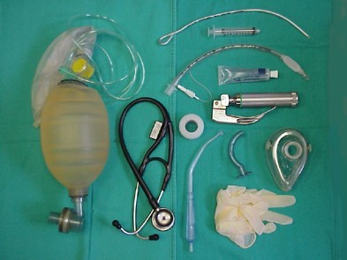
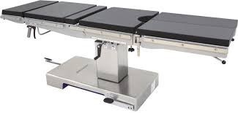
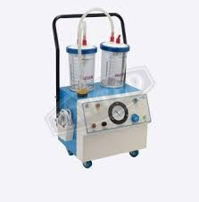
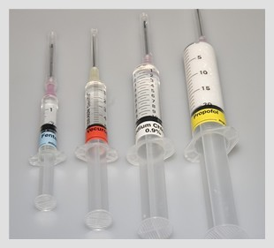
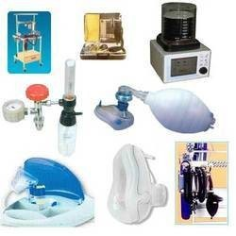
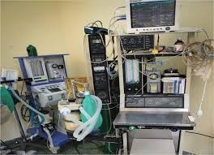
Check resources? Before starting Anaesthesia

Slide 15
Patient
Causes Underlying diseases:
  hyperthyroidism-thyroid storm, diabetes-ketoacidosis , hyperosmolar coma
  Allergic reaction to some drug
Strategies
  Preoperative evaluations

Slide 16

PRE ANESTHESIA CHECK
check patient risk factor
  ASA 1,2,3,4,5, e in case of emergency
  Airway assessment
  Aspiration risk
  Allergies
  Abnormal investigation
  Comorbidity
  Medication
  Formulate anesthesia plan

Slide 17
Causes for Accidents
There is a rarely a single cause for an accident

Slide 18
System error
System failures are the main reason for accidents
  check anesthetic machine
  oxygen supply
  A backup O2 tank
  Never shut down audible alarms (very important)
Emergency ventilation equipment

Slide 19
Human error
Human error contribute to 70 – 80 % of anesthetic incidents
Human error may involve :
  Misjudgments
  Failure to check equipment's
  Fault with technique
  Communication problem

Slide 20
Human error (anesthesia and surgeon)
Anesthetist and Surgeon Human factors affecting performance such as :
  fatigue, noise, boredom, long hours, hunger, tension
Human error is a strong contributor
  Deviations from accepted anesthesia practices.
  A lapse in vigilance and no attention to details
  Vigilance lets anesthetists find abnormal signs as early as possible
  Vigilance allows the anesthetist to remain aware of surrounding events and signals while performing other tasks
  Vigilance lets anesthetist find abnormal sign as early as possible
  Vigilance allows the anesthesit to remain

Slide 21
General safety strategies
A. Prepare a peri-operative plan
  Preoperative visit to the patient to let us know the patient’s condition in detail
  Make an anesthesia plan to let us know clearly how to perform the anesthesia and how to deal with possible crisis
B. Develop situational awareness
  Use a systematic approach to scanning the machine, monitors, patient, surgical field, and surroundings
  If one vital sign is anomalous, quickly assess the others while repeating the measurement and observing what is happening on the surgical field.
C. Verify observations, Cross-check observations, Assess co varying variables Review it with a second person

Slide 22
General safety strategies
D. Implement compensatory responses
If something wrong happens urgently,
  first implementing time-buying measures. e.g., increase the fraction of inspired oxygen when oxygen saturation falls; administer intravenous fluids or vasopressors when hypotension occurs).
  Then search out any correctable primary cause and treat it appropriately
E. Prepare for crisis
  If there is any critical events happened (cardiac arrest, malignant hyperthermia or difficult intubation), call for help early (WHY),
  then use accepted protocols for emergencies and resuscitation (e.g., advanced cardiac life support, malignant hyperthermia protocols).

Slide 23
General safety strategies
F. Enhance teamwork;
  enhance teamwork communication, address surgeons and nurses early in the case by names.
  Make requests and delegate tasks clearly and specifically by name (e.g., “Jack, do task X and tell me when task X is completed.”).
G. Compensate for stressors (Anesthetist is a stressful job).
  If you feel very tired, ask for a relief. Reduce various stressors: noise, fatigue, interpersonal tension, etc. optimize the work environment
Learn from close calls Every mistake is an opportunity to learn and improve.
  Analysis and feedback of adverse events to identify and assess system problems

Slide 24
Quality assurance
The aim is improving the quality of care and minimizing the risk of injury from anesthesia.
  Documentation Any adverse events should be reported truthfully, discussed, analyzed to identify causes and assess system problems. So we can learn from them and develop patterns to prevent recurrence.
  Standards and guidelines :Anesthesists should be aware of their institution's safety policies and procedures. These should include those for monitoring, response to an adverse event, handoff checklist, resuscitation protocols, perioperative testing, and any special procedures or practices for the use of drugs, equipment, and supplies.
  C. Safety training Anesthesia providers
    should obtain training in safety to learn and maintain basic skills.
    Simulation based training techniques

Slide 25
Crucial errors to know and avoid
A. Airway errors , patients receiving general anesthesia have no spontaneous respiration due to use of muscular relaxants, their respiration is controlled by machine via endo-tracheal tube.
  So we must ensure oxygen supply and avoid accidental extubation during surgeries (prone surgery) and transport.
  Once it happens, It can cause severe hypoxia and directly threaten the patient life.

Slide 26
How to avoid
Check the system and guarantee it to function well
Verify the position of end tracheal tube by auscultation for breath sounds bilaterally and detecting ETCO2 with proper fixation
Closely observe the vital signs
Be care when position the patient in prone position

Slide 27
B. Medication errors
  Administration of undiluted potassium by rapid intravenous infusion can cause ventricular fibrillation and cardiac arrest.
  Neostigmine given without an antimuscarinic drug can cause asystole, severe bradycardia and atrioventricular block and can be fatal.
  Succinylcholine can cause severe hyperkalemia and dysrhythmias, may trigger malignant hyperthermia.
  Medications to which a patient is allergic can cause anaphylaxis.
  Administering the wrong blood can cause an incompatibility reaction that can be fatal.

Slide 28
How to avoid
Be Familiar with the medication you use
know clearly its indications and contraindications.
Administrate the medication strictly according to instructions.
Know the patient’s history of allergy ,Cross-check blood type.

Slide 29
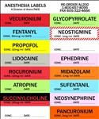
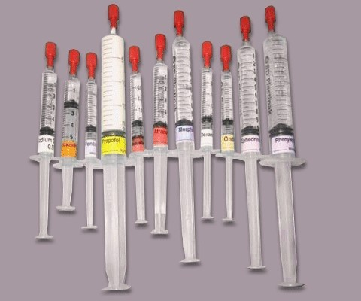
Medication
Human error: most common
All drugs should be clearly labelled; cross check before administering

Slide 30
Basic medication safety
Label all syringes
Eliminate look like ampoules
Read label before administration
Distinctive drug labels
Color coding
Barcoding

Slide 31
Procedure errors
Inadvertent intravascular injection of local anesthetics during a nerve block can cause neurologic and cardiac toxicity,
Avoid epidural hematoma (Hx of coagulopathy)
Air embolism : with insertion or removal of central line

Slide 32
How to avoid
Adequate preoperative evaluation
Follow standards giudelines
Vigilance

Slide 33
V. Standards and protocols
Standards for basic anesthetic monitoring
Qualified anesthesia personnel shall be present in the room throughout the course of all general anesthetics, regional anesthetics, and monitored anesthesia care
Continually evaluate the patient's respiration ,circulation and temperature

Slide 34
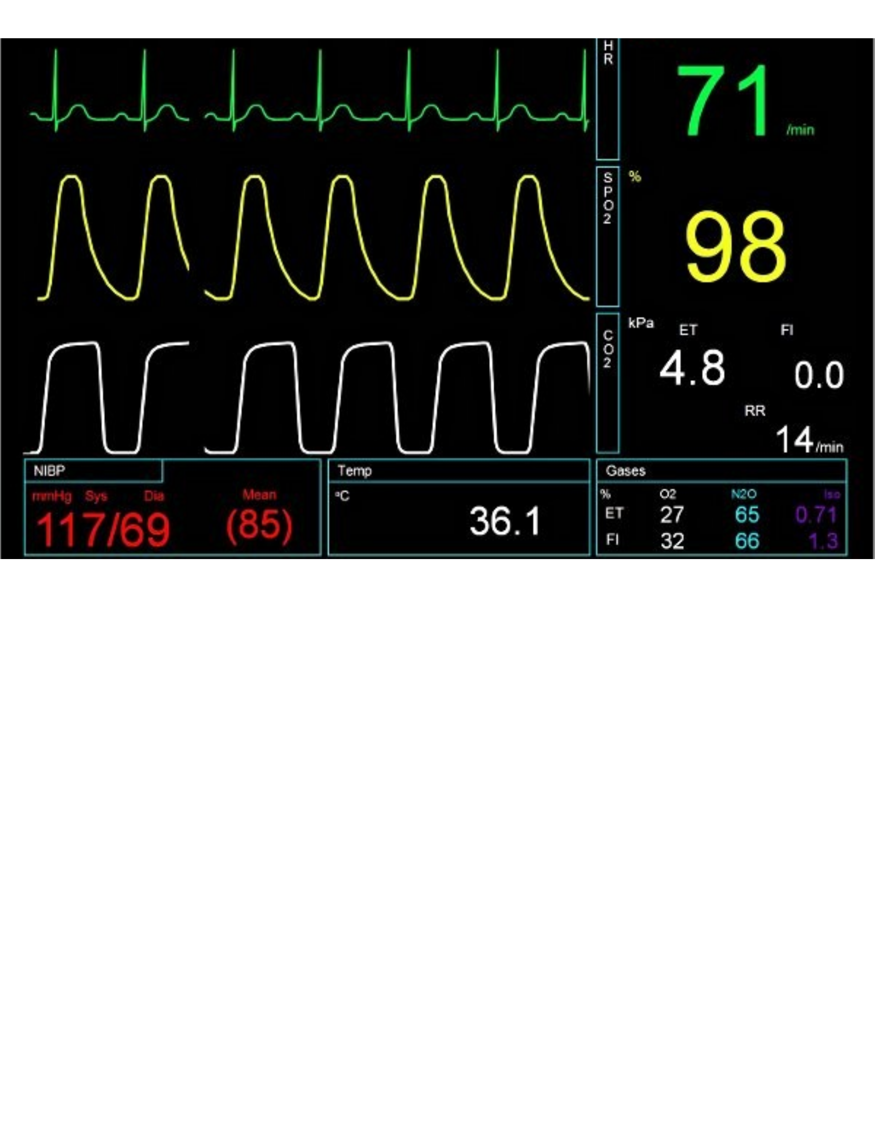
Standard monitoring recommended by ASA

Slide 35
Guidelines for action after an adverse anesthesia event
The anesthesiologist involved in an adverse event should do the following:
  Provide for continuing care of the patient.
  Notify the anesthesia operating room administrator as soon as possible. If a resident or certified registered nurse anesthetist was involved in the event, (s)he should notify the attending staff.
  dont discard supplies or tamper with equipment.
  Document events in the patient record (including the serial number of the anesthesia machine).
  Stay involved with the follow-up care.
  Contact consultants
  Submit a follow-up report to the department quality assurance committee.
  Document continuing care in the patient's record

Slide 36

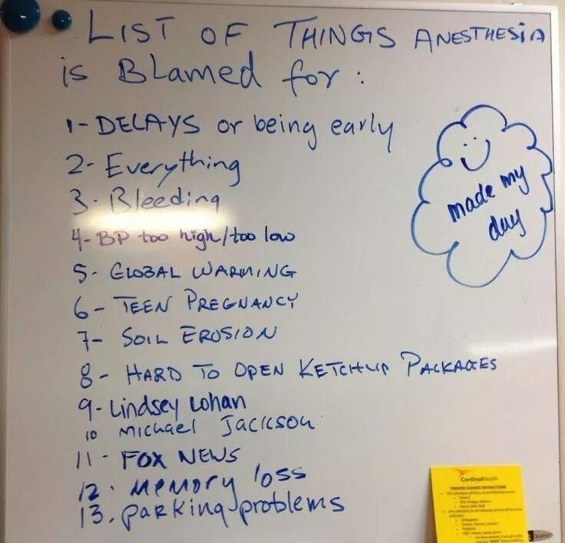



P_{P}o_{o}st_{st} Cri_{Cri}s_{s}i_{i}s_{s}
Avoid blame culture
_{Develop Help Culture}

Slide 37
Post operative pain
Multimodal analgesia
Preemptive preventive analgesia
Greater use of regional anesthesia technique
Regular analgesia technique not PRN
Identify problematic patient and formulate management plan

Slide 38
Why opioid free analgesia
Because opioids lead to:
PONV → delay of start feeding
Bladder bowel function
Sedation delay mobilization , patient discharge
, Pulmonary complication
immuno-suppressive effects infection cancer recurrent /mets
Inadequate analgesia persistence post-op pain into chronic pain

Slide 39
Hypothermia:peri-operative morbidity/mortality
Consequences of hypothermia
Shivering/oxygen requirement increased: myocardial oxygen
supply / demand
Infection: Directly depress immune function, Vasoconstriction-
reduced tissue oxygen- predispose to infection
Delay would healing
λ
Bleeding / transfusion: Depressed platelet and coagulation
Depressed Cardiac function and risk for arrhythmias
Delay recovery from anesthesia

Slide 40
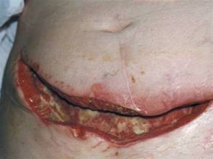
Postoperative infection-Anesthetic role ole
Antibiotic prophylaxis
Hand hyogein
Aseptic precausion for invasive procedures
Fluid balance , blood transfusion
Oxygen –avoiding hypoxia/hyperoxia

Slide 41

Recommendations for Airway Management in a Patient with Suspected Coronavirus (2019-nCoV) Infection

Slide 42
Patients with confirmed or suspected 2019-nCoV infected cases:
  o Should NOT be brought to holding or PACU areas
  o Should be managed in a designated OR, with signs posted on the doors to minimize staff exposure.
  o Should be recovered in the OR or transferred to ICU into a negative pressure room. Ensure a high quality HMEF (Heat and Moisture Exchanging Filter) rated to remove at least 99.97% of airborne particles 0.3 microns or greater is placed between the ETT and reservoir bag during transfers to avoid contaminating the atmosphere.

Slide 43
Plan ahead:
For time to allow all staff to apply PPE and barrier precautions
Consider intubation early to avoid the risk of a crash intubation when PPE cannot be applied safely.

Slide 44
During Airway Manipulation
Apply:
Disposable mask, goggles, footwear, gown and gloves. Consider adopting the double glove technique.
Standard ASA monitoring should be applied before induction of anesthesia.
N95 mask at a minimum should be utilized.
PAPR devices may offer superior protection when manipulating an airway of an infected patient. Assign
Designate the most experienced anesthesia professionals available to perform intubation, if possible. Avoid trainee intubation for sick patients.

Slide 45
Avoid: Awake fiberoptic intubation, unless specifically indicated. Atomized local anesthetic can aerosolize the virus.
Prepare to:
  Preoxygenate for 5 minutes with 100% FiO2
  o Perform a rapid sequence induction (RSI) to avoid manual ventilation of patient's lungs and potential aerosolization of virus from airways.
  Consider using a video-laryngoscope.
Use: Ensure there is a high quality HMEF (Heat and Moisture Exchanging Filter) rated to remove at least 99.97% of airborne particles 0.3 microns or greater placed in between the facemask and breathing circuit or between facemask and reservoir bag.

Slide 46
Dispose:
  Re-sheath the laryngoscope immediately post intubation (double glove technique)
  Seal all used airway equipment in a double zip-locked plastic bag. It must then be removed for decontamination and disinfection.
Remember:
  After removing protective equipment, avoid touching your hair or face before washing hands.

Slide 47

The goal is to provide highest standard of care and safety in any sitting
International Task Force on Anaesthesia Safety
Approved by:
World Federation of Societies of Anaesthesiologists
_{(WFSA)}

Slide 48
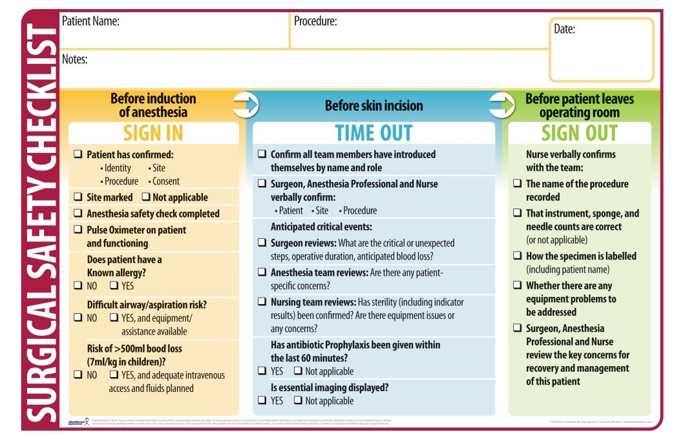

Slide 49

Thank
you

