Slide 1
بسم الله الرحمن الرحيم
د أحمد الروقي

Slide 2
Objectives: Aim of The Course
TEACHING
STUDENTS
THEORITICAL
SKILLS
CLINICAL
SKILLS
OPERATIVE
SKILLS

Slide 3
COURSE Objectives
Summary of the main learning outcomes for students enrolled in the course.
To know the basic ENT anatomy and physiology.
To recognize assessment and management of common ENT diseases, include ability to obtain patients’ history, perform comprehensive physical exam, interprets findings
To know how to handle common ENT emergencies.
To handle simple ENT diagnostic instruments.

Slide 4
COURSE Objectives
To be aware of common ENT operations.
To create an interest for further post-graduate study in ENT.
Enable to acquire and practice the code of medical ethics and demonstrates good and ideal attitude towards patients and their families, with the colleagues and other Staff and Sectors
To learn not only the theoretical and clinical aspects of the course but to mold as an ideal instruments in the line of medical profession includes communication and inter-relationship with colleagues and other Staff

Slide 5
Theoretical and Practical Activities in ORL COURSE 432

Slide 6
Lectures content, new format

Slide 7
Lectures content, new format

Slide 8
COURSE STRUCTURE
1 st Cycle Male
Division I 4 Weeks
Division II 4 Weeks
2 nd Cycle Female
Division I 4 Weeks
Division II 4 Weeks
3 rd Cycle Male
Division I 4 Weeks
Division II 4 Weeks
Note that at its 9th week of each Cycle will be the examination days –Written (MCQ, SAQ) and
Oral (OSCE)
Summer Course 4 weeks

Slide 9
STUDENT’S GROUPING
GROUP 1 ENT – 4 WEEKS 5 DAYS / WEEK | GROUP 2 OPHTHA - 4 WEEKS 5 DAYS / WEEK
Subgroups 6: A, B, C, D, E, F. | Subgroups 6: A, B, C, D, E, F.

Slide 10
ACTIVITIES
ACADEMIC ACTIVITIES
Lectures
First TWO WEEKS
CLINICAL ACTIVITIES
Clinics
Operative session
Communication Disorders
Audiology

Slide 11
ACTIVITIES
ACADAEMIC ACTIVITIES
Lectures:
Theoretical aspects
Building 4 For Male Students.
Main Building 1,4th Floor For Female Students.
First two weeks
From 8 AM – 3 PM
The WHOLE Group

Slide 12
CLINICAL ACTIVITIES
How to Examine ear, nose, throat, head & neck
Common ENT symptoms & signs

Slide 13
CLINICAL ACTIVITIES
CLINICS
OPERATIVE SESSION
AUDIOLOGY
COMMUNICATION DISORDERS (SPEECH)

Slide 14
CLINICAL ACTIVITIES
I. CLINICS
History taking
Examination
Building 3 – ENT Clinic 3rd floor Clinic 3: Building 5 - primary care 3rd floor Male & Female sides.

Slide 15
CLINICAL ACTIVITIES
III. OPERATIVE SESSIONS
To see common surgical procedures and instruments
Building I -2nd floor

Slide 16
CLINICAL ACTIVITIES
IV. AUDIOLOGY
Audiology & Vestibular tests
Audiometry reading
Building 3 - 4th floor

Slide 17
CLINICAL ACTIVITIES
IV. COMMUNICATION DISORDERS (SPEECH DISORDERS)
Observe voice disorders
Building 3 - 4th floor

Slide 19
RECOMMENDED TEXTBOOKS:
1: Ear, Nose and Throat (New Edition)
By: W. Becker (published by Thieme)
2: Lecture Notes of Diseases of Ear, Nose and Throat (New Edition)
By: P. Bull (published by Blackwell Science)

Slide 20
ATTENDANCE
20 % WARNING
- 1 full day lecture
- 2 days clinical activities
25 % - No EXAMINATION
-1 & 1/2 full day lecture;
-2 &1/2 days clinical activities

Slide 21
EXAMINATION 11th Week of each Cycle
10 Marks - Clinical assessment
(on the practical/clinical session/course)
30 Marks - MCQ (Scenario based) (Thursday)
40 Marks - Short answer questions (Wednesday)
20 Marks - OSCE – Oral (stations) (Wednesday) [CELL PHONES ARE NOT ALLOWED]

Slide 22
THANK YOU HAVE A NICE & ENJOYABLE STAY FOR THE ORL COURSE

Slide 23
History and Examination of ORL Patients

Slide 24
Ear Symptoms
Pain (Earache, Otalgia)
Itching
Deafness (hearing impairment)
Discharge (otorrhea)
Tinnitus
Vertigo and/or disequilibrium
Others (deformity, facial paralysis etc )

Slide 25
Earache
Primary Earache
Pain originates within the ear
Due to many inflammatory, traumatic or neoplastic disorder of the external or middle ear
Referred Earache
Pain in the ear referred from a territory sharing its sensory innervation with the external or middle ear e.g nose, throat, spines etc

Slide 26
Sensory Supply of Middle and External Ear
Cervical II & III
V cranial nerve
IX cranial nerve
X cranial nerve
? VII cranial nerve

Slide 27
Deafness
Hearing impairment
Conductive
Sensorineural
Mixed

Slide 28
Itching
Due to irritation of the skin of external canal
Mostly due to otitis externa

Slide 29
Otorrhea
Watery: CSF, otitis externa (viral or eczematous)
Mucoid or mucopurulent : infections of the middle ear
Purulent: suppurative infection of external or middle ear
Blood stained: sever infection, trauma or tumors
Bad odor: anaerobic infection (osteitis)

Slide 30
Tinnitus
The perception of sound in the absence of external stimuli

Slide 31
Types of Tinnitus
Objective tinnitus
sound produced by para-auditory structures which may be heard by an examiner
Subjective tinnitus
sound is only perceived by the patient (most common)

Slide 32
Objective Tinnitus
Arteriovenous malformations
Vascular tumors
Ectopic carotid artery

Slide 33
Subjective Tinnitus
Much more common than the objective
Caused by any ear disorder or in its central pathway

Slide 34
Vertigo & Disequilibrium
Due to disorder of
Vestibular system
Propioceptive sensation
Vision

Slide 35
What Is vertigo?
The word "vertigo" comes from the Latin "vertere", to turn + the suffix "-igo", a condition = a condition of turning about).
It is an allusion of being moving or the world is moving too

Slide 36
Examination of the Ear

Slide 37
Light sources for ENT examination

Slide 38
THE AURICLE

Slide 39
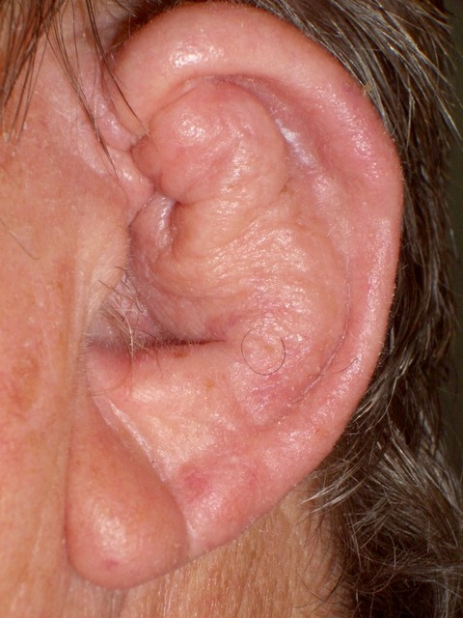

Slide 40
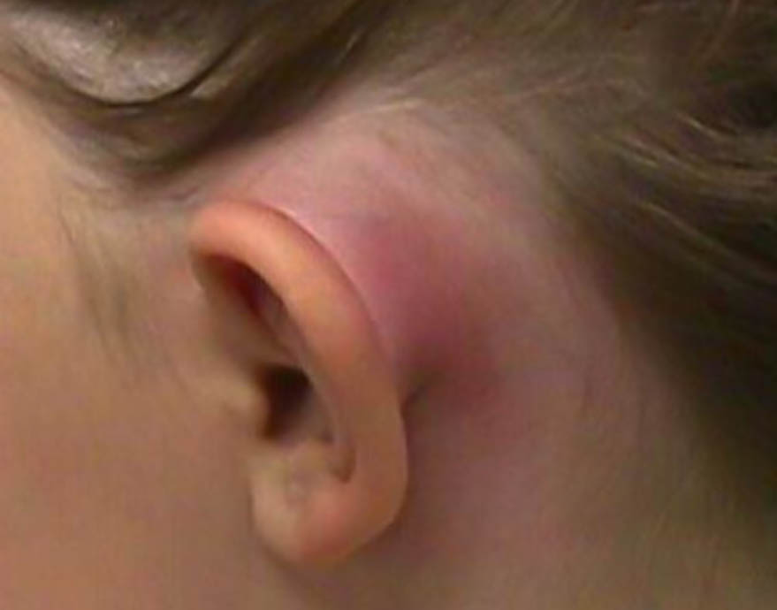
Post auricular region

Slide 41
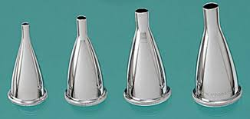
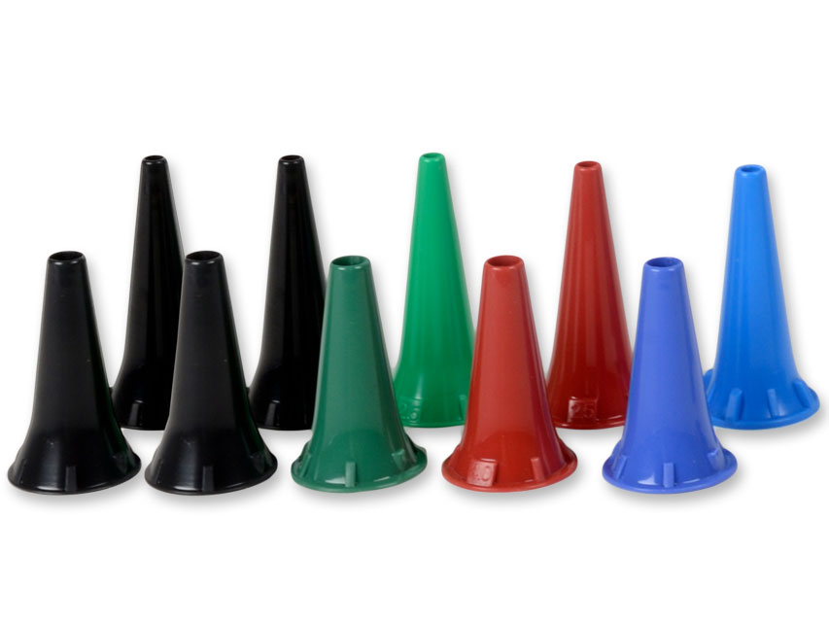
Examination of external canal & TM

Slide 42
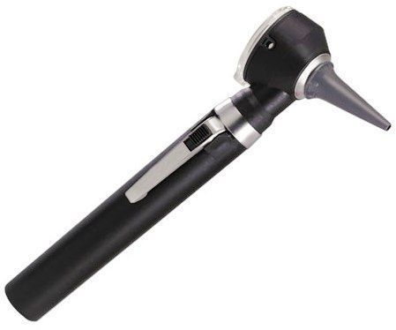
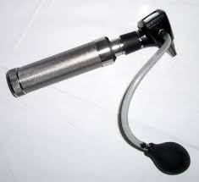
Otoscopy

Slide 43
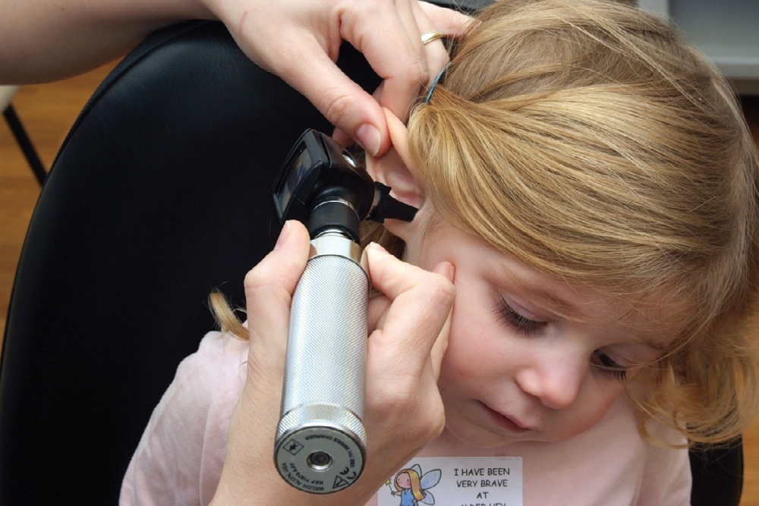

Slide 44
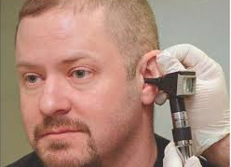
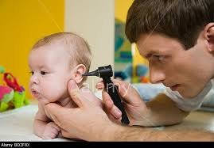
Otoscopy

Slide 45
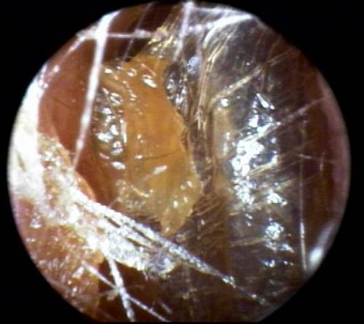
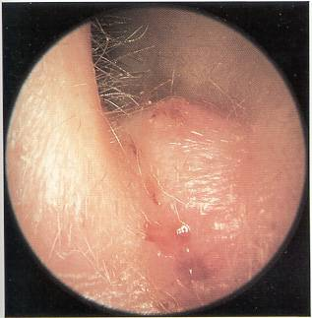
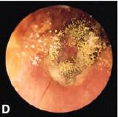

Slide 46
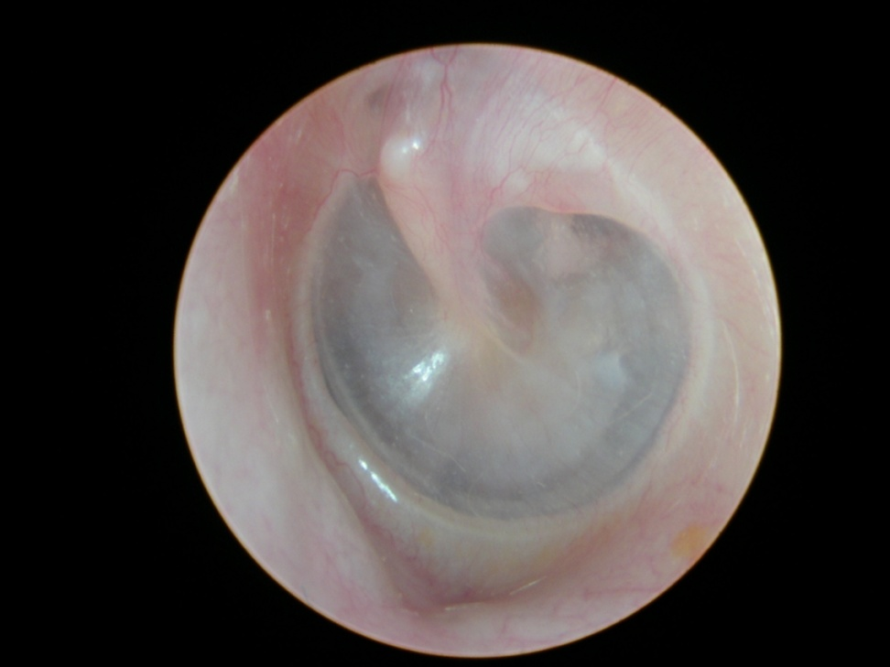
Tympanic Membrane

Slide 47
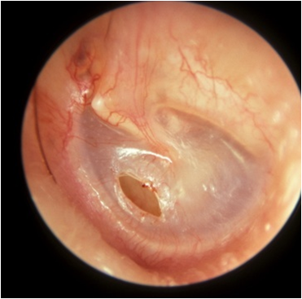
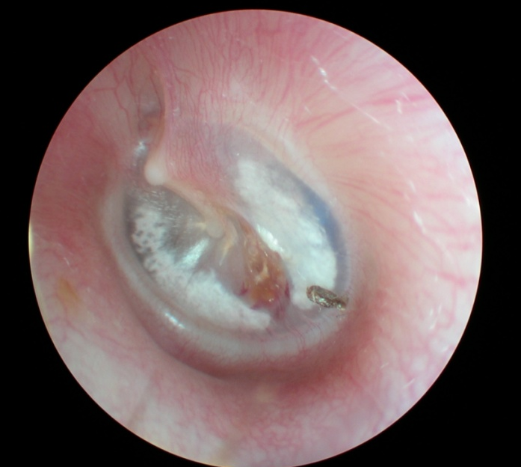
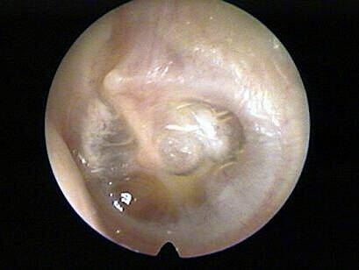

Slide 48
Microscopic examination

Slide 49
Tuning Fork Tests

Slide 50
Tuning Fork Tests
Rinne’s test
Compare AC with BC of the same ear
If AC > BC (positive Rinne ): Normal or SNHL
If BC > AC (negative Rinne): CHL

Slide 51
Weber’s test
Compare BC of both ears
Only useful in unilateral HL
In unilateral CHL: Lateralized to the diseased ear
In unilateral SNHL: Lateralized to the good ear

Slide 52
The Nose

Slide 53
Nasal symptoms
Nasal obstruction
Nasal discharge (rhinorrhea)
Epistaxis
Sneezing & itching
Smell abnormalities
Facial pain
Deformity
Other symptoms (epiphora, proptosis etc)

Slide 54
Smell abnormalities
Hyposmia
Anosmia
Cacosmia
Parosmia

Slide 55
External Examination of the Nose

Slide 56
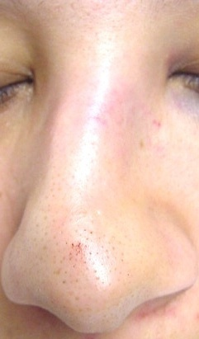

Slide 57
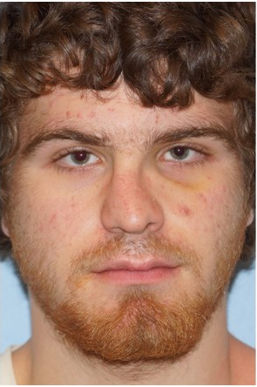
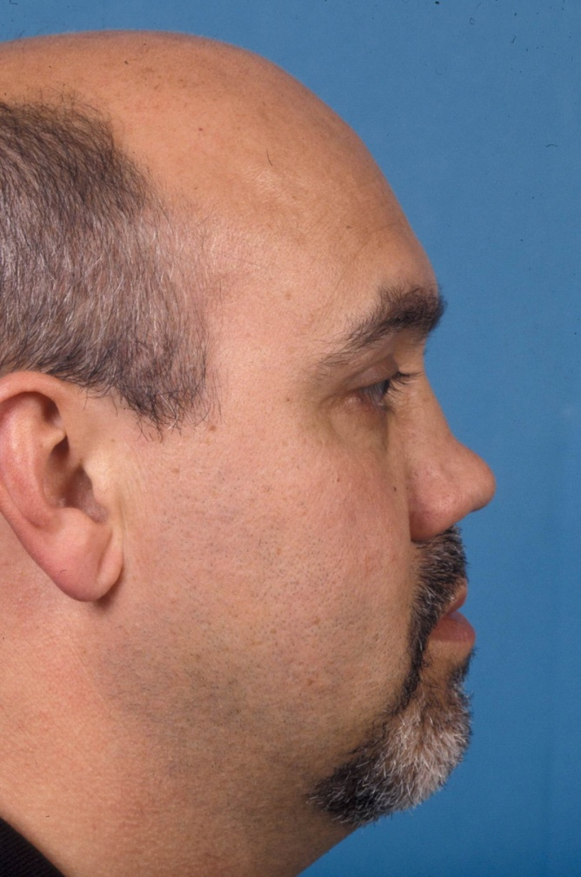

Slide 58
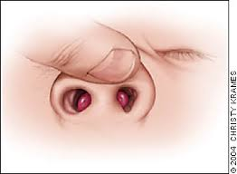
Examination of the nasal vestibule

Slide 59
Examination of the nasal vestibule

Slide 60
Examination of the nasal cavity
Anterior rhinoscopy
Flexible nasal endoscopy
Rigid nasal endoscopy

Slide 61
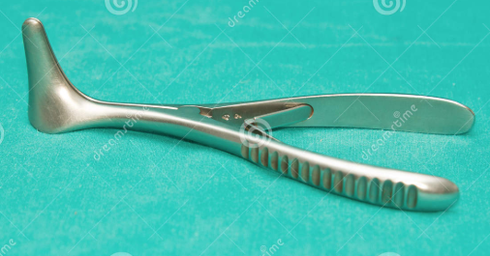
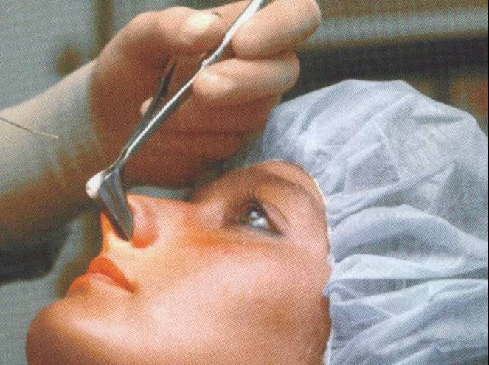
Anterior Rhinoscopy

Slide 62
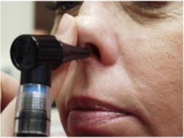

Slide 63
Anterior Rhinoscopy

Slide 64
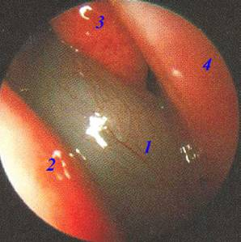

Slide 65
Flexible nasal endoscopy

Slide 66
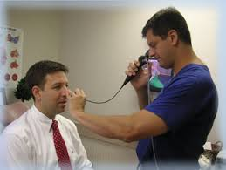
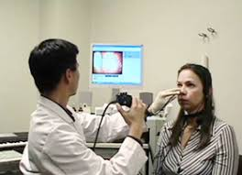

Slide 67
Rigid Nasal Endoscopy

Slide 68
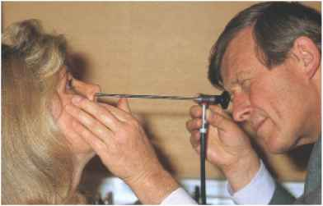

Slide 69
The Mouth & Pharynx

Slide 70
Symptoms
Sore throat
Odynophagia
Snoring
Dysphagia
Neck swelling
Other symptoms

Slide 71
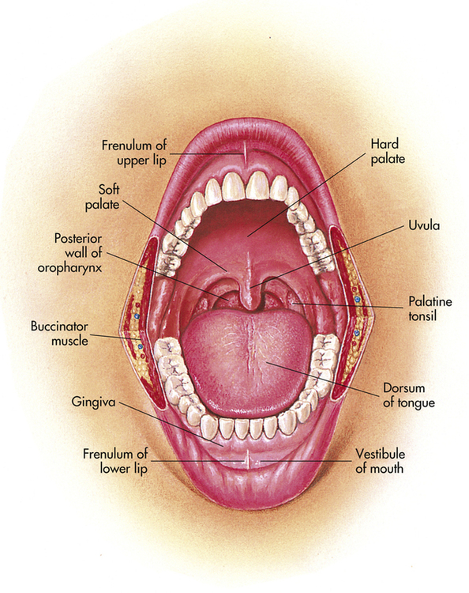
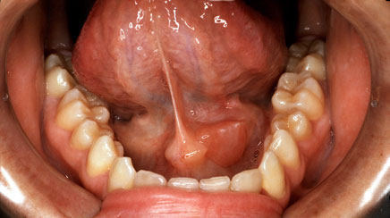
Examination of the mouth

Slide 72
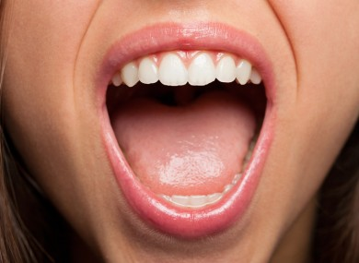
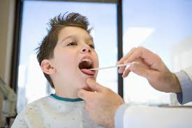

Slide 73
Examination of the pharynx

Slide 74
Examination of nasopharynx

Slide 75
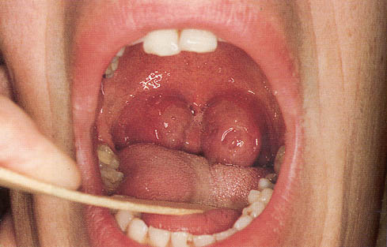
Examination of oropharynx

Slide 76
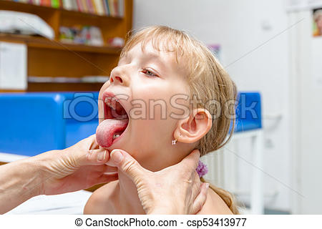

Slide 77
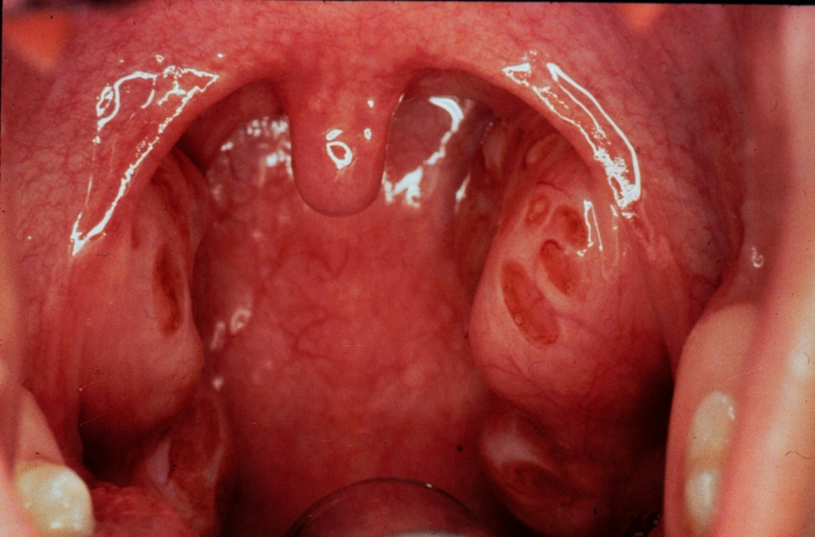
The oropharynx

Slide 78
Examination of laryngopharynx
As the larynx

Slide 79
The Larynx

Slide 80
Symptoms
Stridor
Hoarseness
Cough
Aspiration
Feeding difficulties
Dyspnea

Slide 81
Stridor
High pitch sound due to partial obstruction in the larynx or tracheo bronchial tree
Inspiratory stridor: supraglottic obstruction
Biphasic stridor: glottic obtruction
Expiratory stridor: subglottic or extrathoracic tracheal obstruction

Slide 82
Laryngeal examination
Indirect “mirror” laryngoscopy
Flexible laryngoscopy
Rigid telescopic examination
Direct laryngoscopy

Slide 83
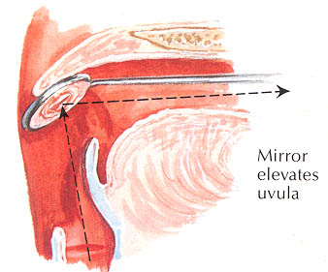
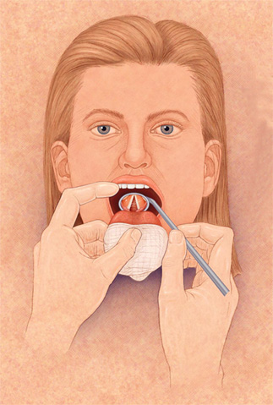
Indirect mirror examination

Slide 84
Flexible Laryngoscopy

Slide 87
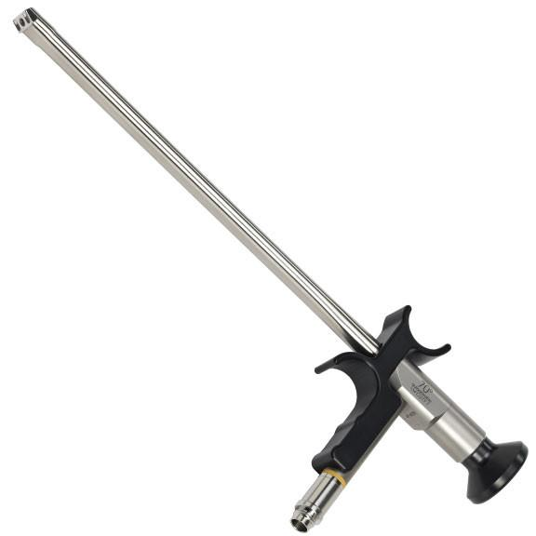
Rigid telescopic examination

Slide 88
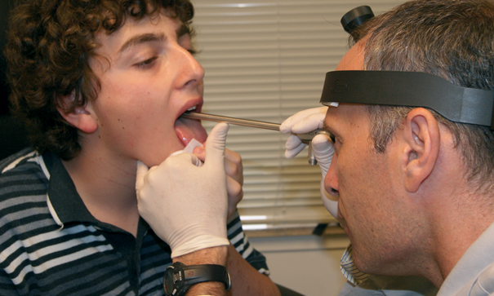

Slide 89
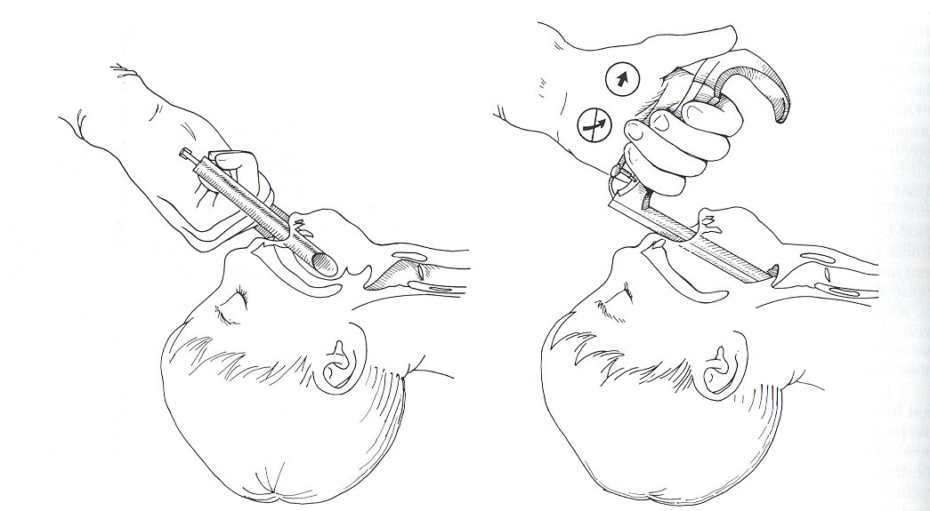
Direct Laryngoscopy

Slide 90
Neck Examination
Inspection
Look for anything unusual in function or structure
Palpation
Feel anything unusual in function or structure
Auscultation
Hear anything unusual in function or structure

Slide 91
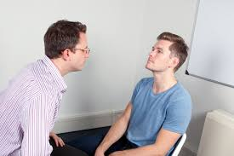
Inspection

Slide 92
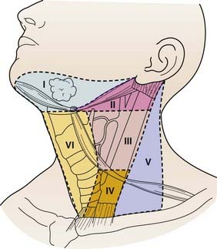
Palpation

Slide 93
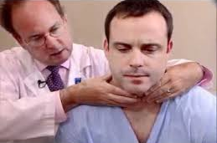
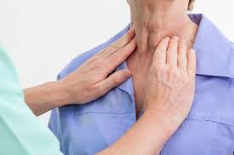

Slide 94
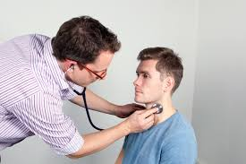
Auscultation

Slide 95
THANK YOU

