Slide 1
Brief ear anatomy Otitis Externa Acute Otitis media

Slide 2
Objectives
Gross applied anatomy of the ear
Nerve supply of the external and middle ears and the principles of referred earache
Central connection of the vestibulo- cochlear nerve
Physiology of the external, middle and inner ears

Slide 3
ANATOMY OF THE EAR

Slide 4
ANATOMY OF THE EAR
External Ear
Middle Ear Cleft
Inner Ear

Slide 5
EXTERNAL EAR
Auricle
External Canal

Slide 6
The Auricle

Slide 8
Perichondritis
Erysipelas

Slide 9
The External Auditory Canal

Slide 10
The External Auditory Canal
Medial Two Thirds:
Lateral Third
Cartilagenous
Hair follicles
Ceruminous glands
Sebacous glands
Bony
Develops after birth

Slide 12
Relations of EAC

Slide 13
ANATOMY OF THE EAR
External Ear
Middle Ear Cleft
Inner Ear

Slide 14
MIDDLE EAR CLEFT
Eustachian (Pharyngo-tympanic) Tube
Tympanum (Middle Ear Cavity)
Mastoid Antrum and Air Cells

Slide 15
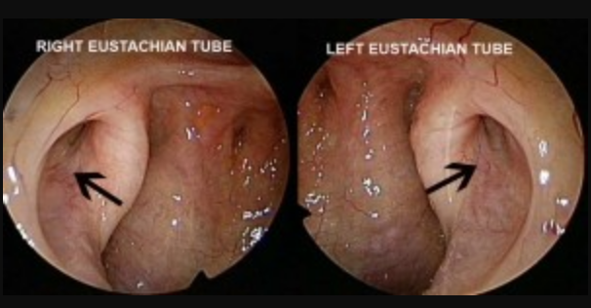
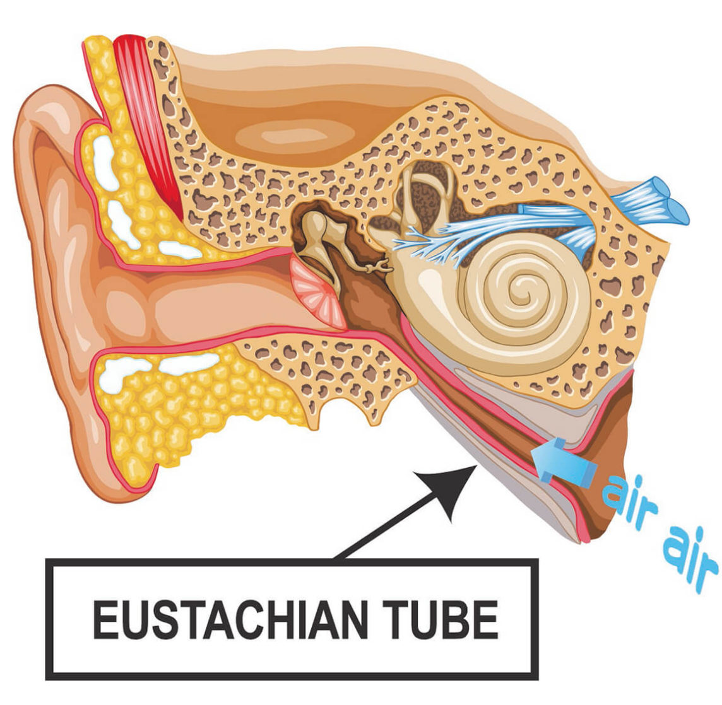
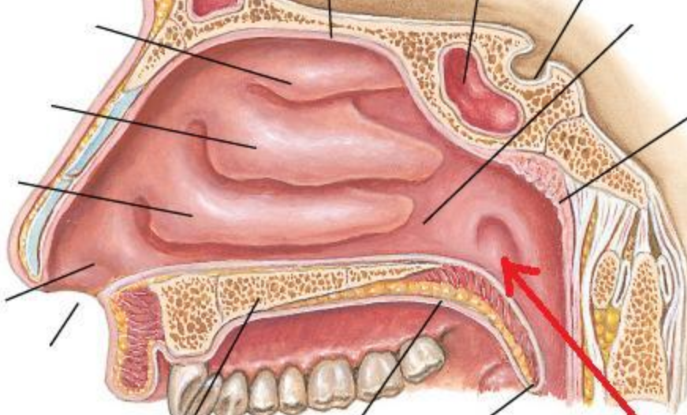
MIDDLE EAR CLEFT
Eustachian (Pharyngo-Tympanic) Tube

Slide 16
MIDDLE EAR CLEFT
Eustachian (Pharyngo-Tympanic) tube
Tympanic cavity (Middle ear cavity)
Mastoid air cells

Slide 17
WALLS OF TYMPANIC CAVITY
Roof
Floor
Anterior wall
Posterior wall
Lateral wall
Medial wall

Slide 18
WALLS OF TYMPANIC CAVITY
Roof
Floor
Tegmen

Slide 19
WALLS OF TYMPANIC CAVITY
Roof
Floor
Anterior wall
Posterior wall

Slide 20
WALLS OF TYMPANIC CAVITY
Roof
Floor
Anterior wall
Posterior wall
Lateral wall
Membrana Flaccida
Membrana Tensa

Slide 21
WALLS OF TYMPANIC CAVITY
Roof
Floor
Epitympanum (attic)
Anterior wall
Mesotympanum
Posterior wall
Hypotympanum
Lateral wall

Slide 22
WALLS OF TYMPANIC CAVITY
Roof
Floor
Anterior wall
Posterior wall
Lateral wall
Medial wall

Slide 25
MIDDLE EAR CLEFT
Eustachian (Pharyngo-tympanic) Tube
Tympanic (Middle Ear) Cavity
Mastoid antrum and air cells

Slide 26
Mastoid Antrum & Air cells

Slide 27
Relationships of the mastoid antrum.

Slide 28
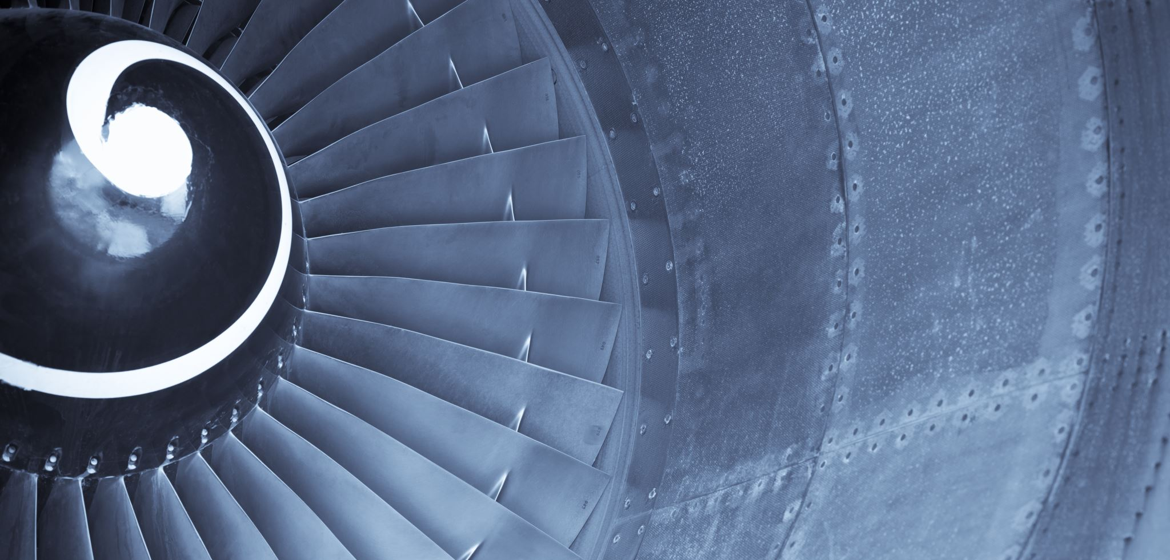
Mastoid Antrum & Air cells

Slide 29
CONTENTS OF MIDDLE EAR CAVITY
Air
Ossicles
Malleus, Incus, & Stapes
Muscles
Tensor Tympani & Stapedius
Nerves
Chorda Tympani & Tympanic Plexus

Slide 31
LINING OF MIDDLE EAR
Mucous membrane: ciliated columnar (anteriorly) and cuboidal or flat elsewhere

Slide 32
SENSARY SUPPLY OF MIDDLE AND EXTERNAL EAR
Cervical II & III ( great auricular and lessor occipital)
V cranial nerve ( auriculotemporal)
IX cranial nerve (tympanic or Jacobson’s)
X cranial nerve ( auricular or Arnold’s)
? VII cranial nerve

Slide 33
Referred Earache
Pain in the ear due to a disease in an area supplied by a nerve that also supply the ear.

Slide 34
Referred Earache
Cervical II & III
Cervical spondylosis, neck injury etc.
V cranial nerve
Dental infections, sinonasal diseases etc.
IX cranial nerve
Tonsillitis, post-tonsillectomy, carcinoma etc.
X cranial nerve
Tumors of hpopharynx, larynx & esophagus

Slide 35
ANATOMY OF INNER EAR

Slide 36
Osseous Labyrinth
Bony Cochlea
Vestibule
Bony semicircular canals

Slide 37
CONTENTS OF THE BONY LABYRINTH
Perilymph
Membranous labyrinth
Cochlear duct
Saccule and utricle
Membranous semicircular ducts

Slide 38
CONTENTS OF MEMBRANOUS LABYRINTH
Endolymph
Sensory epithelium
Cochlea: organ of Corti
Utricle & saccule: maculae
Semicircular canals: cristae

Slide 39
INNER EAR SENSORY EPITHELIUM
Cochlea: organ of Corti
Utricle & saccule: maculae
Semicircular canals: cristae

Slide 40
THE VESTIBULO-COCHLEAR NERVE

Slide 42
CENTRAL CONNECTIONS OF COCHLEAR NERVE

Slide 43
CENTRAL CONNECTIONS OF VESTIBULAR NERVE

Slide 44
PHYSIOLOGY OF THE EAR

Slide 45
FUNCIONS OF THE EXTERNAL EAR
Protection of the middle ear
Curvature
Cerumen
Auditory functions:
Sound conduction
Increase sound pressure by the resonance function

Slide 46
FUNCTIONS OF THE EUSTACHIAN TUBE
Protection
Ventilation
Drainage

Slide 47
FUNCIONS OF THE MIDDLE EAR
Conduction of sound
Transformer mechanism
Hydraulic action
Ossicular leverage

Slide 48
FUNCIONS OF THE MIDDLE EAR
Conduction of sound
Transformer mechanism
Hydraulic action
Ossicular leverage
Protection to the inner ear
stapedial reflex

Slide 49
FUNCIONS OF THE INNER EAR
Hearing Function:
– Transduction of sound
to action potentials

Slide 52
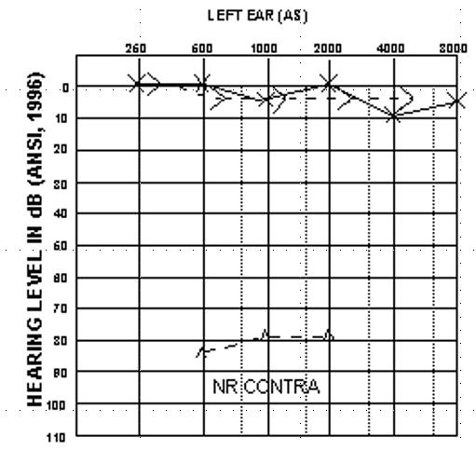

Slide 53
FUNCIONS OF THE INNER EAR
Hearing Function:
– Transduction of sound
to action potentials
Vestibular Function:
– Participate in maintaining body balance

Slide 54
THE BALANCE SYSTEM
C. Cortex
BRAIN-STEM
Cerebellum

Slide 55
THE BALANCE SYSTEM
Vestibular
Proprioceptive
Visual
INPUT
C. Cortex
BRAIN-STEM
Cerebellum

Slide 56
THE BALANCE SYSTEM
Vestibular
Proprioceptive
Visual
INPUT
C. Cortex
BRAIN-STEM
Cerebellum
OUTPUT
Ocular muscles
Postural muscles

Slide 58
Objectives
Recognize the congenital anomalies of the external ear
1
Diagnose and treat wax accumulation
2
Diagnose and treat the common external ear inflammatory conditions
3
Discuss the pathology, clinical features and management of AOM
4

Slide 59
DEVELOPMENT OF THE EAR
External ear: 1st pharyngeal cleft & arch
Middle ear: 1st pharyngeal pouch & 1st and 2 ^{nd} arches

Slide 61
DEVELOPMENT OF THE EAR
External ear: 1st pharyngeal cleft & arch
Middle ear: 1st pharyngeal pouch & 1st and 2 ^{nd} arches
Inner ear: Ectoderm of hindbrain

Slide 63
DISEASES OF THE EXTERNAL EAR

Slide 64
CONGENITAL MALFORMATIONS
Anotia & microtia
Accessory auricle
Preauricular sinus
Protruding ear

Slide 66
TRAUMA TO THE AURICLE
Lacerations
Hematoma auris

Slide 67
Complication
Cauliflower ear

Slide 68
PERICHONDRITIS OF THE PINNA
Usually follow trauma (hematoma auris, surgical, frostbite, burn) or otitis externa
Commonly caused by Pseudomonas
Fever, pain, redness and swelling
Treatment is by antibiotics

Slide 70
OTITIS EXTERNA

Slide 71
DEFINITION
An acute or chronic infection of the whole or a part of the skin of the external ear canal

Slide 72
CAUSES OF OTITIS EXTERNA
CAUSES OF OTITIS EXTERNA

Slide 73
CAUSES OF OTITIS EXTERNA
INFECTIVE
REACTIVE
CAUSES OF OTITIS EXTERNA

Slide 74
CAUSES OF OTITIS EXTERNA
INFECTIVE
REACTIVE
Bacterial
Fungal
Viral
CAUSES OF OTITIS EXTERNA

Slide 75
CAUSES OF OTITIS EXTERNA
INFECTIVE
REACTIVE
Bacterial
Fungal
Viral
Eczematous
Seborrheic
CAUSES OF OTITIS EXTERNA

Slide 76
CAUSES OF OTITIS EXTERNA
INFECTIVE
REACTIVE
Bacterial
Fungal
Viral
Eczematous
Seborrheic
Staph. arues
Pseudomonos
Others
CAUSES OF OTITIS EXTERNA

Slide 77
CAUSES OF OTITIS EXTERNA
INFECTIVE
REACTIVE
Bacterial
Fungal
Viral
Eczematous
Seborrheic
Staph. arues
Aspirigillus Niger
Pseudomonos
Candida Albicans
Others
CAUSES OF OTITIS EXTERNA

Slide 78
CAUSES OF OTITIS EXTERNA
INFECTIVE
REACTIVE
Bacterial
Fungal
Viral
Eczematous
Seborrheic
Staph. arues
Aspirigillus Niger
Herpes zoster
Pseudomonos
Candida Albicans
Others
Others
CAUSES OF OTITIS EXTERNA

Slide 79
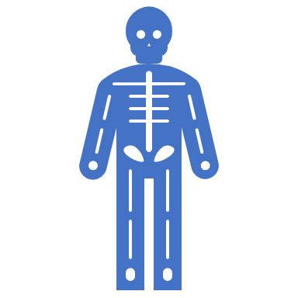
CLINICAL FEATURES OF OTITIS EXTERNA
Itching
Pain
Tenderness and swelling
Otorrhea
Deafness
Changes in the lumen and skin of EAM

Slide 80
CLINICAL TYPES OF OTITIS EXTERNA
Localize O.E ( furuncle)

Slide 81
CLINICAL TYPES OF OTITIS EXTERNA
Localize O.E ( furuncle)
Diffuse infective O.E.

Slide 82
CLINICAL TYPES OF OTITIS EXTERNA
Localize O.E ( furuncle)
Diffuse infective O.E.
Otomycosis

Slide 83
CLINICAL TYPES OF OTITIS EXTERNA
Localize O.E ( furuncle)
Diffuse infective O.E.
Otomycosis
Bullous myringitis

Slide 84
CLINICAL TYPES OF OTITIS EXTERNA
Localize O.E ( furuncle)
Diffuse infective O.E.
Otomycosis
Bullous myringitis
Herpetic O.E.

Slide 85
CLINICAL TYPES OF OTITIS EXTERNA
Localize O.E ( furuncle)
Diffuse infective O.E.
Otomycosis
Bullous myringitis
Herpetic O.E
Eczematous and seborrheic O.E.

Slide 86
CLINICAL TYPES OF OTITIS EXTERNA
Localize O.E ( furuncle)
Diffuse infective O.E.
Otomycosis
Bullous myringitis
Herpetic O.E
Eczematous and seborrheic O.E.

Slide 87
MANAGEMENT OF OTITIS EXTERNA
Swab for culture and sensitivity
Ear toilet
Keep the ear dry
Local medications
Systemic medications
Surgery may be required in chronic cases

Slide 88
NECROTIZING (MALIGNANT) OTITIS EXTERNA
An acute Pseudomonas infection of the skin of the external ear canal which has spread to the adjacent bone. It occurs mostly in elderly diabetic patients.

Slide 89
Complications

Slide 90
DIAGNOSIS
Diabetes
Advanced age
Severe otalgia
Granulation tissue
Cranial nerve involvement
Radiology

Slide 92
TREATMENT
Control of diabetes
Anti Pseudomonas antibiotics
Local treatment and debridement
The role of surgery remains controversial

Slide 93
MISCELLANEOUS CONDITIONS OF THE EXTERNAL EAR

Slide 94
WAX
Mixture of ceruminous and sebaceous glands secretion
Normally is expelled from the canal aided by movements of the jaw
When accumulated it may cause deafness, earache or tinnitus

Slide 96
WAX
Treatment is by removal using syringing, suction or instrumentation

Slide 98
KERATOSIS OBTURANS
Accumulation of desquamated epithelium in the bony canal
It may be associated with sinusitis, bronchiectasis or primary ciliary dyskinesia
Usually cause deafness and pain
Treatment is periodic removal

Slide 99
ACUTE OTITIS MEDIA

Slide 100
DEFINITION
Acute infection of the mucous membrane lining of the middle ear cleft

Slide 101
PREDISPOSING FACTORS
Age
Maleness
Bottle feeding
Climate
Crowded living conditions
Heredity
Associated conditions: cleft palate, immuno-deficiency, down syndrome, cystic fibrosis , and ciliary dyskinesia
,

Slide 102
ROUTE OF INFECTION
Eustachian tube
External auditory canal
Blood borne

Slide 103
BACTERIOLOGY
Streptococcus pneumonia
Haemophilus influenzae
Branhamella catarrhalis
Streptococcus pyogens
Staphylococcus aureus

Slide 104
PATHOLOGY

Slide 105
CLINICAL PICTURE
Tubal occlusion
Suppurative inflammation
Tympanic membrane rupture
Resolution

Slide 106
CLINICAL PICTURE
Tubal occlusion
Discomfort, autophony, retracted drum
Suppurative inflammation
Tympanic membrane rupture
Resolution

Slide 107
CLINICAL PICTURE
Tubal occlusion
Discomfort, autophony, retracted
drum
Suppurative inflammation
Fever, sever earache, deafness,
bulging drum
Tympanic membrane rupture
Resolution

Slide 108
CLINICAL PICTURE
Tubal occlusion
Discomfort, autophony, retracted
drum
Suppurative inflammation
Fever, sever earache, deafness,
bulging drum
Tympanic membrane rupture
Otorrhea... temp. & earache subside
Resolution

Slide 109
CLINICAL PICTURE
Tubal occlusion
Discomfort, autophony, retracted
drum
Suppurative inflammation
Fever, sever earache, deafness,
bulging drum
Tympanic membrane rupture
Otorrhea... temp. & earache
subside
Resolution

Slide 111
TREATMENT
Symptomatic
Antimicrobials
Amoxycillin/clavulanic acid
Tri-methoprim- sulphamethoxazole
Cefaclor, cefixime
Erythromycin-sulfisoxazole
Decongestant
Myringotomy
Ear toilet and local antibiotics

Slide 112
RECURRENT ACUTE OTITIS MEDIA

Slide 113
DEFINITION
Three or more attacks over a 6-months period

Slide 114
TREATMENT
Long-term low dose antimicrobials
Ventilation tube insertion

Slide 116
THANK YOU

