Slide 1
Chronic Otitis Media
and its complications

Slide 2
Chronic Otitis Media

Slide 3
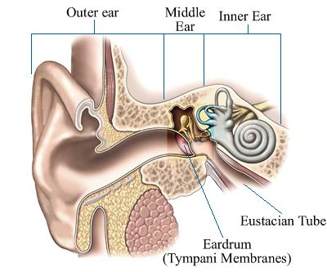
Definition
Inflammation of the middle ear.
May also involve inflammation of mastoid.

Slide 4
Classifications
Chronic Non Suppurative Otitis Media
Otitis media with effusion “OME”
Adhesive otitis media
Chronic Suppurative Otitis Media “CSOM”
Tubotympanic (Safe)
Atticoantral (Unsafe)

Slide 5
Acute Otitis media
Resolution
Persistent Effusion
Acute perforation +Otitis Media
Chronic Supportive Otitis Media
Unsafe
Safe
Resolution Healing

Slide 6
Chronic Non Suppurative Otitis Media

Slide 7
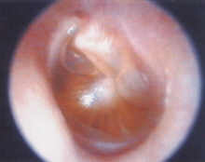
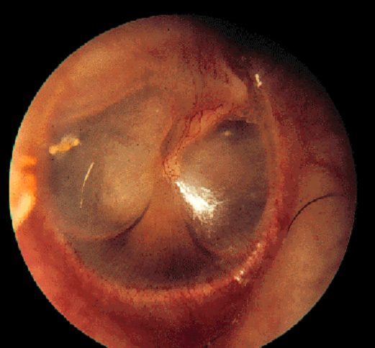
Otitis Media with Effusion
(Chronic non-suppurative Otitis Media)
Middle ear filled with serous or mucoid fluid
No purulence
Often present after acute otitis media is treated appropriately with antibiotics
Most will clear within 3 months

Slide 8
Otitis Media with Effusion
(Chronic non-suppurative Otitis Media)
Etiology :
Bacteria
Strep pnuemonia
Moraxella cat.
Haemophilus influ.
Virus
RSV
Rhinovirus
Parainfluenza virus
Influenza virus

Slide 9
Otitis Media with Effusion
(Chronic non-suppurative Otitis Media)
Diagnosis:
History.
Clinical Examination.
Tuning fork tests.
Audiological assessment.

Slide 10
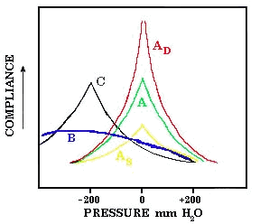
Otitis Media with Effusion
(Chronic non-suppurative Otitis Media)
Tuning fork test
Weber and Rinne test
Audiological assessment:
1. Tympanometry

Slide 11
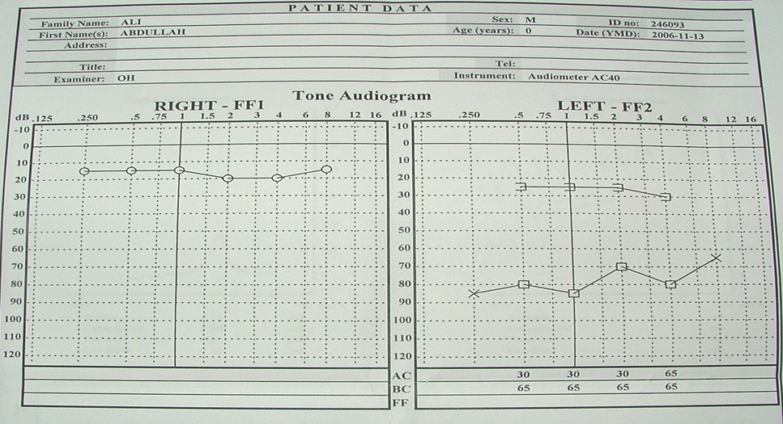
Otitis Media with Effusion
(Chronic non-suppurative Otitis Media)
Audiological assessment:
2. B-Pure tone audiogram

Slide 12
Otitis Media with Effusion
(Chronic non-suppurative Otitis Media)
Medical Treatment of OME :
  Observation – many European countries wait 6-9 months prior to placement of ear tubes.
  Antibiotics
  Meta-analysis shows beneficial short-term resolution of OME
  Audiogram at 3 months with persistent effusion to determine impact on hearing

Slide 13
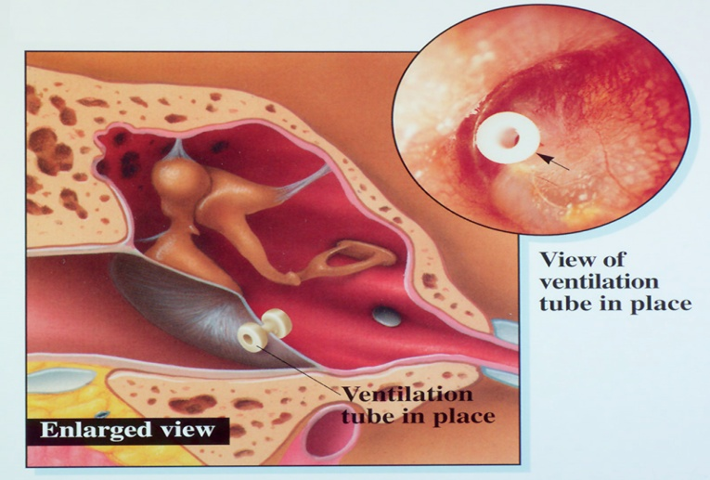
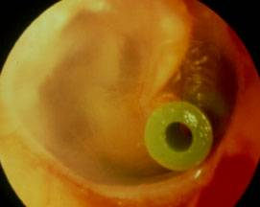
Otitis Media with Effusion
(Chronic non-suppurative Otitis Media)
Surgical treatment (Tympanostomy Tubes ) :
  Bypass Eustachian tube to ventilate middle ear.
  Indication : chronic OME >3mos with hearing loss and/or speech delay is an indication for tympanostomy tube placement.

Slide 14
Adhesive otitis media
(Chronic non-suppurative Otitis Media)
Lack of middle ear ventilation results in negative pressure within the tympanic cavity.
The ear drum retracts onto structures within the middle ear.

Slide 15
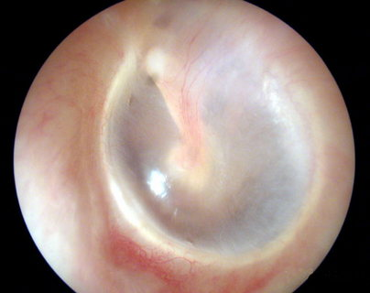
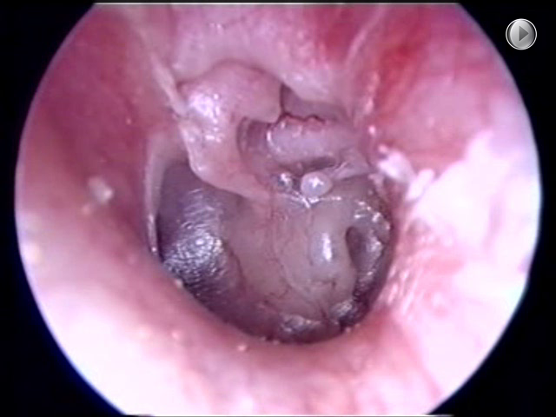
Adhesive otitis media
(Chronic non-suppurative Otitis Media)
The result of long standing Eustachian tube dysfunction.
The drum loses structural integrity and becomes flaccid.
Contact between the drum and the incus or stapes can cause bone erosion at the IS joint.
Can sometimes be treated with tympanostomy tubes.

Slide 16
Chronic suppurative otitis media with and without cholesteatoma

Slide 17
Chronic suppurative otitis media
3D :
Duration > 3 months despite treatment
Discharge mucopurulent otorrhea
Deafness Perforation /Ossicular chains

Slide 18
Chronic suppurative otitis media
Etiology :
Pseudomonas aeruginosa.
Staphylococcus aureus.
Proteus species.

Slide 19
Chronic suppurative otitis media
Classification :
Chronic suppurative otitis media
Tubo-tympanic type (safe)
Attico- antral (un safe)

Slide 20
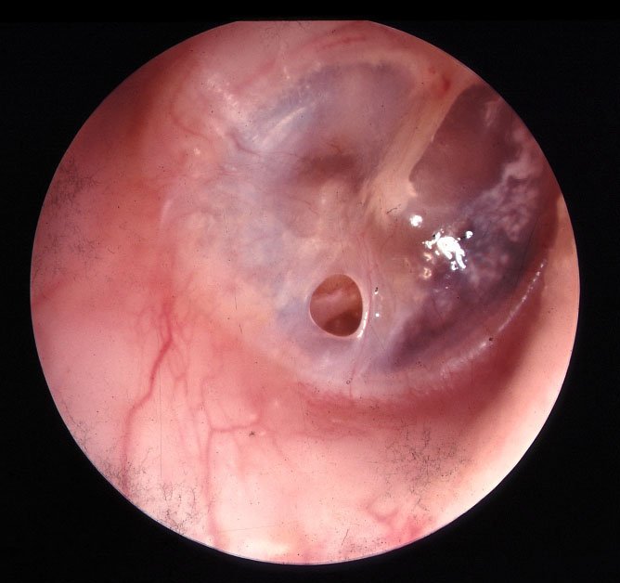
Chronic suppurative otitis media
A- Tubotympanic type (Safe) :
  Simple perforation.
  Intermittent non offensive non bloody ear discharge.
  On examination (central perforation ).

Slide 21
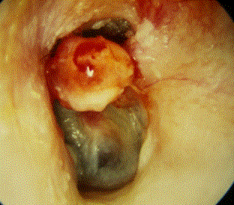
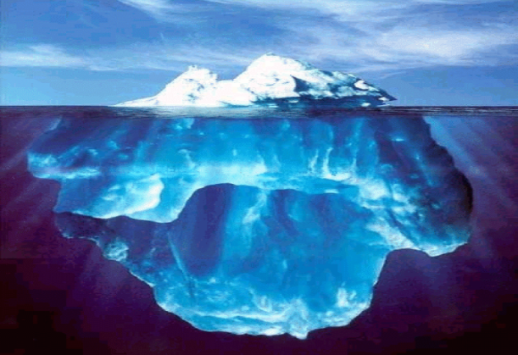
Chronic suppurative otitis media
B- Attico-antral (unsafe) :
  Chronic ,Scanty, offensive and bloody ear discharge.
  On examination marginal perforation.
  You may see cholesteatoma.

Slide 22
Cholesteatoma
Cholesteatomas are epidermal inclusion cysts of the middle ear and/or mastoid with a squamous epithelial lining.
Contain keratin and desquamated epithelium.

Slide 23
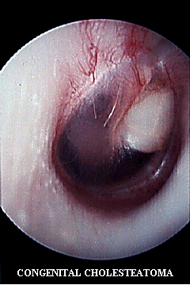
Cholesteatoma
Can be :
congenital or acquired

Slide 24
Cholesteatoma
Pathogenesis of cholesteatoma :
Natural history is progressive growth with erosion of surrounding bone due:
    Pressure effects.
    Osteoclast activation.

Slide 25
Cholesteatoma
Diagnosis
History
Examination
    Otoscopic
    Microscopic
    Tuning fork test
Investigation
    Audiological assessment
    Radiological assessment

Slide 26
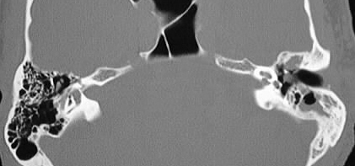
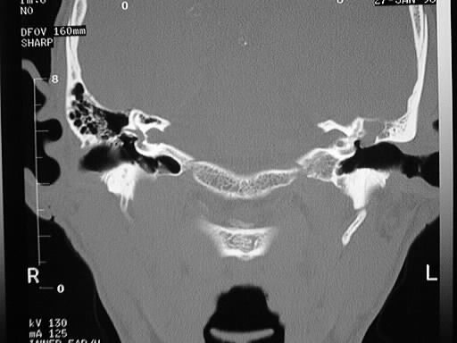
Cholesteatoma
Cholesteatoma Imaging:

Slide 27
Treatment

Slide 28
Chronic suppurative otitis media
Chronic suppurative otitis media without
cholesteatoma ( safe )
A — Ototopical antibiotics.
B — Surgical repair of the TM perforation.

Slide 29
Chronic suppurative otitis media
A— Ototopical Medications :
Antibiotic only otic drops
  Floxin (ofloxacin)
Antibiotic with steroid otic drops
  Ciprodex (ciprofloxin and dexamethasone)
  Cipro HC (ciprofloxin and hydrocortisone)

Slide 30
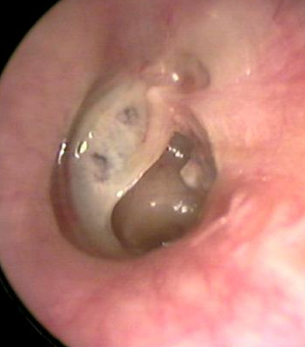
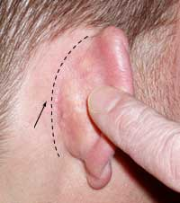
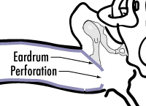
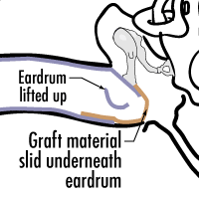
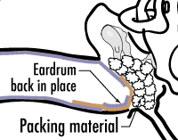
Chronic suppurative otitis media
B — Surgical repair of the TM perforation :
Myringplasty
Tympanoplasty

Slide 31
Chronic suppurative otitis media
Chronic suppurative otitis media with cholesteatoma
(Unsafe)
Surgery

Slide 32
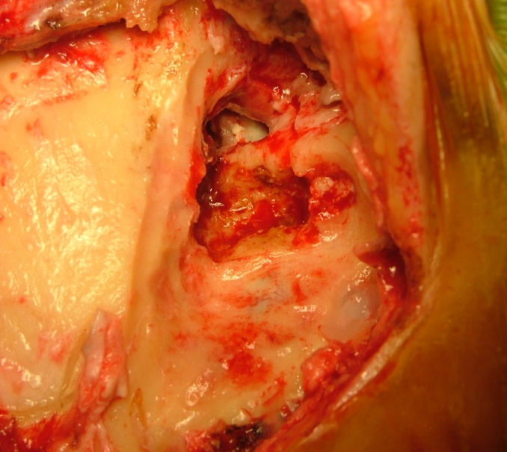
Cholesteatoma Surgery :
Mastoidectomy ( CWU & CWD )

Slide 33
The complications of chronic otitis media

Slide 34
The complications of acute and chronic otitis media
Predisposing factors :
  Virulent organisms.
  Chronicity of disease
  Presence of Cholesteatoma and bone erosion.
  Obstruction of natural drainage e.g. by a polyp.
  Low resistance of the patient

Slide 35
The complications of acute and chronic otitis media
Pathways of infection :
  Extension of infection is by bone erosion due to a cholesteatoma.
  Vascular extension (retrograde thrombophlebitis).
  Congenital dehiscence.
  Fracture lines.
  Round or oval window membrane to the labyrinth.
  Dehiscence due to previous surgery.

Slide 36
The complications of acute and chronic otitis media
Classification :
    • Intra-cranial complications.
    • Intratemporal complications.
    • Extra-cranial complications.

Slide 37
Intra-cranial complications
What are the natural barriers between brain and temporal bone ?
    Bone .
    Meninges .

Slide 38
Intra-cranial complications
Extradural Abscess
Subdural Abscess
Meningitis
Venous Sinus Thrombosis
Brain Abscess

Slide 39
Extradural abscess
Collection of pus against the dura.
middle or posterior cranial fossa.
Extradural abscess is the commonest
intracranial complication of otitis media.

Slide 40
Extradural abscess
Clinical Picture :
  – Persistent headache on the side of otitis media.
  – Pulsating discharge.
  – Fever
  – Asymptomatic (discovered during surgery)

Slide 41
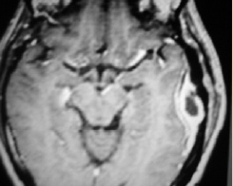
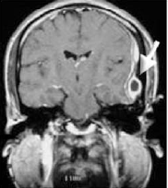
Extradural abscess
Diagnosis:
  – CT scans reveal the abscess as well as the middle ear pathology.
Treatment:
  – Mastoidectomy and drainage of the abscess.

Slide 42
Subdural abscess
Definition :
  – Collection of pus between the dura and the arachnoid.
  – It’s a rare pathology
Clinical picture :
  – Headache without signs of meningeal irritation
  – Convulsions
  – Focal neurological deficit (paralysis, loss of sensation, visual field defects)

Slide 43
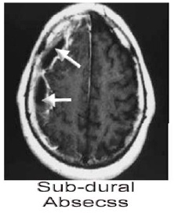
Subdural abscess
Investigations :
  – CT scan, MRI
Treatment:
  – Drainage (neurosurgeons)
  – Systemic antibiotics
  – Mastoidectomy

Slide 44
Meningitis
Definition :
  Inflammation of meninges (pia & arachinoid).
  Clinical picture:
– General symptoms and signs:
    • high fever, restlessness, irritability,
    • photophobia, and delirium.
– Signs of meningeal irritation?

Slide 45
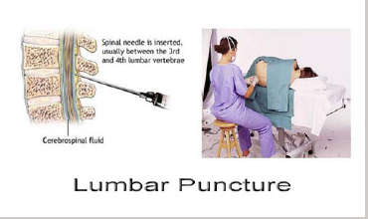
Meningitis
Diagnosis :
  Lumbar puncture is diagnostic.
Treatment:
  – Treatment of the complication itself and control of ear infection:
    • Specific antibiotics.
    • Antipyretics and supportive measures
    • Mastoidectomy to control the ear infection.

Slide 46
Venous Sinus Thrombosis
Definition :
  Thrombophlebitis of the venous sinus.
Etiology:
  It usually develops secondary to direct extension.

Slide 47
Venous Sinus Thrombosis
Clinical picture:
  – Headache, vomiting, and papilledema(increase intracranial pressure ).
  – Signs of blood invasion:
      • (spiking) fever with rigors and chills .
      • persistent fever (septicemia).

Slide 48
Venous Sinus Thrombosis
Diagnosis
  CT scan with contrast.
  MRI, MRA, MRV
  Angiography, venography.
  Blood cultures is positive during the febrile phase.

Slide 49
Venous Sinus Thrombosis
Treatment :
  – Medical:
    • Antibiotics and supportive treatment.
    • Anticoagulants.
  – Surgical:
    • Mastoidectomy with exposure of the affected sinus and the intra-sinus abscess is drained.

Slide 50
Brain Abscess
Definition :
  Localized suppuration in the brain substance.
  It is most lethal complication of suppurative otitis media.
Incidence:
  50% is Otogenic brain abscess.

Slide 51
Brain Abscess
Pathology :
  – Site: Temporal lobe or Less frequently, in the cerebellum. (more dangerous).

Slide 52
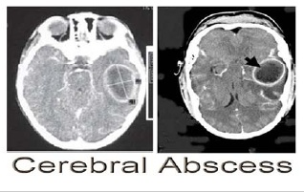
Brain Abscess
Diagnosis :
  CT scans.
  MRI

Slide 53
Brain Abscess
Treatment :
  – Medical:
    • Systemic antibiotics.
    • Measure to decrease intracranial pressure.
  – Surgical:
    • Neurosurgical drainage of the abscess .
    • mastoidectomy operation after subsidence of the acute stage.

Slide 54
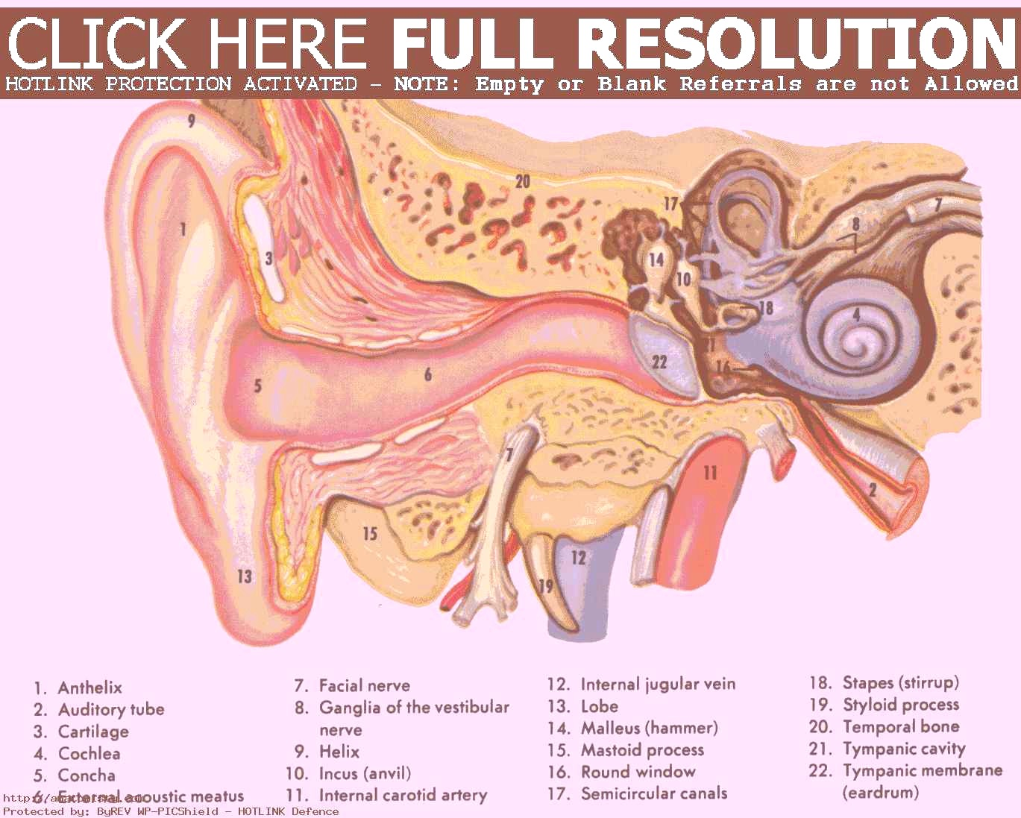
Intratemporal complications

Slide 55
Intratemporal complications
Labybrinthitis
Ossicular fixation or erosions
Labyrithine fistula
Facial nerve paralysis
Mastoiditis /mastoid abscess

Slide 56
Labyrinthine fistula
Definition :
  communication between middle and inner ear
Atiology :
  It is caused by erosion of boney labyrinth due cholesteatoma.

Slide 57
Labyrinthine fistula
Clinical picture :
    Hearing loss.
    Attack of vertigo mostly during straining ,sneezing and lifting heavy object.
    Positive fistula test.

Slide 58
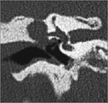
Labyrinthine fistula
Diagnosis:
  High index of suspicion
  longstanding disease
  fistula test
  CT scan of temporal bone
Treatment :
  Mastoidectomy.

Slide 59
Facial nerve paralysis
Congenital or acquired dehiscence of nerve canal.
It is possibly a result of the inflammatory response within the fallopian canal to the acute or chronic otitis media.
Tympanic segment is the most common site to be involved.

Slide 60
Facial nerve paralysis
Diagnosis :
  Clinically
  CT scan.

Slide 61
Facial nerve paralysis
Treatment :
  Acute otitis media and acute mastoiditis : (cortical mastoidectomy + ventilation tube).
  chronic otitis media with cholestetoma: (mastoidecomy ± facial nerve decompresion )

Slide 62
Mastoiditis
Definition :
  It is the inflammation of mucosal lining of antrum and mastoid air cells system.

Slide 63
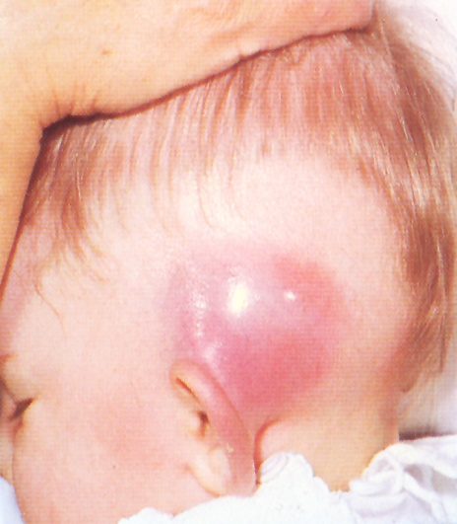
Mastoiditis
Signs:
  Mastoid tenderness
  Sagging of posterosuperior meatal wall
  TM perforation
  Swelling over mastoid
  Hearing loss
Symptoms:
Earache
Fever
Ear discharge

Slide 64
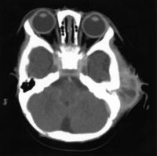
Mastoiditis
Investigation :
  • CT scan temporal bones.
  • Ear swab for culture and sensitiveity.

Slide 65
Mastoiditis
Medical treatment:
    − Hospitalize
    − Antibiotics
    − Analgesics
Surgical treatment:
    − Myringotomy
    − Cortical mastoidectomy

Slide 66
Extracranial complications
Subperiosteal abscess
Bezold abscess ( extension of infection from mastoid to SCM).
Septicemia

Slide 67


