Slide 1
Audiology presentation
Murad Almomani, Ph.D., CCC-A, FAAA
American Board of Audiology

Slide 2
Outline
Students will be able
Identify type, degree and configuration of hearing loss.
Identify possible site of lesion for each type of hearing loss.
Determine middle ear function from Tympanometry measurement.
Understand origin, indications and clinical applications of OAE, ABR and speech audiometry.

Slide 3
Pure tone audiometry

Slide 4
Ranges of Hearing Loss
-10 – 25 dB HL = Normal range
26 – 40 dB HL = Mild hearing loss
41 – 55 dB HL = Moderate
56 – 70 dB HL = Moderately Severe
71 – 90 dB HL= Severe
Greater than 90 dB HL = Profound

Slide 5
Normal Hearing

Slide 6
Conductive Hearing Loss

Slide 7
Sensorineural Hearing Loss

Slide 8
Mixed Hearing Loss

Slide 9
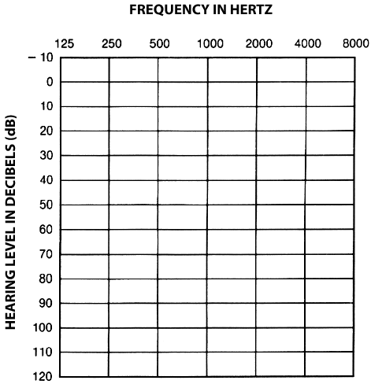
AUDIOGRAM

Slide 11
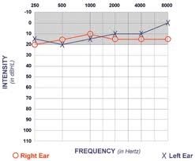

Slide 12
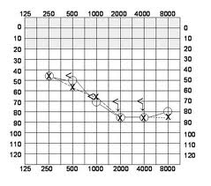

Slide 13
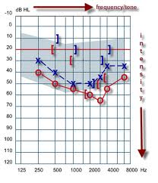

Slide 14
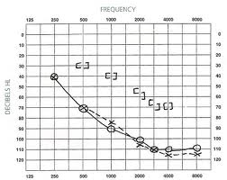

Slide 15
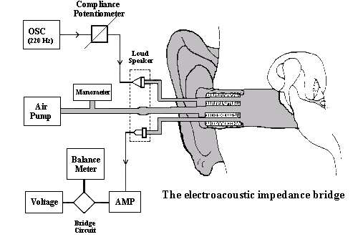

Slide 16
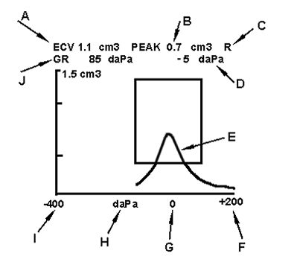

Slide 17
TYMPANOMETRIC FEATURES
Tympanometric shapes.
Static acoustic admittance.
Tympanometric width (gradient).
Tympanometric peak pressure.
Equivalent ear canal volume.

Slide 18
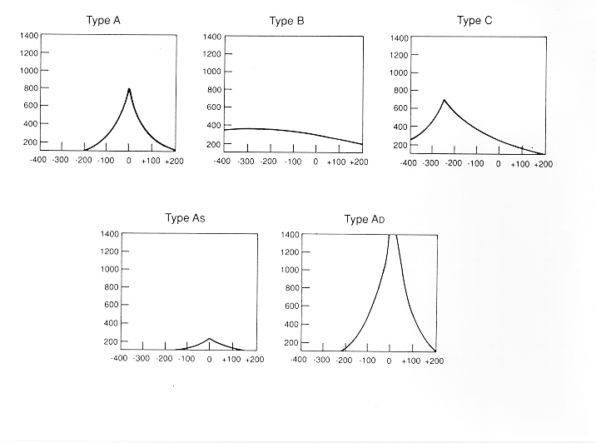

Slide 19
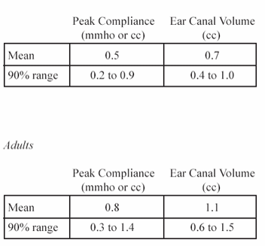
Static Compliance (Peak Compliance)
Acceptable Range by Age
Flaccid: disarticulation, flaccid TM, etc.
0.9
1.4
Normal mobility
0.2
0.3
Stiff: otosclerosis fluid, tympanosclerosis, etc.
Child
Adult

Slide 20
otoacoustic emissions

Slide 21
Origin of OAE
Initially reported by Kemp in 1978.
OAE are considered a by-product of sensory OHCs transduction and represent cochlear amplifier that thought to be as a result of the contraction of OHCs in synchrony with BM displacement.
The contraction of the OHCs (movement) is then propagated outward toward the middle ear and moves the TM.
This in turn creates acoustic energy that is picked by the OAE probe.

Slide 22
otoacoustic emissions

Slide 23
Origin of OAE
Initially reported by Kemp in 1978.
OAE are considered a by-product of sensory OHCs transduction and represent cochlear amplifier that thought to be as a result of the contraction of OHCs in synchrony with BM displacement.
The contraction of the OHCs (movement) is then propagated outward toward the middle ear and moves the TM.
This in turn creates acoustic energy that is picked by the OAE probe.

Slide 25
Clinical applications of EOAE
1- can be used in newborn hearing screening. The results will indicate either fail or pass. Fail means that hearing thresholds are worse than 30 dB HL. Pass results means hearing thresholds are 30 dB HL or better.
So, we can not use this tool to measure threshold of hearing.

Slide 26
Applications of OAE
TEOAE can be recorded in all non-pathologic ears that do not display hearing loss of greater than 30 dB.
OAE can be recorded in both adults and infants.
Accordingly TEOAE and DPOAE can be used to screen for hearing loss in infants.
DPOAE provide more frequency specific evaluation that TEOAE.

Slide 27
Clinical applications of EOAE
2- in differential diagnosis of hearing loss (site of lesion). This can help in differentiating sensory from neural hearing loss.
3- monitoring of the effect of ototoxicity or noise exposure.
4- although still under research: DPOAE can be used to screen for the carriers of the recessive hearing loss genes: many studies found that DPOAE is larger (especially at high frequencies) in carriers than in non carriers when using f2/f1 of 1.3 and low stimulus levels of 50-60 dB.

Slide 28
clinical limitations
Problems because of middle ear disease
Not sensitive for neonates within 24 hours of birth
Results affected by test conditions
Noise
Not a test of hearing- limited application

Slide 29
Clinical applications of ABR
Murad Almomani, Ph.D., CCC-A, FAAA

Slide 30
The normal ABR waveform
Is characterized by 5-7 peaks.
Occurs in a latency epoch of 1.4 – 8.0 ms.
Responses are usually displayed with positive peaks reflecting neural activity toward the vertex.
These peaks are labeled with the roman numerals I through XII.
The most prominent waves are I, III, and V.

Slide 32
Example Normal Hearing
18 Month-Old – 2000 Hz Tone-Burst
70 dBnHL
10 dBnHL

Slide 33
Example Normal Hearing
18 Month-Old – 2000 Hz Tone-Burst
70 dBnHL
10 dBnHL

Slide 34
Using ABR to estimate hearing thresholds
Can be obtained by progressively decreasing intensity of the stimulus (click or toneburst) and observing wave V.
The last intensity that wave V appears at is considered its threshold.
ABR threshold is within 10-20 dB from the subjective threshold.

